Slide 1
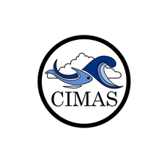
MERIDIONAL OVERTURNING CIRCULATION (MOC)
IN THE ATLANTIC OCEAN
Denis Volkov
NOAA-AOML / CIMAS-UM
Laboratory Review 2019

Slide 2
Why do we need to observe the Meridional Overturning Circulation (MOC)?
MOC carries large amounts of water, heat, salt, carbon, nutrients and other substances around the globe
Atlantic MOC (AMOC) is responsible for ~2/3 of the oceanic northward heat transport
AMOC impacts global and regional climate, sea level, extreme weather events, ecosystems, and fisheries
Perez et al. (2015), created by R. Lumpkin
Notes:
We observe and study the MOC, because MOC carries water, heat, salt, carbon, nutrients and other substances around the globe. The focus of our lab is on the Atlantic MOC or the AMOC. The Atlantic Ocean is unique as it is the only oceanic basin where heat is carried northward in both hemispheres, and the AMOC is responsible for about 2/3 of the oceanic northward heat transport. So, AMOC plays an important role in global and regional climate with impacts on sea level, extreme weather events, ecosystems, and fisheries.

Slide 3
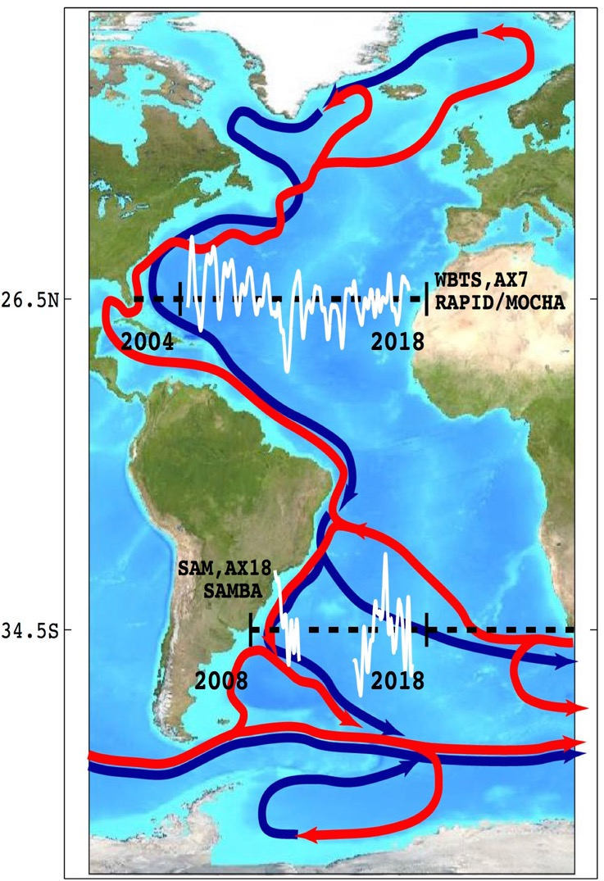
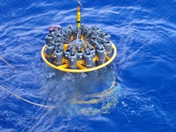
AOML is monitoring AMOC in both the North and South Atlantic
Satellite Altimetry
Argo
Continuous measurements of the Florida Current transport with a submarine cable supplemented with hydrographic surveys since 1982;
Multi-year in situ observations (XBT and Argo) and the advent of satellite altimetry made it possible to combine satellite and in situ observations to derive the AMOC and Meridional Heat Transport estimates at different latitudes.
Cable
CTD
ADCP
XBT
Florida Current
Transport with submarine cable
Satellite Altimetry
AX7
AX18
Argo
1982
1992
1995
2002
2004
Notes:
We observe the AMOC in both the North and South Atlantic. One of the main AOML’s contributions to the AMOC monitoring is by measuring the Florida Current transport by a submarine cable that started back in 1982, and now we provide the longest continuous record of a boundary current transport. The advent of new technology, in particular satellite altimetry and Argo, and multi-year observations have made it possible to combine satellite and in situ data to derive the MOC and Meridional Heat Transport at different latitudes.

Slide 4
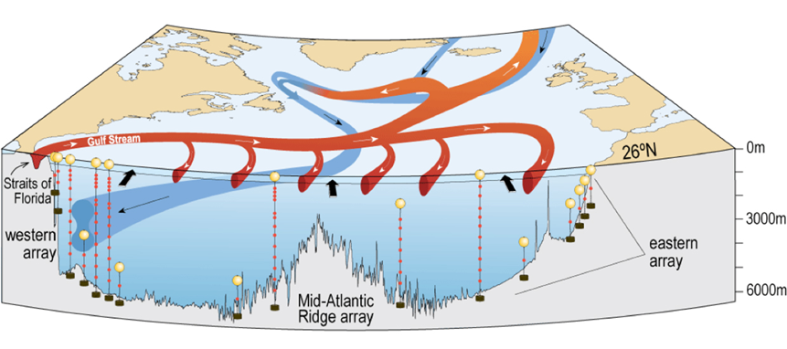
AOML is monitoring AMOC in both the North and South Atlantic
North Atlantic: RAPID-MOCHA-WBTS moored array at 26.5N since 2004
  Why at this latitude: (i) Leveraging the already existing measurements of the Florida Current, (ii) targeting the latitude of the maximum northward oceanic heat transport in the Atlantic Ocean;
  Observing platforms: cable, tall moorings, Pressure Inverted Echo Sounders (PIES), Argo, hydrography;
  Partners: RSMAS-UM and National Oceanographic Centre (UK).
Cable
Florida Current
Transport with submarine cable
Satellite Altimetry
https://mocha.rsmas.miami.edu/methods/index.html
Argo,
RAPID-MOCHA-WBTS
AX7
AX18
1982
1992
1995
2002
2004
Notes:
The need for direct and continuous measurements of the AMOC led to the establishment of the first ever trans-basin AMOC observing array at 26.5N in the North Atlantic in 2004, in partnership with colleagues from the University of Miami and National Oceanographic Centre in the UK. This latitude was selected to leverage the already existing measurements of the Florida Current with the cable and because 26.5N is approximately the latitude of the maximum oceanic northward heat transport.

Slide 5
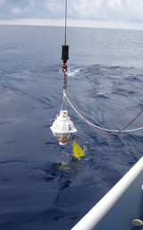
AOML is monitoring AMOC in both the North and South Atlantic
South Atlantic: MOC Basin-wide moored Array (SAMBA) at 34.5S since 2009
  Why in the South Atlantic: (i) Convenient to monitor inter-ocean exchanges, (ii) freshwater flux into the South Atlantic may control the AMOC stability, (iii) South Atlantic is the only basin with equatorward heat transport
  Observing platforms: PIES, tall moorings
  Partners: France, South Africa, Argentine, and Brazil.
Locations of PIES moorings
PIES
Florida Current
Transport with submarine cable
Argo,
RAPID-MOCHA-WBTS
SAMBA
1982
1992
1995
2002
2004
2009
This Photo by Unknown Author is licensed under CC BY-SA-NC
This Photo by Unknown Author is licensed under CC BY-SA
Notes:
The AMOC anomalies that we observe in the North Atlantic can originate in the South Atlantic and beyond, in the Southern and Indian Oceans. It has been reported that freshwater flux into the South Atlantic may control the AMOC stability. In order to monitor inter-ocean exchanges the South Atlantic MOC Basin-wide Array or SAMBA at 34.5S was established in 2009 in partnership with France, Brazil, Argentina, and South Africa.

Slide 6
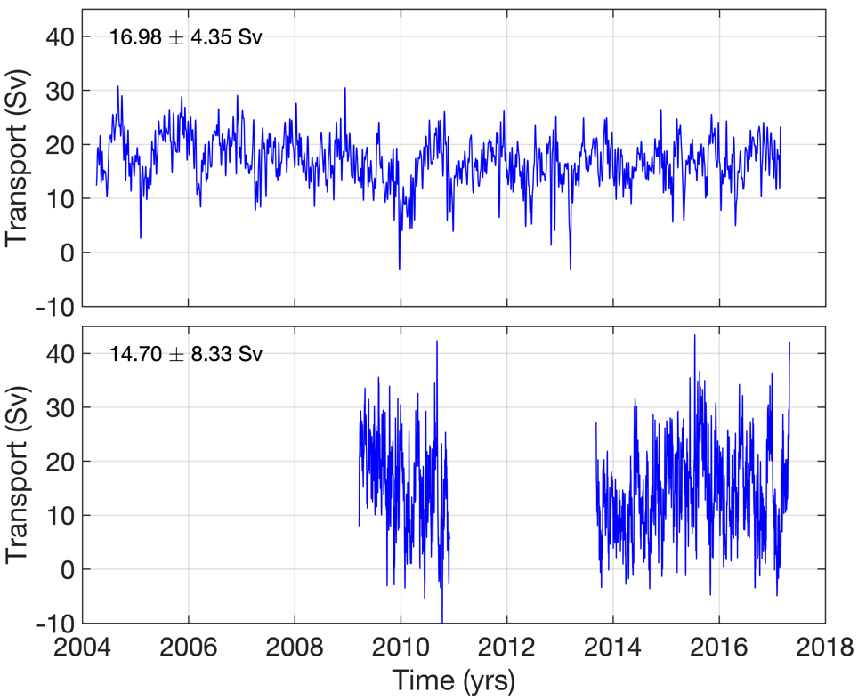
Main discoveries & implications
AMOC northward transport
AMOC is highly variable!
  Time scales from a few days to interannual
  Lack of coherency between the North and South Atlantic MOC
  The dip of 30% in 2009/10 at 26.5N exceeded the range of interannual variability found in climate models
  Continuous monitoring is necessary to avoid aliasing of high-frequency variability, and to identify any climate-related trends
  The North Atlantic Ocean is in a state of reduced overturning since 2008
    Between 2004-2008 and 2008-2012, the AMOC reduced by 2.9 Sv (significant at the 95% level)
    Consistent with the concurrent change in other key climate parameters, such as heat content, SSH, SST, and air-sea latent heat flux
18.8 Sv
15.9 Sv
16.3 Sv
26.5N
34.5S
Frajka-Williams et al. (2019), Meinen et al. (2018), Smeed et al. (2018)
Notes:
The AMOC appeared to be highly variable, changing on time scales from a few days to interannual. As you can see in these plots, there is lack of coherency between the North and South Atlantic MOC. In 2009/2010, we observed a 30% reduction in the AMOC transport at 26.5N, which exceeded the range of interannual variability found in climate models. Continuous monitoring of the AMOC is necessary to avoid aliasing of high-frequency variability and to identify any climate-related trends.
Thanks to the multi-year observations of the AMOC at 26.5N, it became possible to determine that since 2008 the North Atlantic Ocean is in a state of reduced overturning compared to the preceding 4 years of observations. This reduction was found to be consistent with other key climate parameters, such as heat content, SST, sea level, and air-sea latent heat flux.
References:
Frajka-Williams, E., I.J. Ansorge, J. Baehr, H.L. Bryden, [...], D. Volkov, C. Wilson (2019), Atlantic Meridional Overturning Circulation: Observed transports and variability, Front. Mar. Sci., doi:10.3389/fmars.2019.00260.
Meinen, C.S., Speich, S., Piola, A.R., Ansorge, I., Campos, E., Kersalé, M., Terre, T., Chidichimo, M.P., Lamont, T., Sato, O.T., Perez, R.C., Valla, D., Van den Berg, M., Le Hénaff, M., Dong, S., and Garzoli, S.L., 2018: Meridional Overturning Circulation transport variability at 34.5°S during 2009-2017: Baroclinic and barotropic flows and the dueling influence of the boundaries. Geophysical Research Letters, 45(9):4180-4188 (doi:10.1029/2018GL077408).
Smeed, D.A., Josey, S.A., Beaulieu, C., Johns, W.E., Moat, B.I., Frajka-Williams, E., Rayner, D., Meinen, C.S., Baringer, M.O., Bryden, H.L. and McCarthy, G.D., 2018: The North Atlantic Ocean is in a state of reduced overturning. Geophysical Research Letters, 45(3):1527-1533 (doi:10.1002/GL076350).

Slide 7
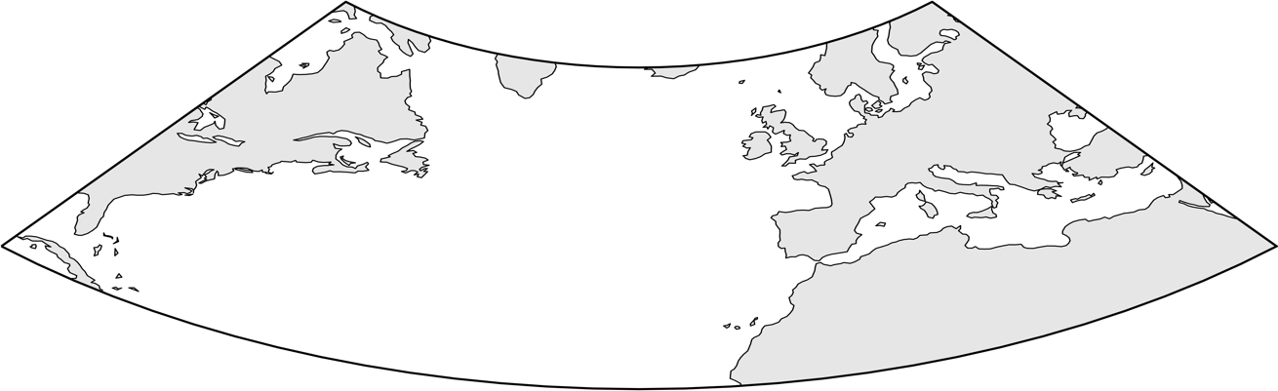
Main discoveries & implications
NAO+
Lower
Sea Level
Higher
Sea Level
Stronger Westerlies
Ocean Heat Content Increases
Westward Wind
Q_{NET}
Lower Mediterranean Sea Level
The AMOC-driven heat divergence controls heat content in the subtropical gyre and in the tropics and is largely responsible for the interannual sea level variability along the U.S. southeastern seaboard and in the Mediterranean Sea
There is a potential to use continuous AMOC observations at 26.5N to develop and/or improve coastal sea level predictions
Stronger Trades
Outflow
Stronger
AMOC/MHT
Lower Sea Level
COOLING
Weaker Southward
UMO Transport
Upwelling
Reduced Heat Advection
Lowers Steric Sea Level
NAO−
Higher
Sea Level
Lower
Sea Level
Weaker Westerlies
Ocean Heat Content Decreases
Eastward Wind
Weaker Trades
Inflow
Higher Mediterranean Sea Level
Q_{NET}
Weaker
AMOC/MHT
Higher Sea Level
WARMING
Stronger Southward
UMO Transport
Downwelling
Increased Heat Advection
Raises Steric Sea Level
Volkov et al. (2019a,b)
Notes:
Since the AMOC-driven heat divergence largely controls heat content in the North Atlantic subtropical gyre and in tropics, It has recently been shown that AMOC also impacts interannual variability of sea level along the U.S. southeast coast, and along the eastern boundary of the subtropical North Atlantic, including the Mediterranean Sea. The continuous AMOC observations at 26.5N can potentially be used to develop or improve coastal sea level predictions.
References:
Volkov D.L. , S.-K. Lee, R. Domingues, H. Zhang, M. Goes (2019), Interannual sea level variability along the southeastern seaboard of the United States in relation to the gyre-scale heat divergence in the North Atlantic, Geophys. Res. Lett., doi:10.1029/2019GL083596.
Volkov D.L. , M. Baringer, D. Smeed, W. Johns, F. Landerer (2019), Teleconnection between the Atlantic Meridional Overturning Circulation and sea level in the Mediterranean Sea, Journal of Climate , 32, 935-955, doi:10.1175/JCLI-D-18-0474.1.

Slide 8
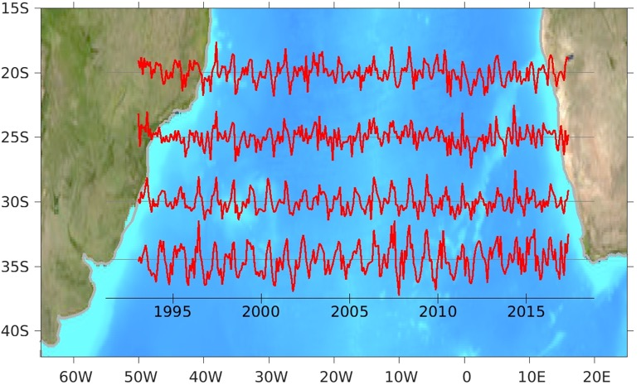
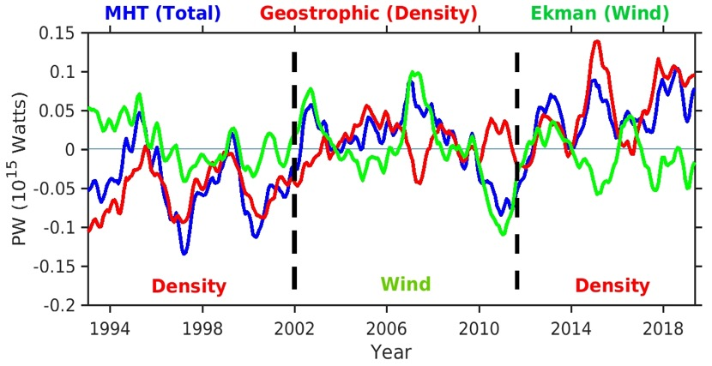
Main discoveries & implications
Brazil
Using a suite of hydrographic and satellite data we have obtained the first estimates of the South Atlantic MHT
  Both density and wind-driven components are important contributors to the variability of MHT
  Dominance of density and wind-driven components in the South Atlantic MOC varies with time and latitude
Meridional Heat Transport
34.5°S
Dominated by density
Dominated by wind
Dominated by density
Dong et al. (2015)
Notes:
In the South Atlantic, combining in situ and satellite data we have obtained the first estimates of the meridional heat transport at several latitudes. It has been shown that density and wind components are both important contributors to the variability of the meridional heat transport, but their individual contribution can vary with time and latitude.
References:
Dong, S ., G. Goni , and F. Bringas, 2015: Temporal variability of the Meridional Overturning Circulation in the South Atlantic between 20S and 35S. Geophys. Res. Lett., 42, 7655 - 7662, (doi:10.1002/2015GL065603).

Slide 9
AMOC observations are used to validate ocean and climate models
AMOC transports from models vs RAPID-MOCHA-WBTS at 26.5N
RAPID-MOCHA-WBTS
1.6
Observed estimates of the AMOC and MHT are useful metrics to assess ocean and climate models;
Models often fail to reproduce the mean and the variability of the AMOC and its components;
Continuous observations are necessary to improve model’s physics.
1.2
AMOC transport (Sv)
0.8
0.4
0
60S
40S
20S
Eq
20N
40N
60N
Msadek et al. (2013)
Seasonal variations of the AMOC at 34S from observations and models (Dong et al., 2014)
Notes:
One of the important reasons why our observations are valuable is because they are widely used to validate and eventually improve ocean and climate models. Models often fail to reproduce the mean and the variability of the AMOC and its components as illustrated in these plots. So continuous monitoring is necessary to improve model’s physics.
References:
Dong, S. , M. O. Baringer , G. J. Goni , C. S. Meinen , and S. L. Garzoli, 2014: Seasonal variations in the South Atlantic Meridional Overturning Circulation from observations and numerical models , Geophys. Res. Lett., 41 , 4611 - 4618 , doi: 10.1002/2014GL060428.
Msadek, R., W.E. Johns, S.G. Yeager, G. Danabasoglu, T.L. Delworth, and A. Rosati, 2013: The Atlantic Meridional Heat Transport at 26.5°N and Its Relationship with the MOC in the RAPID Array and the GFDL and NCAR Coupled Models. J. Climate, 26, 4335–4356, https://doi.org/10.1175/JCLI-D-12-00081.

Slide 10






Number of MOC papers
Partnership with institutions from
~180
6
by PhOD authors/co-authors since 1982
countries including the U. S.

