Slide 1

Global climate predictions for coral reef ecosystems
Ruben van Hooidonk, OCED

Slide 2
Photo: Derek Manzello

Slide 3
Corals: why should we care?
Provide economic goods and services worth
South East Florida corals valued at
$375billion
$8.5billion
(in 1997, worldwide)

Slide 4
Coral: why should we care?
$4.4billion
$2
billion
70,400
In local sales
In local income
Full and part time jobs

Slide 5
Global projections of coral bleaching
van Hooidonk R, Maynard JA, Planes S (2013) Temporary refugia for coral reefs in a warming world. Nature Climate Change, 3, 1–4.

Slide 6
Local scale projections of coral bleaching
Hooidonk R, Maynard JA, Liu Y, Lee S-K (2015) Global Change Biology, 21, 3389–3401.
van Hooidonk RJ, Maynard J, Tamelander J et al. (2016). Nature Scientific Reports, 6, 39666.

Slide 7

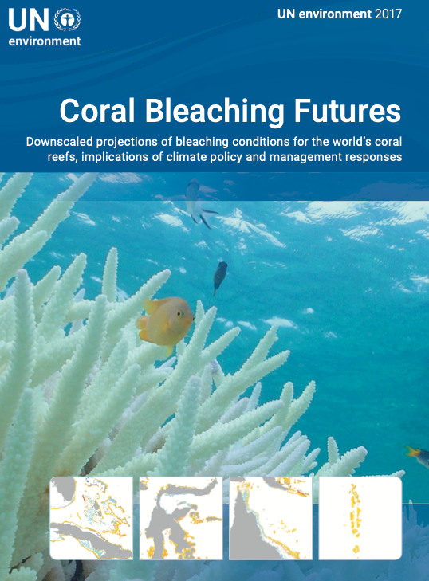




Slide 8
Acropora out planting tool
Stakeholders/Users:
University of Miami
Nova Southeastern University
Mote Marine Laboratory & Aquarium
The Nature Conservancy
Coral Restoration Foundation

Slide 9
Key outcomes
Projections of coral bleaching ranging in resolutions from 100-4 km that show under a BAU scenario annual severe bleaching conditions around 2040.
Projections are made available as google earth tools, GIS layers, netCDF and static images.
Downscaled projections show regional variation in the onset of annual severe bleaching conditions.
Tool to maximize survivorship in planted critically endangered Acropora cervicornis

Slide 10
Future work: Update projections of bleaching and OA
Next generation of model data is becoming available
Higher spatial and temporal resolution
More processes modeled
New emission scenarios

Slide 11
Thank you for your attention!

