Slide 1

Ocean and Ecosystem
In Support of Southeast Fisheries Management and Ocean Acidification Monitoring
Sang-Ki Lee, PhOD
Notes:
During the past several years, PhOD has worked closely with OCED and SEFSC to support fisheries management and ocean acidification monitoring in the US Gulf and East Coasts.

Slide 2
Physical Oceanographic Analysis and Modeling Studies
Preferred physical environments for Atlantic bluefin tuna larvae in the Gulf of Mexico (SEFSC - NASA)
Future projection of changes in the Gulf of Mexico and its implication for migratory pelagic species (SEFSC – NASA)
Downscaled projections of Caribbean coral bleaching for conserving planning (OCED – CRCP)
Transport pathways of Sargassum into the Caribbean Sea (USF - NOAA/Ocean Watch)
High-resolution modeling of the Mississippi water intrusions to South Florida reefs (SEFSC - NCCOS)
Notes:
So, I am going to briefly introduce some of those collaboration research works. I divided them into two groups. The first group is physical oceanographic analysis and modeling studies.

Slide 3
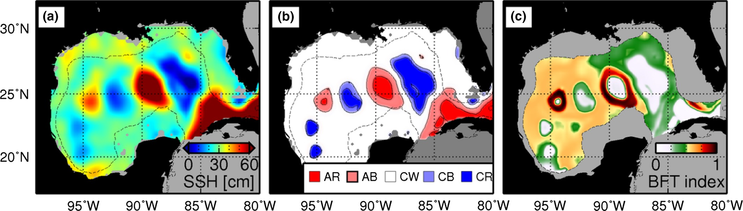
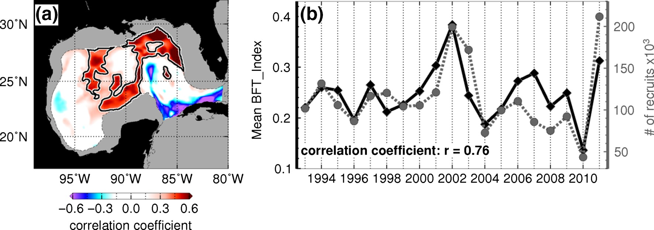
Preferred physical environments for Atlantic bluefin tuna larvae in the Gulf of Mexico
Favorable regions for bluefin larvae - linked to mesoscale ocean features
The proxy larvae index ~58% of the recruitment variability
Currently used to guide NOAA’s interdisciplinary research cruise
Domingues et al. (2016, Fish. Oceanogr.)
PhOD - SEFSC Collaboration
Notes:
In this study, we used satellite altimetry data and ship measurement of bluefin larvae to show that the areas of favorable conditions for bluefin larvae in the Gulf of Mexico are linked to mesoscale ocean circulation features. So, we used this relationship to develop a proxy larval index, which explains more than half of the recruitment variability of bluefin tuna. And, this proxy index is currently used to guide NOAA’s interdisciplinary research cruise (that we carry out every year in March and April).

Slide 4
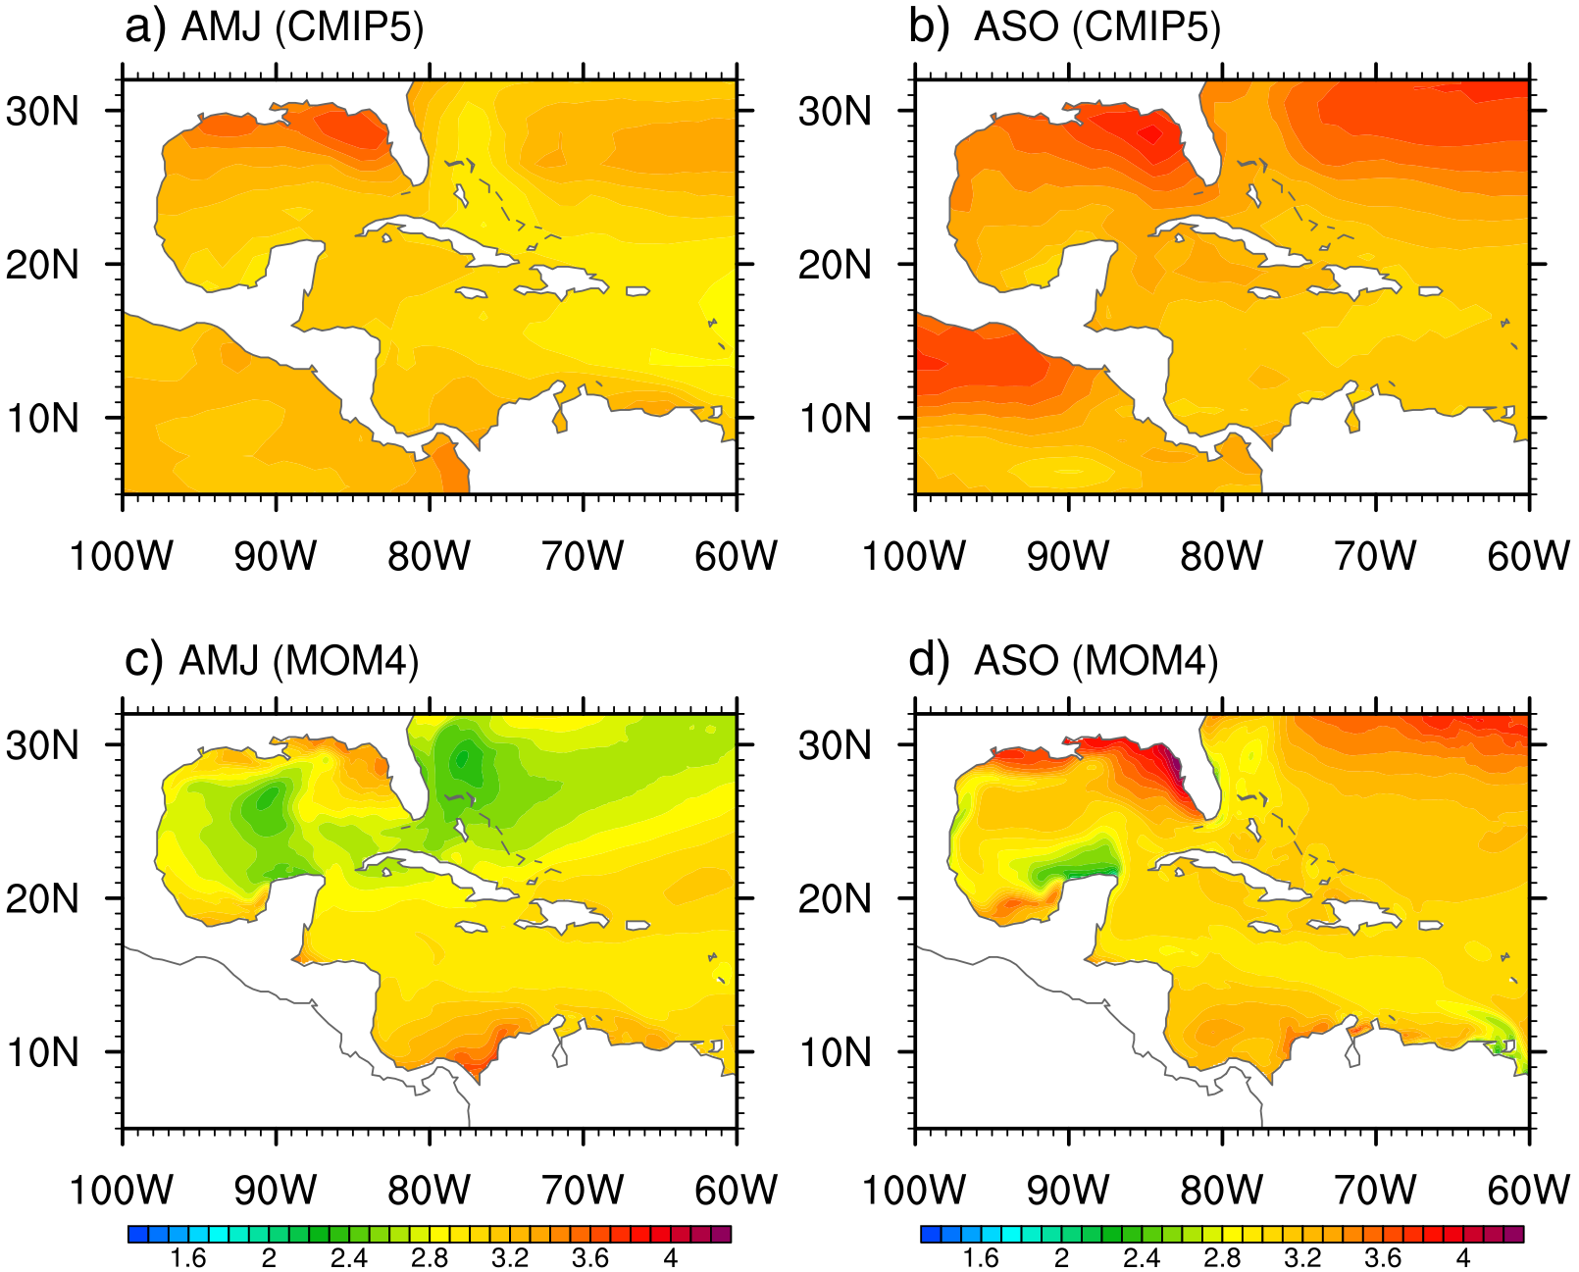
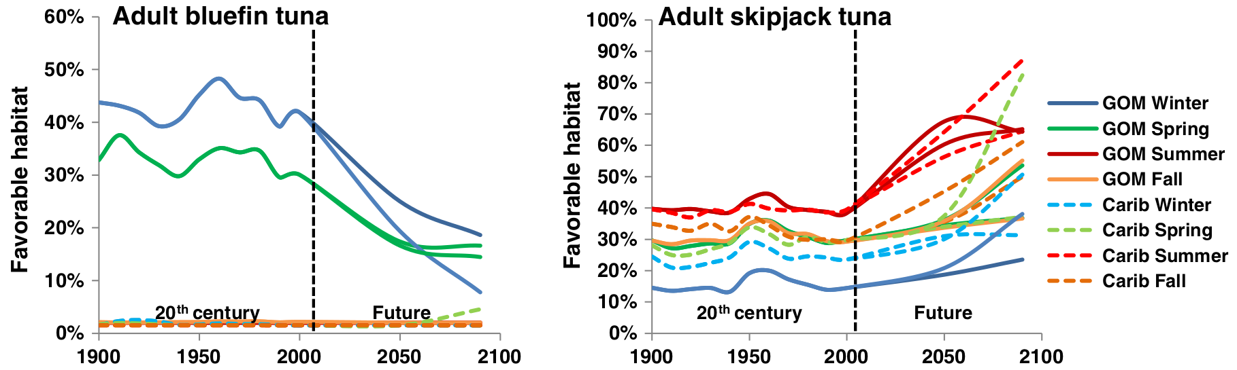
Future projection of the Gulf of Mexico and its implication for migratory pelagic species
CMIP5
High-resolution MOM
Downscaling CMIP5 using GFDL’s MOM (~ 10km)
US Gulf coast is warming hot spot (~ 4°C)
Coastal pelagic species
Frequency of hypoxia
Favorable habitat (2090s)
Bluefin (~50% reduction)
Skipjack (~60% increase)
Liu et al. (2015, J. Mar. Sys.), Muhling et al. (2015, J. Mar. Sys.; 2017, ICES J. Mar. Sci.)
PhOD - SEFSC Collaboration
Notes:
In the next study, we used a high-resolution Modular Ocean Model from GFDL to downscale the CMIP5 model projection for the 21st century in the Gulf of Mexico. The model results showed that the US Gulf coasts is a warming hot spot, with up to a 4degC increase in sea surface temperature during the rest of this century. This may results in a decrease in coastal pelagic species, such as king mackerel and cobia, and also increased frequency of hypoxia. This study also showed that in the deep Gulf region, the favorable habitat for bluefin tuna will be drastically decreased. But for the skipjack tuna, the favorable habitat will be increased greatly.

Slide 5
Ocean Biogeochemical Modeling and Analysis Studies
Seasonal patterns in phytoplankton biomass across the northern and deep Gulf of Mexico (SEFSC - NGI)
ENSO-induced co-variability of salinity, plankton and coastal currents in the Gulf of Mexico (SEFSC - NGI)
Seasonal patterns of surface inorganic carbon system variables in the Gulf of Mexico (OCED - OAP)
Notes:
The next group is ocean-biogeochemical modeling and analysis studies. This is relatively a new addition to AOML’s research and a fully interdisciplinary research area that requires very close collaboration among physical, biogeochemical, fisheries and climate scientists.

Slide 6
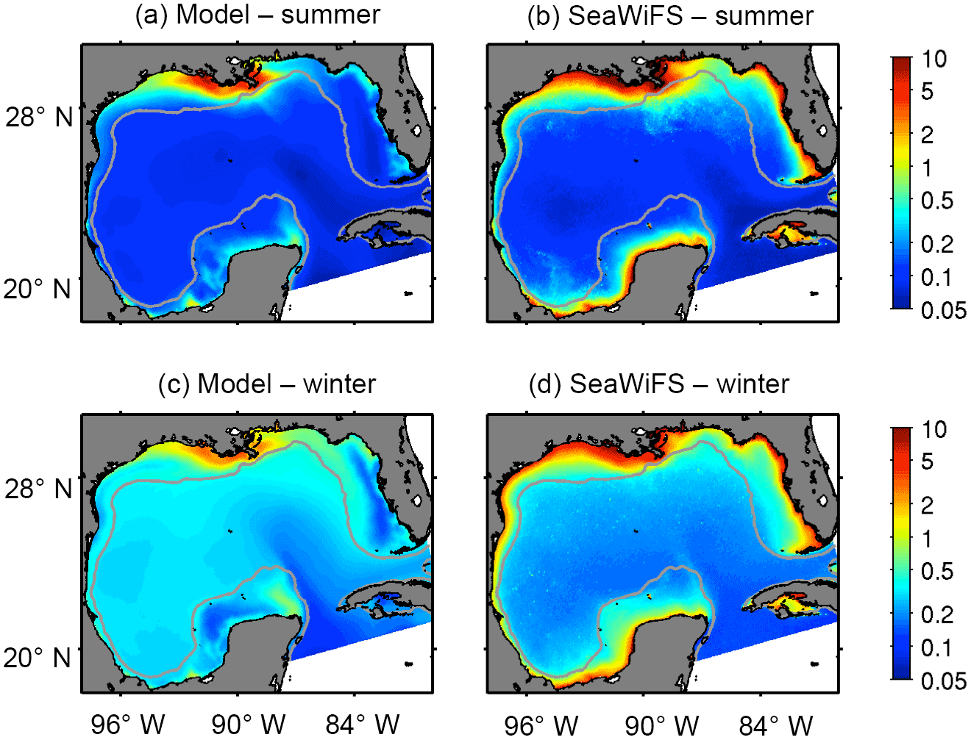
Seasonal patterns in plankton biomass across the northern and deep Gulf of Mexico
High-resolution ROMS for the Gulf of Mexico
13-component biogeochemical variables
Validated against buoy data
2 - phytoplankton & 2 - zooplankton types
54 river sources
Submarine ground water discharge
Potential modeling tool for EBFM and S2S ecosystem forecast
New additions
Gomez et al. (2018, Biogeosciences)
PhOD - OCED - SEFSC Collaboration
Notes:
So, we developed a high-resolution Ocean-BGC model for the Gulf of Mexico using the Regional Ocean Model (ROMS) coupled to a new BGC model designed for the Gulf of Mexico. This BGC model simulates two types of phytoplankton and two type of zooplankton. And, we added 54 river sources of freshwater and nutrients along the Gulf of Mexico (obtained from USGS). So, we developed this model as a potential tool for Ecosystem Based Fisheries Management (EBSM) and S2S ecosystem forecast.

Slide 7
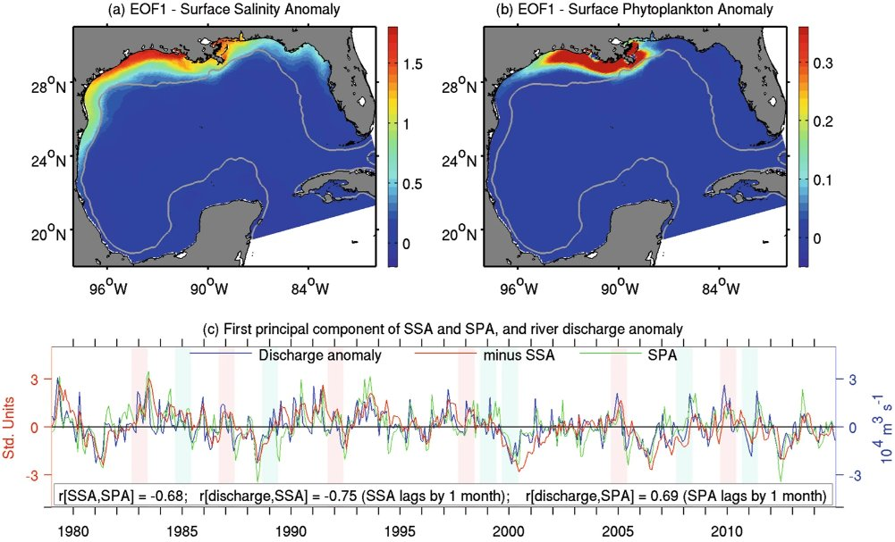
ENSO-induced co-variability of salinity, plankton & coastal currents in the Gulf of Mexico
El Niño is the main driver of plankton biomass variability in the Gulf of Mexico
Increased freshwater & nutrients discharge
Density-driven coastal currents
Carry highly productive water downstream
Show a potential for S2S ecosystem forecast (e.g., EBFM, red tide & hypoxia)
El Niño events
La Niña events
Gomez et al. (2019, Sci. Rep.)
PhOD - OCED - SEFSC Collaboration
Notes:
As the first application, we used this model to understand interannual variability of plankton biomass in the Gulf of Mexico. The main conclusion of this study is that El Niño - Southern Oscillation is the main driver of plankton biomass variability in the Gulf of Mexico. For example, during El Niño winter and spring, the Mississippi River discharges of freshwater and nutrients significantly increase. That produces density-driven coastal current that carries highly productive water to the west to increase productivity along the entire Texas-Louisiana shelf. So, this study shows a potential for S2S ecosystem forecast in the Gulf of Mexico.

Slide 8
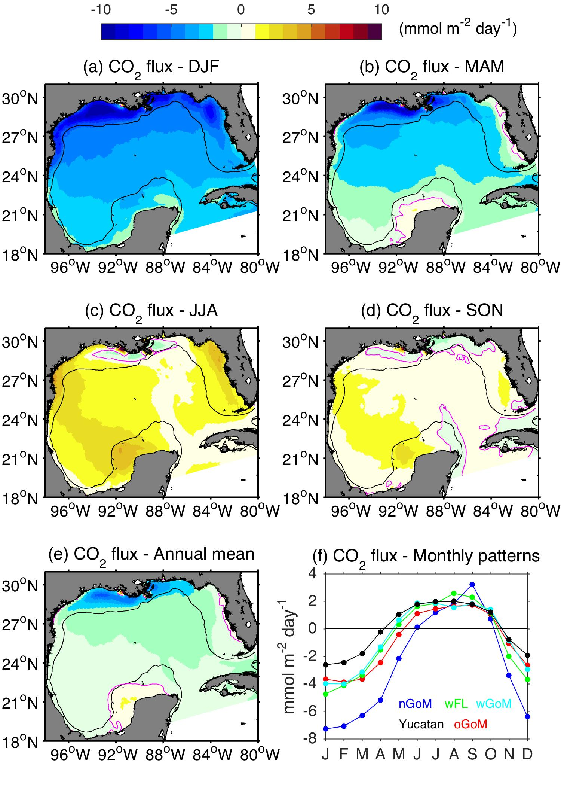
Seasonal patterns of surface inorganic carbon system variables in the Gulf of Mexico
Data gaps in carbon variables remain large in the Gulf of Mexico
A carbon module added
River runoff controls DIC, TA and Ω_{Ar} changes over Texas-Louisiana shelf
Annually, a basin-averaged net CO₂ uptake (0.35 mol m^{–2} yr^{–1})
CO₂ uptake in winter-spring
CO₂ outgassing in summer-fall
Gomez et al. (2019, Biogeosciences Diss.)
https://www.biogeosciences-discuss.net/bg-2019-430
PhOD – OCED Collaboration in support of OAP
Notes:
Previous two studies are mainly for helping fisheries management. This study is to support ocean acidification monitoring by OCED. So, we added a new carbon module (mainly based on Laurent et al., (2017)) in our BGC model. The main objective of this study is to use the high-resolution Ocean-BGC model to understand what causes pH change in the US Gulf coast in seasonal, interannual and decadal time scales. One of the main things we learned from the study is that the Mississippi River runoff and associated change in productivity largely determines ocean acidification (OA) variables along the Texas-Louisiana shelf. Another important finding from this study is that the Gulf of Mexico is the region of net CO₂ uptake, with a very strong seasonal cycle. This is the first Ocean-BGC model study to report that.

Slide 9
Future Works
Enhance Collaborations with SEFSC and other NOAA labs and line offices
Build and explore S2S forecast capability of EBFM, Red Tide, Hypoxia, and Ocean Acidification using statistical and dynamic models
Explore the role of river discharge variability on ocean acidification and its impact on fishery species across the US Gulf and South Atlantic Bight
Explore the impacts of climate variability and changes on coastal pelagic species along the US Gulf and South Atlantic Bight
By strengthening collaborations in science, modeling and observations with GFDL, PSD and PMEL
Notes:
In the future, we will continue our work toward building S2S ecosystem forecast capability for the US Gulf and east coast, by strengthening PhOD’s collaboration with OCED, SEFSC, GFDL, PSD and PMEL. Thank you very much. The next speaker is George Halliwell.

Slide 10
THANK YOU

