Slide 1

Using airborne observations to better characterize and understand physical processes in tropical cyclones
Robert Rogers, HRD

Slide 2
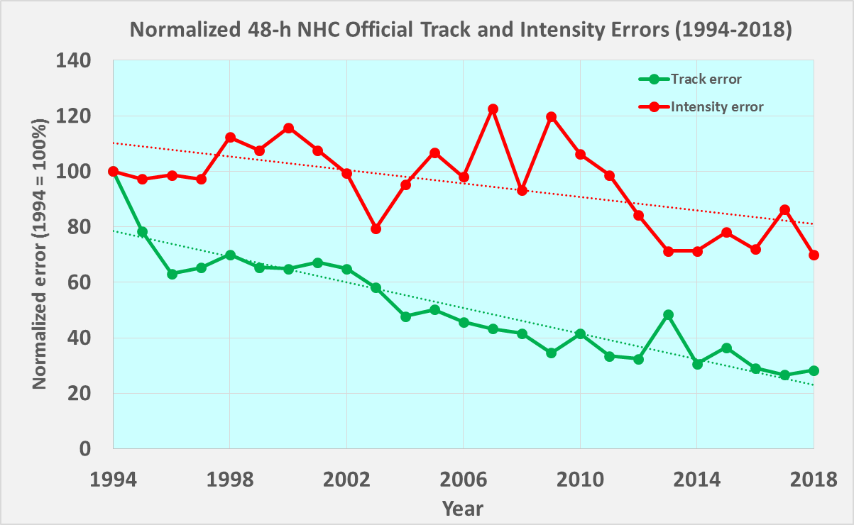
The Challenge: Tropical Cyclone Intensity Forecasting
NHC 48-h Track & Intensity Forecast Errors
intensity
Track forecast
errors reduced by
Intensity forecast errors reduced by
70%
30%
track
Notes:
Track forecast errors reduced by 70% since 1994
Intensity forecast errors reduced by 30%

Slide 3
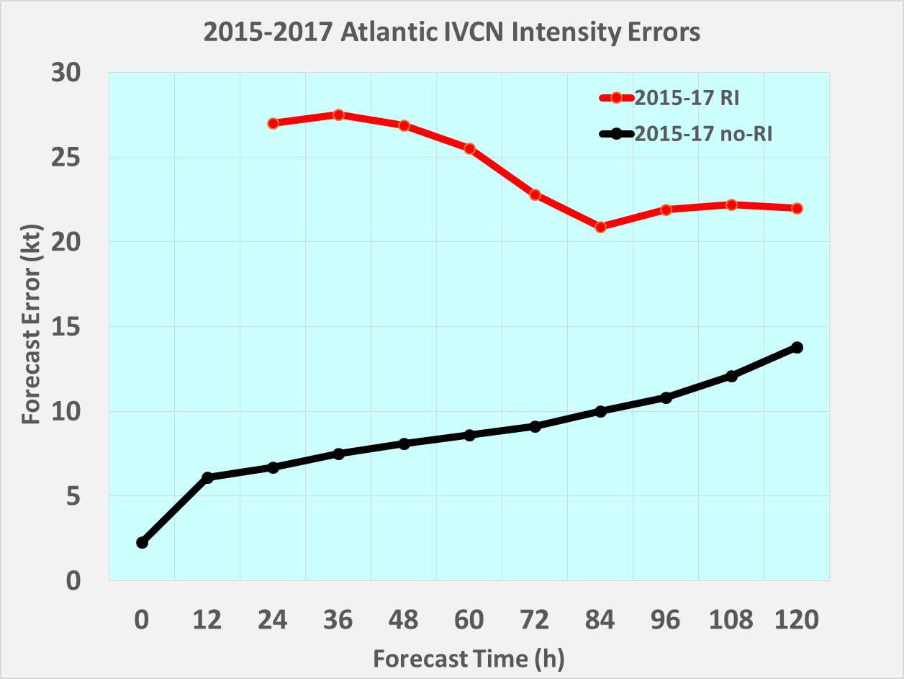
The Challenge: Tropical Cyclone Intensity Forecasting
Intensity Forecast Errors for Rapid Intensification &
Non-Rapid Intensification Events (2015-2017)
Rapid Intensification
3x larger error
Non-Rapid Intensification
Notes:
RI forecast errors 3x larger than non-RI at 48hr

Slide 4
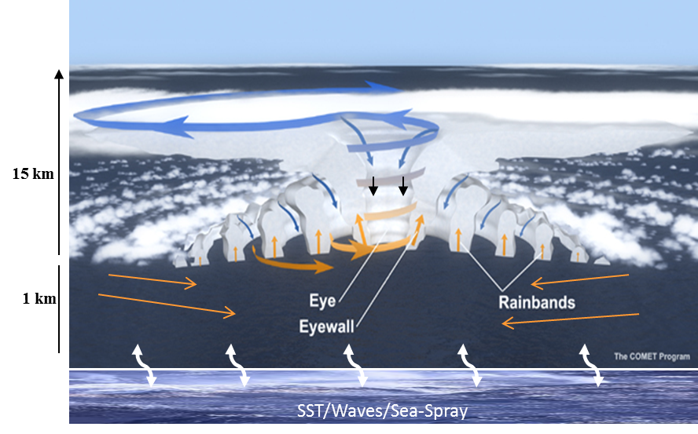
The Challenge: Tropical Cyclone Intensity Forecasting
Multiscale nature of processes are major reason for this difficulty
Environment
Vortex
Convective
Turbulent
Notes:
Characterizing and understanding these processes and their interactions are key steps in forecast improvement
Airborne observations provide a unique opportunity to study these processes across scales

Slide 5
Vortex Scale
RESEARCH RESULT
Vortex alignment in Hermine (2016)
4PM Aug 30 - 30 kt
Tilted
36 h later - 55 kt
Aligned
28
25
Low-level center
latitude
27
24
Non-intensifying
Midlevel center
26
23
Non-intensifying
Intensifying
-88
-87
-87
-86
-85
longitude
longitude
(Rogers et al., MWR, 2019)

Slide 6
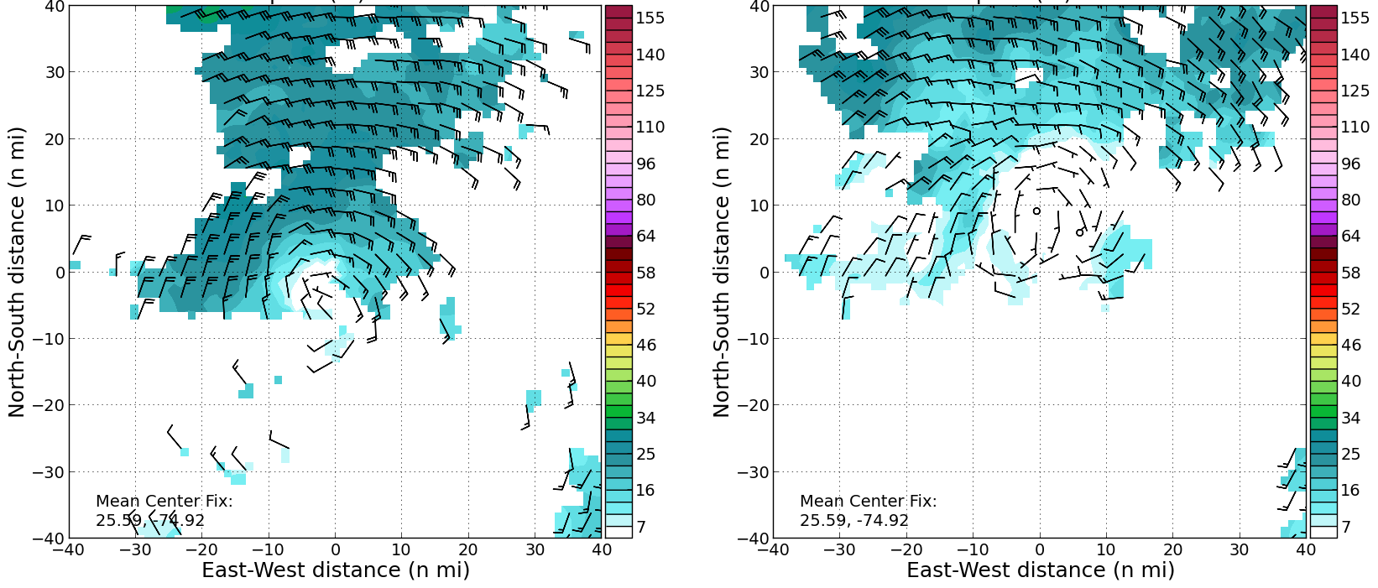
Vortex Scale
OPERATIONAL APPLICATION
Real-time airborne radar observations of Humberto (2019)
Midlevel center
Low-level center
Winds at 2 km
Winds at 2 km
Winds at 5 km
Winds at 5 km
Notes:
Circulation tilted toward north with height

Slide 7
Vortex Scale
OPERATIONAL APPLICATION
NHC Humberto Discussion, 2 h later:
“The storm is still feeling some effects of southwesterly shear and drier air, which is causing…strong tilt in the aircraft data… conditions are expected to gradually become more conducive for strengthening ”
Notes:
Assessment made by NHC forecaster in real-time

Slide 8
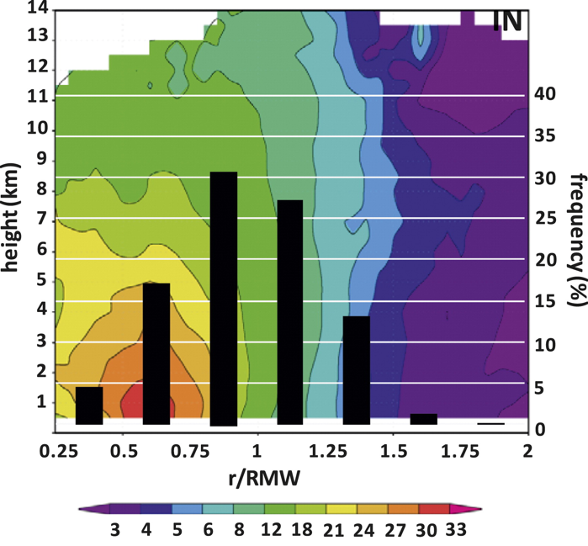
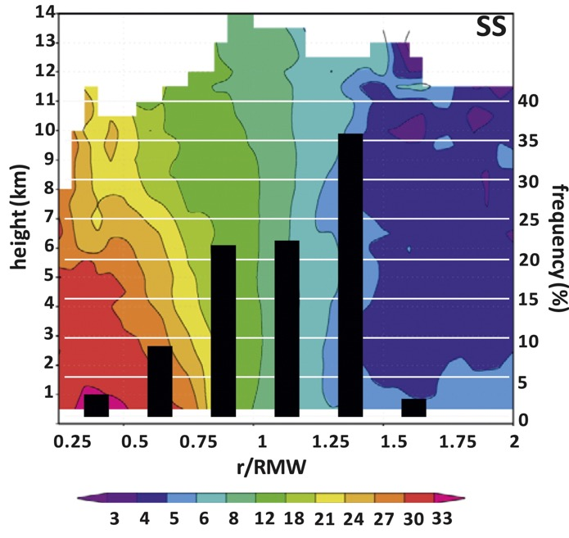
Convective Scale
RESEARCH RESULT
Radial distribution of strong thunderstorms for intensifying (IN), steady-state (SS) storms
RMW
Intensifying
Steady state
strong thunderstorms
(Rogers et al., MWR, 2013)
Notes:
More strong thunderstorms inside radius of maximum wind for intensifying hurricanes

Slide 9
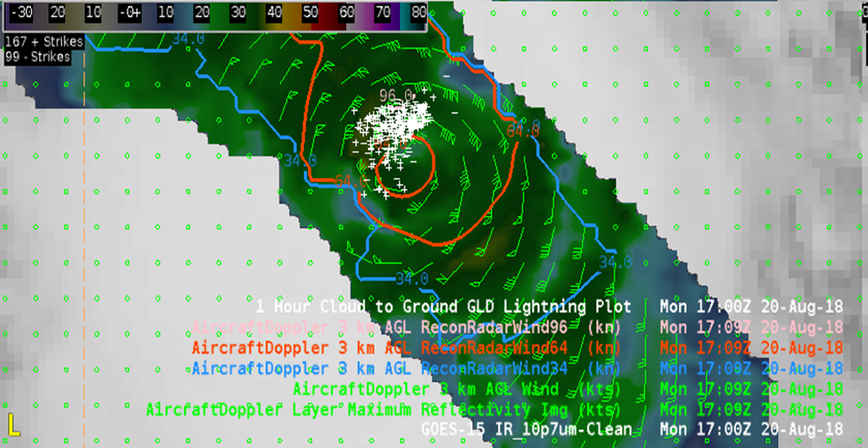
Convective Scale
OPERATIONAL APPLICATION
Real-time NHC Advanced Weather Interactive Processing System display of
airborne radar winds, satellite-detected lightning flashes in Hurricane Lane (2018)
Lightning flashes
Radius of Maximum Winds
Notes:
Lightning concentrated within RMW
Intensified 15 kt to near Category 5 in next 12 hours

Slide 10
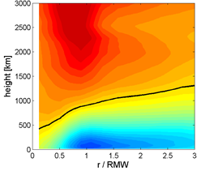
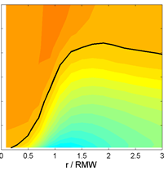
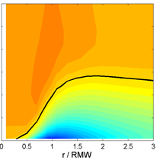

Turbulent Scale
RESEARCH RESULT
Radial flow in hurricane boundary layer from Hurricane Weather Research & Forecasting model using different vertical eddy diffusivity (K_{m})
Observed
Incorrect K_{m}
Corrected K_{m}
Inflow layer
(Zhang et al., MWR, 2015)
Notes:
Using eddy diffusivity corrected by observations produces PBL structure more consistent with observed structure

Slide 11
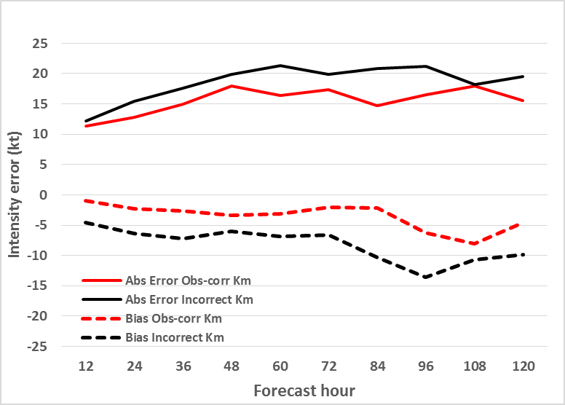
Turbulent Scale
OPERATIONAL APPLICATION
Intensity forecast errors for two Rapidly Intensifying hurricanes using different K_{m}
in HWRF model (55 cases)
FSP(%)
47
51
53
58
70
66
58
62
50
64
smaller error
reduced bias
Notes:
Using correct K_{m} gives better RI prediction in operational HWRF model

Slide 12
THANK YOU!

