Slide 1
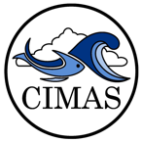
From Atmosphere to Ocean
Tracking the carbon on ships
Dr. Denis Pierrot – CIMAS
OCED – Global Carbon Cycle
Notes:
I’m part of the Global Carbon Cycle and we track the carbon as it goes from ATM to ocean
Our ship of opportunity program (SOOP) monitors the surface
We perform Carbon measurements in the GO-SHIP program to track its accumulation in the interior of the ocean

Slide 2
Why Do We Care about Carbon
Ice Melts
Food Chain
Sea Level Rise
2.5 Gt Carbon/year
Air Temperature Rise
Ocean Circulation
Sea Temperature Rise
Weather Perturbations
CO2
Ocean Acidification
Corals
Plankton
(Shell)-Fish
Food Chain
Notes:
CO2 emitted has 2 FATES – LAND or OCEAN
~25% absorbed by ocean - SINK
Accumulates in interior in different forms

Slide 3
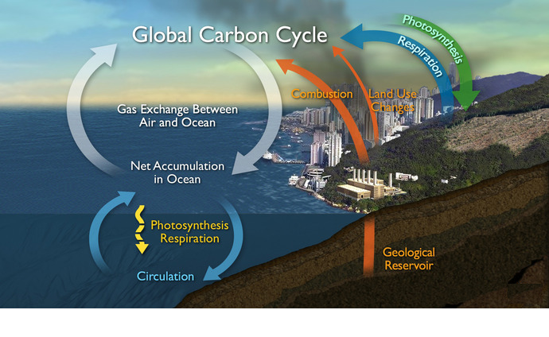
Fate of Anthropogenic Carbon
2.5 Gt Carbon/year
25%
Notes:
CO2 emitted has 2 FATES – LAND or OCEAN
~25% absorbed by ocean - SINK
Accumulates in interior in different forms

Slide 4
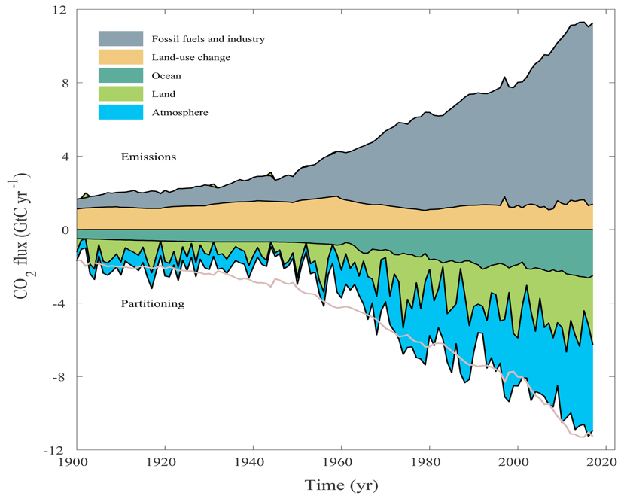
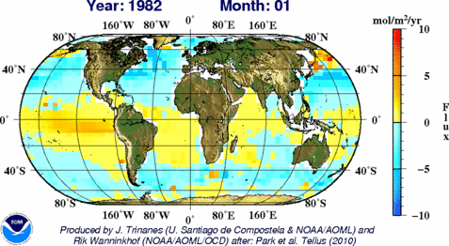
A Varying Sink
Fossil Fuels
+ Industry
OCEAN
LAND
ATMOSPHERE
Global Carbon Budget 2018.
Le Quéré et al., Earth Syst. Sci. Data, 2018
Notes:
Sink varies with time and space

Slide 5
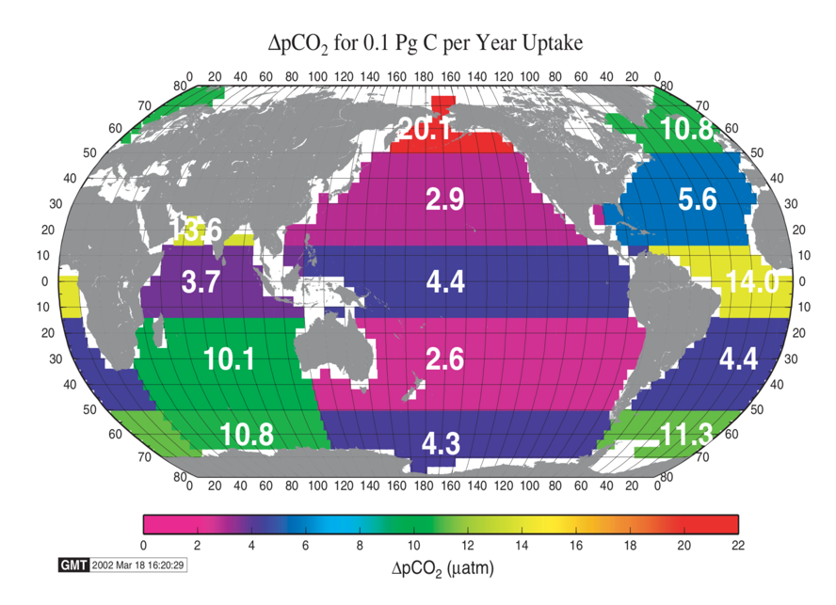
Monitoring the Surface Ocean
YOU NEED:
An accurate instrument
Platforms to install it on
To cover the world
Bender et al. (2002)
Notes:
We design our own instrument and made it available to the community

Slide 6
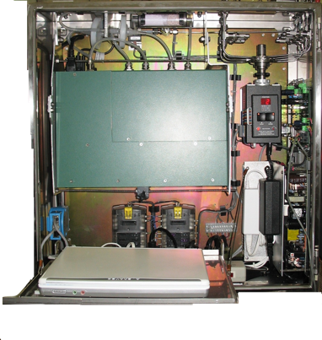
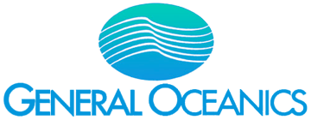
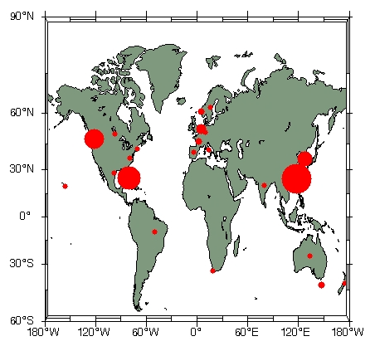
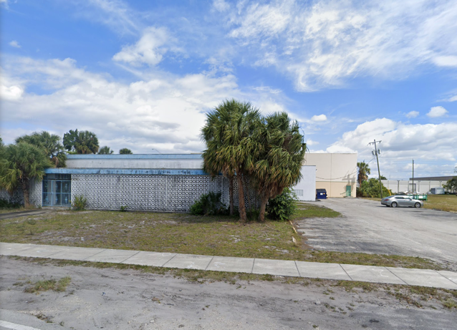
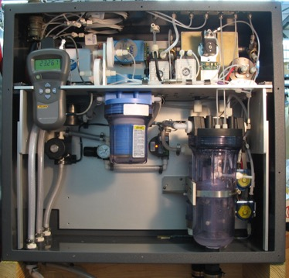
Collaboration with Industry
“Gold Standard”
100+ systems worldwide
(GO)

Slide 7
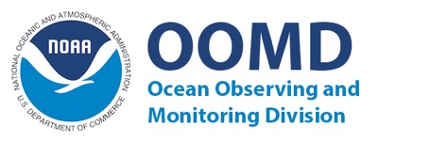


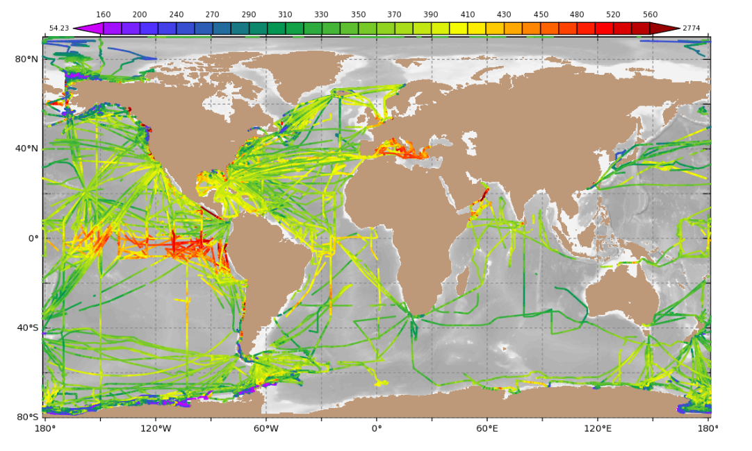




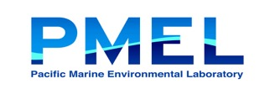



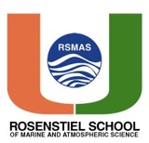
Collaboration at National Level
SOOP-CO2: Funded in majority by NOAA/CPO/OOMD
Some OAP participation
Notes:
Promote best practices and data sharing with SOCAT

Slide 8
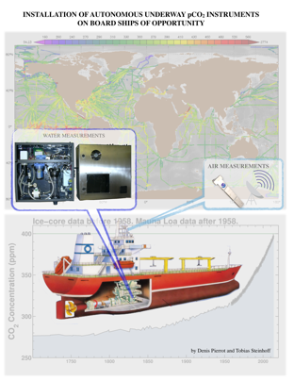
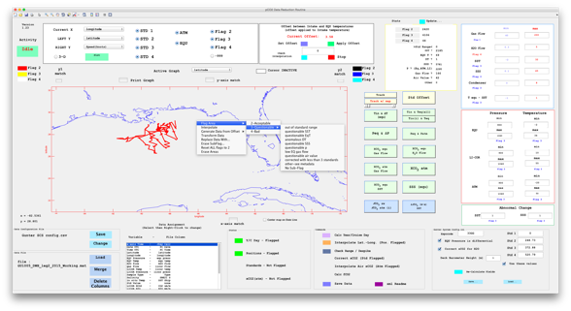
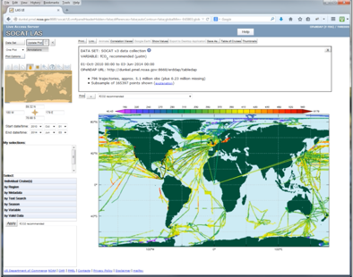










SUPPORT
Collaboration at International Level: Leading by Example
SOFTWARE
QC TOOLS (SOCAT)
Consultants to GO
Support to other groups or vessels
Installation Manual
Ease of data treatment
Speed of data treatment
Ease of data submission
Promotes uniform quality
Upload dashboard
QC cookbook
QC tools (data checks & plots)
Community data

Slide 9
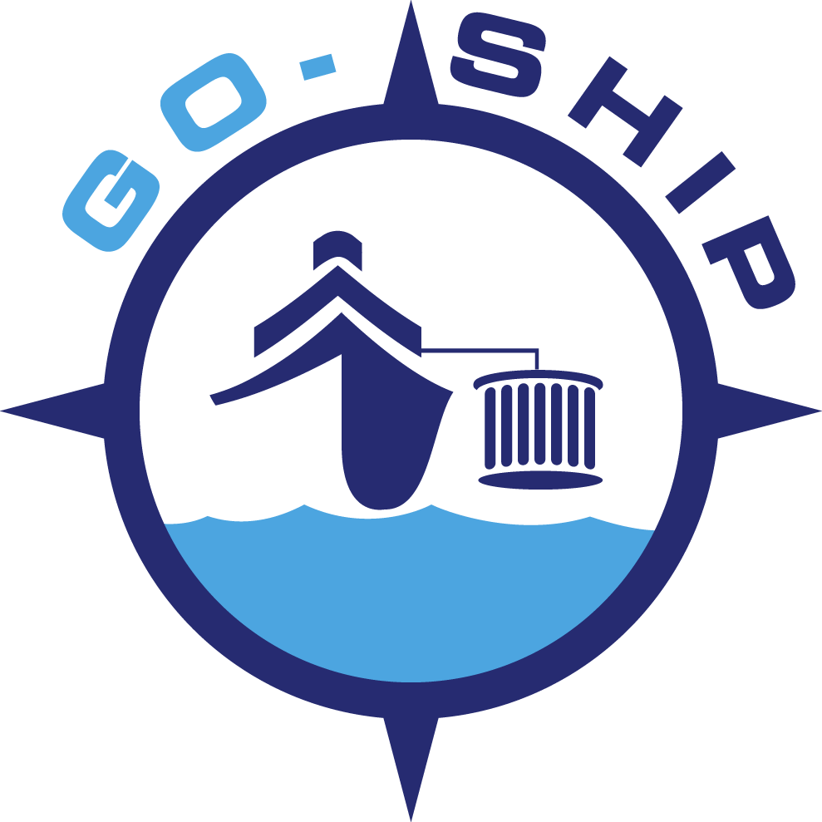
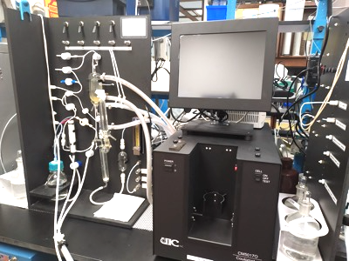
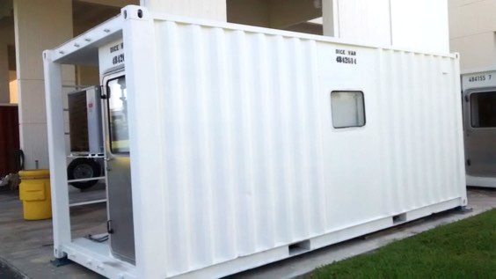
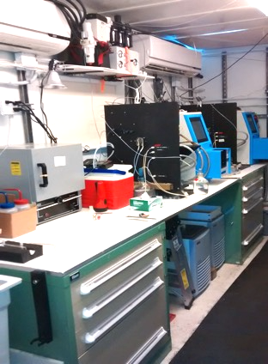
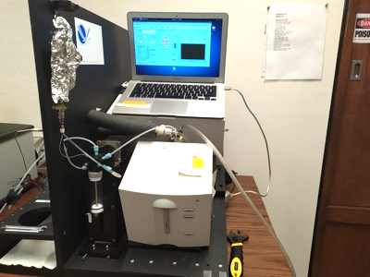
GO-SHIP: Cost Effective Climate Quality Data
in-house upgrades and automation
Portable laboratories to better control
the quality of the data
Dissolved Inorganic Carbon
Automated pH
Notes:
We have the expertise in-house to built the community’s gold standards for the other carbonate parameters
Portable lab to control variables and improve quality

Slide 10
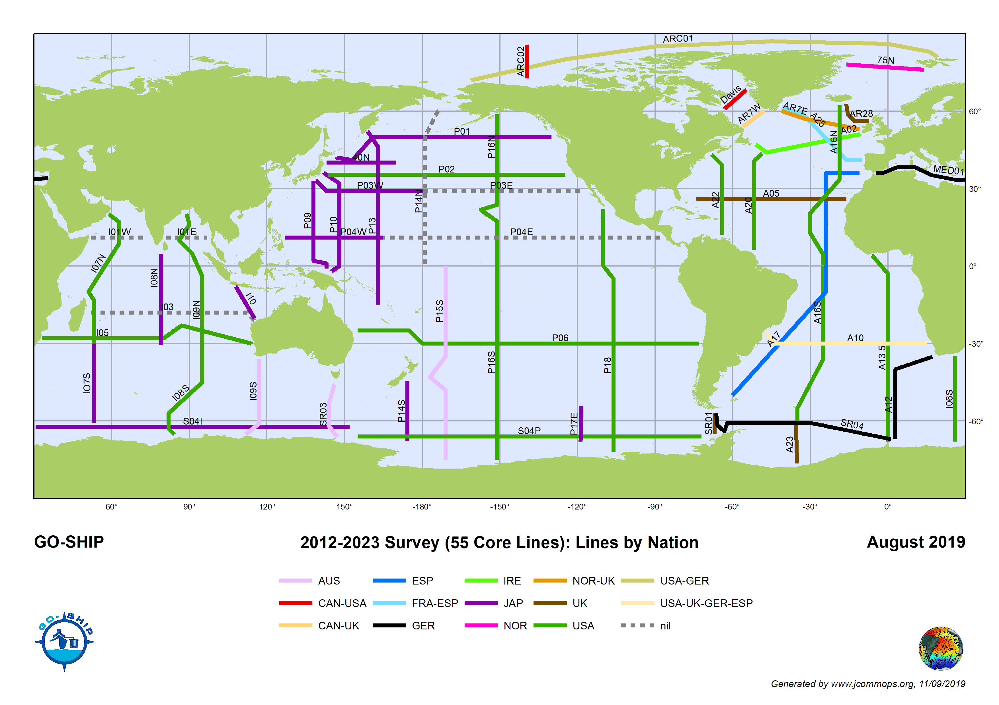












GO-SHIP: Collaboration at International Level
Countries responsible for specific lines
US is major player
AOML heavily involved at national and international level
Notes:
Countries responsible for lines

Slide 11

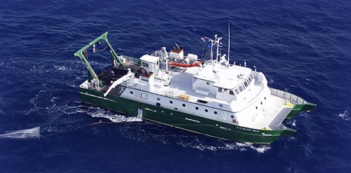
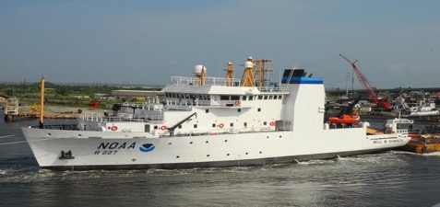
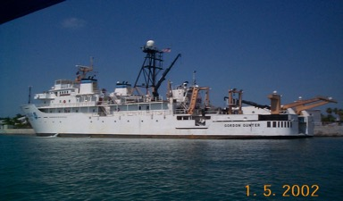

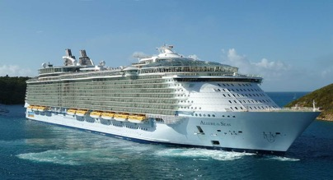
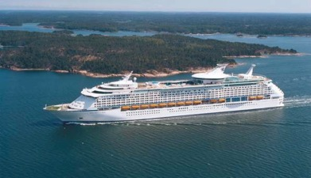
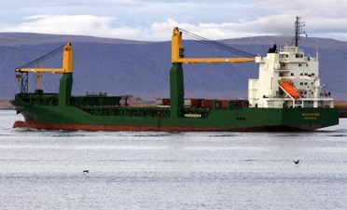
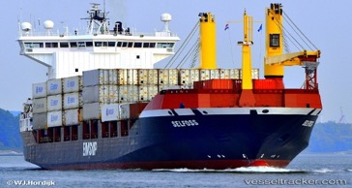


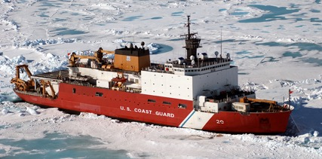
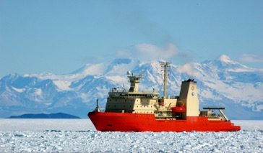
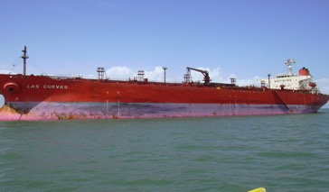
Ship of Opportunity Program
16 Ships (Research, Cruise, Merchants, Ice-breakers)

Slide 12
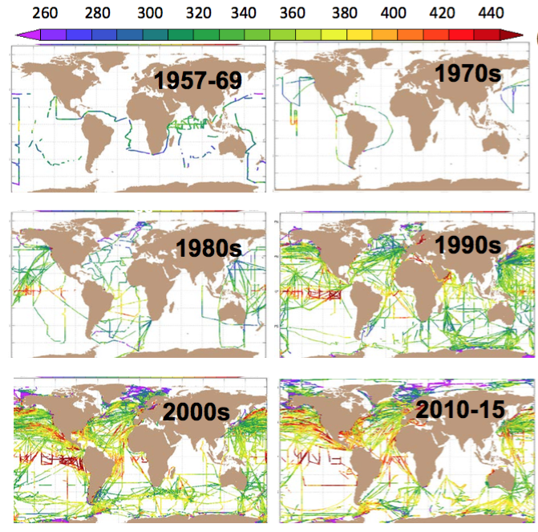
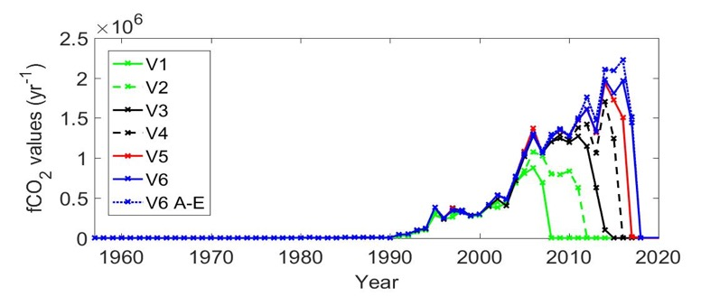
World Wide Data Delivery
~750,000 Data points/year
Major data provider and partner in the international SOCAT effort (public quality controlled data set) (23M data points)
AOML collects approx. a third of these observation
SOCAT database evolution per decade
(Bakker et al., 2016 ESSD)

Slide 13
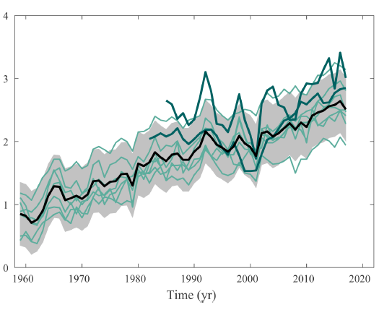
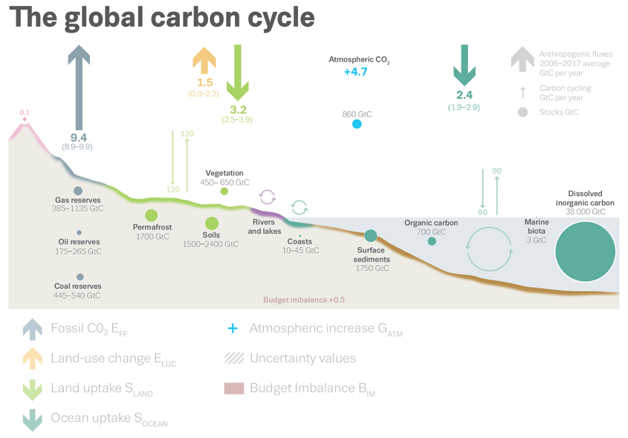
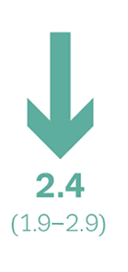
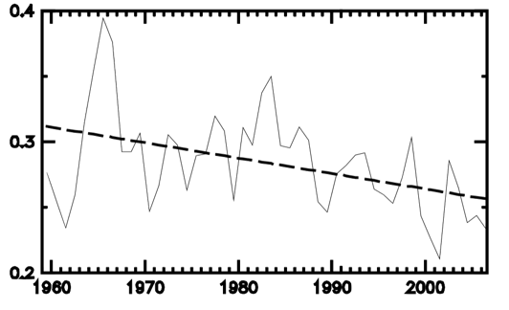
Ocean carbon sink state and evolution
Oceans take up 2.4 Gigatons of Carbon /year
+/- 0.5 (20%)
Amount in Gigatons of Carbon / year
Le Quéré et al. (2018)
Fraction of Anthropogenic Carbon
Canadell et al. (2007) PNAS

Slide 14
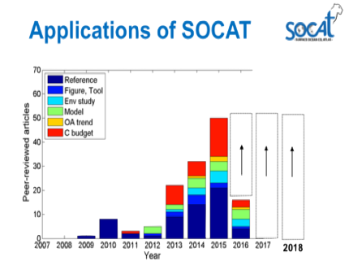



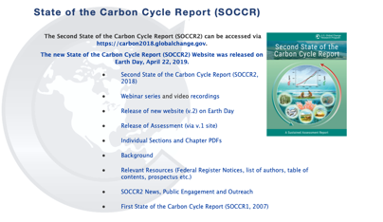
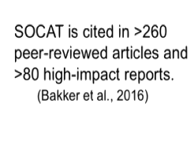
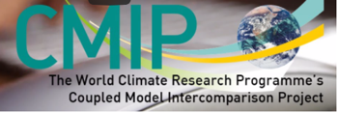
Data Applications
Publications generated
Data Usage
Ocean Carbon Sink Studies
Ocean Acidification Studies
Sensor Validation
Model Validation

Slide 15
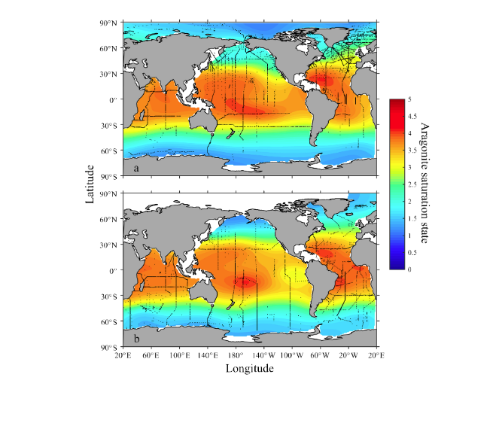
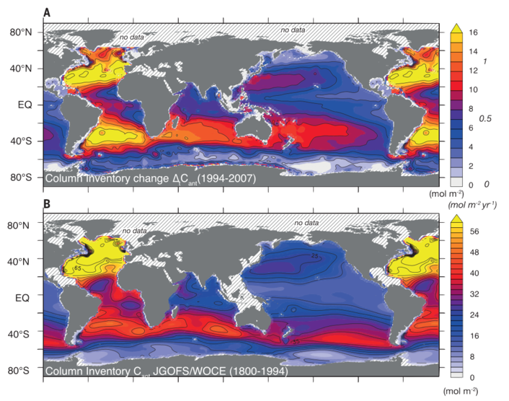
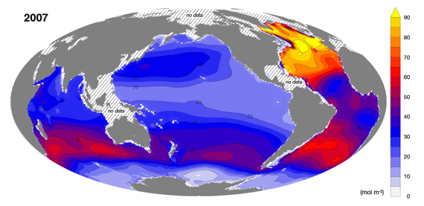
Monitoring the Increase in
Anthropogenic Carbon Column Inventory
Aragonite Saturation State (Ω_{arag})
in surface water
Its evolution from 1800s
In 2007
(Gruber et al. Science 2019)
(Jiang et al. Global Biogeochem Cycles 2015).

Slide 16

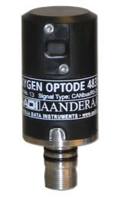
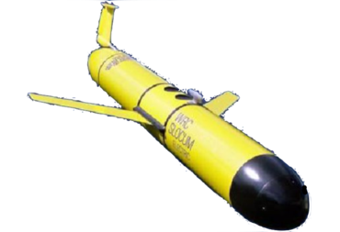

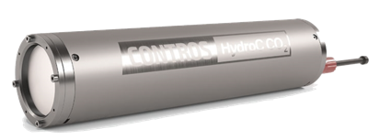
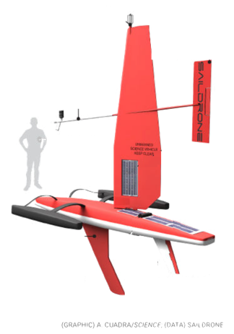




Looking to the Future
Smaller Instrumentation
Augmenting measurements
Unmanned
Vehicles
Gliders
Floats
(BGC Argo)
Oxygen
Alkalinity
Saildrones
Nitrate

Slide 17


Looking to the Future
US involvement – 15 Cruises
US Cruises for 2020- 2026
NOAA vessel
UNOLS vessel
AOML in all US cruises for carbon
AOML will lead 3 or more cruises
A13.5 in FY20, A16S, A16N

Slide 18















THANK YOU

