Slide 1

TROPICAL ATLANTIC OBSERVING SYSTEM
RENELLYS C. PEREZ

Slide 2
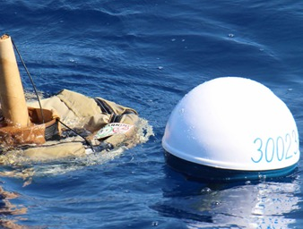
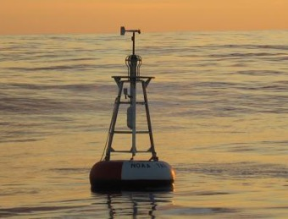
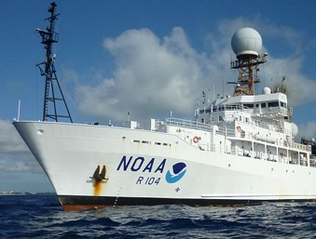
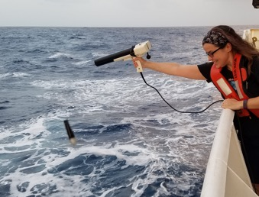
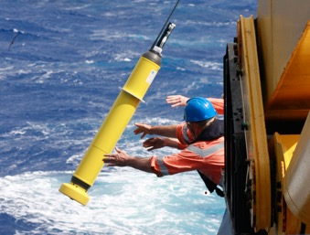
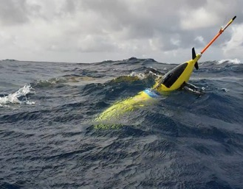
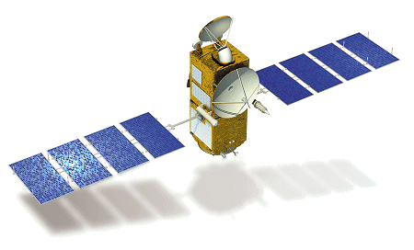
Tropical Atlantic Observing System
Drifter: T(z), SSS,
wind, SLP
Mooring: T(z), S(z), v(z),
Surface meteorology
Ship: T(z), S(z), v(z), Surface meteorology
XBT: T(z)
Argo: T(z), S(z), …
Glider: T(z), S(z), v(z)
Satellites: SST, SSH, SSS, winds, …
Partners: NOAA/OOMD, NOAA/PMEL, NOAA/IOOS, NOAA/NESDIS, NASA, NSF, Navy, Int’l Agencies

Slide 3
PhOD Publications (1999 – present)
237
43
28
Atlantic publications
Equatorial or Tropical Atlantic publications
Caribbean or Atlantic Warm Pool publications
Source: https://www.aoml.noaa.gov/phod/docs.php

Slide 4
Tropical Atlantic Partnerships
40 %
30%
30%
US Non-NOAA Partners
Caribbean, Americas
Europe, Africa, Asia
Research collaborations, cruise personnel, ship time, instrument
recovery and deployments, data sharing/processing/synthesis, …

Slide 5
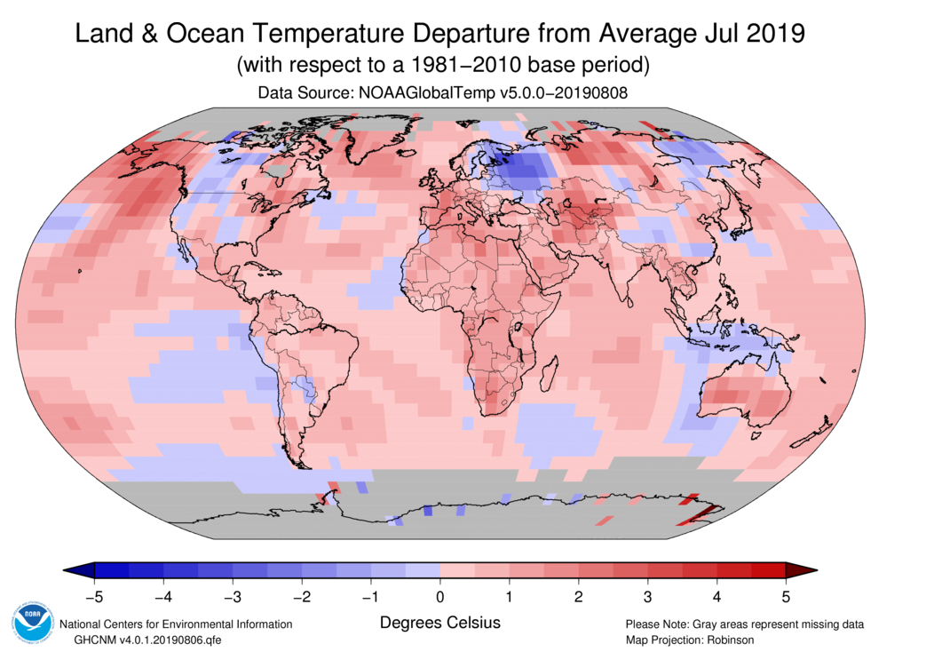
Observations for Climate Adaptation
Science Driver:
How does the coupled ocean-atmosphere system affect sea surface temperature (SST)?
Drive Innovative Science

Slide 6
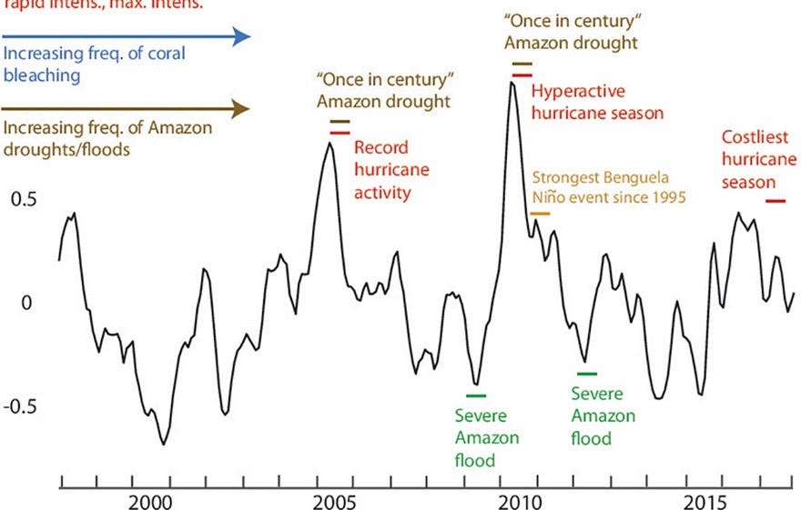
Observations for Climate Adaptation
Societal Driver:
How does SST variability impact climate and society?
SST Anomaly (deg. C)
Climate Adaptation & Mitigation
Weather Ready Nation
Improve Forecasts
Adapted from Foltz et al. 2019
Notes:
PHOD-author/coauthor publications:
FOLTZ, G.R., P. Brandt, I. Richter, B. Rodriguez-Fonseca, F. Hernandez, M. Dengler, R.R. Rodrigues, J.O. Schmidt, L. Yu, N. Lefevre, L.C. Da Cunha, M.J. McPhaden, M.C. de Araujo Filho, J. Karstensen, J. Hahn, M. Martin-Rey, C.M. Patricola, P. Poli, P. Zuidema, R. Hummels, R.C. PEREZ, V. Hatje, J. Luebbecke, I. Polo, R. LUMPKIN, B. Bourles, F.E. Asuquo, P. Lehodey, A. Conchon, P. Chang, P. Dandin, C. SCHMID, A.J. Sutton, H. Giordani, Y. Xue, S. Illig, T. Losada, S. Grodsky, F. Gasparin, T. Lee, E. Mohino, P. Nobre, R. WANNINKHOF, N.S. Keenlyside, V. Garcon, E. Sanchez-Gomez, H.C. Nnamchi, M. Drevillon, A. Storto, E. Remy, A. Lazar, S. Speich, M. GOES, T. Dorrington, W.E. Johns, J.N. Moum, C. Robinson, C. Perruche, R.B. de Souza, A. Gaye, J. Lopez-Parages, P.-A. Monerie, M. Castellanos, N.U. Benson, M.N. Hounkonnou, J. Trotte Duha, R. Laxenaire, and N. Reul. The tropical Atlantic observing system. Frontiers in Marine Science, 6:206 (doi:10.3389/fmars.2019.00206) (2019).

Slide 7
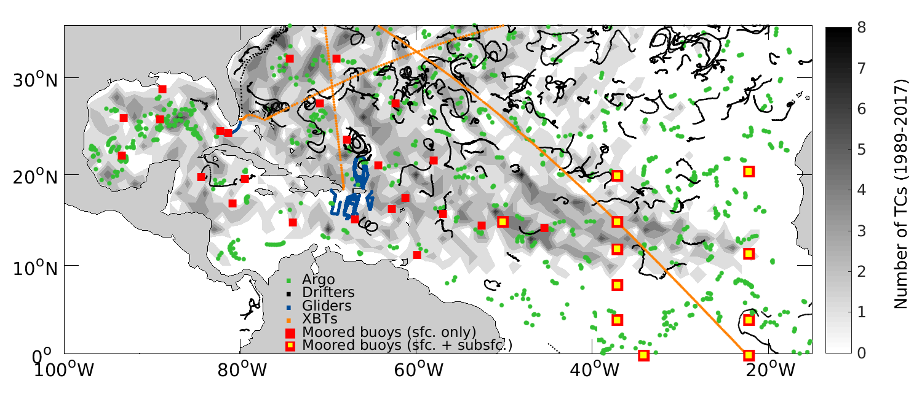
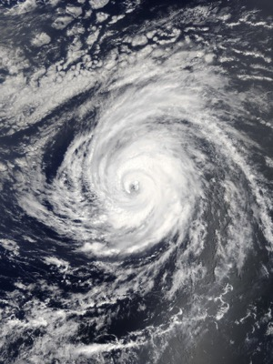
Observations for Extreme Weather Forecasts
Weather Act
Weather Ready Nation
Improve Forecasts
Data transmitted in real-time
Adapted from Foltz et al. 2019
Notes:
PHOD-author/coauthor publications:
FOLTZ, G.R., P. Brandt, I. Richter, B. Rodriguez-Fonseca, F. Hernandez, M. Dengler, R.R. Rodrigues, J.O. Schmidt, L. Yu, N. Lefevre, L.C. Da Cunha, M.J. McPhaden, M.C. de Araujo Filho, J. Karstensen, J. Hahn, M. Martin-Rey, C.M. Patricola, P. Poli, P. Zuidema, R. Hummels, R.C. PEREZ, V. Hatje, J. Luebbecke, I. Polo, R. LUMPKIN, B. Bourles, F.E. Asuquo, P. Lehodey, A. Conchon, P. Chang, P. Dandin, C. SCHMID, A.J. Sutton, H. Giordani, Y. Xue, S. Illig, T. Losada, S. Grodsky, F. Gasparin, T. Lee, E. Mohino, P. Nobre, R. WANNINKHOF, N.S. Keenlyside, V. Garcon, E. Sanchez-Gomez, H.C. Nnamchi, M. Drevillon, A. Storto, E. Remy, A. Lazar, S. Speich, M. GOES, T. Dorrington, W.E. Johns, J.N. Moum, C. Robinson, C. Perruche, R.B. de Souza, A. Gaye, J. Lopez-Parages, P.-A. Monerie, M. Castellanos, N.U. Benson, M.N. Hounkonnou, J. Trotte Duha, R. Laxenaire, and N. Reul. The tropical Atlantic observing system. Frontiers in Marine Science, 6:206 (doi:10.3389/fmars.2019.00206) (2019).

Slide 8
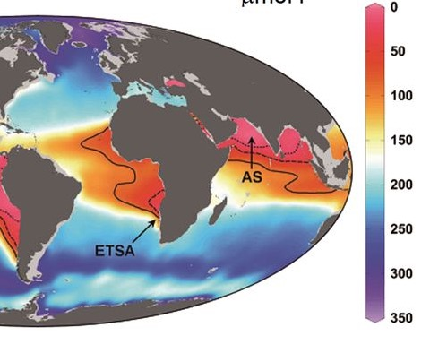
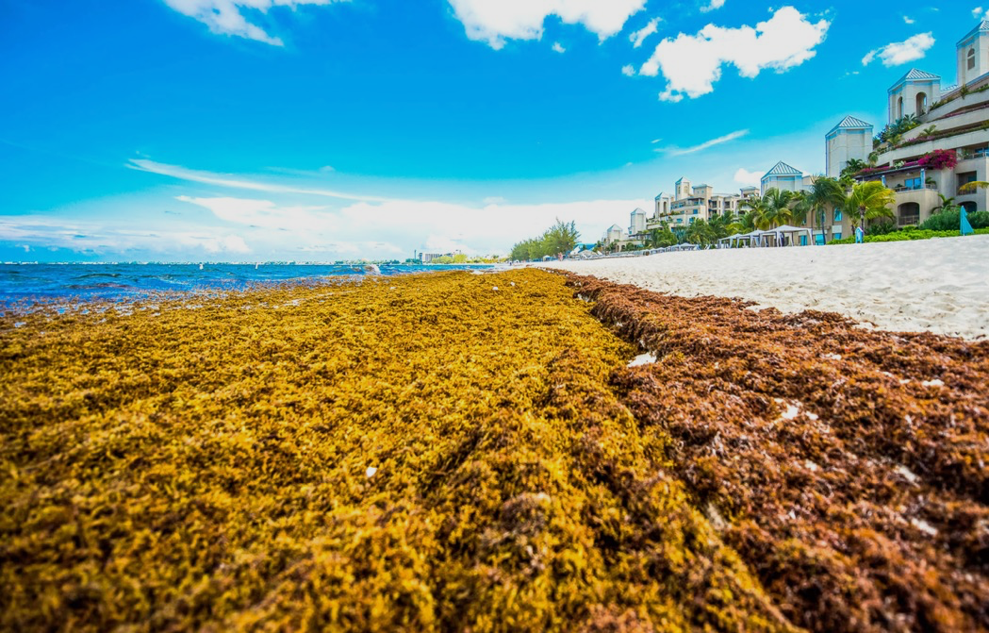
Observations to Detect Ecosystem Changes
Oceans becoming anoxic
(Brandt et al., 2010; Breitberg et al., 2018)
Increasing Sargassum threat to fishing and tourism in the Caribbean
(Putman et al., 2018; Johns et al., submitted)
Blue Economy
Healthy Oceans
Detect Changes in Ocean
Notes:
PHOD-author/coauthor publications:
Brandt, P., V. Hormann, A. Kortzinger, M. Visbeck, G. Krahmann, L. Stramma, R. LUMPKIN, and C. SCHMID. Changes in the ventilation of the oxygen minimum zone of the tropical North Atlantic. Journal of Physical Oceanography, 40(8):1784-1801, doi:10.1175/2010JPO4301.1 2010 FY2010
PUTMAN, N.F., G.J. GONI, L.J. GRAMER, C. Hu, E.M. JOHNS, J. TRINANES, and M. Wang. Simulating transport pathways of pelagic Sargassum from the equatorial Atlantic into the Caribbean Sea. Progress in Oceanography, 165:205-214, doi:10.1016/j.pocean.2018.06.009 2018 FY2018
JOHNS, E.M., R. Lumpkin, N. F. PUTMAN, R. H. SMITH, F. E. Muller‐Karger, D. Rueda‐Roa, M. T. Brooks, C. Hu, M. Wang, L. J. GRAMER, and F. E. Werner. The establishment of a Sargassum population in the tropical Atlantic: biological consequences of a basin‐scale long distance dispersal event. Progress in Oceanography. In Revision.
Non-PHOD authored publication:
D. Breitburg et al., Science 359, eaam7240 (2018). DOI: 10.1126/science.aam7240

Slide 9
Contributions to Tropical Atlantic Observations
Sustained observations + pilot/process studies with partners
CoastWatch Caribbean Node
Northeast Extension of PIRATA Array
PIRATA Array
Current Study
(TACOS)
GO-SHIP Decadal
Hydrography
2007
2014
…
2000
1999
2006
2012
2017
Tropical Atlantic XBT line (AX8)
Global Coverage:
Argo, Drifters
Hurricane Glider Project
Partners: NOAA/OOMD, NOAA/PMEL, NOAA/IOOS, NOAA/NESDIS, NASA, NSF, Navy, Int’l Agencies

Slide 10
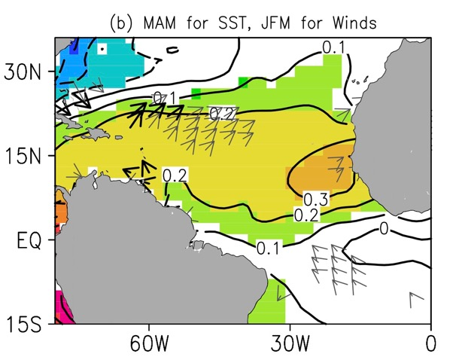
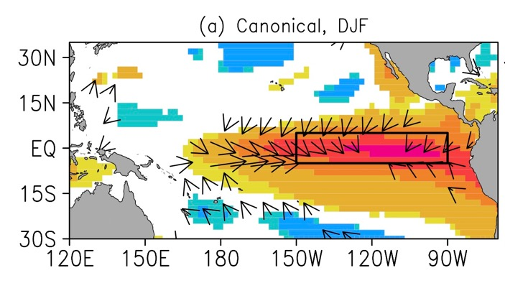
+Atlantic Meridional Mode
Warm tropical North Atlantic, more Atlantic hurricanes
Canonical El Niño leads to warm North Atlantic next season (but not central Pacific El Niño)
Amaya* and Foltz, 2014
Funded by: NOAA/AOML
Partners: NOAA/Hollings Scholarship (D. Amaya)
Notes:
PHOD-author/coauthor publications:
Amaya, D.J., and G.R. FOLTZ. Impacts of canonical and Modoki El Niño on tropical Atlantic SST. Journal of Geophysical Research, 119(C2):777-789, doi:10.1002/2013JC009476 2014 FY2014
D. Amaya was a Hollings Scholar working with G. FOLTZ

Slide 11
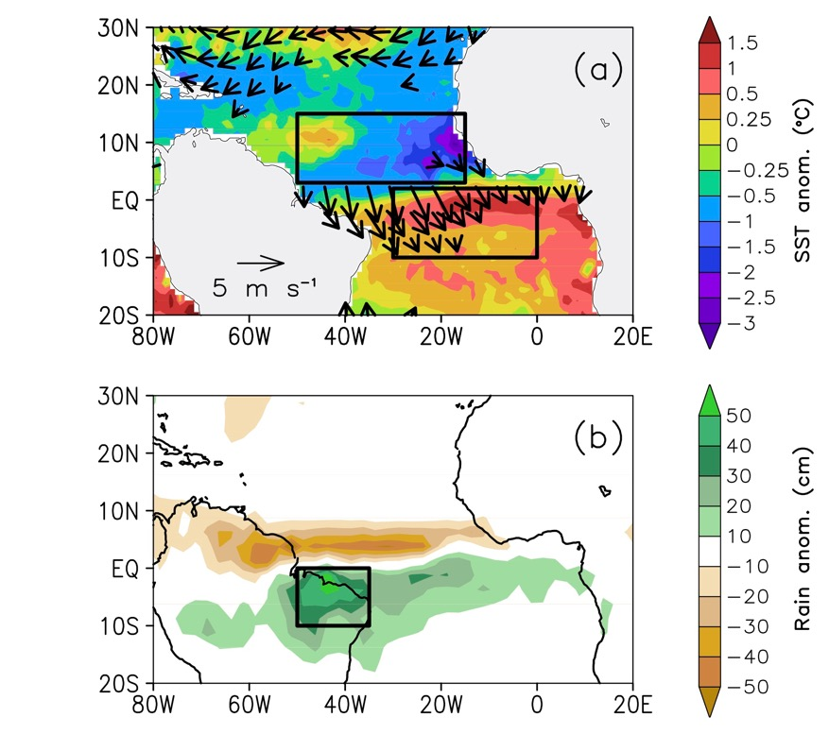
-Atlantic Meridional Mode
Cold tropical North Atlantic, severe flooding in NE Brazil
Large AMM event-to-event variability due to impact of winds and ocean dynamics on SST
Foltz et al., 2012; Rugg* et al., 2016
Funded by: NOAA/AOML, NOAA/CPO
Partners: NOAA/PMEL, NOAA/Hollings Scholarship (A. Rugg)
Notes:
PHOD-author/coauthor publications:
FOLTZ.R., M.J. McPhaden, and R. LUMPKIN. A strong Atlantic meridional mode event in 2009: The role of mixed layer dynamics. Journal of Climate, 25(1):363-380, doi:10.1175/JCLI-D-11-00150.1 2012 FY2012
Rugg, A., G.R. FOLTZ, and R.C. PEREZ. Role of mixed layer dynamics in tropical North Atlantic interannual sea surface temperature variability. Journal of Climate, 29(22):8083-8101, doi:10.1175/JCLI-D-1500867.1 2016 FY2017
A. Rugg was a Hollings Scholar working with G. FOLTZ and R. PEREZ

Slide 12
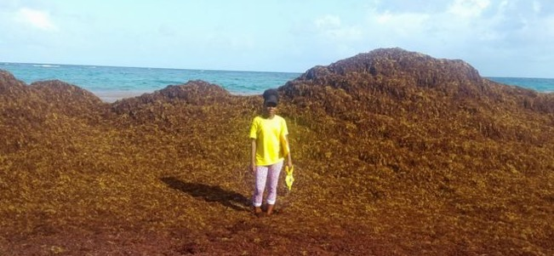
Sargassum
Tipping Point
Extreme wind anomaly caused important ocean-scale ecosystem changes with significant societal impacts
Image from BBC.com
Johns et al., 2019
Funded by: NOAA/AOML, MBON
Partners: LGL Ecological Research Associates, Univ. South Florida, Univ. Maryland CES, Scripps, NOAA Fisheries
Notes:
PHOD-author/coauthor publications:
JOHNS, E.M., R. Lumpkin, N. F. PUTMAN, R. H. SMITH, F. E. Muller‐Karger, D. Rueda‐Roa, M. T. Brooks, C. Hu, M. Wang, L. J. GRAMER, and F. E. Werner. The establishment of a Sargassum population in the tropical Atlantic: biological consequences of a basin‐scale long distance dispersal event. Progress in Oceanography. In Revision.

Slide 13
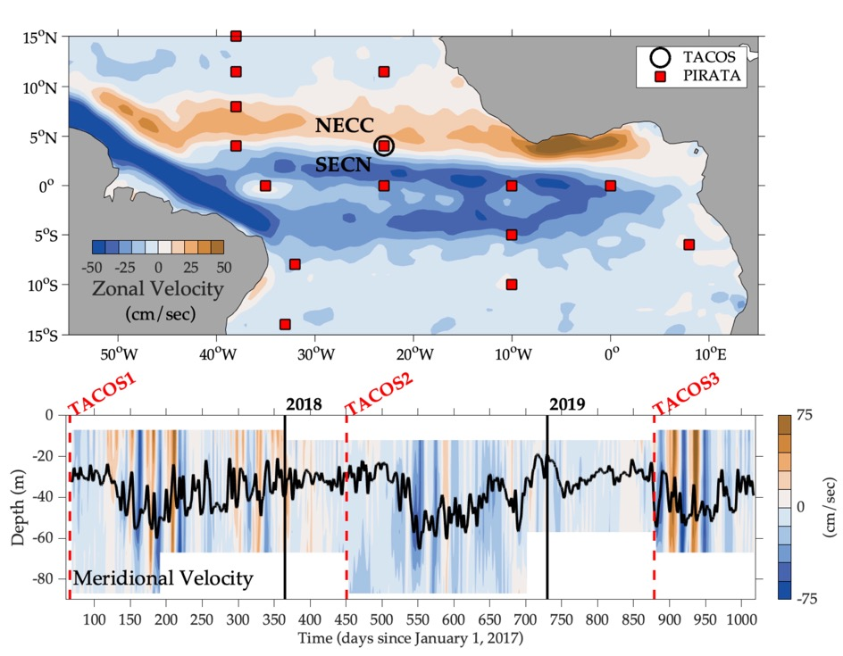
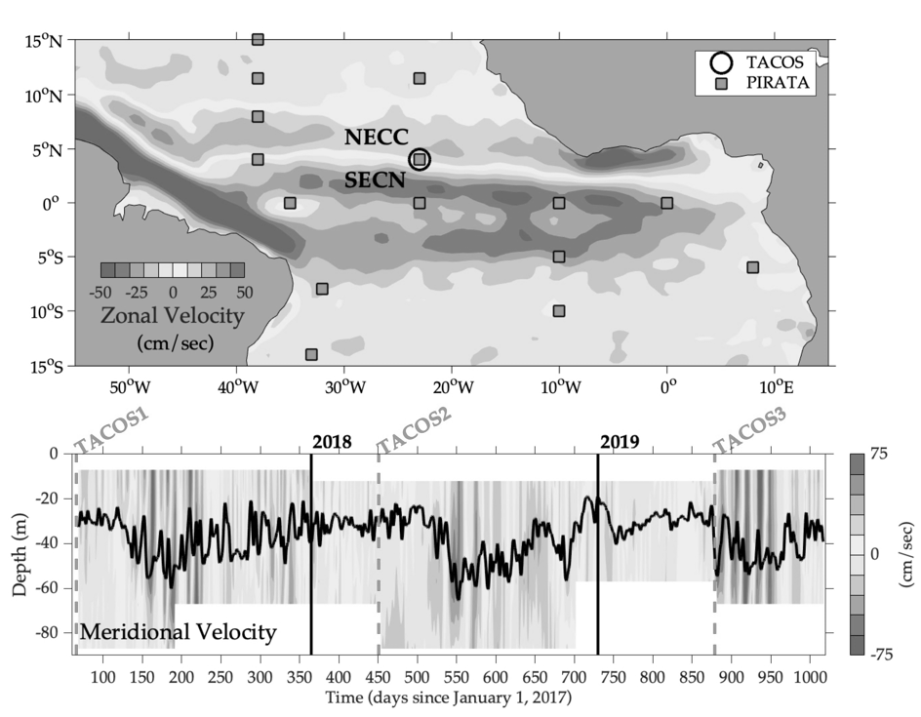

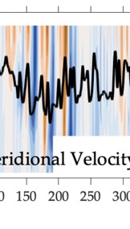
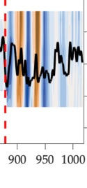
Tropical Atlantic Current Observations Study (TACOS) resolves upper ocean velocity at 4N, 23W
Energetic fluctuations (Tropical Instability Waves or TIWs) drive mixing and turbulent cooling which are needed to close SST budget
Perez et al., 2019; Foltz et al., 2019
Funded by: NOAA/AOML, NOAA/OOMD
Partners: NOAA/OOMD, NOAA/PMEL, UFPE/Brazil, GEOMAR/Germany
Notes:
PHOD-author/coauthor publications:
PEREZ, R.C., G.R. FOLTZ, R. LUMPKIN, and C. SCHMID. Direct measurements of upper ocean horizontal velocity and vertical shear in the tropical North Atlantic Ocean at 4°N, 23°W. Journal of Geophysical Research-Oceans, 124(6):4133-4151, doi:10.1029/2019JC015064 2019 FY2019
FOLTZ, G.R., R. Hummels, M. Dengler, R.C. PEREZ, and M. Araujo. Vertical turbulent cooling of the mixed layer in the Atlantic ITCZ and trade wind regions. Journal Geophysical Research, In Revision.

Slide 14
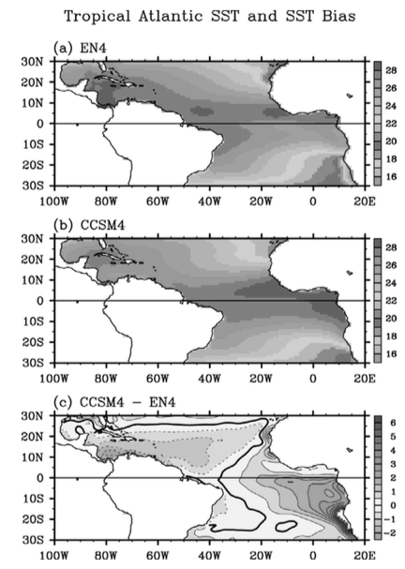
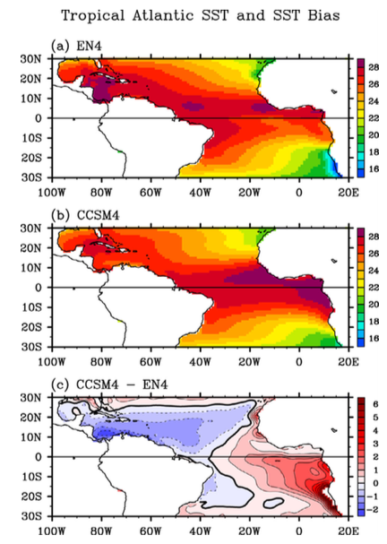

Reduce SST Biases
Obs
Coupled models have large tropical Atlantic SST biases
Large part of SST bias is due in part to weak mixed layer cooling and entrainment, and more joint model-observation studies are needed
Model
Bias
Song et al., 2015
Funded by: NOAA/AOML, NSF, NSFC/China
Partners: Univ. of Miami, First Institute of Oceanography/China
Notes:
PHOD-author/coauthor publications:
Song, Z., S.-K. LEE, C. Wang, B.P. Kirtman, and F. Qiao. Contributions of the atmosphere-land and ocean-sea ice model components to the tropical Atlantic SST bias in CESM1. Ocean Modelling, 96(2):280-290, doi:10.1016/j.ocemod.2015.09.008 2015 FY2016

Slide 15
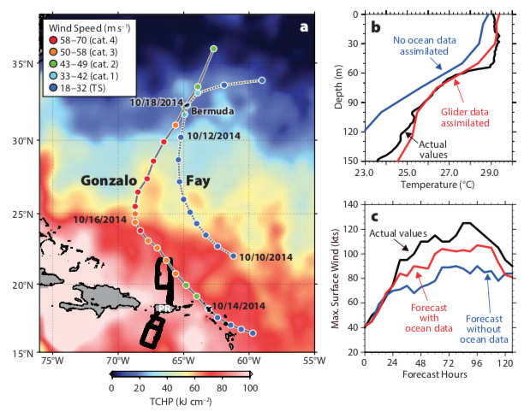
Improve Hurricane Intensity Forecasts
Studies show importance of surface and subsurface measurements
In situ surface pressure and winds have high impact on ECMWF weather forecasts
e.g., Centurioni et al. 2017
Goni et al., 2017
Funded by: NOAA/AOML, Sandy Supplemental, NOAA/OOMD, NOAA/CPO
Partners: Scripps, ECMWF, WMO, NOAA/CARICOOS, NOAA/IOOS, WHOI, Rutgers Univ., NOAA/EMC, NOAA/NCEP, NOAA/NHC, AOML/HRD
Notes:
PHOD-author/coauthor publications:
Centurioni, L., A. Horanyi, C. Cardinali, E. Charpentier, and R. LUMPKIN. A global ocean observing system for measuring sea level atmospheric pressure: Effects and impacts on numerical weather prediction. Bulletin of the American Meteorological Society, 98(2):231-238, doi:10.1175/BAMS-D-15-00080.1 2017 FY2017
GONI, G.J., R.E. Todd, S.R. Jayne, G.R. HALLIWELL, S. Glenn, J. Dong, R. Curry, R. DOMINGUES, F. BRINGAS, L. Centurioni, S.F. DiMarco, T. Miles, J. Morell, L. Pomales, H.-S. Kim, P.E. Robbins, G.G. Gawarkiewicz, J. Wilkin, J. Heiderich, B. Baltes, J.J. CIONE, G. Seroka, K. Knee, and E.R. Sanabia. Autonomous and Lagrangian ocean observations for Atlantic tropical cyclone studies and forecasts. Oceanography, 30(2):85-95, doi:10.5670/oceanog.2017.227 2017 FY2017

Slide 16
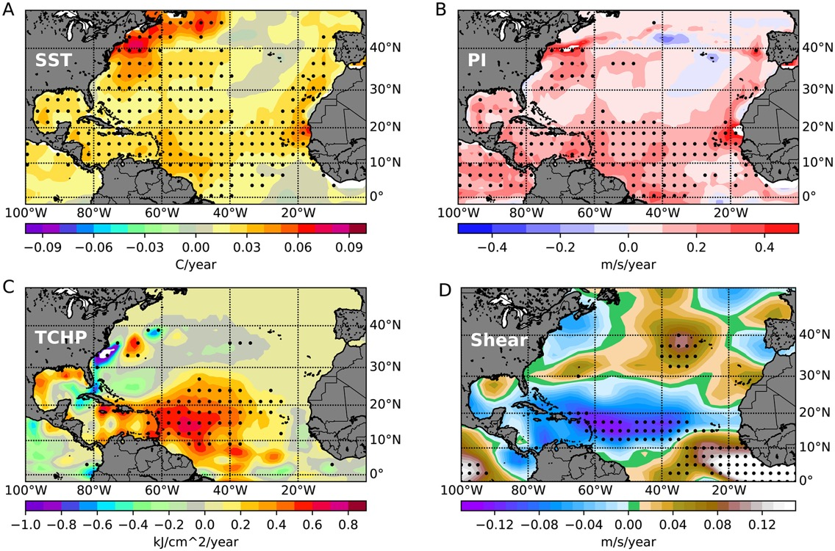
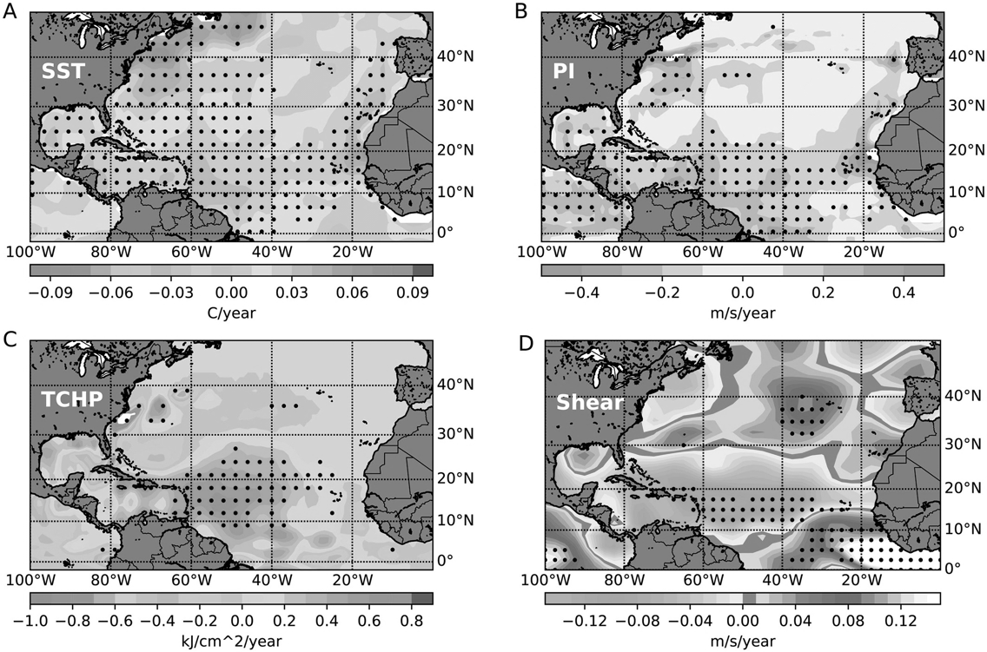
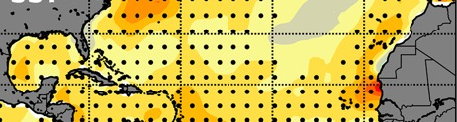
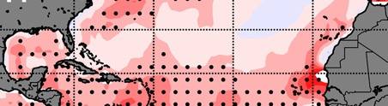
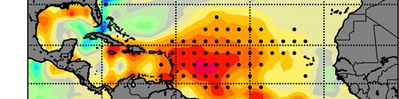
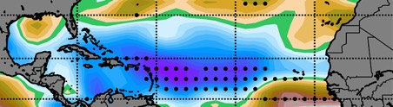
Hurricane Rapid Intensification (RI)
Shift in Atlantic Multidecadal Oscillation from 1986-2015 caused environment to become more favorable for RI
Balaguru et al., 2018
Funded by: NOAA/AOML, Office of Science/BER, DOE/RGCM
Partners: Pacific Northwest National Laboratory
Notes:
PHOD-author/coauthor publications:
Balaguru, K., G.R. FOLTZ, and L.R. Leung. Increasing magnitude of hurricane rapid intensification in the central and eastern tropical Atlantic. Geophysical Research Letters, 45(9):4238-4247, doi:10.1029/2018GL077597 2018 FY2018

Slide 17
Hurricane Rapid Intensification (RI)
Salinity stratification is important for hurricane RI
Statistical RI forecasts can benefit from inclusion of salinity as a predictor
0.0
0.2
0.4
0.6
0.8
1.0
Balaguru et al., in prep.
Salinity impact on vertical density stratification
Funded by: NOAA/AOML, NOAA/CPO, Office of Science/BER, DOE/RGCM
Partners: Pacific Northwest National Laboratory, NOAA/NHC, AOML/HRD
Notes:
PHOD-author/coauthor publications:
Balaguru et al., manuscript in prep for Bulletin of Marine Science (with G. FOLTZ)

Slide 18
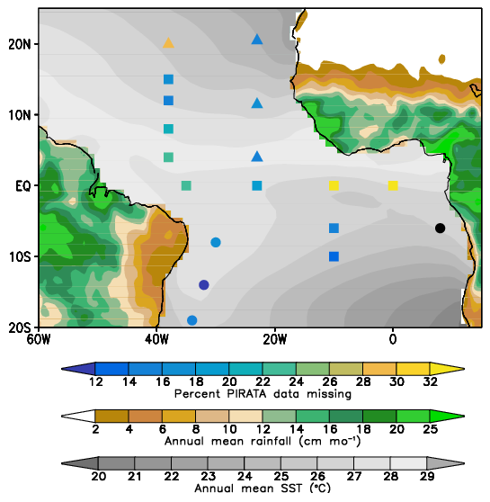
Products for Climate Studies: ePIRATA
Foltz et al., 2018
Enhanced PIRATA dataset: https://www.aoml.noaa.gov/phod/epirata/
Funded by: NOAA/AOML, NOAA/CPO
Partners: NOAA/PMEL, INPE/Brazil, Meteo-France, IFREMER/France
Notes:
New product, 111 page views since November 2018. Top downloads from US, Brazil, Germany, France.
From 2015 to 2019, approximately 3 million PIRATA data files (web + FTP) delivered from NOAA/PMEL
servers were delivered.

Slide 19
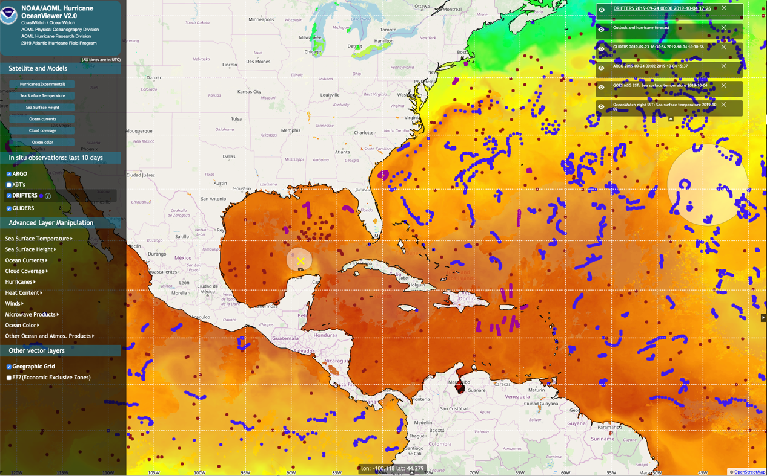
Products for Hurricane Field Operations:
OceanViewer
https://cwcgom.aoml.noaa.gov/cgom/OceanViewer/index_hrd.html
Funded by: CoastWatch, NOAA/AOML
Partners: CoastWatch, NOAA/NHC, AOML/HRD
Notes:
Google Analytics data not available yet.

Slide 20

Real-Time Ocean Data
Helene passed 150 km east of 20N, 38W PIRATA mooring
Funded by: NOAA/OOMD, NOAA/PMEL, NOAA/AOML, INPE/Brazil, Meteo-France, IFREMER/France
Notes:
From 2015 to 2019, approximately 3 million PIRATA data files (web + FTP) delivered from NOAA/PMEL
servers were delivered.

Slide 21
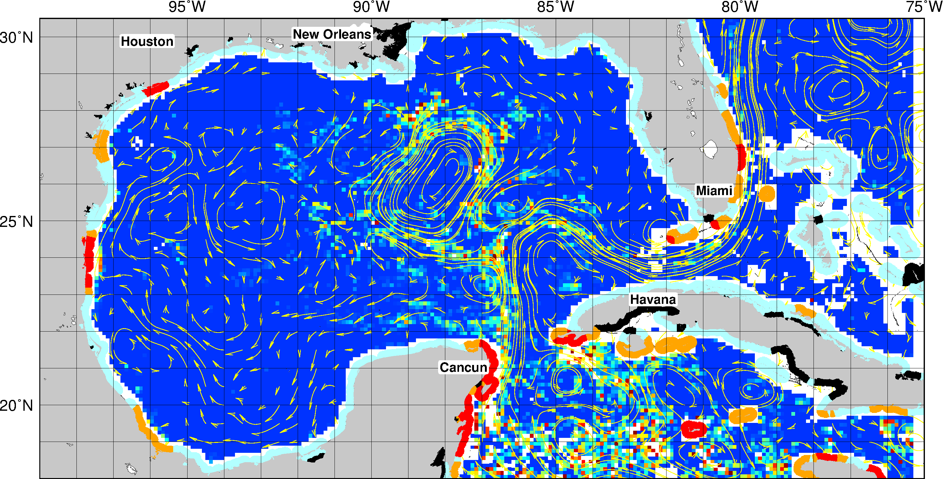

Products for Sargassum inundation
https://www.aoml.noaa.gov/phod/sargassum_inundation_report/
Funded by: CoastWatch, NOAA/AOML
Partners: CoastWatch, Univ. South Florida
Notes:
Google Analytics data not available yet.

Slide 22
THANK YOU

