Slide 1

In Situ Climate Change and Ocean Acidification Monitoring of US Coral Reefs
Derek Manzello, OCED

Slide 2
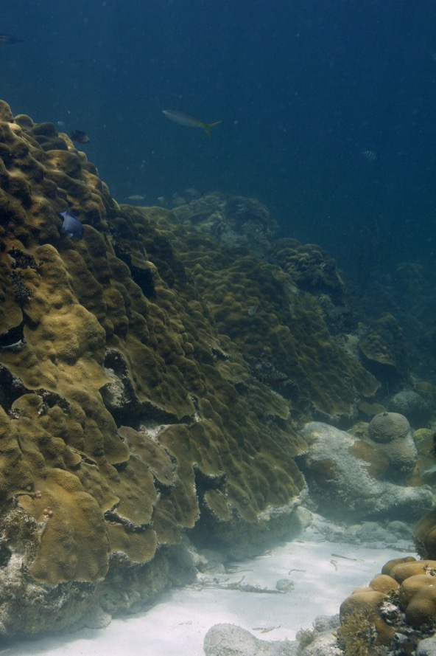
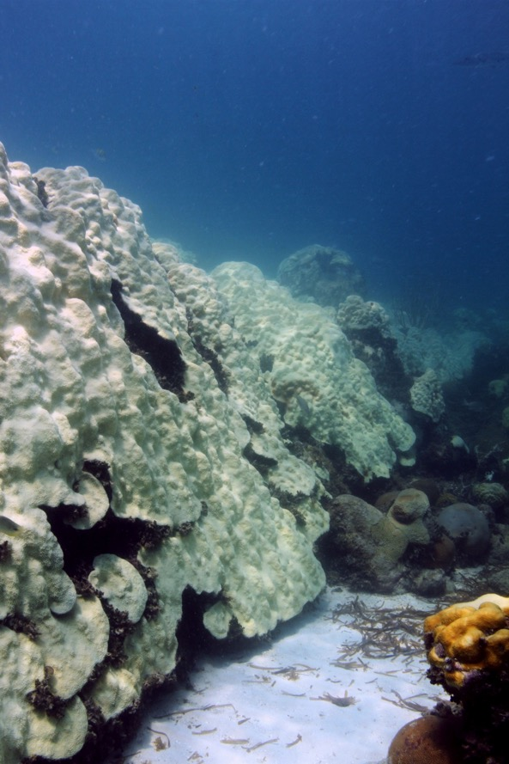
Warming and Coral Bleaching
Corals live in symbiosis with intracellular algae
Highly sensitive to elevated temperature

Slide 3

Warming and Coral Bleaching
3
Breakdown in symbiosis between algal endosymbiont and coral animal host

Slide 4
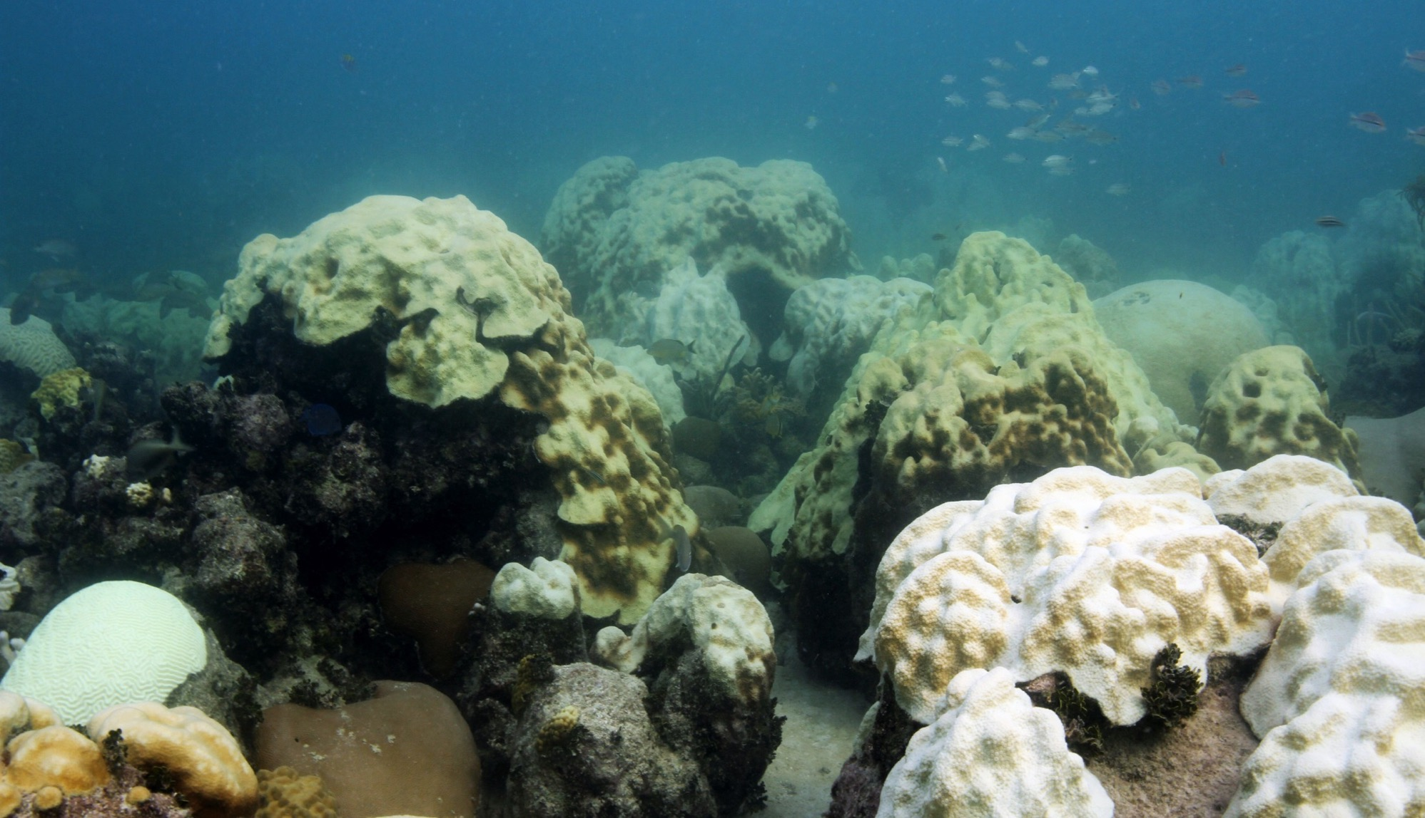
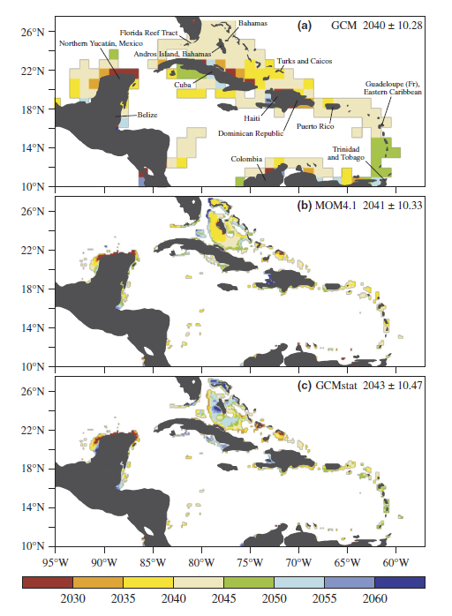
Warming and Coral Bleaching
4
Bleaching
  Mortality
  Susceptibility to disease
  Depressed growth
  Impaired reproduction
Bleaching events increasing in frequency and severity
Annual bleaching in Caribbean within 20-30 years
Van Hooidonk et al. (2015, Glob. Change Biol.)

Slide 5

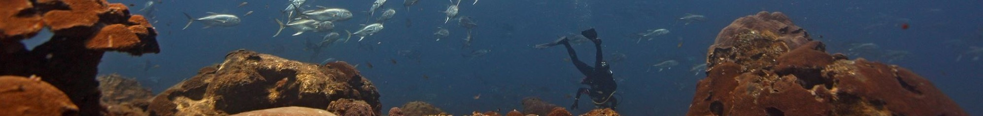
National Coral Reef Monitoring Program:
In Situ Climate and Ocean Acidification
What is the impact of climate change and ocean acidification on US coral reefs?

Slide 6
National Coral Reef Monitoring Program:
In Situ Climate and Ocean Acidification
6
What are the spatiotemporal trends in temperature and ocean acidification on US coral reefs?
What are the ecosystem impacts to US coral reefs?

Slide 7











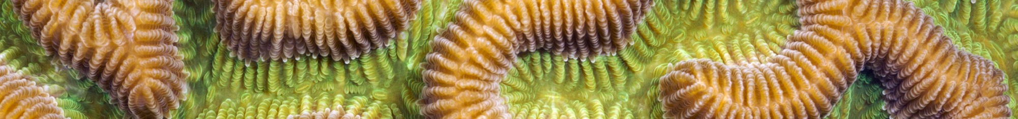
NCRMP partners
Flower Garden Banks
Florida Keys
American Samoa
Salt River, USVI
Dry Tortugas
American Samoa
SEFSC
PIFSC

Slide 8
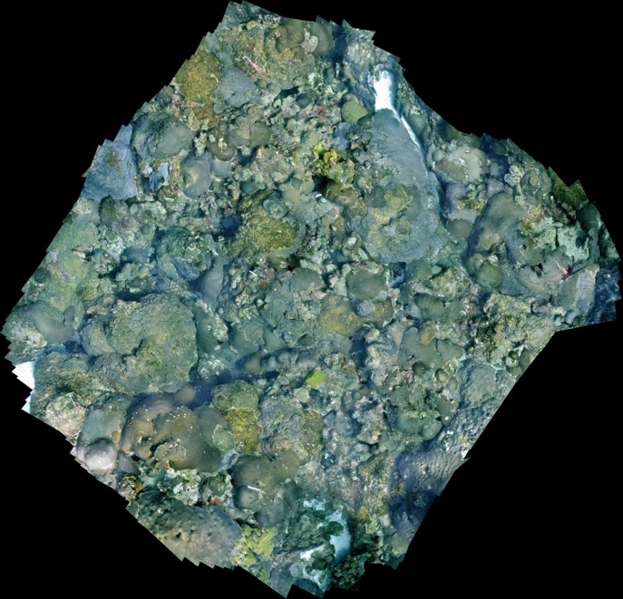
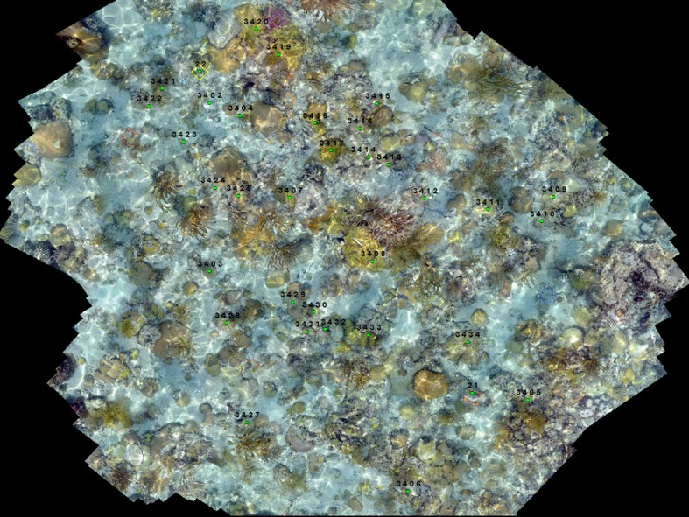
  Ecosystem Response Monitoring
  Landscape mosaics
Cheeca Rocks
Flower Garden Banks
High-resolution benthic characterization

Slide 9
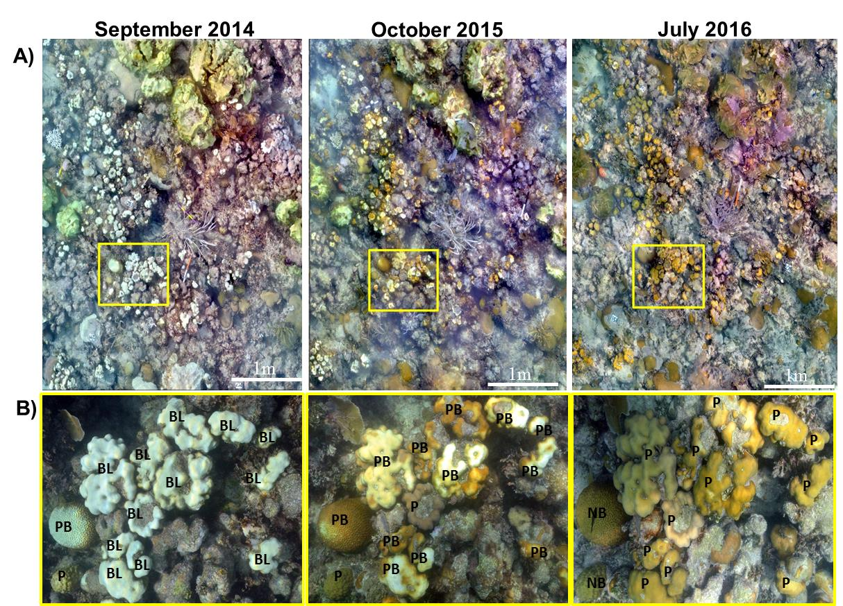
Landscape mosaics
Cheeca Rocks Coral Bleaching
Fate tracking of individual coral colonies
Gintert et al. (2018, Coral Reefs)

Slide 10
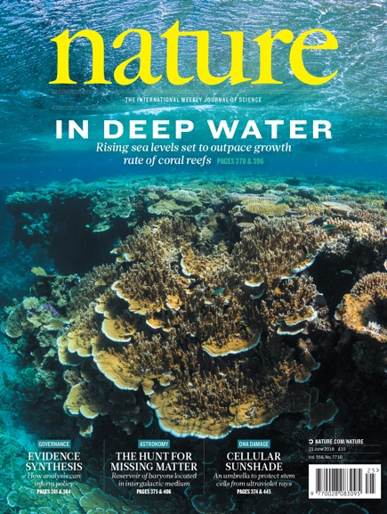
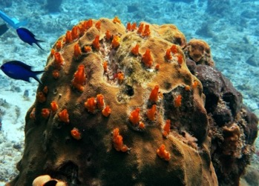
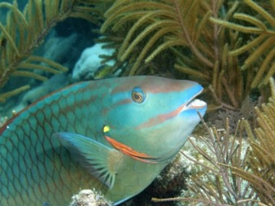
ReefBudget CaCO₃ Budget Monitoring
Developed by Perry et al. (2012, Coral Reefs)
CaCO₃ flux via measurement of calcifying and bioeroding taxa abundances
Shift to net erosion around 5-10% coral cover
Perry et al. (2018, Nature)

Slide 11
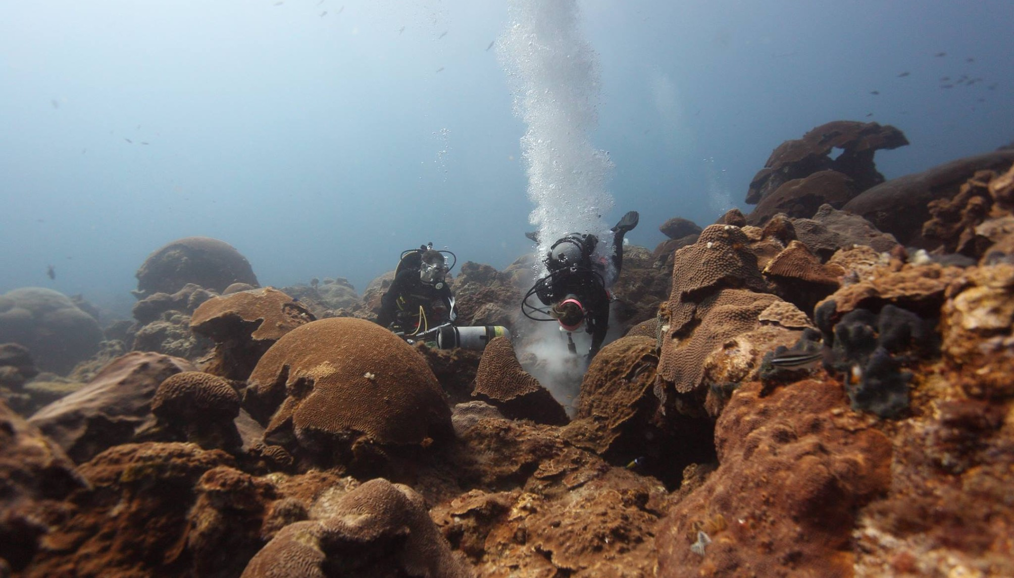
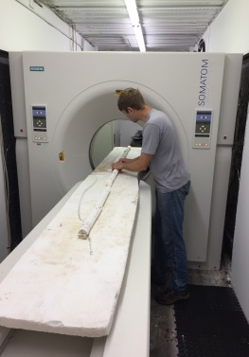
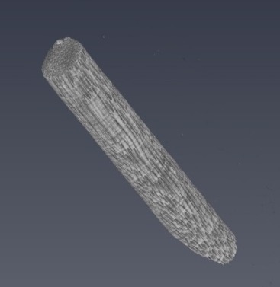
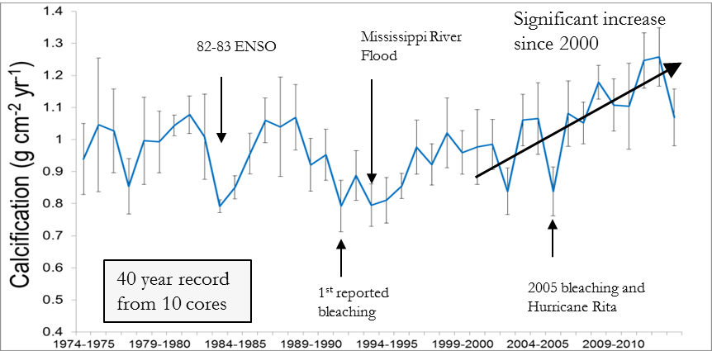
Coral Calcification
Collection of cores every 5-10 years
CT scan of Orbicella faveolata
Analyzed using CT
Long-term baseline by which to monitor future change
ACCRETE divers take coral core at Flower Garden Banks, June 2015

Slide 12
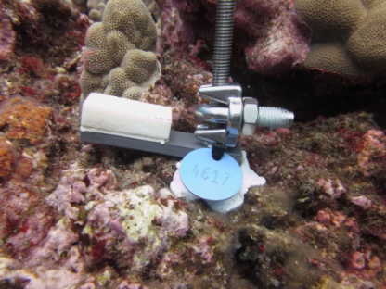
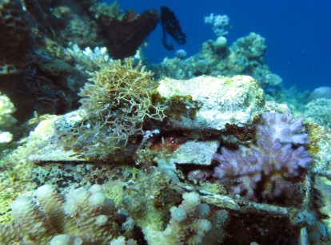
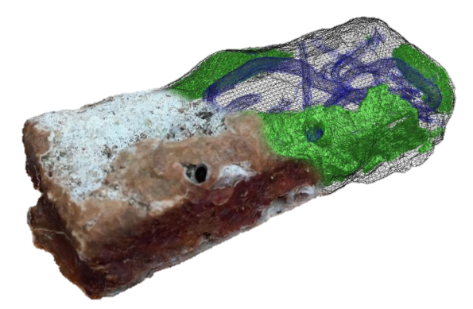
Bioerosion Monitoring Unit (BMU)
Developed by I. Enochs
Coral skeleton cut into small, rectangular prisms
Blocks collected after 3 years and CT scanned
3 years

Slide 13
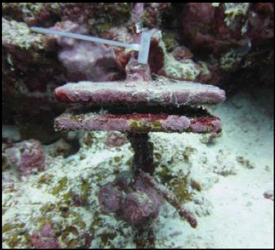
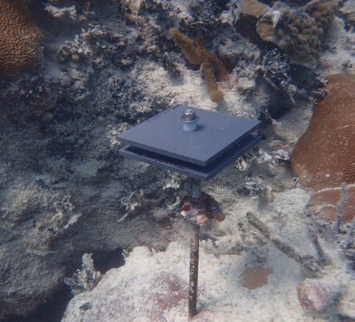
Calcification Accretion Unit (CAU)
Secondary accretion
Deployed for 3 years
3 years

Slide 14
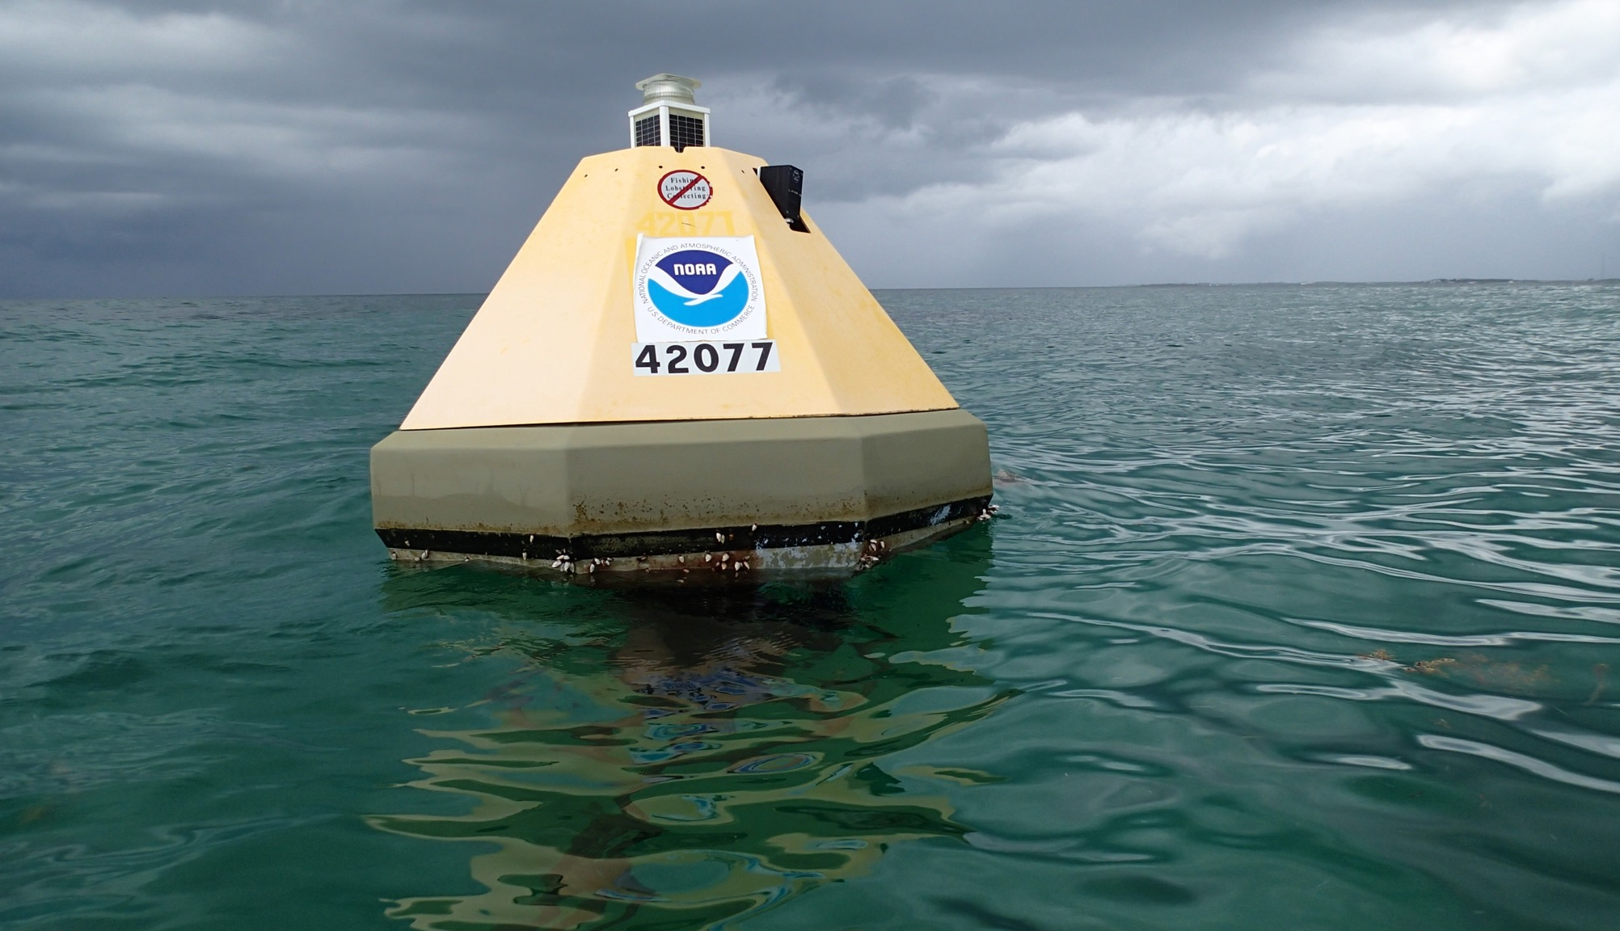
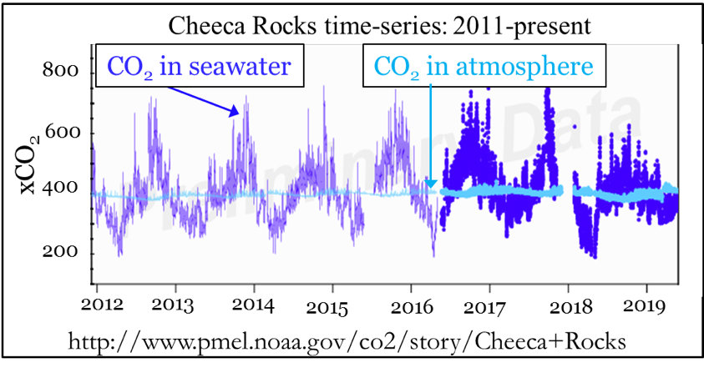
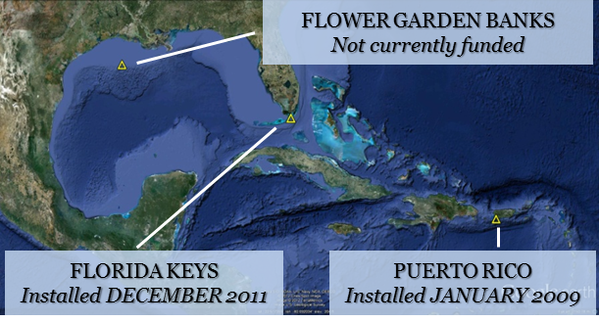
Sentinel Monitoring Sites
CO₂ Time Series
Full suite of Ecosystem Response Monitoring
2 of 3 planned sites fully instrumented in ATL
AOML led establishment of MAPCO₂ buoy in American Samoa
Cheeca Rocks MAPCO₂

Slide 15
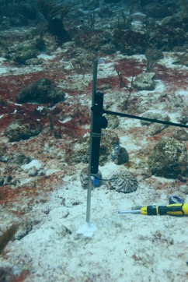
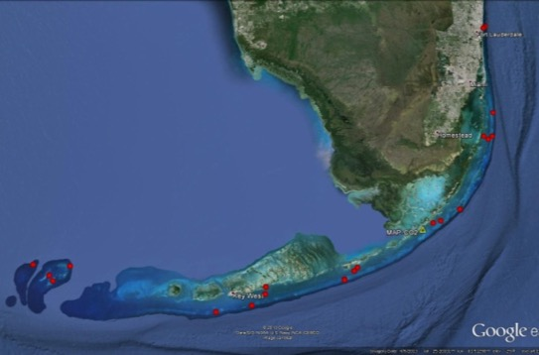
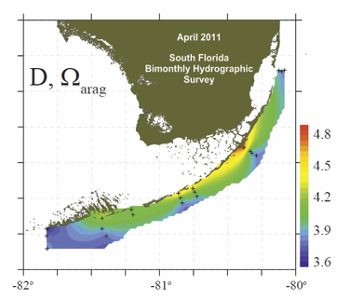
National Coral Reef Monitoring Program physical monitoring
Vertical thermal structure
CO₂ snapshots
108 thermistors
Arrays across depth gradients in each jurisdiction
Randomized CO₂ bottle sampling, taken by SEFSC and NCCOS
Each jurisdiction sampled once every two years (n=150 bottles/year)
Manzello et al. (2012, PLoS One)
Class I
Lang Bank, St Croix
Class I sites on Florida Reef Tract

Slide 16
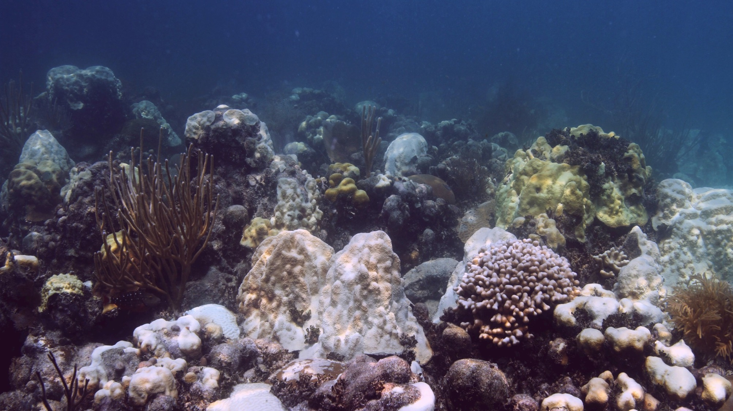
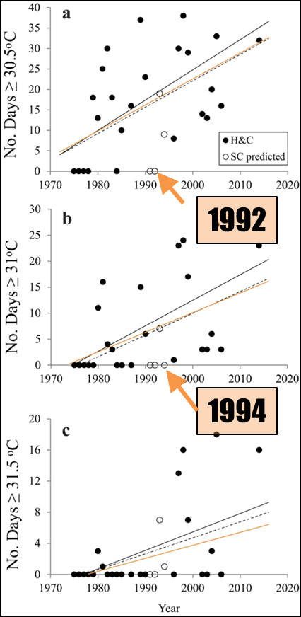
  Initial National Coral Reef Monitoring Program Data Products: Temperature Data
Temperature patterns
7 FL Keys-wide mass bleaching events since 1987
Number of thermally stressful days per year increased > 2500% over past 20 years
2014 and 2015 were warmest years on record
Manzello (2015,
Sci. Rpt.)

Slide 17
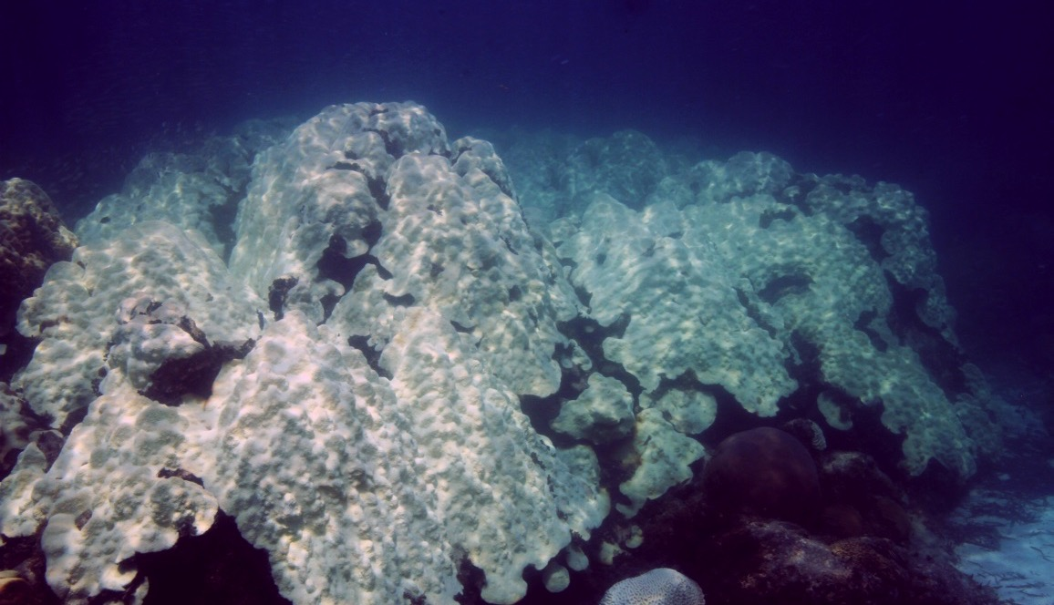
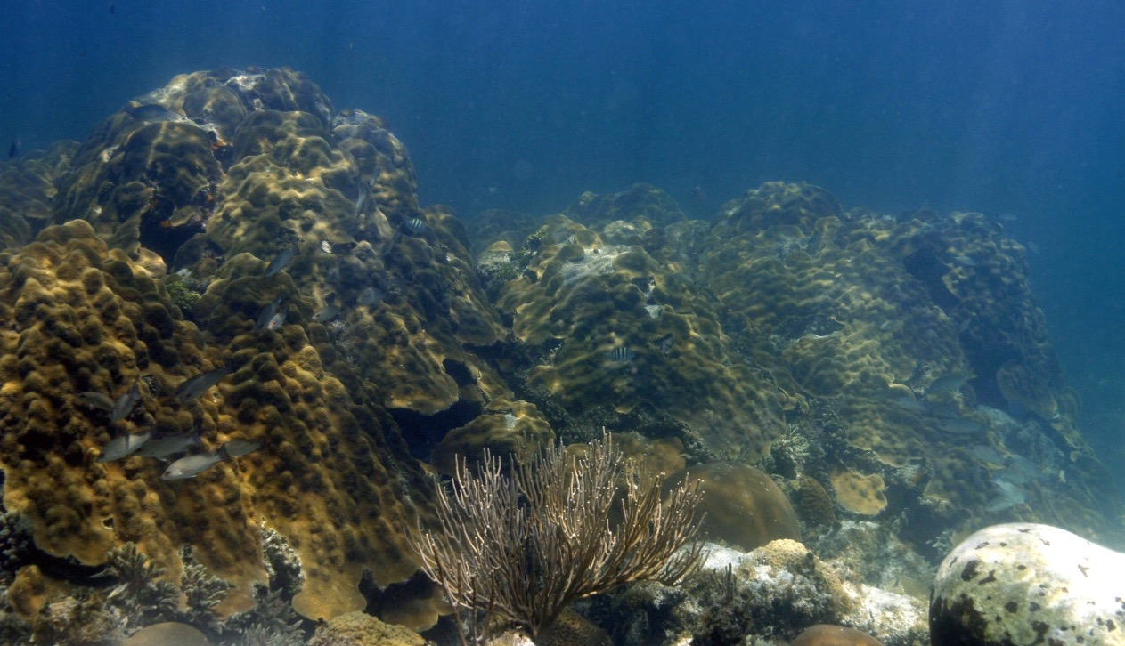
  Initial National Coral Reef Monitoring Program Data Products: Site of Hope?
April 2018
Sept. 2014
Cheeca Rocks
Marked resilience to bleaching (Gintert et al. 2018, Coral Reefs)
Refuge for ESA-listed Orbicella annularis spp. complex (Manzello et al. 2018, Mar. Biol.)
This work led to proposed expansion of Sanctuary Preservation Area

Slide 18
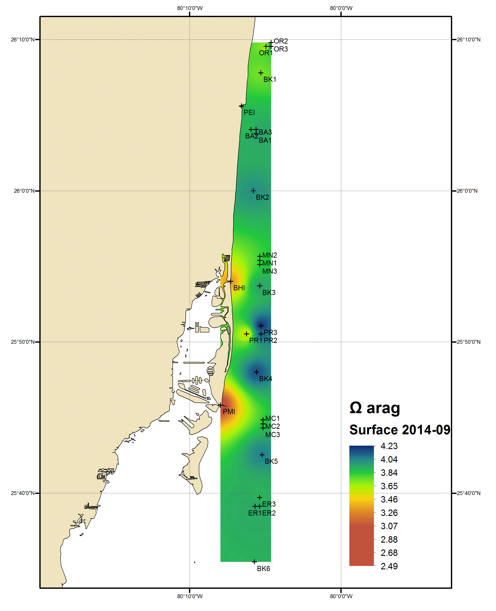
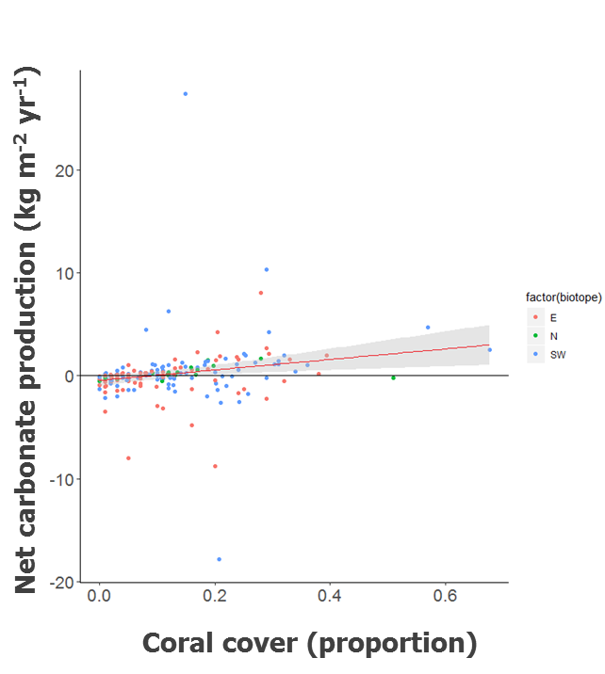
Initial National Coral Reef Monitoring Program Data Products
Localized acidification from navigational inlets in Southeast Florida
Nearly half of reefs in Puerto Rico and USVI are net erosional; 89% in Florida Keys
Enochs et al. (In prep)
Enochs et al. (2015, Bull. Mar. Sci)
Enochs et al. (2019, Front. Mar Sci)

Slide 19
Conclusions
Careful accounting of CaCO₃ cycling and other factors (bleaching, disease, etc.) is a pre-requisite to determining OA impact (if any)
Many reefs already erosional due to losses in coral cover from bleaching and disease since late 1970s
Warming significantly impacting US coral reefs in Western Atlantic, but still hope
Research findings feed into NOAA omics portfolio: mechanisms of resilience for reef restoration

Slide 20
Thank you

