Slide 1
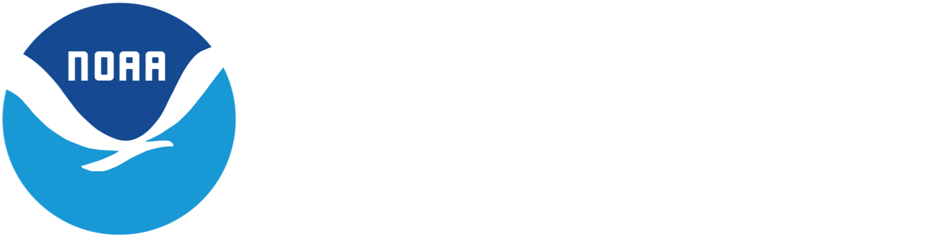
AOML’s contributions to the Global Ocean Observing System
Rick Lumpkin
Deputy Director, Physical Ocn. Division
NOAA/AOML/Physical Ocn. Division
NOAA’s Atlantic Oceanographic and Meteorological Laboratory U.S. Department of Commerce
Laboratory Review 2019
Notes:
Hi, I’m Rick Lumpkin, deputy director of AOML’s Physical Oceanography Division and lead of the US delegation to the Data Buoy Cooperation Panel

Slide 2
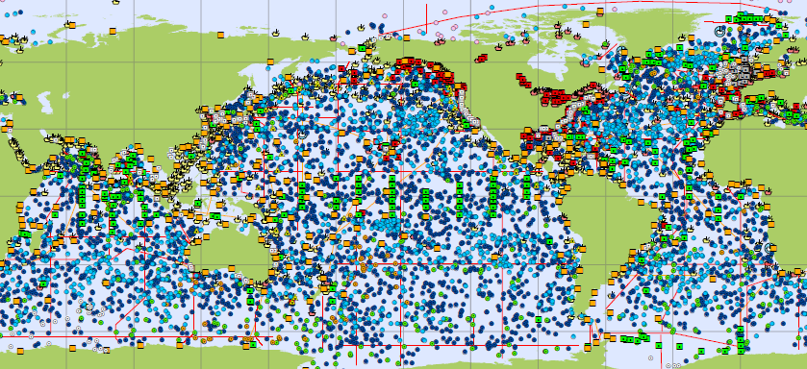
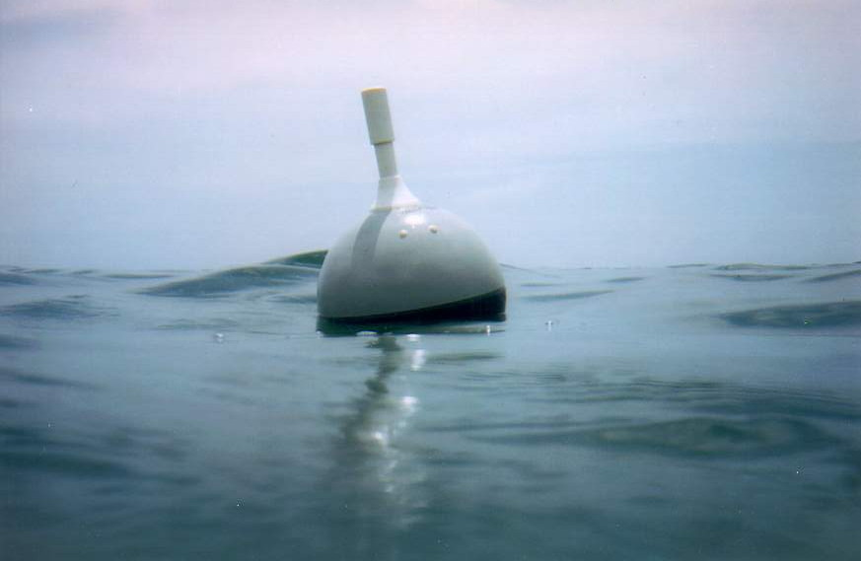
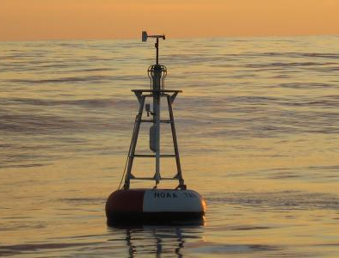
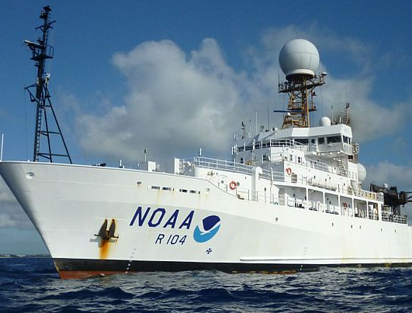
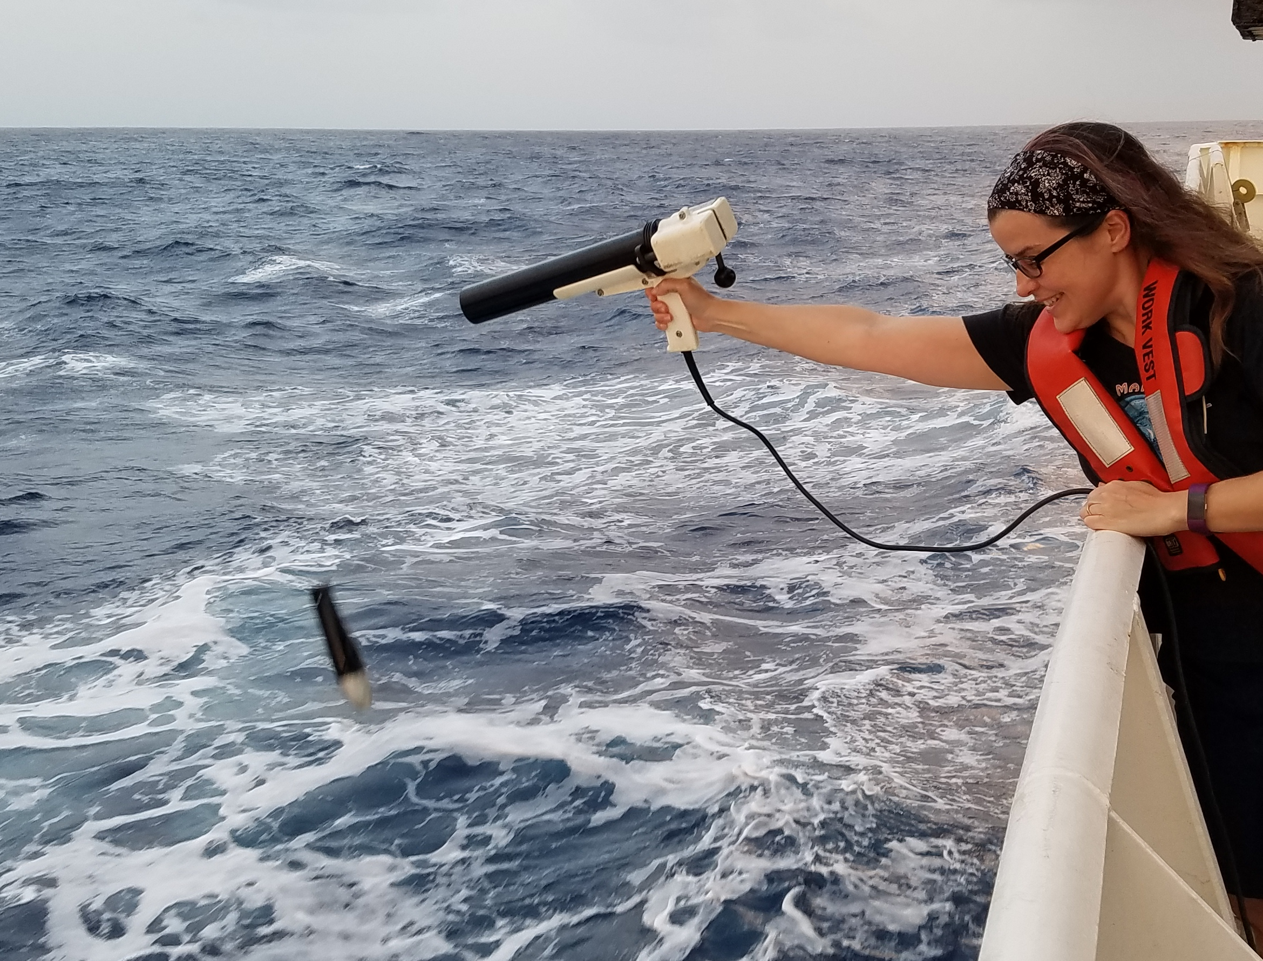
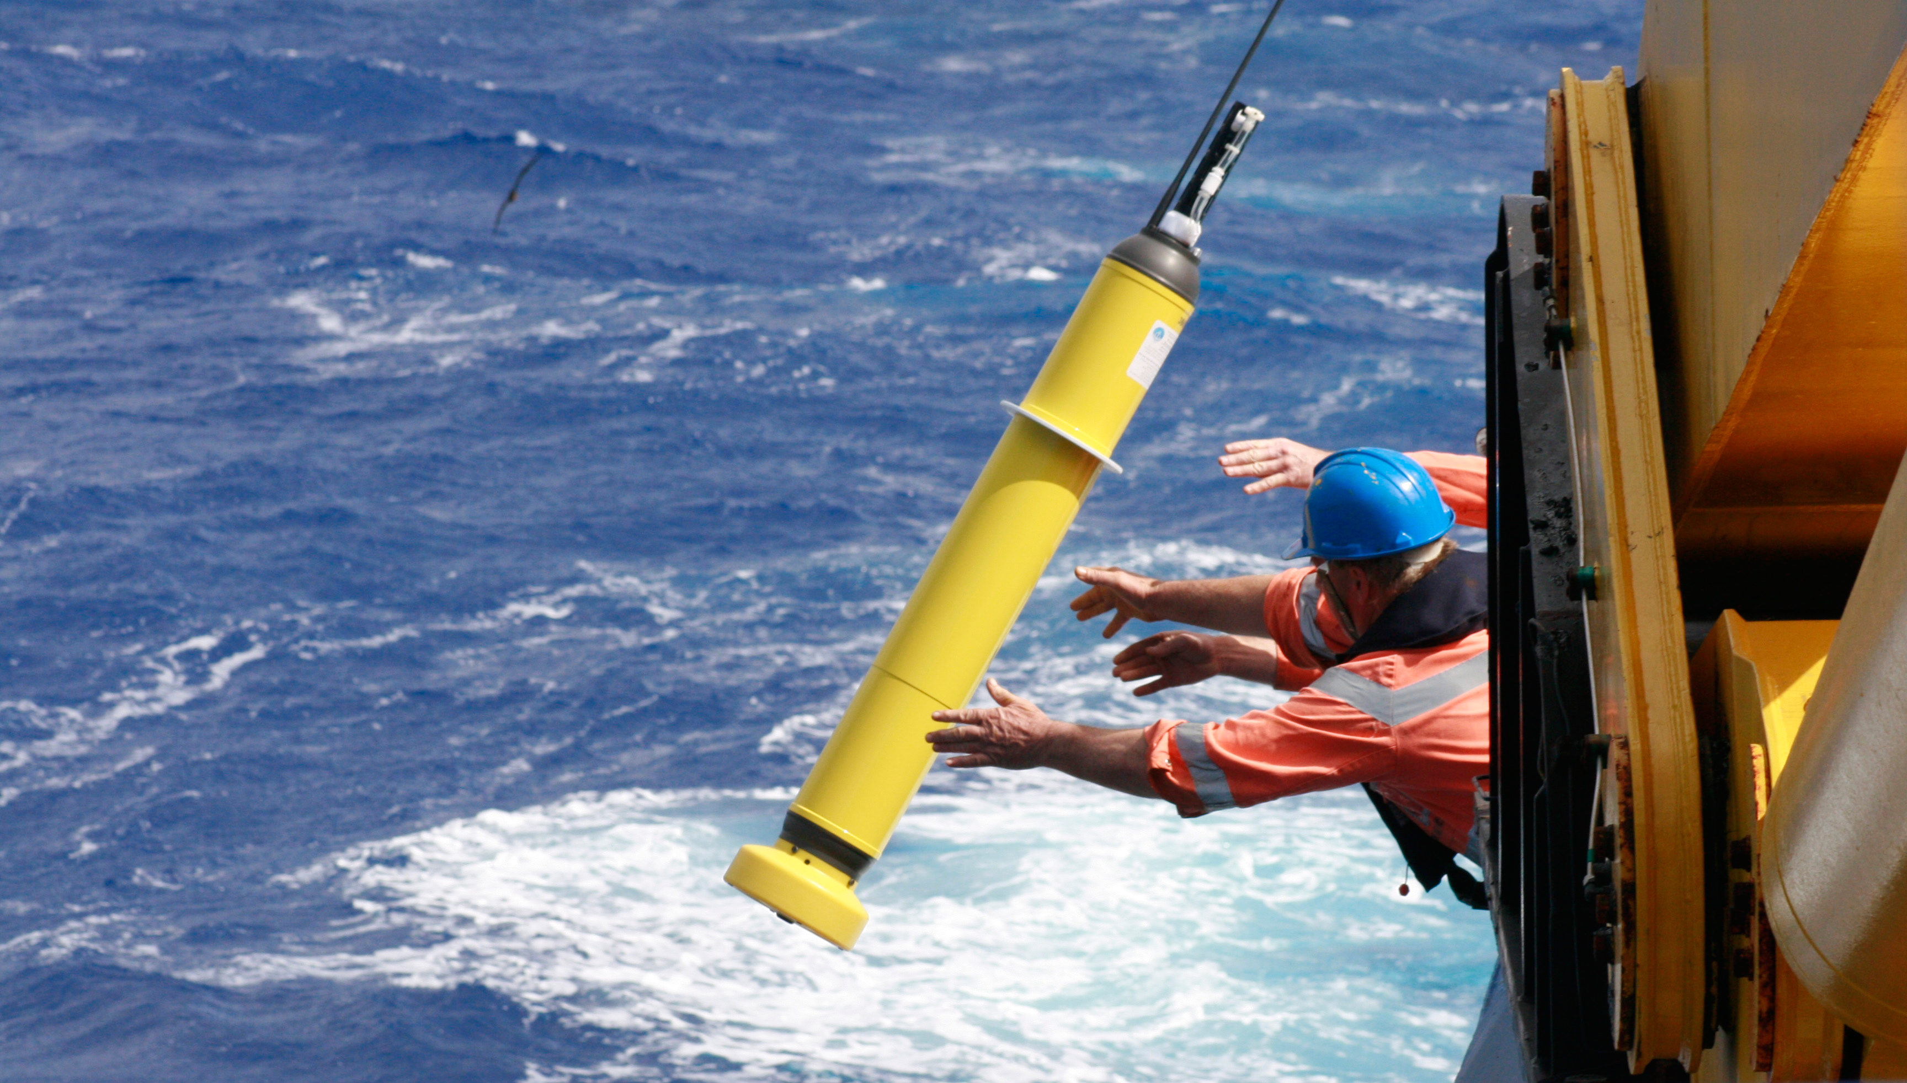
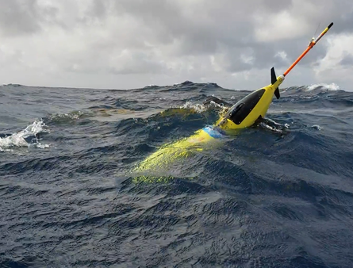
Notes:
The Global Ocean Observing System consists of a number of components ranging from drifting and moored buoys to shipboard observations to autonomous vehicles. AOML leads or contributes to many of these critical components, and we manage, quality control, and distribute the data that they provide.

Slide 3
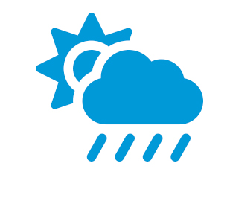
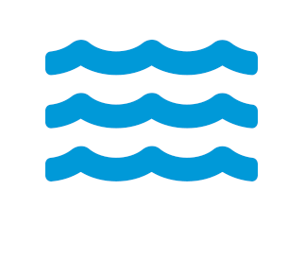

How Our Observations Impact Society
Contribute to better prediction and reduced weather damage
Monitor and understand climate change impacts
Understand ocean impacts on ecosystems and fish stocks
Contribute to Blue Economy
Improve marine search and oil spill response efforts
Address marine debris
Notes:
These observations are motivated by a number of key societal and science drivers, including improving weather forecasts, monitoring climate change, and contributing to the blue economy. You’ll be hearing several specific examples in the lightning talks to come.

Slide 4
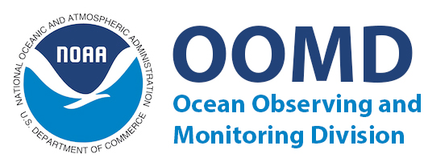

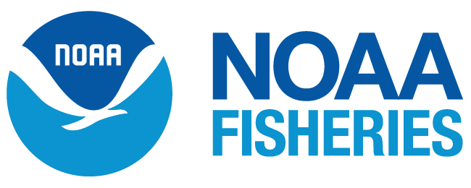
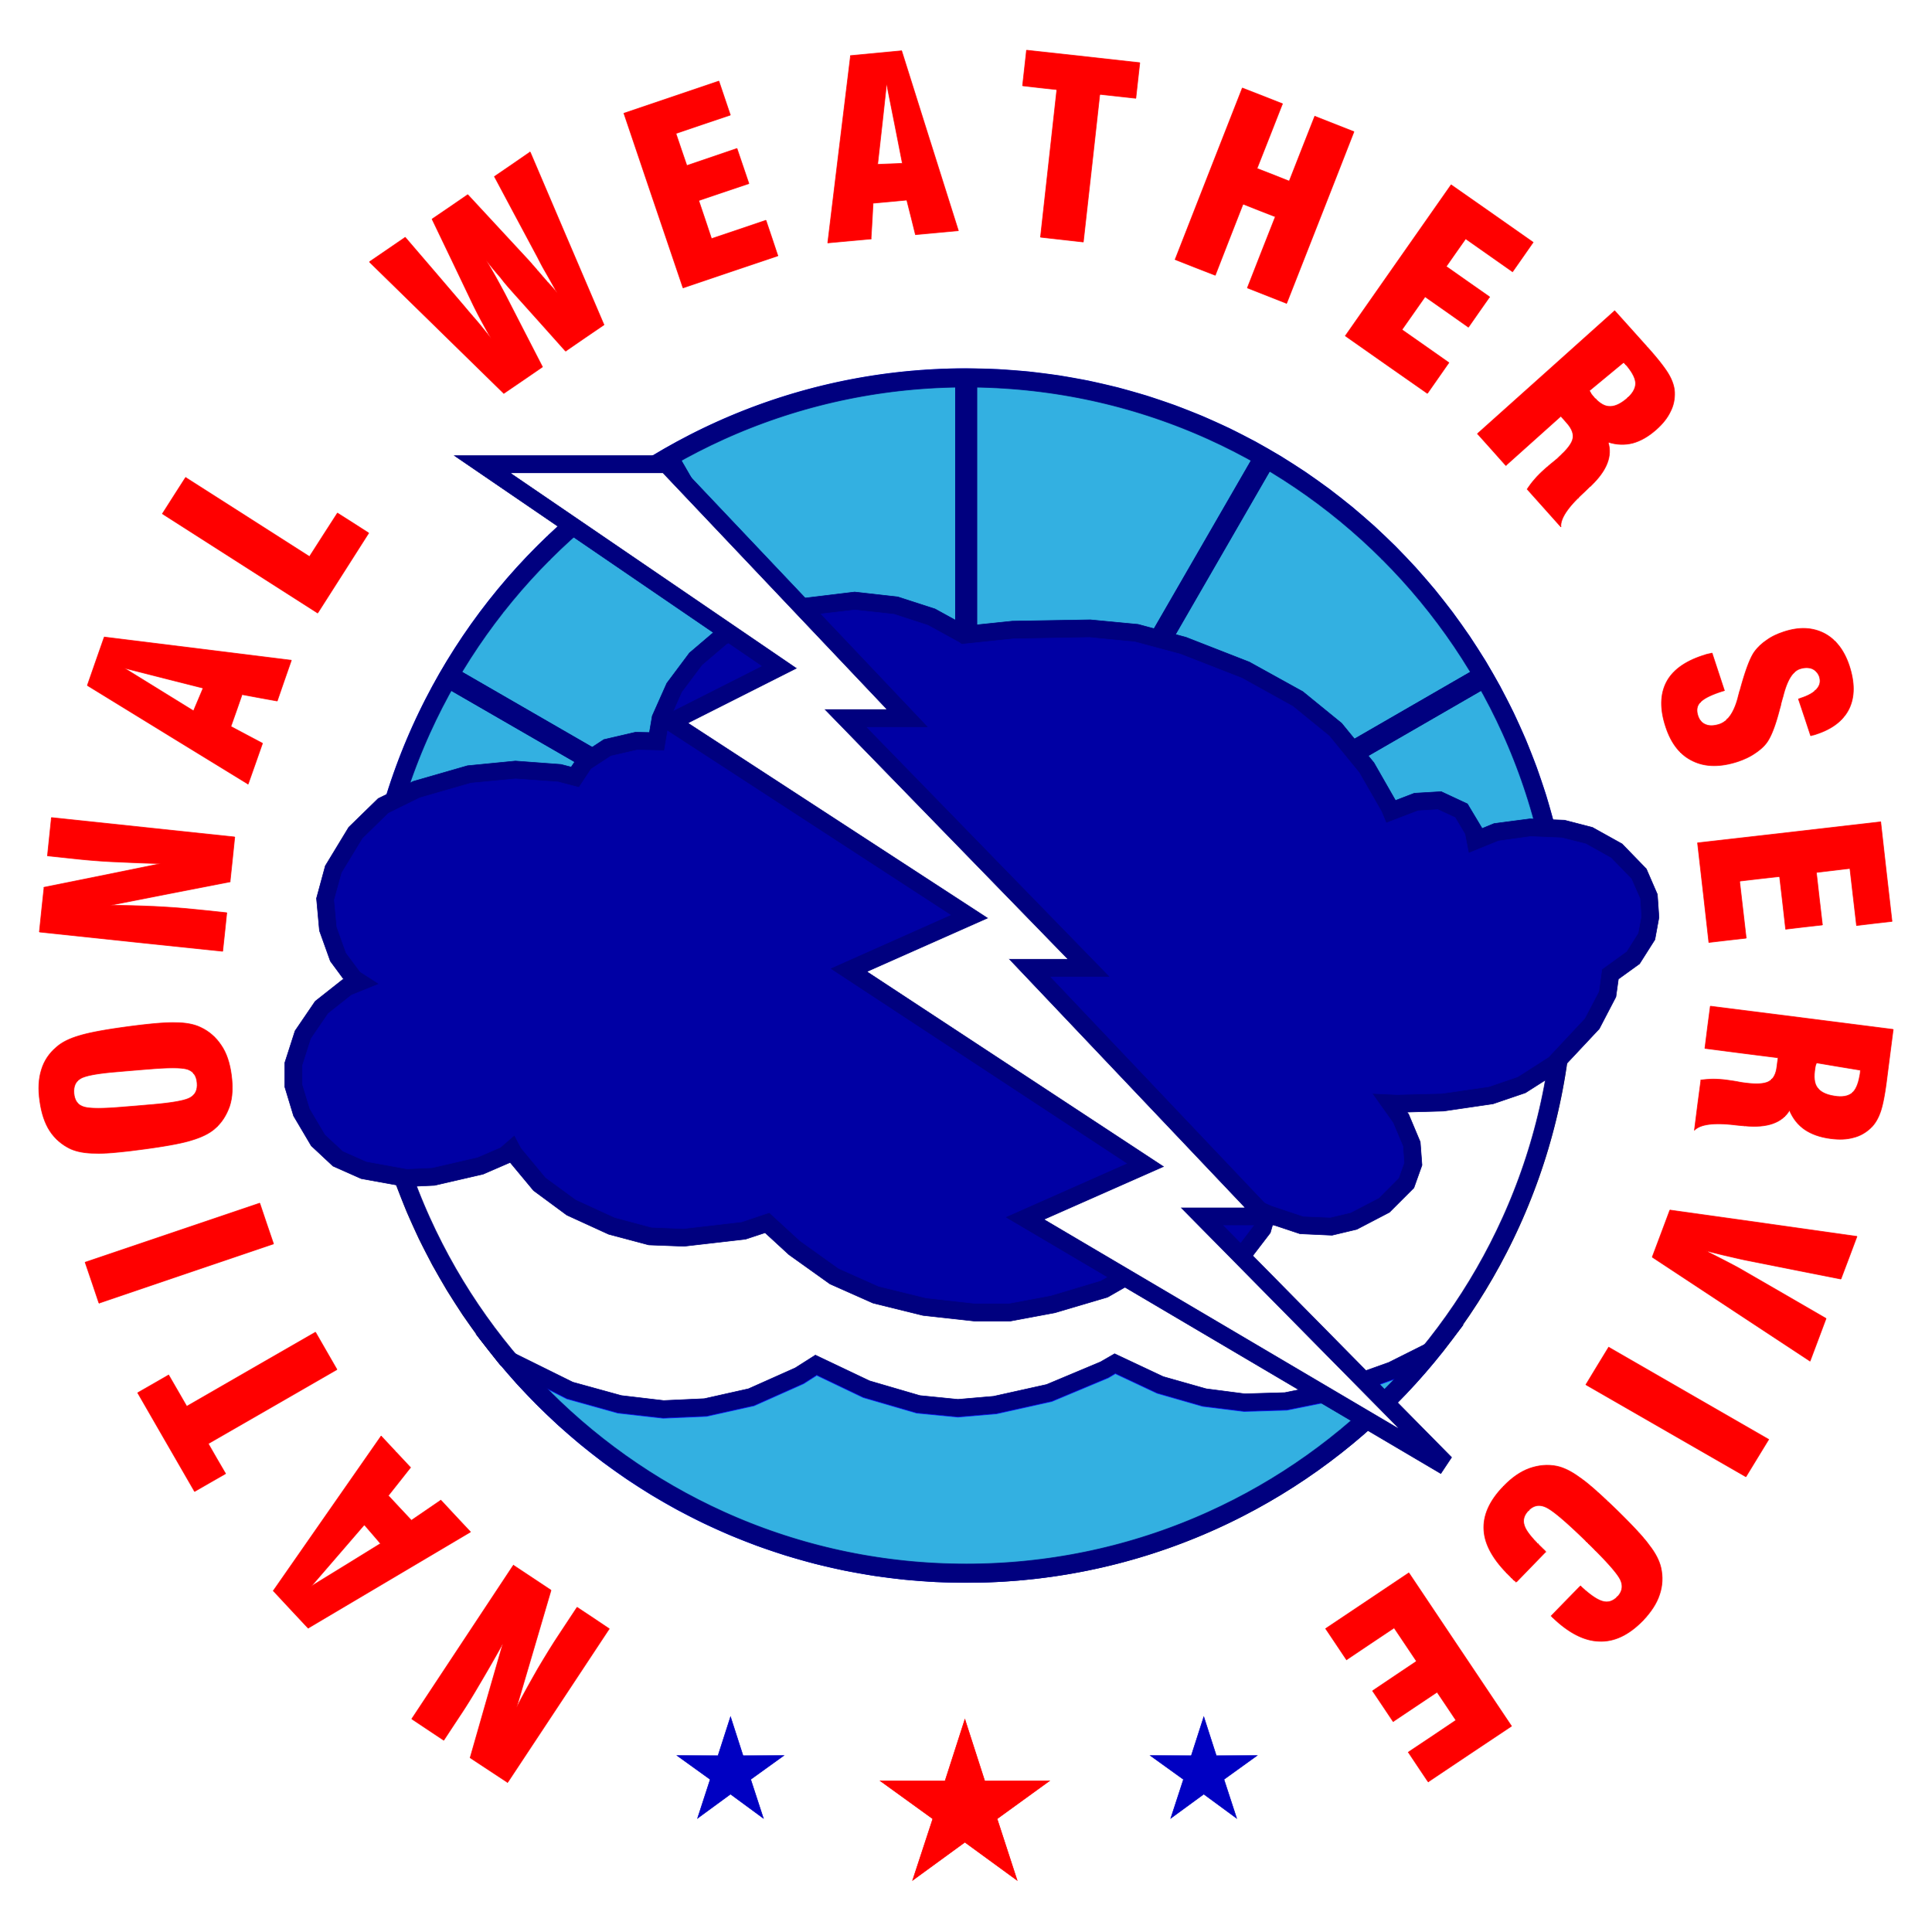
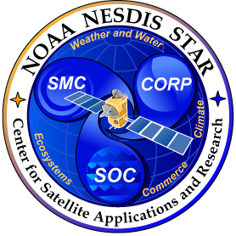
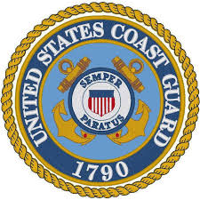
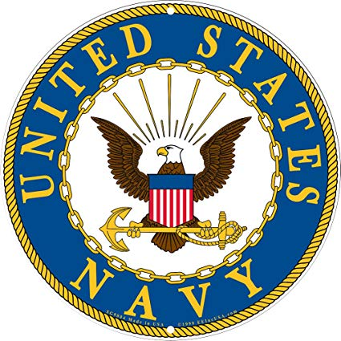



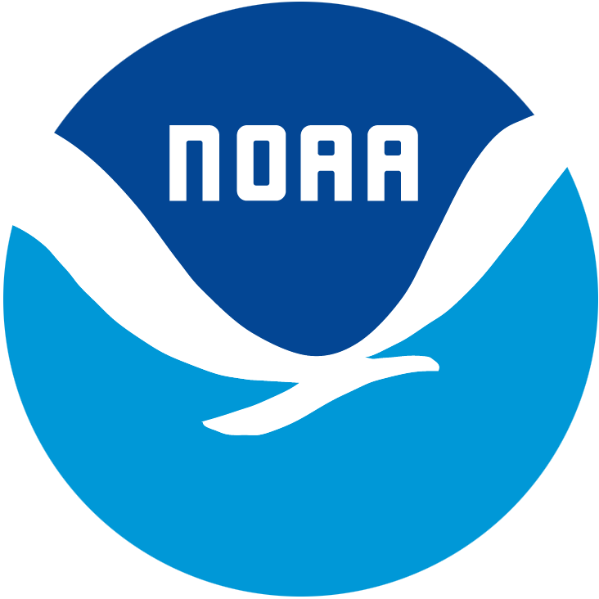
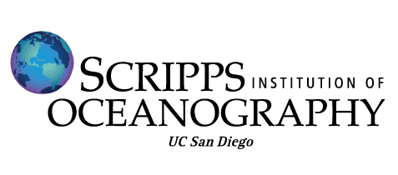





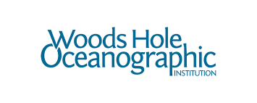
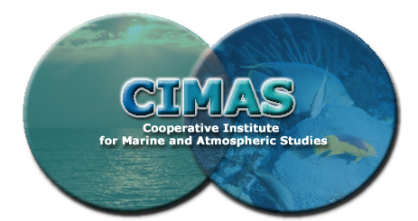







Partners: US Government and Academia
Notes:
To maintain the observing system, we work with a number of partners within OAR, particularly PMEL, with other NOAA line offices, other US agencies, and many academic partners within the United States.

Slide 5

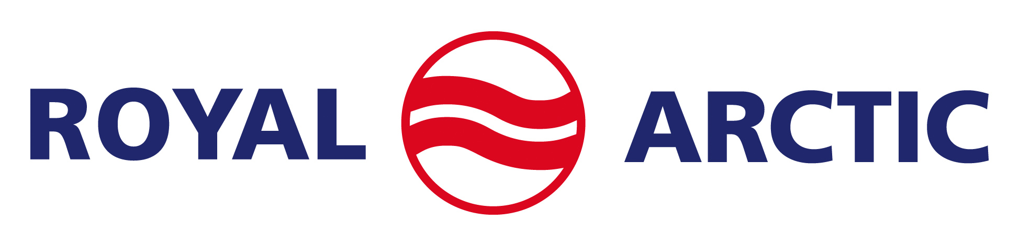
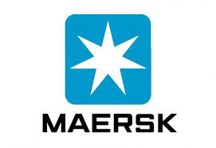
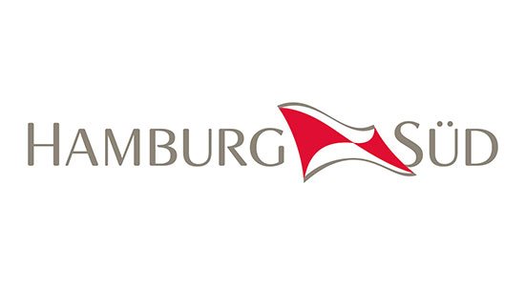
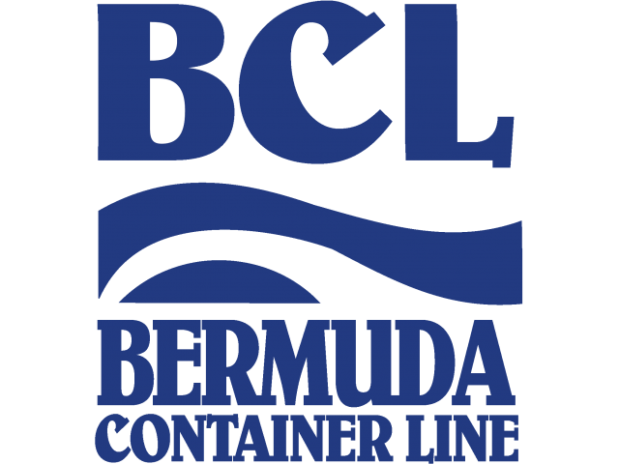


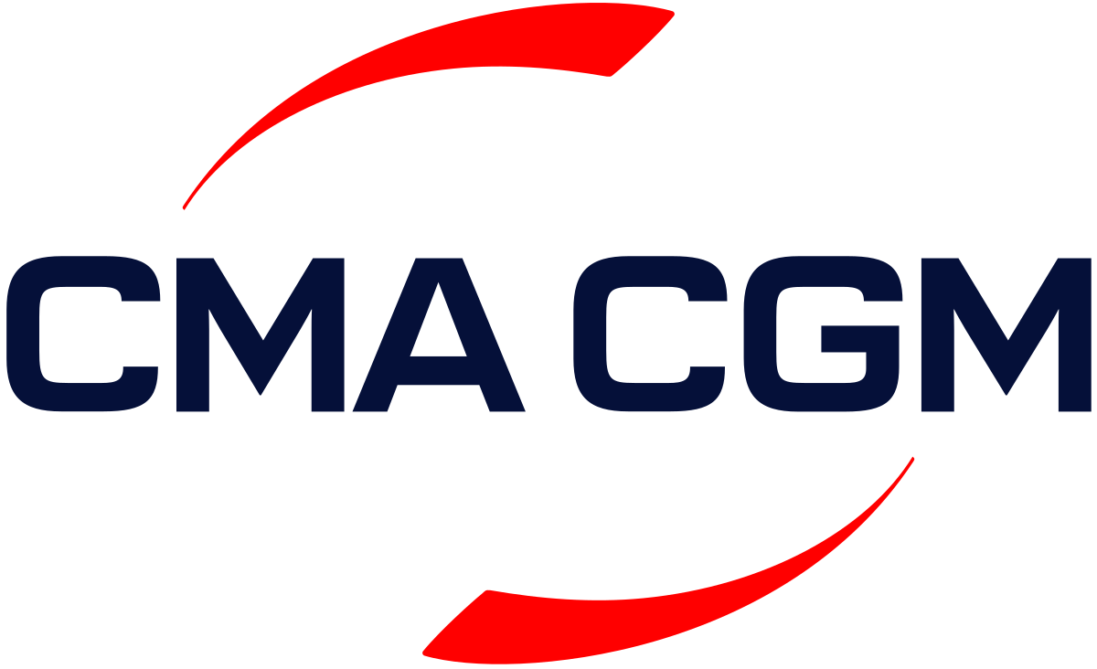
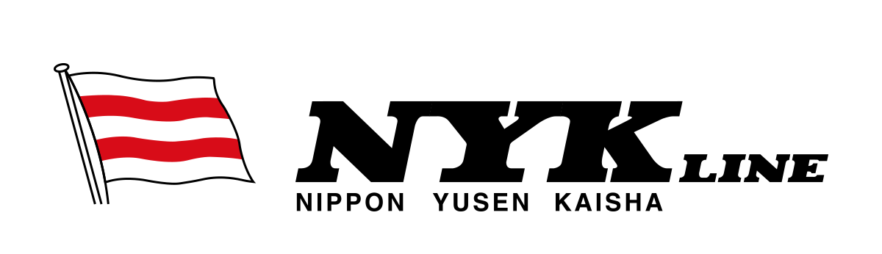
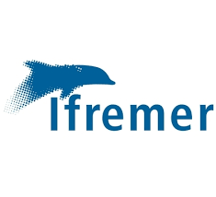


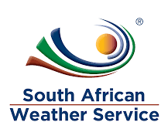



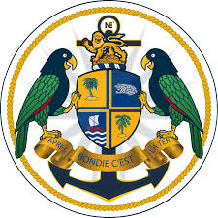

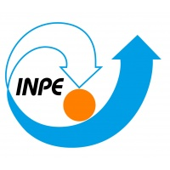
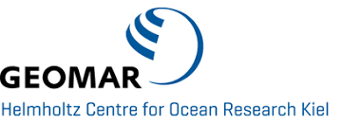
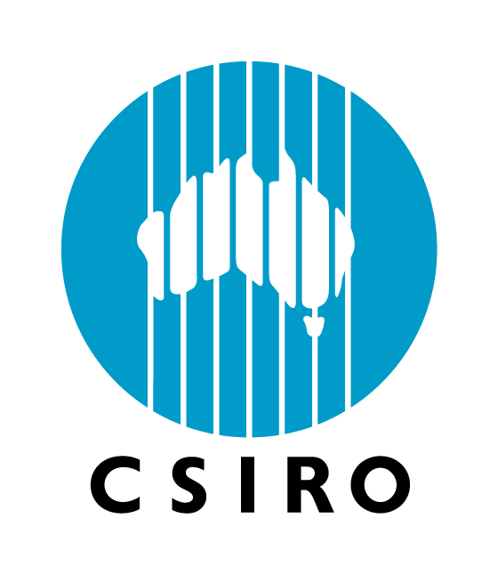





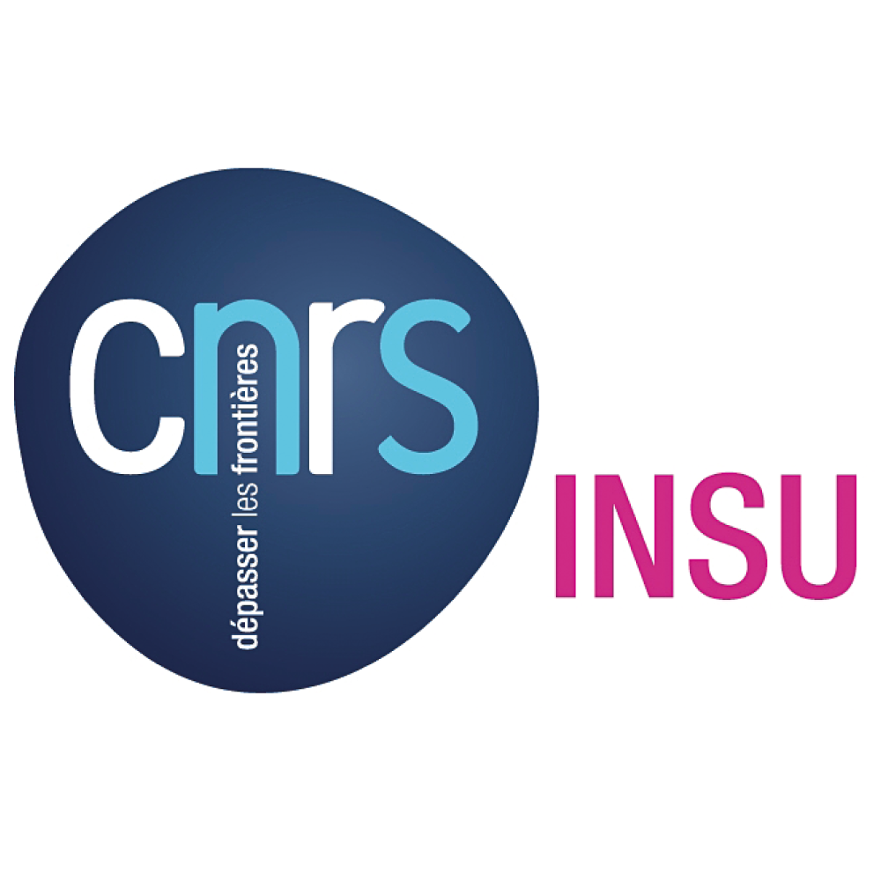
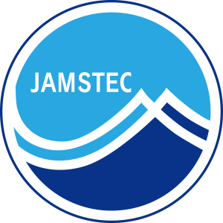

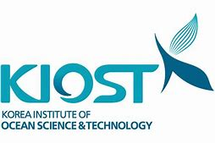
Partners: Private Sector and International
Notes:
We also work with partners in the private industry and with international institutions around the world. This helps us leverage ship time to maintain the global arrays – it would be prohibitively expensive to solely rely on NOAA ship time to deploy instruments around the world.

Slide 6
Funding
CPO/Ocean Observation and Monitoring Division
AOML base funds
Hurricane supplemental funds
OMAO support for ship time
NSF, NOAA, NASA proposals
Notes:
Support for this work comes from the Ocean Observation and Monitoring Division, our base funds, hurricane supplemental funds, OMAO support for NOAA ship time, and funded proposals that provide additional support.

Slide 7
How are the data used?
IPCC, State of the Climate, National Climate Assessment reports
Weather forecasts, ocean models
Data synthesis products: ICOADS, World Ocean Database, etc.
Satellite cal/val (GHRSST, GlobCurrent, etc.)
Ocean and climate research
Notes:
The data are used for climate assessments, weather forecasts and ocean state estimates, assessing models, the production of gridded, synthesis data products, satellite observation calibration and validation, and to increasing our understanding of ocean and climate science.

Slide 8
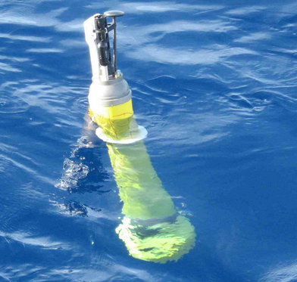
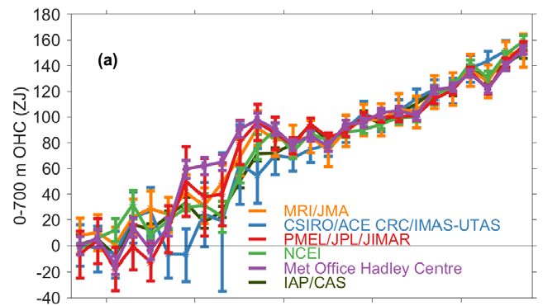

Argo: global ocean profiles
8
8
Source: 2018 State of the Climate report
Argo provides heat and salt profiles of the upper 2000m of the global ocean
Notes:
The Argo float program provides heat and salt profiles of the upper 2000m of the ocean and is the primary reason why we have much more confidence in recent estimates of global ocean heating and its associated sea level rise, as you can see in the most recent State of the Climate report.

Slide 9
Argo: global ocean profiles
9
9
Source: 2018 State of the Climate report
AOML is the US data assembly center: quality control, distribution
AOML contributes to maintaining the Atlantic component of the global array
Notes:
At AOML, we house the US Argo data assembly center, which provides data quality control and distribution, and we contribute to maintaining the Atlantic component of the array.

Slide 10
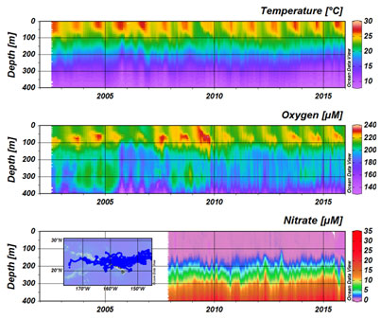
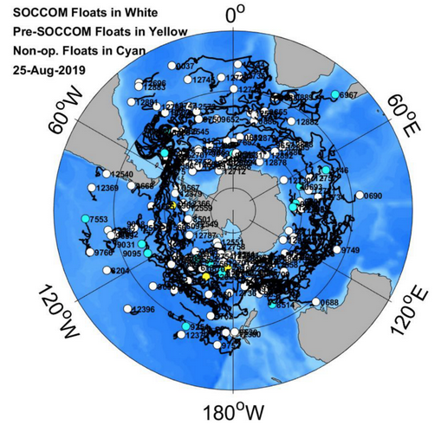
Biogeochemical Argo floats
10
10
BGC float-derived time series near Hawaii (source: http://biogeochemical-argo.org/)
Measurements of oxygen, nitrate, pH, chl-A, suspended particles, and downwelling irradiance
AOML is developing quality control routines for BGC float data
BGC float locations in the Southern Ocean
(source: SOCCOM)
Notes:
With the increasing number of Argo floats measuring biogeochemical properties such as oxygen, nitrate, pH, chl-A, suspended particles, and downwelling irradiance, we are taking the lead in developing quality control procedures for these data.

Slide 11
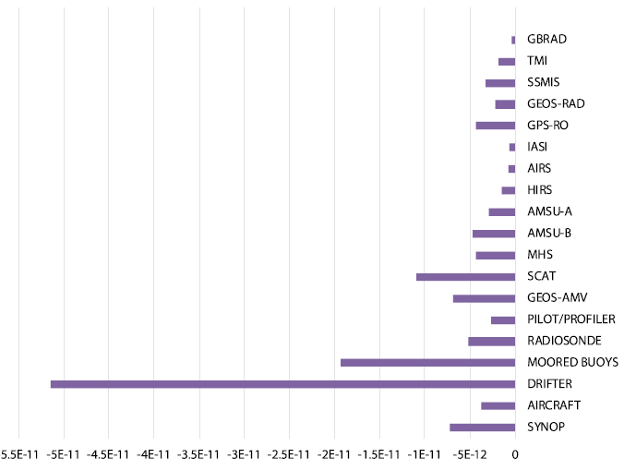
The Global Drifter Program
11
11
Reduction of weather forecast errors by various observations in ECMWF system (per observation). From Centurioni et al. (2017)
Global measurements of surface currents, temperatures, barometric pressure, and directional wave spectra
Notes:
The Global Drifter Program provides measurements of surface current, temperature, and waves. Their pressure measurements are the single largest contributor on a per-observation basis in improving weather forecasts.

Slide 12
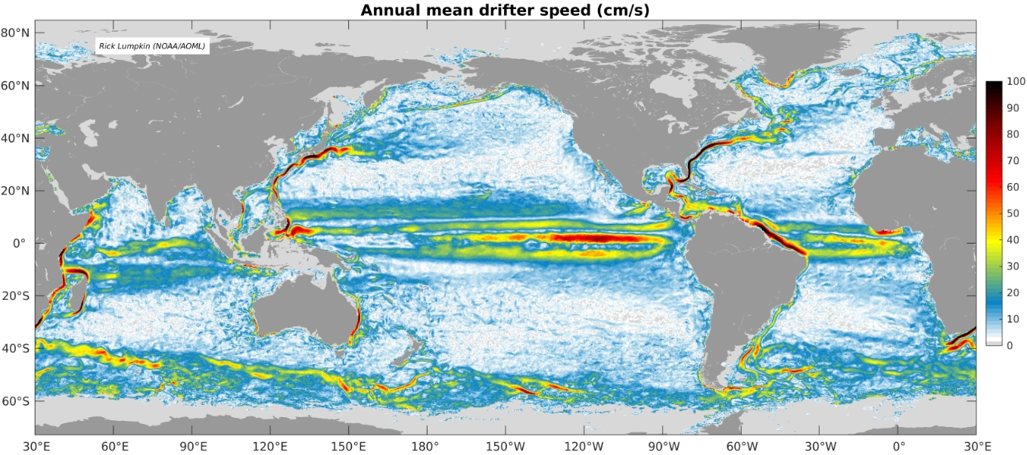
The Global Drifter Program
12
Reduction of weather forecast errors by various observations in ECMWF system (per observation). From Centurioni et al. (2017)
AOML maintains the global array and houses the drifter Data Assembly Center (quality control, distribution, products)
Notes:
AOML leads the international effort to maintain the global array, and houses the Data Assembly Center which quality controls and distributes the data ad provides products such as surface current climatologies.

Slide 13
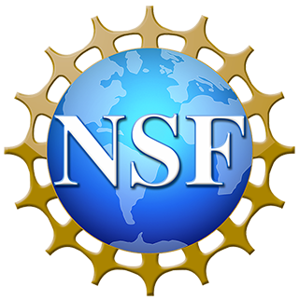
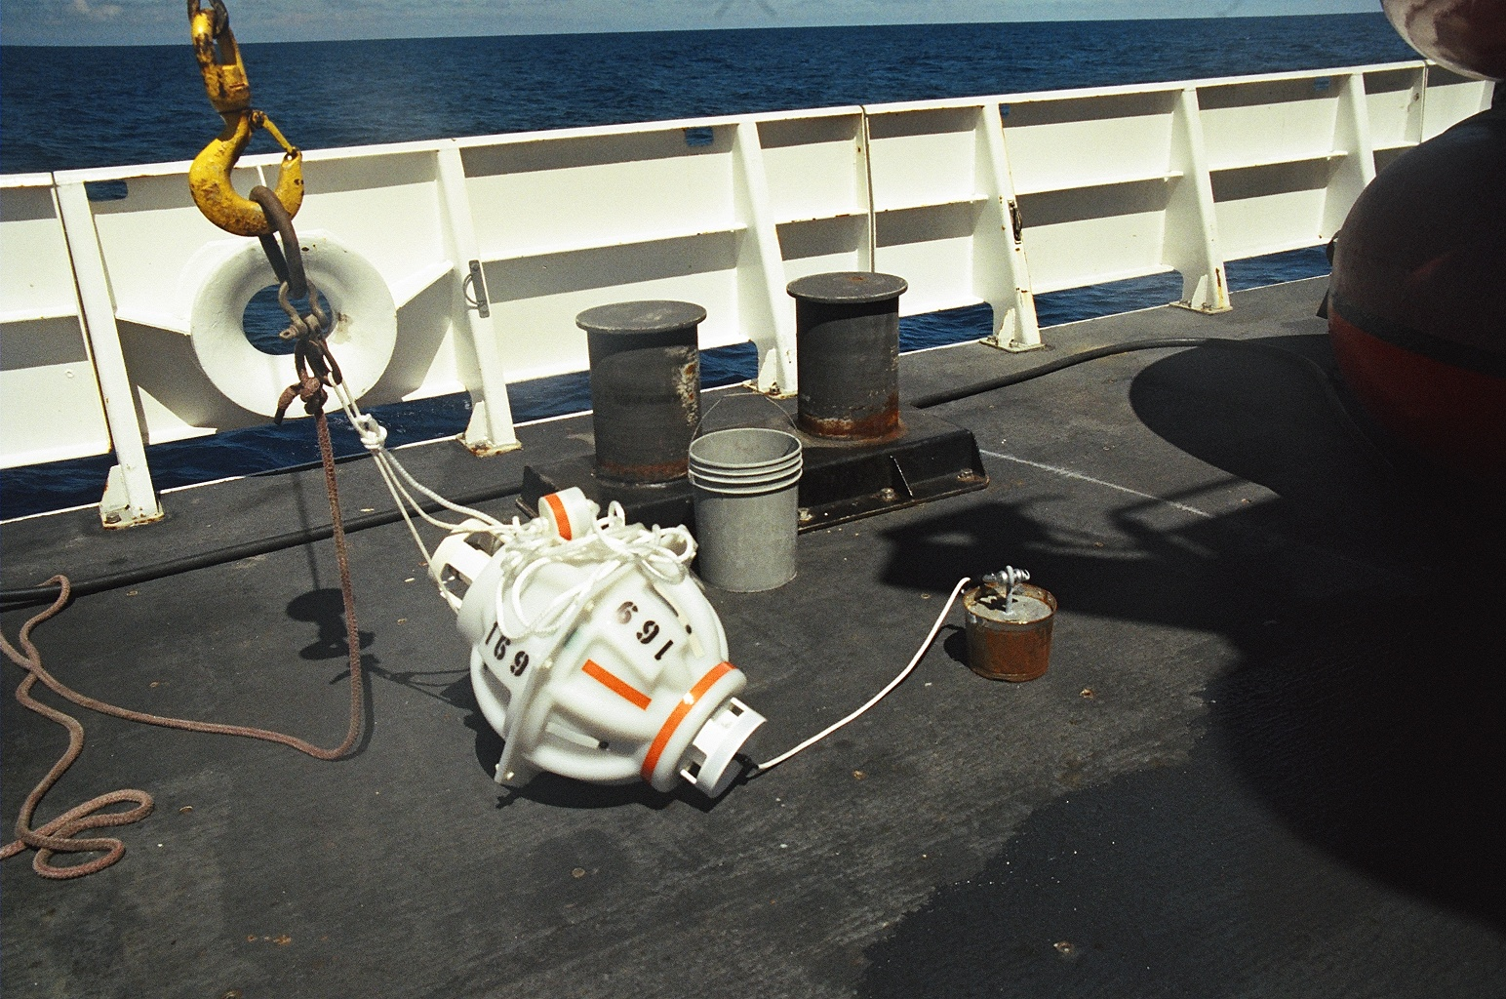
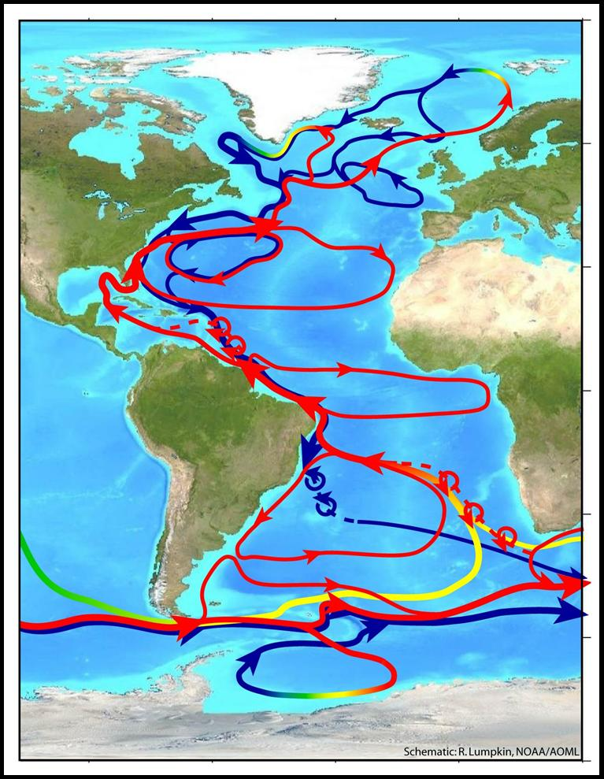
Atlantic Western Boundary Current arrays
AOML leads the Western Boundary Time Series program (26.5°N) and the western boundary component of the South Atlantic MOC program (34.5°S)
AOML has measured the Florida Current transport since 1982
Notes:
AOML leads the western boundary components of two efforts to monitor the Atlantic Meridional Overturning Circulation, at 26.5N and at 34.5S. As part of this, we have monitored the transport of the Florida Current since 1982 – one of the longest ocean climate records.

Slide 14
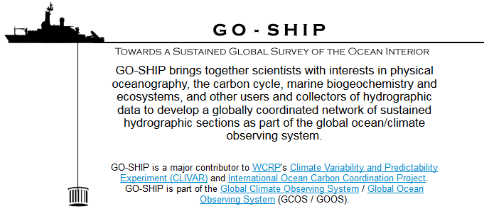
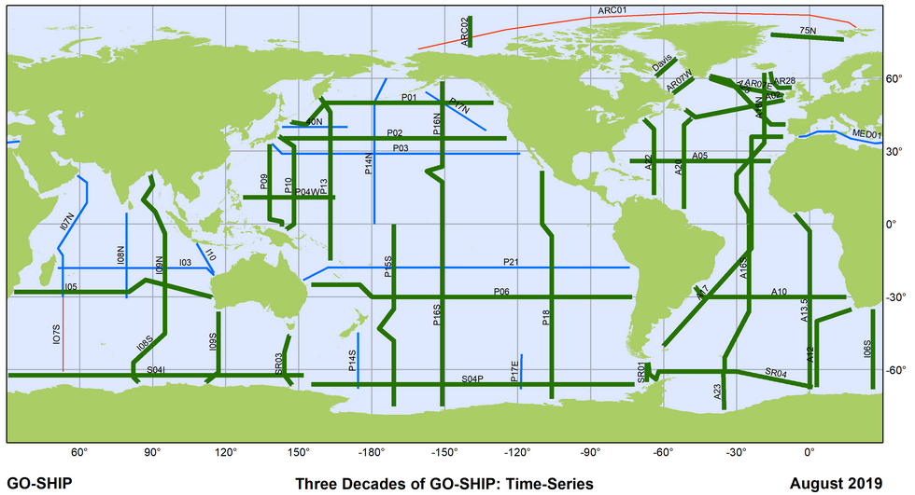
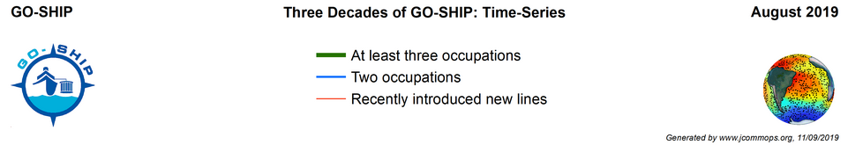
Repeat Hydrography and CO₂ inventories
AOML personnel routinely participate (and have been chief scientists) on repeat hydrography cruises to sample top-to-bottom ocean properties
Notes:
We routinely participate in, and lead, repeat hydrographic cruises of WOCE, CLIVAR, and now GO-SHIP. These repeat surveys allow us to see large scale, long term changes in a broad suite of ocean properties.

Slide 15
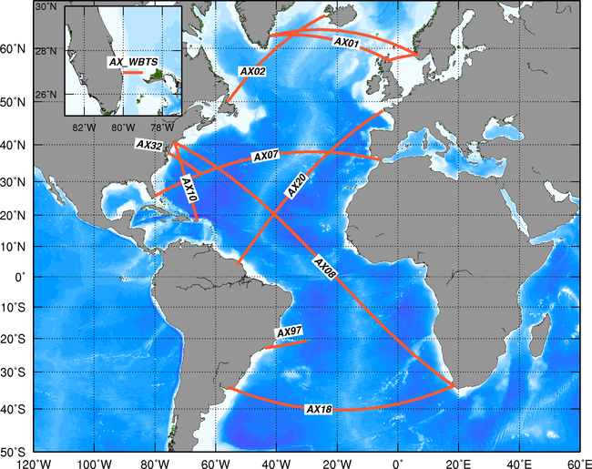
The Expendable Bathythermograph (XBT) and Ship of Opportunity (SOOP) networks
AOML-led eddy and boundary current-resolving transects of upper ocean temperature
SOOP: Leveraging ship time from corporate partners to deploy XBTs, drifters, Argo floats, etc.
Notes:
We lead the Expendable Bathythermograph and Ship Of Opportunity networks. These observations resolve eddy and boundary current variability, and leverage ship time from partners in the private industry. These transects are also used to help maintain the Argo and Global Drifter Program arrays.

Slide 16
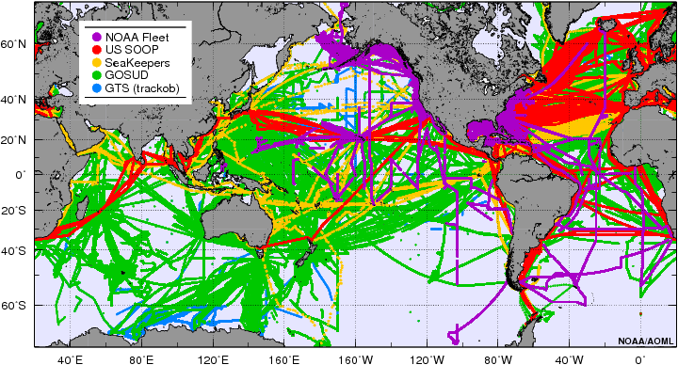
Thermosalinograph operations
16
14 NOAA and 2 SOOP vessels collecting underway temperature, salinity, and pCO₂
AOML leads this program, performs quality control on the data, and distributes the data on the GTS
Notes:
We maintain underway observations of temperature, salinity, and pCO2 from 14 NOAA and 2 Ship Of Opportunity vessels. We also quality control and distribute these data in near real time.

Slide 17
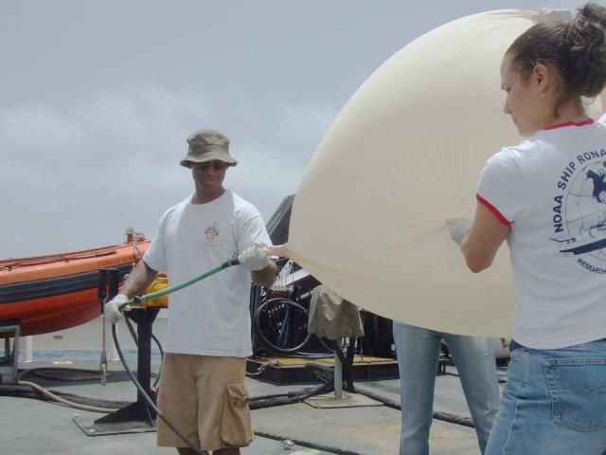





The Prediction and Research moored Array in the Tropical Atlantic (PIRATA)
PIRATA is the backbone of the Tropical Atlantic observing system
Upper ocean and air-sea interface measurements of many properties
AOML leads the annual cruise to service the four US-led moorings in the northeastern array
Notes:
The PIRATA array is the backbone of the tropical Atlantic observing system, providing upper ocean and air-sea measurements of many properties. AOML organizes and leads the annual servicing cruise for the northeastern part of the array, the main development region of Cape-Verde style tropical cyclones.

Slide 18



NOAA Hurricane Gliders
AOML is leading an international effort to collect ocean observations aimed at improving hurricane forecasts
Notes:
AOML is leading an international effort to create a picket fence of underwater gliders to collect observations intended to improve hurricane forecasts. These gliders are operated during hurricane season in the Caribbean, Gulf of Mexico, and tropical Atlantic.

Slide 19


Contributing to the future of the observing system
Notes:
We’re also contributing to the future of the observing system: developing data pod systems to reduce our need for ship time, working with private manufacturers to add new sensors such as this dual salinity drifter, and developing new data transmission hardware as we look toward a future of ocean broadband coverage.

Slide 20
AOML’s contributions to the Global Ocean Observing System
Rick Lumpkin
Deputy Director, Physical Ocn. Division
NOAA/AOML/Physical Ocn. Division
NOAA’s Atlantic Oceanographic and Meteorological Laboratory U.S. Department of Commerce
Laboratory Review 2019
Notes:
Thank you for your attention to this whirlwind overview! I’d now like to introduce my colleague Denis Volkov for the next talk.

