Slide 1

Ben Kirtman
CIMAS Director
Department of Atmospheric Sciences
University of Miami - RSMAS

Slide 2
CIMAS
Enabling Scientific Collaboration
  Examples: Hurricane Modeling, Heat Waves, Operational Seasonal Forecasts
Enable Scientific Collaboration: Workforce Development
  CIMAS Staff Career Trajectory

Slide 3
CIMAS Partners
NOAA – Atlantic Oceanographic and Meteorological Laboratory (AOML)
NOAA – Southeast Fisheries Science Center (SEFSC)
NOAA - National Hurricane Center (NHC)
Florida Atlantic University -FAU
Florida Institute of Technology - FIT
Florida International University -FIU
Florida State University –FSU
NOVA Southeastern University -NOVA
University of Florida –UF
University of South Florida -USF
University of the Virgin Islands – UVI
University of Puerto Rico at Mayaquez –UPRM

Slide 4
CIMAS Research Themes
Climate Research and Impacts
Tropical Weather
Oceans and Coastal Observations
Ocean Modeling
Ecosystem Modeling and Forecasting
Ecosystem Management
Protection and Restoration

Slide 5
Graduate Student - CIMAS Employee – NOAA Fed

Slide 6
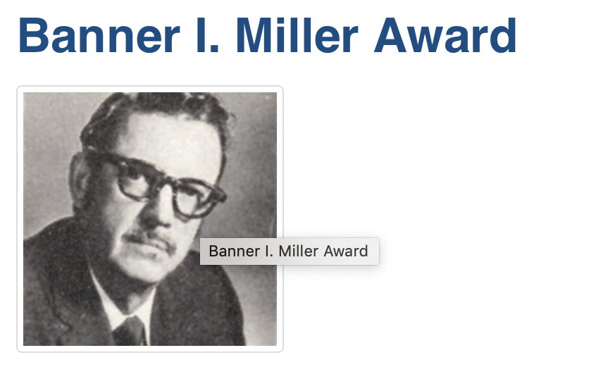
2017
Notes:
JONR – ECMWF Nature run; NHR1 is the WRF Nature run

Slide 7
PBL11
PBL12
2019
Obs. Est.
Notes:
FIG. 8. Plots of (a)–(c) tangential wind and (d)–(f) radial wind as a function of r/RMW and height. (top) PBL11, (middle) PBL12, and (bottom) the dropsonde composites from J. A. Zhang et al. (2011b). The dashed line represents the height of the maximum tangential wind speed and the solid line represents the inflow layer depth defined as the height of 10% peak inflow. White lines show the estimates of boundary layer height based on linear hurricane boundary layer theory.
RMW: In our composite framework, data are grouped as a func- tion of the radius to the storm center r normalized by the radius of maximum wind speed; that is, r* = r/RMW, where RMW is defined as the radius of maximum axi- symmetric wind speed at 2 km

Slide 8
Generalize Pareto (GP) Distribution of Extreme Temperatures
Northern Plains
Great Lakes
Western US
Southern Plains
H. Lopez: RSMAS PhD – CIMAS Post Doc – CIMAS Asst. Scientist – NOAA Fed

Slide 9
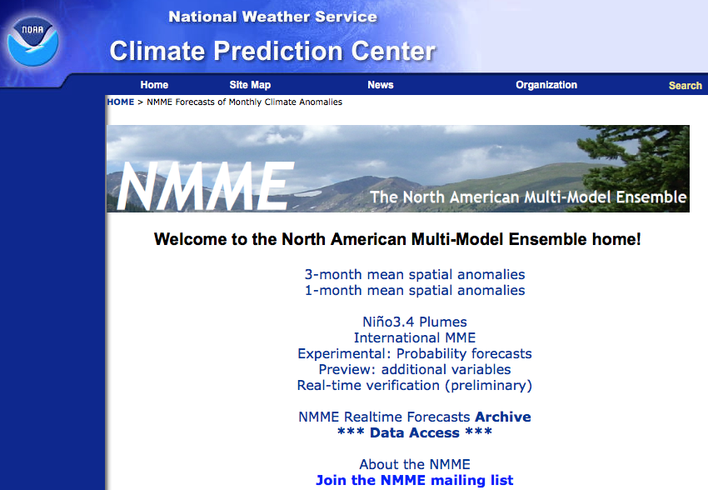
UM-CIMAS Lead Multi-Agency Multi-Institutional Effort to Improve NOAA Operational Forecasts

Slide 10
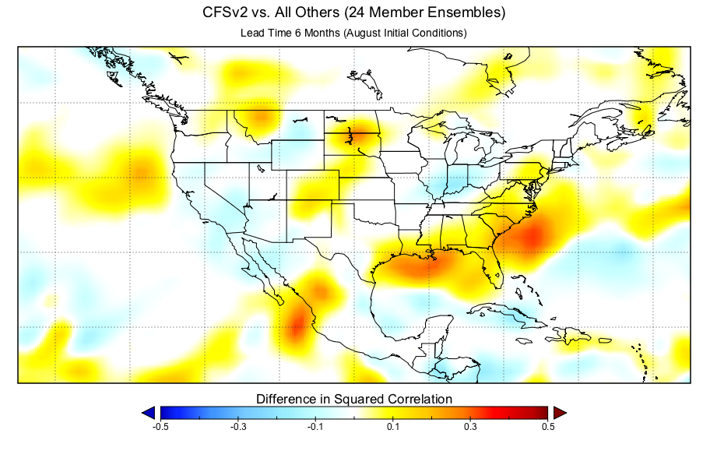
All Others (24 Member Ensemble) vs. CFSv2
NMME Benefits
CFSv2 Ensemble
CFSv2 Benefits
NMME

Slide 11
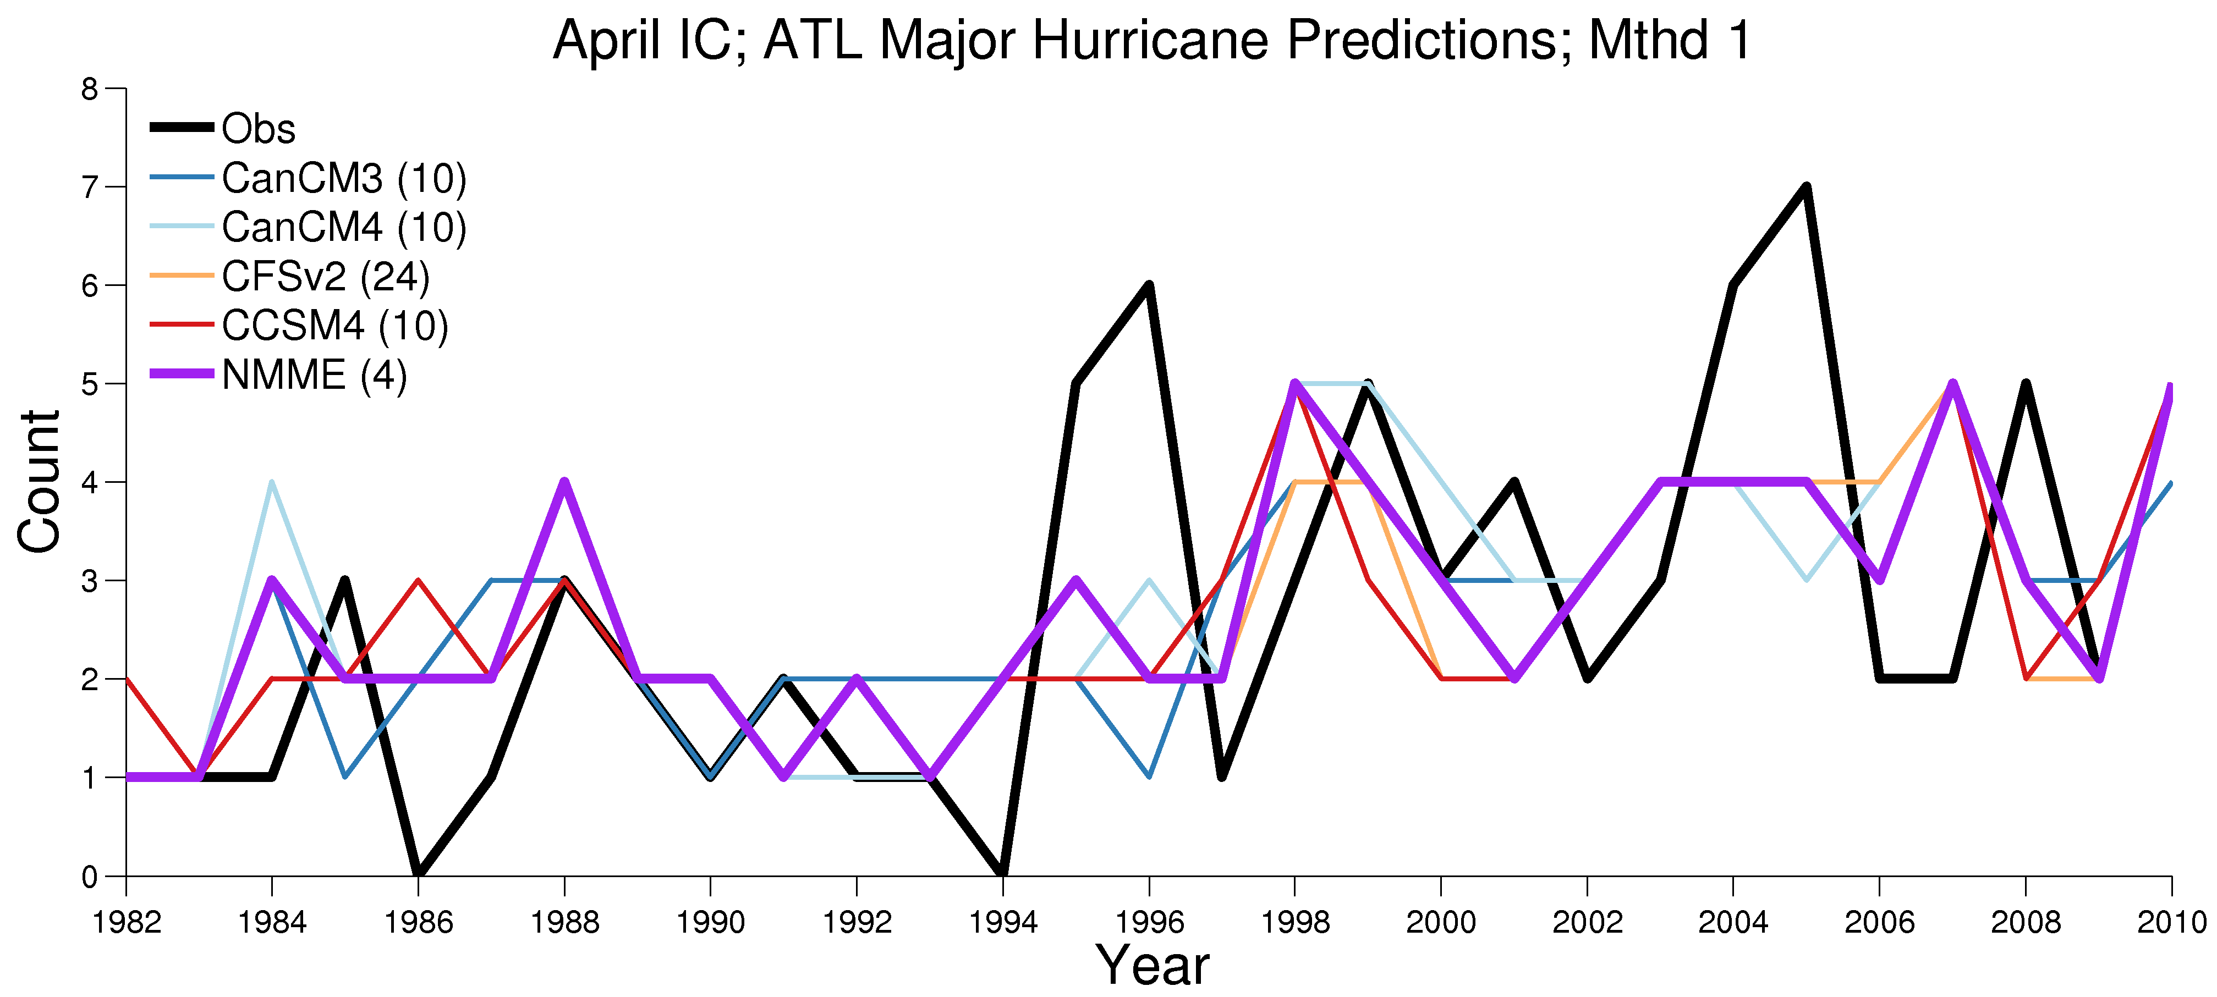
Number of Major Hurricanes Prediction; Atlantic Basin
 | CanCM3 (10) | CanCM4 (10) | CFSv2 (24) | CCSM4 (10) | NMME (4)
Correlation | 0.35 | 0.48 | 0.41 | 0.35 | 0.52 (1st)
RMSE | 1.83 | 1.72 | 1.77 | 1.83 | 1.63 (1st)
Method 1: Predictors are predicted ASO shear and JFM NATL SST

Slide 12
Enable Scientific Collaboration – Workforce Development
CIMAS Graduate Fellowship
  AOML and SEFSC on Selection Committee
  Student will Participate in Collaborative Research at NOAA Labs
CIMAS/NOAA Participation in Graduate Education
  Participation in RSMAS 3/5 Model
  Participation in Graduate Admissions
  Dissertation Director
CIMAS Staff Career Trajectories
  CIMAS Scientists Encourage to be PI’s

Slide 13
CIMAS
Enabling Scientific Collaboration
  Examples: Hurricane Modeling, Heat Waves, Operational Seasonal Forecasts
Enable Scientific Collaboration: Workforce Development
  CIMAS Staff Career Trajectory

