Slide 1
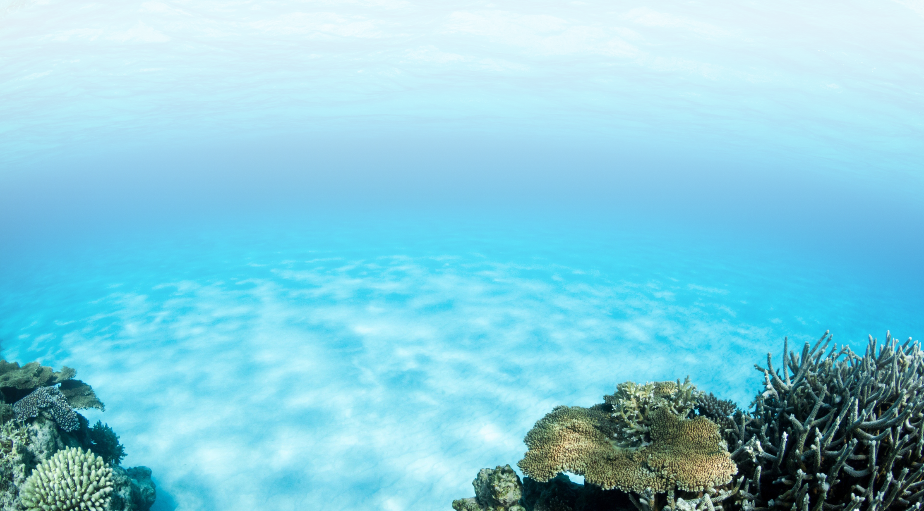

NOAA/AOML
Ocean Chemistry and Ecosystems Division (OCED)
Jim Hendee
2019 AOML Laboratory Review

Slide 2
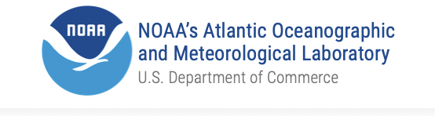
Our vision
Be a world leader in understanding the impact of anthropogenic and natural stressors on coastal and marine ecosystems, and in understanding the provisioning of services from these ecosystems. We apply this knowledge to enhance coastal and marine ecosystem sustainability and resilience.
Notes:
NEED TO MODIFY

Slide 3
Divisional Goals
To accomplish our vision we will:
1
Quantify the role of the oceans in sequestering carbon dioxide
Characterize, understand and predict the impact of pressures and their synergistic interactions, on marine ecosystems.
Develop products to enhance coastal and marine resiliency and sustainability.
2
3
Notes:
NEED TO MODIFY

Slide 4
Divisional Objectives
We will accomplish our goals with:
1
Diverse, world-class workforce
Cutting edge research
Technology development
Communicating
Partnering
Transitions
Secure funding
2
3
4
5
6
7
Notes:
Building a diverse, world-class workforce
Conducting cutting edge research on the biogeochemical state of the ocean and how its changes impact ecosystems and society
Developing and applying new technologies
Communicating our science to partners, stakeholders, and the general public
Partnering to apply our science to enhance ecosystem and community resilience and sustainability
Performing transitions to operations and applications
Securing funding to support current and future projects, initiatives, and workforce growth

Slide 5
Our Workforce
41
14
25
Members
Federal employees
Cooperative Institute employees and contractors
1
20 scientists
20 science support
5 CIMAS postdocs
4
3 Graduate Students
1 NRC postdoc
1 NOAA Corps Officer
2
5
3
6
5

Slide 6
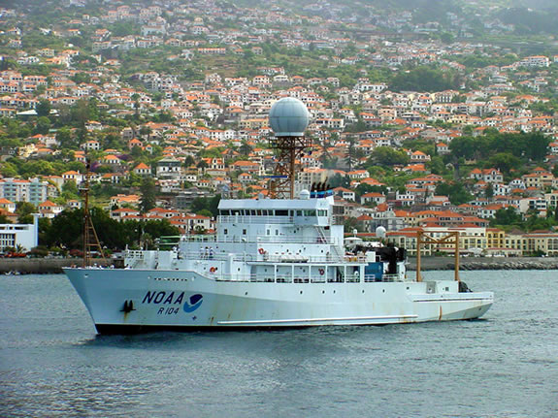
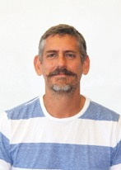
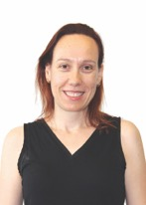
Major research areas
Ocean Carbon Cycle:
Ocean carbon inventories and fluxes
Sustained global and regional carbon observations
Seasonal to decadal variability in CO₂ uptake
Surface ocean CO₂ observing network
Global and coastal ocean carbon modeling and synthesis
From Atmosphere to Oceans: Tracking Carbon via Ships
Understanding OA at the regional scale in the Gulf of Mexico and Atlantic Ocean
NOAA Ship Ron Brown
Notes:
Make sure to reference AOML’s leading role in ocean carbon within the global community
The images of people at bottom are for you to reference the talks they will see and posters affiliated with this theme. (not who works on what)

Slide 7
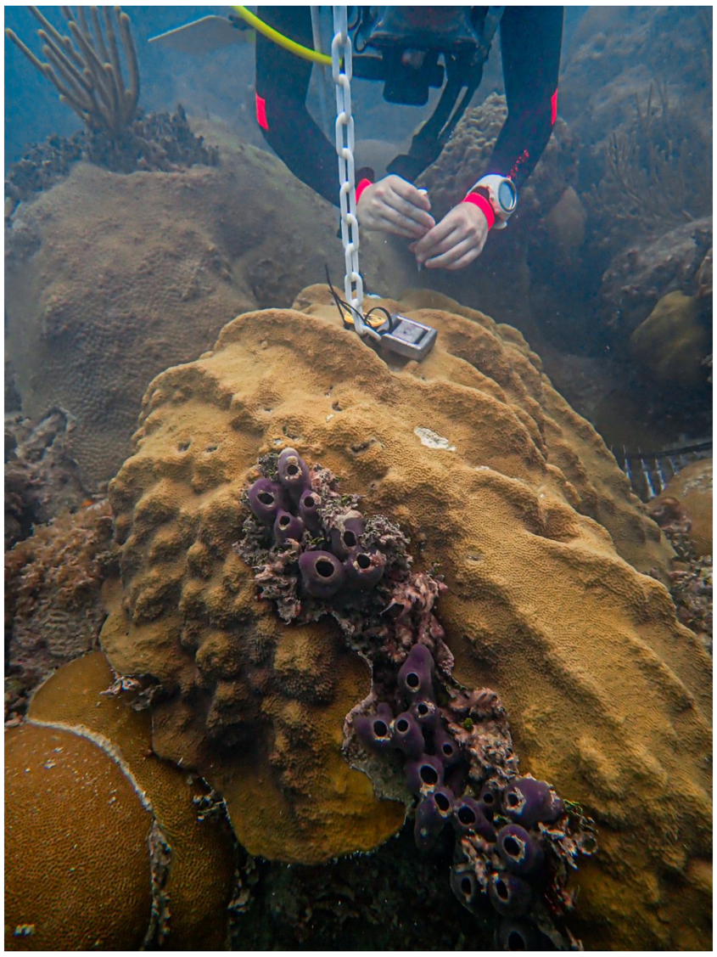
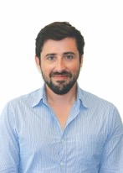
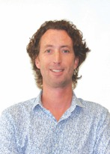
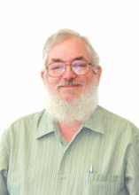
Major research areas
Coral Health and Restoration:
Coral reef bioerosion
Coral calcification
Corals in marginal environments
National Coral Reef Monitoring Program
Molecular mechanisms and source tracking
Decadal projections of coral bleaching
Coral Reefs in an Era of Global Change
Global Climate Predictions for Coral Reef Ecosystems
Microbial Source Tracking Technology
Notes:
The images of people at bottom are for you to reference the talks they will see and posters affiliated with this theme. (not who works on what)

Slide 8
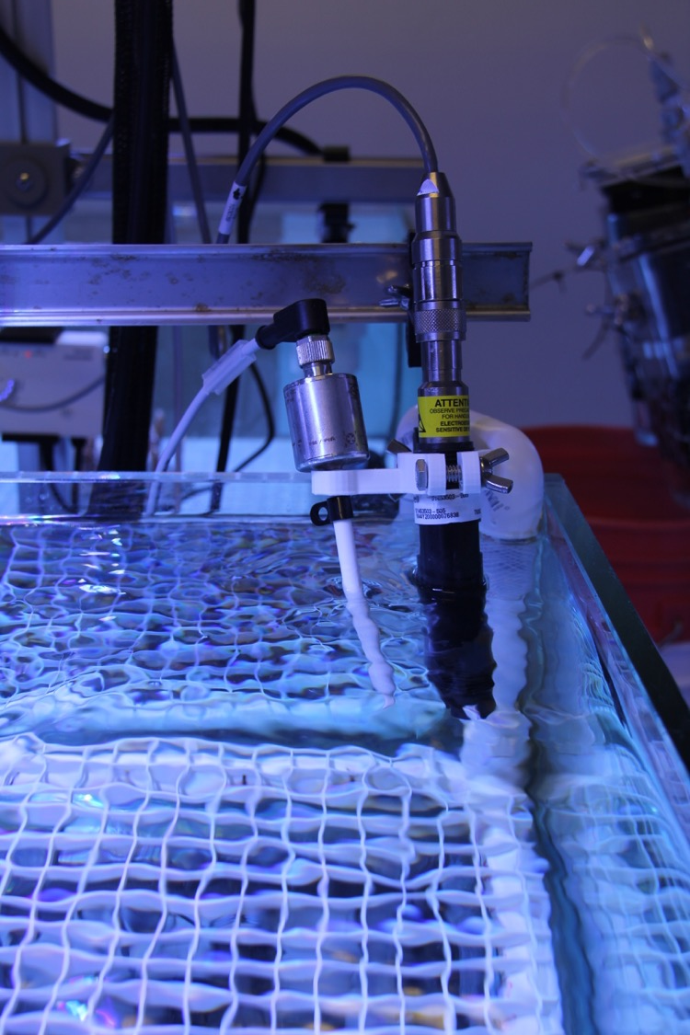
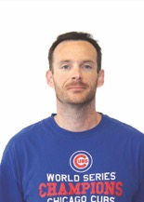
Major research areas
Ocean Acidification:
Mesophotic CO2 dynamics (coral reefs)
Ocean Acidification Product Suite
Coastal and marginal Seas OA network: GOMECC & SOOP-OA (GOA-ON); product: GoM pCO2/OA database
Quantify Ecosystem impacts of Ocean Acidification
Effect of Ocean Acidification on calcification and erosion in coral reefs
Understanding OA at the regional scale in the Gulf of Mexico and Atlantic Ocean
In Situ Climate Change and Ocean Acidification Monitoring on US Coral Reefs
Notes:
Make sure to mention our leadership in OA
Global Ocean Ship-based Hydrographic Investigations Program. (Repeat Hydrography).
GOMECC: Gulf of Mexico Ecosystems and Carbon Cycle
SOOP: Ship of Opportunity Program
GOA-ON: Global Ocean Acidification Observing Network
GoM-pCO2/OA: Gulf of Mexico partial pressure of CO2/Ocean Acidification
Southeast Ocean and Coastal Acidification Network (SOCAN)–Steering Committee and Science Working Group
Surface Ocean Carbon Atlas (SOCAT) Global Group

Slide 9

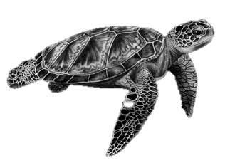
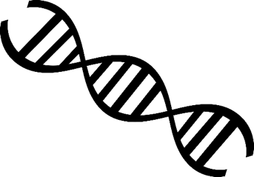
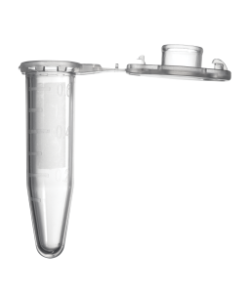




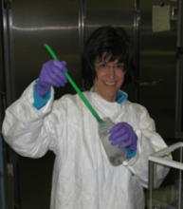
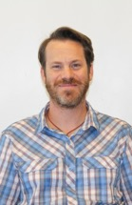
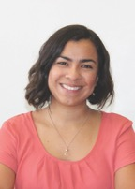
Major research areas
‘Omics:
Autonomous 'omics platforms
eDNA to support ecosystem understanding (indicators and modeling)
Ichthyoplankton metabarcoding
in-situ HAB toxin warning
Green turtle monitoring
Pathogens potentially associated with red tide
Larval genetics and proteomics of heat resistant coral genotypes
‘Omics: New Technologies to Address NOAA’s Mission
Standards Enabled Insights into Environmental DNA: from microbes to mammals
Advancing our understanding of Stony Coral Tissue Loss Disease with ‘Omics
Notes:
Kelly as leadership in ‘omics
3G-ESP/LRAUV mobile 'omics platform and eDNA
‘Omic Technologies to Support Ecosystem Understanding and Fisheries Stock and Ecosystem Assessments
Ichthyoplankton metabarcoding
Advancement of mobile, in-situ HAB toxin warning and genomic observation for Great Lakes decision support tools
eDNA applications for green turtle monitoring
Assessment of potential ancillary pathogens associated with red tide
Larval Genetics and Proteomics of Heat Resistant Genotypes of the Endangered Coral, Orbicella faveolata, from Inshore Patch Reefs of the Florida Keys

Slide 10
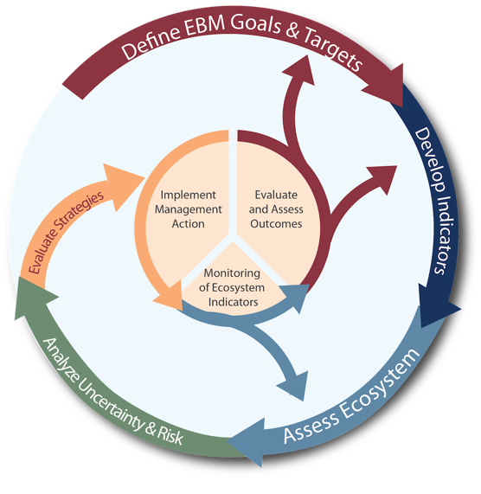
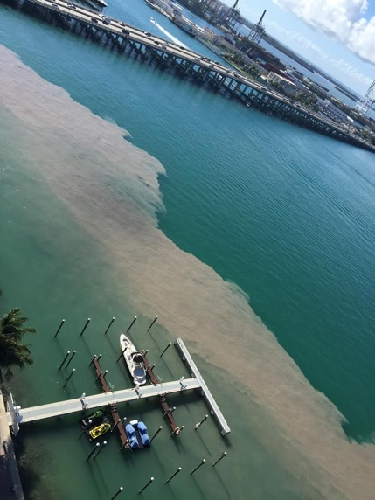
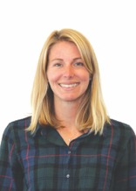
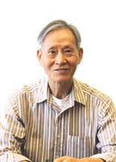
Major research areas
Integrated Ecosystem Assessments:
socio-ecological status of coastal and marine ecosystems
community resiliency to red tide
National Marine Sanctuaries
South Florida Ecosystem Restoration
Eutrophication early warning signs
Using Integrated Ecosystem Assessments to improve Resource Management
Eutrophication of sub-tropical Coastal Ecosystems
Collaborative Red Tide Research to Improve Resource Management

Slide 11
Divisional funding
FY 2019
$7.6M
funding
=
$2.3M
Base funds
+
$5.3M
20 Proposals
Funding (*1,000)
PROPOSAL FUNDING
BASE FUNDING

Slide 12
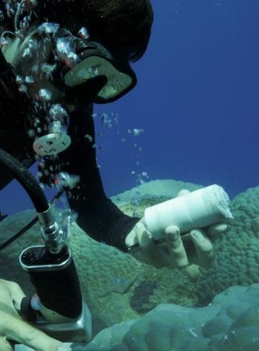
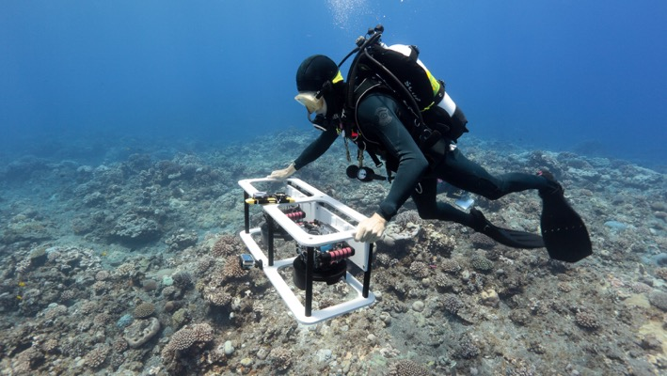
Major observational activities
Repeat Hydrography: Global GO-SHIP cruises, dissolved inorganic nutrients, carbon chemistry
Gulf of Mexico Ecosystems and Ocean Acidification: (GOMECC):
SOOP-pCO₂: Surface Ocean Carbon Atlas (SOCAT)
National Coral Reef Monitoring Program Network: Puerto Rico, Florida Keys, Flower Gardens
South Florida Ecosystem Restoration Research: Small boat and regional research vessel (R/V Walton Smith)
Red Tide Monitoring in Partnership with Florida Commercial Watermen’s Conservation: Water quality and oceanography
eDNA on Fisheries Surveys: California Current and Gulf of Mexico
Characterization of Marginal Reef Environments: high CO₂, high urbanization, high nutrients
Photo by S. Gordon, Open Boat Films
Notes:
Erica: Maybe delete? Or see which observing systems should be highlighted [not reading all of them]

Slide 13







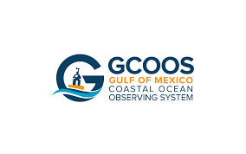
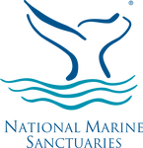
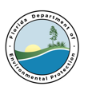








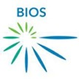

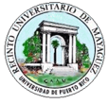
















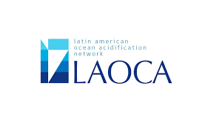














Partnerships and collaborations
Private Sector
Government Entities
International
NOAA
Academia

Slide 14
Leveraging resources
1
Ship time: use of partners’ ships (non-profits, academia) for cruises, equipment deployments, logistics
Federal-State-Academic-Industry Collaborations: pool resources with partners to extend and strengthen research cruises and enhance temporal and spatial observations (e.g., red tide)
Cargo and Cruise ships: collaborate with marine industry to provide space for TSG and pCO₂ installations
2
3
Notes:
Emphasize why we need partnership to make these cruises, etc happen

Slide 15
Divisional collaborations within AOML
OCED
* Repeat Hydrography
* TSG observations in support of pCO2 assessments
* Ocean conditions during Red Tide events
* Climate Integrated Ecosystem Assessments
* BGC-Argo
Hurricane Impacts on Coral Reefs *
Role of Hurricanes in Red Tide *
* Impact of hurricanes on O2, pCO2
HRD
PHOD
Notes:
Consider removing

Slide 16
Divisional collaborations with NOAA Line Offices
NMFS
OMAO
NESDIS: CoastWatch, STAR, NCEI
NMFS: SEFSC, SWFSC, NWFSC,
NOS: COOPS, IOOS
OMAO: fleet and charter
Biscayne Bay HFA *
‘Omics for EBFM, Coral, and Stock Assessment *
* Research Vessels
State of Climate *
SOOP-OA & SOOP-CO₂ *
IEA *
South Florida Ecosystem Restoration *
NCRMP *
* Red Tide
NESDIS
OCED
NOS

Slide 17
Scientific and technical leadership
Ecosystems
Ecosystem Indicators Working Group
Integrated Ecosystem Assessment Steering Committee
Marine Biodiversity Observing Network Working Group
NOAA in the Caribbean Steering Committee
Ocean Acidification Advisory Committee
RESTORE Project Development Tiger Team
South Florida Ecosystem Restoration Science Coordination Group
‘Omics
U.S Geological Survey eDNA Bilateral Organizing Committee
Government eDNA Working Group
National Microbiome Data Collaborative Steering Committee
NOAA Research Council ‘Omics Task Force
Marine Microbes and Ecosystem Health Working Group
Research and Development Database User Group
Ocean Carbon
Southeast Ocean and Coastal Acidification Network (SOCAN)–Steering Committee and Science Working Group
Surface Ocean Carbon Atlas (SOCAT) Global Group
U.S. Global Ocean Ship-based Hydrographic Investigations Program (GO-SHIP) Executive Council & Science Committee
International Argo Science Team (AST) for Biogeochemistry
National Centers for Environmental Information—World Ocean Atlas
Notes:
Leading within NOAA and outside NOAA; regionally, nationally and internationally

Slide 18
Divisional Peer Reviewed Publications
2019
39 peer-reviewed manuscripts
2018-19: Manuscripts with authors/co-authors with more than 200 different affiliations
Editors: Chris Kelble (Bull Mar Sci), Derek Manzello (Scientific Rep), Jia-Zhong Zhang (Scientific Reports)
Notes:
All pdfs in web pages

Slide 19
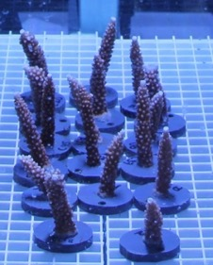
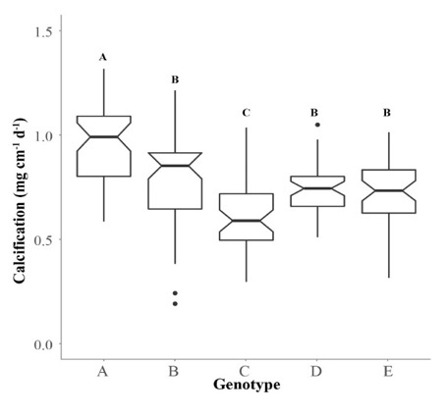
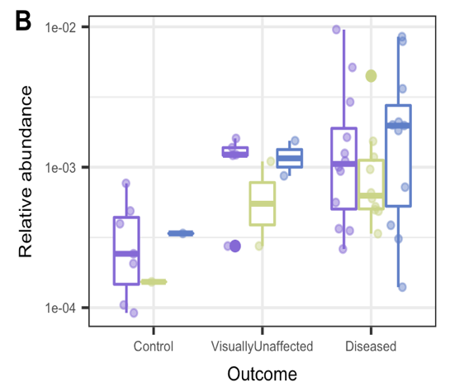
Key area of research:
Coral Restoration ‘Omics
Relevance: Coral reefs are highly valuable ecosystems that are threatened by a number of stressors
What are we doing: Experimental observations, genomics, transcriptomics, and proteomics
What we have learned: There are more resilient genotypes; transcriptomic differences and putative pathogens between diseased and controlled Acropora
Current work: Coral Health Assessment (pre-death), ‘omic investigations into resilience in marginal environments
Notes:
$8.5 billion and 70,400 jobs annually in SE Florida

Slide 20
Key area of research:
Detecting Eutrophication Before Regime Shift
Relevance: Eutrophication is a global problem that is difficult or impossible to address after it causes regime shift
What we are doing: Developing statistical methods to detect long-term trends in nutrients and chlorophyll a in oligotrophic ecosystems
What we have learned: We can detect spatial chlorophyll a and nutrient trends that signal a likely regime shift
Plan: Apply these results to effectively manage land-based sources of pollution in Biscayne Bay Habitat Focus Area
Millette et al. 2019

Slide 21
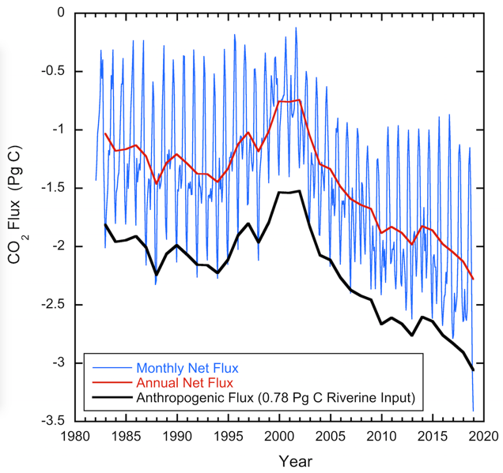
Key area of research:
The Changing Ocean Carbon Cycle
Relevance: Understand and predict changes in ocean climate and impacts of ocean health.
What we are doing: Obtain accurate ocean carbon data, increased understanding of physical and biogeochemical processes to constrain ocean carbon inventories, fluxes, and trends in ocean acidification. Improve methodologies, autonomous platforms and sensors.
Our current work: Largest data provider to SOCAT, and lead regional Ocean Acidification cruises. With PMEL, lead NOAA component of GO-SHIP. Collaboratively, use data, remote sensing and Artificial Intelligence schemes to provide monthly near real-time air-sea CO₂ flux estimates.
Monthly/annual air-sea CO₂ flux product based on data and remote sensing using AI approaches (SOTC BAMS, 2019)
Notes:
Surface Ocean Carbon Atlas

Slide 22
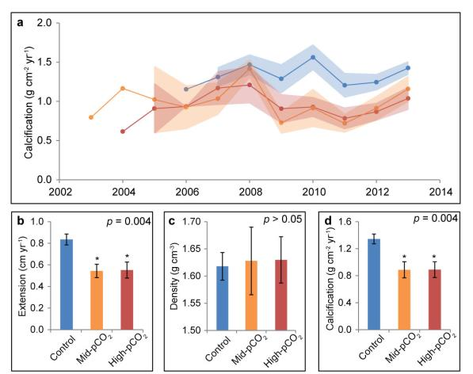
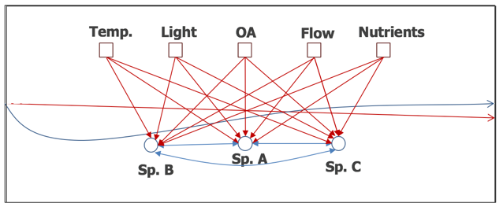
Key area of research:
Coral Monitoring, Research, and Modeling
Relevance: Coral reefs are highly valuable ecosystems that are threatened by a number of stressors
What we are doing: laboratory experiments, field observations, modeling, 3D scanning
What have we learned: 1) Ocean Acidification affects coral and algae species richness, 2) Ocean Acidification decreases calcification and increases bioerosion, 3) Business-as-Usual scenario will result in annual severe bleaching by 2040, 4) there is an effect of genotype and environment on restoration success
Our current work: 1) Land Based Sources of Pollution impacts in south Florida, 2) nursery resiliency scorecard, 3) reef framework persistence model, 4) coral ecosystems in marginal environments, 5) long-term coral and Ocean Acidification monitoring

Slide 23



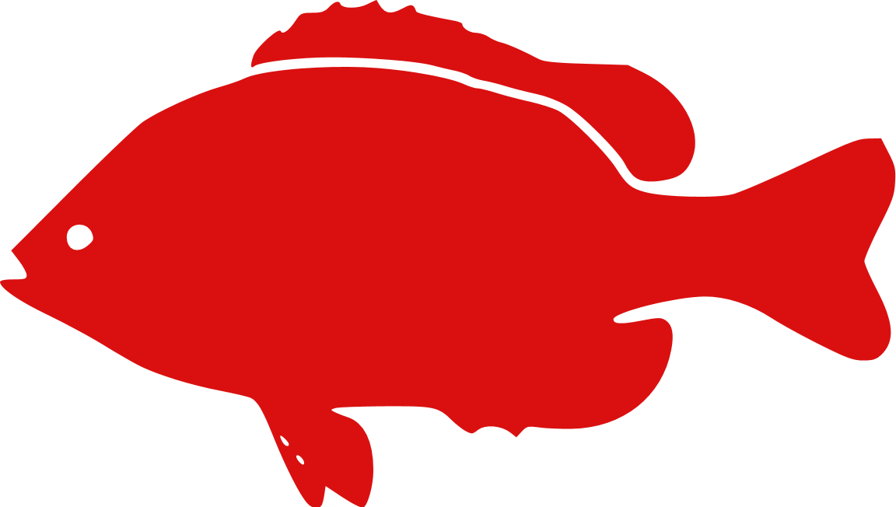





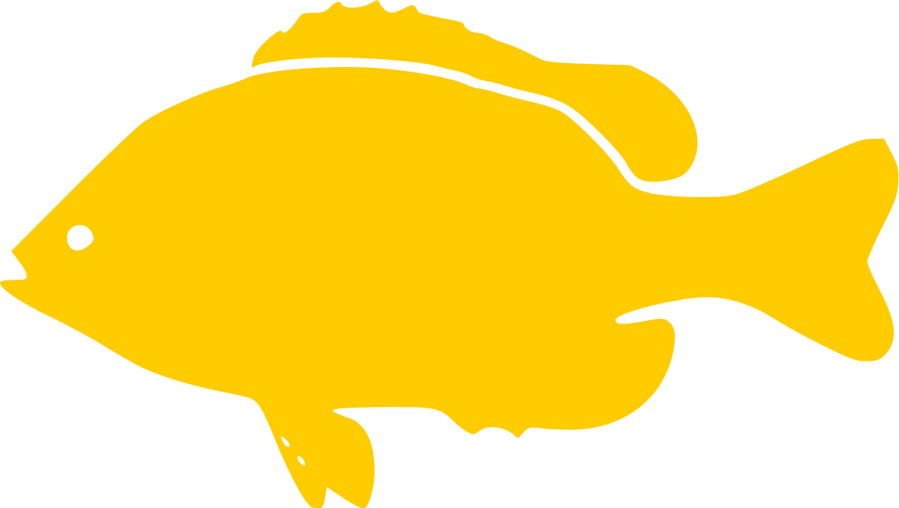

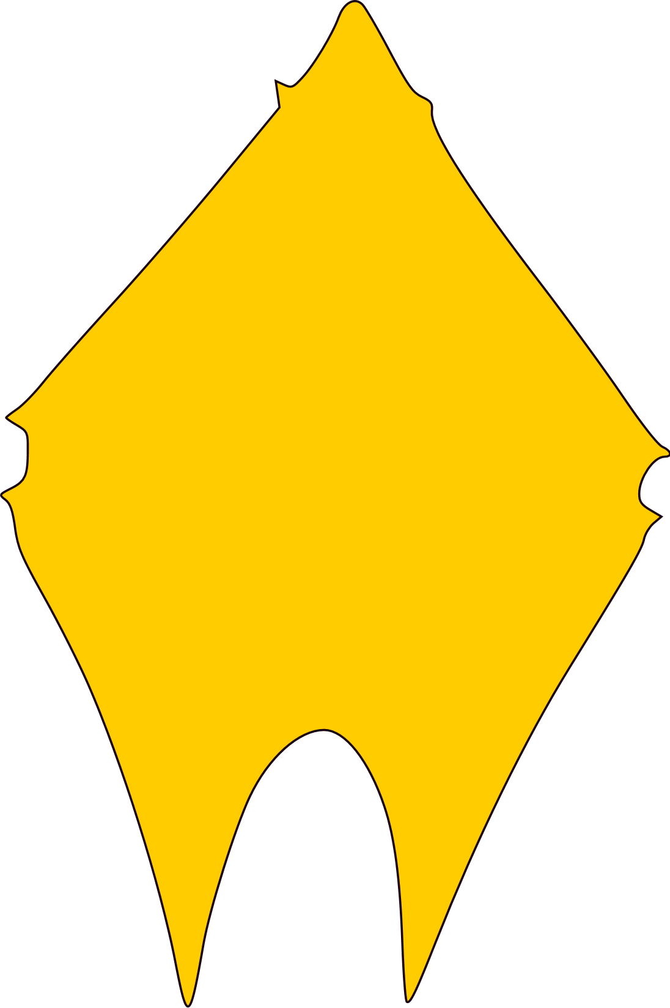


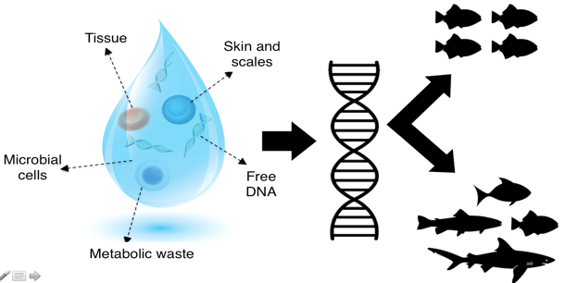
Key area of research:
Environmental DNA (eDNA)
12S rDNA
?
COI
Relevance: eDNA provides an opportunity to collect massive amounts of data about populations and diversity quickly (i.e., via water samples)
What we are doing: Biodiversity assessment from microbes to whales, pathogen abundance, coral holobiome, potential ecosystem indicator evaluation, use for ecosystem modeling
We have learned: eDNA can detect organisms that divers cannot, eDNA varies temporally and spatially along known biogeographies,
eDNA can detect zooplankton and phytoplankton shifts in Cal Current
Plan: 1) Sample eDNA on ongoing research cruises to answer pressing questions (Fisheries, Norway, HABs), 2) Develop technology to sample eDNA autonomously on ships, 3) add eDNA to ongoing open ocean cruises
(e.g., GO-SHIP)
18S rDNA
16S rDNA

Slide 24
Transition:
Sanctuary Condition Reports
Relevance: NOAA’s national marine sanctuaries would like to use indicators in their condition report and ensuing management plans
Objective: Develop a method to select indicators for condition reports and pilot the implementation of indicators into the Florida Keys National Marine Sanctuary Management process
What we have learned: Indicators were developed and analyzed for all condition report questions
Transitioned: 1) Indicators were used in the draft environmental impact statement for FKNMS, 2) Indicator selection process is currently being transferred for use in Olympic Coast NMS
Notes:
Kelly Montenaro’s work

Slide 25
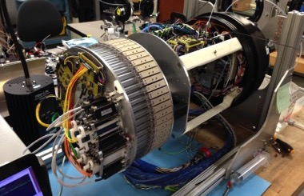
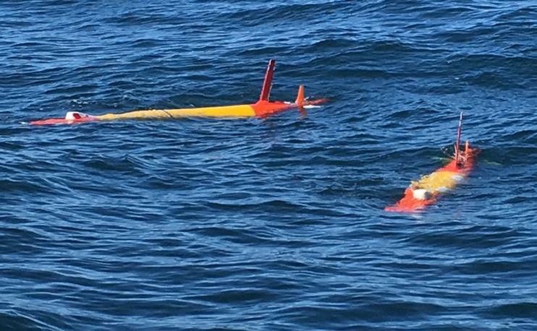
Transition:
eAUV
Relevance: Develop autonomous systems and further eDNA approaches to advance ocean science & stewardship, and support the Blue Economy.
Objective: Demonstrate proof-of-concept to show the feasibility of a prototype instrument ("eAUV") to collect and process samples for molecular biological analyses.
What we have learned Utilize deployment missions to define operational requirements and inform engineering developments to increase the readiness level (RL) of the instrument
Transitioned: Readiness level moved from ~RL 4 to RL 5 for mobile, autonomous sample collection and on-board sample preservation (DNA archival) for ‘omic analysis.
Notes:
Consider removing

Slide 26

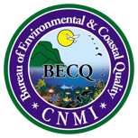
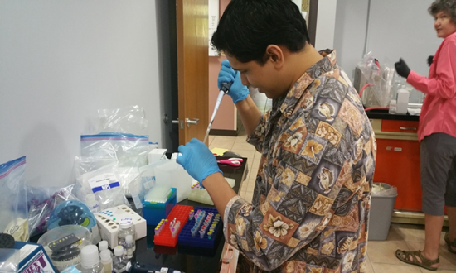
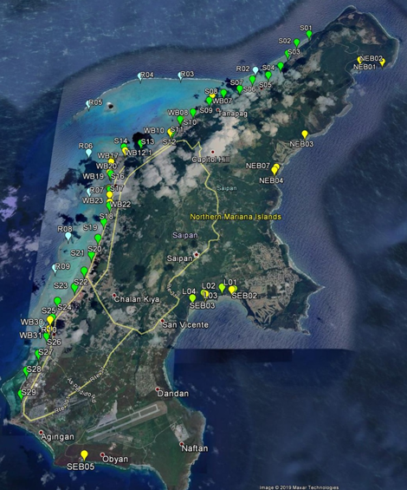
Transition:
Molecular Microbial Source Tracking
Relevance: US territories (e.g., CNMI) need Microbial Source Tracking capacity to better manage and mitigate Land Based Sources of Pollution impacts in coastal waters.
Objective: Adapt qPCR instrumentation for Microbial Source Tracking analyses; train personnel with their own in-house instrumentation to develop a Microbial Source Tracking facility.
What we have learned: Microbial Source Tracking capability was used to conduct a pollution source tracking study in Saipan Lagoon.
Transitions: 1) Adaptation and modification of qPCR instrumentation; 2) Training of lab personnel in Microbial Source Tracking methods; 3) Ongoing consultations between AOML and CNMI for Land Based Sources of Pollution studies
Notes:
Edit first paragraph; shorten whole thing.

Slide 27
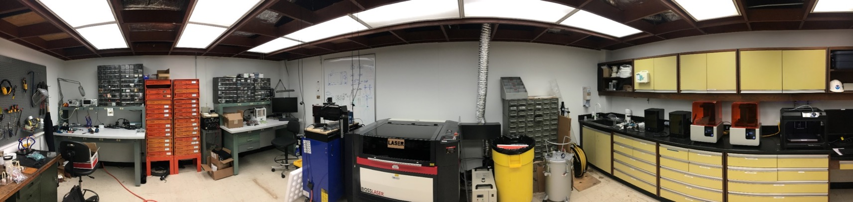
Investments to Improve our Capacity
1
Experimental Reef Lab Bioinformatics Computing
Advanced Manufacturing and Design Laboratory ‘Omics Laboratory
2
3
4
experimental precision, ‘omics capabilities, prototype development, instrument repairs
Digital design
CNC
3D print post processing
Soldering station
Pressure chamber
Circuit board milling
3D printers
Laser cutter

Slide 28
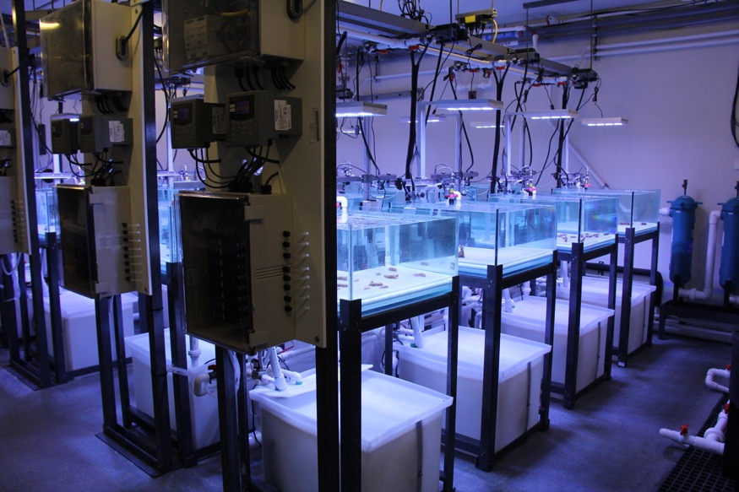
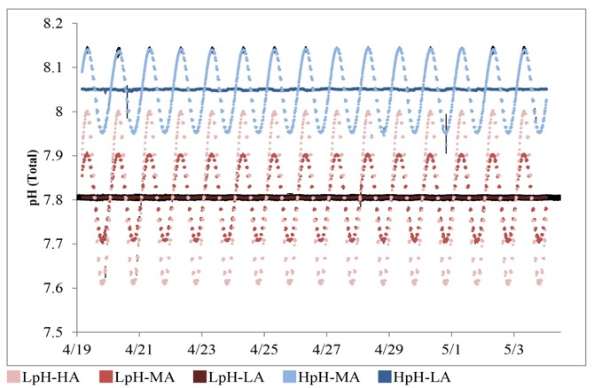
AOML Experimental Reef Laboratory
What is it ?
Precise control on environmental conditions (pCO2, nutrients, temperature, etc.)
Why do we need it ?
simulate in situ conditions (e.g. diel variability) and overlay these on experimental scenarios (e.g., elevated pCO₂).
Originally developed to experiment on corals, but can be used for any smaller organism or mesocosm.

Slide 29
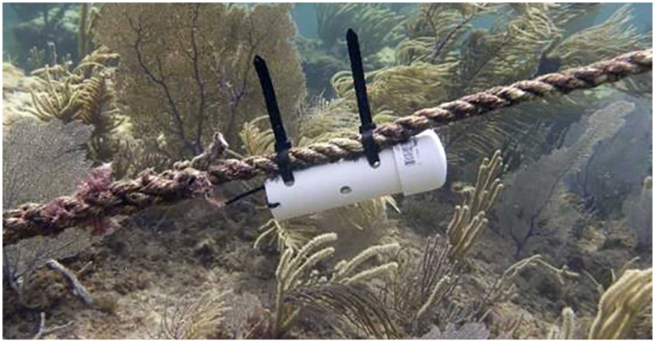
AOML Opuhala Temperature Sensor
What is it ?
A low-cost ($9), high-accuracy temperature sensor
Why do we need it?
Monitor benthic bottom temperature for marine habitats and ecosystems.
Plan: Global deployment at critical coral reef ecosystems (~200)
Field Tested: Southeast Florida (Hendee et al. 2019).

Slide 30
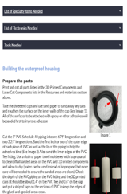
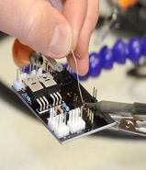




AOML Sub-Surface Autosampler (SAS)*
What is it? A low cost, open-source autonomous sub-surface sampler
Why do we need it? Diel variability is often not adequately sampled and can be quite large. Without an understanding of diel variability, data cannot be put in the proper context
Plan: Increased applications, modify to enable Sterivex filter collection for eDNA sampling, add ability to trigger sample collection from a cell phone
Accessible 3D printing
Website instructions
Hardware
Software
Circuit design
* Basis for Ian Enochs winning the DOC Silver Medal, with Nathan Formel of CIMAS as his chief collaborator.
Notes:
Asterisk—silver medal

Slide 31


SAS school materials and open source
3 online lesson plans
Intro to chemistry and Ocean Acidification
Science and Technology
Build a mini-SAS
https://www.coral.noaa.gov/accrete/sas/

Slide 32




Division-sponsored RSMAS graduate students
Charline Quenee
Benjamin Young
John Morris
Allyson Demerlis

Slide 33

2019 Divisional Interns
Brianna Alannis (CCME NERTO/University of Texas – Rio Grande Valley)
Rachel Martin (Hollings Scholar; Ohio University)
Laurean Shea, Amanda Kirkland, Isabelle Basden, Austin Schlenz (CIMAS Interns)
Naja Murphy, Patrick Michael Kiel, Hyo Won Lee (UM Undergrad Theses)
Aiden Wells (MAST Academy High School)
We also serve on numerous PhD and MS Committees
Notes:
Chris Kelble is co-technical monitor for CCME

Slide 34
Challenges
1
Base Funding (level to decreasing)
Infrastructure (Laboratories and Instruments)
FTEs dwindling
Talent Recruitment and Retention
Ship time
Transitions (operational partner)
2
3
4
5
6

Slide 35

Looking to the Future: BGC-Argo
Sensors in BGC-ARGO:
- Temperature, Salinity (core Argo)
- Additional 6 core ocean variables: Chlorophyll fluorescence, particle backscatter, O₂, NO₃, pH, irradiance
Regional pilot site: Gulf of Mexico
Develop capacity of BGC data assimilation, improve coupled models, calibration with shipboard observations
Advantages: OCED expertise with BGC-Argo parameters
Need: Increase AOML capacity with biogeochemical observations, models and data assimilation
Notes:
Example of what to say: Looking into the future, OCED is working on developing a BGC-ARGO pilot project in the Gulf of Mexico.
BGC-Argo floats have the standard temp and sal sensors of “classic” argo floats (aka core Argo), but incorporate sensors to measure 6 additional core ocean variable of interest for biogeochemistry: Chlorophyll fluorescence, particle backscatter, dissolved oxygen, nitrate, pH, and irradiance. Successful BGC-Argo test programs are being carried out e.g. in the Southern Ocean (SOCCOM), or the Mediterranean (NAOS).
The GoM is a good test site due to ease of access (our backdoor), potential for collaborations with institutions with interest in the GoM, good knowledge of circulation patters, water flows, etc.
AOML and OCED in particular have decades of expertise in BGC-Argo parameters (e.g. pH, O2, NO3) and are working to develop validation reference layers in the GoM to aid in QCing the BGC-Argo data.
The data from the BGC floats can be used for Observation System Simulation Experiments (OSSEs), to improve coupled physical-biogeochemical models
This project would benefit from increasing AOML’s capacity with regards to biogeochemical modelling and data assimilation expertise.

Slide 36
Focus on our future
Critical presence in Marine Chemistry and Ecosystem Science within NOAA and throughout the scientific community:
New generation of early career scientists, engineers, and support personnel (increase Diversity and Inclusion)
Emphasis on Social Sciences (collaboration and workforce enhancement)
Cutting edge NOAA-oriented research and transitions to applications for societal benefits
State of the Art Experimental Capabilities (larger scale)
State of the art Ecosystem Modeling and Forecasting with data assimilation
Artificial Intelligence and Machine Learning
1
2
3
4
5
6

Slide 37
NOAA AOML Ocean Chemistry and Ecosystems Division Laboratory Review, November 2019 Thank you

