Slide 1
Ocean Studies and Monitoring for Hurricane Forecasts
George Halliwell, NOAA/AOML/PhOD
Impact of ocean observations on reducing intensity prediction errors in coupled forecast models
Key collaborations: NWS/NCEP/EMC, AOML/HRD

Slide 2
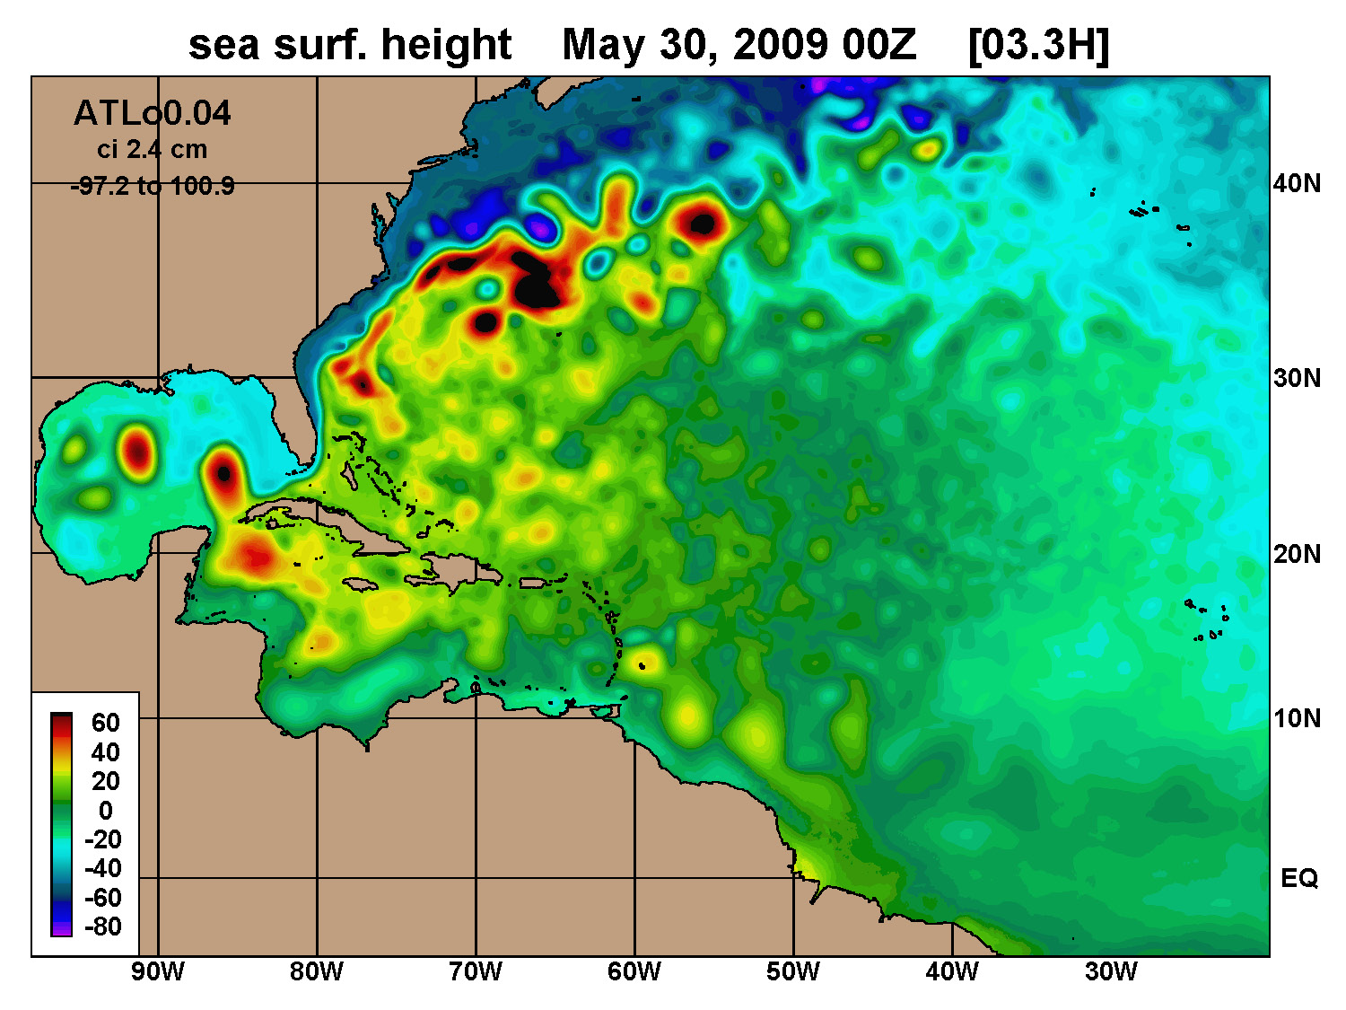
Overview
Overarching goal: Improve hurricane intensity prediction
Major Objectives:
Determine impacts of individual ocean observing systems on reducing errors in ocean model initialization and subsequent intensity forecasts
Improve ocean observing strategies (“optimal” combination of new & existing systems)
Advance NOAA goals:
Weather-ready nation
Improve severe storm prediction
Advance implementation of Weather Act
Regional ocean model domain for hurricanes

Slide 3
Overview
Overarching goal: Improve hurricane intensity prediction
Major Objectives:
Determine impacts of individual ocean observing systems on reducing errors in ocean model initialization and subsequent intensity forecasts
Improve ocean observing strategies (“optimal” combination of new & existing systems)
Advance NOAA goals:
Weather-ready nation
Improve severe storm prediction
Advance implementation of Weather Act
Regional ocean model domain for hurricanes

Slide 4
Timeline: Observing system evaluation for hurricane intensity prediction
HWRF intensity prediction experiments for 2017-18 storms
Ocean data assimilation system development
2015-17
2018-19
<2015
2019==>
Develop HWRF Prediction Capability (with EMC)
Perform ocean Observing System Experiments (OSE) for 2017-18 storms
Initialize HWRF with ocean analyses generated by the OSE system
[Hurricanes Maria (2017) and Michael (2018)]
Initialize HWRF with ocean analyses generated by the ocean data assimilation system.
[Hurricane Gonzalo (2014)]
Assess observing system impacts on improving ocean model initialization

Slide 5
Timeline: Observing system evaluation for hurricane intensity prediction
HWRF intensity prediction experiments for 2017-18 storms
Ocean data assimilation system development
2015-17
2018-19
<2015
2019==>
Develop HWRF Prediction Capability (with EMC)
Perform ocean Observing System Experiments (OSE) for 2017-18 storms
Initialize HWRF with ocean analyses generated by the OSE system
[Hurricanes Maria (2017) and Michael (2018)]
Initialize HWRF with ocean analyses generated by the ocean data assimilation system.
[Hurricane Gonzalo (2014)]
Assess observing system impacts on improving ocean model initialization

Slide 6
Simple OSE for Hurricane Gonzalo (2014) (with and without ocean DA)
AOML analysis product
No DA
Assim. all obs.
Anomalously warm ocean during 2014.
Unconstrained model - TCHP was ~30% too low in the warm pool
Ocean DA necessary to correct the model.
Tropical Cyclone Heat Potential (TCHP, kJ cm⁻²)

Slide 7
Simple OSE for Hurricane Gonzalo (2014) (with and without ocean DA)
AOML analysis product
No DA
Assim. all obs.
Anomalously warm ocean during 2014.
Unconstrained model - TCHP was ~30% too low in the warm pool
Ocean DA necessary to correct the model.
Tropical Cyclone Heat Potential (TCHP, kJ cm⁻²)

Slide 8
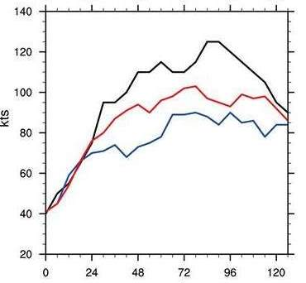
Results from Simple OSE: predicted intensity
Observed intensity
v_{max}
The negative intensity bias was substantially reduced because ocean DA improved the initialization.
With DA
No DA
from (J. Dong et al, 2017,
Weather and Forecasting)
_{Forecast hour}

Slide 9
Results from Simple OSE: predicted intensity
Observed intensity
v_{max}
The negative intensity bias was substantially reduced because ocean DA improved the initialization.
With DA
No DA
from (J. Dong et al, 2017,
Weather and Forecasting)
_{Forecast hour}

Slide 10
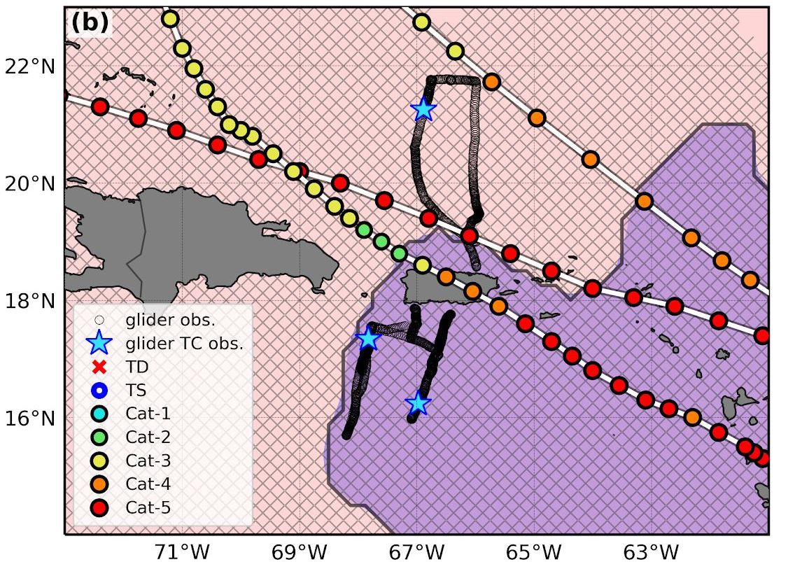
Hurricane Maria (2017) OSE, intensity bias
p_{min}(hPa)
No DA
All obs.
PhOD Gliders
Average over 6 forecast cycles
Observed
Prior to Puerto Rico landfall: Intermediate reduction of intensity bias results from assimilating individual observing systems.

Slide 11
Hurricane Maria (2017) OSE, intensity bias
p_{min}(hPa)
No DA
All obs.
PhOD Gliders
Average over 6 forecast cycles
Observed
Prior to Puerto Rico landfall: Intermediate reduction of intensity bias results from assimilating individual observing systems.

Slide 12
Hurricane Maria (2017) OSE, intensity bias
p_{min}(hPa)
No DA
All obs.
PhOD Gliders
Average over 6 forecast cycles
Observed
Prior to Puerto Rico landfall: Intermediate reduction of intensity bias results from assimilating individual observing systems.

Slide 13
Observing system impacts on Hurricane Maria intensity at 17.6N (6 forecast cycle average)
Maximum wind speed bias
Observed | 140.0 kt
Unconstrained model | 106.5 kt
Bias | -33.5 kt
All obs.
38%
Altimetry
9%
Argo
23%
All SST
17%
Gliders
17%
Ocean model initialized by an unconstrained analysis
Percentage reduction in negative bias resulting from assimilating different observing systems

Slide 14
Observing system impacts on Hurricane Maria intensity at 17.6N (6 forecast cycle average)
Maximum wind speed bias
Observed | 140.0 kt
Unconstrained model | 106.5 kt
Bias | -33.5 kt
All obs.
38%
Altimetry
9%
Argo
23%
All SST
17%
Gliders
17%
Ocean model initialized by an unconstrained analysis
Percentage reduction in negative bias resulting from assimilating different observing systems

Slide 15
Observing system impacts on Hurricane Maria intensity at 17.6N (6 forecast cycle average)
Maximum wind speed bias
Observed | 140.0 kt
Unconstrained model | 106.5 kt
Bias | -33.5 kt
All obs.
38%
Altimetry
9%
Argo
23%
All SST
17%
Gliders
17%
Ocean model initialized by an unconstrained analysis
Percentage reduction in negative bias resulting from assimilating different observing systems

Slide 16
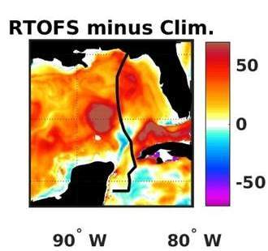
Sensitivity of Hurricane Michael (2018) Intensity Forecasts to Ocean DA
Observed
All obs.
Clim.
No DA
The Gulf is much warmer than normal north of 24.5N

Slide 17
Sensitivity of Hurricane Michael (2018) Intensity Forecasts to Ocean DA
Observed
All obs.
Clim.
No DA
The Gulf is much warmer than normal north of 24.5N

Slide 18
Observing system impacts on Hurricane Michael intensity at 29N (3 forecast cycles)
Maximum wind speed bias
Observed | 125.0 kt
Unconstrained model | 80.9 kt
Bias | -44.1 kt
All obs.
77%
Altimetry
Larger bias
Argo/Alamo
45%
All SST
60%
Ocean model initialized by an unconstrained analysis
Percentage reduction in negative bias resulting from assimilating different observing systems

Slide 19
Observing system impacts on Hurricane Michael intensity at 29N (3 forecast cycles)
Maximum wind speed bias
Observed | 125.0 kt
Unconstrained model | 80.9 kt
Bias | -44.1 kt
All obs.
77%
Altimetry
Larger bias
Argo/Alamo
45%
All SST
60%
Ocean model initialized by an unconstrained analysis
Percentage reduction in negative bias resulting from assimilating different observing systems

Slide 20
Thank you!
Plans:
Continue to perform ocean Observing System Experiments (OSE) to assess the impact of existing ocean observing systems on intensity prediction.
Perform ocean Observing System Simulation Experiments (OSSE) to assess the impact of new ocean observing systems and to design “optimal” ocean observing strategies for improving intensity prediction.

