Slide 1

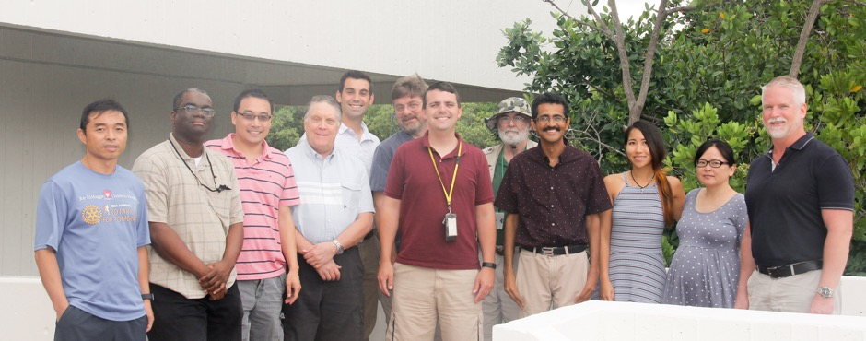
Advances in Tropical Cyclone Forecast Modeling Systems
Sundararaman Gopalakrishnan (Gopal)

Slide 2
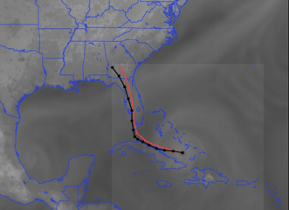
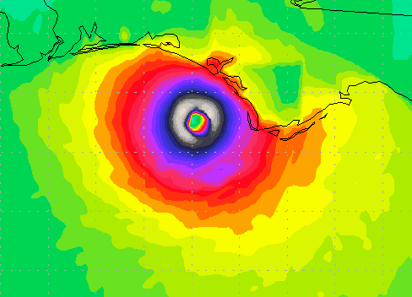


Our Objectives – Improving Hurricane Forecast
Develop next-generation hurricane research and forecast models
Utilize observations from the Hurricane Field Program to improve physical parameterizations in those models
Advance our understanding of hurricane processes using high-resolution forecast modeling systems
Transition model research and developments into operations

Slide 3
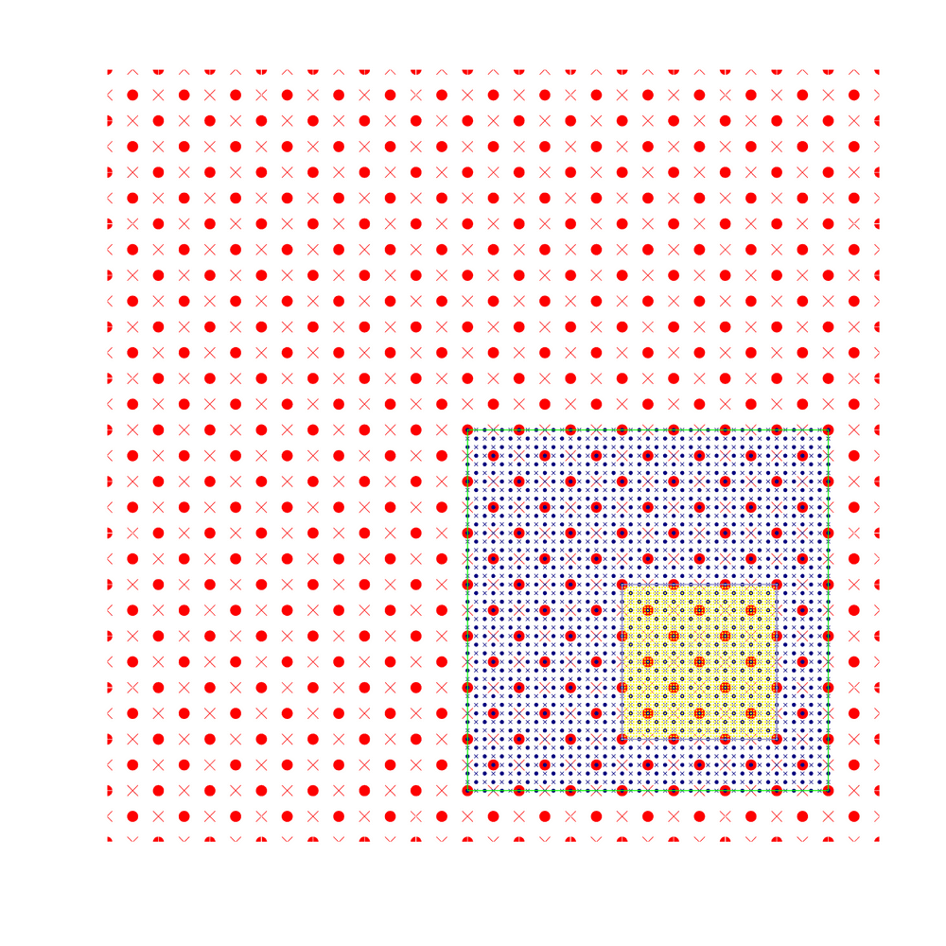
Creating Next-Generation Hurricane Models for NOAA
Storm-following nests are the back-bone for all NOAA hurricane models (HWRF, HWRF-B, HMON & HAFS)

Slide 4
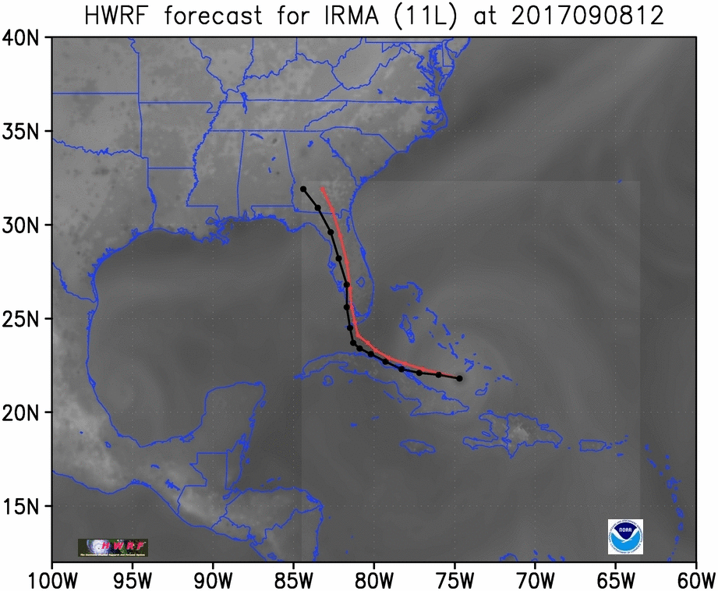
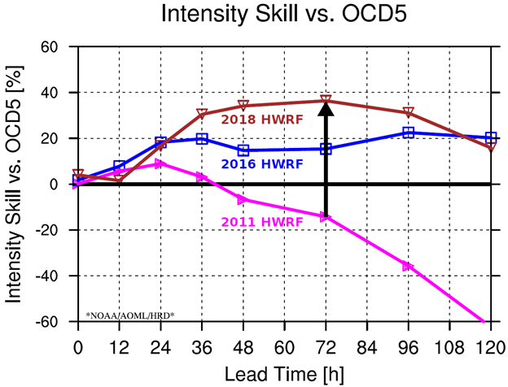

Model Developments: Operational HWRF
60%
First ever high-resolution moving nested grid modeling system to run in NOAA operations for Hurricanes
High-resolution nests, physics and DA advancements
Gopal et al., 2011, 2012, 2013 WAF, MWR, JAS
Notes:
We went all the way from negative scales for intensity skill
For more information, visit: https://www.aoml.noaa.gov/our-research/hurricane-research-division/modeling-prediction/

Slide 5

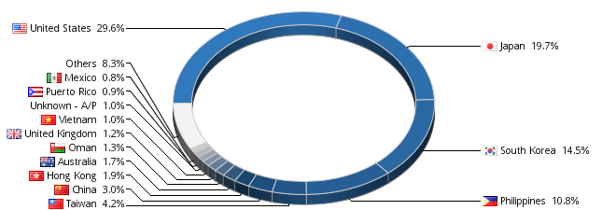
NOAA Capacity for Advancing Hurricane Prediction!
The HWRF System
Countries
People
Web of Science
192
1000
119
Use NOAA Products
Modelers & Developers
Publications (5 years)

Slide 6
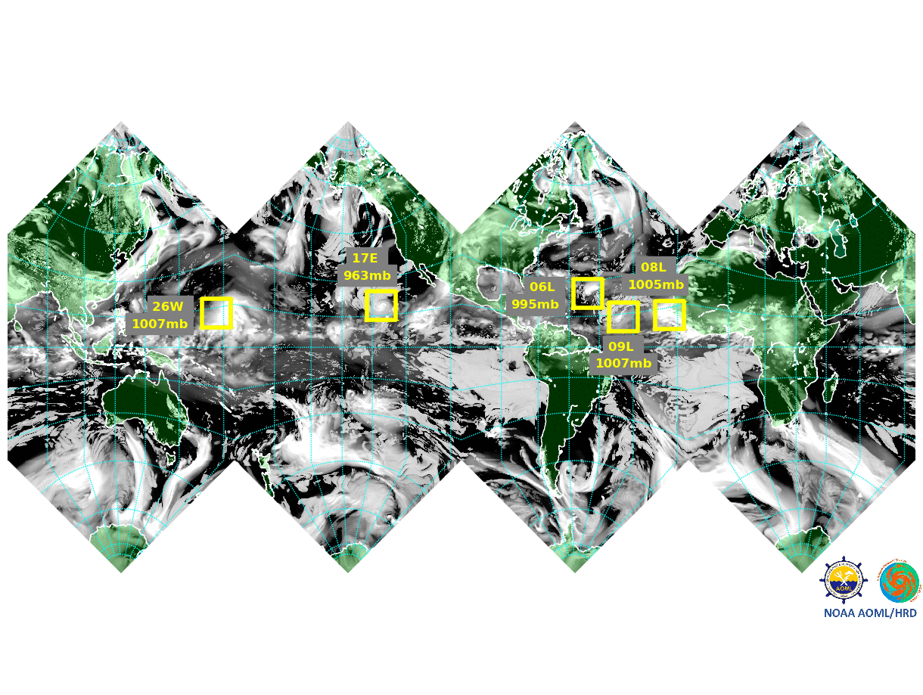
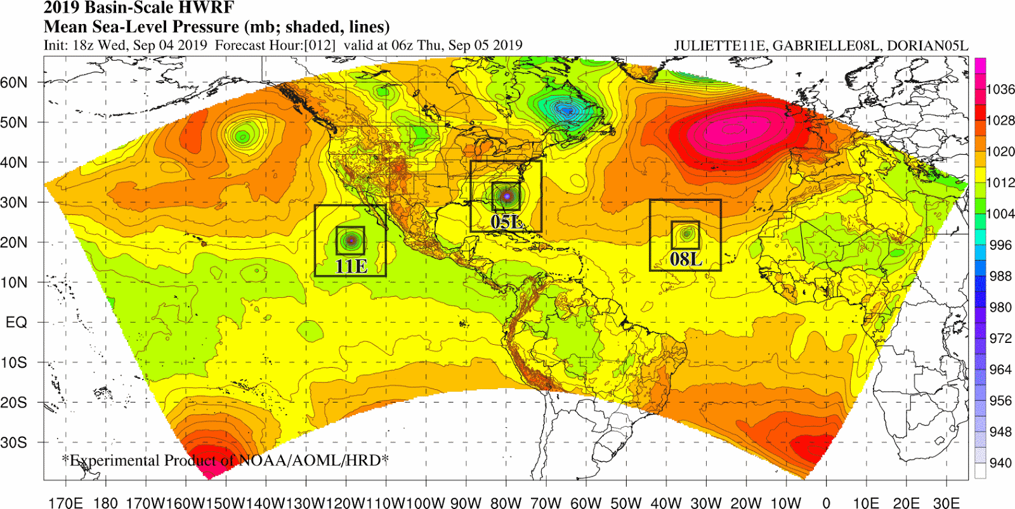
Model Developments: State-of-the-Art & Beyond
Moving Nests in Global FV3
to Track all Hurricanes
For Improved Land-storm and
Storm-storm Interactions
Tracking One
Storm at a Time
FV3- HAFS
Basin-Scale HWRF
Operational HWRF
2012
2019
2023

Slide 7
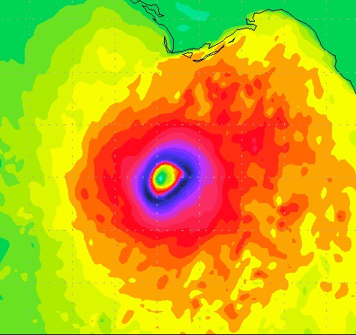

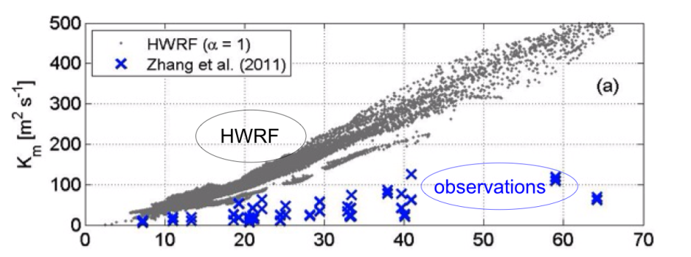
Use of P-3 Data for Improved Physics for Hurricanes
Original GFS Planetary Boundary Layer
FV3-HAFS simulation of Michael
A Study of the Impacts of Vertical Diffusion on the Structure and Intensity of the Tropical Cyclones Using the High-Resolution HWRF System (Gopal et al. JAS 2013)
Notes:
Observe that the image on the right has a more diffusive inner core structure

Slide 8
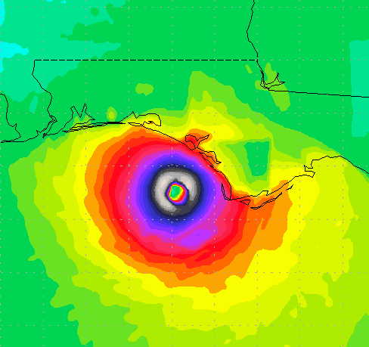
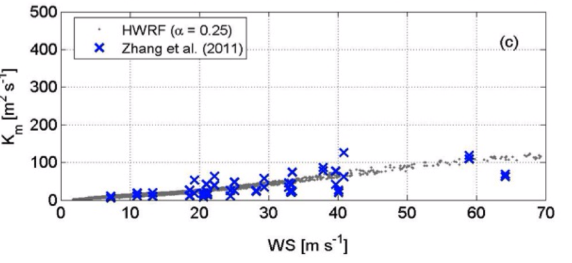
Use of P-3 Data for Improved Physics for Hurricanes
Modified GFS Planetary Boundary Layer
K_{m} = k (U*/F_{m}) Z {a(1 – Z/h) ²}
FV3-HAFS simulation of Michael
A Study of the Impacts of Vertical Diffusion on the Structure and Intensity of the Tropical Cyclones Using the High-Resolution HWRF System (Gopal et al. JAS 2013)
Notes:
Observe the second image, which has a smaller and tighter inner core and better structure consistent with observations

Slide 9



Advancing our understanding of Forecast
Alaka Jr, Ghassan J., et al. "Track Uncertainty in High-Resolution HWRF Ensemble Forecasts of Hurricane Joaquin." Weather and Forecasting 2019 (2019).
Leighton, Hua, et al. "Azimuthal distribution of deep convection, environmental factors, and tropical cyclone rapid intensification: A perspective from HWRF ensemble forecasts of Hurricane Edouard (2014)." Journal of the Atmospheric Sciences 75.1 (2018): 275-295.
Mohanty, Uma Charan, and Sundararaman G. Gopalakrishnan, eds. Advanced Numerical Modeling and Data Assimilation Techniques for Tropical Cyclone Predictions. Springer, 2016.
Chen, Hua, and Sundararaman G. Gopalakrishnan. "A study on the asymmetric rapid intensification of Hurricane Earl (2010) using the HWRF system." Journal of the Atmospheric Sciences 72.2 (2015): 531-550.

Slide 10
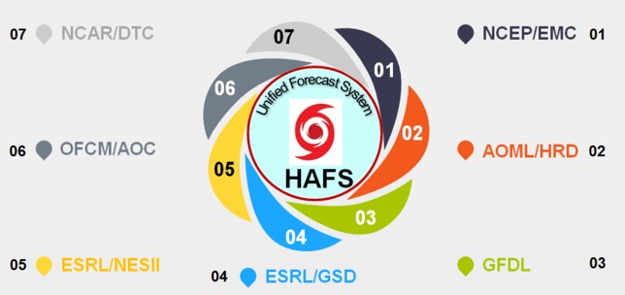
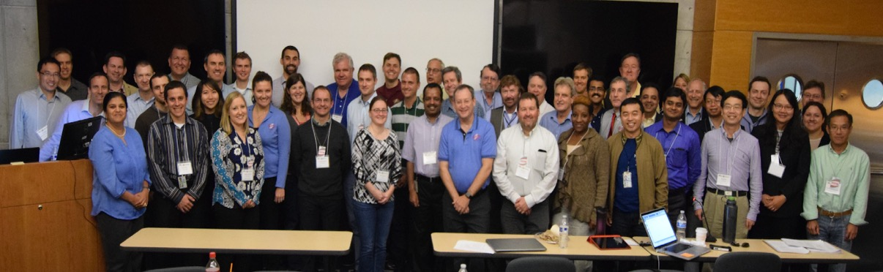
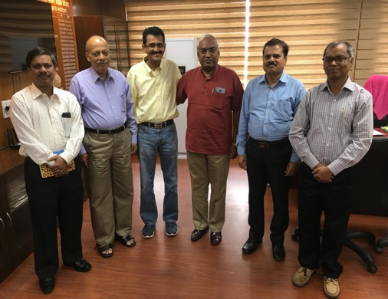
Transition to
Operations
NCEP/EMC: HWRF Team
NOAA
HFIP
AOML/HRD:
Modeling and Observations
Forecast offices: NHC, JTWC, International
Thank you to our Partners
Developmental Test Bed Center/UCAR
University Collaborators and partners
NOAA-MOES Team
Thank You

