Slide 1
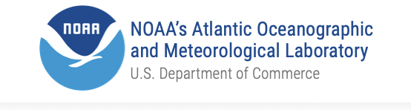
NOAA AOML
Physical Oceanography Division
Laboratory Review, November 2019
Gustavo Jorge Goni
Notes:
observations, research, technology, science, and transitions

Slide 2
Our vision
Be a world leader in physical oceanography research to strengthen scientific understanding of the state and variability of the ocean and its role in climate, weather (esp. extreme weather events), ecosystems, fisheries, and others, geared to societal benefits, particularly to protect lives and property…

Slide 3
Divisional objectives
Our vision is accomplished by:
Proposing hypotheses and carrying out cutting edge scientific research
Carrying out field work, data management
Conducting data analyses, numerical modeling, and data assessments
1
2
3

Slide 4
Divisional objectives
Carrying out technological developments
Performing scientific communications
Performing transitions to operations and applications
Securing funding to support current and future projects, initiatives, and workforce growth
4
5
6
7

Slide 5
Divisional members
50
20
30
Members
Federal employees
Cooperative Institute employees and contractors
1
60% from under-represented minorities in STEM
20 scientists
20 science support
5 CIMAS postdocs
High school and undergraduate interns
2
3
4
5

Slide 6
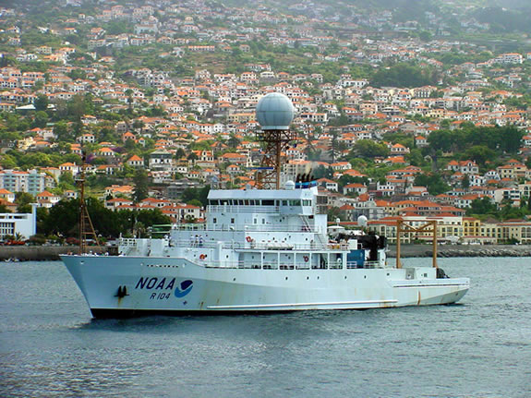
Major research areas
Ocean State and Variability:
Assessment of the state and variability of the ocean
Boundary, surface, and subsurface currents
Meridional Overturning Circulation/Meridional Heat Transports
Tropical dynamics and air-sea exchanges
Regional sea level changes
NOAA Ship Ronald H. Brown

Slide 7
Major research areas
Oceans and extreme weather events:
Forecasts (to 1 week): impact of ocean conditions on Atlantic hurricanes
Outlooks (~seasonal): outlooks of tornadoes and heat waves
Predictions and projections: MHT on rainfall, droughts, tornados, etc.
Argo float deployment

Slide 8
Major research areas
Numerical modeling and Observing Systems Experiments:
Atlantic hurricanes
MOC, Meridional Heat Transport
Ecosystems in the Gulf of Mexico
NOAA hurricane glider

Slide 9
Major research areas
Oceans, Ecosystems and Fisheries:
Environmental changes within climate models
Fisheries in the Gulf of Mexico
Biogeochemical studies and ocean acidification
Sargassum monitoring
Plankton survey in the Gulf of Mexico

Slide 10
FY 2019
$12.5M
funding
=
$4M
Base funds
+
$8.5M
22 Proposals
Divisional funding
Base funding
Proposal
Funding (*1,000)
Proposals
Base funding
2000
2005
2010
2015
2019

Slide 11
Major observational activities
1
Design
Implementation
Maintenance
Data management
Data analysis, research
Model assessments and initialization, data impact
2
3
4
5
6
NOAA RV Ron Brown at PIRATA site

Slide 12
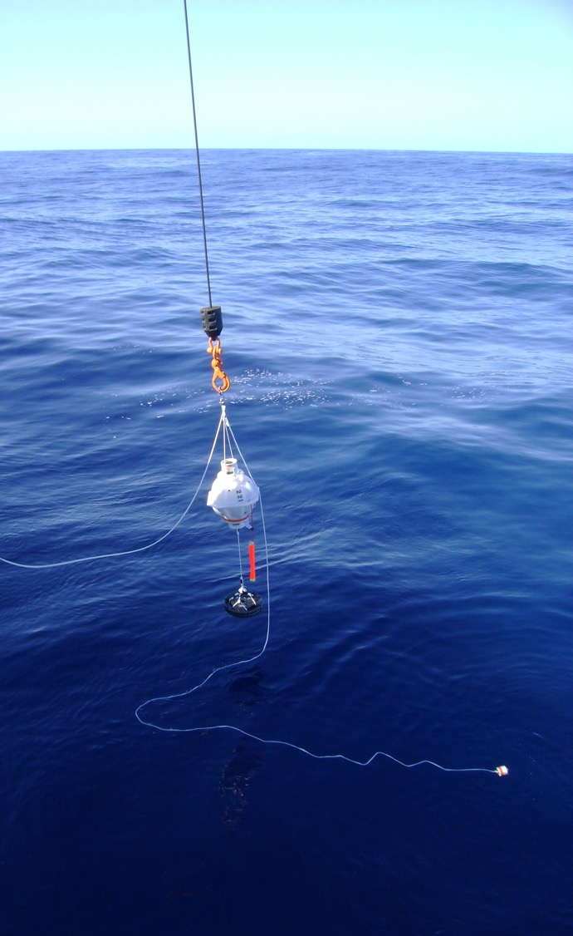
Major observational activities
Western Boundary Time Series: Florida Current and hydrographic cruises
Repeat Hydrography: global GO-SHIP cruises
Drifters deployments and DAC: ~1,500 drifters and DT QC
XBT transects: ~6.5K XBT observations, pCO2 and TSG from SOOP
SAM: moored instruments (PIES), hydrographic cruises for South Atlantic MOC
Argo DAC: ~100K RT QC; ~60 float deployments/yr
PIRATA cruises: hydrographic cruises service of NOAA moorings.
ThermoSalinoGraphs (TSG): ~100K surface observations
Hurricane gliders: +100K observations in the Tropical Atlantic and Caribbean
Deployment of PIES in the South Atlantic

Slide 13
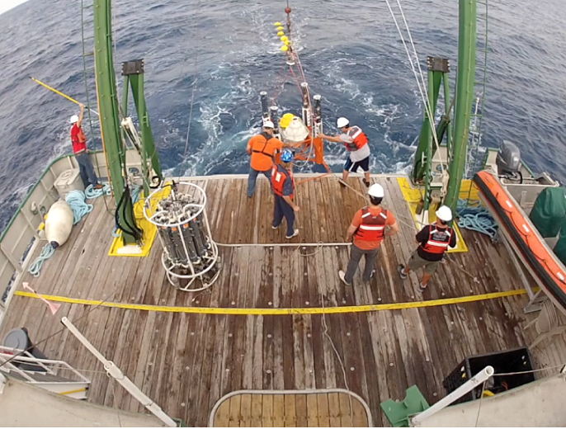
Ocean observations highlights
500
Days at sea in 2019
60+
US and international partnerships
100,000+
Ocean observations per year
Florida Current cruise

Slide 14




































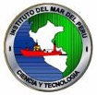


























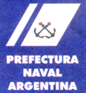







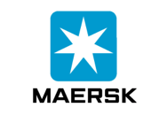


Partnerships and collaborations
Universities
Federal government agencies and laboratories
Local governments
Private industry
U.S. and international

Slide 15
Leveraging resources
1
Ship time: use of partners ships (Brazil, Argentina, South Africa, etc.) for cruises, equipment deployments, logistics
Glider ports: collaborate in the use of space, logistics, vessels, personnel for hurricane glider operations
Cargo ships: collaborate with shipping companies to provide space for XBT deployments, TSG and pCO2 installations, drifters and Argo float deployments
2
3
Cargo ship conducting XBT transect

Slide 16
Divisional collaborations within AOML
PHOD
* Repeat Hydrography
* TSG observations in support of pCO2 assessments
* Ocean conditions during Red Tide events
* Climate Integrated Ecosystem Assessments
* BGC
Ocean observing experiments *
Hurricane Field Program *
Ocean indicators for hurricane intensification forecasts *
* Impact of hurricanes on O2, pCO2, ecosystems
HRD
OCED

Slide 17
Divisional collaborations with NOAA Line Offices
OMAO
NWS: EMC, NHC, CPC
NESDIS: CoastWatch, NCEI
NMFS: SEFSC, MSR
NOS: COOPS, IOOS, NCOOS
OMAO: Ship scheduling, support
OAR: OOMD, OER, GFDL
NMFS
Fisheries Indicators *
Mandatory Ship Reporting *
* Research vessels
NWS
* Ocean-atmospheric modelling
* Tornado and heat waves outlooks
* VOS data flow
Satellite products *
State of Climate *
* Hurricanes
Vibrio *
NESDIS
Sea level *
Ocean Observing
Research
Portfolios
PHOD
NOS
OAR

Slide 18
Scientific and technical panels
Participation in 60+ panels:
Argo Science Steering Team
Argo Data Management
PIRATA Steering Team
WMO/IOC Data Buoy Cooperation Program
WMO/IOC Ship Of Opportunity Program
WMO/IOC GO-SHIP Hydrography Scientific Steering Team
WMO/IOC Ocean Gliders
NASA Aquarius and SPURS Science Team
NASA Ocean Surface Topography Science Team
South Atlantic Meridional Overturning Circulation
NESDIS Global Temperature/Salinity Profile Program
and 50+ more panels
WMO=World Meteorological Organization
IOC=Intergovernmental Oceanographic Commission
SPURS= Salinity Processes in the Upper Ocean Reginal Study

Slide 19
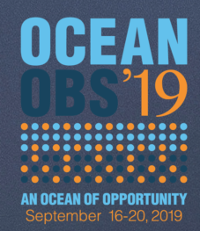
OceanObs19 Frontiers in Marine Science
17
manuscripts with divisional authors
PHOD manuscripts on:
Oceans and hurricanes (Lead)
XBT network (Lead)
Tropical Atlantic observing (Lead)
Boundary currents
Meridional overturning circulation
Oceans and hurricanes
Arctic observing system
Sargassum
Marine debris
Ocean-atmospheric fluxes
…

Slide 20
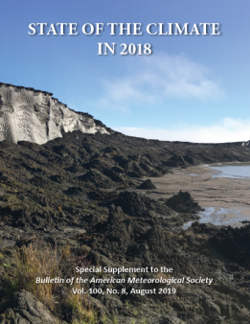
2018 BAMS State of the Climate report
8
manuscripts with divisional authors
Rick Lumpkin was lead editor of the “Global Oceans” chapter AOML authors contributed to the following sections:
Global Oceans (overview)
Ocean Heat Content
Salinity
Surface Currents
Global Ocean Carbon Cycle
Sargassum Inundations (sidebar)
Florida Red Tide blooms (sidebar)
Tropical Cyclone Heat Potential
- Upper Ocean Heat Conditions during Hurricane Michael (sidebar)
Notes:
The State of the Climate report is an international, peer-reviewed publication compiled by NOAA/ NWS/NCEI and released each summer. It is the authoritative annual summary of the global climate published as a supplement to the Bulletin of the American Meteorological Society (BAMS).

Slide 21
PHOD Refereed Publications
2019
55 peer-reviewed manuscripts
2018-19: manuscripts with authors/co-authors with more than 200 different affiliations
Editorial: Denis Volkov (JTech), Gregory Foltz (JPO), Gustavo Goni (JTECH, until march 2019), Rick Lumpkin (BAMS SofC 2018), Progress in Oceanography (E. Johns)
Notes:
All pdfs in web pages

Slide 22
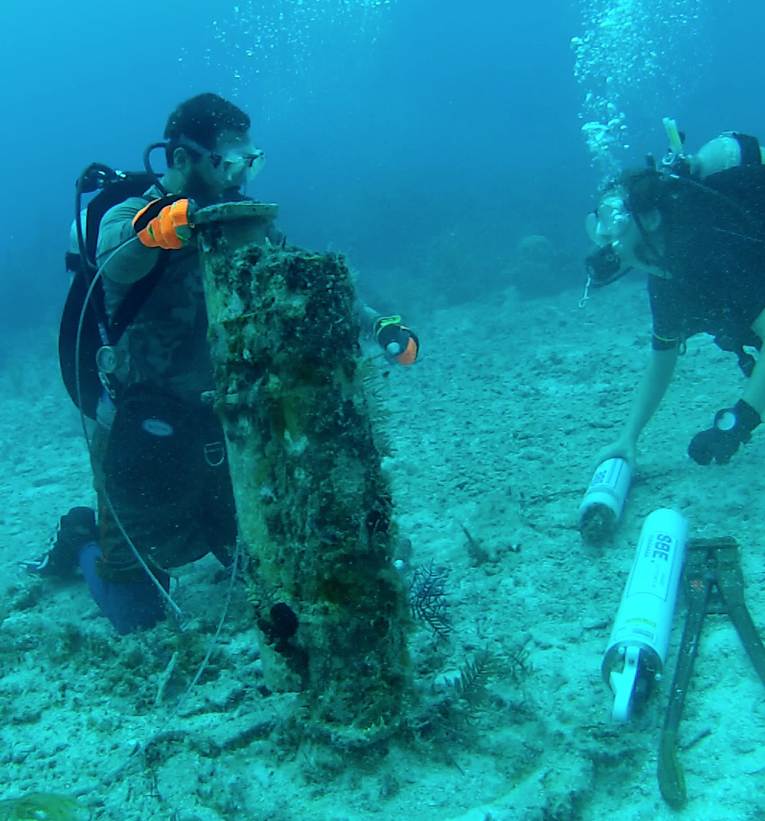
Key area of research:
Attributions of sea level changes along the US East Coast
Relevance: During 2010-2015 the sea level in the SE US coast increased by 10+ cm, 5 times the global average
Data we use: Cable measurements, dropsondes, XBTs, CTDs, Argo, tide and pressure gauges, satellite observations
Impact: Improved understanding of ocean state on sea level changes: Observed accelerated sea level increase was due to warming of the Florida Current, 0.2C per year
Current work: Active participant within SE Florida government groups to assess and plan for community impacts from sea level changes
Pressure gauge off Bahamas

Slide 23
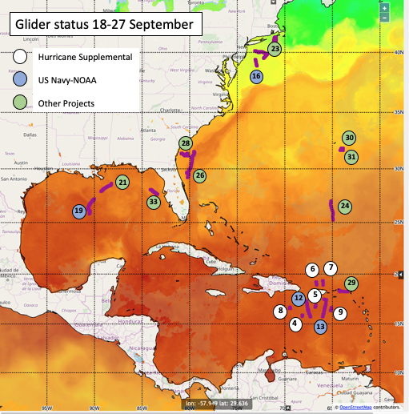
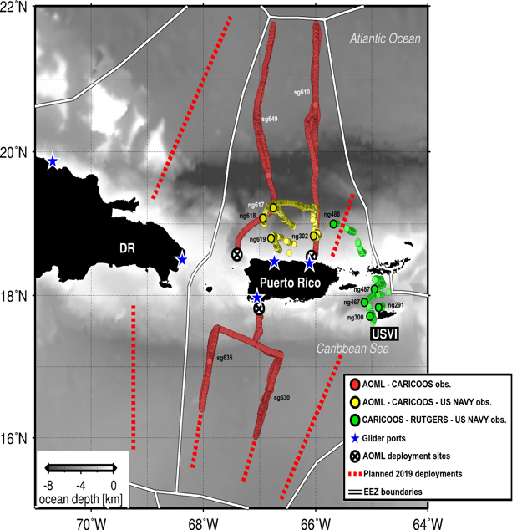
Key area of research:
2019 NOAA Atlantic hurricane glider picket fence
32
Hurricane gliders missions
8
NOAA/AOML gliders
12+
US and international partners
100,000+
T and S profiles

Slide 24
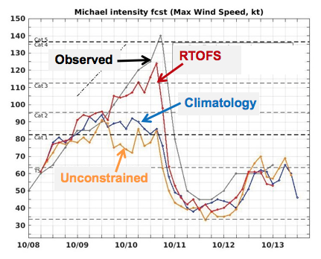
Key area of research:
Oceans and hurricane intensification
Relevance: Improved intensity forecasts save life and property.
What we are doing: Assess the impact of using accurate ocean representation in ocean-atmosphere forecast models using all available field (floats, gliders, XBTs, drifters, etc) and satellite data.
Our current work: Partner with NWS/EMC to improve ocean DA and NOAA ocean-atmosphere operational forecast model
Impact: Correct assessment of ocean observations within NOAA operational forecast models
Halliwell et al, 2019
RTOFS = real-time ocean forecast system

Slide 25
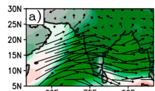
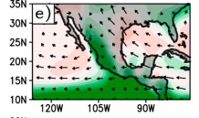
Key area of research:
Meridional Heat Transport and extreme weather
South Atlantic MHT
Relevance: Extreme rainfall in monsoon regions cause life and property loss
What we are doing: Understanding teleconnections to assess impact of MHT in the South Atlantic (SA) on monsoon-related rainfall events
We have learned: Low values of MHT in the SA increase 10-15% extreme rainfall in monsoon areas
Impact: Improved outlooks of monsoon related rainfall
XBTs+ Altimetry+SST models
SA MHT and monsoon rainfall relationships
Dong et al, 2015; Lopez et al, 2016, 2017

Slide 26
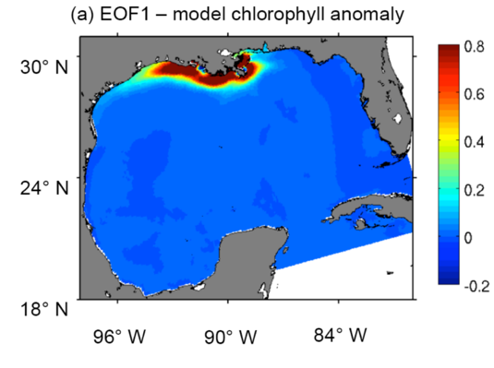
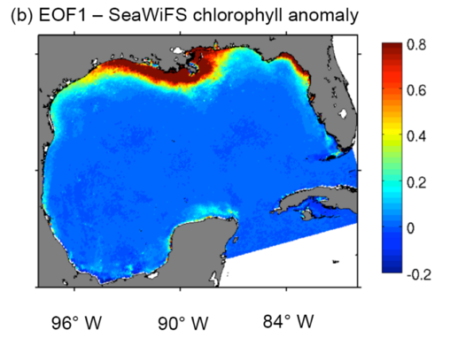
Key area of research:
Gulf of Mexico and its impact on plankton biomass
Relevance: Fisheries assessments in coastal areas in the Gulf of Mexico
What we are doing: Assessing plankton biomass variability using satellite observations and numerical models
What we have learned: ENSO is the main climate factor affecting plankton biomass
Impact: Correct assessments of BGC numerical models and forecast of fish habitats
Gomez, 2018

Slide 27
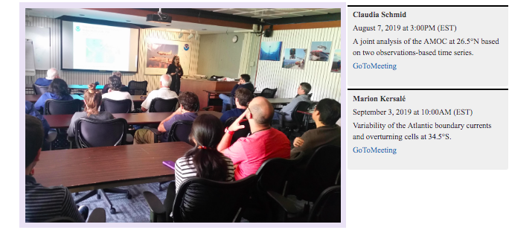
Divisional videos: seminars and projects
https://www.youtube.com/user/phodaoml

Slide 28
Transition:
Global Ocean Observing System
Data into Global Telecommunication System (GTS)
Every year PHOD leads and/or contributes to:
(~13,000,000) some aspects of RT QC surface drifter observations
(~700,000) SEAS marine meteorological observations from NWS Volunteer Observing Ships
(~90,000) Argo float profiles
(~100,000) ThermoSalinograph (TSGs) T and S surface observations
(~8,000) XBT (AOML and collaborators) profile observations
(~6,500) Hurricane glider T/S/O2 profile observations
Surface drifter

Slide 29
Transition:
Natural and anthropogenic influences on heat waves
Relevance: Heat waves cause the largest number of deaths in the US due to extreme weather events
Objective: Developing a prediction system of heat waves and droughts at national scale through identification of potential modulators (monsoons, MOC, etc).
Impact: Understanding that:
Anthropogenic forcing will dominate heat wave occurrence over the Western and Great Lakes regions early in the 21st Century
Internal variability will govern heat wave occurrence in the Great Plains, into the second half of the 21st Century
Lopez et al, 2018
More information in climate.gov

Slide 30
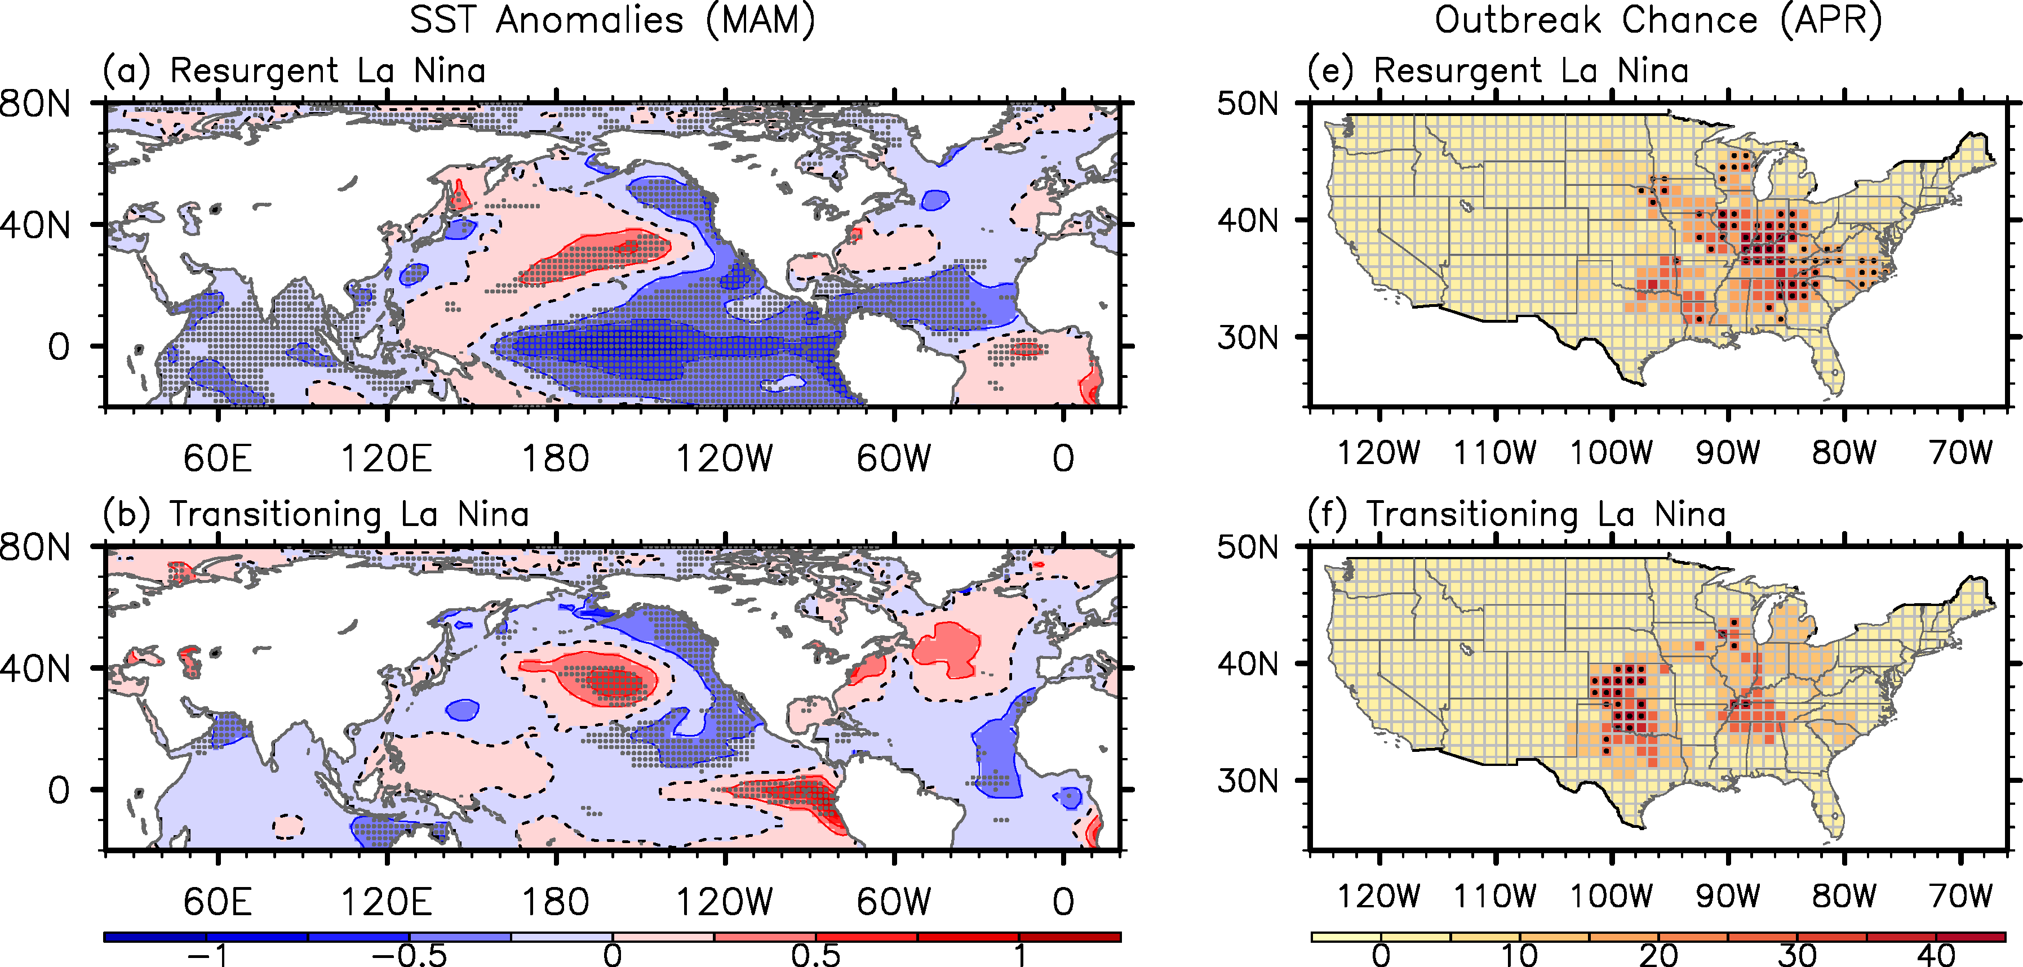
Transition:
AOML seasonal outlook for US tornado activity
Relevance: location change of large number of tornado outbreaks
What we have learned (Impact): Spring El Niño-Southern Oscillation generates large-scale atmospheric conditions conducive to US tornado outbreaks
Impact: Development and submission to NOAA/NWS/CPC every February a seasonal US tornado outlook that uses forecasts from NCEP CFSv2,
Plan: Investigate subseasonal variability using MJO
SST Anomalies (Mar-May)
Probability of Outbreak (APR)
La Niña that builds into another La Nina
La Niña that transitions to El Nino
Sang-Ki Lee, Hosmay Lopez, Dongmin Kim, and Andrew Wittenberg (GFDL)

Slide 31
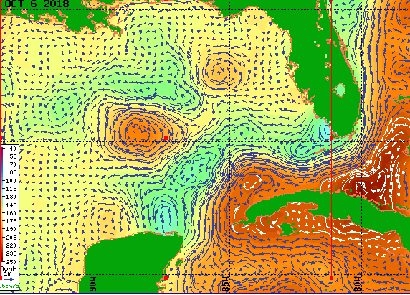
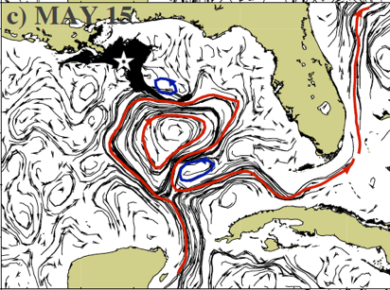
Transition:
NESDIS OceanWatch/CoastWatch data and products
Surface currents to monitor oil spills
Relevance: Oil spills create damage to environment, coastal populations, economy
What we are doing: estimation of NRT satellite-derived surface ocean currents to track of oil spill particles in the open ocean
What we have learned: ocean currents, together with surface winds (including hurricanes), determine oil spill extensions
Impact: NOS Office of Response and Restoration. Provide AOML NRT currents for GNOME application
Smith et al, 2015; Goni et al, 2015

Slide 32
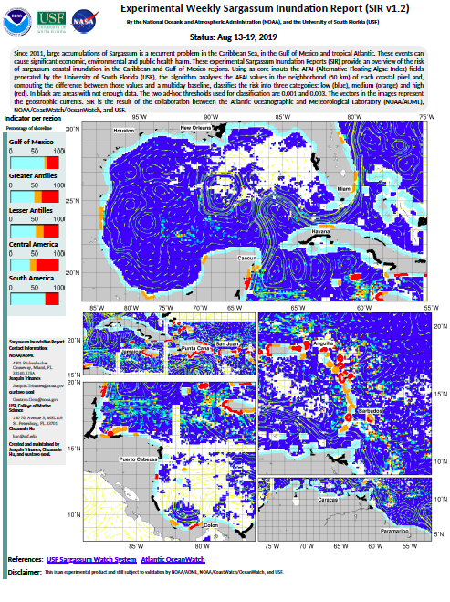
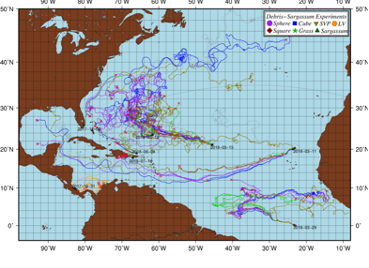
Transition:
NESDIS OceanWatch/CoastWatch data and products
Sargassum Inundation Reports
Relevance: coastal communities and ecosystems suffer damage due to extreme Sargassum abundance
Goal: Provide warning to coastal communities
What we are doing: create satellite-derived weekly fields of Sargassum coastal Inundation Risk
What we are learning: Impact of wind on trajectories and translation speed
Impact: Provide early warning system for sargassum
www.aoml.noaa.gov/phod/sargassum_inundation_report/

Slide 33
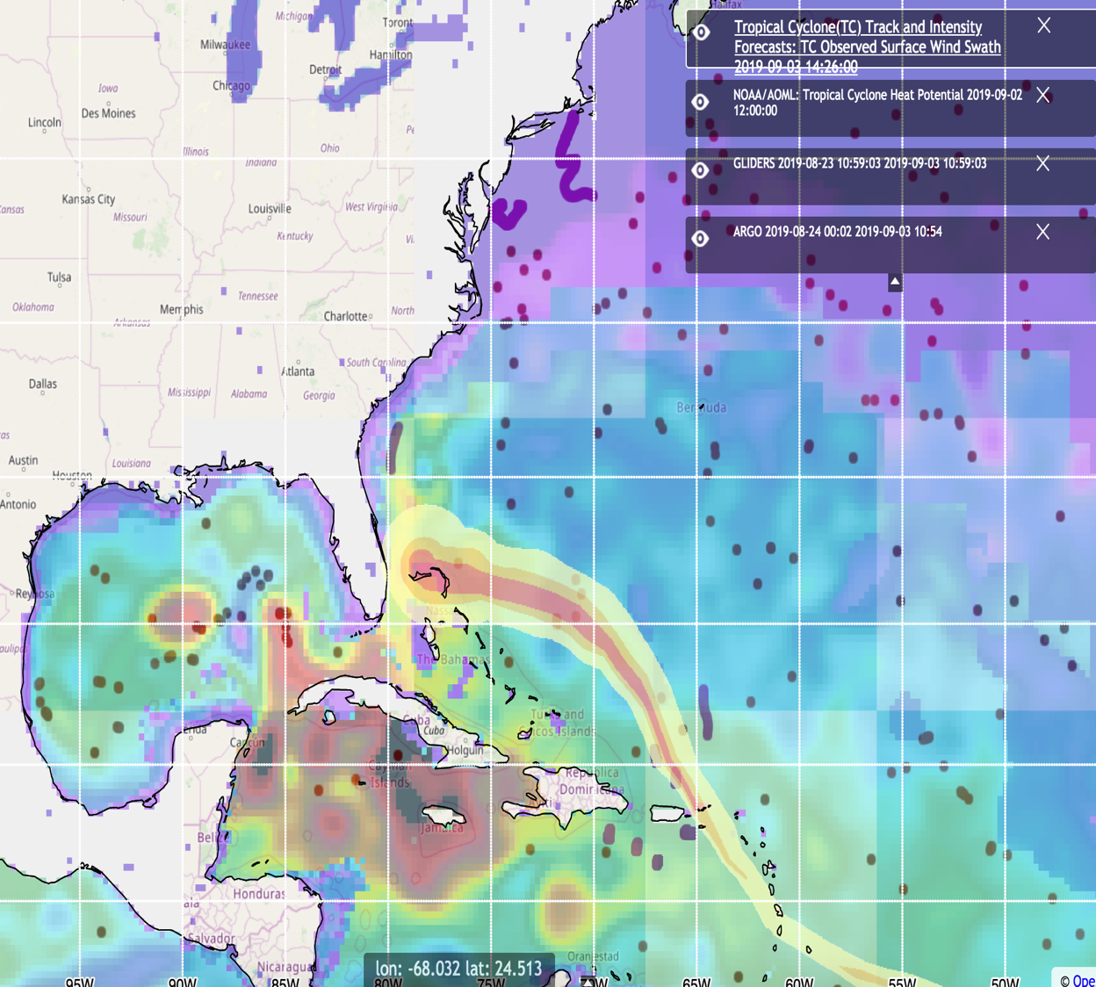
Transition:
NESDIS CoastWatch and OceanWatch Satellite Observations and Products
OceanViewer:
https://cwcgom.aoml.noaa.gov/cgom/OceanViewer
Objective: Display of RT and NRT ocean observations and products
Impact: Help guide hurricane field operations
Plan: jointly with HRD and EMC create historical ocean data base

Slide 34
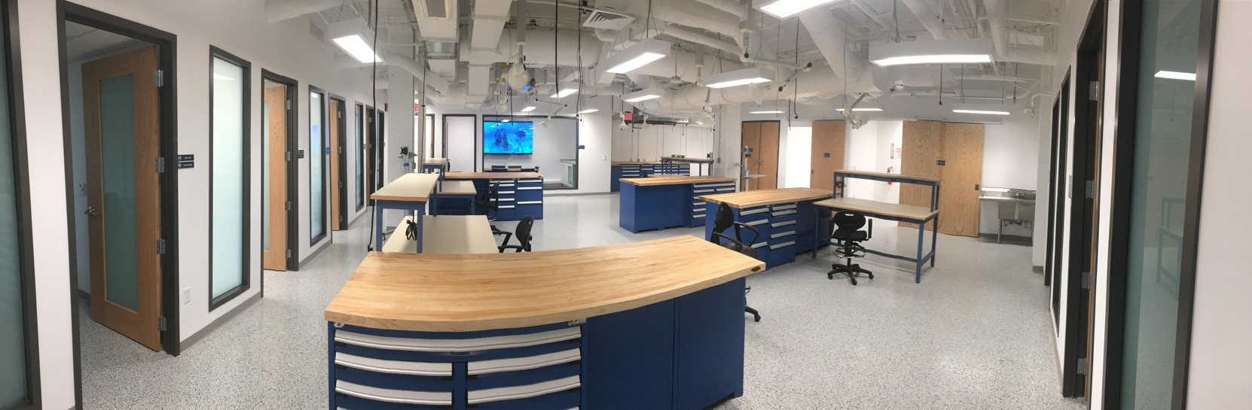
Divisional new technology and technology development
3,500
Sq. ft. of new engineering work space
and meeting room
9
Offices
6
Electronic
workstations
New engineering space

Slide 35
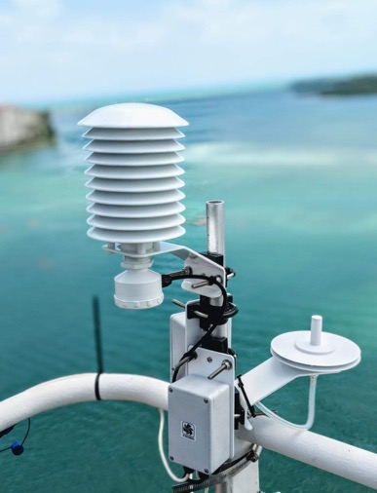
Divisional new technology and technology development
3,500
Sq. ft. of new engineering work space
and meeting room
9
Offices
6
Electronic
workstations

Slide 36
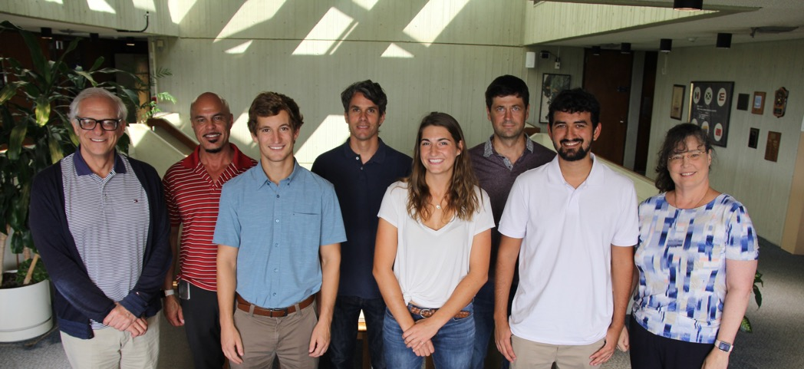
Division-sponsored RSMAS graduate students
Leah Chomiak, variability of Meridional Overturning Circulation
Lev Looney, ocean stratification and hurricane intensification
Ivenis Pita, boundary currents and sea level rise
Lev
Leah
Ivenis
3 2019 PHOD-sponsored RSMAS students

Slide 37
Focus on our future
Lead or have a key presence in the ocean observing system:
Interdisciplinary and multiplatform observations
BGC observations (Argo, gliders, moorings, …) and modelling
New and enhanced data sets and products
Autonomous technologies
Closer partnerships with other NOAA LOs (NWS, NESDIS, NOS, NMFS, ..)
Carry out observations that guide NOAA’s forecasts, outlooks, and projections
Increase leverage of work with non-NOAA, particularly international, partners

Slide 38
Focus on our future
Support new generation of early career scientists, engineers, and support personnel
Carry out cutting edge NOAA-oriented research and transitions to operations and applications for societal benefits
  Oceans and extreme weather events, sea level changes, ecosystems, and fisheries
  Seasonal to subseasonal forecasts
  Data assimilation and data impact assessments on operational ocean and coastal forecast and projection models
Conduct work on Artificial Intelligence and Machine Learning
Conduct interaction with social scientists

Slide 39
PHOD lightning talks and posters
Contributions to the Global Ocean Observing System
Rick Lumpkin
Meridional Overturning Circulation in the Atlantic Ocean
Denis Volkov
Ocean Transport Monitoring
Shenfu Dong
The Meridional Overturning Circulation and extreme weather events
Hosmay Lopez
The Tropical Atlantic Observing System
Renellys Perez
The Oceans and Ecosystems
Sang-Ki Lee
Ocean Studies and Monitoring for Hurricane Forecasts
George Halliwell
Assessment of Attributions of Sea Level Changes in the US
Ricardo Domingues
Ocean Variability and Fish Stock Assessments
Sang-Ki Lee
Observations of the South Atlantic Meridional Overturning Circulation
Christopher Meinen
Ocean Data Management for Climate Data Records
Claudia Schmid, Mayra Pazos, and Francis Bringas
Instrumentation Development in Support of NOAA's Mission
Ulises Rivero and Pedro Pena
Notes:
All pdfs in web pages

Slide 40
NOAA AOML
Physical Oceanography Division
Laboratory Review, November 2019
Gustavo Jorge Goni
Thank you
Questions ?

