Slide 1
Coral reefs in an era of global change
New technologies to monitor and protect US marine resources
Ian Enochs
ian.enochs@noaa.gov

Slide 2
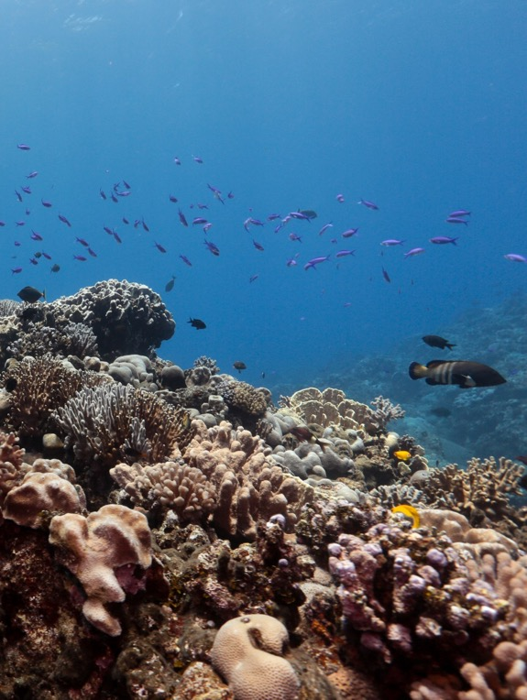
Ecosystem services related to
reef habitat
1
Fisheries
2
Tourism
3
Storm protection
4
Biodiversity
Photo by S. Gordon, Open Boat Films
Introduction

Slide 3
Ocean acidification
Atmospheric CO₂
Seawater CO₂
Seawater pH
Adapted from C. Sabine and Doney et al, 2010
Introduction

Slide 4
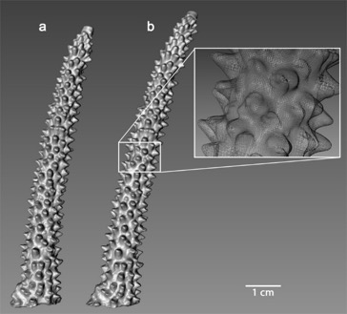
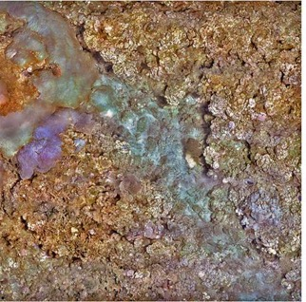
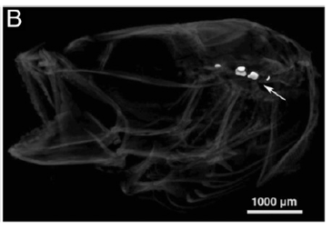
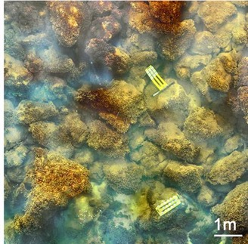
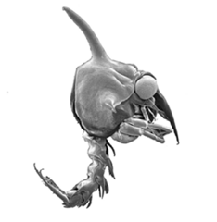
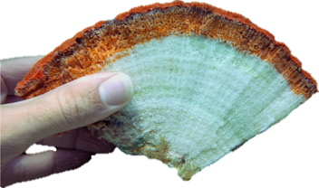
Ocean acidification impacts:
Habitat engineers
Fished species
Ecosystem structure
Enochs et al. 2014, Coral Reefs
Enochs et al. 2014, Bull Mar Sci
Bignami et al. 2013, PNAS
Gravinese et al. 2018, ECSS
Enochs et al. 2014, Nat Clim Change
Introduction

Slide 5
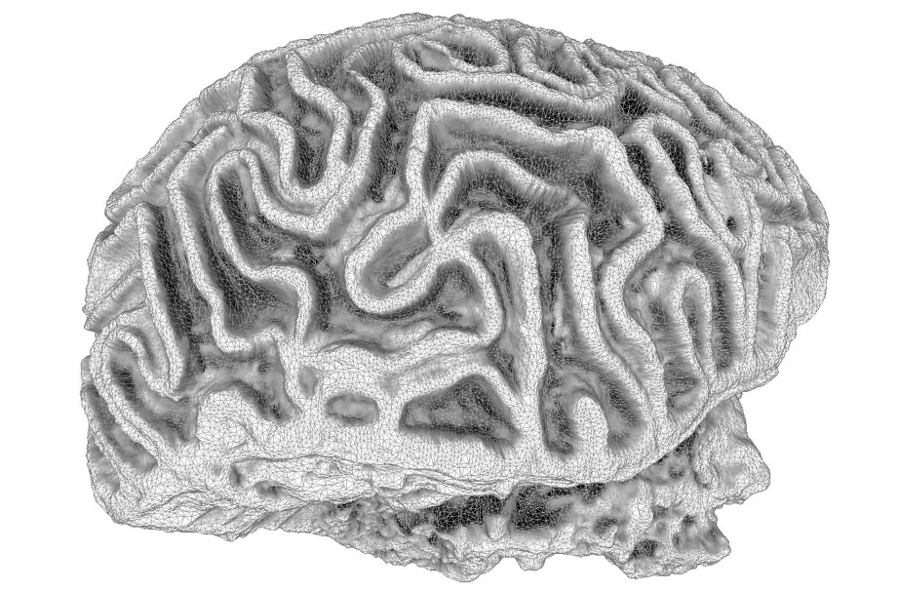
1
Characterize organismal responses
2
Monitor reef conditions
3
Experimentally test resilience
4
Tools for restoration
Introduction

Slide 6
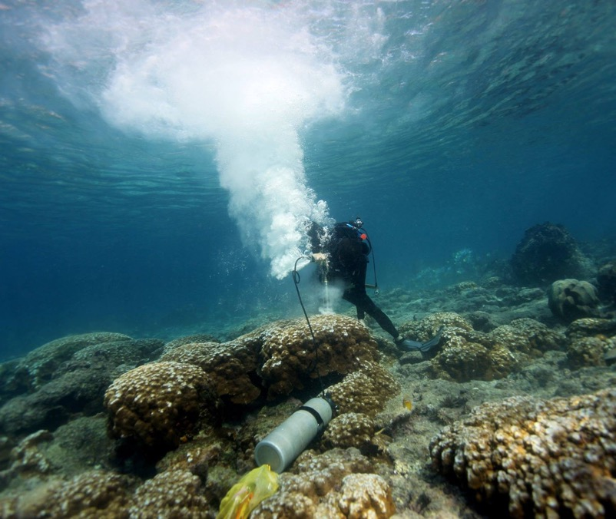
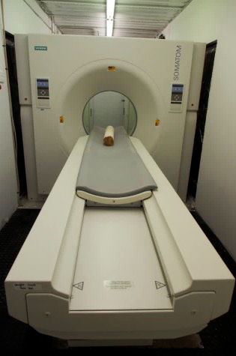
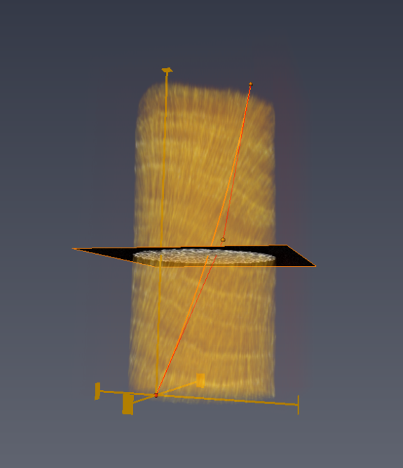
CT scanning reveals changes in coral growth
1
Characterize organismal responses
PARTNERS: NOAA PIFSC UM, FIU, USGS, UVI, CNMI BECQ, Bigelow, Scripps, LOF

Slide 7
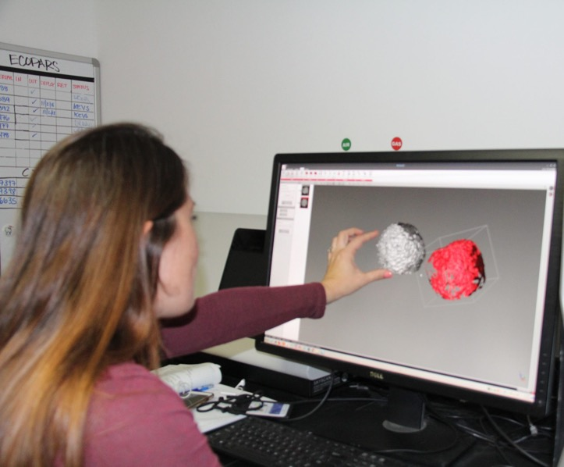
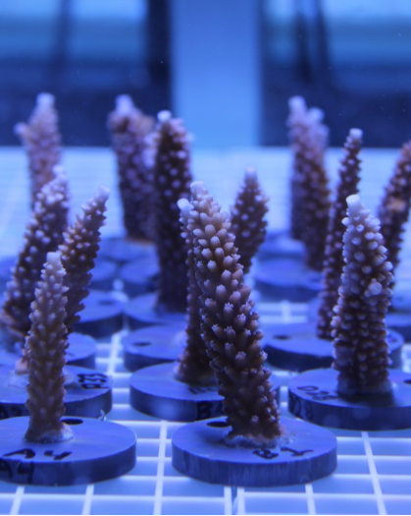
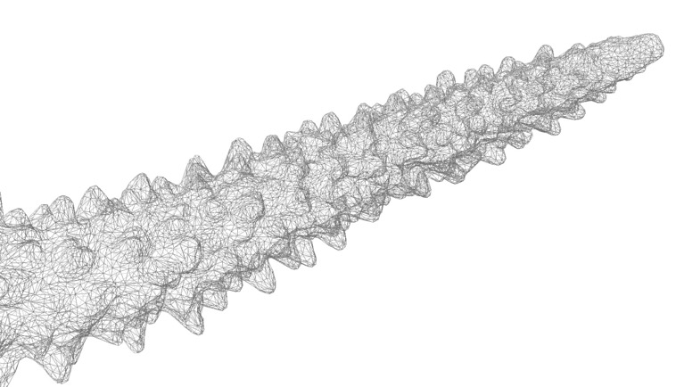
3D scanning morphometry of living corals
1
Characterize organismal responses
PARTNERS: UM, Mote

Slide 8
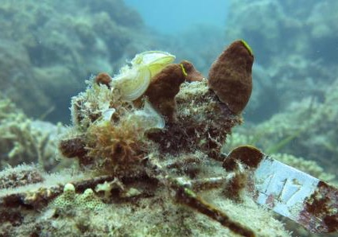
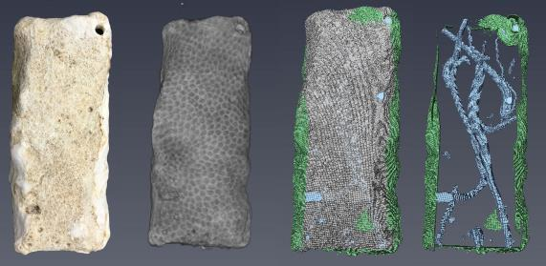
Micro CT to quantify reef habitat loss
1
Characterize organismal responses
PARTNERS: NOAA PIFSC, UM, AIMS

Slide 9
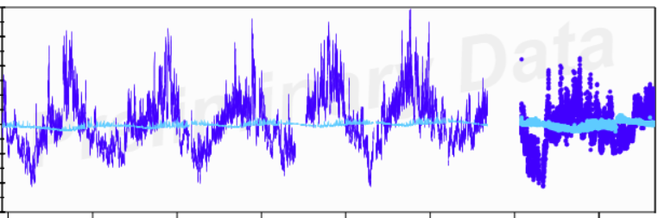
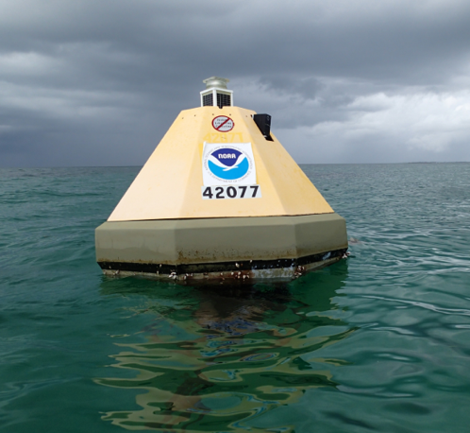
High variability: difficult to characterize
800
Water
600
CO₂ concentration
400
200
Air
2012
2014
2016
2018
Year
2
Monitor reef conditions

Slide 10
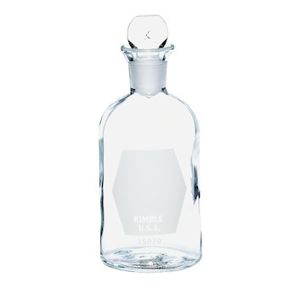
The need:
1
Ship time is expensive
2
Instruments are expensive and often inaccurate
3
Single parameter characterization is incomplete
4
Sampling is time consuming and can be dangerous
2
Monitor reef conditions

Slide 11
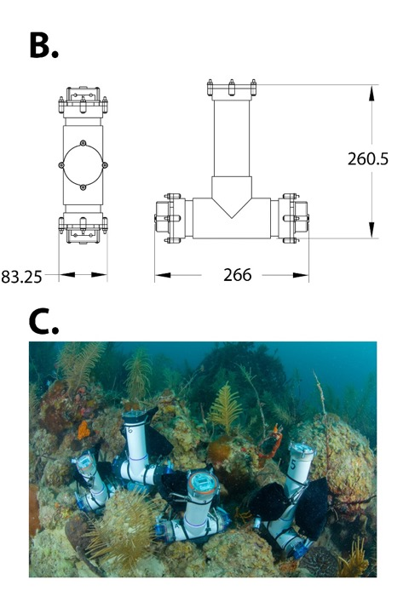
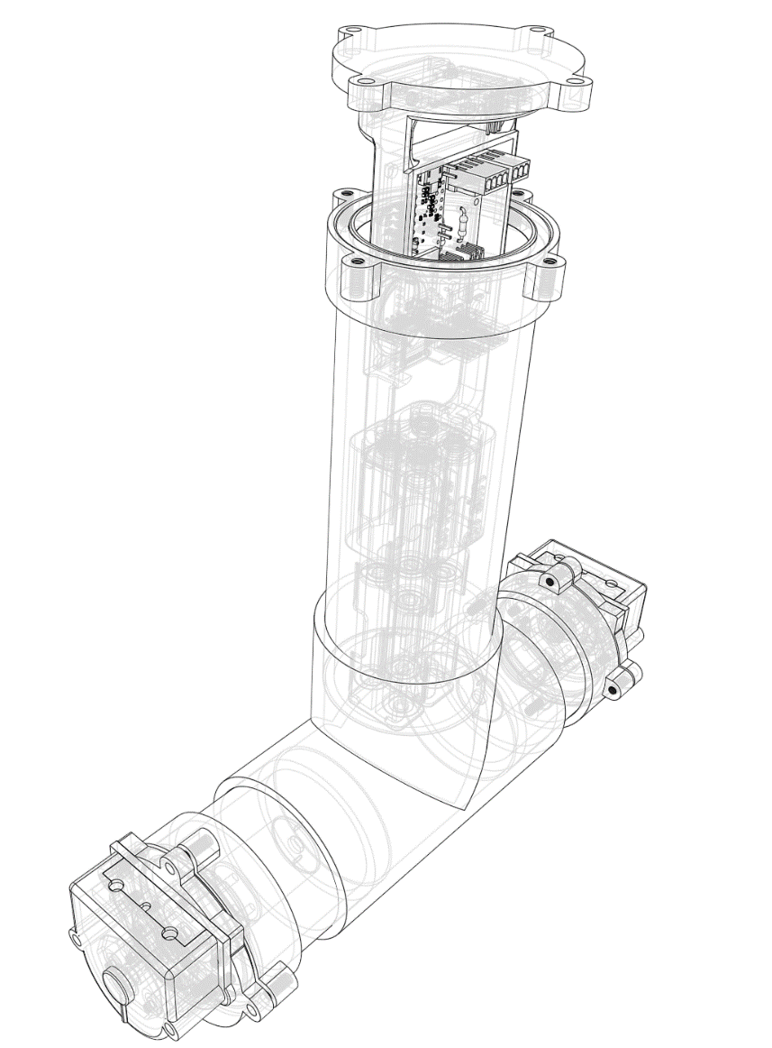
S
ubsurface
A
utomated
S
ampler
2
Monitor reef conditions
PARTNERS: NOAA PIFSC, UM, Mote, NSU, UP, Cal Academy, TAMU, more

Slide 12

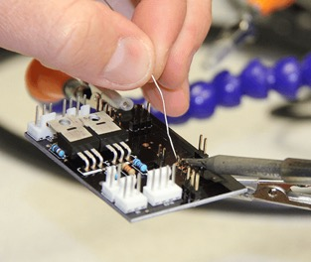
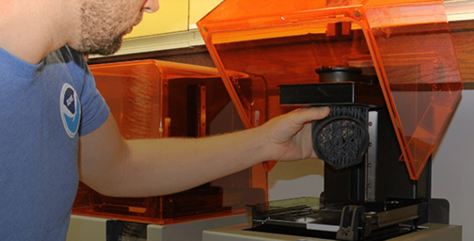
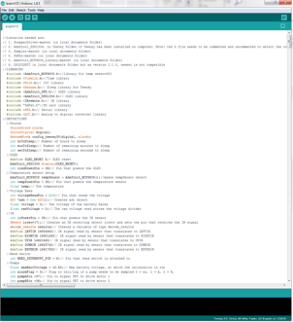
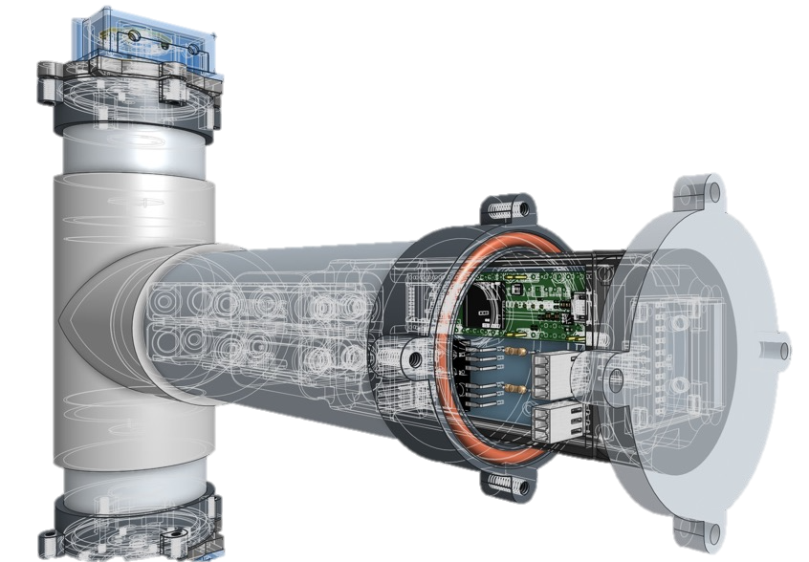
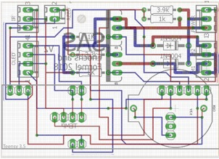
Website instructions
Accessible 3D printing
Hardware
Software
Circuit design
2
Monitor reef conditions

Slide 13

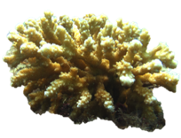
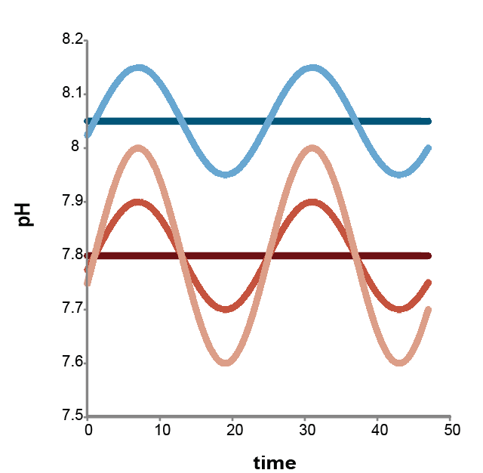


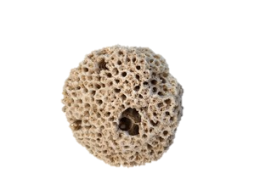
Variability may influence persistence
3
Experimentally test resilience

Slide 14
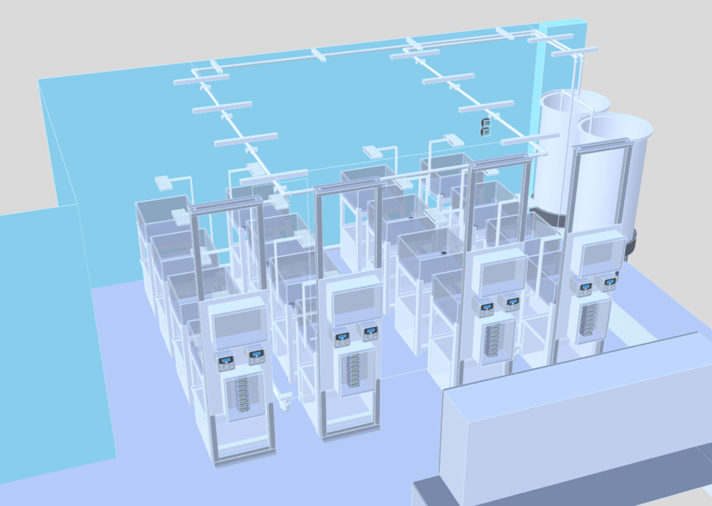
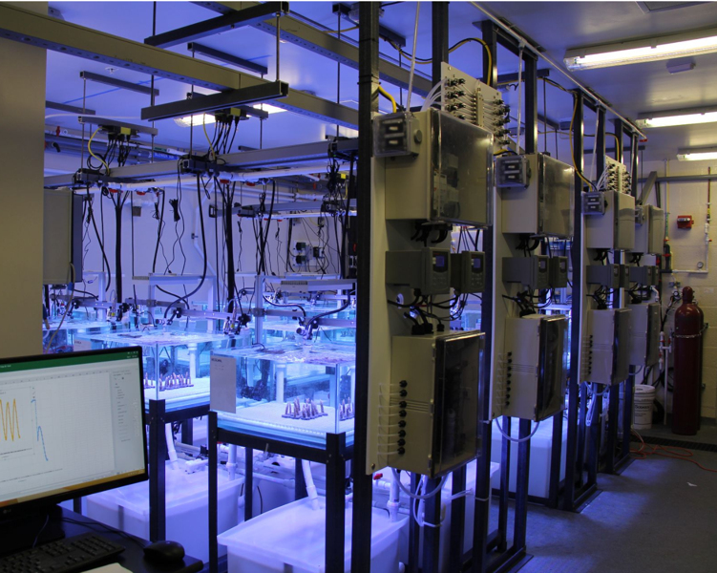
A lab designed and built in 3D
3
Experimentally test resilience
PARTNERS: NOAA PIFSC, UM, Harbor Branch

Slide 15
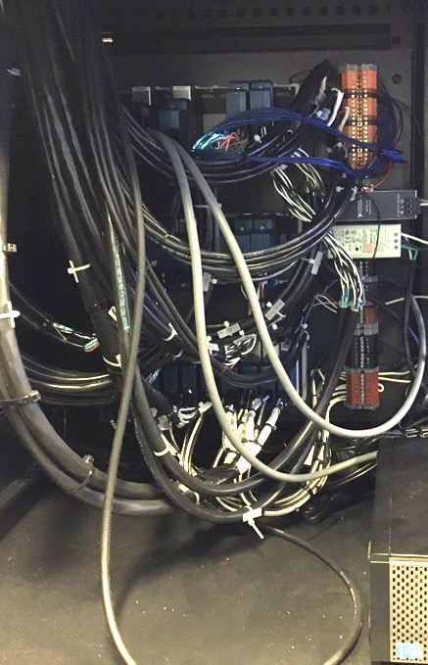
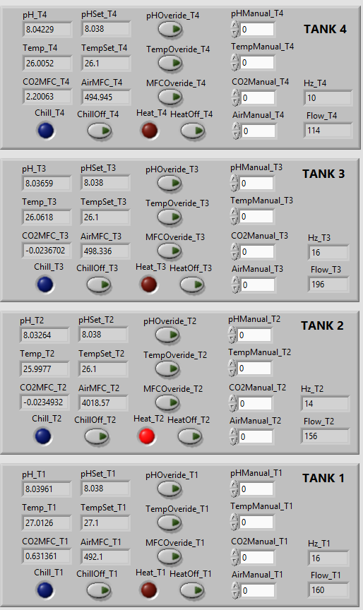
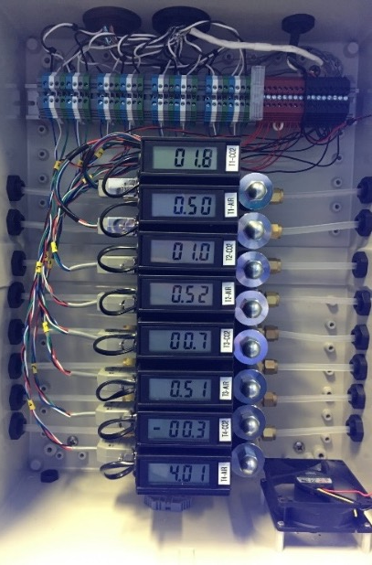
Robotic systems - computer controlled
3
Experimentally test resilience

Slide 16
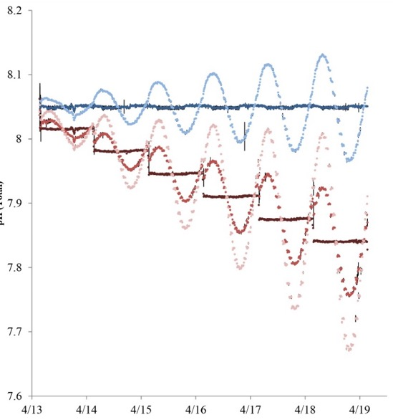
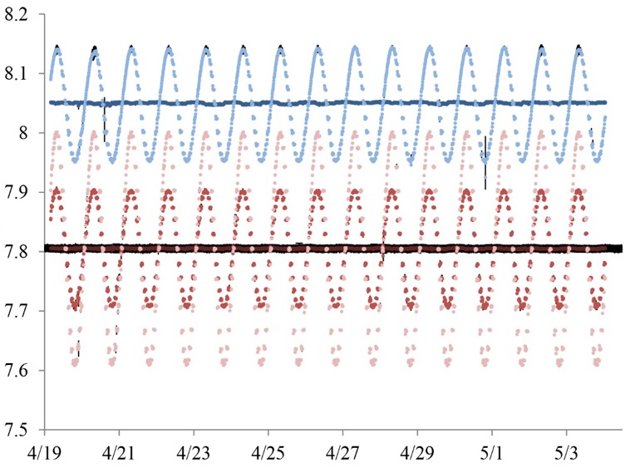
Dynamic treatments - unprecedented accuracy
pH (Total)
pH (Total)
ramping
treatment
3
Experimentally test resilience
Enochs et al. 2018

Slide 17
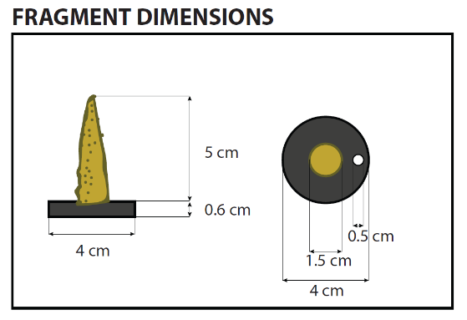
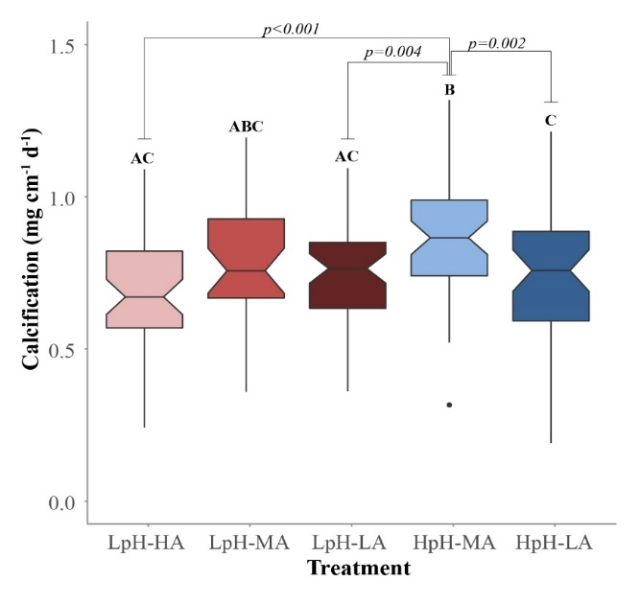
Variable systems can be refugia
3
Experimentally test resilience

Slide 18
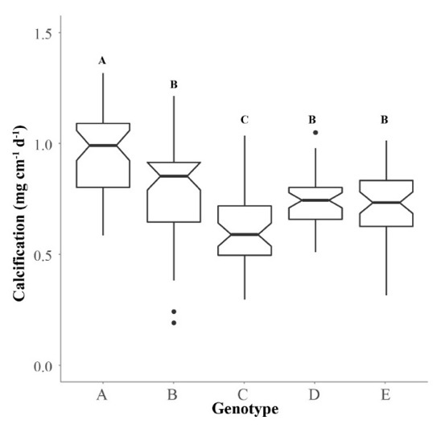
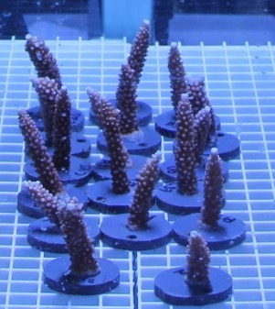
Resilient genotypes
genetic variability
informed restoration
4
Tools for restoration

Slide 19
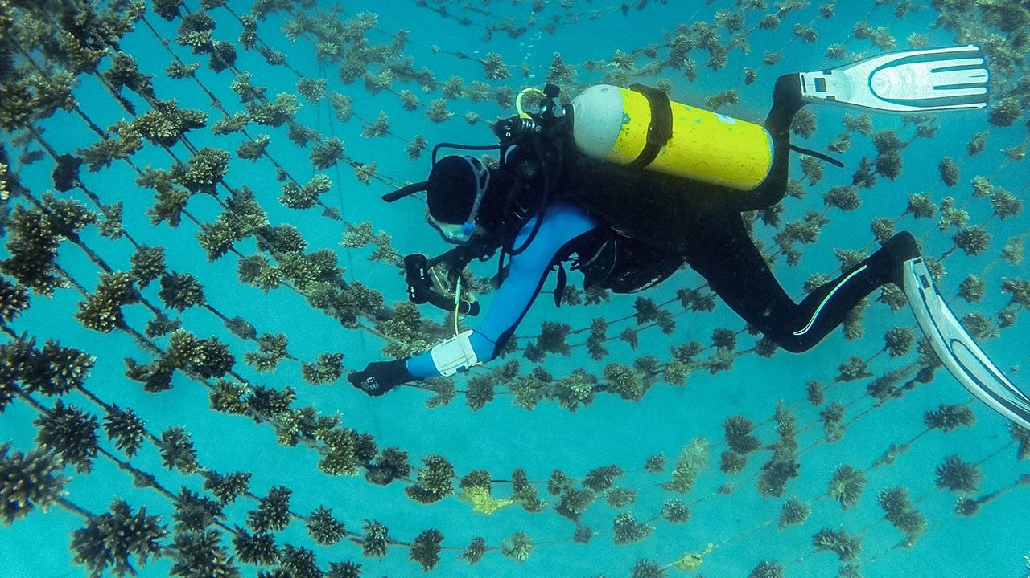
How to scale?
Photo Credit: Mia Tranthem
4
Tools for restoration

Slide 20
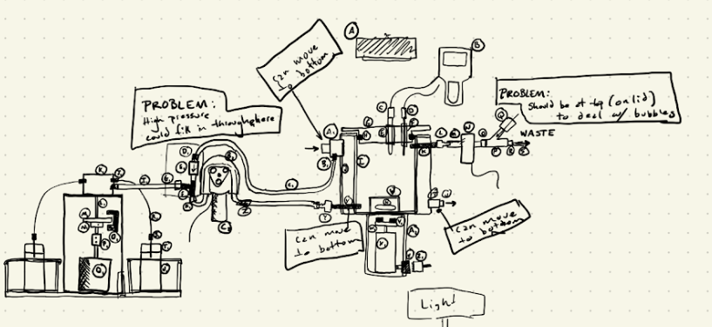
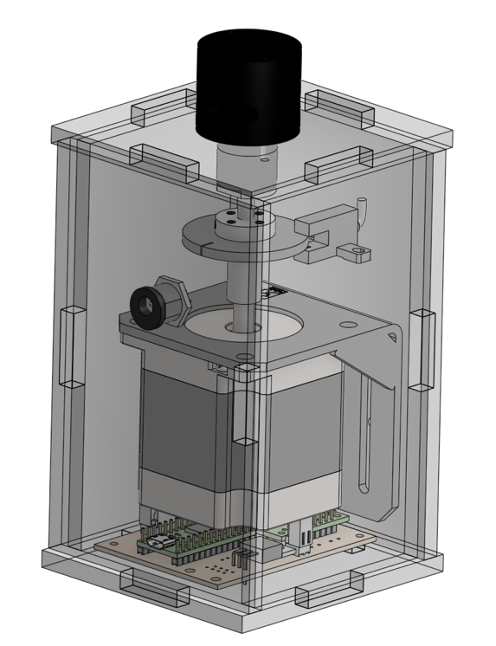
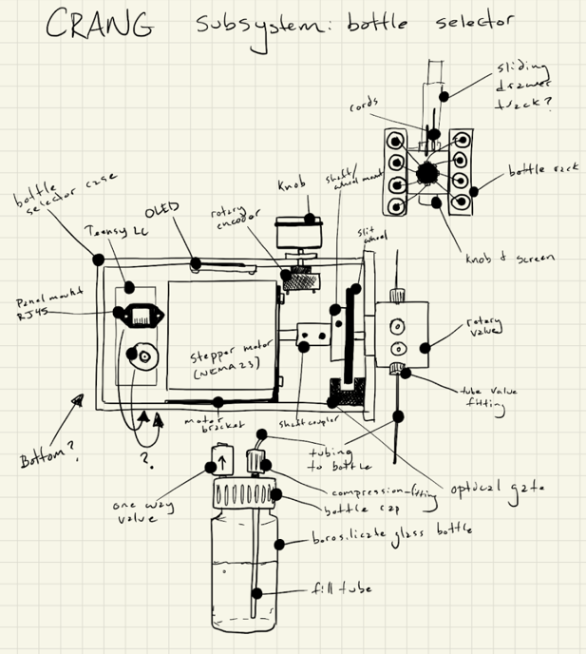
Rapid resilience evaluator
4
Tools for restoration

Slide 21
















THANK YOU
+‘Omics initiative

