Slide 1

Development of new technologies for real-time monitoring of tropical cyclone intensity, structure, and environment
Jason Dunion

Slide 2

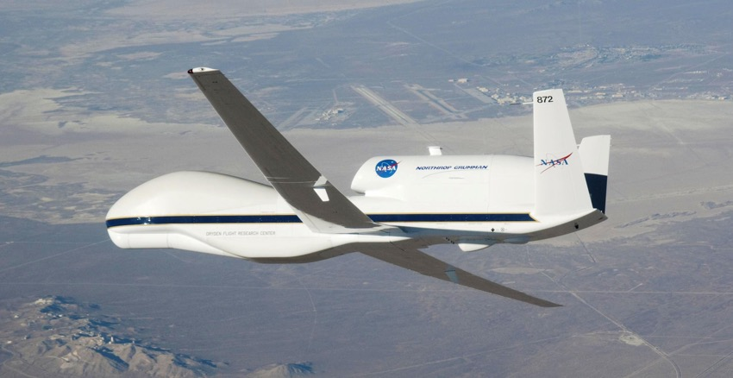
Sensing Hazards with Operational
Unmanned Technology
Demonstrate an Unmanned Aircraft Systems (UAS) concept of ops
Data impact studies
Observing System Experiments (UAS data)
Observing System Simulation Experiments
(simulated UAS data)
Global Hawk
SHOUT MISSON SCIENCE TEAM (2015-2016):
NOAA HRD, NOAA AOC, NOAA PSD, NOAA EMC, MRL-Monterey, Naval Post Graduate School, UW-CIMSS, NASA Goddard, University of Miami, University at Albany-SUNY, Pennsylvania State University, University of Utah

Slide 3
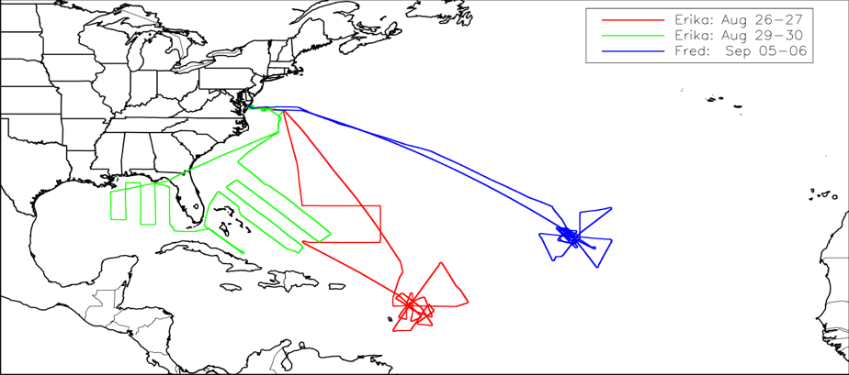
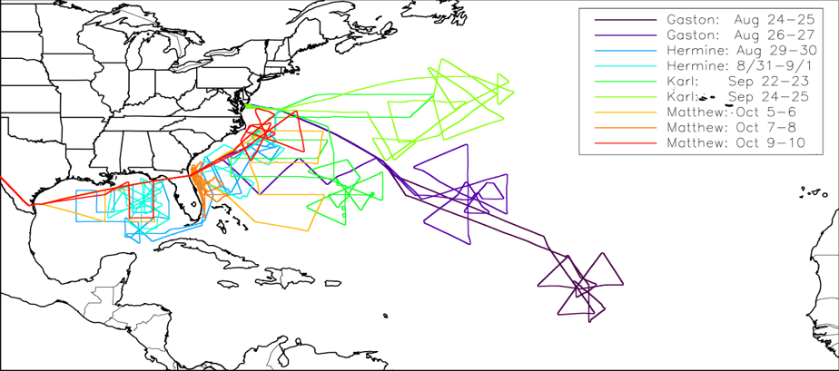
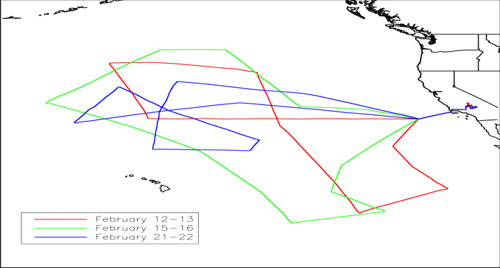
NOAA SHOUT Field Campaigns (2015-2016)
Hurricanes 2015
Hurricane Rapid Response (HRR) 2016
3 missions- 2 tropical cyclones (TCs)
9 missions- 4 TCs
El Niño Rapid Response 2016
3 missions- targeting 2 high-impact weather events
Notes:
Mention that SHOUT’s operational conops followed (2012-2014) NASA HS3

Slide 4
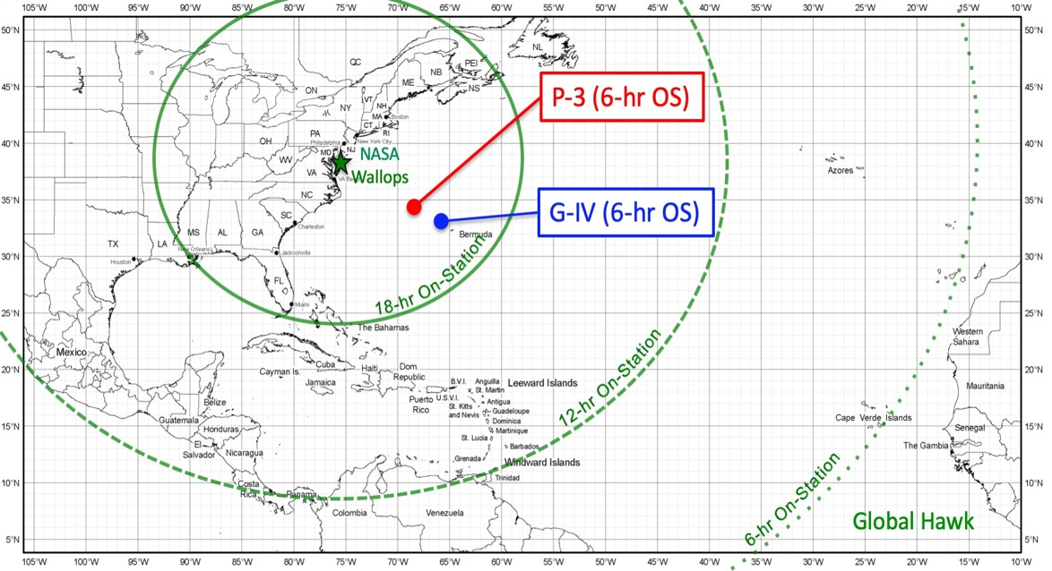
NOAA SHOUT: Global Hawk Aircraft
Duration: ~24 hr
Flight Level: ~55-65,000 ft
Range: 8-10,000 nm
Payload: 1,500+ lbs

Slide 5
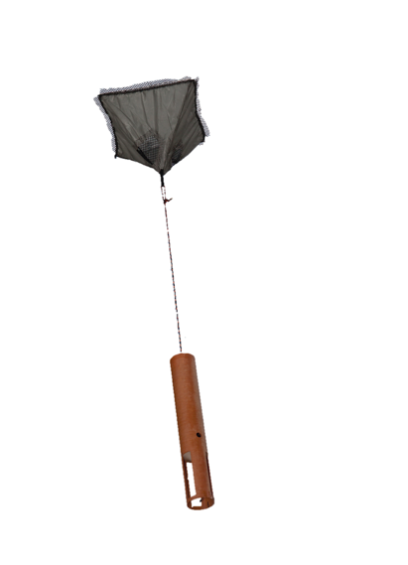
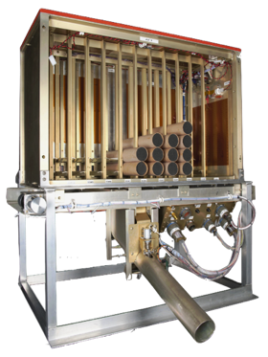
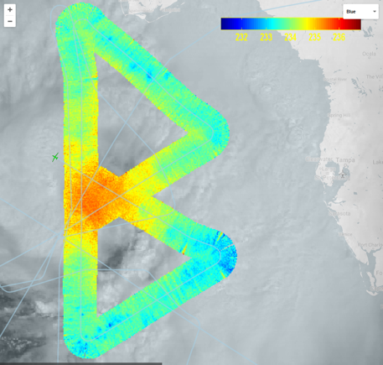
Global Hawk SHOUT Instrumentation
GPS Dropsondes
HAMSR Microwave Sounder
HIWRAP Doppler Radar
55 GHz Channel (~250 hPa)
Radar Reflectivity (dBZ) & 1 km wind
warm core
2016
Matthew
2016 Hermine
Measurements:
In situ P, T, H, & wind
90 dropsondes per flight
Measurements:
25 channels (50-60, 118, & 183 GHz)
3-D T, water vapor, & CLW
Measurements:
Dual frequency (Ka & Ku band)
3-D winds & precipitation
Notes:
Airborne Vertical Atmospheric Profiling System (AVAPS)
High Altitude Monolithic Microwave Integrated Circuit (MMIC) Sounding Radiometer (HAMSR): 2km vertical res; 40 km wide swath;
High-Altitude Imaging Wind and Rain Airborne Profiler (HIWRAP) : dual beam, conical scanning; 60 m vertical res; 1 km horizontal res

Slide 6
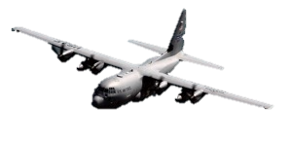
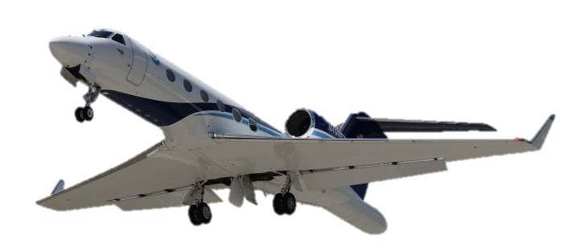
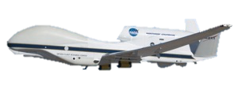
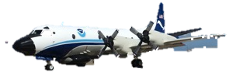
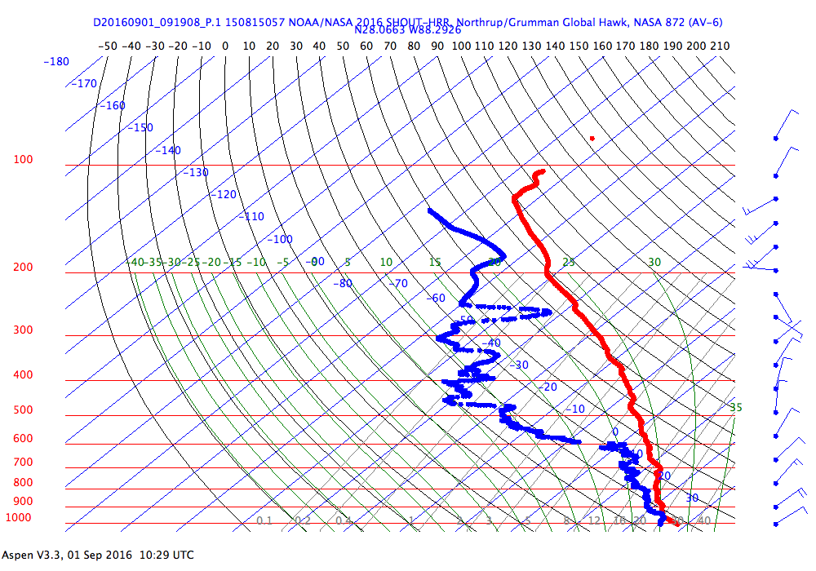
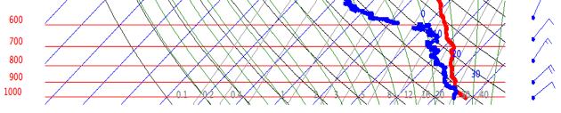
Sampling the Tropical Cyclone Environment
P-3 Orion
AF C-130
G-IV
Global Hawk
Tropopause
Outflow
Layer
20 km
15 km
10 km
10 km
Temperature
Temperature
Mid Latitude
Dry Air
5 km
5 km
Dewpoint
Dewpoint
Dewpoint
Temperature
1 km
1 km

Slide 7
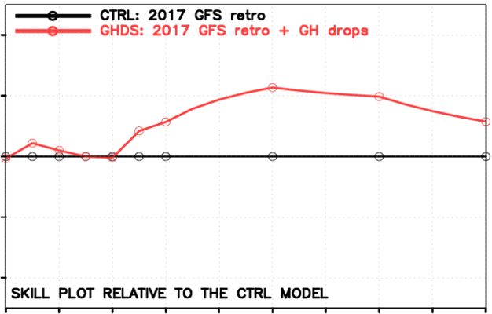
Impact of Global Hawk Dropsondes on GFS Track Forecasts
GH Dropsonde Impact: GFS Track
24
12
15%
0
Track Forecast Skill (%)
-12
Global Hawk
No Global Hawk
-24
12
24
48
72
96
120
Forecast Hour
Notes:
Shown here is the impact of the GH dropsonde data only on the GFS track forecast when added to the full current observing system (i.e., includes all routine observations from satellites, RAOBS, and other aircraft)
NOAA EMC views these as notable improvements
Results courtesy Jason Sippel and Vijay Tallapragada, NOAA/NCEP/EMC
FV3 GFS results are ongoing and will be available soon

Slide 8
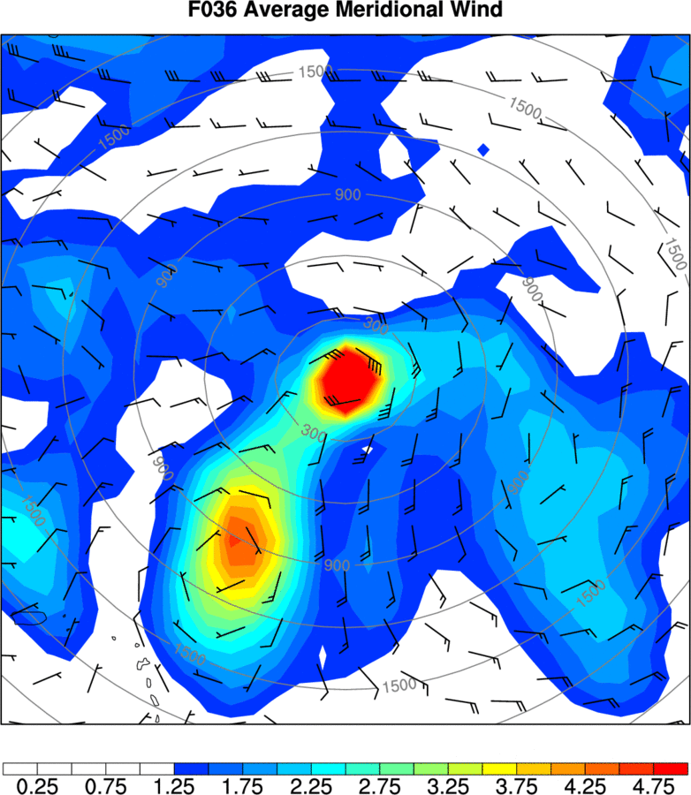
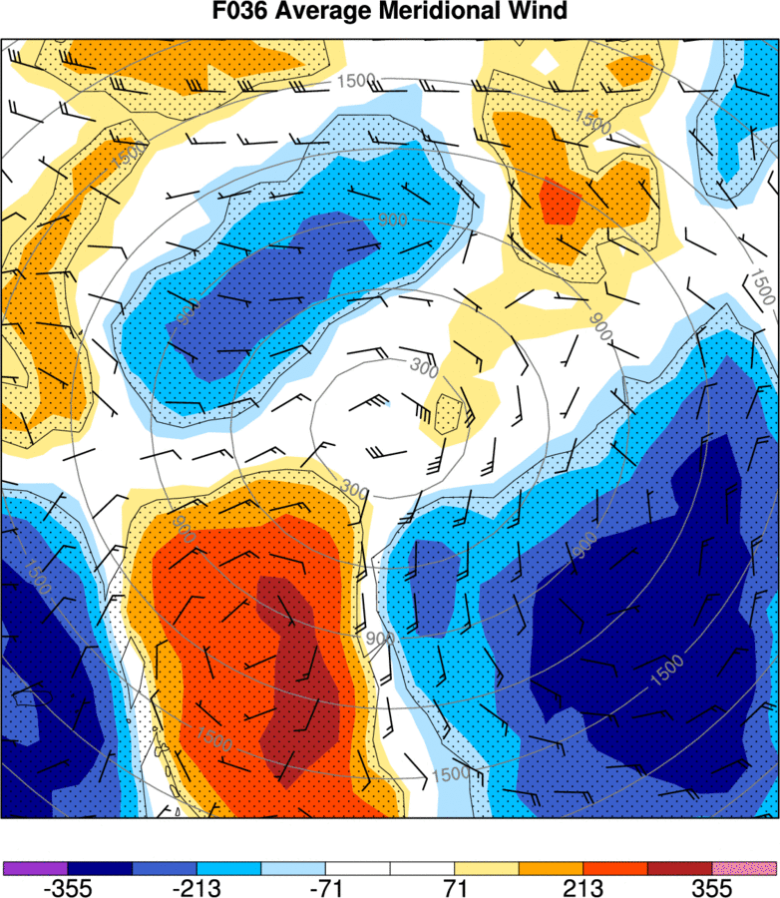
Targeting Dropsondes to Improve Model Forecasts*
Where is there uncertainty in the model forecast?
Where is the model more vs less sensitive to observations?
Where do you sample and will the model be sensitive to your added data?
* Research (NOAA SHOUT) to operations (NOAA Joint Hurricane Testbed)

Slide 9
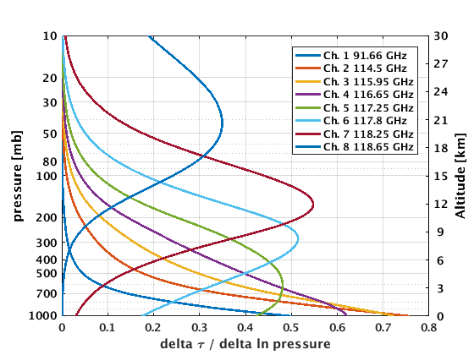
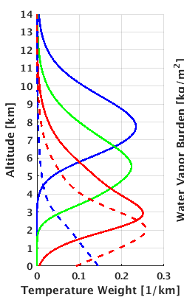
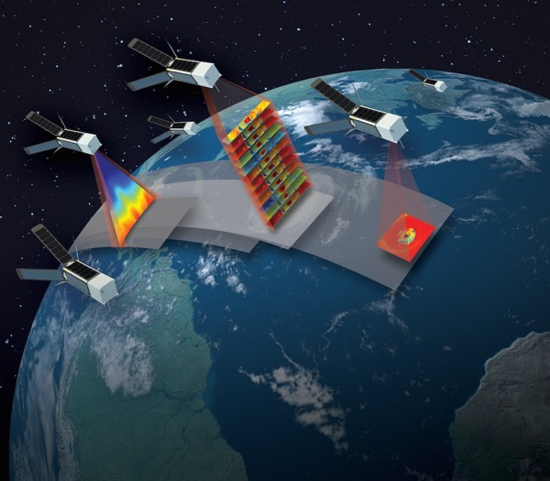

TROPICS Satellite Mission
Time-Resolved Observations of Precipitation structure and storm Intensity with a Constellation of Smallsats
Rapid-refresh microwave obs
(temperature, moisture, & precipitation)
5 WV Channels
(91-205 GHz)
8 Temperature Channels
(91-118 GHz)
TROPICS Applications Workshop: February 19-20, 2020 University of Miami
Notes:
1) the baseline mission will have six satellites
2) we have built a seventh satellite that is fit for flight – we could launch it early (my preference, but need concurrence from NASA) or use it as a spare, TBD
3) all hardware will be complete in December, and NASA hopes to launch us in 2022 but hasn’t issued a contract to a launch provider yet

Slide 10
THANK YOU

