Slide 1
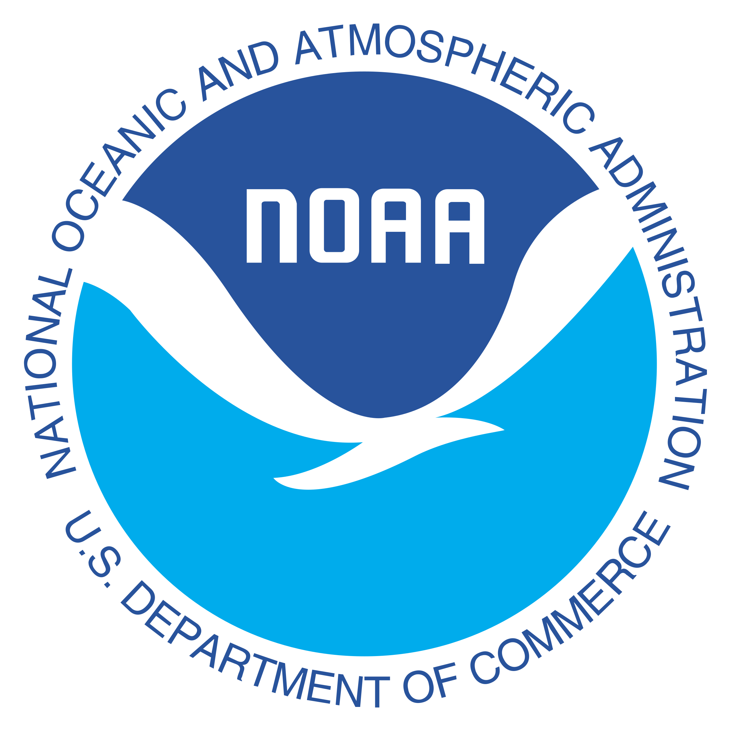
Ocean Transport Monitoring
Understanding the current state and changes in the ocean and climate
Shenfu Dong, PHOD

Slide 2
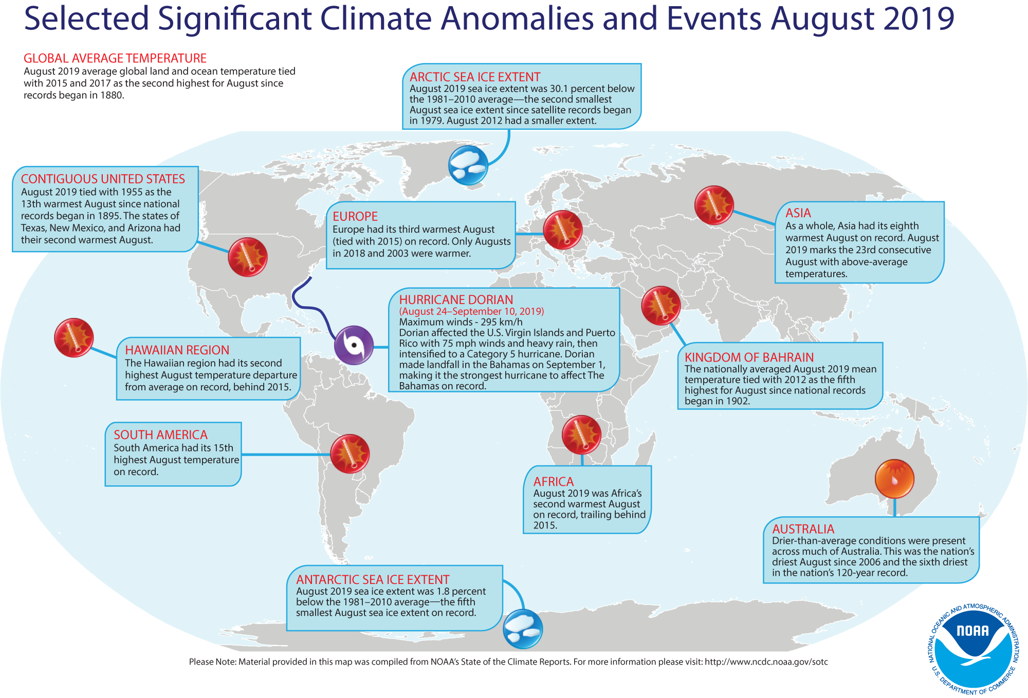
Selected Significant Climate Anomalies and Events August 2019

Slide 3
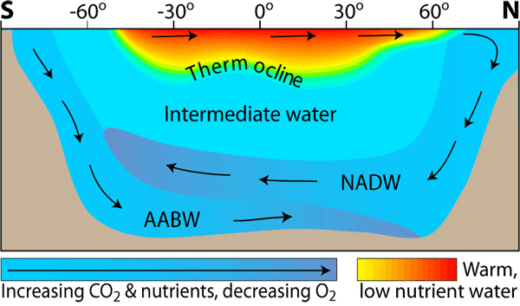
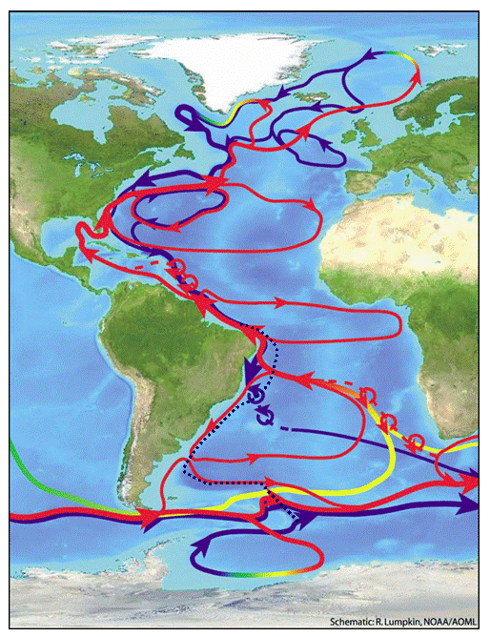
Importance of Boundary Currents
AOML leads key NOAA efforts to monitor ocean transports in the Atlantic Ocean.

Slide 4
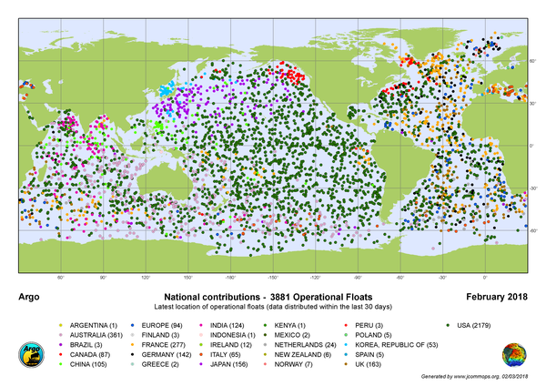
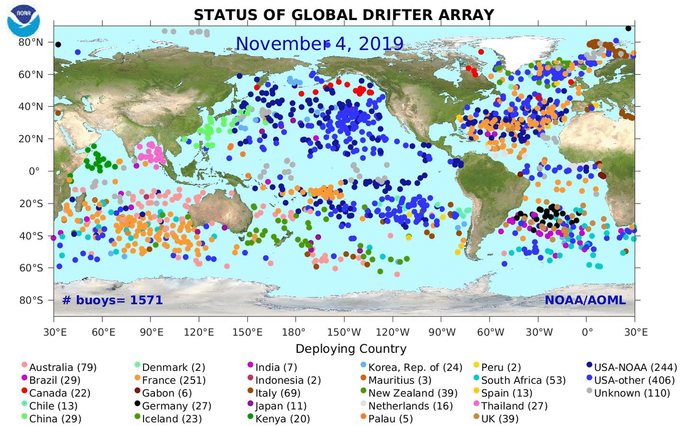
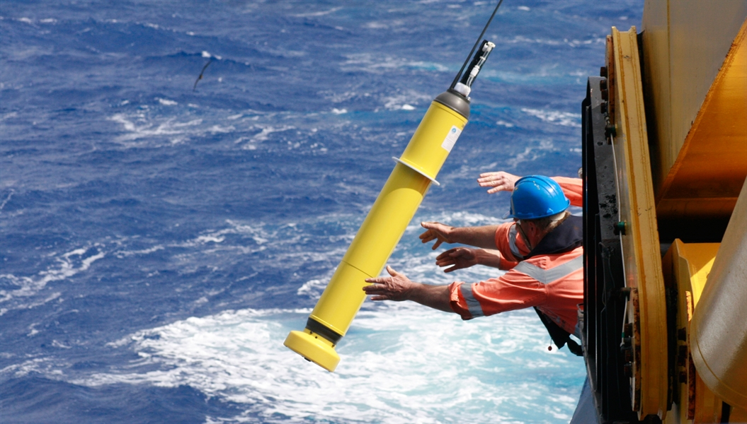
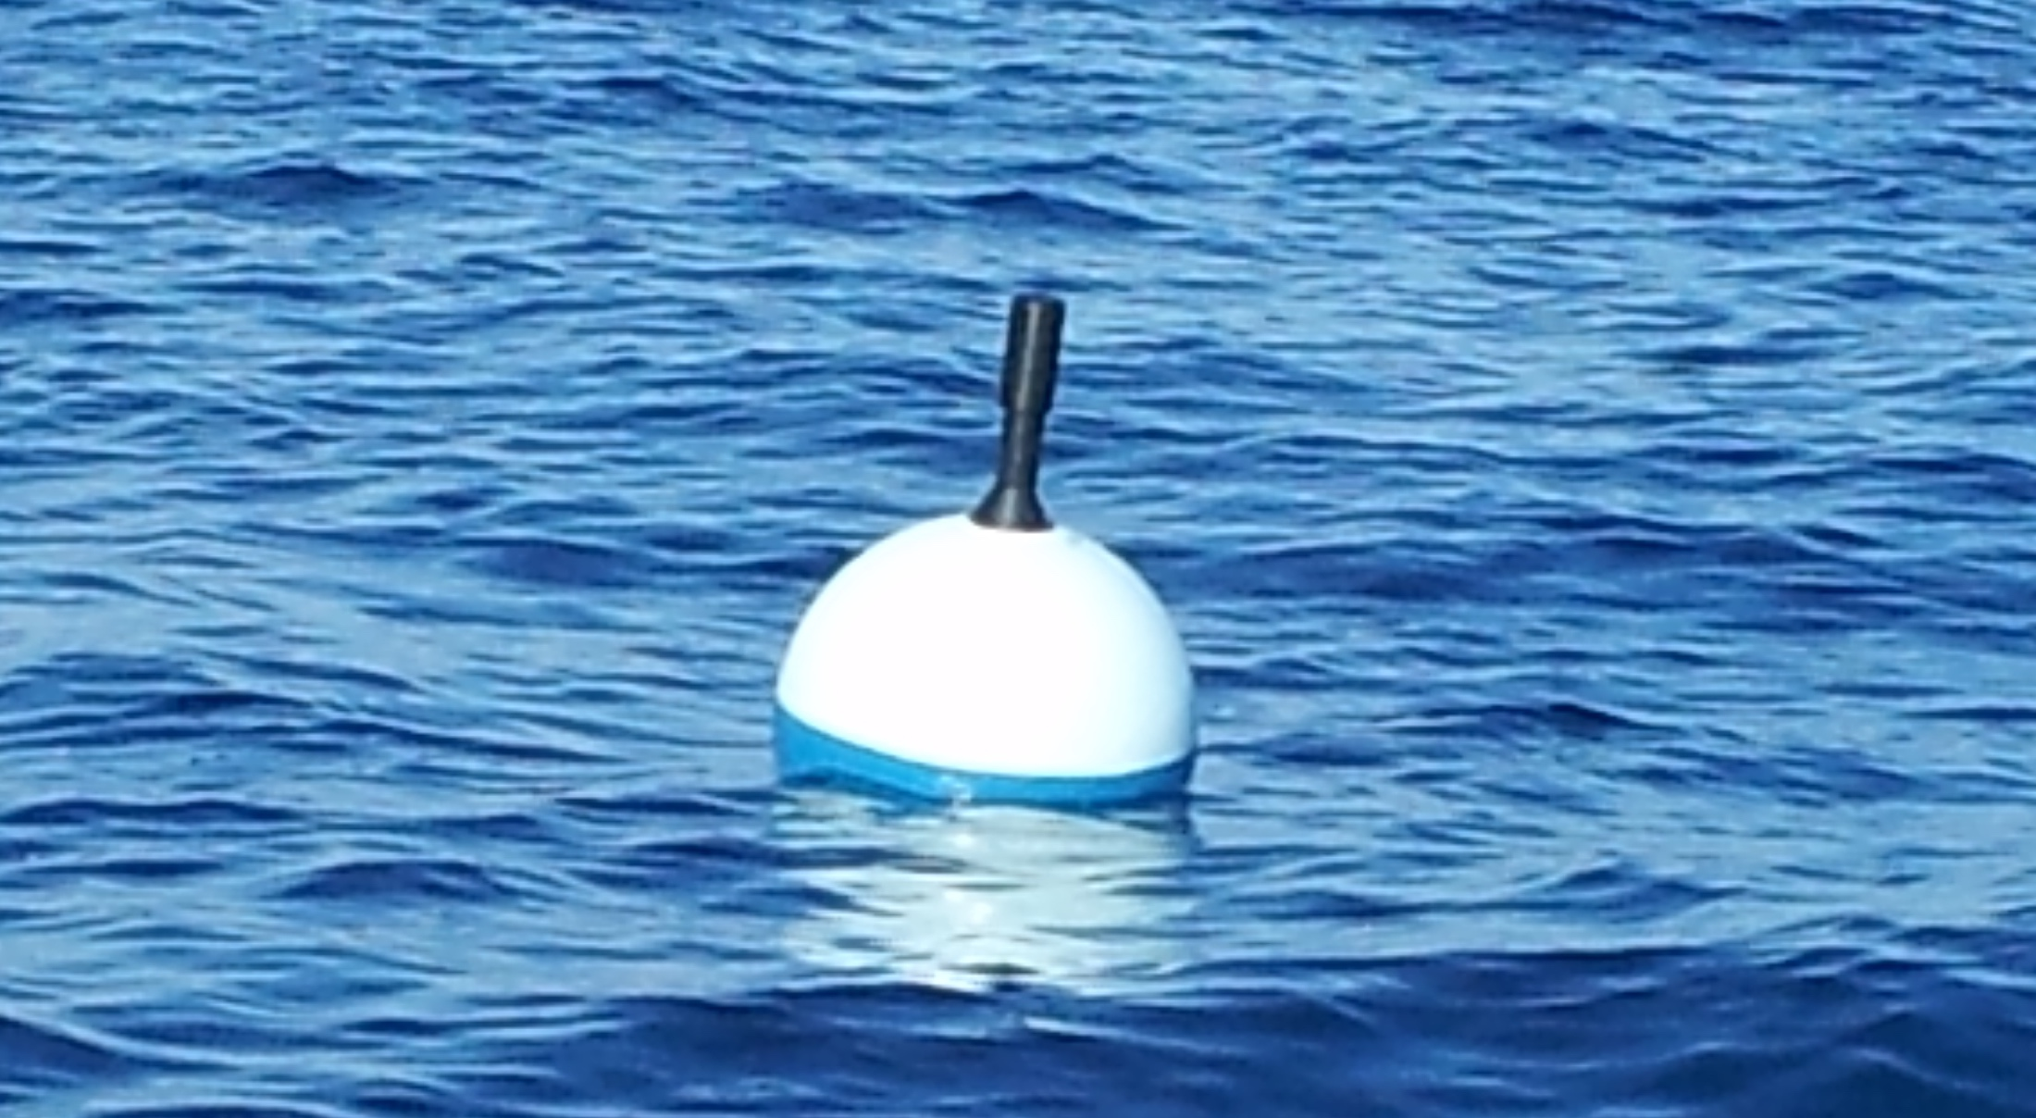
Observing Systems
Argo
Drifter

Slide 5
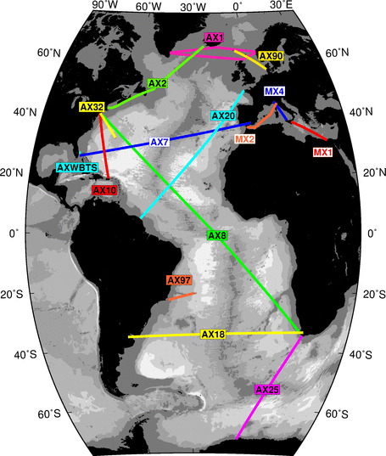
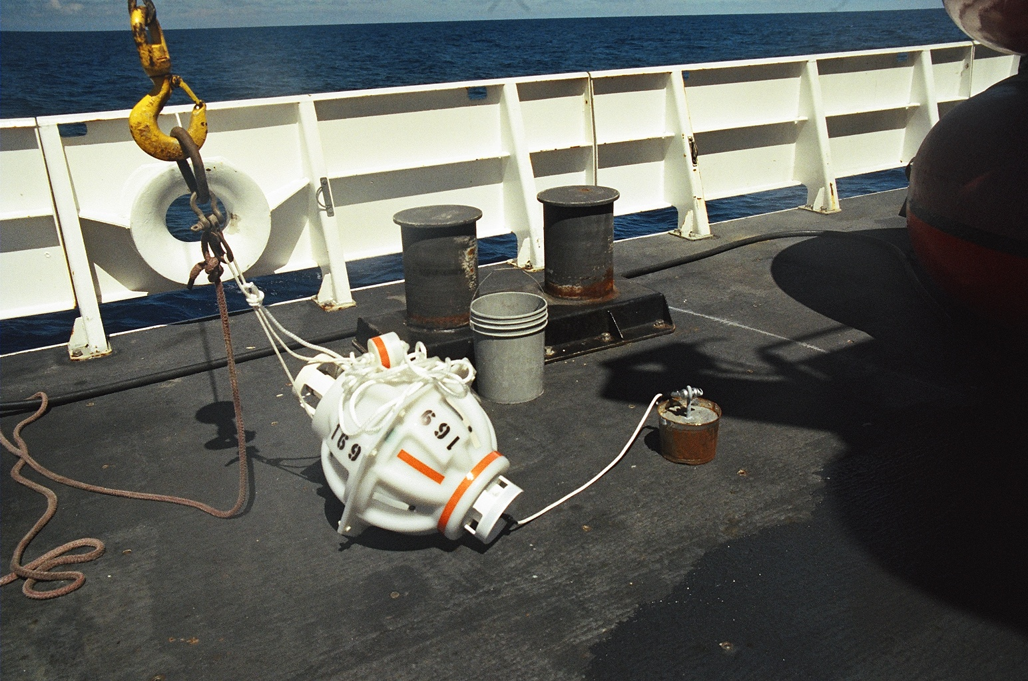
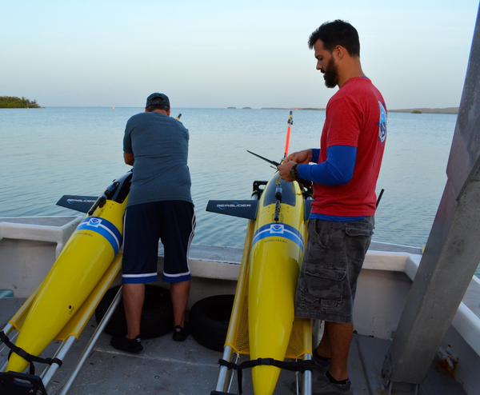
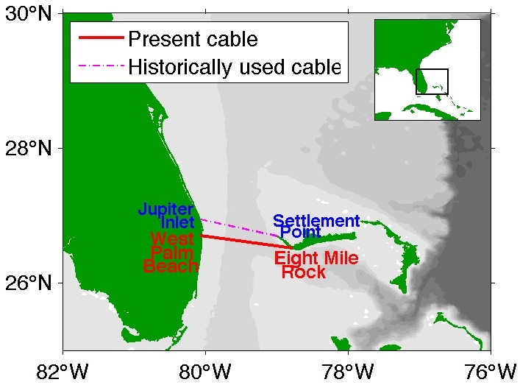
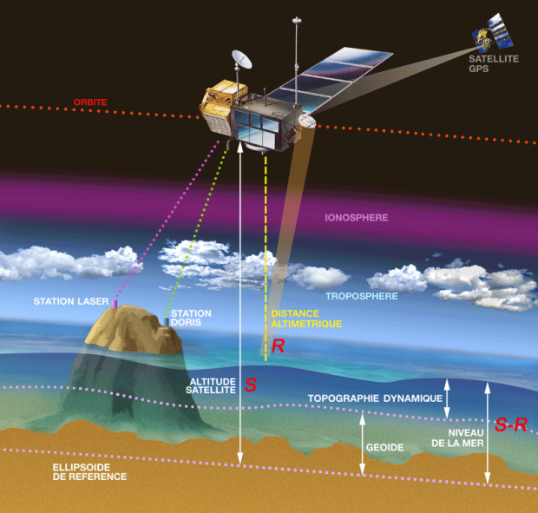
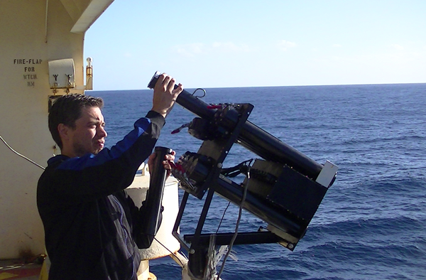
Observing Systems
XBTs
Moorings
Gliders
Submarine Telephone Cables
Altimeter

Slide 6
Ocean Currents Monitored by AOML
Collaborating
Using
Monitoring
30+
12
~20
Countries
Platforms
Ocean Currents
Key ocean currents indicators and indexes: https://www.aoml.noaa.gov/phod/indexes/index.php

Slide 7
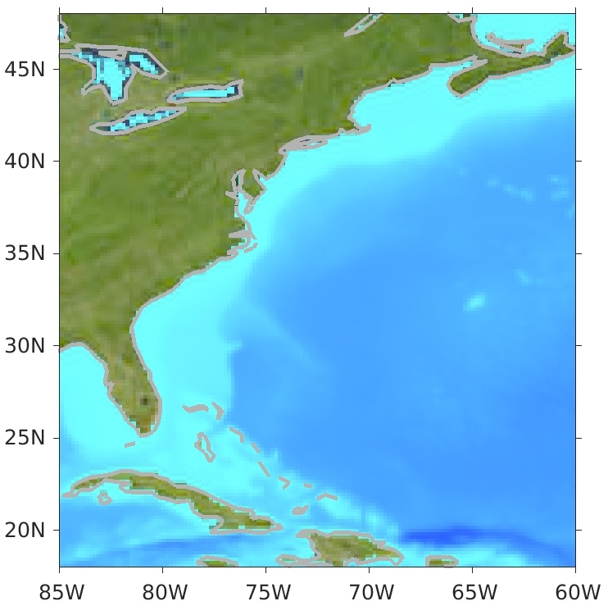
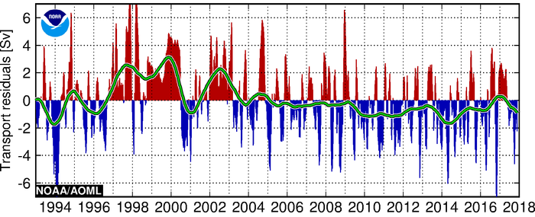
Monitoring the Gulf Stream Transport
XBT AX08
A key component for the MOC and subtropical gyre
Main carrier of heat from low to high latitudes
Linked to the development of mid-latitude storms, maintain and anchor storm-tracks
XBT AX32
XBT AX10
Florida Current – Cable-derived
Florida Current transport data (1982-present):
https://www.aoml.noaa.gov/phod/floridacurrent/data_access.php
Gulf Stream temperature sections from XBTs: 1967-present.
Partners: Univ. of Miami, Univ. of Rhode Island, Stony Brook Univ., Bermuda Institute of Ocean Sciences, shipping companies

Slide 8
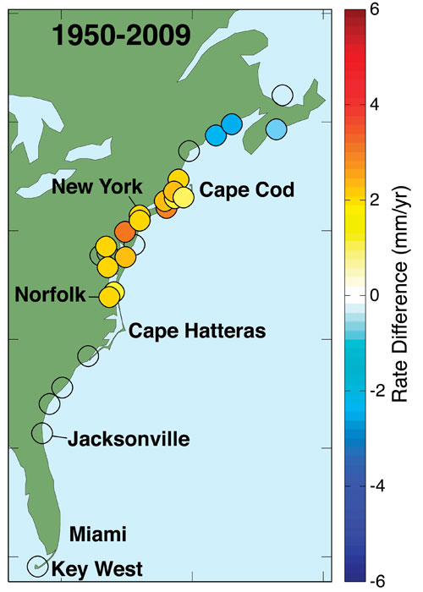
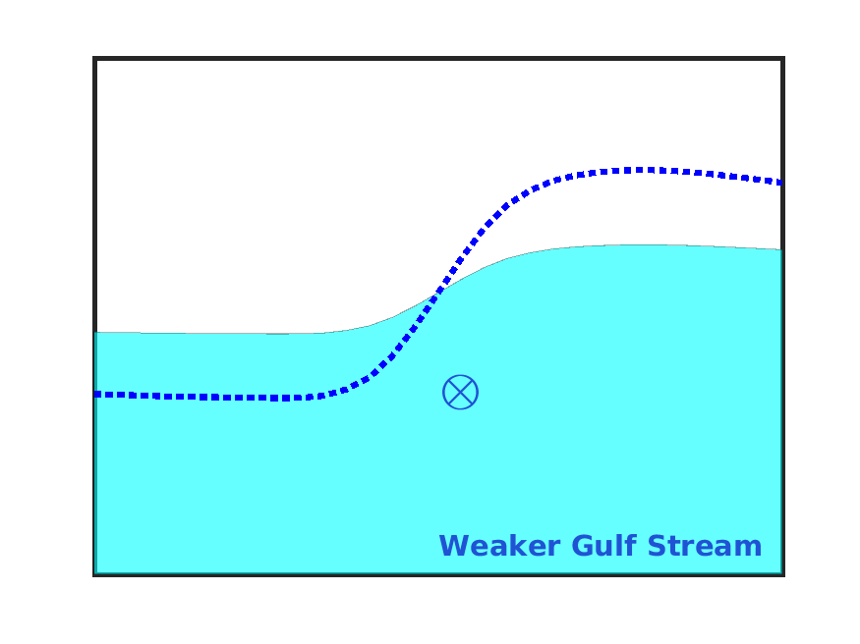
Impact of the Gulf Stream on Coastal Sea Level
Sea level changes in response to the Gulf Stream transport change
mean sea level
Inshore
Offshore
Previous argument: dynamic response to a slowdown of the Gulf Stream,
increased sea level inshore
decreased sea level offshore
Accelerated sea level rise between Cape Hatteras and Cape Cod.
(Sallenger et al. 2012)
(Ezer et al. 2013)

Slide 9
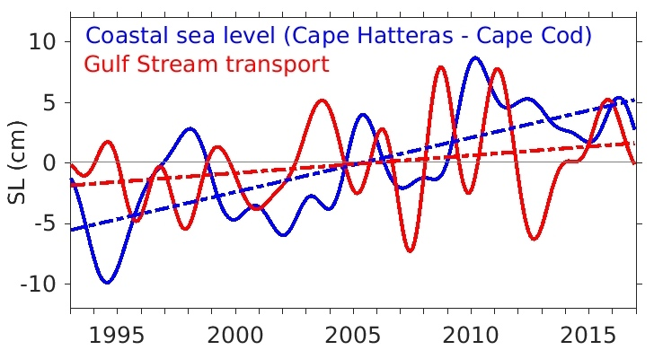
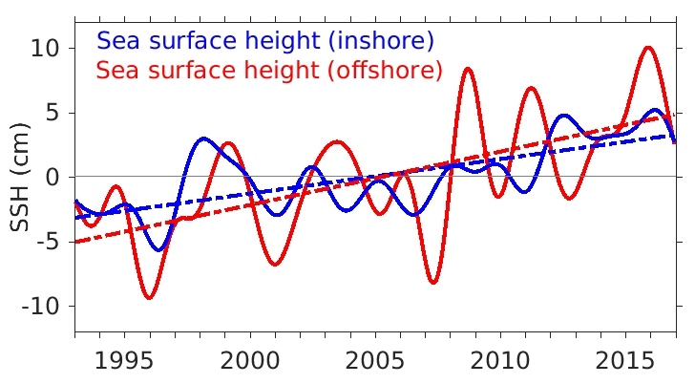
Impact of the Gulf Stream on Coastal Sea Level
Rate of sea level rise (1993-2018):
Results from our in situ measurements combined with satellite altimeter data:
Sea level rise is due to warming and increase in water mass and not a dynamic response to the Gulf Stream.
This is different from sea level changes upstream at Florida Straits where dynamic response does play a role (Ricardo’s talk).
Global average
3.1 mm/yr
Cape Hatteras – Cape Cod 4.7 mm/yr
Accelerated sea level rise between Cape Hatteras and Cape Cod.
(Sallenger et al. 2012)
(Dong et al., 2019)

Slide 10
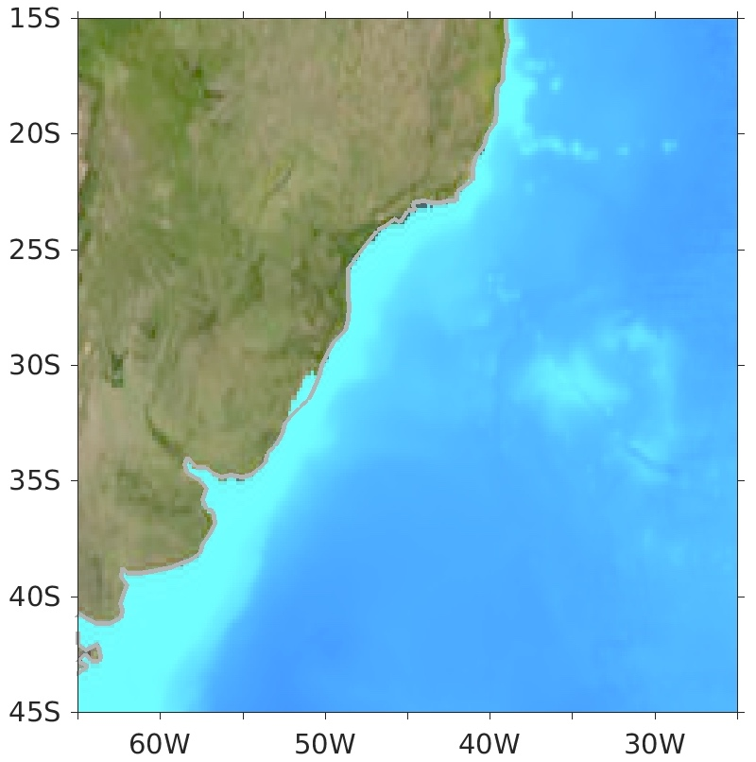
Monitoring the Brazil Current
A key component for the MOC and subtropical gyre in the South Atlantic.
Main carrier of heat from tropics to the subtropics.
Heat content in the South Atlantic ocean can modulate the strength of global monsoons.
XBT AX97
84 sections
Brazil
Altimeter + Argo
XBT AX18
54 sections
https://www.aoml.noaa.gov/phod/indexes/index.php
Partners: Brazil (Federal University of Rio Grande), South Africa (Univ. of Cape Town, Weather Service, Department of Environ. Affairs)

Slide 11
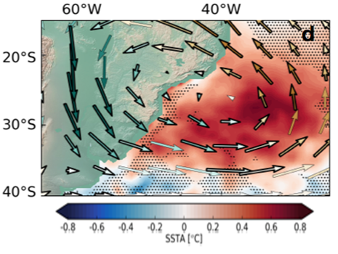
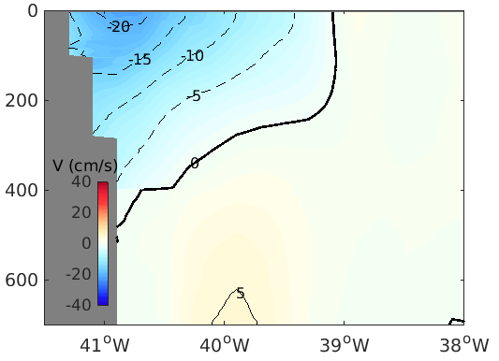
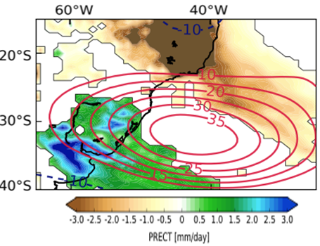
Impact of Brazil Current on Weather
Stronger Brazil Current brings more warm water from tropics, warms the subtropical region.
Warm anomalies induces strong precipitation in the Southeast Brazil.
Mean Brazil Curent:
-4.7 Sv
Partners: Federal University of Rio Grande, Federal University of Rio de Janeiro, Brazil.
(Provided by M. Goes)

Slide 12
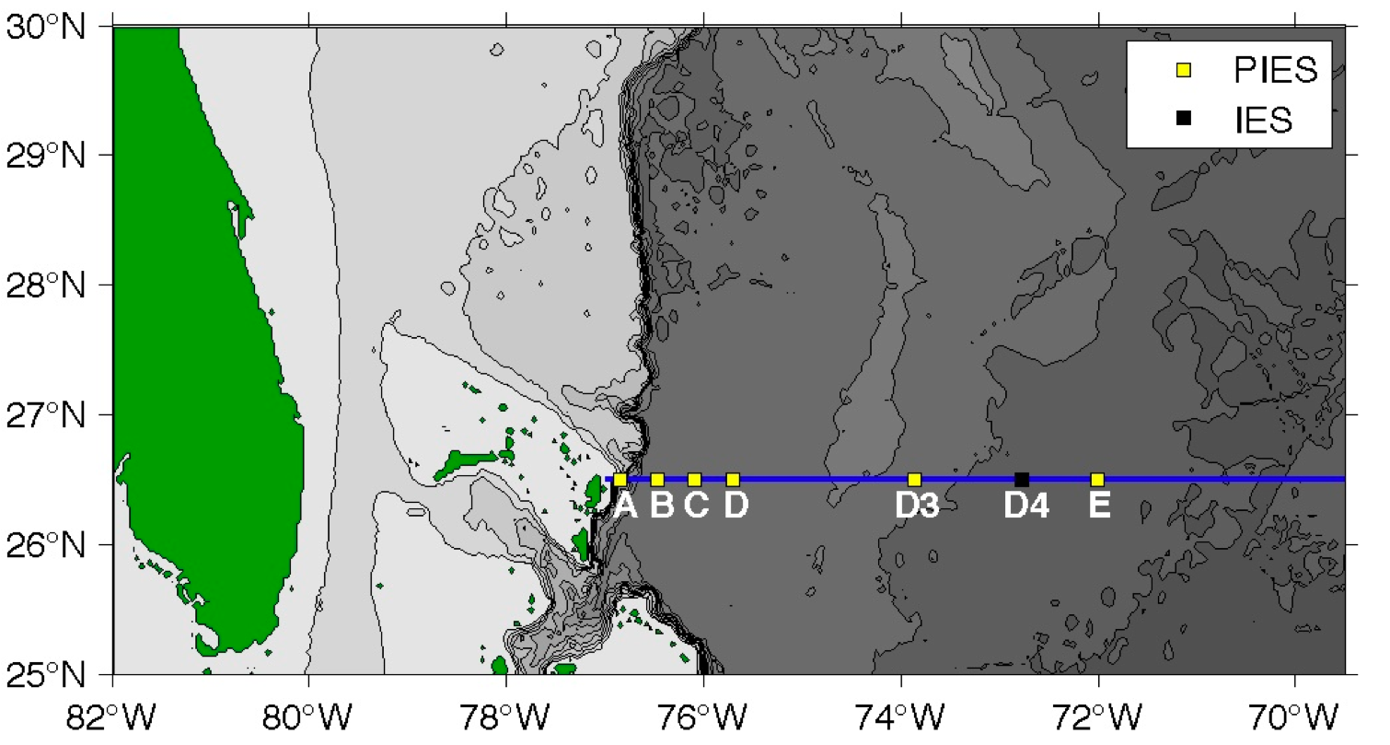
Monitoring the Deep Western Boundary Current at 26.5°N (2004-present) and at 34.5°S (2009-present)
An important component of global heat balance
Connection of high-latitude regions with the global ocean
Water mass transformation and variations may control the stability of the MOC
Brazil
Partners: University of Miami, United Kingdom, Argentina and Brazil

Slide 13
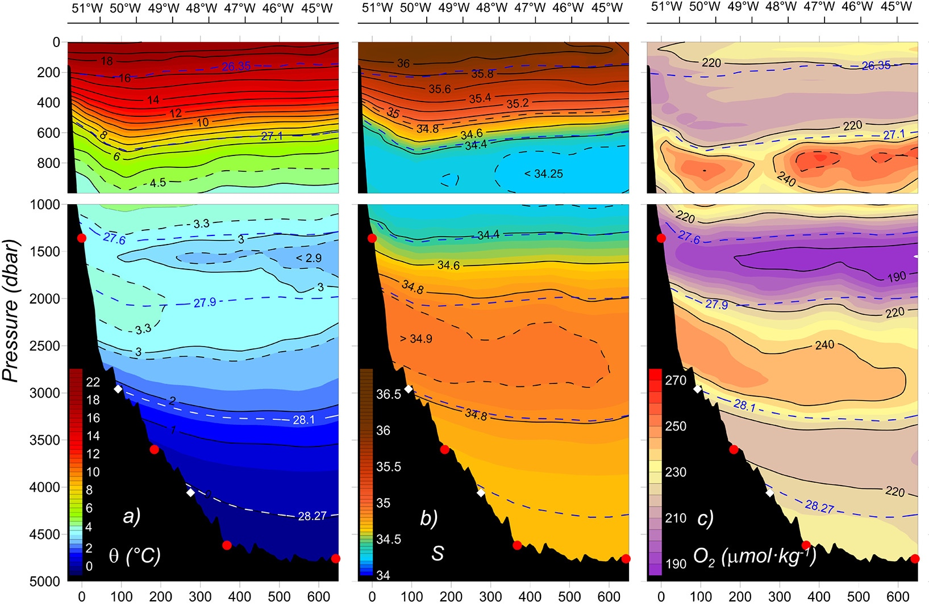
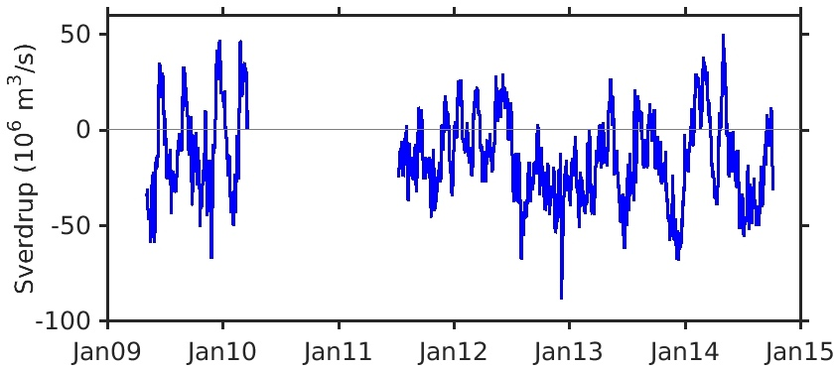
Deep Western Boundary Current at 34.5°S
SACW
Strong variability on time scales ranging from a few days to a few months
AAIW
UCDW
NADW
LCDW
DWBC (34.5°S)
AABW
(Meinen et al., 2017)
Distance (km)
SACW − South Atlantic Central Water NADW − North Atlantic Deep Water
AAIW − Antarctic Intermediate Water UCDW − Lower Circumpolar Deep Water
LCDW − Lower Circumpolar Deep Water AABW − Antarctic Bottom Water
Partners: Argentina and Brazil
(Valla et al., 2019)

Slide 14
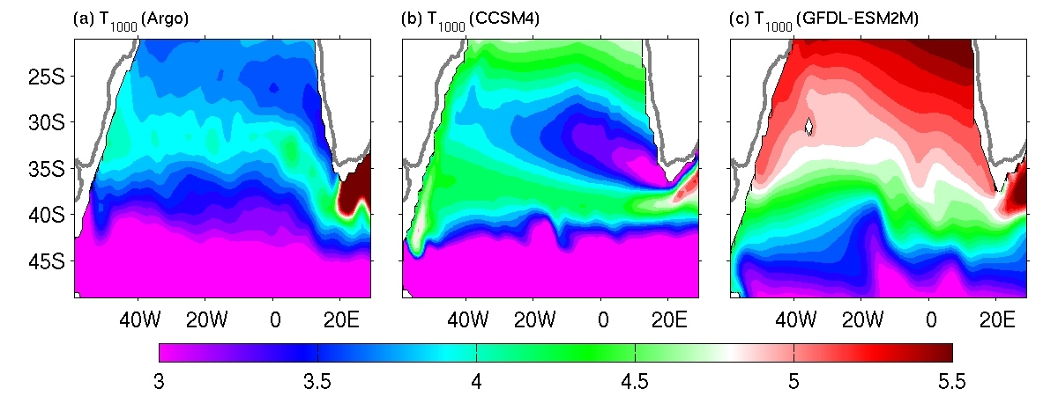
Evaluation of Climate Models
°C
Models do not capture the flow pathways
Plan: work with modelers to assess deficiencies and improve models
(Dong et al., 2014)

Slide 15
Evaluation of Ocean Forecast Model
Florida Current transport is used for verification of Global Real-Time Ocean Forecast System (RTOFS) at Environmental Modeling Center, which is part of a larger national backbone capability of ocean modeling at the National Weather Service in a strong partnership with the US Navy.
Hurricane Dorian
Record low transport
Notes:
The Florida Current transport is widely used for the verification of ocean models. And here you see an example of using this data during Hurricane Dorian to validate the Global Real-Time Ocean Forecast System that is run at Environmental Modeling Center.

Slide 16
THANK YOU

