Slide 1

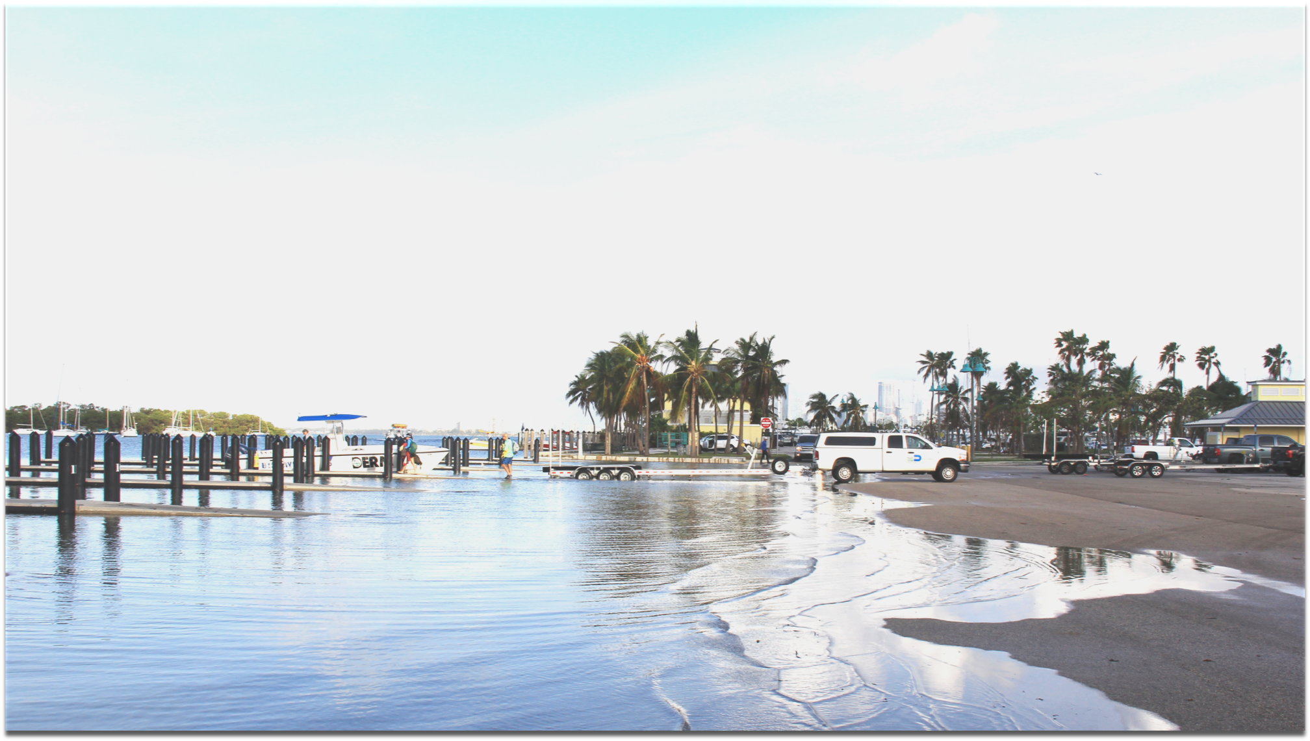


Assessing Attributions of Coastal Sea Level Changes Along the U.S. East Coast
Ricardo Domingues
CIMAS University of Miami
AOML Laboratory Review
Miami, November 19, 2019
Photo by Grant Rawson (UM/CIMAS)

Slide 2
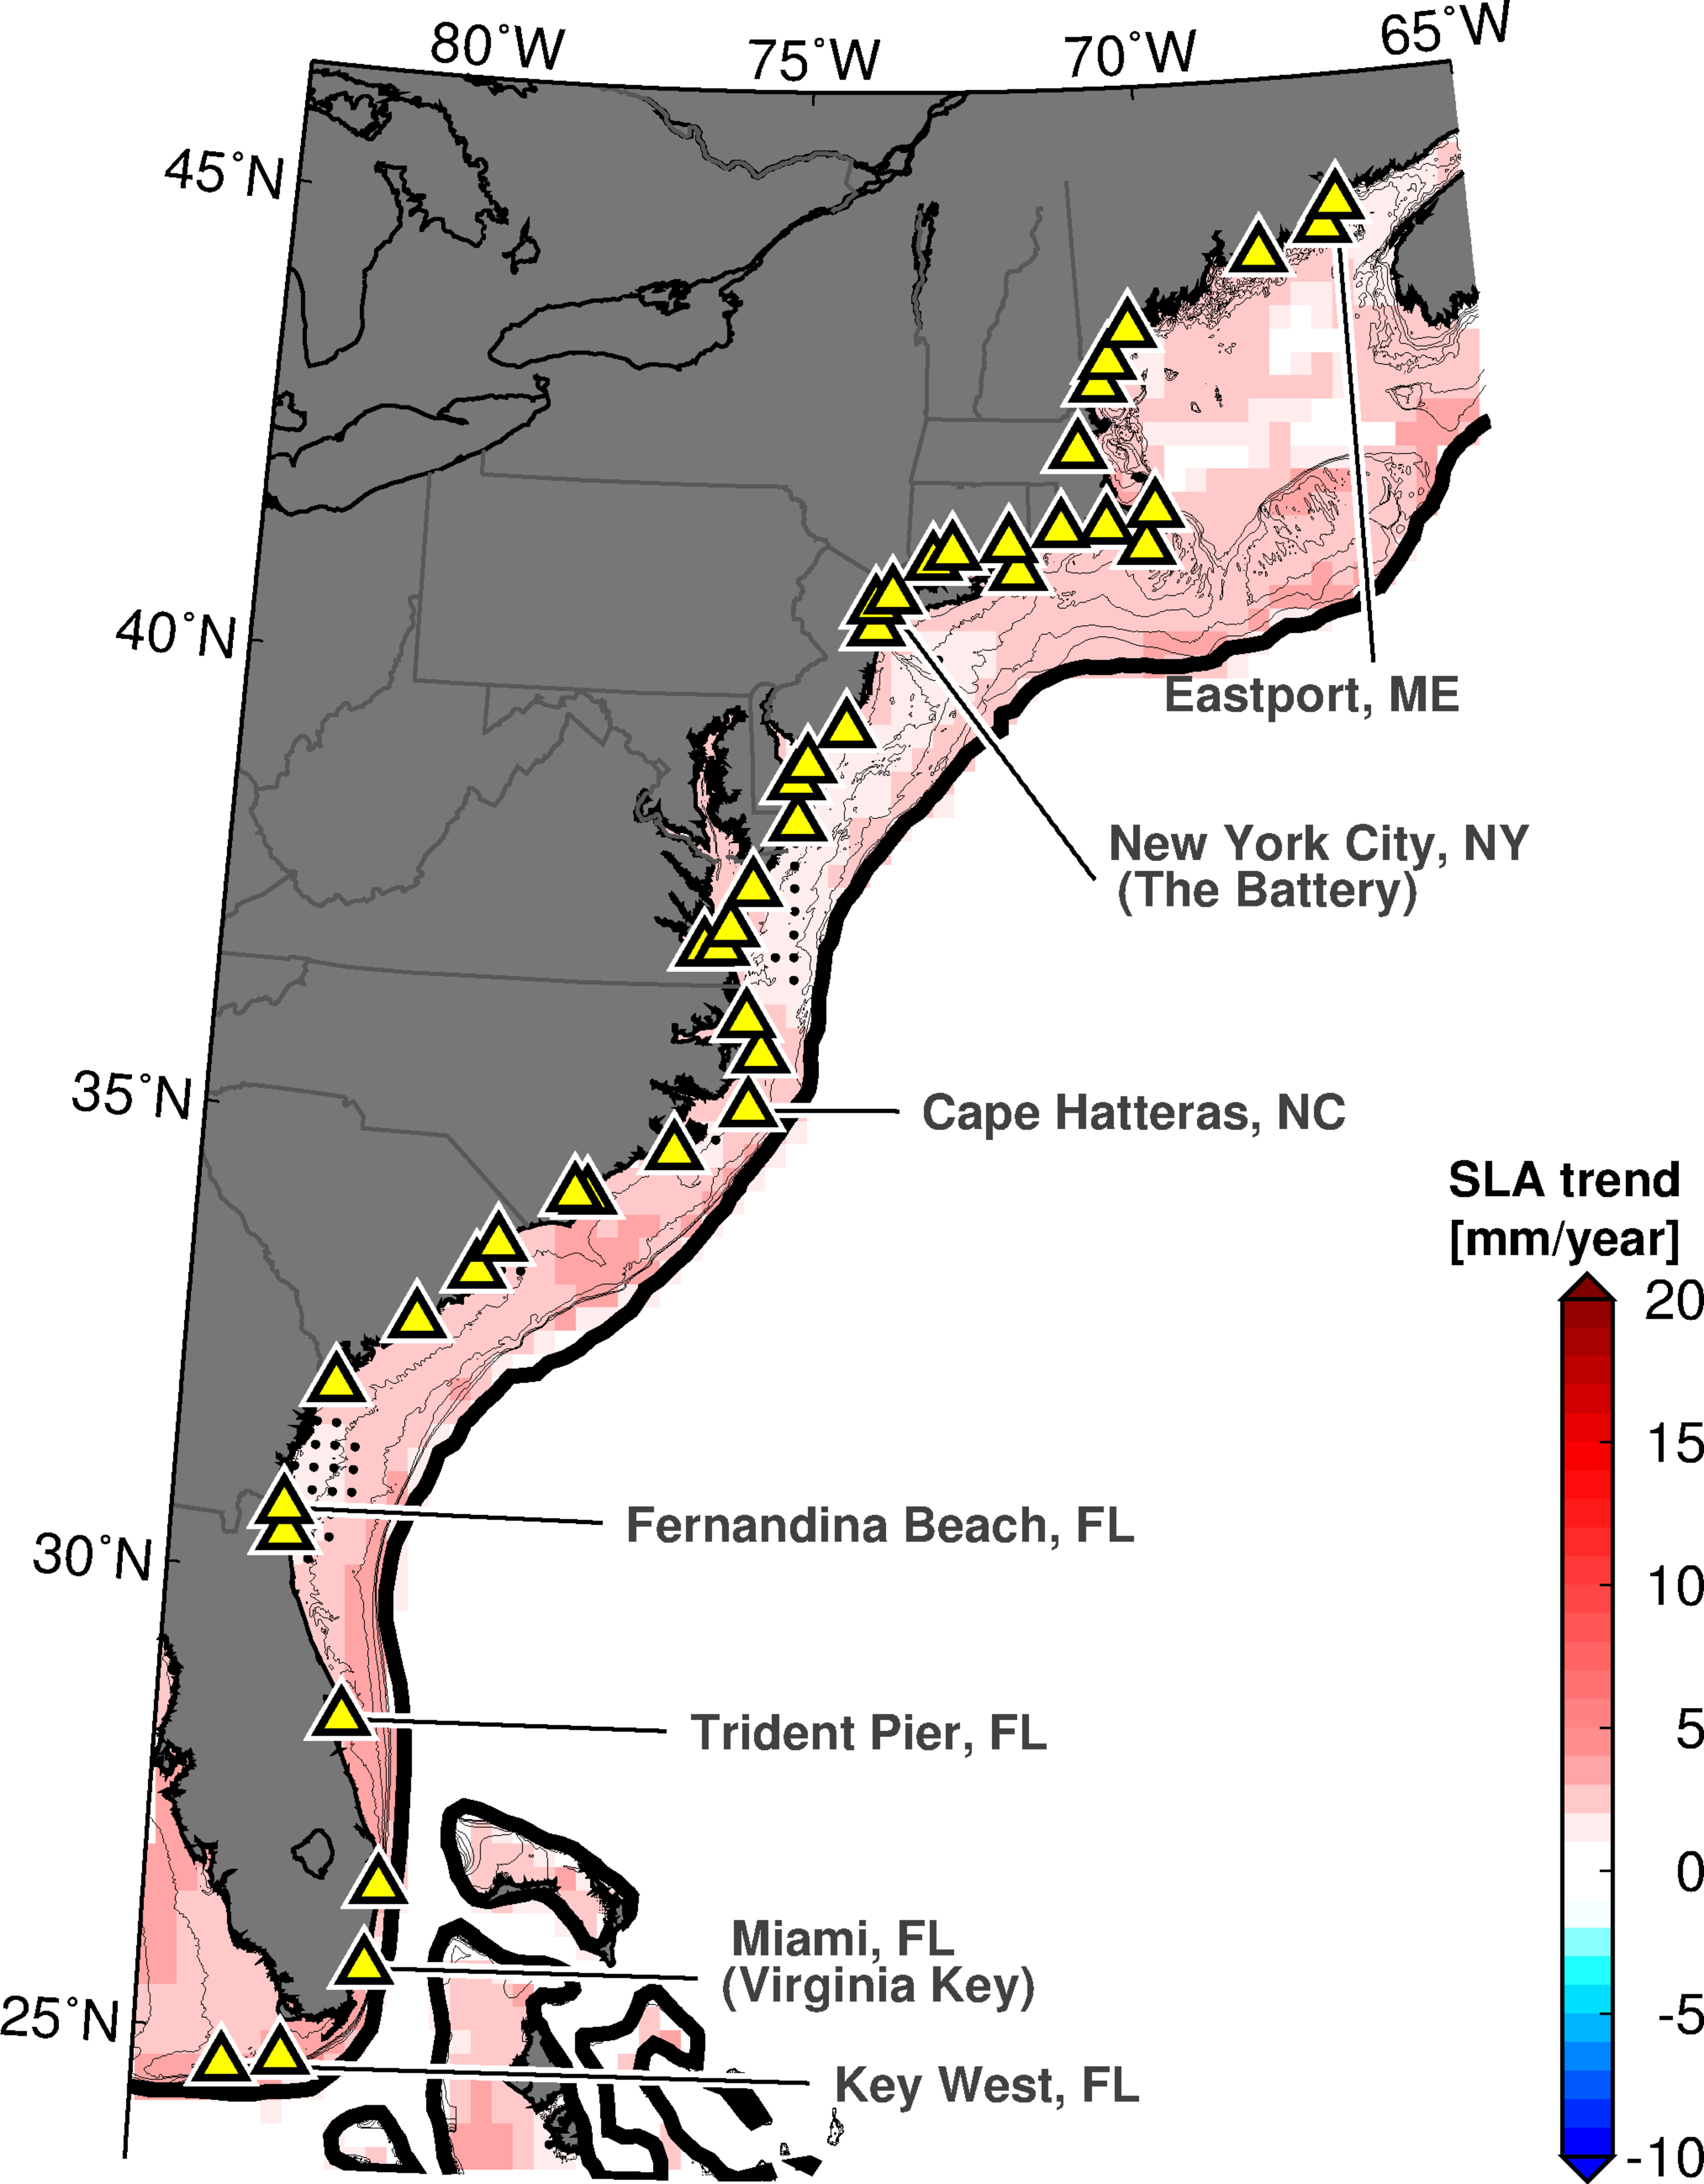
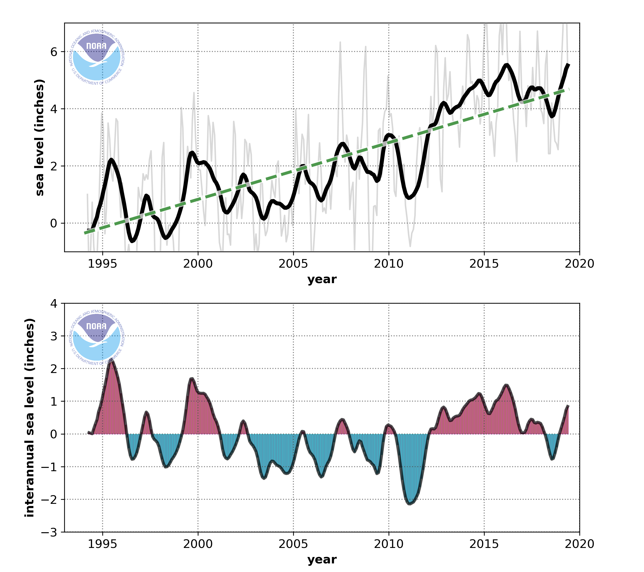

Long-term Sea-level Rise Along the U.S. East Coast
Sea level Observations at Miami
(Virginia Key)
Miami Sea Level Rise = 5.1 mm year⁻¹
Global Mean Sea Level Rise = 3.3 mm year⁻¹

Slide 3
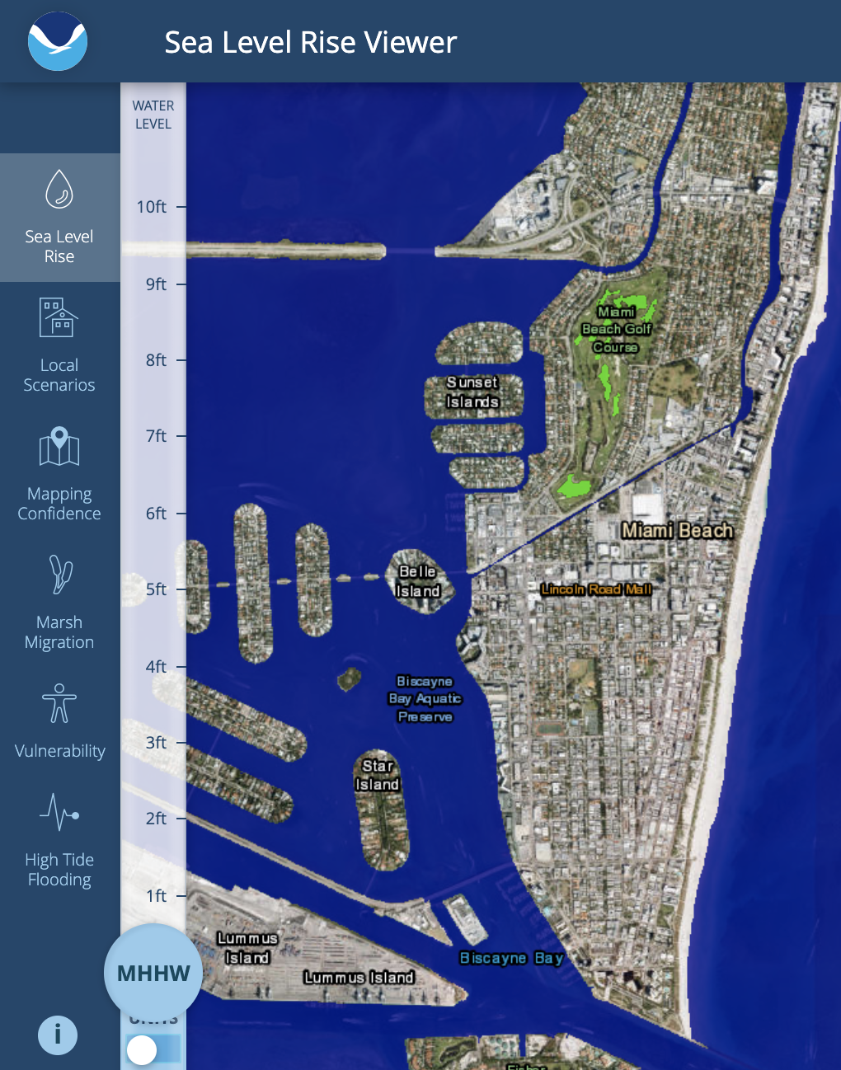
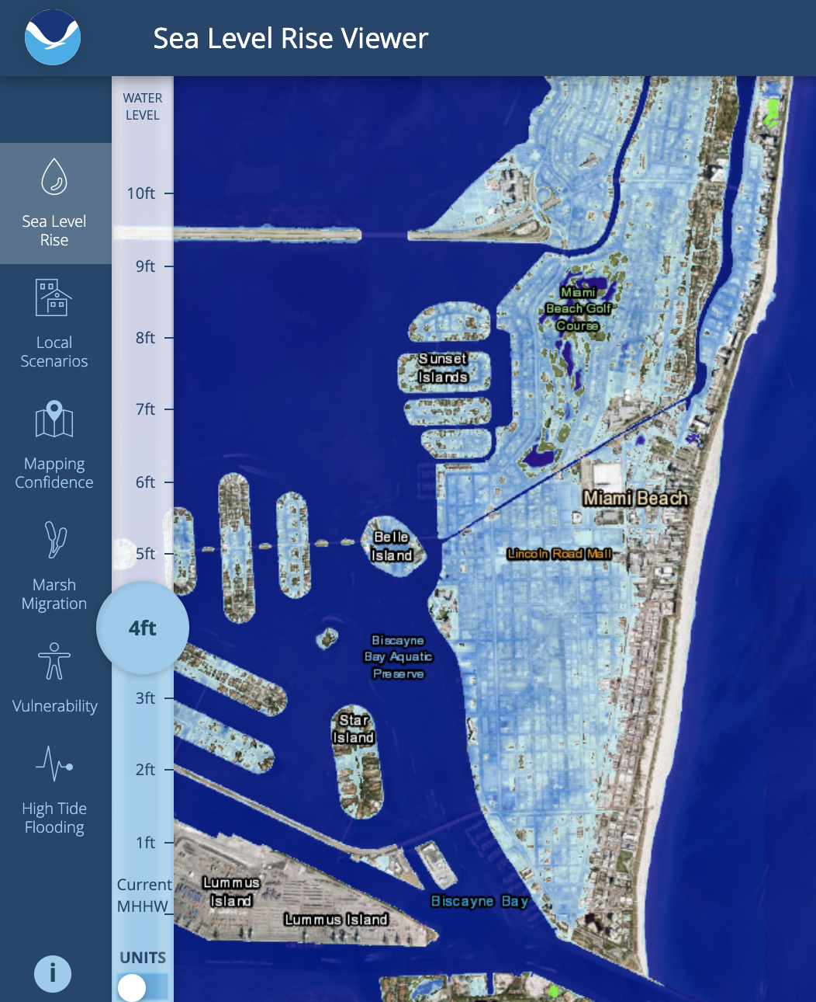
Southeast Florida Vulnerabilities to Sea Level Rise
Current Conditions
4 ft of SLR by 2100
(NOAA intermediate scenario)
Miami is one of the most vulnerable locations in the U.S. to the long-term effects of sea level rise
Notes:
Relevant science manuscript:
Kulp, S. A., & Strauss, B. H. (2019). New elevation data triple estimates of global vulnerability to sea-level rise and coastal flooding. Nature communications, 10(1), 1-12. (https://www.nature.com/articles/s41467-019-12808-z)

Slide 4
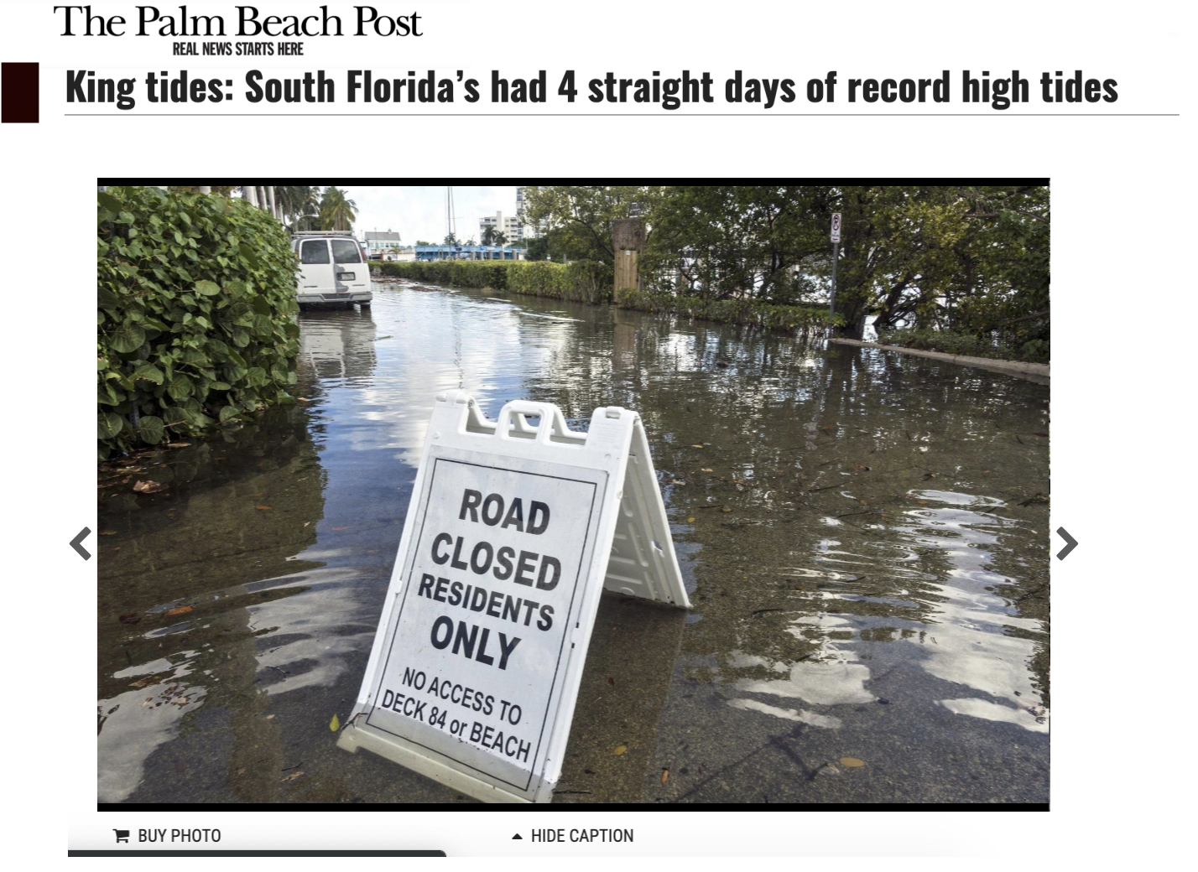
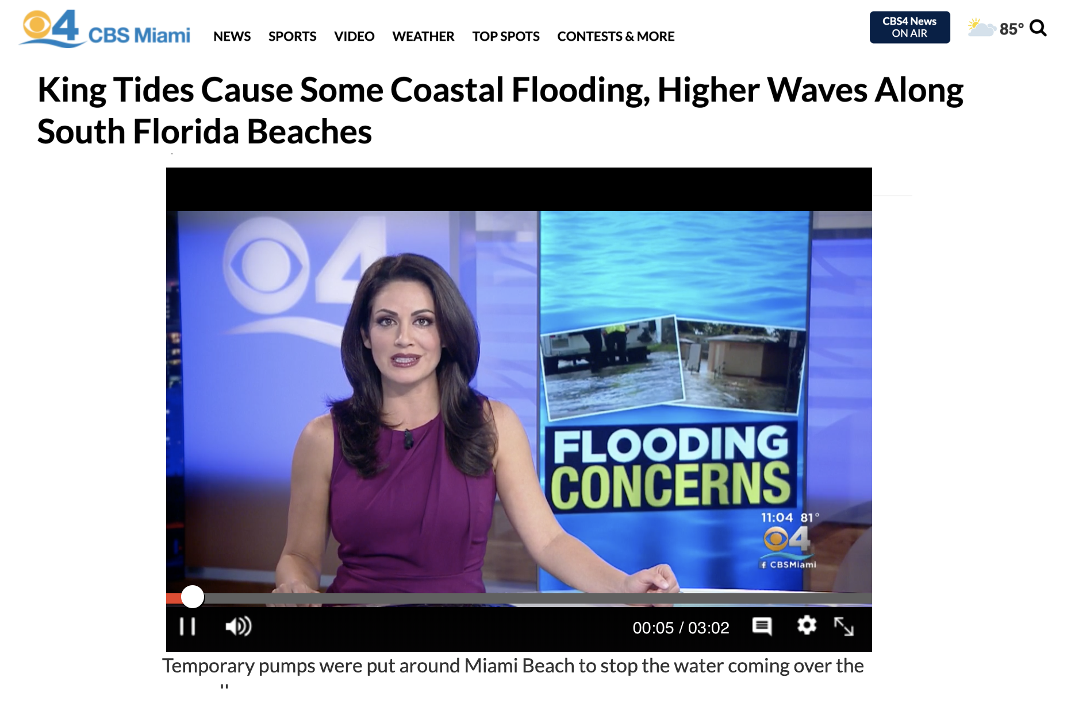
Nuisance Flooding Frequency is Increasing
Extensive flooding events are being frequently observed throughout Miami, and Southeast Florida, causing several impacts to local communities
The 2019 King Tides Flooding
Notes:
News articles:
https://www.palmbeachpost.com/news/20191015/king-tides-south-floridarsquos-had-4-straight-days-of-record-high-tides
https://www.nytimes.com/2019/02/20/opinion/ban-ki-moon-miami-climate-change.html
https://www.miaminewtimes.com/news/sea-level-rise-to-destroy-6000-florida-historic-sites-by-2100-9872871

Slide 5
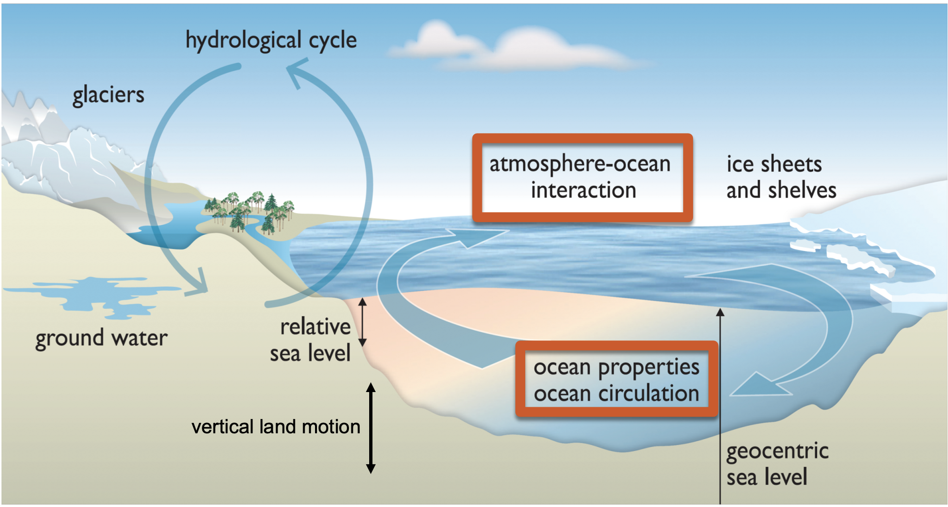
Sources of Sea Level Changes
Several global, regional, and local process contribute to sea level changes experienced at each location
Oceanic/Atmospheric Dynamics play a major role on interannual and synoptic time-scales
Source: IPCC 2013

Slide 6
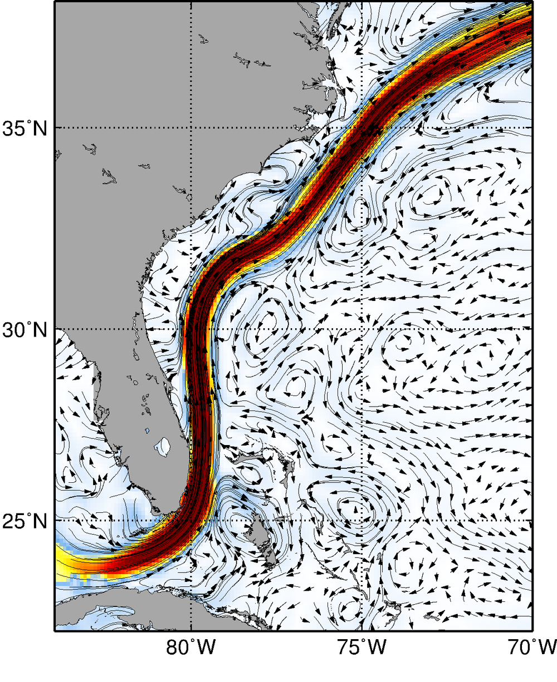
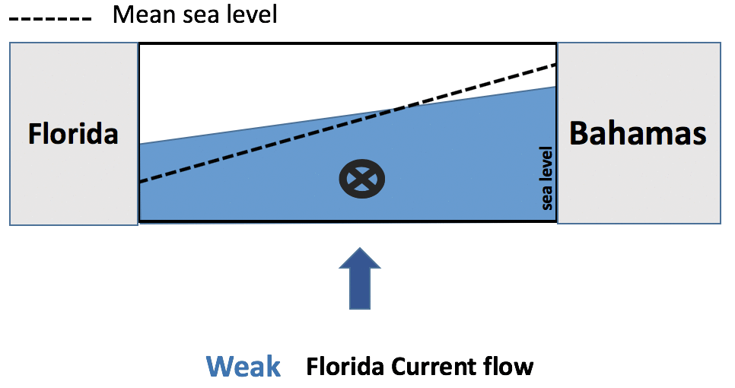
Florida Current Effects on U.S. Coastal Sea-level
Gulf Stream
Florida Current
A weak Florida Current flow can increase sea-level in Miami by up to 20 cm
Notes:
Reference:
Domingues, R., Baringer, M., & Goni, G. (2016). Remote sources for year‐to‐year changes in the seasonality of the F lorida C urrent transport. Journal of Geophysical Research: Oceans, 121(10), 7547-7559.

Slide 7
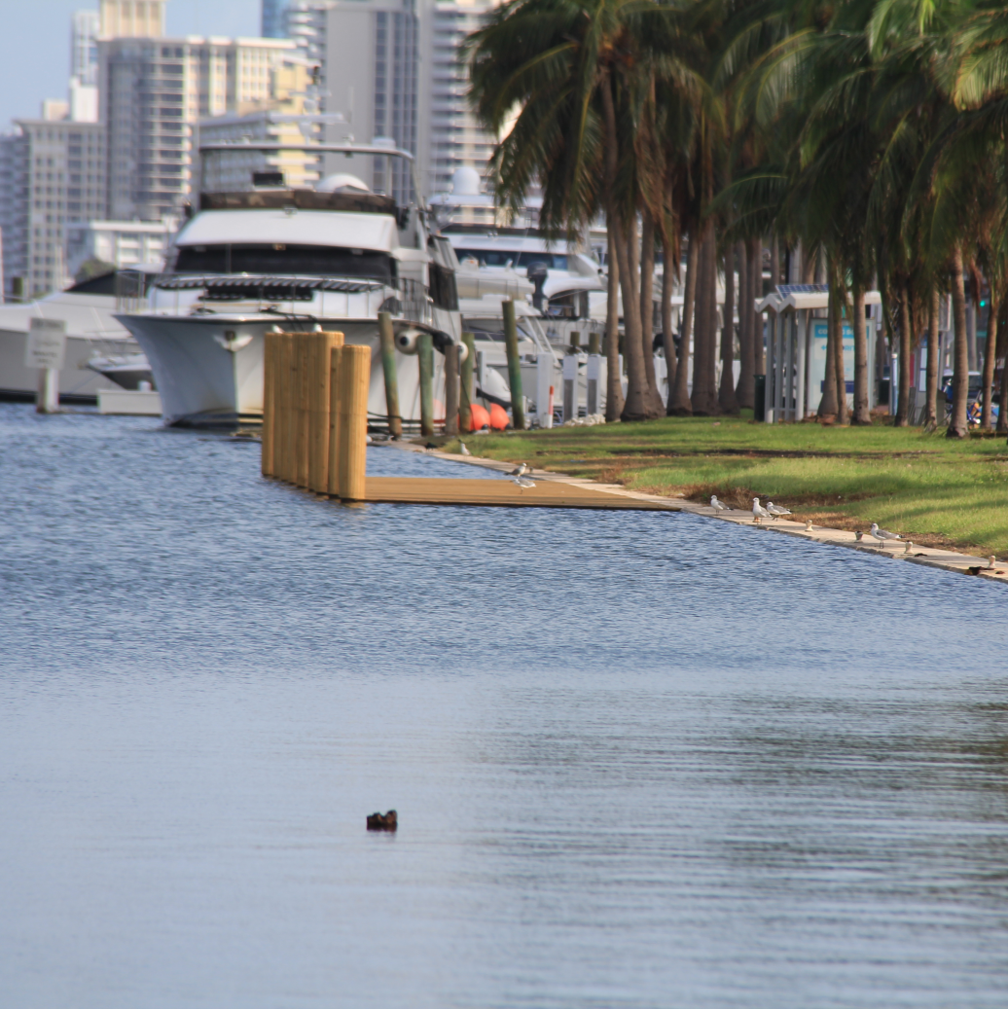
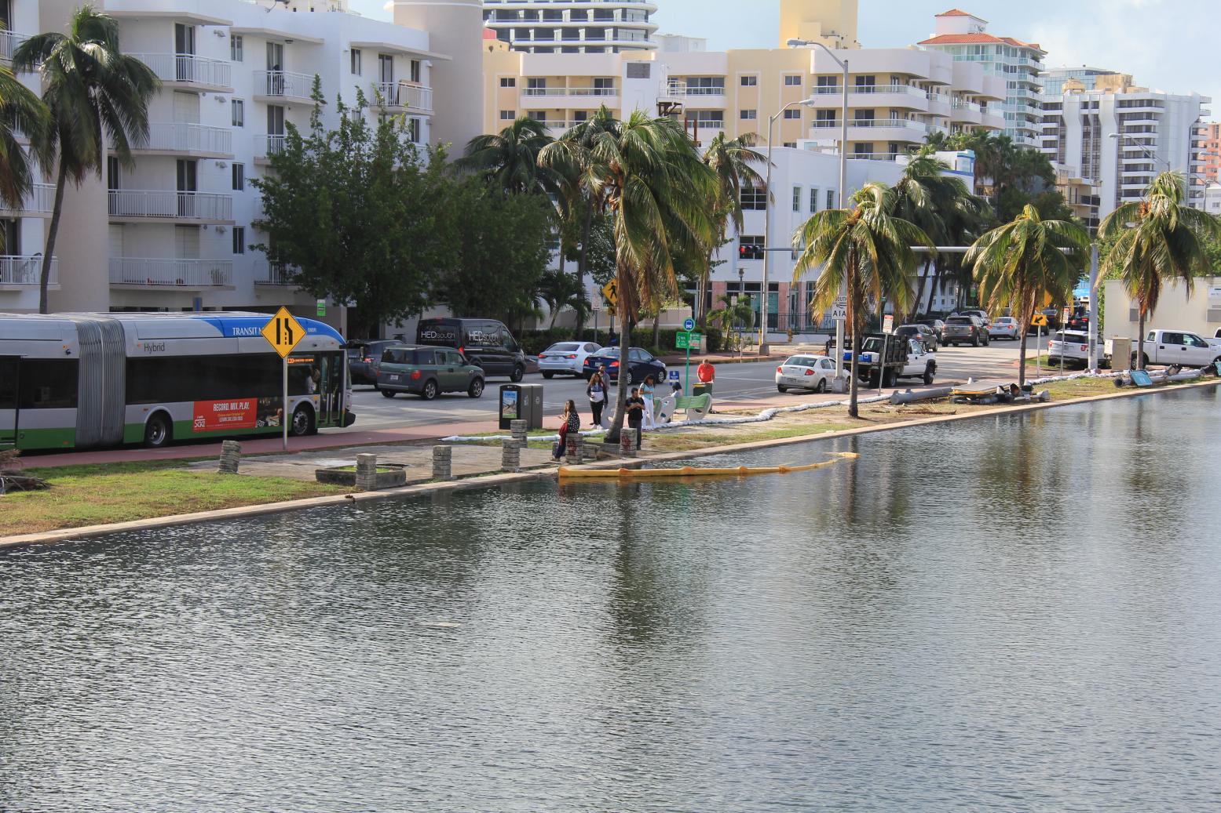
Are few centimeters relevant?
Miami Beach – 2017 King Tides
Few centimeters of above normal sea level can provide the difference needed to drive water levels to overtop sea walls and initiate floods
Photos by Grant Rawson (UM/CIMAS)

Slide 8
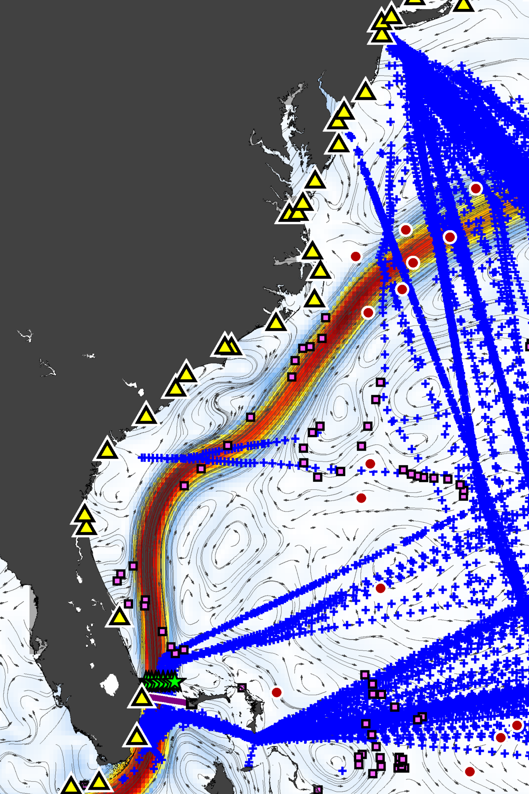
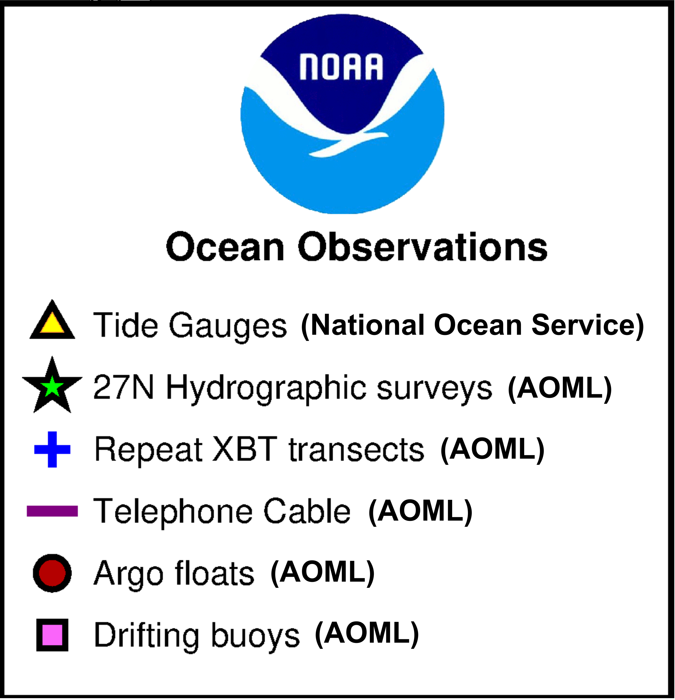
Ocean Observations in Support of Sea Level Attributions Studies
AOML plays an important role in supporting key components of the ocean observing system used in sea-level attributions studies (funded by CPO/OOMD)
Ocean currents derived from satellite altimetry

Slide 9
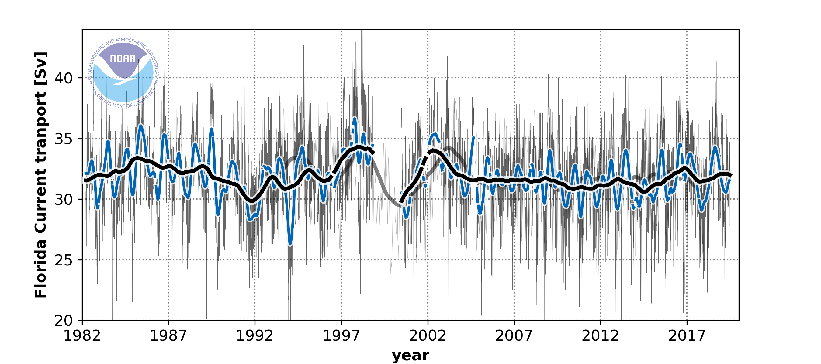
The Florida Current Transport Time-series
Continuous monitoring of the Florida Current since 1982 allows for detailed analysis of changes in its dynamics on various timescales
funded by CPO/OOMD

Slide 10
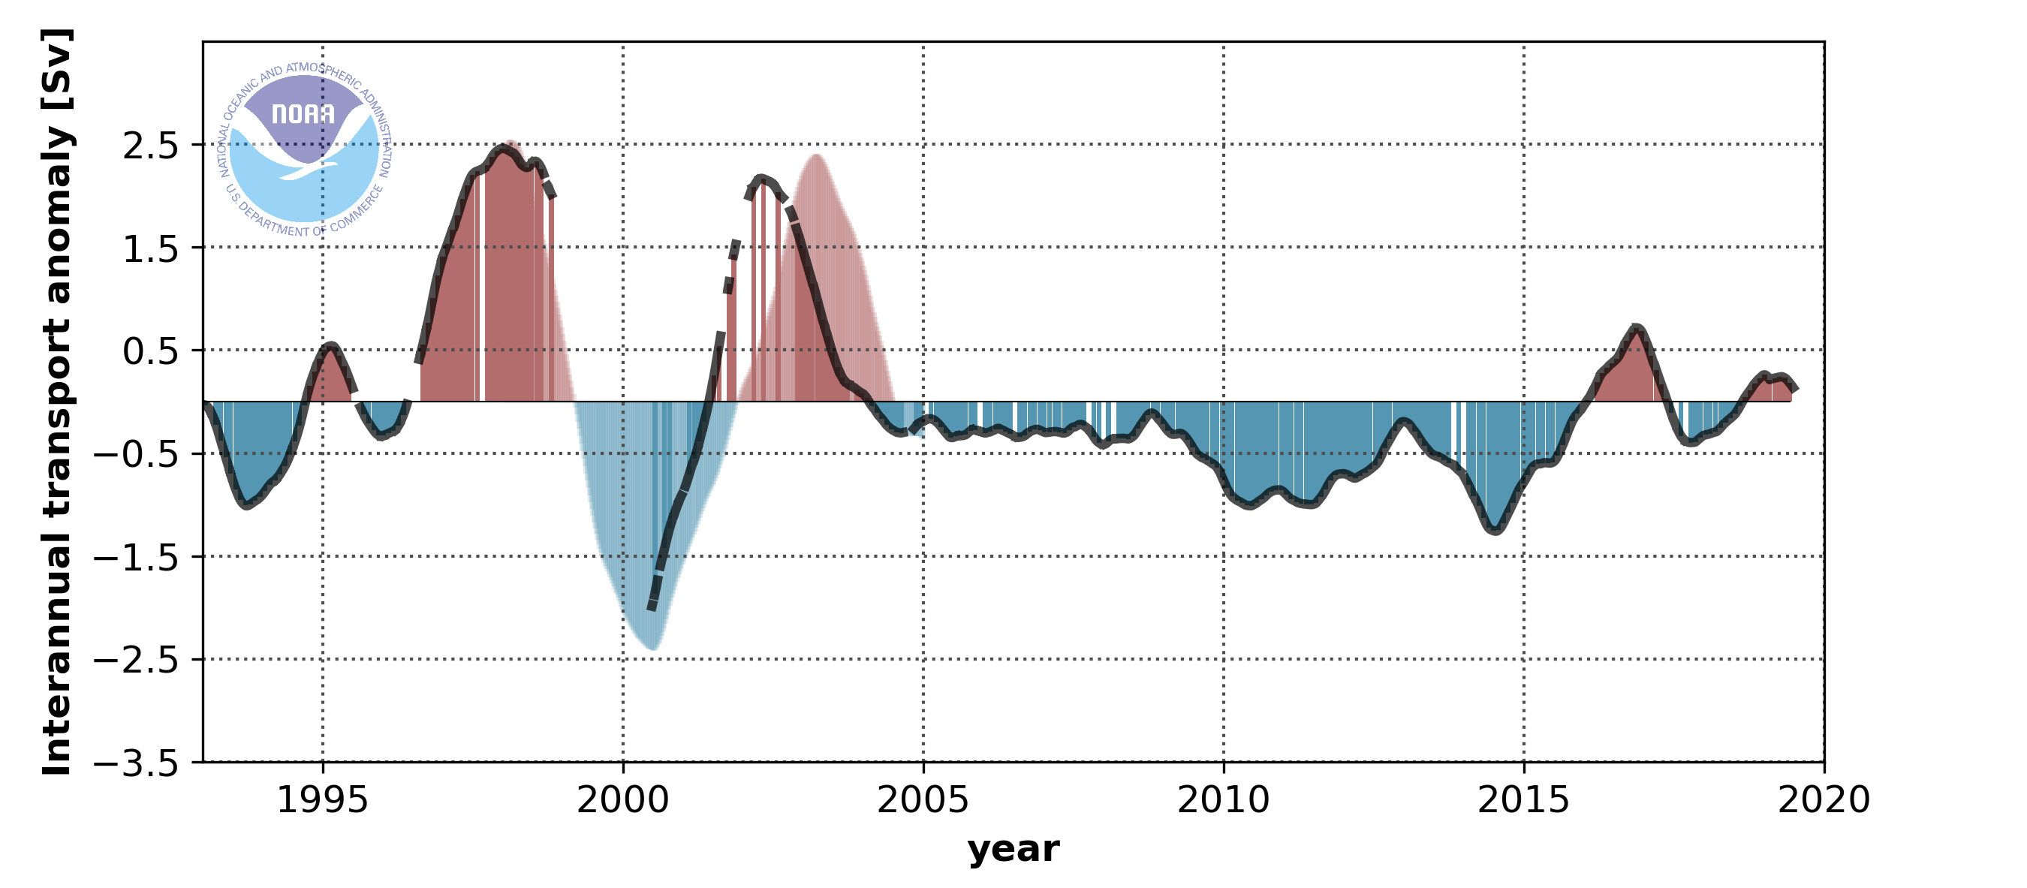
Florida Current Effect on Interannual Sea Level Changes
Florida Current transport
Strong oscillations in the Florida Current intensity played a major role for sea-level variations in Miami from 1997-2005
Sea-level in Miami
Domingues et al., (2016), Domingues et al., (2018)
Notes:
References:
Domingues, R., Baringer, M., & Goni, G. (2016). Remote sources for year‐to‐year changes in the seasonality of the F lorida C urrent transport. Journal of Geophysical Research: Oceans, 121(10), 7547-7559.
Domingues, R., Goni, G., Baringer, M., & Volkov, D. (2018). What caused the accelerated sea level changes along the US East Coast during 2010–2015?. Geophysical Research Letters, 45(24), 13-367.

Slide 11
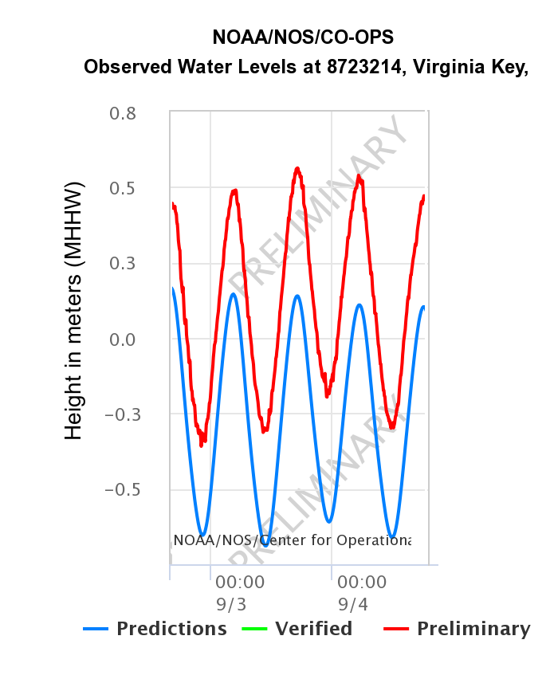
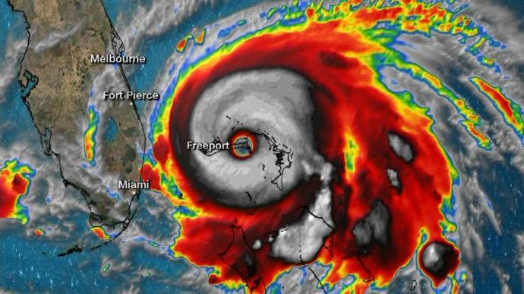
Florida Current Effect on Synoptic Sea Level Changes
In September 2019, sea-level in Miami was 40 cm above predicted associated with offshore Hurricane Dorian
~40 cm difference

Slide 12
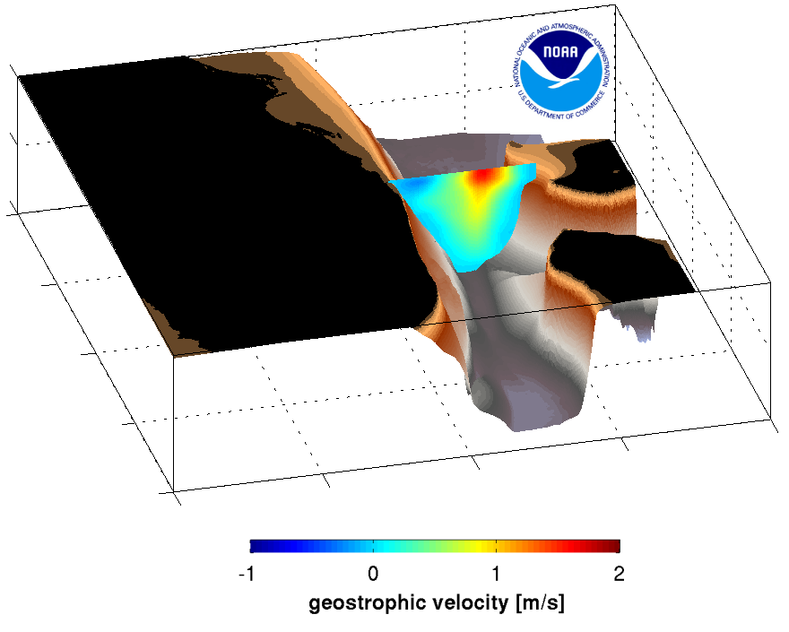
Florida Current Effect on Synoptic Sea Level Changes
AOML 27N Florida Current Survey – 09/26/2019
Above normal sea levels in Miami were associated with the disruption of the Florida Current flow by Hurricane Dorian, causing a reduction by 47% in the flow
Depth [m]
Latitude
The low Florida Current transport contributed to the above normal sea-level
Longitude

Slide 13
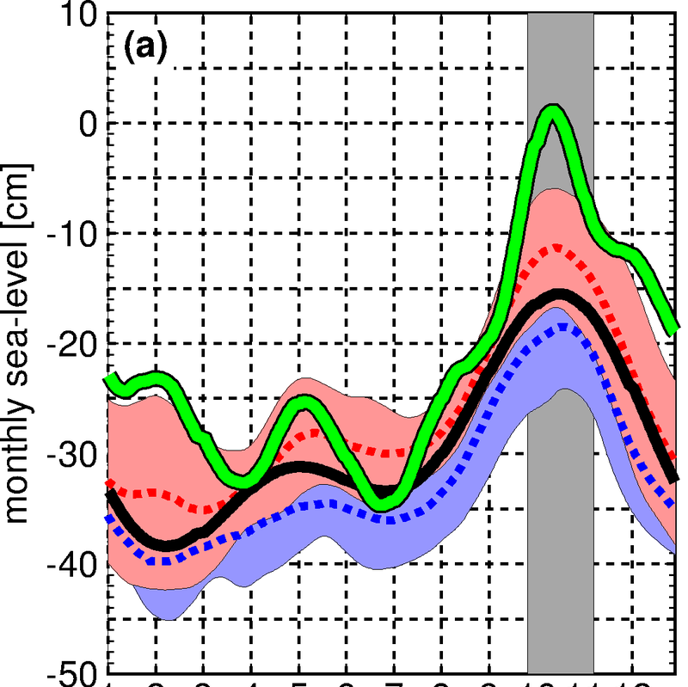
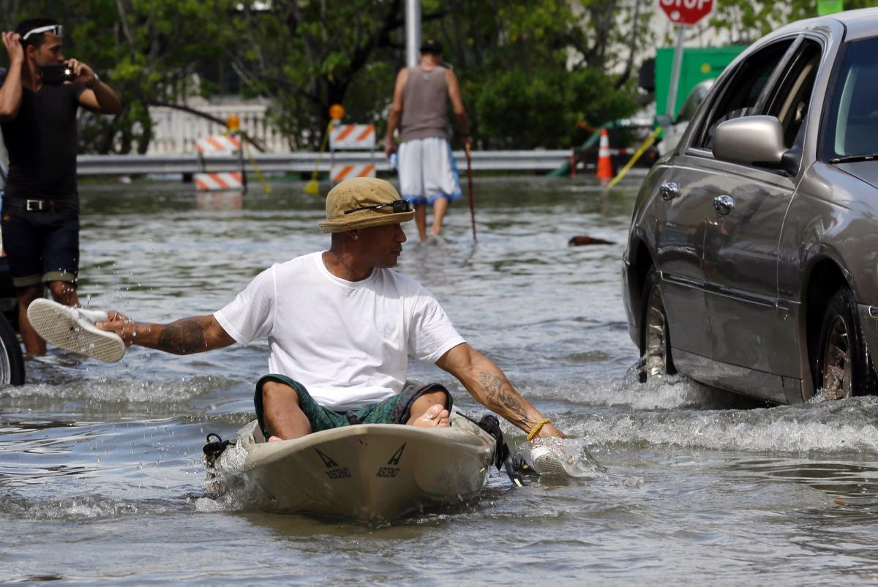
What Caused the Extensive King Tide Flooding in 2015?
Monthly Sea-level in Miami
2015
2006-2017
King Tides
Astronomical tides
source: The New York Times
2015 King Tides were the result of the combined effect of long-term sea level rise with interannual sea level variability
1995-2005
J F M A M J J A S O N D
Sea-level data from NOAA/NOS/CO-OPS
Notes:
References:
Domingues, R., Goni, G., Baringer, M., & Volkov, D. (2018). What caused the accelerated sea level changes along the US East Coast during 2010–2015?. Geophysical Research Letters, 45(24), 13-367.

Slide 14
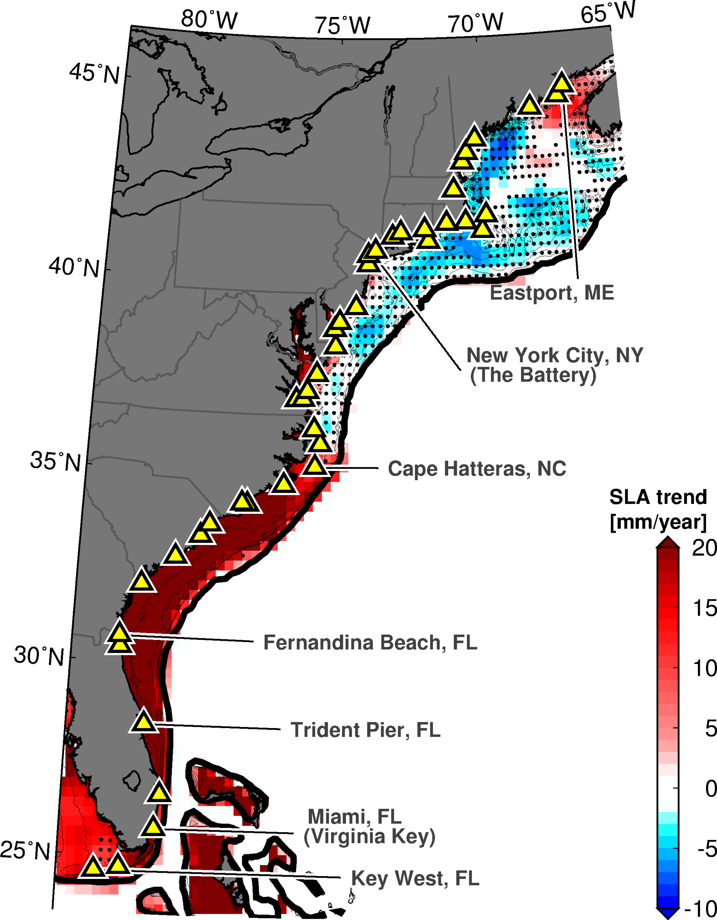
What Caused the Extensive King Tide Flooding in 2015?
1993-2016 Sea Level Rise
2010-2015 Sea Level Change
Notes:
References:
Domingues, R., Goni, G., Baringer, M., & Volkov, D. (2018). What caused the accelerated sea level changes along the US East Coast during 2010–2015?. Geophysical Research Letters, 45(24), 13-367.

Slide 15
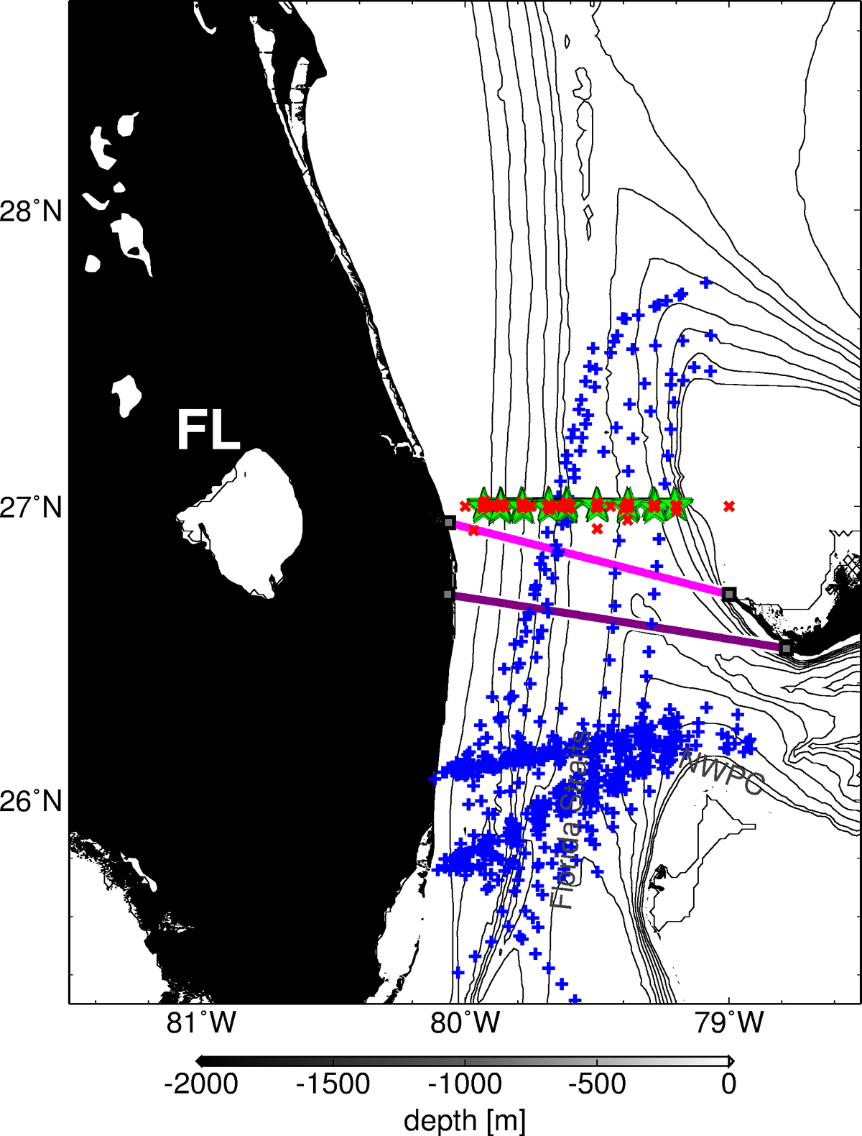

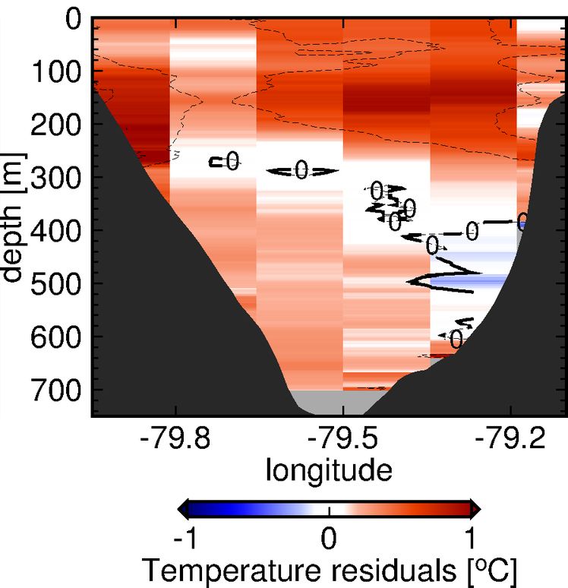

What Caused the Extensive King Tide Flooding in 2015?
Florida Current Temperature Anomalies
(Fall 2015)
Cape Canaveral
Bahamas
Miami
Warming of the Florida Current caused
10 cm of anomalous sea level rise during 2010-2015, contributing to the 2015 flooding
funded by CPO/OOMD
Domingues et al., (2018)
Notes:
References:
Domingues, R., Goni, G., Baringer, M., & Volkov, D. (2018). What caused the accelerated sea level changes along the US East Coast during 2010–2015?. Geophysical Research Letters, 45(24), 13-367.

Slide 16
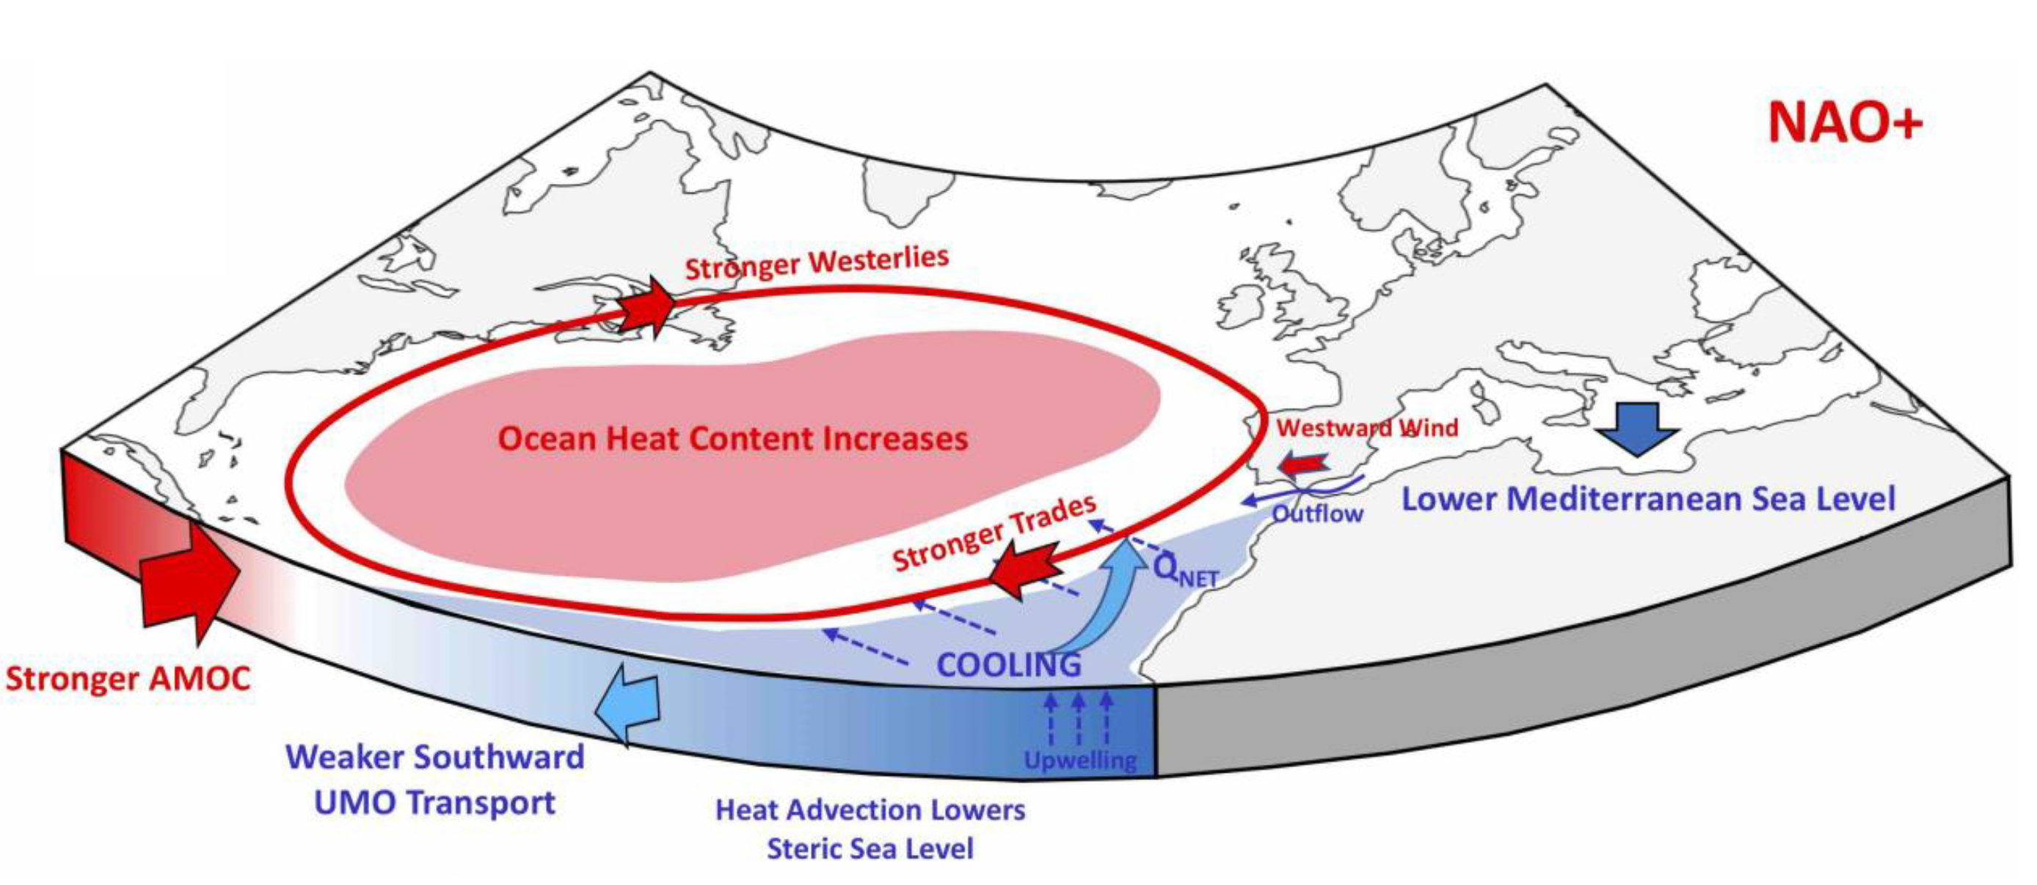
Warming of the Florida Current during 2010-2015
AMOC and NAO driven Large-scale Heat Convergence
Warming of the Florida Current associated with large-scale heat convergence in the North Atlantic's subtropical gyre heat content caused by changes in the Meridional Heat Transport
Volkov et al., (2019), Domingues et al., (2018)
Notes:
References:
Domingues, R., Goni, G., Baringer, M., & Volkov, D. (2018). What caused the accelerated sea level changes along the US East Coast during 2010–2015?. Geophysical Research Letters, 45(24), 13-367.
Volkov, D. L., Lee, S. K., Domingues, R., Zhang, H., & Goes, M. (2019). Interannual sea level variability along the southeastern seaboard of the United States in relation to the gyre‐scale heat divergence in the North Atlantic. Geophysical Research Letters.

Slide 17
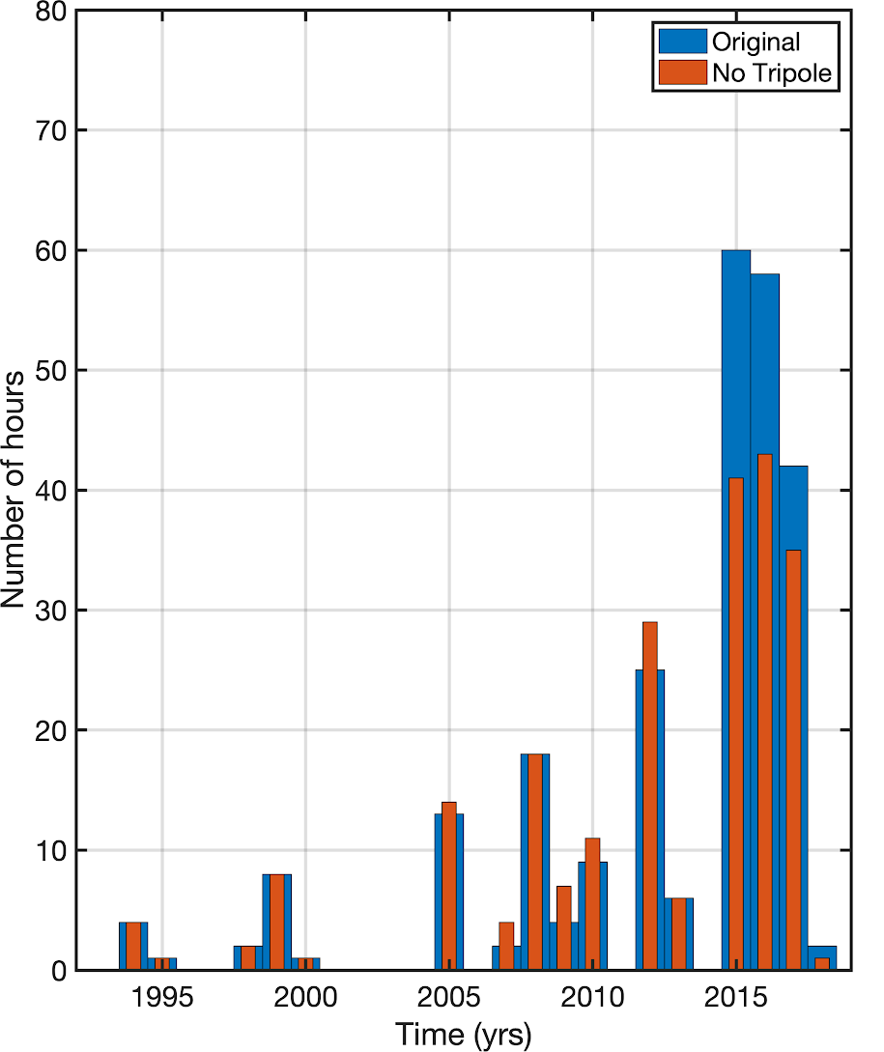
Large-scale Effects on Sunny Day Flooding in Miami
Interannual heat convergence in the North Atlantic is playing a significant role to increase the number of flooding hours in Miami
Sea-level data from NOAA/NOS/CO-OPS
Volkov et al., (in preparation)

Slide 18
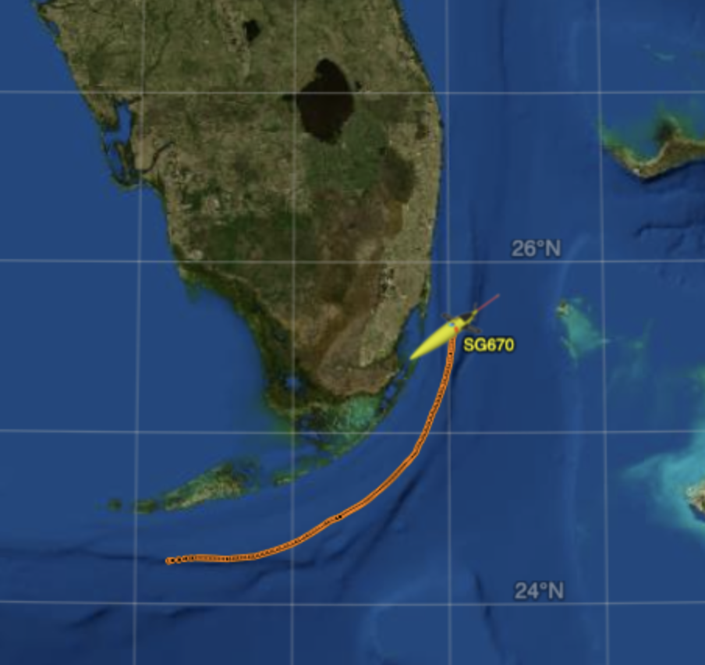
Applications & Plans
Results presented here are currently helping plan for resiliency efforts led by Southeast Florida Regional Climate Change Compact*
Potential future applications and partnerships:
NOAA/NOS seasonal sea-level outlook
NOAA/NWS storm surge probabilities and forecasts
Expand Observing Capabilities
*https://southeastfloridaclimatecompact.org/
Notes:
Southeast Florida Regional Climate Change Compact: https://southeastfloridaclimatecompact.org/

Slide 19
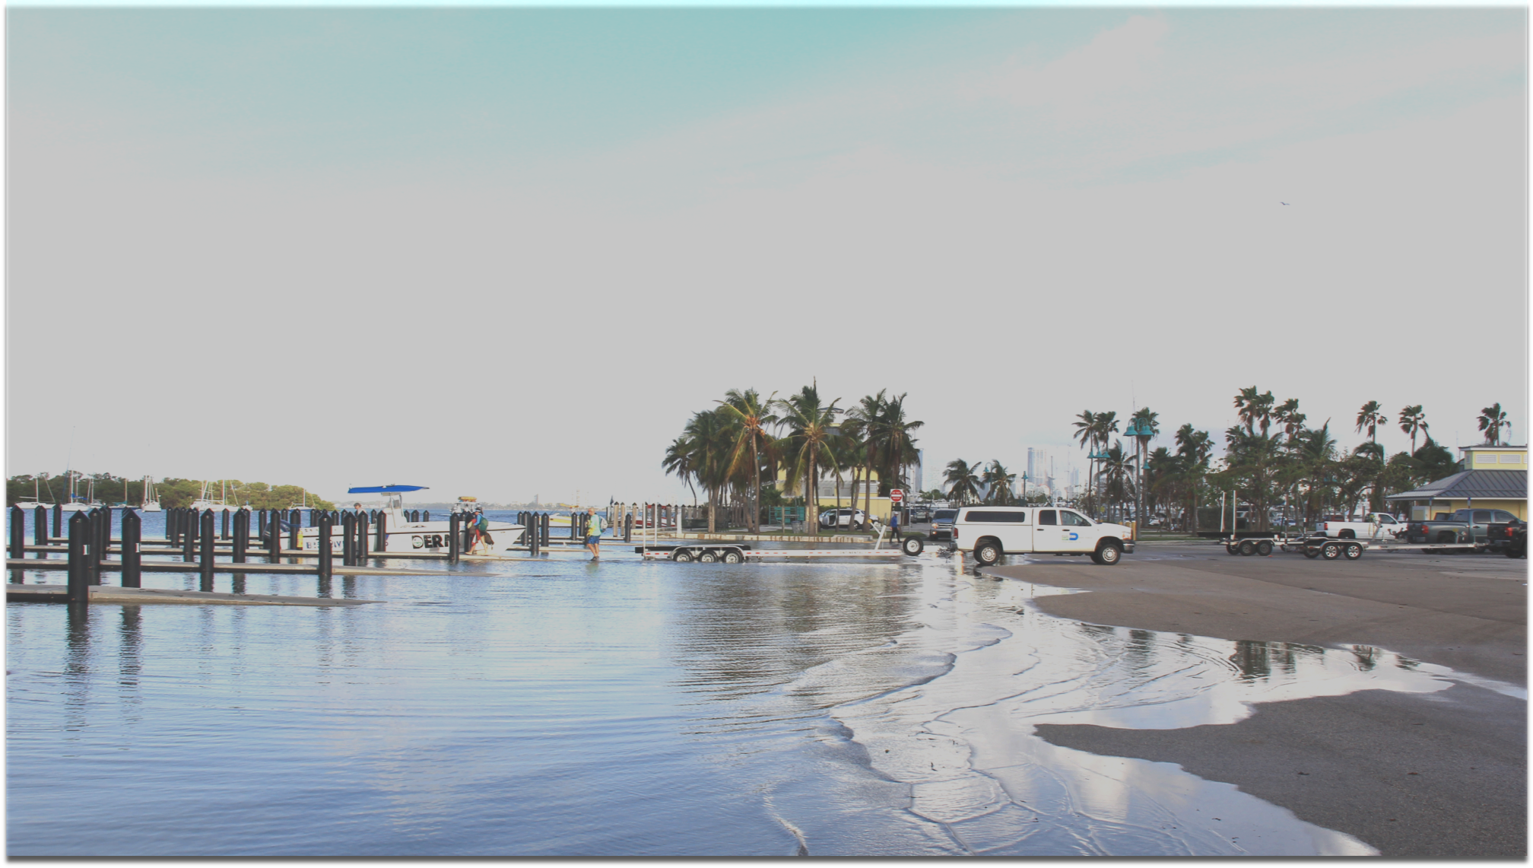








Thank you!
AOML Laboratory Review
Miami, November 19, 2019
Photo by Grant Rawson (UM/CIMAS)

