Slide 1
AOML Overview
2019 AOML Review
John Cortinas, Ph.D., Director

Slide 2


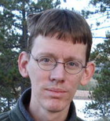

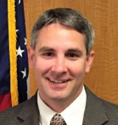

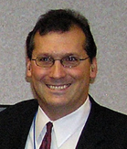
2019 AOML Review Panel
Arlindo da Silva, Ph.D. - NASA (Review Chair)
Bill Lau, Ph.D. - Univ. of Maryland
George Bryan, Ph.D. - NCAR
Laura Lorenzoni, Ph.D. USF/on IPA to NASA
Steve Thur, Ph.D. - NOAA/NOS
Daniel Rudnick, Ph.D. - Scripps
Paul DiGiacomo, Ph.D. - NOAA/NESDIS/STAR

Slide 3
Review Criteria
Quality
Publications, citations (e.g., H-index), committees, awards
Relevance
Transitions, co-authors with other partners, stakeholder engagement
Performance
Alignment with priorities, resource management, employee engagement, outreach metrics

Slide 4
Reviewer Feedback Request
Building collaborations
Quantifying the value of AOML’s research
Enhancing the communication of AOML research
Managing science to address NOAA’s needs
Retaining and building a diverse scientific workforce for the future
Identifying emerging research areas

Slide 5
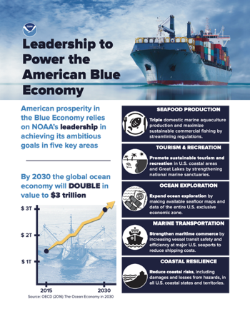
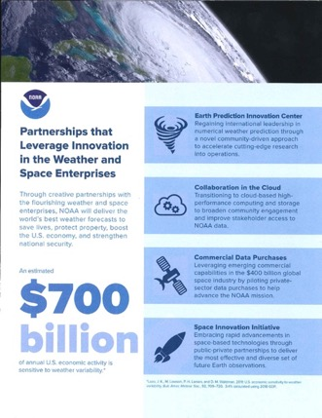
NOAA Priorities
Blue Economy
Increase the sustainable economic contributions of our fishery and ocean resources
Weather Act
Reduce the impact of extreme weather and water events

Slide 6





OAR Vison, Mission, and Goals
VISION:
MISSION:
Deliver NOAA’s Future
Research, Develop, Transition – Conduct research to understand and predict the Earth system; develop technology to improve NOAA science, service, and stewardship; and transition the results so they are useful to society
GOALS:
Explore the Marine Environment
Define the characteristics of the ocean, coastal areas, and their resources for mission, management, and knowledge.
Detect Changes in the Ocean & Atmosphere
Produce long-term observation records for NOAA’s operational services; to identify changes in the Earth System and understand them.
Make Forecasts Better
Improve accuracy of weather, water, ocean, and climate forecasts and predictions to support a vibrant economy and save lives and property.
Drive Innovative Science
Deliver innovative research to advance NOAA’s mission using the unique capabilities of NOAA’s research community.

Slide 7
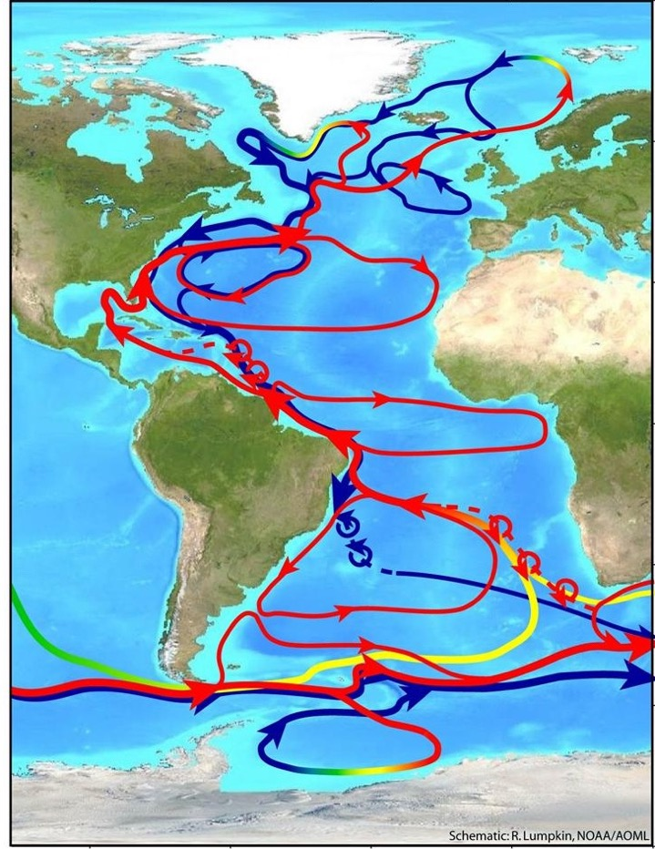
AOML Mission
The Atlantic Oceanographic and Meteorological Laboratory conducts research to understand the physical, chemical, and biological characteristics and processes of the ocean and the atmosphere, both separately and as a coupled system.
The principal focus of these investigations is to conduct NOAA’s mission with knowledge that leads to more accurate forecasting of severe storms, better use and management of marine resources, better understanding of the factors affecting both climate and environmental quality, and improved ocean and weather services for the nation.

Slide 8
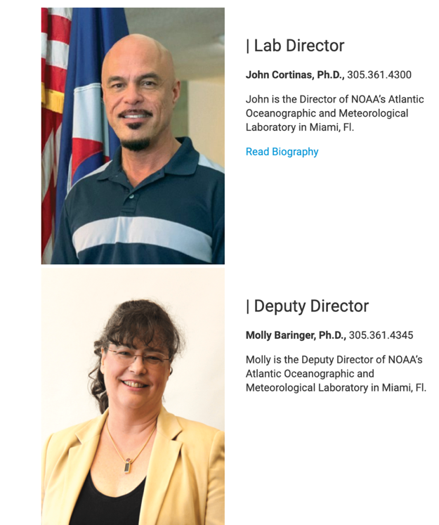
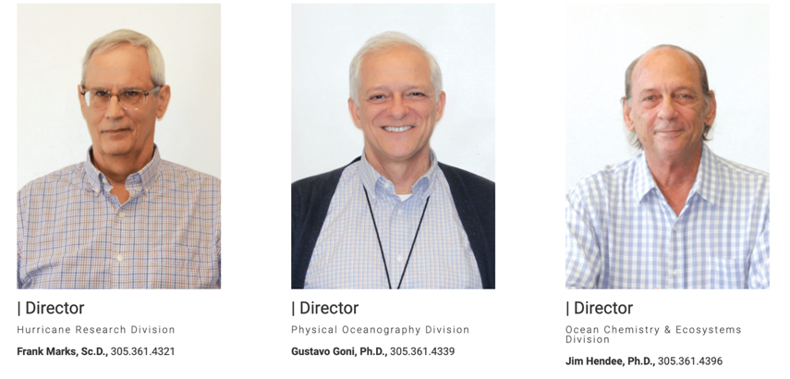
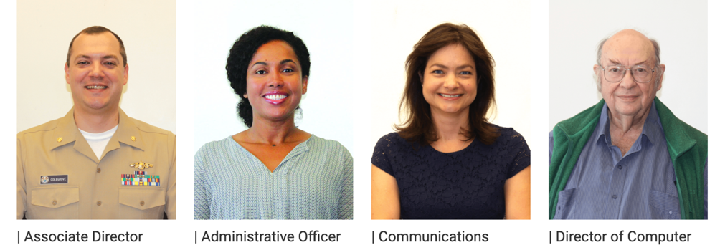
AOML Organization
John Cortinas
Hurricane Research
Physical Oceanography Research
Ocean Chemistry & Ecosystems Research
Molly Baringer

Slide 9
Hurricane Research Division
Characterize, understand, and predict physical process important to the prediction of tropical cyclone track, intensity, and structure change and their impacts (rainfall, storm surge, flooding, damaging waves, winds, and severe weather) in support of AOML’s Hurricane Field Program.
Optimize the use of current and proposed observations to improve global and hurricane forecast guidance.
Advance hurricane forecast guidance by creating and verifying the next generation numerical models, and advancing data assimilation techniques in support of NOAA’s unified forecast system.
Emerging activities: NOAA Unified Forecast System (UFS), unmanned aerial systems
Science Themes

Slide 10
Physical Oceanography Division
Observe variations in the ocean circulation and property transport from fine-scale mixing to long-term climate change and improve our understanding of the physical processes and mechanisms that control these variations.
Characterize, understand and predict the influence of the ocean on regional and global climate, extreme weather, sea level, and ecosystems to improve assessments, outlooks, forecasts, and resource management.
Evaluate how new and existing observations improve ocean modeling forecasts, outlooks, and assessments.
Emerging Activity: Autonomous underwater vehicles, NWS marine weather mission, sargassum research, biogeochemical (BGC) Argo
Science Themes

Slide 11
Ocean Chemistry and Ecosystems Division
Quantify the role of the oceans in sequestering carbon dioxide and the role and feedback of coastal oceans in the marine carbon cycle.
Characterize, understand and predict the impact of remote and local forcing pressures, including climate change, ocean acidification, and land-based sources of pollution, and their synergistic interactions, on critical marine ecosystems.
Apply data, models, and ecological assessments for resource management decision support.
Emerging Activities: BGC Argo, ‘Omics
Science Themes

Slide 12
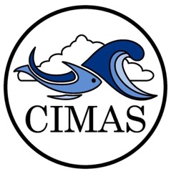
Cooperative Institutes
Climate Research & Impacts
Tropical Weather
Sustained Ocean and Coastal Observation
Ocean Modeling
Ecosystem Modeling and Forecasting
Ecosystem Management
Protection and Restoration of Resources
Research Themes
Ecosystem Management
Effective and Efficient Data Management Systems Supporting a Data-driven Economy
Climate Change and Climate Variability Effects on Regional Ecosystems
Coastal Hazards

Slide 13
AOML Budget
Hurricane Supplemental funding varies year to year: $0 to $6.7M

Slide 14

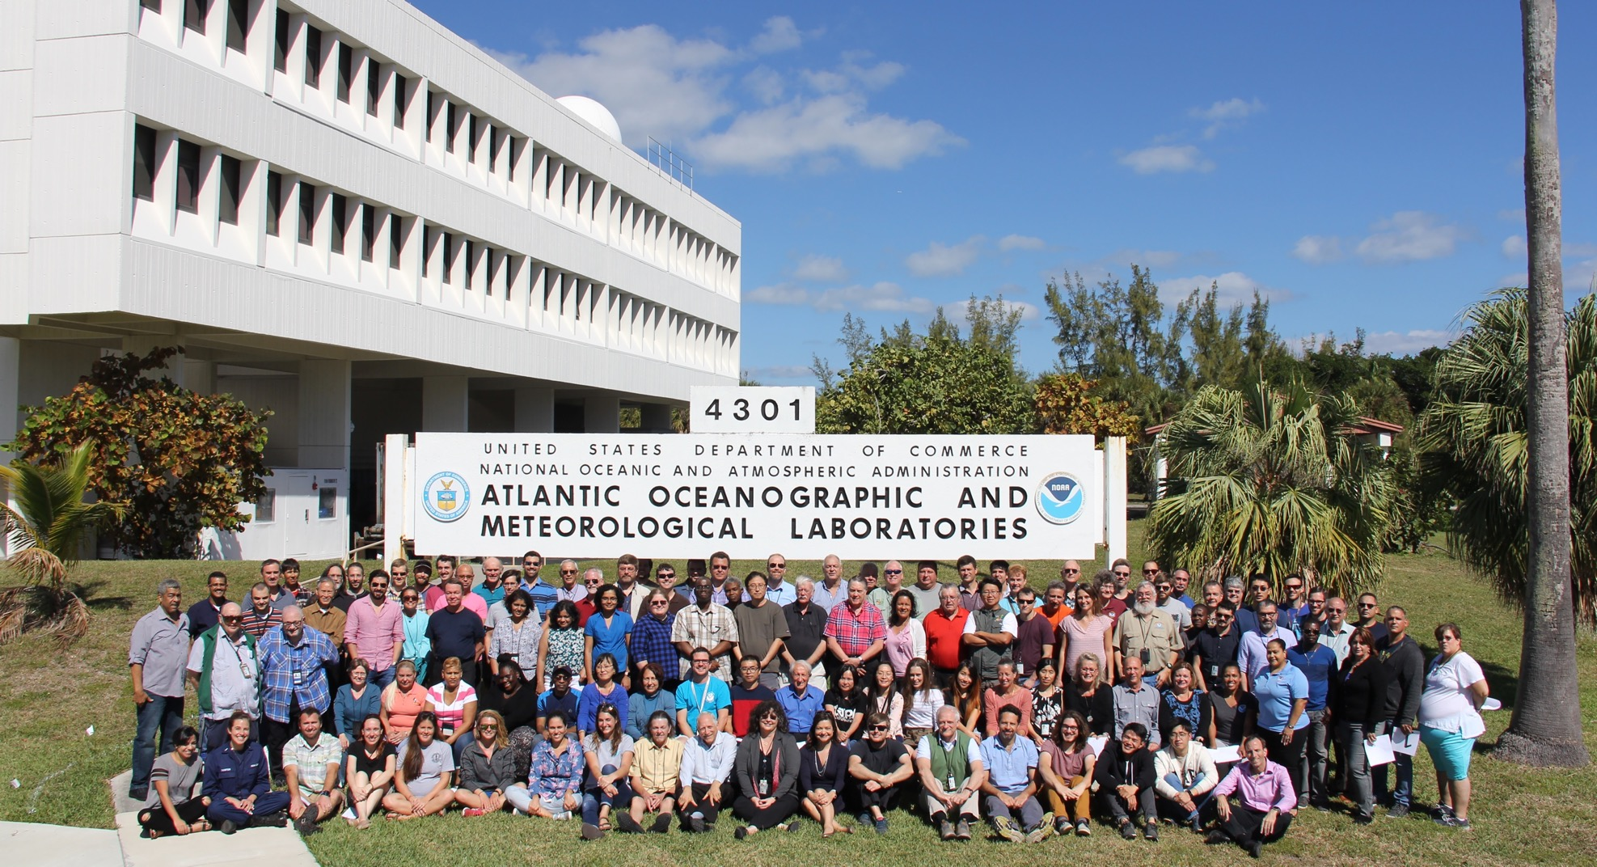

Slide 15
AOML Resources
35% of federal workforce is retirement eligible
26% more are eligible in within 5 years
34% of federal employees represent minorities in STEM
AOML’s federal workforce is 31% female

Slide 16
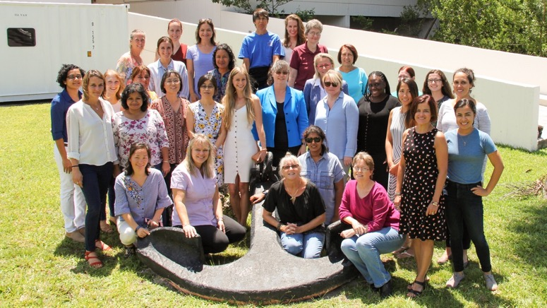
Diversity and Inclusion
AOML’s Diversity, Inclusion and YOU! (DIY)
Engagement with Minority Serving Institutions (e.g., NOAA Cooperative Science Centers)
Employee engagement in minority-serving and major scientific organizations
Outreach to school groups, career fairs, and high school intern programs (e.g, NOAA Open House)
#Women@AOML

Slide 17
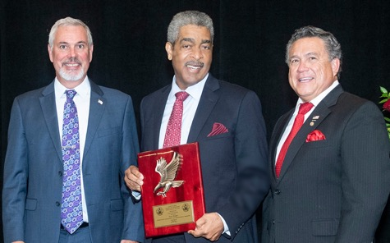
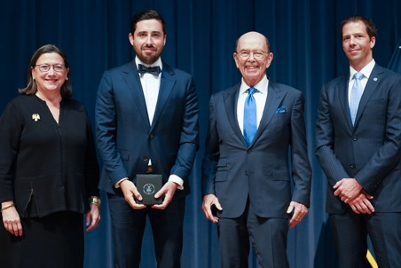
AOML Honors and Awards
2014 - 2019
State/Local
South Florida Federal Employee of the Year (10)
Leadership Circle of CLEO
Program Development Award
DOC/NOAA/OAR
DOC Gold Medalists (2)
DOC Silver Medalists (6)
DOC Bronze Medalists (4)
NOAA Administrator’s Award (10)
NOAA Albritton Communicator Award
NOAA EEO Diversity
NOAA Employee of the Month (3)
NOAA Employee of the Year (2)
NOAA Energy and Environmental Stewardship
NOAA Order of Sherman’s Lagoon (2)
NOAA Team Member of the Month (5)
OAR Outstanding Scientific Paper Award (2)
National
AMS Banner I Miller Award
AMS Special Award
AMS Fellow
Excellence in Partnering Award
Laureate Award for Dual Defense Use Award
Special Appreciation Award
International
The Denny Medal—Institute of Marine Engineering, Science, and Technology
Outstanding Reviewer Award—IOP Publishing
Sustainability Award—Netherland-America Foundation
Early Career Scientist Award—International Union of Geodesy and Geophysics
Notes:
2014 - 2019

Slide 18
112

Slide 19
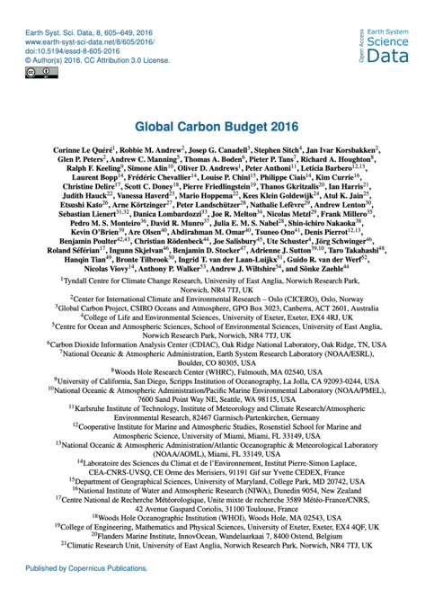
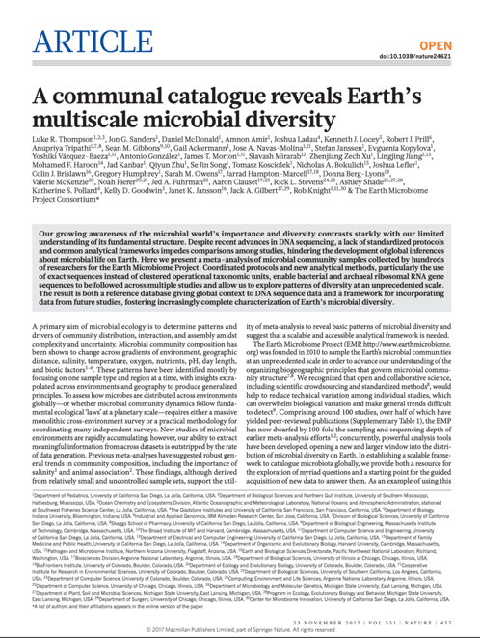
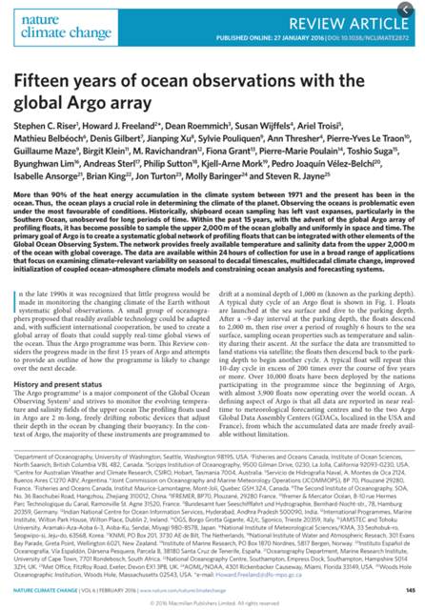


Recent Most Cited Research
149 citations
(2015)
496 citations
(2016)
244 citations
(2017)
156 citations
(2016)
Notes:
Global Carbon Budget 2016https://www.earth-syst-sci-data.net/8/605/2016/
A communal catalogue reveals Earth's multiscale microbial diversity
https://www.nature.com/articles/nature24621
Fifteen years of ocean observations with the global Argo array
https://www.nature.com/articles/nclimate2872
The reinvigoration of the Southern Ocean carbon sink
https://science.sciencemag.org/content/349/6253/1221.editor-summary

Slide 20
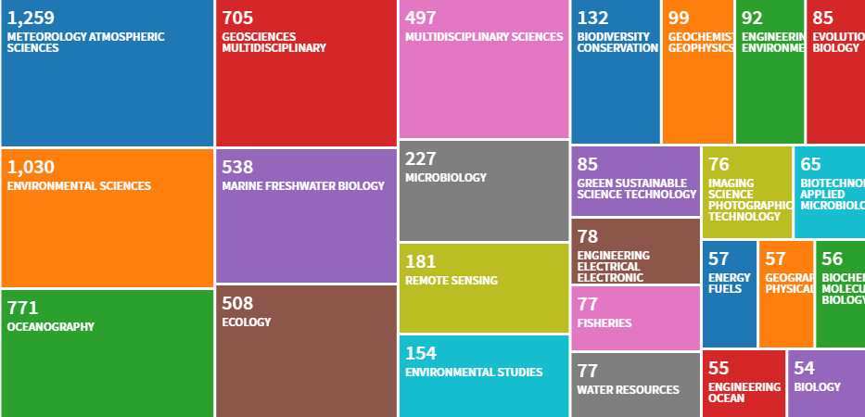
Fields of study citing AOML research

Slide 21
Transitions (40 in total in FY19)
15 of these transitions were at readiness level 9
Readiness Level 1-3
Readiness Level 4-6
Readiness Level 7-9
2
6
32
Total number of projects in early development
Total number of projects in demonstration/validation
Total number of projects transitioning to operations or application

Slide 22
AOML Outreach by the Numbers
Life-long learners reached
Social Media
Student Interns 2015-2019
129k
115
8,734
Followers
Students and public reached through outreach since 2015
Post-docs, EPP, Hollings Scholars, and high school volunteers
Twitter and You Tube
@NOAA_AOML

Slide 23

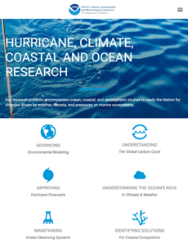
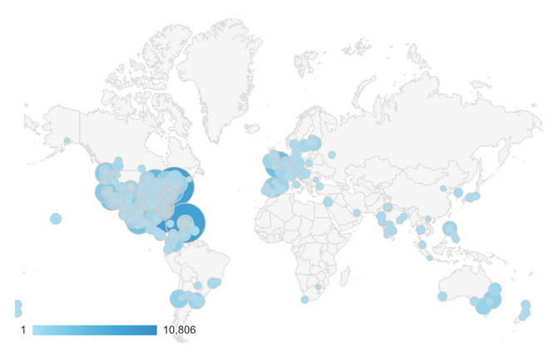

Web performance since AOML launched a complete redesign of our website July 8, 2019
Users Referred by Another Site
94k
Referral Traffic
3X more mobile viewers
Major Sites Value and Share Links to Our Content
415k
Visits from around the globe to the new website
6% bounce rate
Returning Users Stay Longer
Notes:
Explanation for web performance by the Numbers:
Reduction in Bounce Rate (a positive):
A bounce rate is when a visitor comes to your site, makes no other action, and leaves indicating some dissatisfaction with the result. The lower the bounce rate, the more your visitors are happy with their click to your site.
Our First Impression Success is far above average (20-40%). Further, our bounce rate for mobile is very promising, at 7.44% (compared to 86% this time last year)
Increase in Click Through Rate:
Our Content matches what people are searching for on Google (number is double the national average for our position in search (8.9 is our current average search position)
Referral Traffic:
Of 400k visitors, 94k or 23% of our users were referred by another site (not google). This is a 350% Increase from the same time last year. Top referrers include twitter, facebook, national geographic, CNN, axios.com, reddit, weather.com, bbc.com, among others

Slide 24
New Director’s Priorities
People
Incorporate diversity and inclusion into lab culture; ensure fair, inclusive, and transparent decision making; focus on employee performance, training, and recognition
Science
Provide facility that fosters outstanding research and innovation; improve collaborations to ensure research benefits NOAA’s operations through transitions; increase earth system research; incorporate social science into AOML research
Communication
Increase communication of AOML’s research and benefits of such research to the public and key stakeholders.

Slide 25
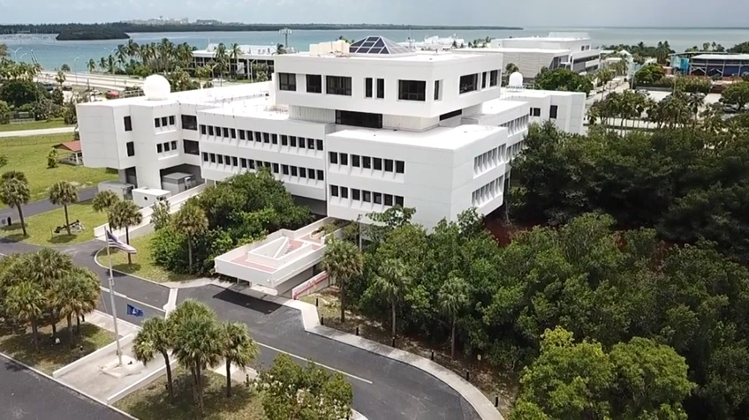
Challenges
Aging facilities
High number of retirement-eligible employees
Flat budget
Greater competition for scientific talent
Evolving role of government scientists
Sustaining flexibility and innovation

Slide 26
Thank You

