Slide 1
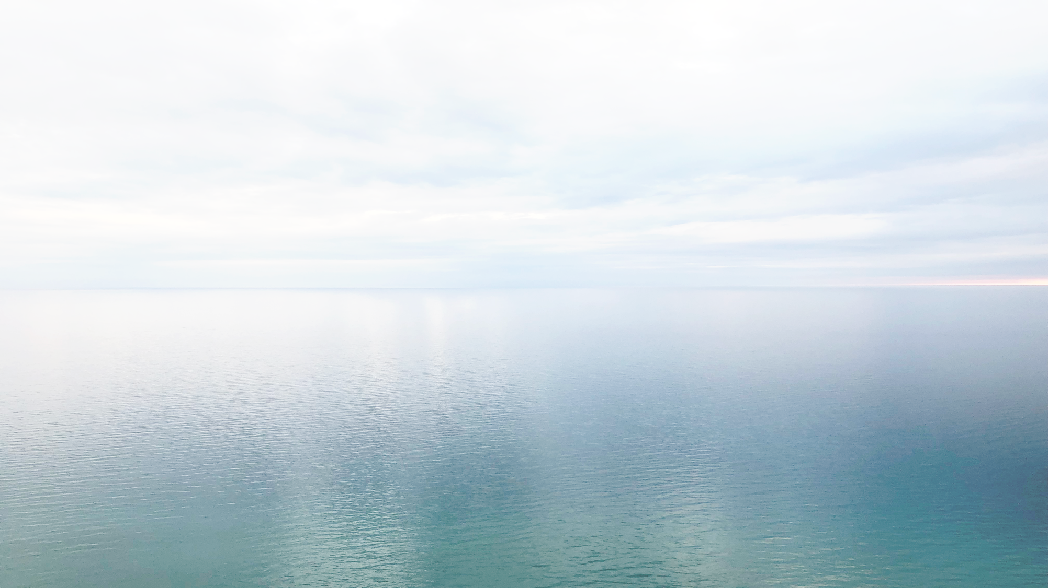
Physical Assets Supporting Science
AOML Infrastructure Overview
LCDR Andrew Colegrove, NOAA
AOML Associate Director

Slide 2
AOML Infrastructure Overview
Current Status
  Main Building, Warehouse, Small Boats, Mobile Containers
Existing Issues
  Aging facility, lack of modern technology
Preparing for the Future
  Immediate (1 Year), Short Term (3 Year), Long Term (Beyond 3 Year)

Slide 3
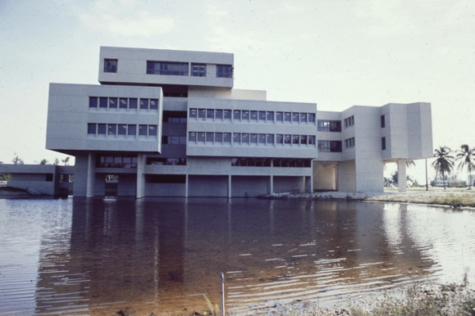
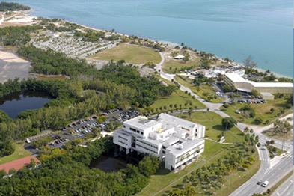
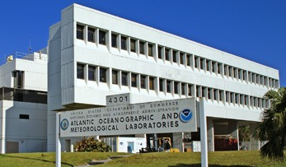
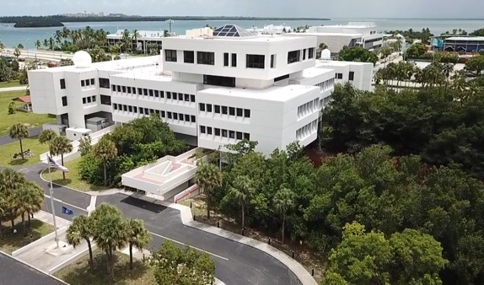
Main Building
Commissioned in 1973
40 year life span
NOAA/OAR owned
57,000 usable sqft
  27,000 office (47%)
  2,690 lab (6%)
Lab Spaces
  Water Quality, Core, Inorganic Chem, Ammonia, Micro Biology, Chlorophyll
1973

Slide 4
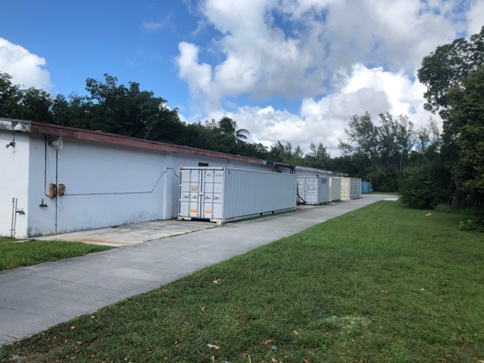
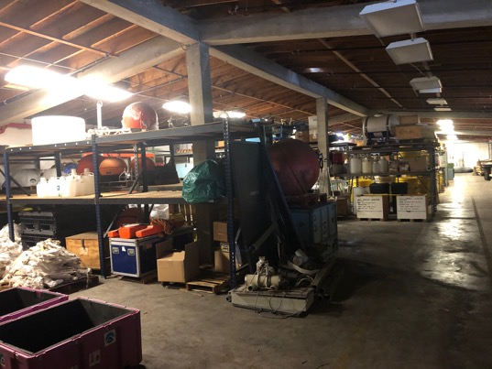
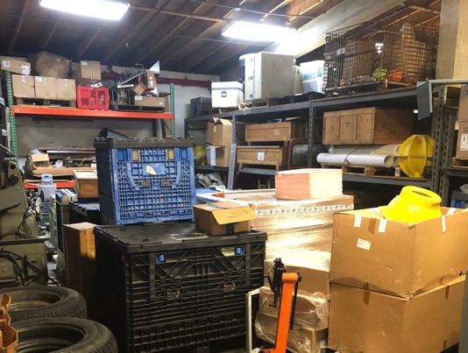
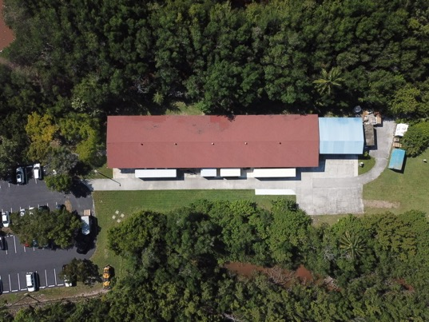
Warehouse
Built 1989
30 year roof life span
10,000 sq. ft.
Multi-level shelving
Multiple storage bays
Not climate controlled
Approaching roof end-of-life

Slide 5
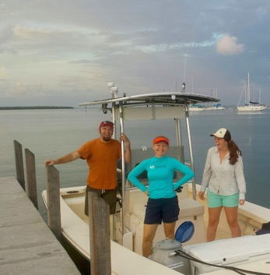
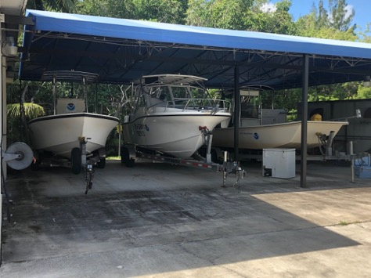
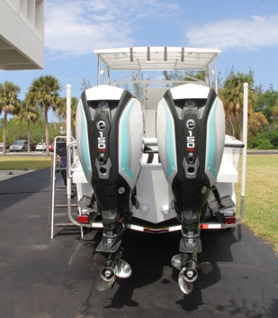
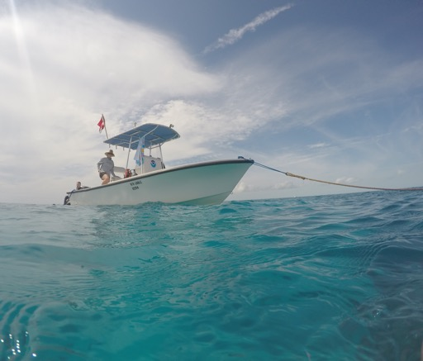
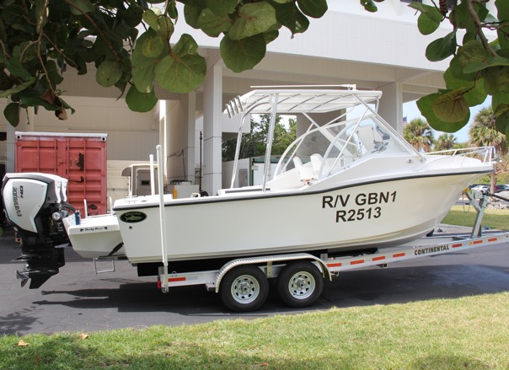
Small Boats
R/V Cable
  21’ Parker
  Built: 1990
R/V GBN1
  25’ Dusky
  Built: 2018
R/V Whipray
  22’ JB
  Built: 2014

Slide 6
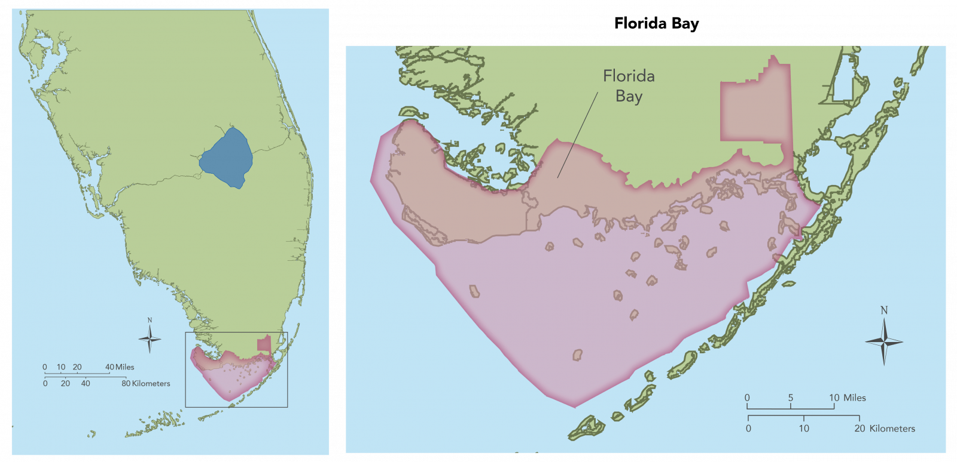
Small Boats
R/V Cable
  21’ Parker
  Built: 1990
R/V GBN1
  25’ Dusky
  Built: 2018
R/V Whipray
  22’ JB
  Built: 2014

Slide 7
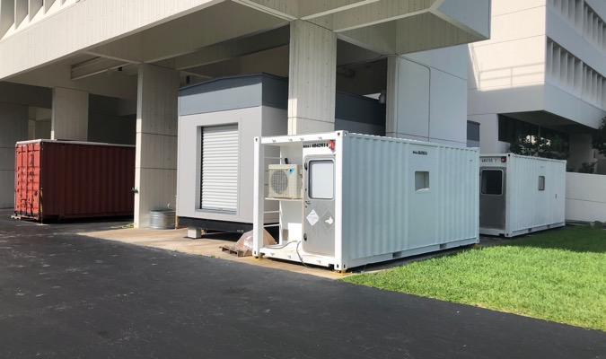
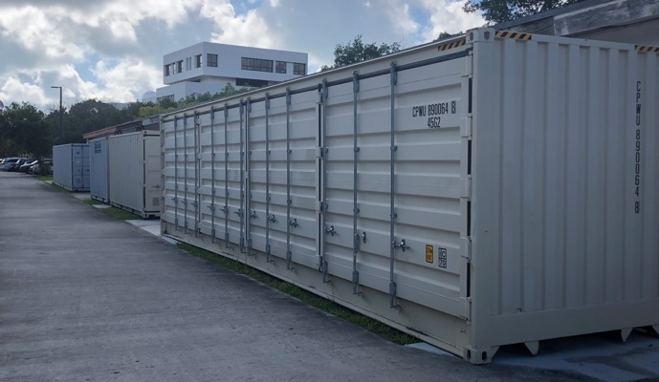
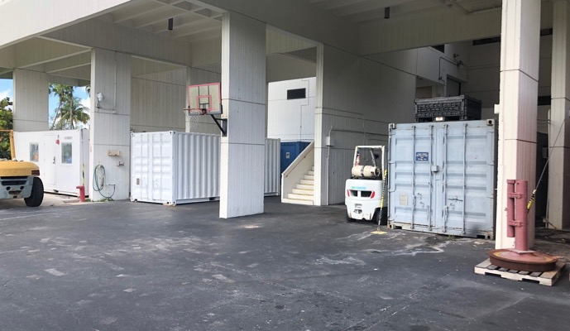
Exterior Containers
Expanding needs
  Cold sample storage
  Gliders
  Buoys
5
6
1
2
A/C Containers
Storage Containers
Occupiable trailer
Mobile Labs
Notes:
5 - A/C containers
6 - Storage containers
1 - Occupiable trailer
2 - Mobile Labs (ships)

Slide 8
Existing Issues
1
Utilities
Failing Roof Systems
HVAC
Water Pressure
Emergency Power
3
Code Compliance
Fire Sprinkler System
4
Modernization
Aging Labs
Lack of Storage
Failing Lab Systems
Wall & Ceiling Deterioration
2
Data & Comms
High Speed Network Systems
Data Center Damage
UPS Clean Power

Slide 9
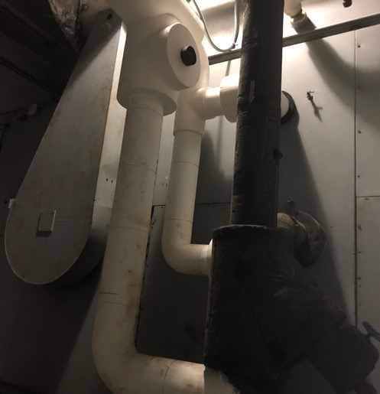
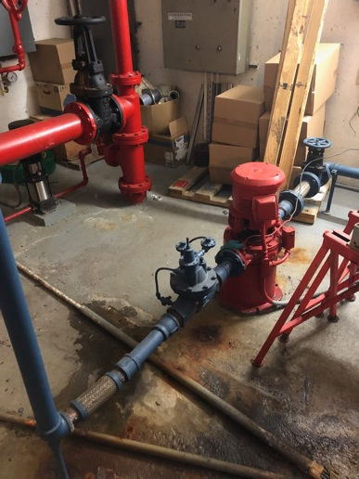
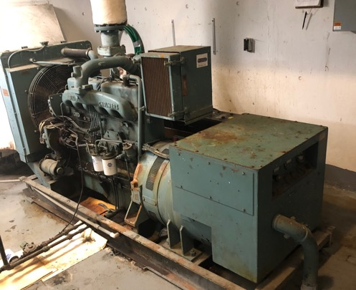
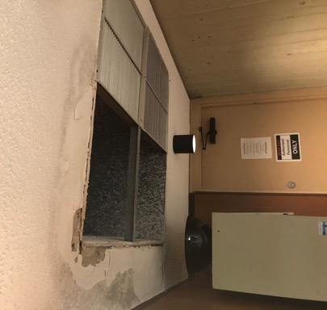
Utilities
Roof Systems
  End of lifespan, failing at seams and penetrations
HVAC
  Aged & inefficient
  Leaking condensation
Water Pressure
  Failed Lift station pump
Emergency Power
  No functional or sufficient source of back-up power

Slide 10
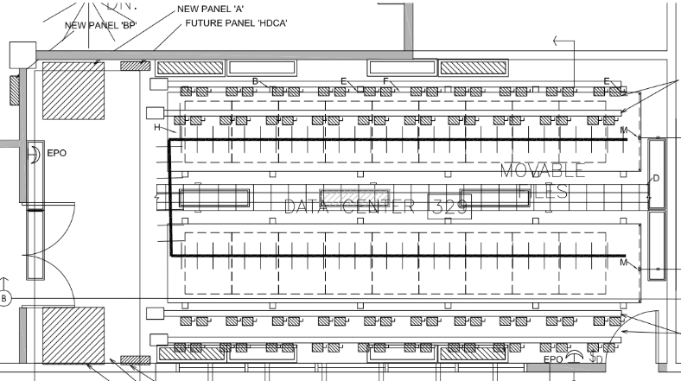
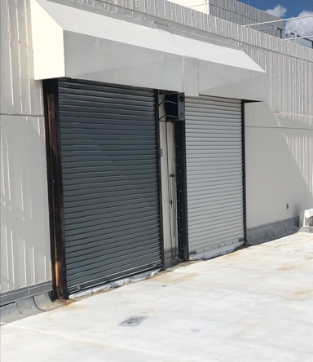
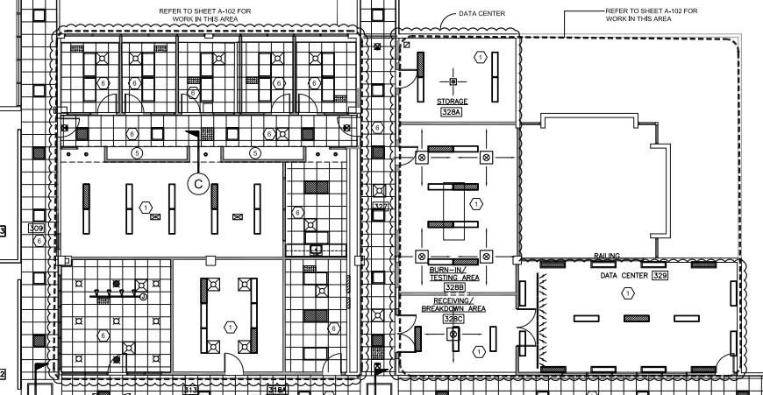
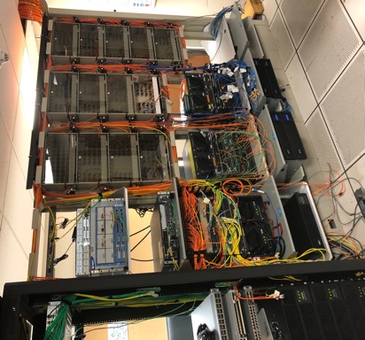
Data & Comms
High Speed Data Needs
  Facility re-cabling
  High speed backbone
Data Center Damage
  Poor facility placement
  Faulty roll-up doors
UPS Clean Power
  Provide clean power to data center & labs

Slide 11
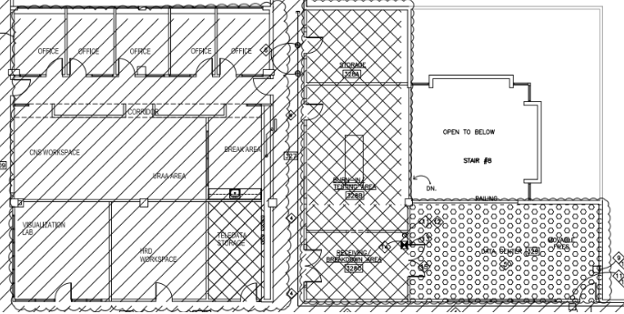
Code Compliance
Sprinkler System
  Required for renovations
  Needed for whole facility

Slide 12
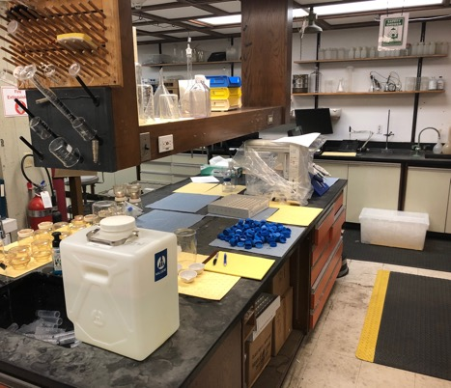
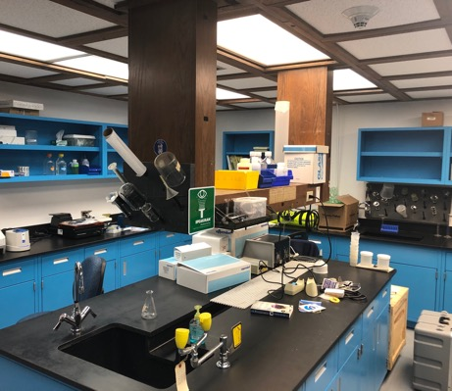
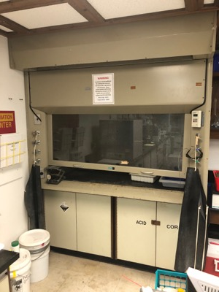
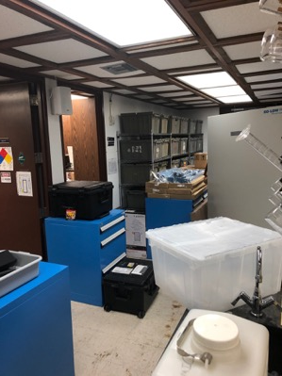
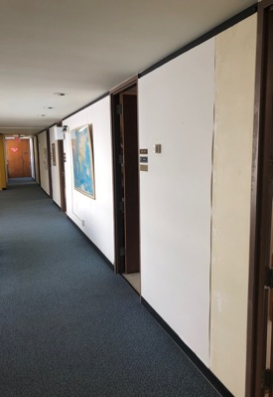
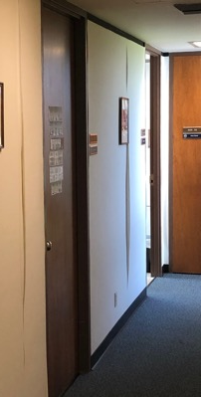
Modernization
Failing Lab Systems
Fume hoods, clean power
Aging Labs
Utilities, work surfaces, sink basins, drainage, lighting
Lack of Storage
Lab space used for storage
Utilizing exterior A/C containers is inefficient and costly
Wall & Ceiling Deterioration Throughout the facility
Notes:
Failing Lab Systems
Fume hoods, clean power
Aging Labs
Utilities, work surfaces, sink basins, drainage, lighting
Lack of Storage
Lab space used for storage
Utilizing exterior A/C containers is inefficient and costly
Wall & Ceiling Deterioration
Throughout the facility

Slide 13
Preparing for the Future
1
Immediate Plan (FY20)
Critical Facility Needs
  Keeping the weather outside
  Hurricane Damage Repair & Prevention
  Main Roof Replacement
  HVAC replacement
  Fire Sprinkler System
  E-Power Backup
2
Short-Term Plan (FY20 - FY22)
Updating Workspaces & facility capabilities
  Fume Hood Replacement
  Wall & ceiling resurfacing
  Renovate office spaces
  IT/Data re-cable
  UPS Clean Power
  VAV Climate Control
3
Long-Term Plan (Beyond FY22)
Infrastructure Improvements
  Warehouse rebuild or renovate for A/C
  Renovate laboratory spaces
  Conference & meeting room renovations
  Workshop renovations

Slide 14
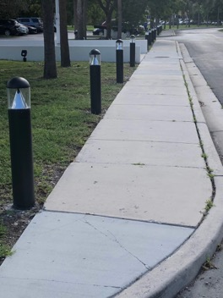
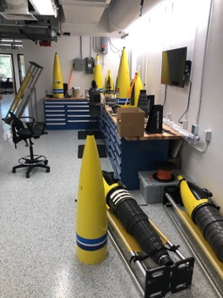
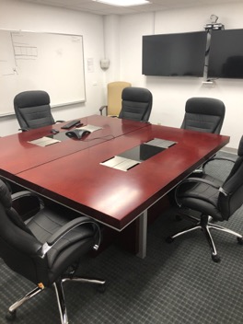
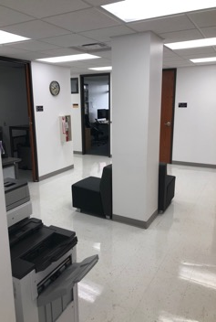
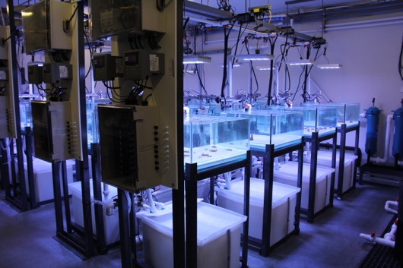
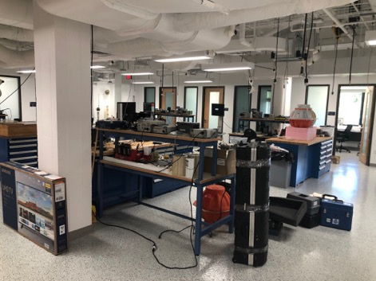
Accomplishments So Far
Admin Space Renovation
  Updated meeting room
  Large common administrative space
PhOD Engineering Renovation
  Significant functional improvement
  New meeting space
  Supports Glider engineering
Experimental Coral Lab at RSMAS
Exterior pathway lighting

Slide 15
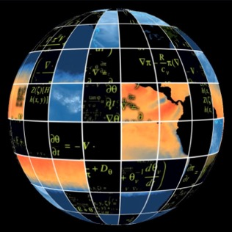
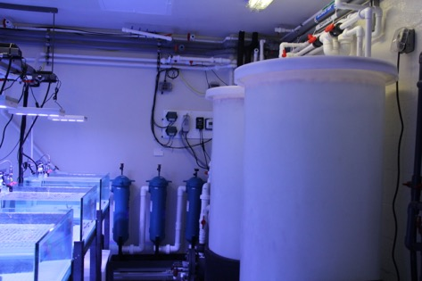
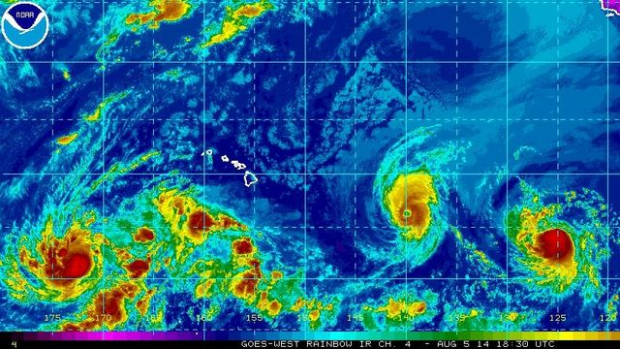
Powering the Science
Need Direct Access to Ocean Water
  Coral reef restoration
  Local event response
  SEFSC Partnership
Potential for High Performance Computing
  Support AI research
  Aligns with OCIO HPC Strategic Plan
  Support HRD real-time data needs
Small Boat Improvements
  Increase survey distance beyond 20nm
  Increase scientific reach & capability

Slide 16
THANK YOU
Questions?

