Slide 1
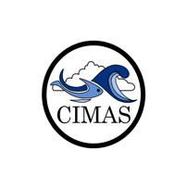
Understanding Ocean Acidification on the regional scale in the Atlantic Ocean and Gulf of Mexico
Leticia Barbero, OCED

Slide 2
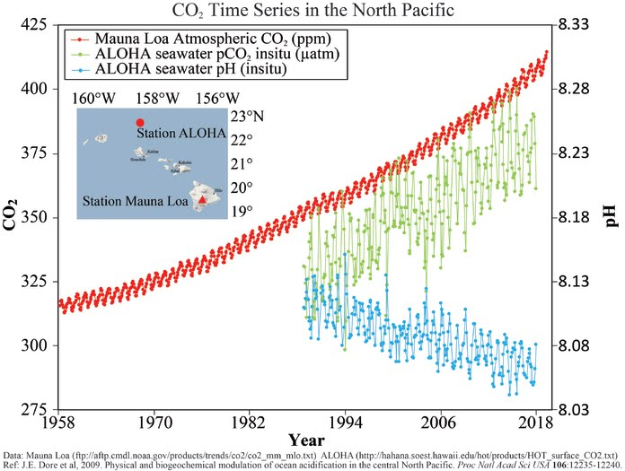
What is Ocean Acidification?
CO₂ + H₂O H₂CO₃⁻ HCO₃⁻ + H⁺ CO₃⁻ + H⁺
[H⁺] & [CO₃⁻]

Slide 3
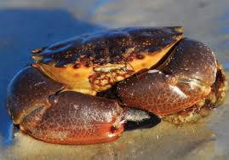
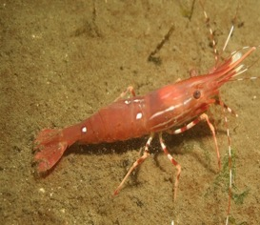
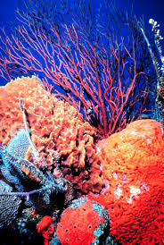
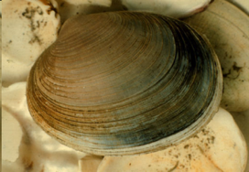
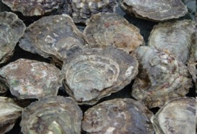
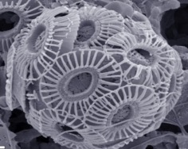
What is Ocean Acidification?
CO₂ + H₂O H₂CO₃⁻ HCO₃⁻ + H⁺ CO₃⁻ + H⁺
[H⁺] & [CO₃⁻]

Slide 4
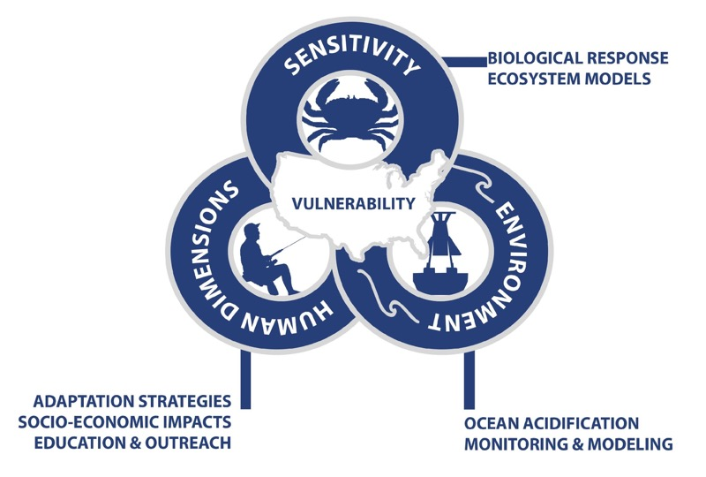


Why study Ocean Acidification?
FOARAM ACT: Federal Ocean Acidification Research and Monitoring Act of 2009

Slide 5
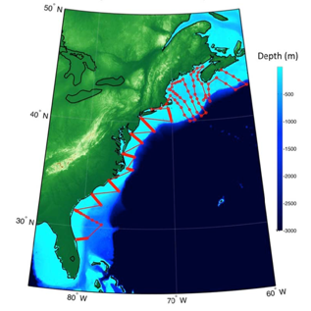
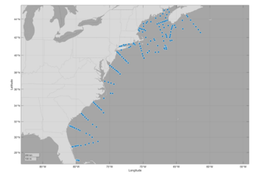
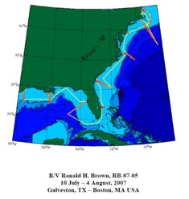
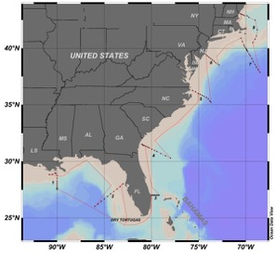
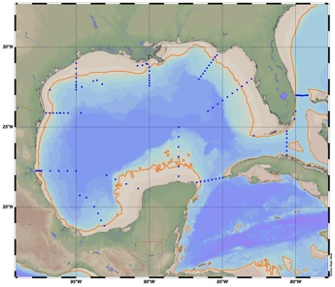

Coastal Ocean Acidification monitoring
2012
GOMECC-2
2017
GOMECC-3
2021
GOMECC-4
2007
GOMECC-1
2015
ECOA-1
2018
ECOA-2

Slide 6

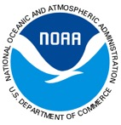

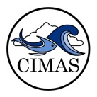













Coastal Ocean Acidification Partnerships
Federal
Academic
International

Slide 7
How do we make a difference?
Climate quality datasets of OA parameters in GoM and East coast submitted to NCEI
Working towards data synthesis of US coastal OA (collaboration with NCEI and PMEL)
Model training and validation (e.g. OAPS, machine learning, ROMS, models)
Outreach and communication

Slide 8
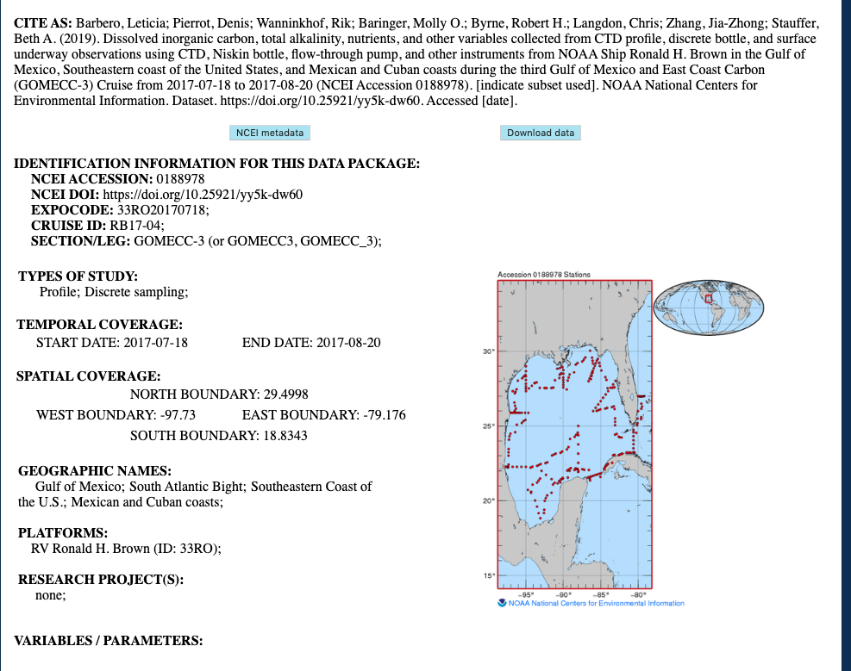
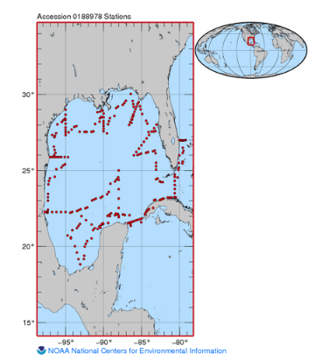
Climate quality datasets of ocean acidification in GoM and East coast submitted to NCEI
https://doi.org/10.25921/yy5k-dw60

Slide 9
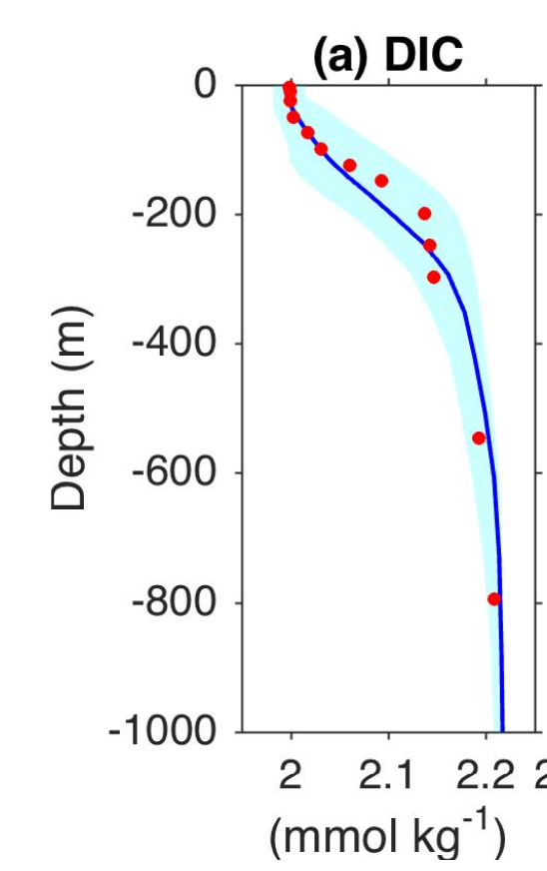
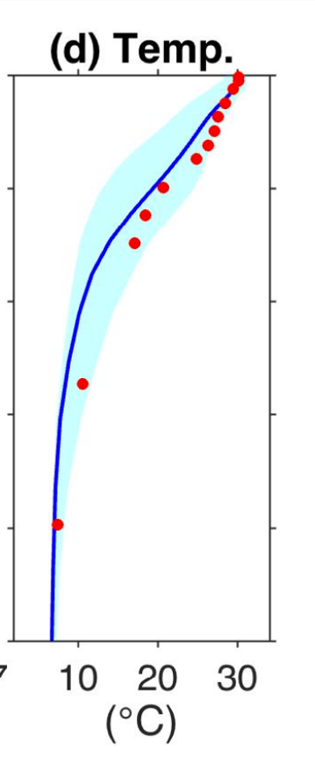
Model training and validation (e.g. OAPS, machine learning, ROMS, models)
Gomez et al., 2019 (in review)

Slide 10
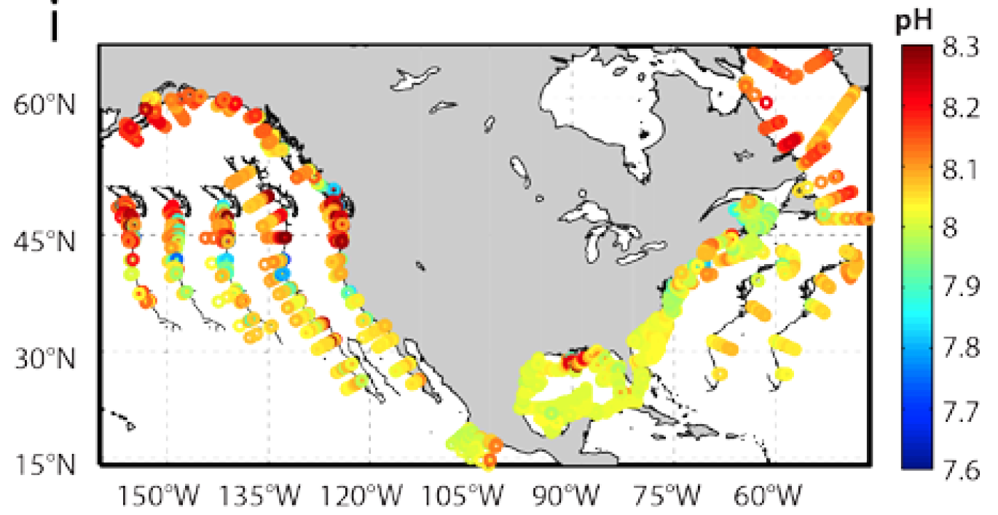
Working towards data synthesis of US coastal OA (collaboration with NCEI and PMEL)
Cai et al., 2019 (submitted)

Slide 11
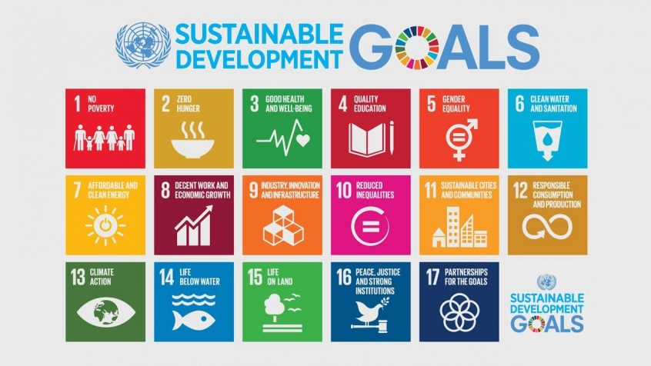
Outreach and communication
2030 Agenda for Sustainable Development, adopted by all United Nations Member States in 2015

Slide 12


Outreach and communication
Target 14.3: Reduce ocean acidification
UN definition: “Minimize and address the impacts of ocean acidification, including through enhanced scientific cooperation at all levels.”
Goal: Minimize and address the impacts of ocean acidification by 2030.

Slide 13
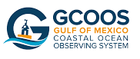
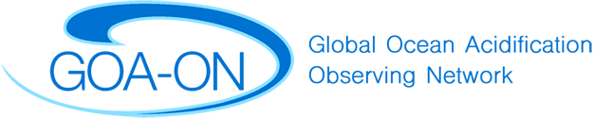

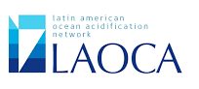
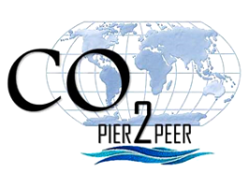
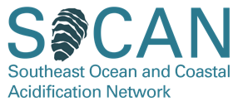

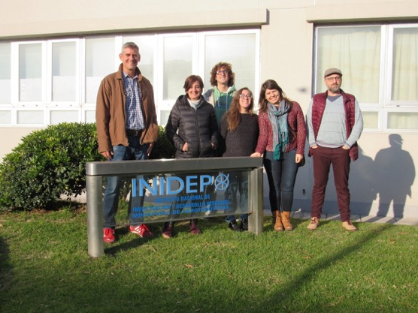
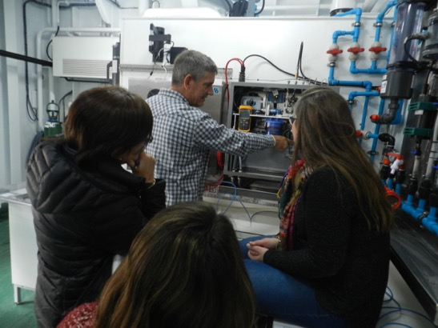
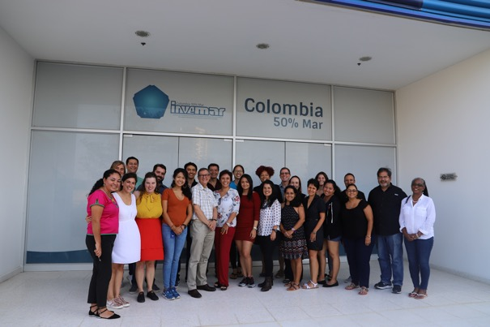
Outreach and communication

Slide 14
Coastal OA: what’s next
2021: GOMECC-4,
2022: ECOA-3
Extend modelling efforts to nowcast and forecast, expand area from GoM to East coast
Ongoing seasonal monitoring in Northeast: EcoMon cruises, NEFSC collaboration, HABs, ongoing coastal SOOP.
Expand portfolio of OA-related ecosystem monitoring through collaborations with partners and stakeholders.

Slide 15
What NOAA strategic directives does our group address?
Climate adaptation and mitigation (SOOP, GO-SHIP, OA)
Resilient coastal communities and economies (OA)
Healthy Oceans (SOOP, GO-SHIP, OA)

Slide 16
THANK YOU

