Slide 1

Advances in Research Transitions and Model Evaluation
Ghassan J. Alaka, Jr.

Slide 2
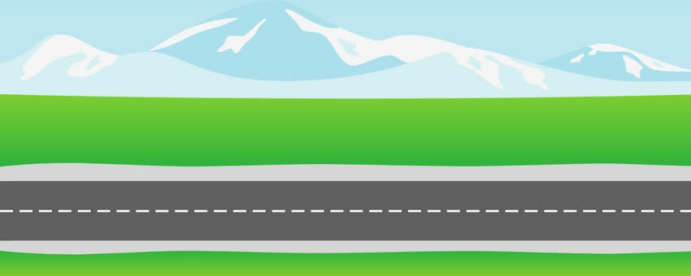

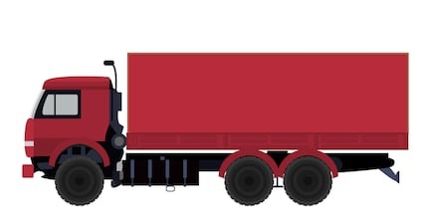
Research to Operations
Building the Bridge, then the Highway
Research
Operations
O2R R2O
HFIP
VALLEY OF DEATH
We’ve bridged the gap!

Slide 3
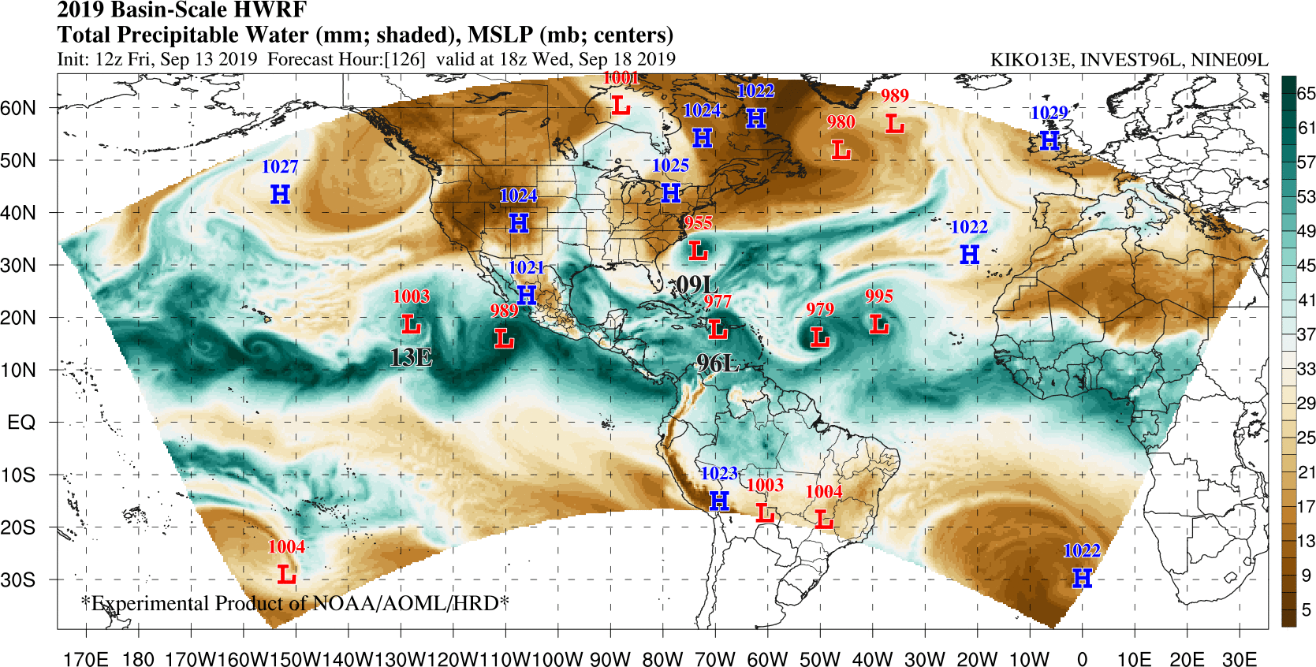
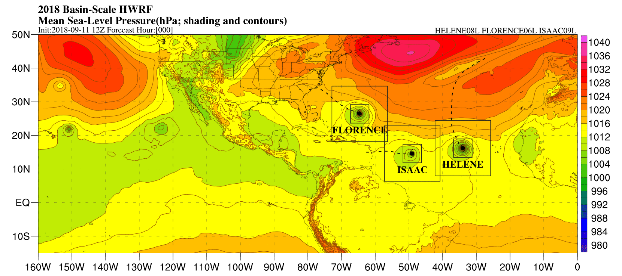
Basin-scale HWRF (HWRF-B)
A successful R2A transition
Built on collaborations
Multiple moving nests
Multi-scale interactions
Improved performance
Paving way to HAFS
X. Zhang et al. 2016
Alaka et al. 2017
HRD collaborated with EMC, DTC, & RDHPCS

Slide 4
Evolution of HWRF-B
Oper. HWRF Implementation
& Public Release
HRD/EMC
HWRF-B Development
R2A @ Readiness Level 4
HRD/EMC/DTC
Real-Time Demonstrations
R2A @ Readiness Levels 5-7
HRD/EMC/DTC/RDHPCS; Supported by HFIP
Community Code Merge
R2A
HRD/EMC/DTC
Better Data Assimilation
O2R & R2O
HRD/EMC/DTC
Dynamic Ocean Coupling
R2A
HRD/EMC
HWRF-B Implementation
R2O @ Readiness Level 8
HRD/EMC/DTC
2011
2012
2013
2014
2015
2016
2017
2018
2019
2020
Notes:
IN LOCKSTEP WITH OPER. HWRF:

Slide 5
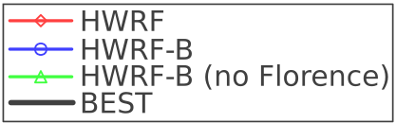
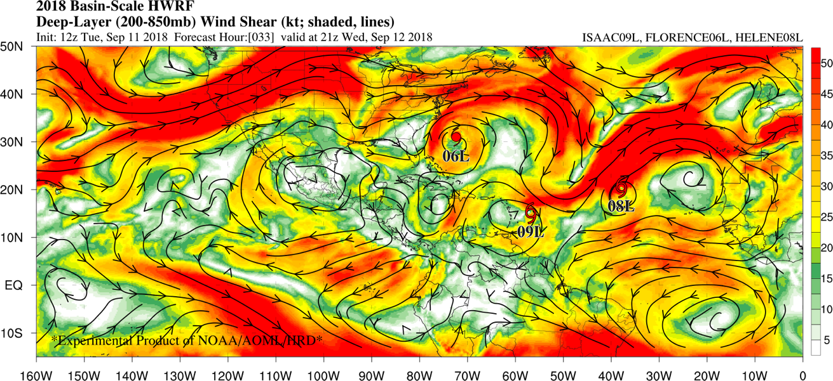
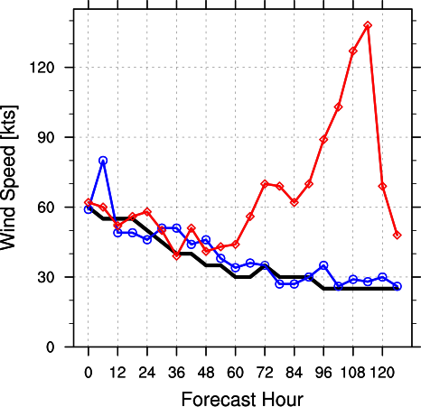
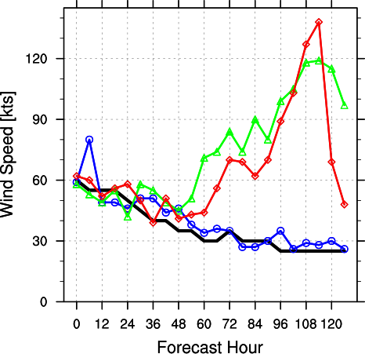
The Value of Multiple Moving Nests
Would Hurricane Isaac Intensify or Dissipate?
Achievement
Multiple hurricane nests within a single model domain
FLORENCE
Outflow from Florence & Helene intensified the wind shear near Isaac
HELENE
High shear tilted Isaac’s vortex and entrained dry air into Isaac’s core
ISAAC
High-resolution forecasts for Florence were critical to improve Isaac forecasts.
Alaka et al. 2019, in preparation

Slide 6
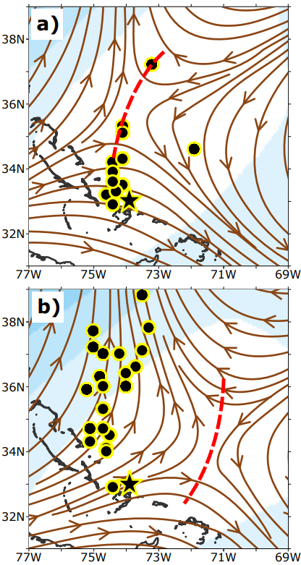
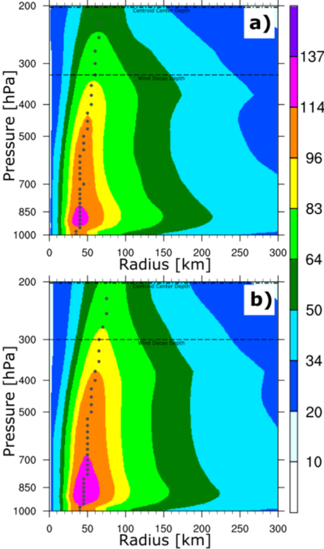
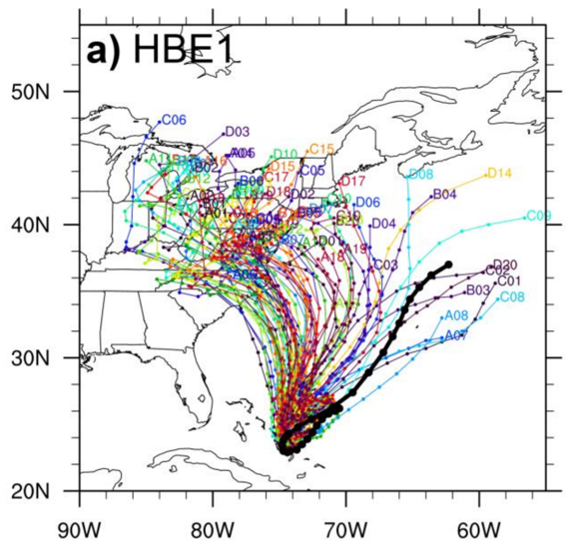
Multi-Scale Interactions Using Ensembles
Was Hurricane Joaquin Going to Hit the U.S.?
Environment – Steering Flow
Vortex - Winds
80-member HWRF-B Ensemble
for Hurricane Joaquin
Good Tracks
Environment differences
dominated track uncertainty.
Differences could be traced back to initial conditions.
Vortex structure did not impact track uncertainty.
Bad Tracks
Alaka et al. 2019

Slide 7
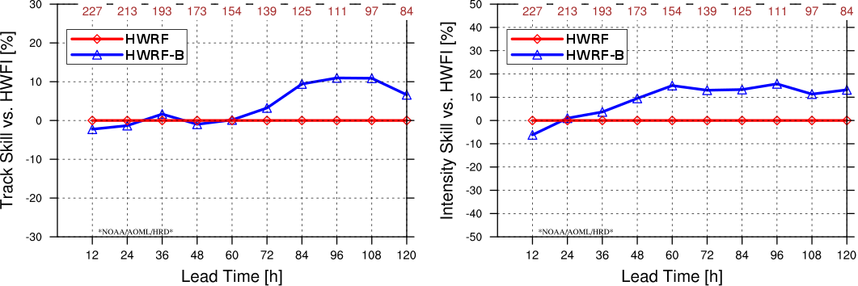
Improved Performance
2019 North Atlantic Verification
TRACK SKILL
INTENSITY SKILL
HWRF-B better
HWRF-B better
HWRF better
HWRF better

Slide 8
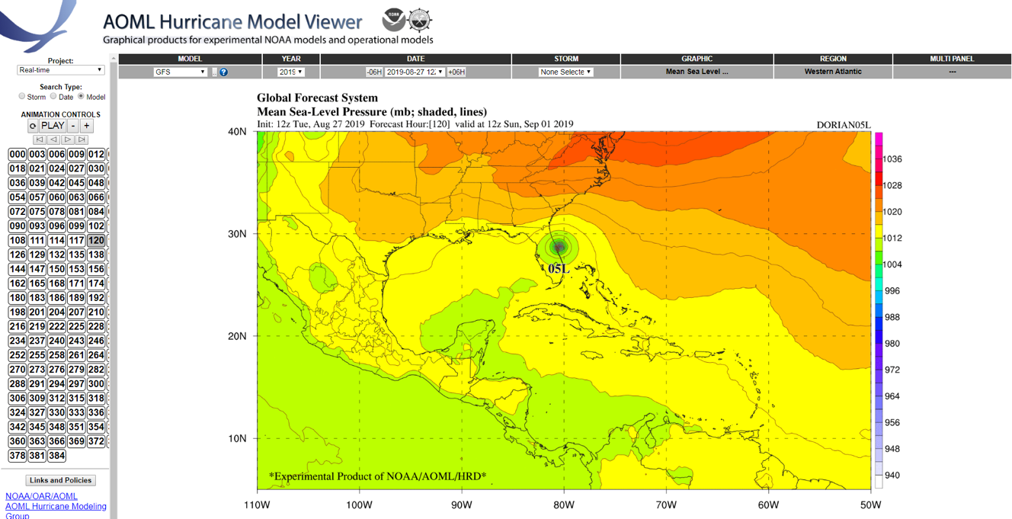
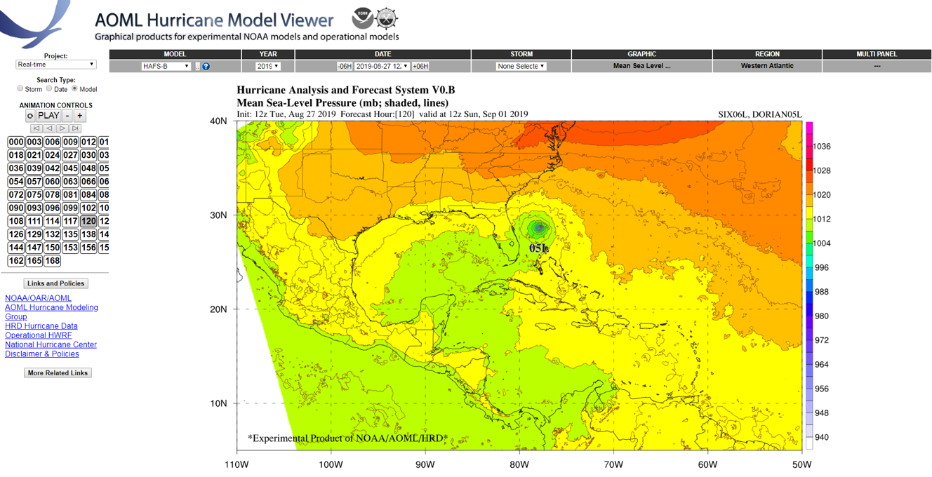
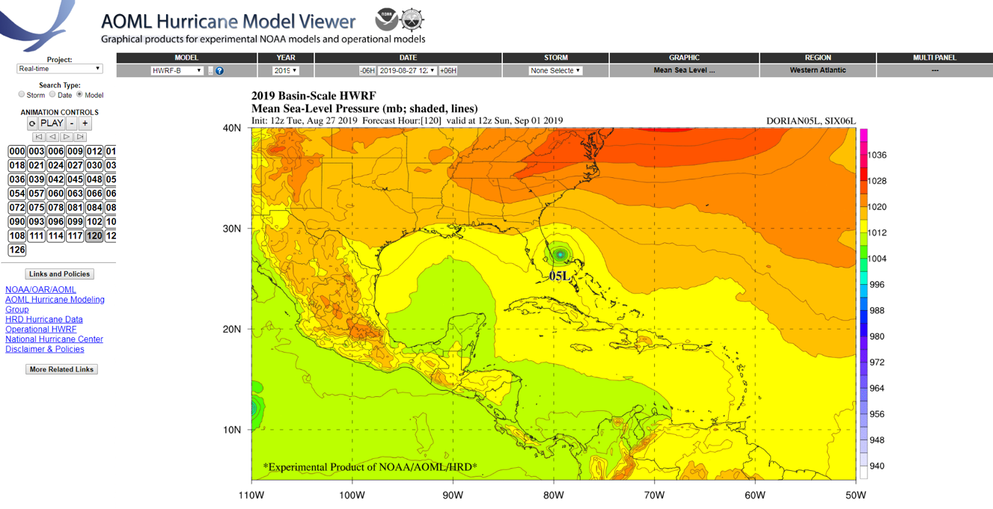
AOML Hurricane Model Viewer
Visualization for Experimental & Operational Models
https://storm.aoml.noaa.gov/basin

Slide 9
THANK YOU!

