Slide 1
Genesis flights into AL96/TD2
Debrief July 16, 2010
Agenda
1. Overview of system and flights (Rogers)
2. Mission summaries
a) 100706H1 (Black)
b) 100706N (Dunion)
c) 100707H1 (Aberson)
d) 100707H2 (Black)
e) 100707N (Dunion)
3. Logisitics
a) meeting with AOC (Rogers)
b) MGOC (Friedman)
c) administrative/travel (Calderon)

Slide 2
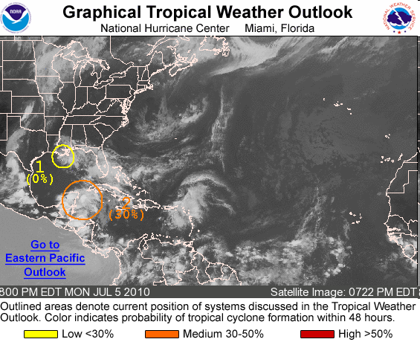
0001 UTC July 6
2. A BROAD AREA OF LOW PRESSURE OVER THE NORTHWESTERN CARIBBEAN SEA AND THE YUCATAN PENINSULA CONTINUES TO PRODUCE WIDESPREAD CLOUDINESS AND DISORGANIZED THUNDERSTORMS. UPPER-LEVEL WINDS ARE FORECAST TO BECOME MORE CONDUCIVE FOR DEVELOPMENT...AND A TROPICAL DEPRESSION COULD STILL FORM OVER THE NEXT COUPLE OF DAYS AS THIS SYSTEM MOVES NORTHWESTWARD AT 10 TO 15 MPH. THERE IS A MEDIUM CHANCE...30 PERCENT...OF THIS SYSTEM BECOMING A TROPICAL CYCLONE DURING THE NEXT 48 HOURS. REGARDLESS OF DEVELOPMENT...LOCALLY HEAVY RAINFALL AND GUSTY WINDS ARE POSSIBLE OVER THE YUCATAN PENINSULA AND WESTERN CUBA OVER THE NEXT DAY OR SO.

Slide 3
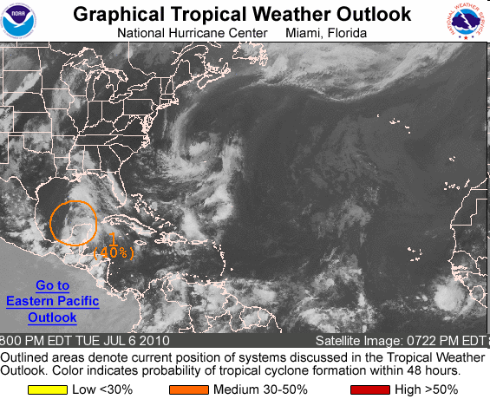
2357 UTC July 6
1. SHOWERS AND THUNDERSTORMS CONTINUE IN ASSOCIATION WITH A BROAD LOW PRESSURE SYSTEM CENTERED OVER THE NORTHWESTERN YUCATAN PENINSULA OF MEXICO NEAR MERIDA. THE LOW IS BEING INVESTIGATED THIS EVENING BY TWO NOAA AIRCRAFT CONDUCTING A RESEARCH MISSION AROUND THE SYSTEM. DATA FROM THIS MISSION INDICATES ENVIRONMENTAL CONDITIONS REMAIN CONDUCIVE FOR SOME DEVELOPMENT OF THIS DISTURBANCE DURING THE NEXT COUPLE OF DAYS AS IT MOVES WEST-NORTHWESTWARD AT 10 TO 15 MPH. THERE IS A MEDIUM CHANCE...40 PERCENT...OF THIS SYSTEM BECOMING A TROPICAL CYCLONE DURING THE NEXT 48 HOURS. HEAVY RAINFALL AND GUSTY WINDS ARE POSSIBLE OVER PORTIONS OF THE YUCATAN PENINSULA DURING THE NEXT DAY OR SO.

Slide 4
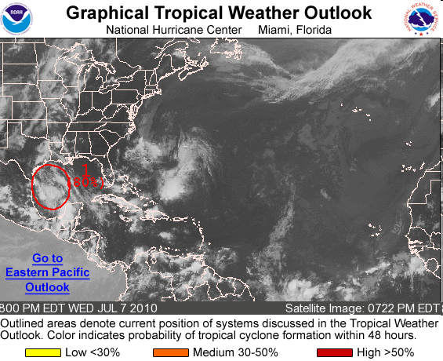
2353 UTC July 7
1. A LARGE LOW PRESSURE SYSTEM LOCATED ABOUT 290 MILES SOUTHEAST OF THE TEXAS/MEXICO BORDER IS MOVING WEST-NORTHWESTWARD AT 10 TO 15 MPH. THIS SYSTEM HAS BECOME MUCH BETTER ORGANIZED THIS AFTERNOON AND EVENING...AND THUNDERSTORM ACTIVITY HAS BECOME MORE CONCENTRATED NEAR THE CENTER. TWO NOAA RECONNAISSANCE AIRCRAFT ARE CURRENTLY CONDUCTING A RESEARCH MISSION IN AND AROUND THE DISTURBANCE...AND INFORMATION RECEIVED SO FAR SUGGESTS THAT A TROPICAL DEPRESSION MAY BE FORMING. ENVIRONMENTAL CONDITIONS ARE CONDUCIVE FOR FURTHER DEVELOPMENT AND IF ADDITIONAL ORGANIZATION CONTINUES...THEN FORECAST ADVISORIES WILL BE INITIATED LATER TONIGHT OR THURSDAY MORNING...WHICH WOULD REQUIRE THAT TROPICAL STORM WATCHES OR WARNINGS BE ISSUED FOR PORTIONS OF THE COASTAL REGIONS OF CENTRAL AND LOWER TEXAS AND NORTHEASTERN MEXICO. THERE IS A HIGH CHANCE...80 PERCENT...OF THIS SYSTEM BECOMING A TROPICAL CYCLONE. THIS DISTURBANCE IS FORECAST TO BRING LOCALLY HEAVY RAINS AND GUSTY WINDS TO PORTIONS OF EASTERN AND SOUTHERN TEXAS AND NORTHEASTERN MEXICO OVER THE NEXT FEW DAYS.

Slide 5
Summary information on flights

Slide 6

AL96 Genesis: 100706H1 Yucatan Coast Mission
Science issues:
Wave axis over Yucatan
Convection over or on east Yucatan coast
Decided that a coastal survey pattern around Yucatan worthwhile
Similar to Pre-Gert mission in 2005
Convection active on both east and west coast during flight
No closed circulation detected by sondes or Doppler - strong wave
Mission Issues
Some problems with sonde communications to HRD WS
Editsonde incorrectly encoded TEMP DROP messages for some sondes
Editsonde crashed on some sondes- TEMP DROP was created but not PDS file
All these problems “magically” disappeared by next flight
Will investigate to check communications, sonde files, software

Slide 7
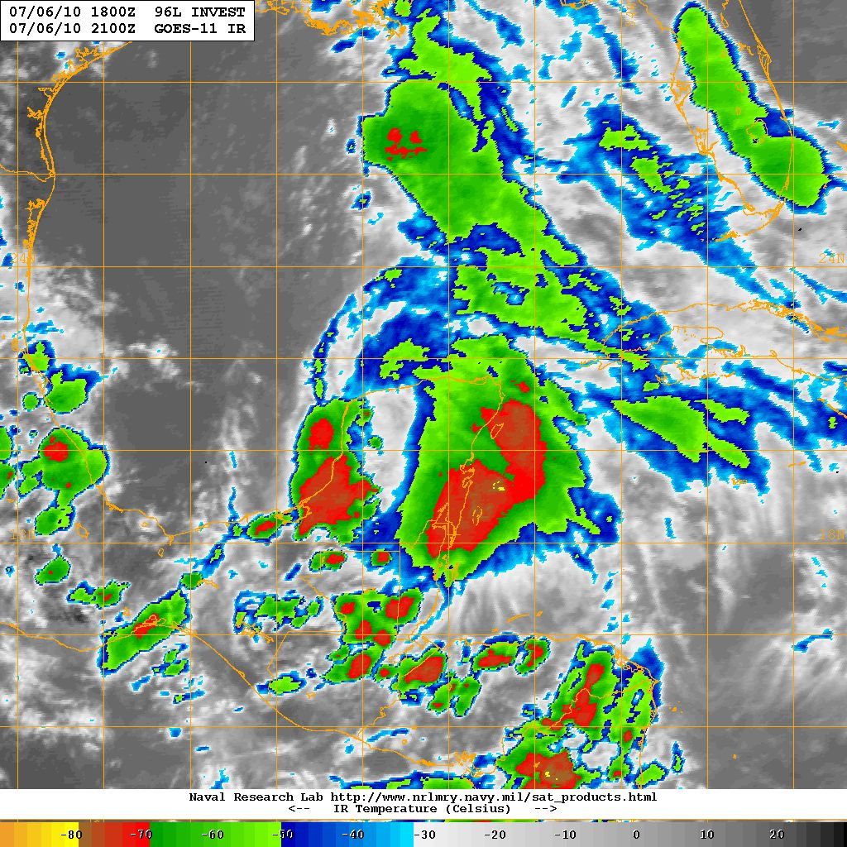

Slide 8
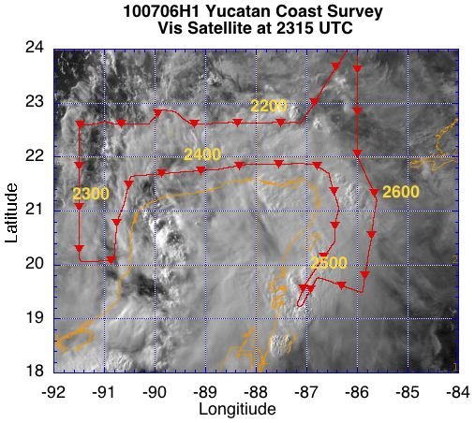

Slide 9
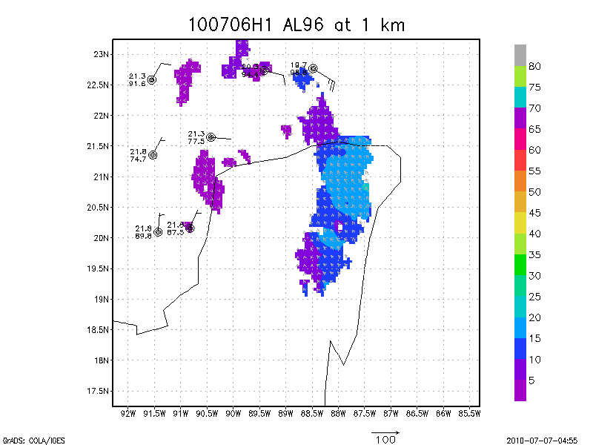
Note: Sondes on east side are missing from this plot

Slide 10
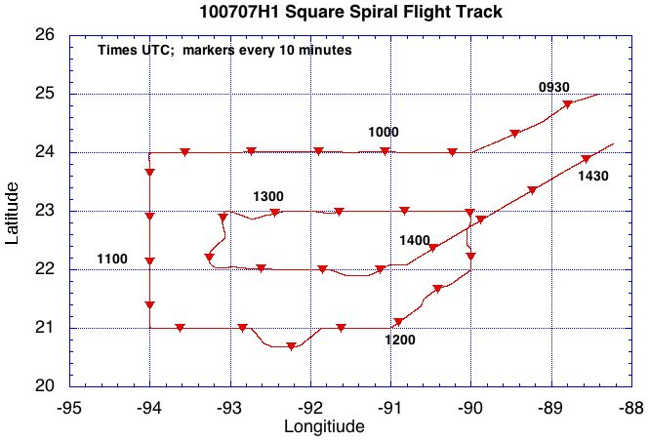
100707H1
AL96
Aberson, Sellwood, Zhang

Slide 11
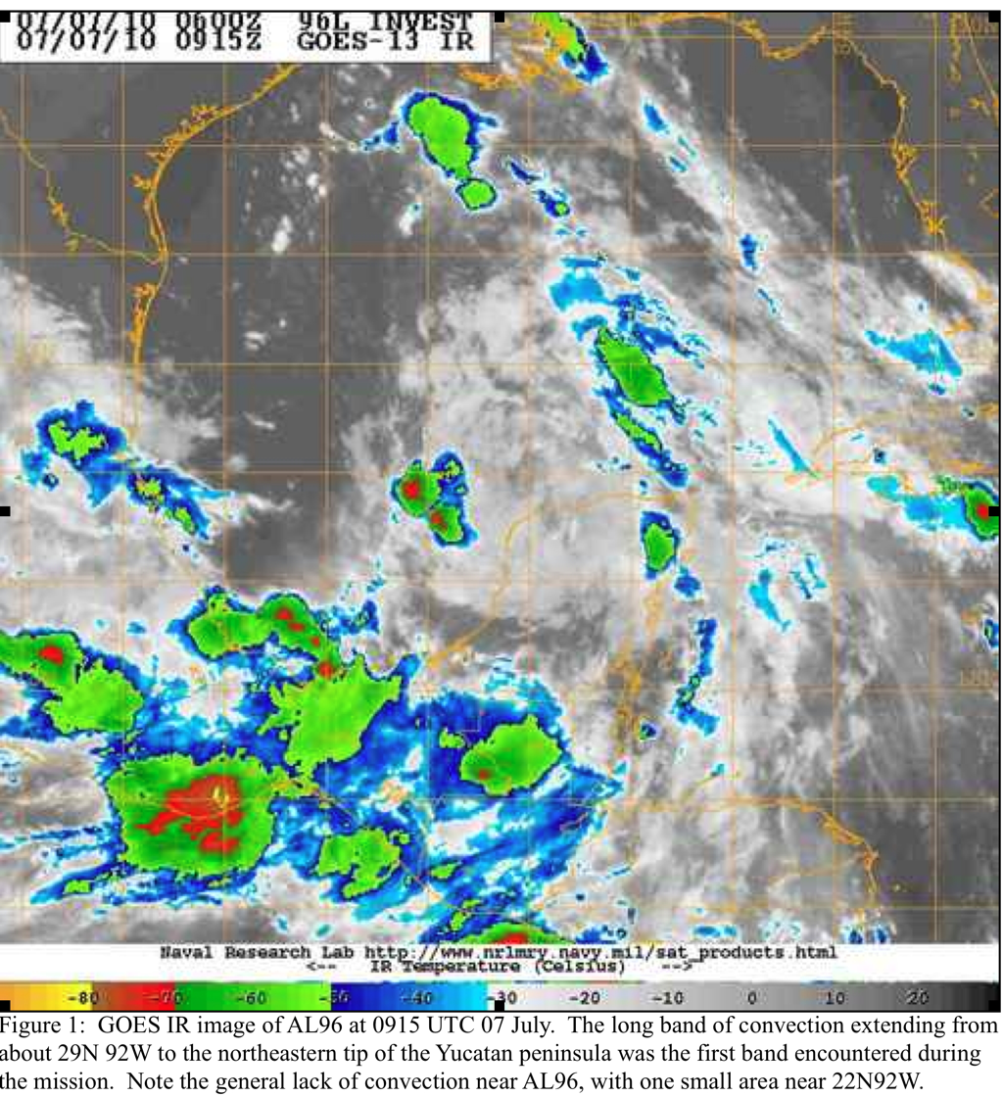

Slide 12
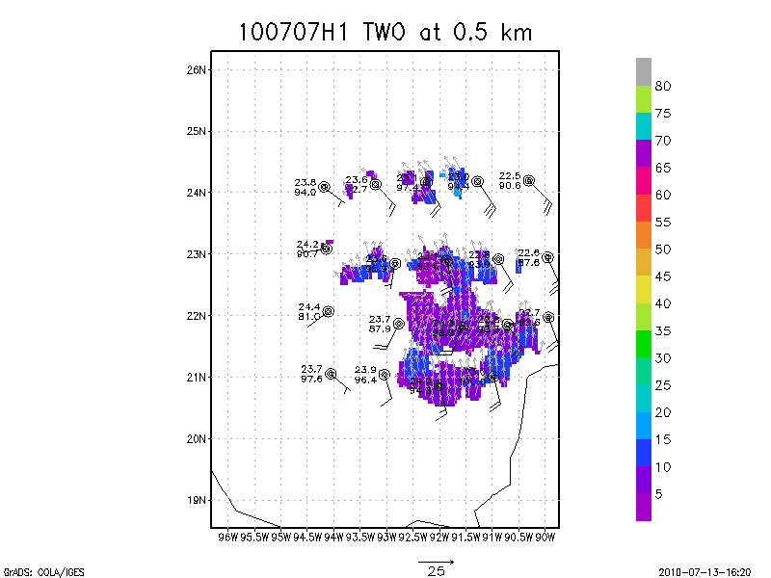

Slide 13
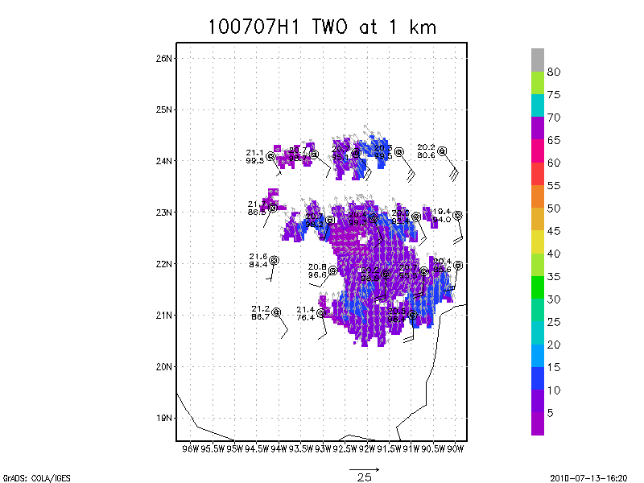

Slide 14
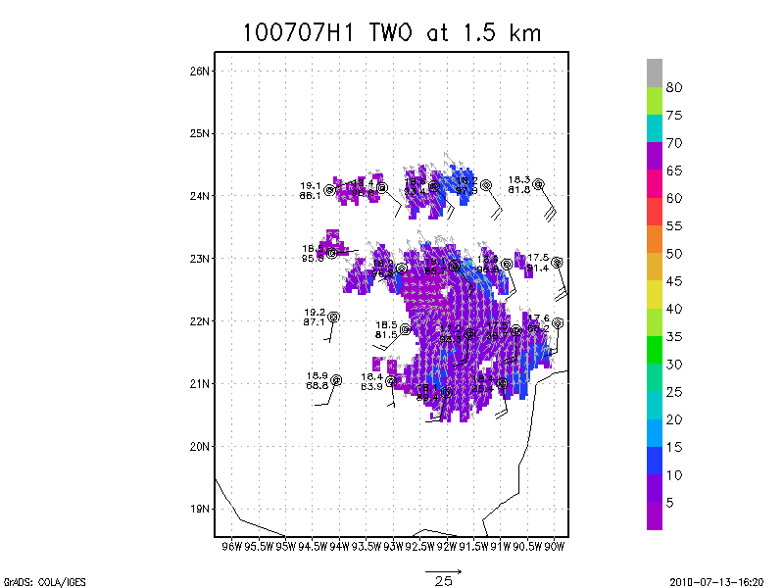

Slide 15


Slide 16
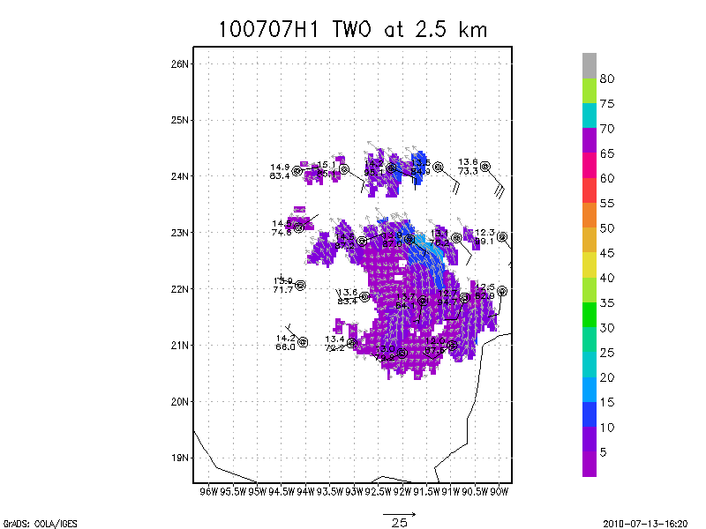

Slide 17


Slide 18
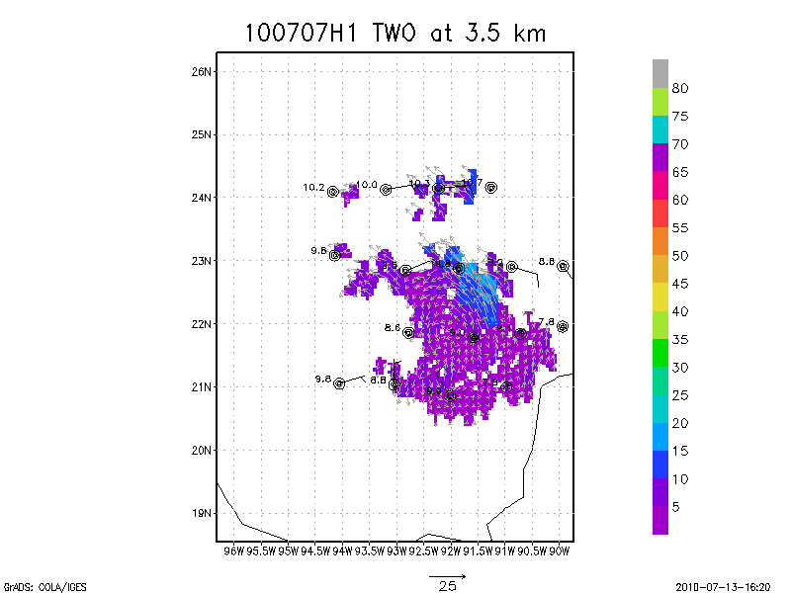

Slide 19


Slide 20


Slide 21


Slide 22


Slide 23


Slide 24


Slide 25


Slide 26


Slide 27


Slide 28
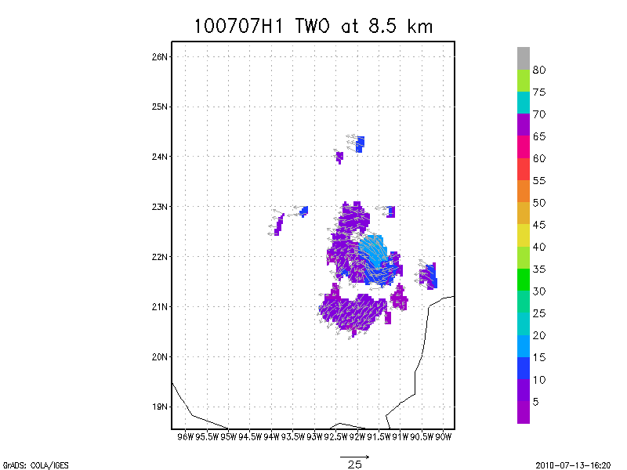

Slide 29
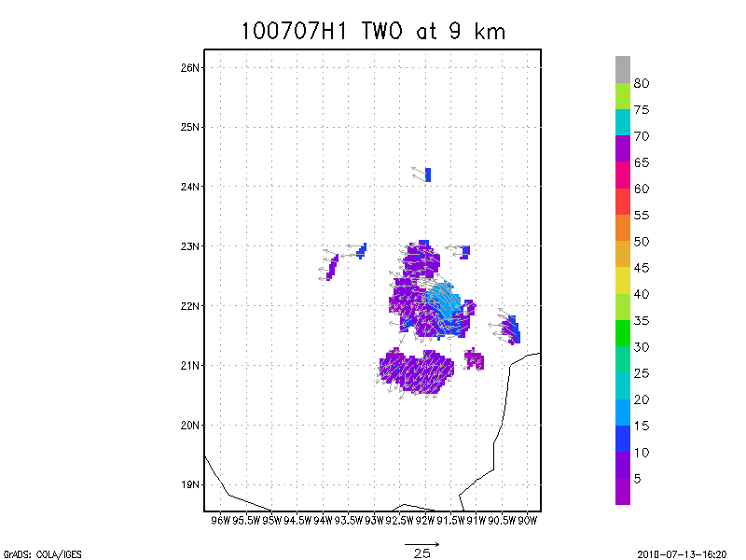

Slide 30
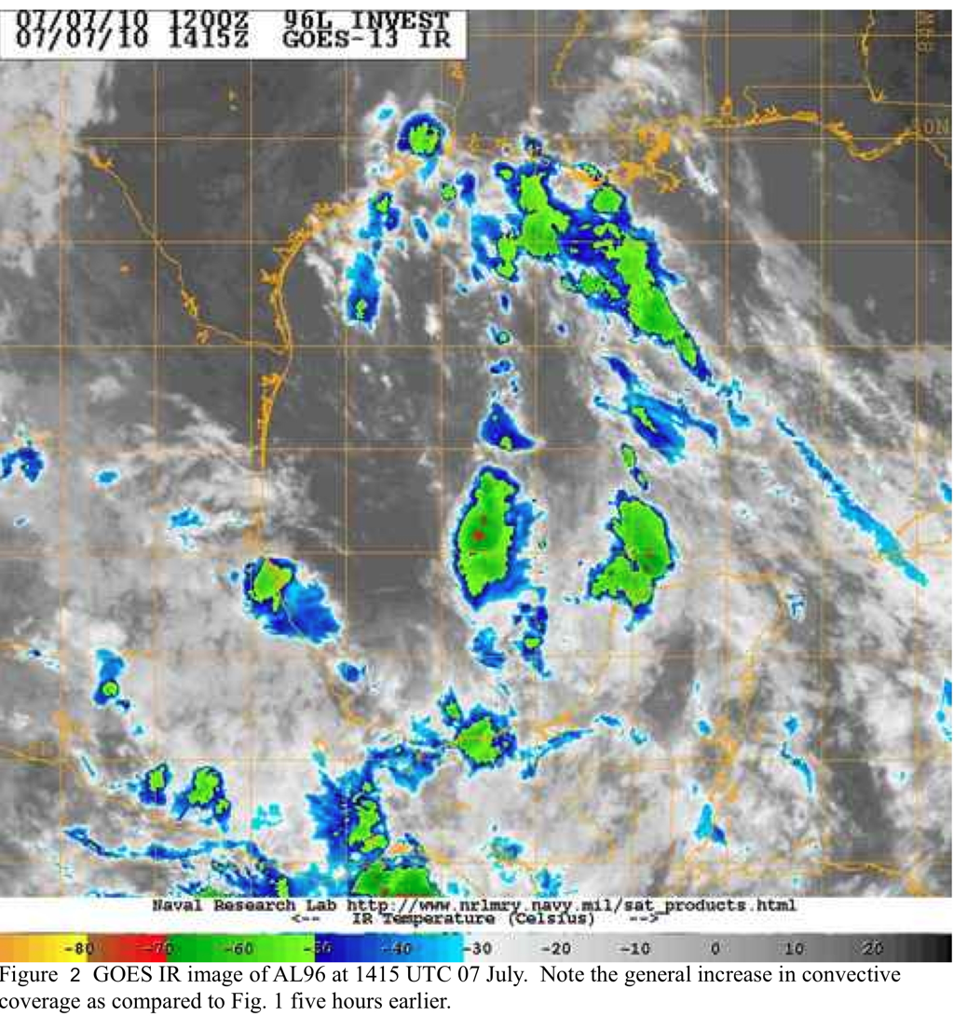
Increase in convective coverage. Rapid development of high-dBZ cells toward end of mission throughout area seen about 1 h before they were seen on IR satellite images.

Slide 31
Composite code needs work to be fully automated.
The code crashed on the aircraft but not on my own Mac using identical data.
Composite software will probably have difficulty when there is not a center to follow.
Dropwindsondes and radar worked well.

Slide 32
AL96/TD2 Genesis: 100707H2 Square Spiral Mission
Science issues:
Poorly organized and possible multiple centers
Convection scattered but mainly on south side of possible center
Try and do a convective burst module
Two main areas of convection: south and east side
Large areas of stratiform encountered during flight
Weak and broad circulation center at 12 kft flt alt
Mission Issues
Sondes and software worked well
Tried two quasi- convective burst modules - Pilots and Nav. were concerned about fuel
Concentrating on LPS duties and using web, x-chat was better than also doing sondes
John Gamache processed sondes- thank you!
HRD WS tape drive not working- got sonde data via ftp on flash drive- works fine

Slide 33
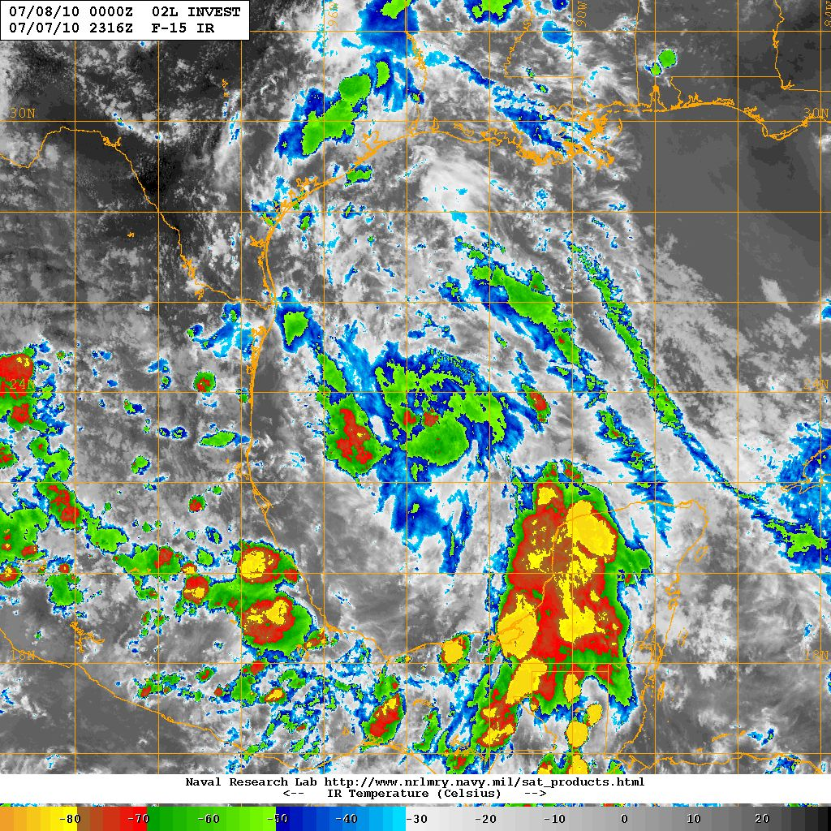

Slide 34
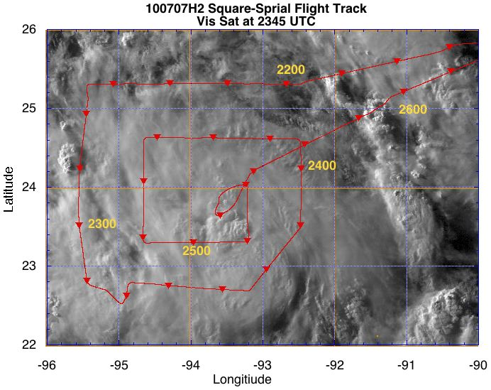

Slide 35
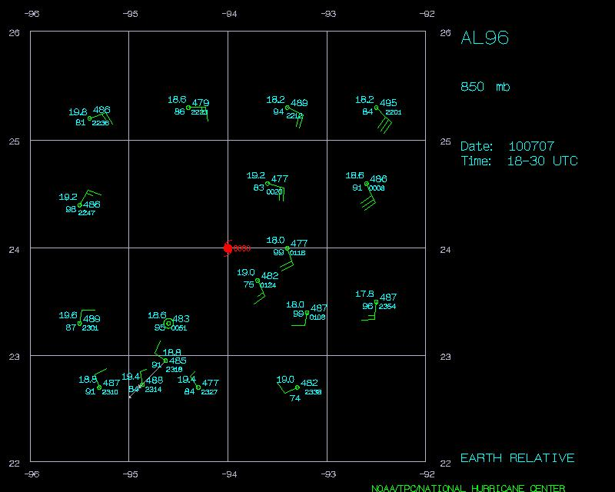

Slide 36
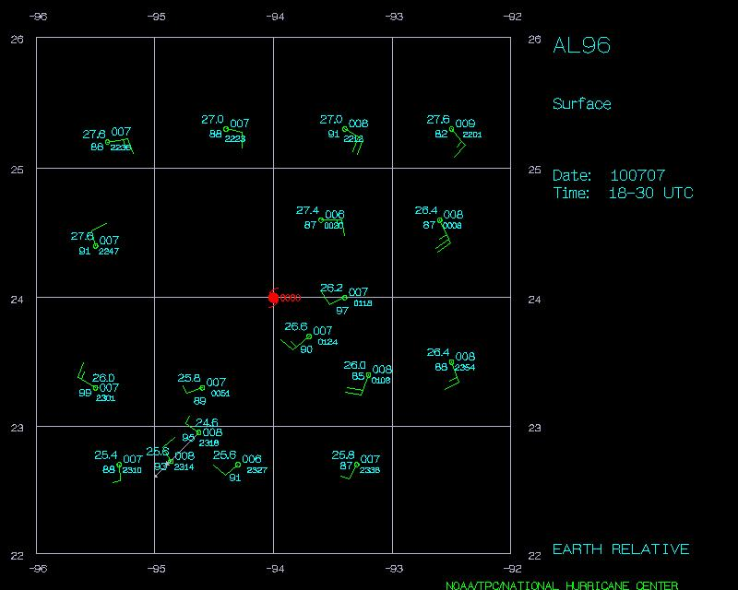

Slide 37
Unified radar analysis for three flights

Slide 38
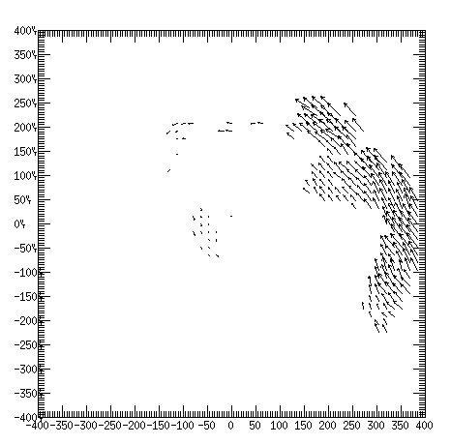
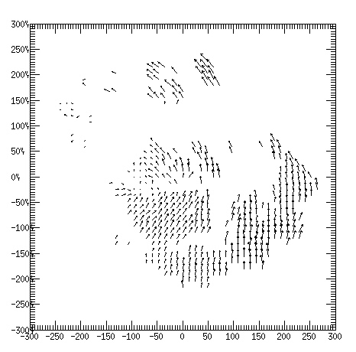
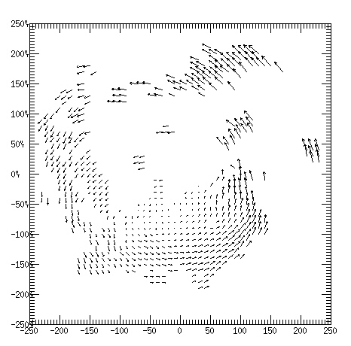
100706H2
100707H1
1.0 km
100707H2

Slide 39

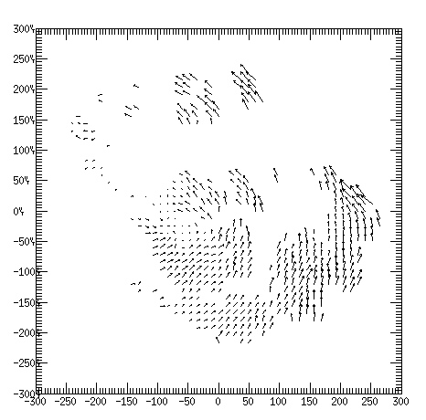
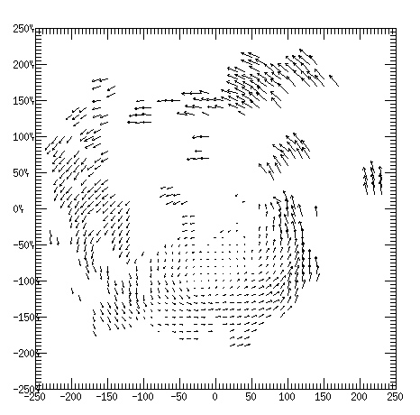
2.0 km

Slide 40
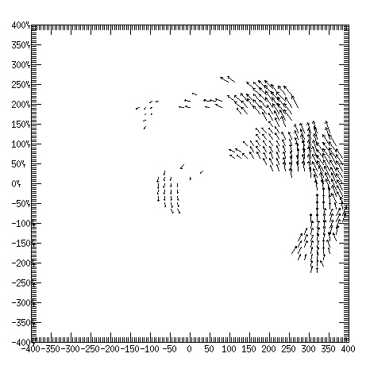
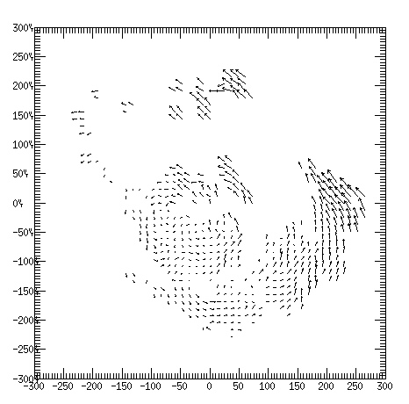
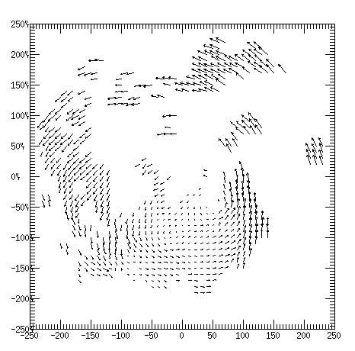
3.0 km

Slide 41
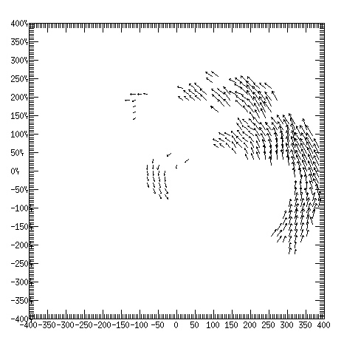
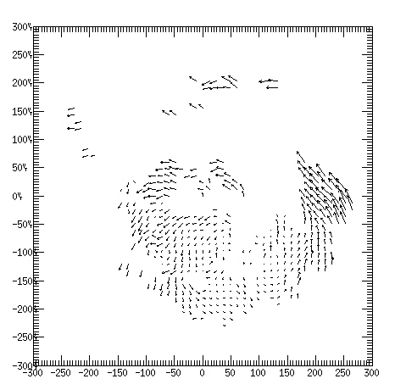
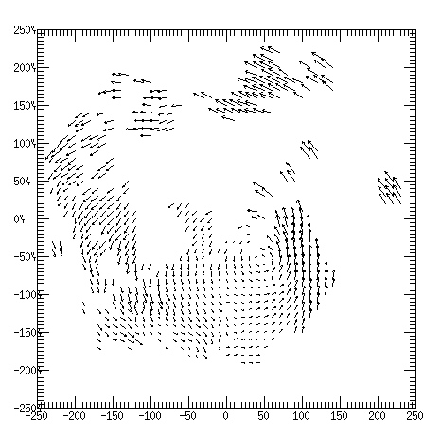
4.0 km

Slide 42
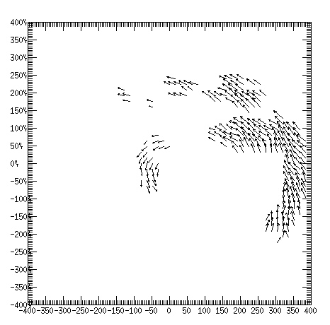
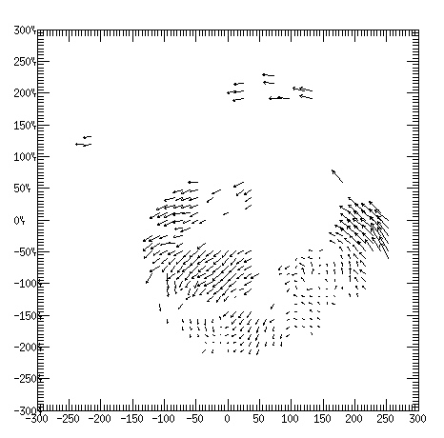
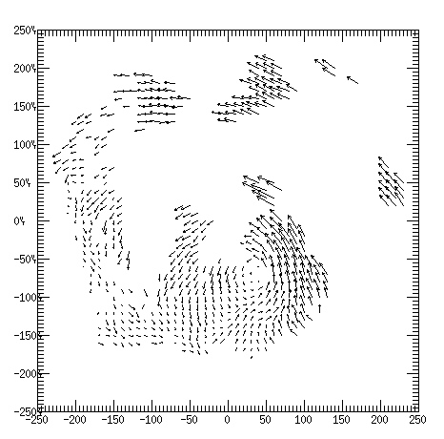
6.0 km

Slide 43
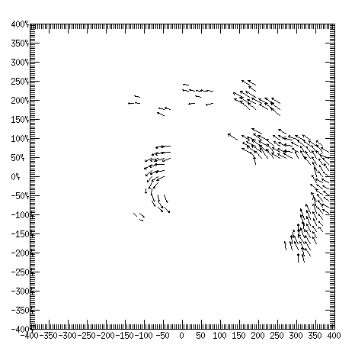
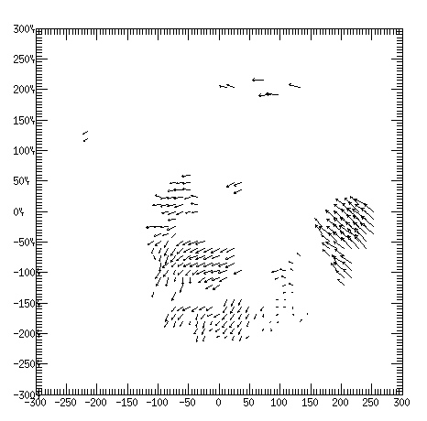
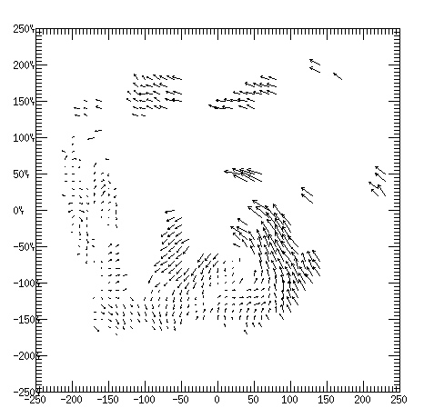
8.0 km

Slide 44
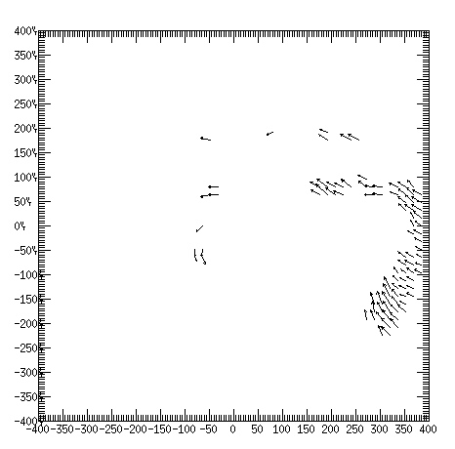
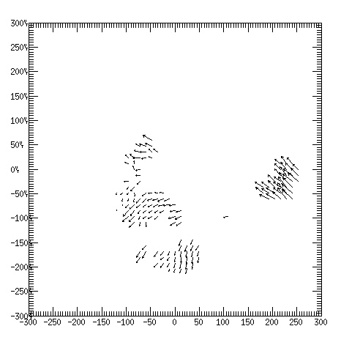
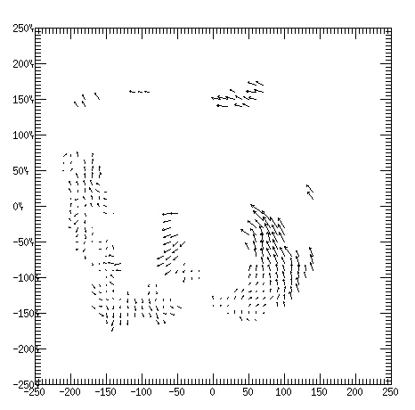
10.0 km

Slide 45
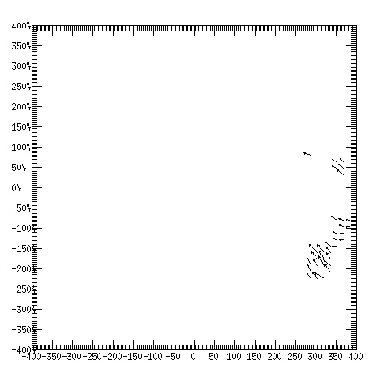
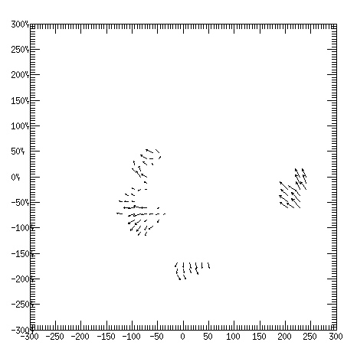
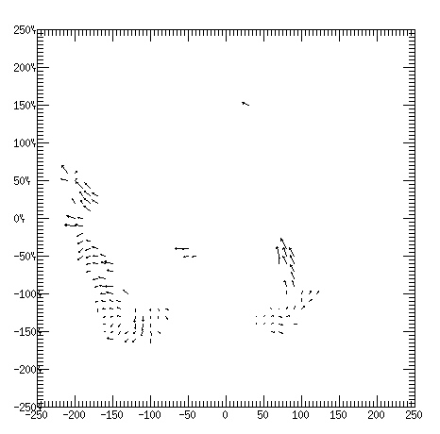
12.0 km

Slide 46
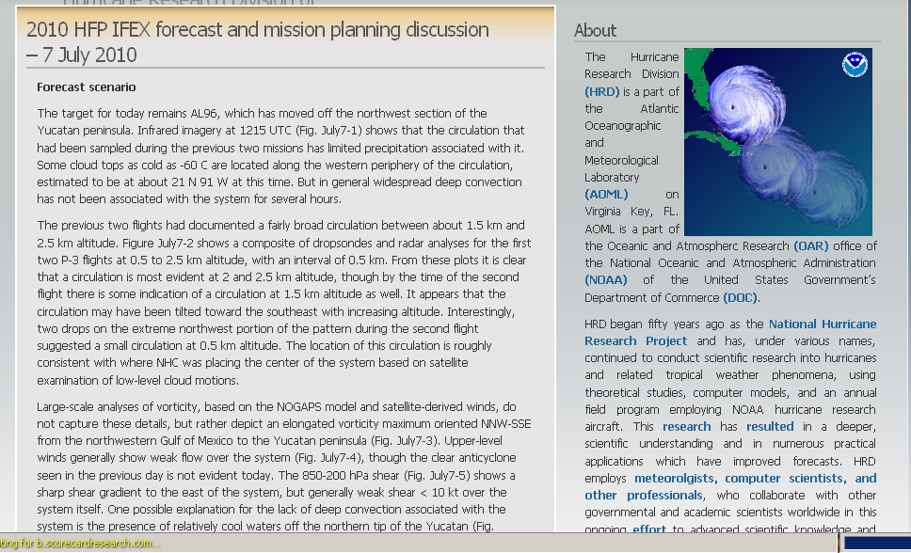
HFP blog posting – July 7

Slide 47
Meeting with AOC July 13, 2010
Major issues
Possible impact of Deepwater Horizon missions on HFP
Possible deployment to Barbados
Flight tracks
  all flight plans for both the P-3s and G-IV should be in our hands at least by 1400 on the day preceding the flight for initial filing with the FAA
  any changes should be provided NLT than 1000L on the day of for the 1600L flight and 1400L on the day prior for the 0400L next day mission
  the 1400 deadline will serve as first and final for the 0400 next day mission
  changes may be required at the last minute, but these will have to be worked out between the pilots and the affected Centers
  required: Graphic of the track; text list of the turn points with positions in degrees and minutes; and third, text list of the drop points
  the first two items will be sent to the ARTCC Centers for the P-3s and all three for the G-IV

