Slide 1

South Africa - infrastructure

Slide 2
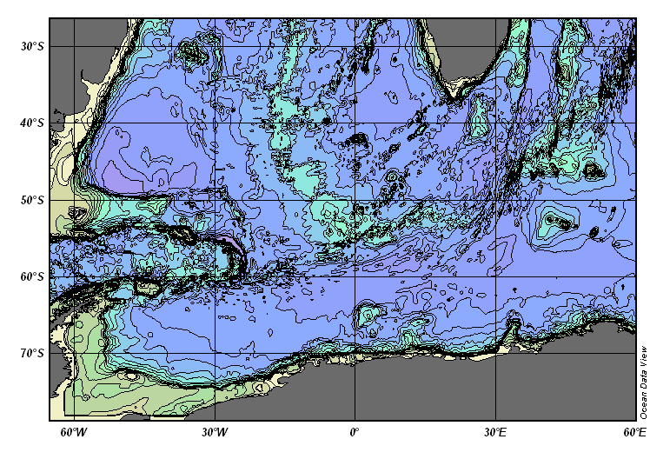
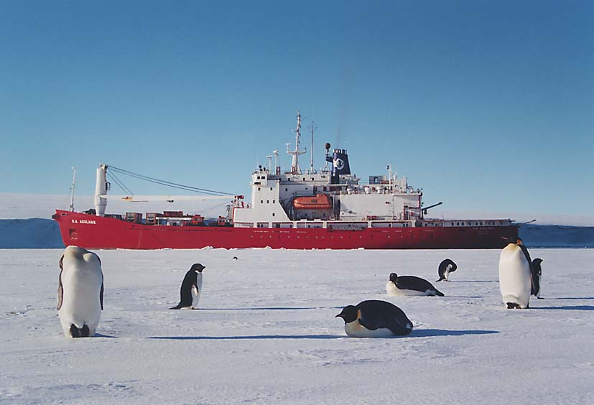
Current opportunities
Gough Island
September
Prince Edward Island April
GoodHope/AX25
December – February

Slide 3

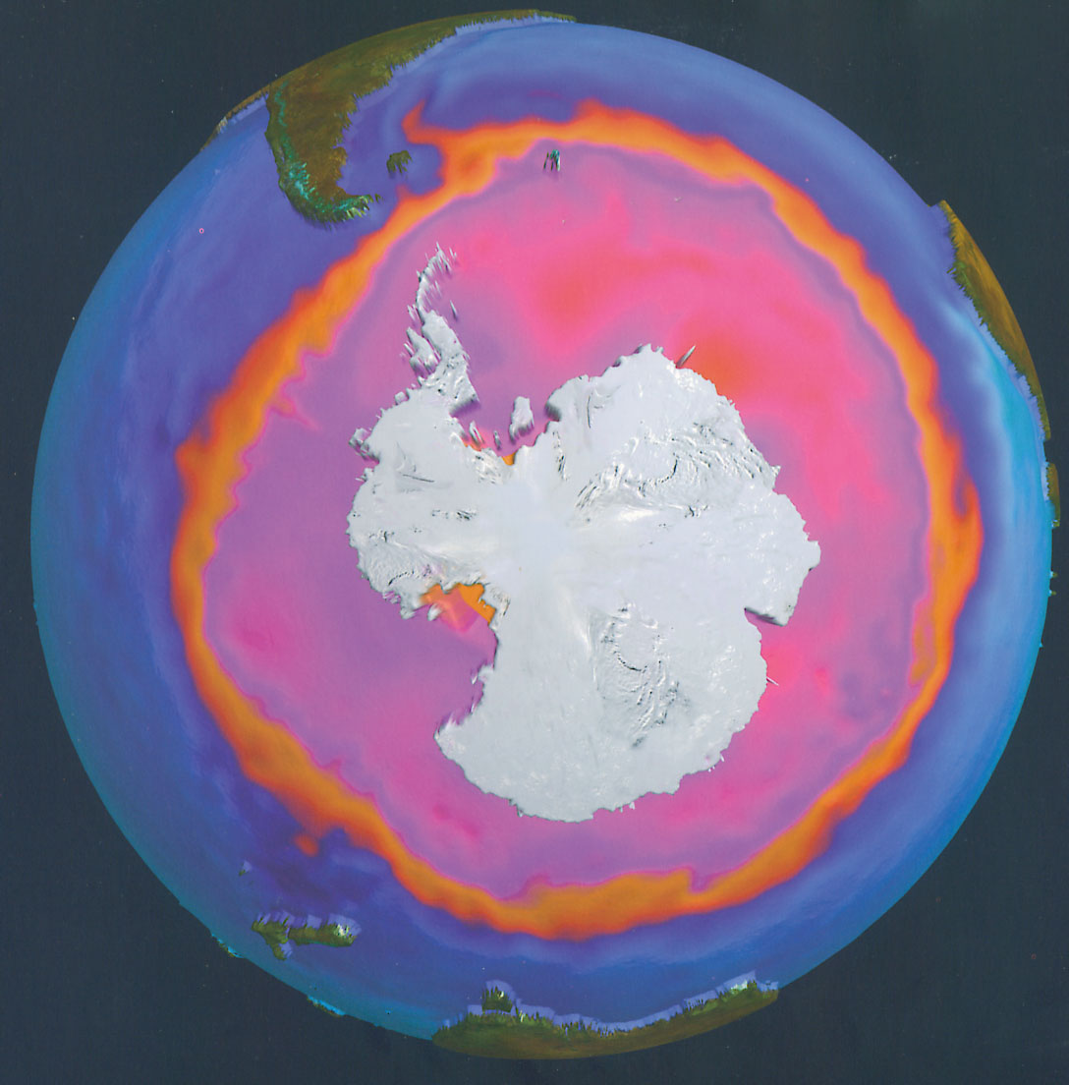
As a ‘chokepoint’

Slide 4
GoodHope since 2004.
XBT, ARGO yearly - #16.
Restricted to Dec/Feb.
Since 2009, full underway
programme XBT, XCTD,
Nutrients, CO₂, Chl-a.
New suite of equipment
onboard $1 million.
Plans for further funding.
Results starting to look at
Variability, heat etc...
Increase in Seal tagging as
part of MEOP/Seaos

Slide 5
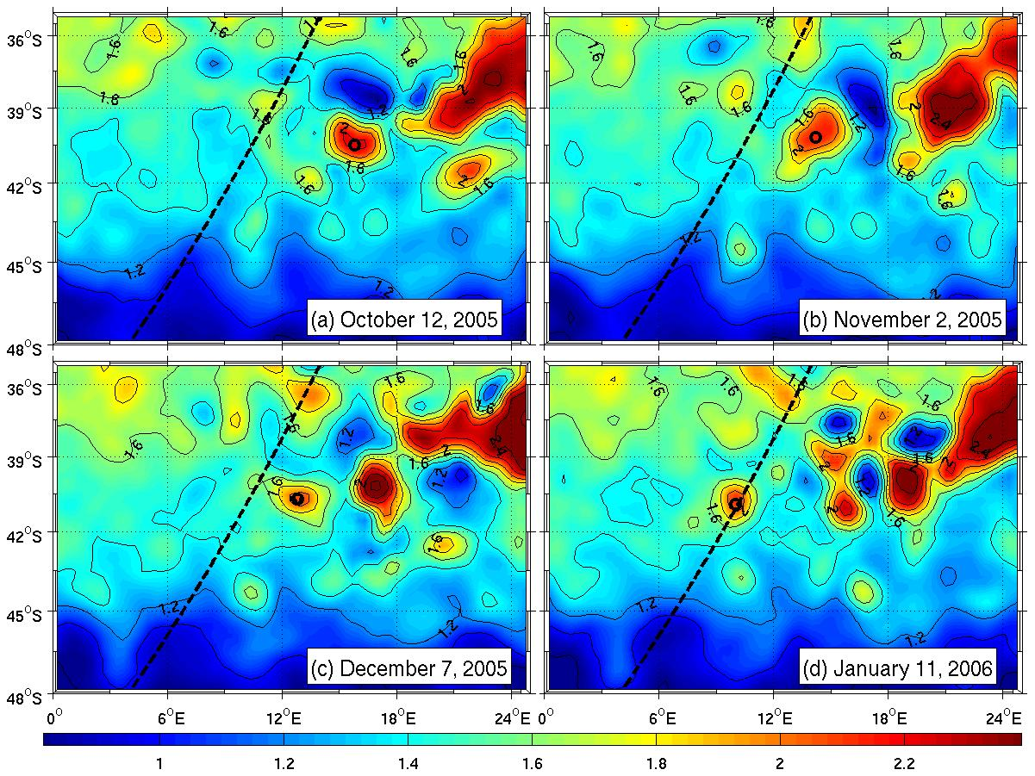

Slide 6
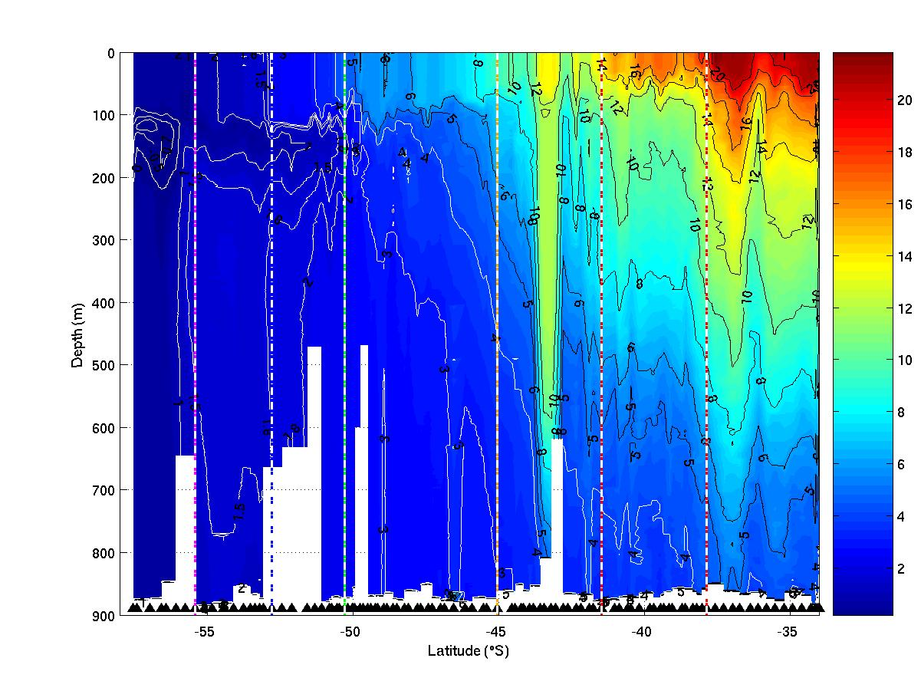
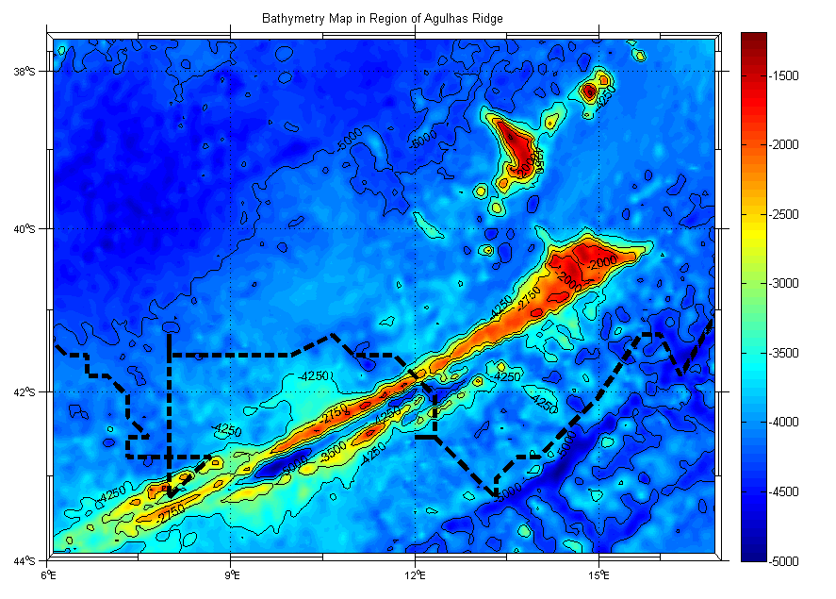
BONUS GoodHope 2008

Slide 7
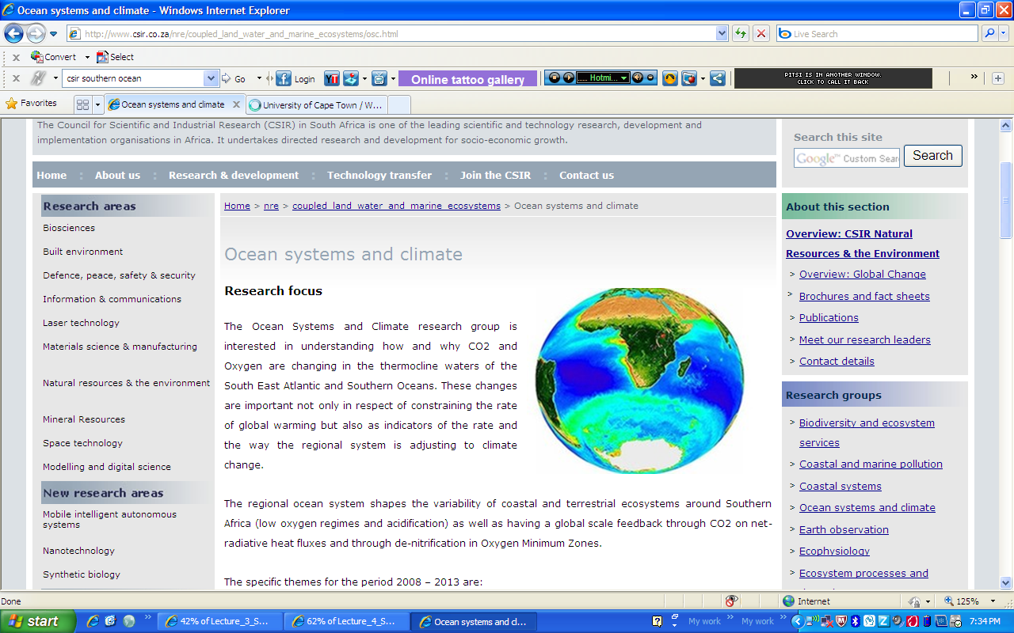

Slide 8
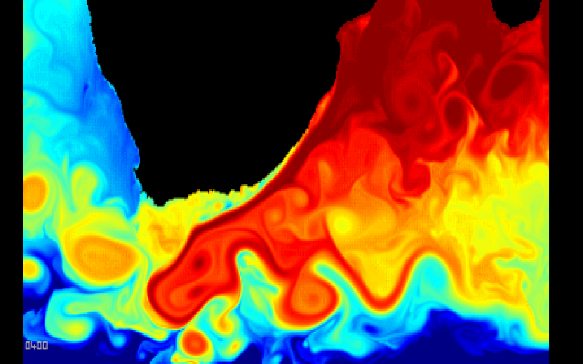
Transects across Agulhas Rings and Agulhas retroflection
Annual Transects
Gough Island
Marion Island
Part of Carbon
Observatory
Dedicated cruises

Slide 9
Old vessel >30 years old
Lack of temperature controlled facilities
Restricted to relief voyages and same season studies
Poor mooring facilities/support
Limited expertise
Limited technical support
CTD depth restricted (<3500 m) by spooling problems
Gough Island
September
Prince Edward Island April
GoodHope/AX25
December – February

Slide 10
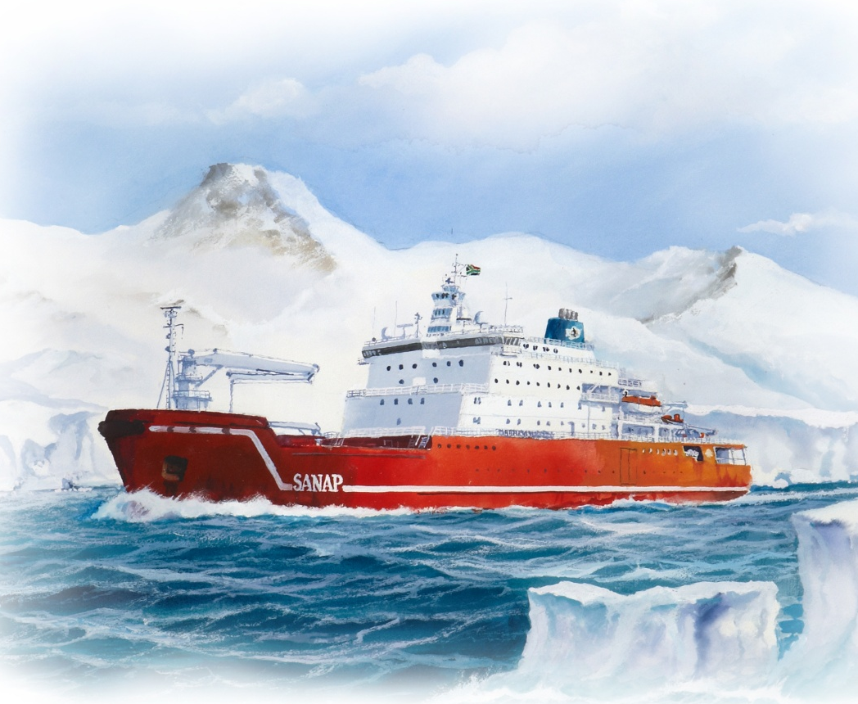
New Polar Vessel delivery date April 2012
Emphasis on multi-national, disciplinary and institutional approach to science.
Dedicated sea time will be provided ~180 days.
Logistic lines will be completed – faster!
Applications to “hire” the vessel will be encouraged.
R50 million to be ploughed into improving oceanographic facilities, R&D, autonomous equipment i.e. gliders

Slide 11
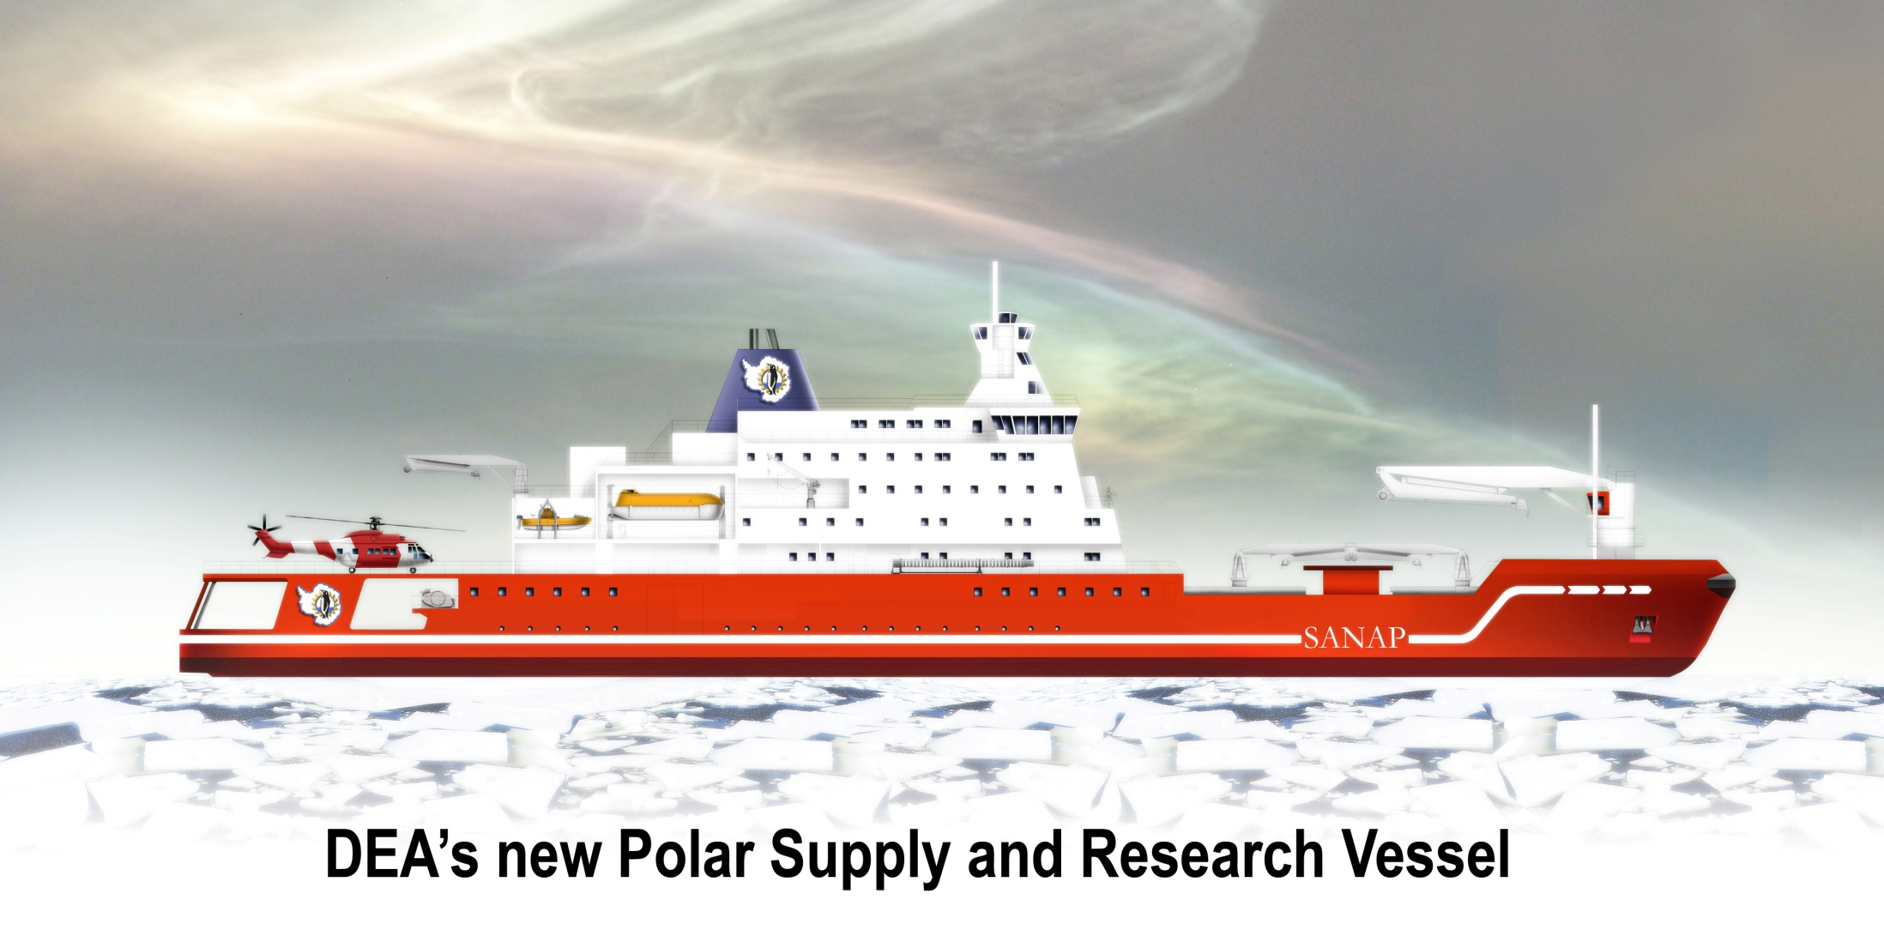
repeat of BONUS 2008
SAMOC/GoodHope cruise 2013? –

Slide 12
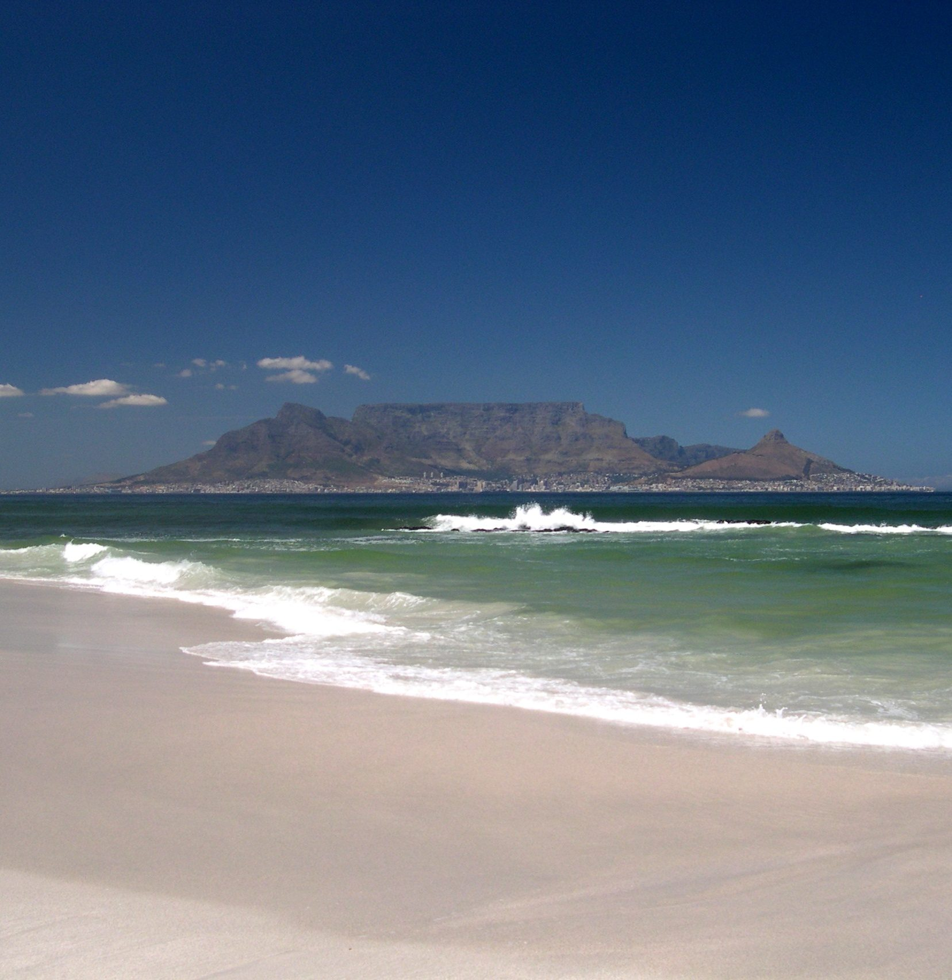
New South African National Antarctic Facility planned 2014
Funded by Dept. Science and Technology.
In April 2009 the South African Southern Ocean Community (SASOC) formed – covers all disciplines
New Facility modelled on “a mini BAS or AWI”.
Links research, logistics, students, technical support…. “one stop shop”…link into SAEON.

Slide 13
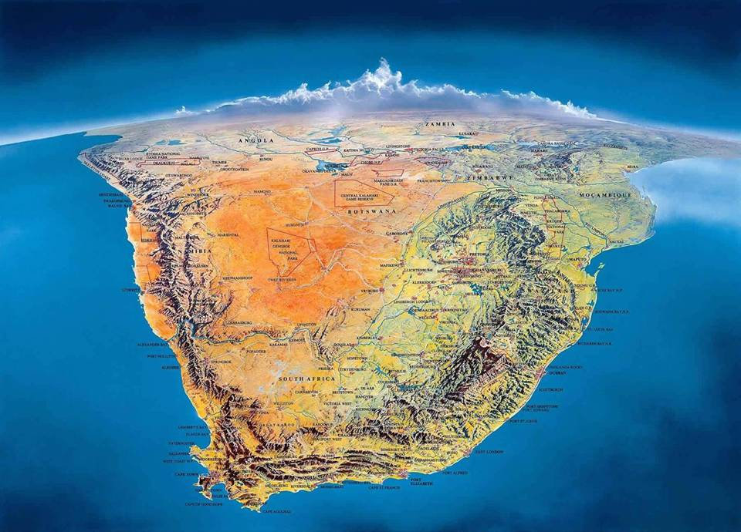
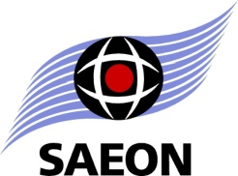
SAEON NODES
Ndlovu, Lowveld Savanna - SANParks, Phalaborwa
National Office
Arid Lands – SANParks, Kimberly
Grasslands /
Forests/Wetlands – Ezemvelo KZN Wildlife, Pietermaritzburg
Egagasini, Marine-Offshore – MCM,
Cape Town
Fynbos - SANBI, Kirstenbosch
Elwandle, Coastal-Inshore - SAIAB, Grahamstown

Slide 14
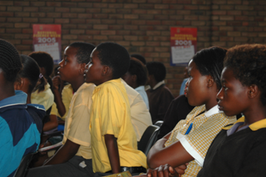
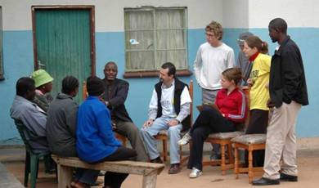
Four Core Tasks of the offshore node
Data collection (monitoring – abiotic, biotic and human)
Data management (archiving and dissemination of data)
Analysis, research and reporting (including mapping, modeling and synthetic products)
Education Outreach/capacity building

Slide 15
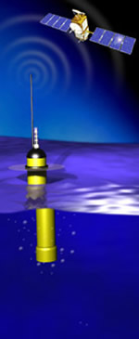
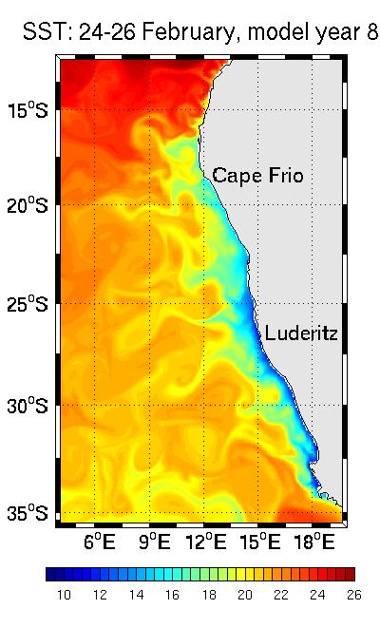
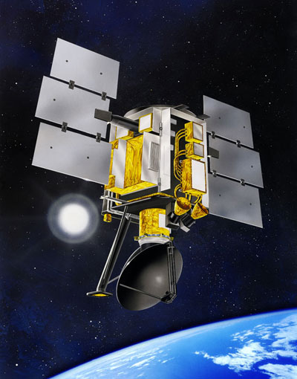
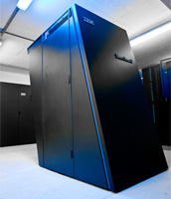
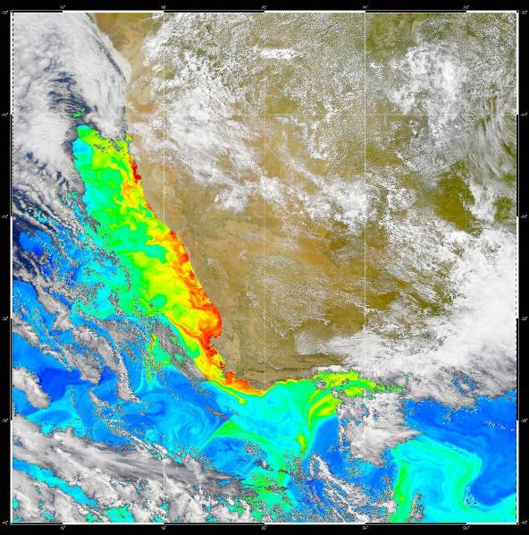
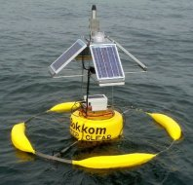
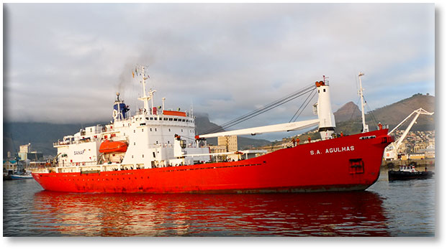
OceanSAfrica:
an operational oceanography initiative
Vision:
Through a combination of modelling and observations we will deliver regular and systematic information on the state of the ocean that is of known quality and accuracy on open ocean to shelf-scales.

Slide 16
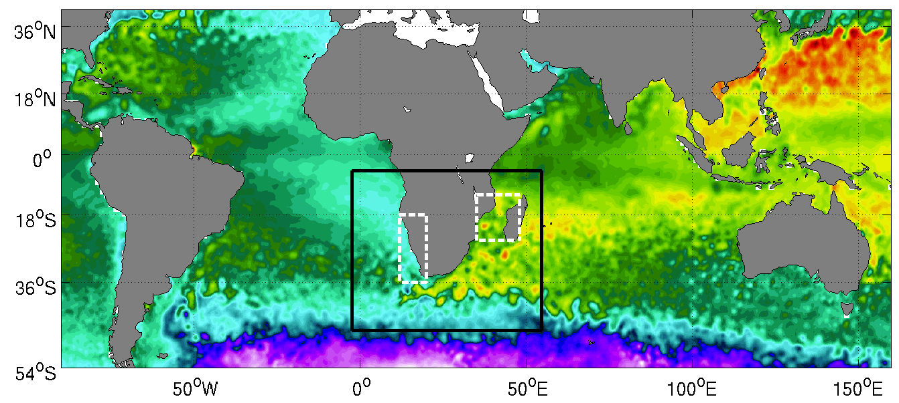
Global model
Regional model – mesoscale eddy resolving
→ Limited areas model – very high resolution
Notes:
In setting up a regional ocean modelling system for Southern Africa we will adopt a downscaling strategy, which means we will downscale from a global model to a high resolution regional model to a very high resolution limited areas model using a series of nested models.
However, we do not intend to run our own global model - we don't have the resources to do so operationally.
The plan is to obtain lateral boundary conditions from operational groups that run global models, for example MyOcean or the HYCOM Consortium.
MyOcean is a large European project that presently runs a 1/4 degree (25 km) global model, on a weekly basis producing 14 day assimilated forecasts and hindcasts. With plans to move to a 1/12th of a degree global model.
The HYCOM Consortium runs a 1/12th of a degree (9 km) global model, daily producing assimilated 5 day forecasts and hindcasts for the U.S. Navy.
WP-1: Assess the global forecast products for use as lateral boundary conditions for the regional model of Southern Africa.
This assessment is two-fold:
1. Vaidate the global models ability to simulate the regional ocean dynamics
2. Assess the reliability and timeous availability of the data, and the efficiency of the data transfers - the cyber-infrastructure.
WP-2: Implement a eddy-resolving regional model of Southern Africa.
Use the Regional Ocean Modelling System
1/12th of a degree (9 km) horizontal resolution
Based on the SAfE configuration designed by Dr Pierrick Penven
Geographical boundaries mimic Arne Biastoch's NEMO model to enable potential inter-model comparisons.
Scope for including other regional models, e.g. HYCOM, for multimodel studies and multimodel forecasts.
WP-3: Limited areas model of the Benguela - pilot operational experiment
Nest 1/36th of a degree (3 km) resolution limited areas model of the Benguela region in the regional model.
The Benguela is a key area for fisheries and is therefore regularly monitored. It is also a region that is subject to the seasonal occurance of harmful algal blooms, providing a good testing for a pilot operational experiment.
The aim is to make the nesting approach and grid generation for the limited areas model as generic as possible so that it is easily ported to other regions of interest within the regional model.

Slide 17
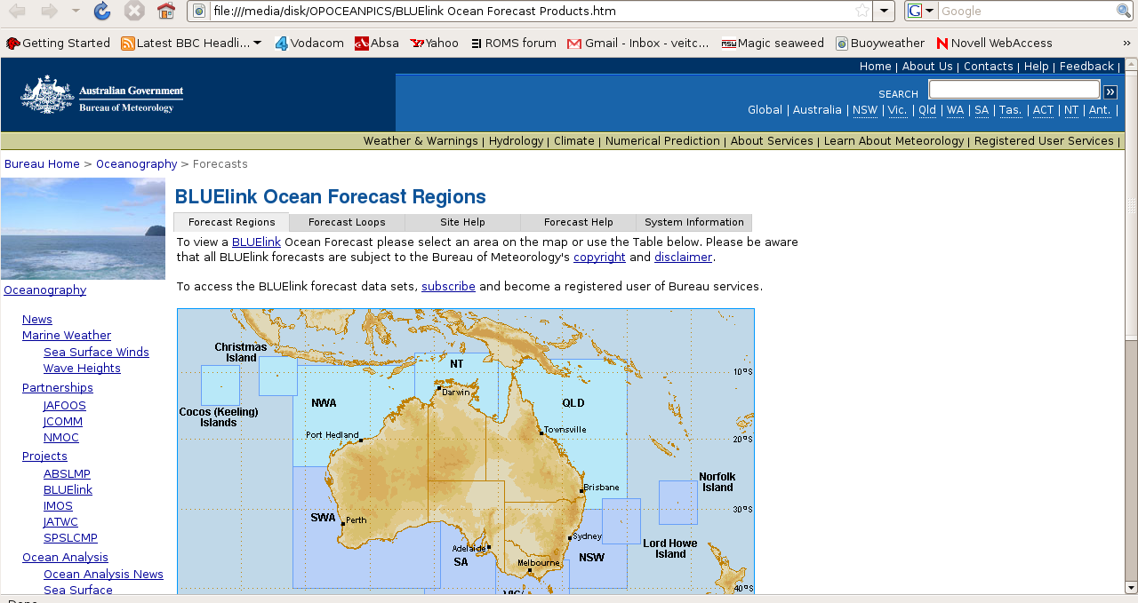
Phase II: long-term vision,
Model:
MOM v.4p0d, 7 day forecast, forcing: 6-hourly
Global Assimilation and Prediction System (GASP)
Observations:
Argo floats, XBTs, CTDs,TAO/Triton Array, Satellite
Assimilation:
BODAS (Bluelink Ocean Data Assimilation System)-ensemble optimal interpolation
Notes:
This includes data assimilation, which will improve the skill of the forecasts. This is the long-term goal and will require very close collabotration with in situ and remote sensing pillars of OceanSAfrica

Slide 18
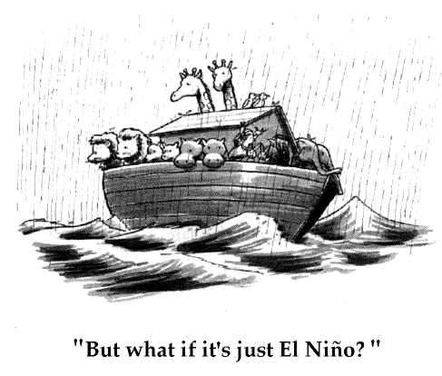
Thank you!

