Slide 1
Institute of Oceanography Federal University of Rio Grande (FURG)
Director Carlos Garcia
Vice-Director José H. Muelbert

Slide 2
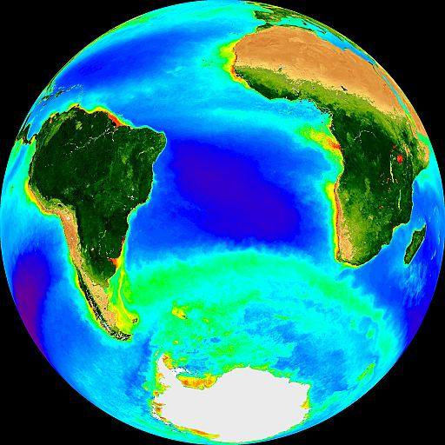
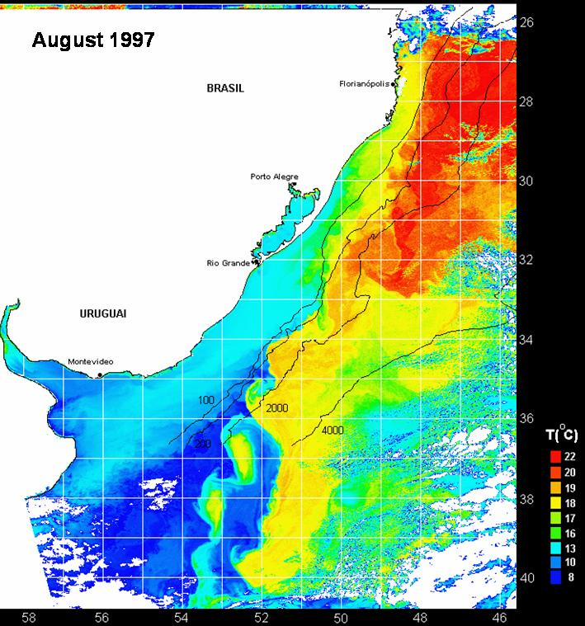
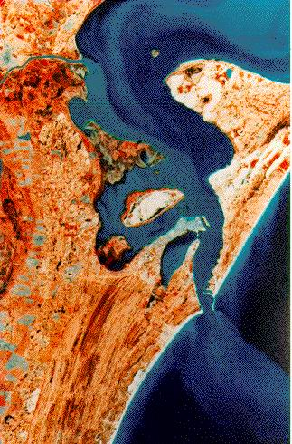

Slide 3
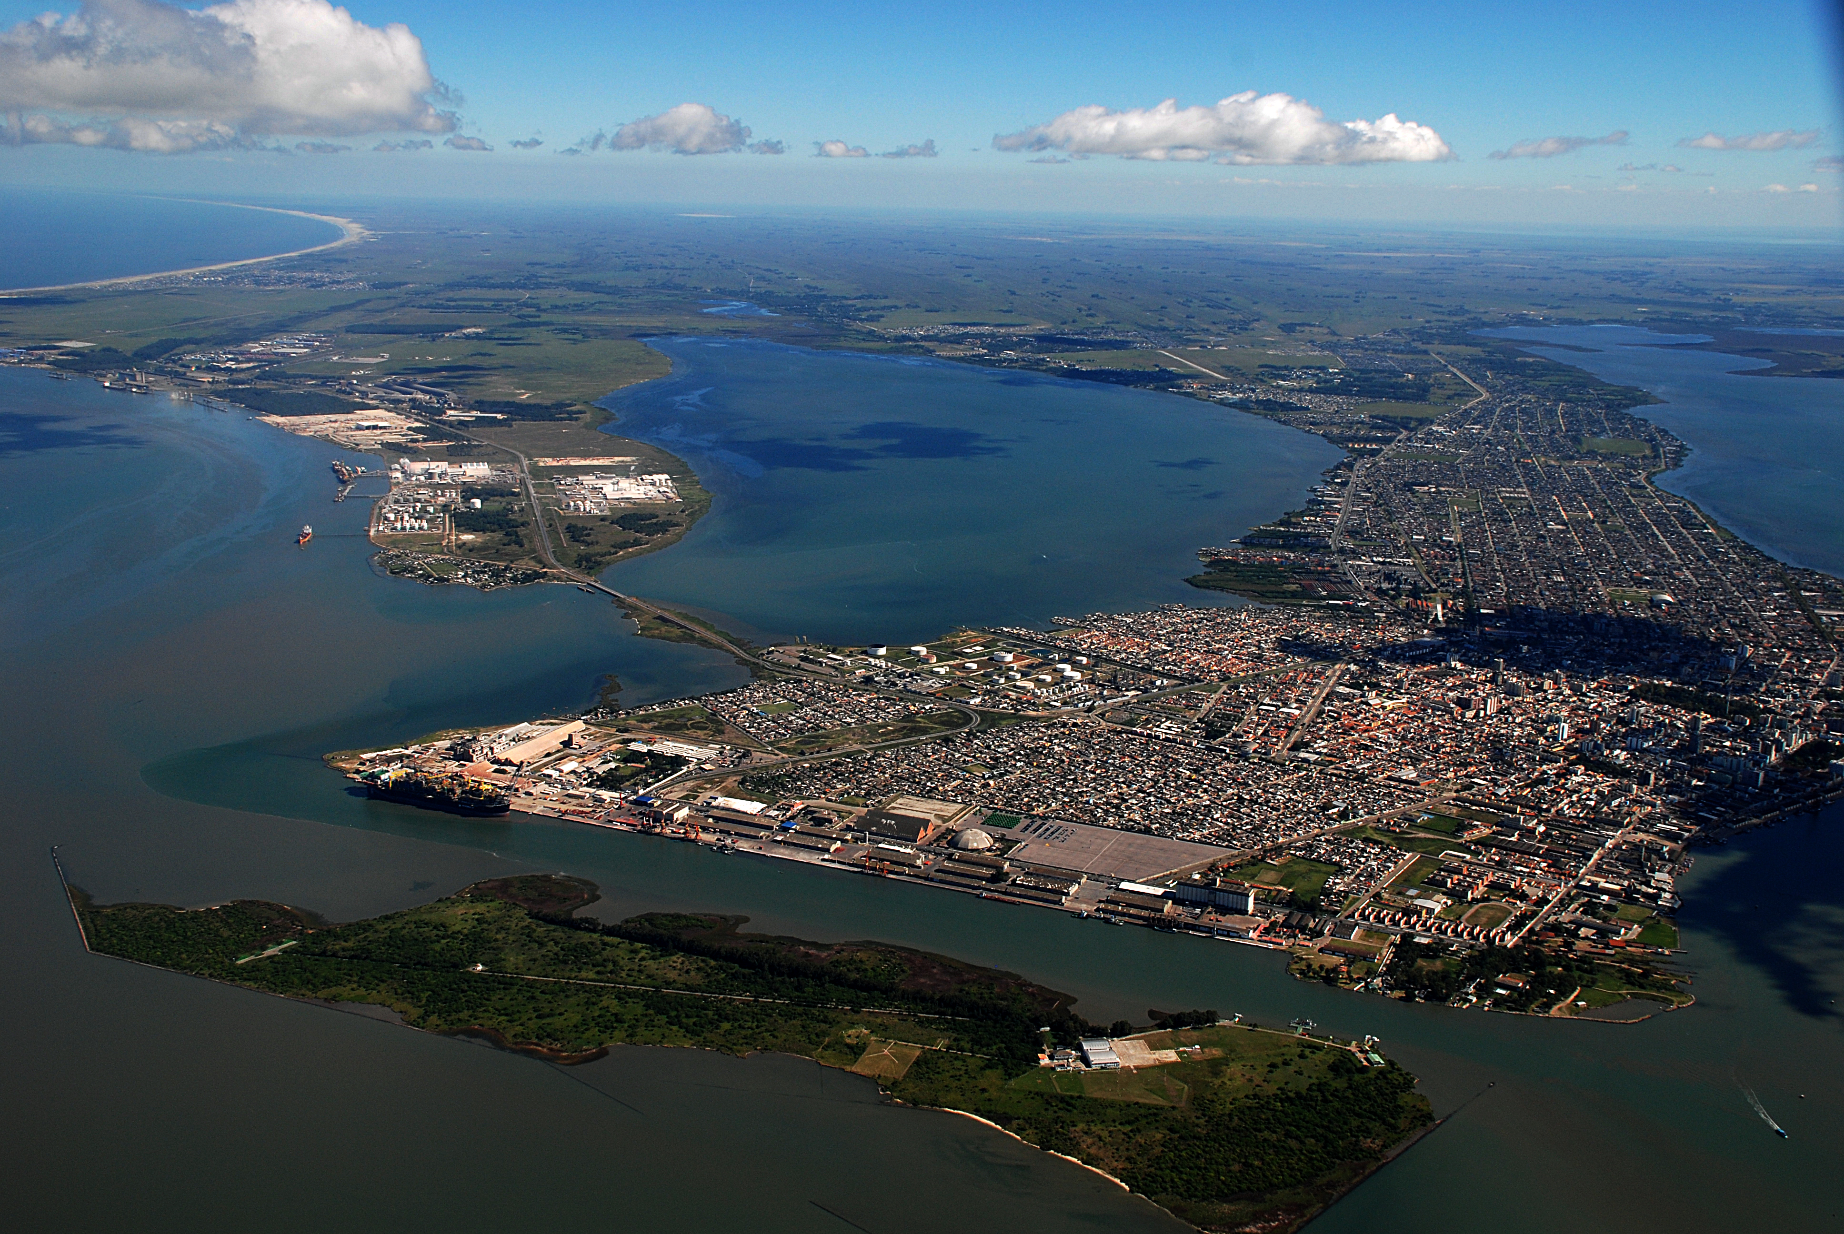
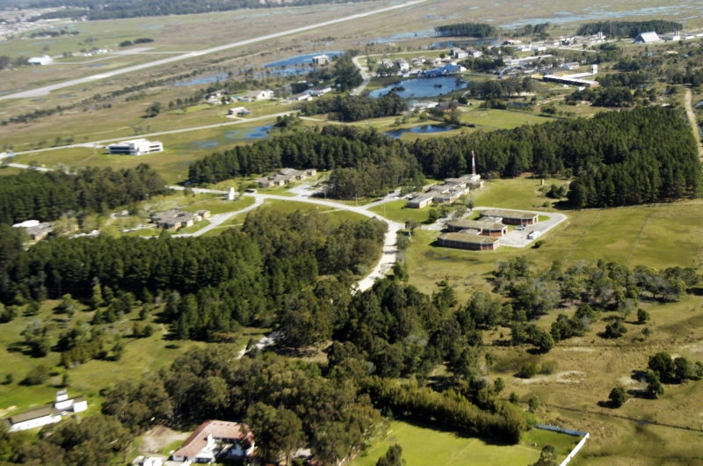
Institute of Oceanography Federal University of Rio Grande (FURG)

Slide 4
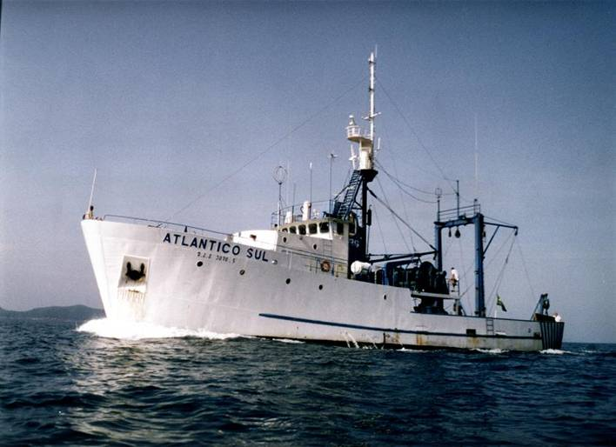
Institute of Oceanography (IO-FURG)
Physical Oceanography
Chemical Oceanography
Geological Oceanography
Biological Oceanography
Living Marine Resources
Coastal Management
Aquaculture
~ 60 lecturers
~ 25 technicians

Slide 5
Physical Oceanography
Osmar O. Moller Jr. – Coastal and Estuarine Physical Oceanography
Carlos A. E. Garcia – Remote Sensing & Physical Oceanography
Mauricio M. Mata – Meso and Large Scale Physical Oceanography
Ivan D. Soares – Modeling of Coastal Circulation
Elisa Fernandes – Modeling of Estuarine Circulation
José L. L. de Azevedo – Analytical and Numerical Modeling

Slide 6
Undergrad and Graduate Courses
2 undergraduate courses:
Oceanography
Environment Management
4 graduate courses
Biological Oceanography
Physical, Chemical and Geological Oceanography
Aquaculture
Coastal Management
~ 20 post-doc assistants

Slide 7
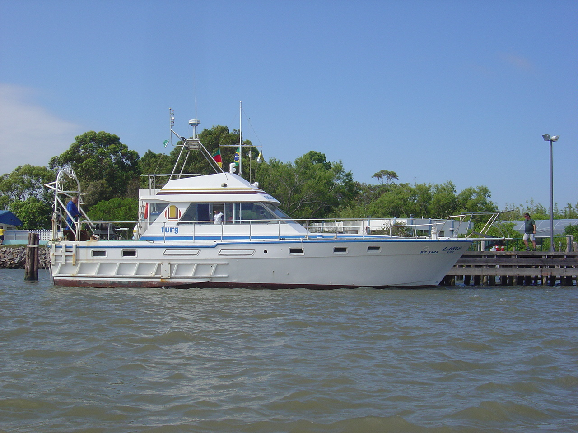
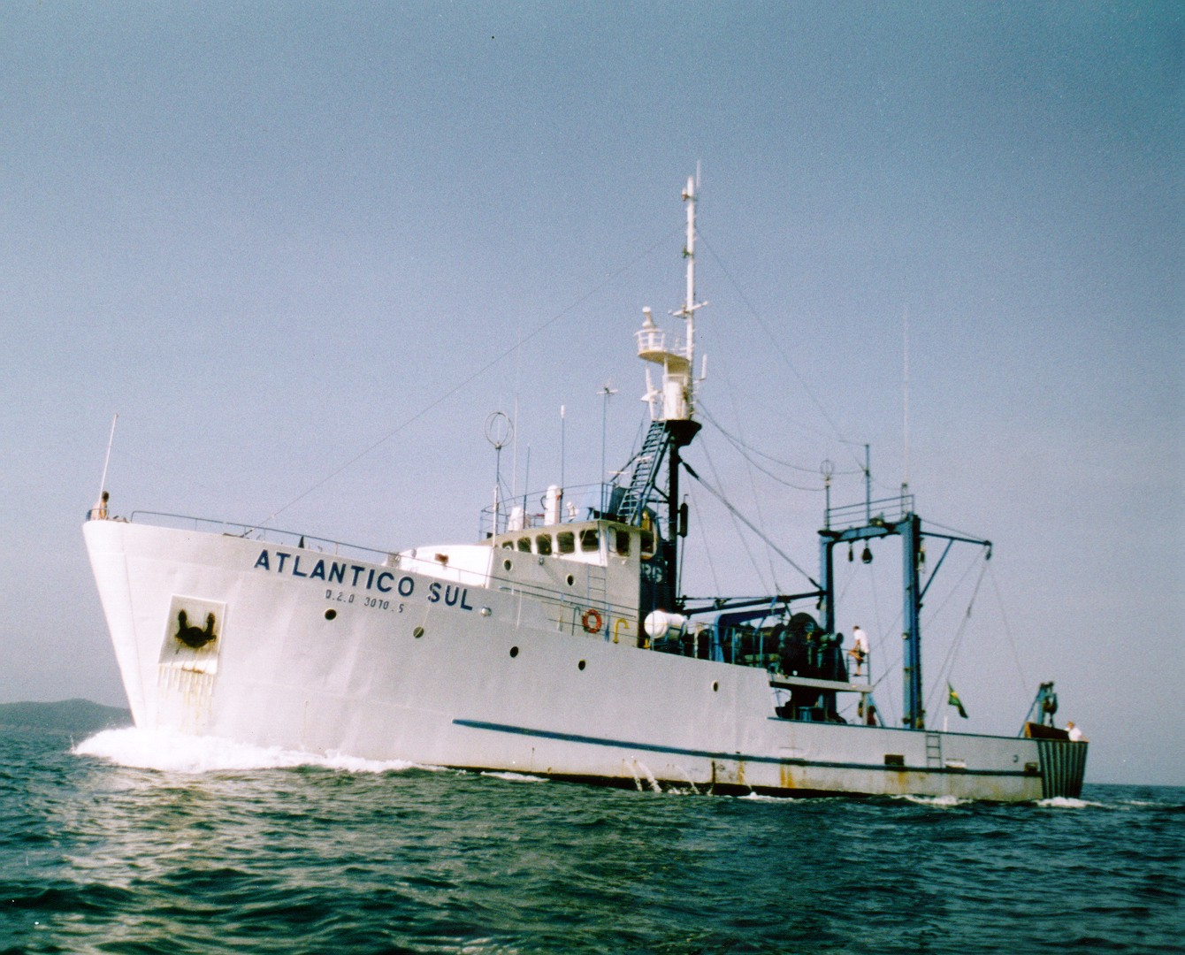
Research Vessels
“Larus”
“Atlântico Sul”
(35 m)

Slide 8
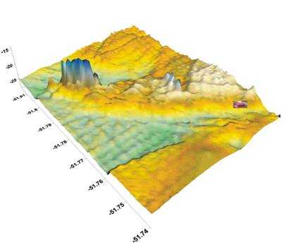
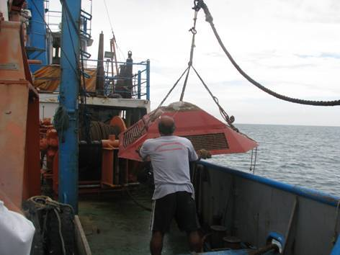
Moorings in the coastal zone
Sontek ADP moored at Parcel do Carpinteiro
From 2011: three coastal moorings – FINEP founded project – Extreme Events – 34º S, 32º S, 29º S
Surface buoys
ADCP with pressure sensors and directional wave measurements
2 CTs/moooring
Cruises

Slide 9
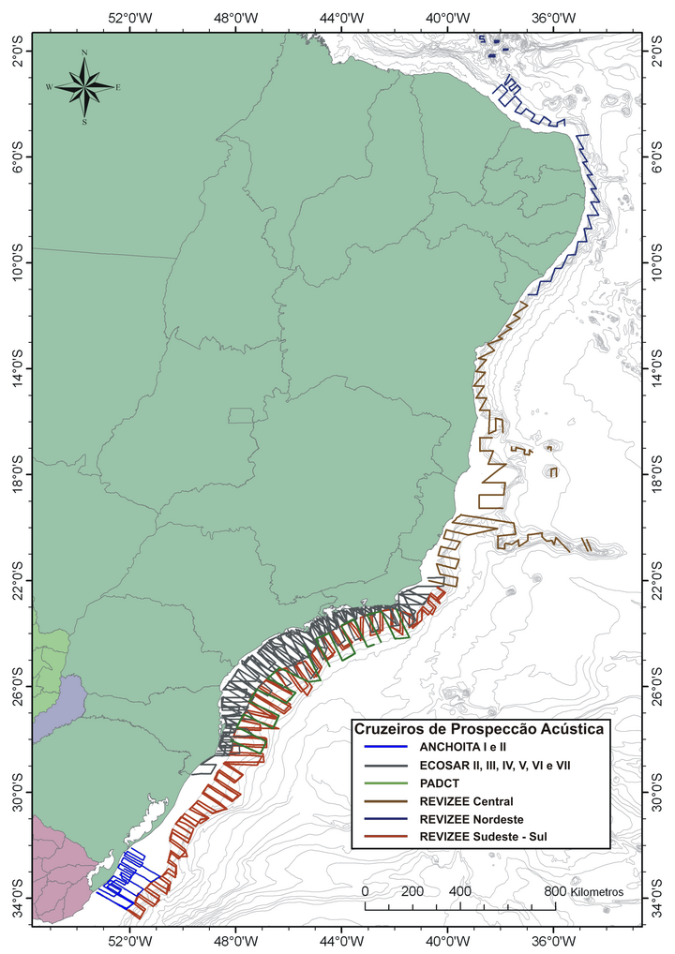
Only Hydroacoustic Cruises
R.V. Atlântico Sul

Slide 10
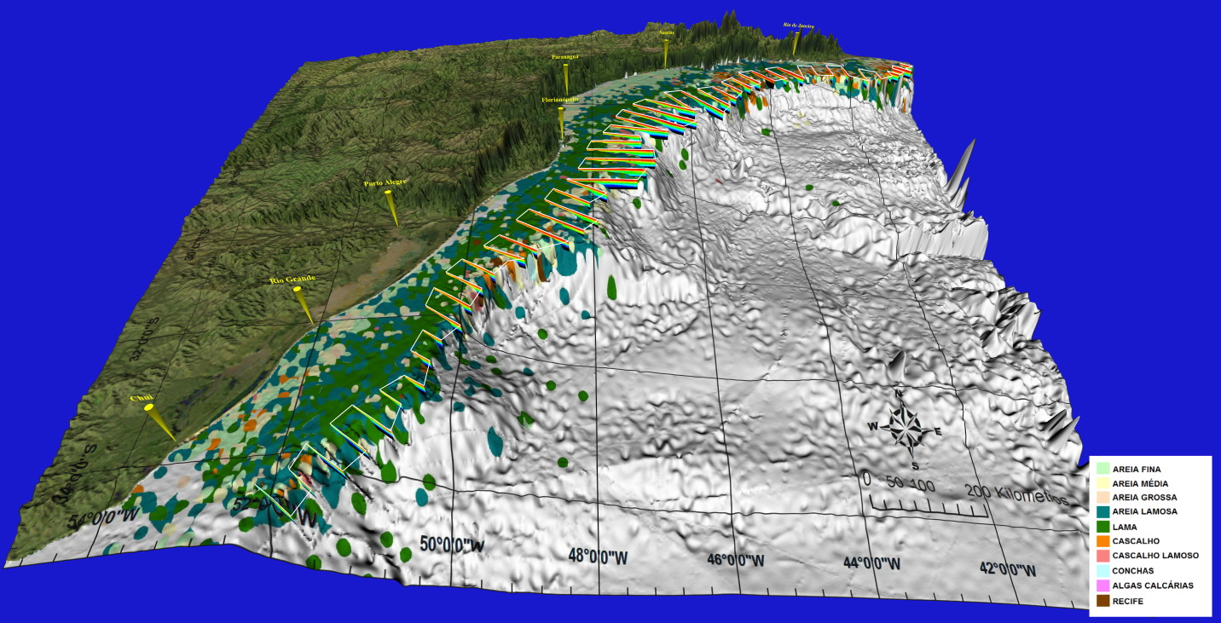
3-D Visual Analysis of Bottom Structure

Slide 11
Evolution of Courses in Oceanography or Marine Sciences
Undergraduate Level

Slide 12
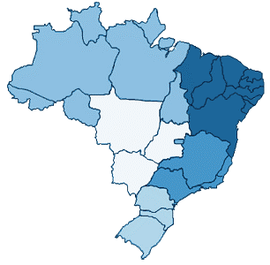
Undergraduation in Oceanography or Marine Sciences – 1st Cycle -
Few Universities offer Undergrad courses in Oceanography or Marine Sciences
UERJ (1977)
UNIVALI (1992)
FURG (1971)

Slide 13
Undergraduation in Oceanography or Marine Sciences – 2nd Cycle -
LDB gives freedom to Universities to create undergrad courses
UFPA (2000)
UFBA (2004)
FAMEC (2006)
UFES (2000)
UNIMONTE (1998)
USP (2002)
UFPR (2004)

Slide 14
Undergraduation in Oceanography or Marine Sciences – 3nd Cycle -
REUNI – A National Program of Expansion of Federal Universities and Technical Colleges
UFMA (2009)
UFC (2008)
UFPE (2009)
UFAL (2012)
UFS (2010)
UNIFESP (2012)
UFSC (2008)

Slide 15
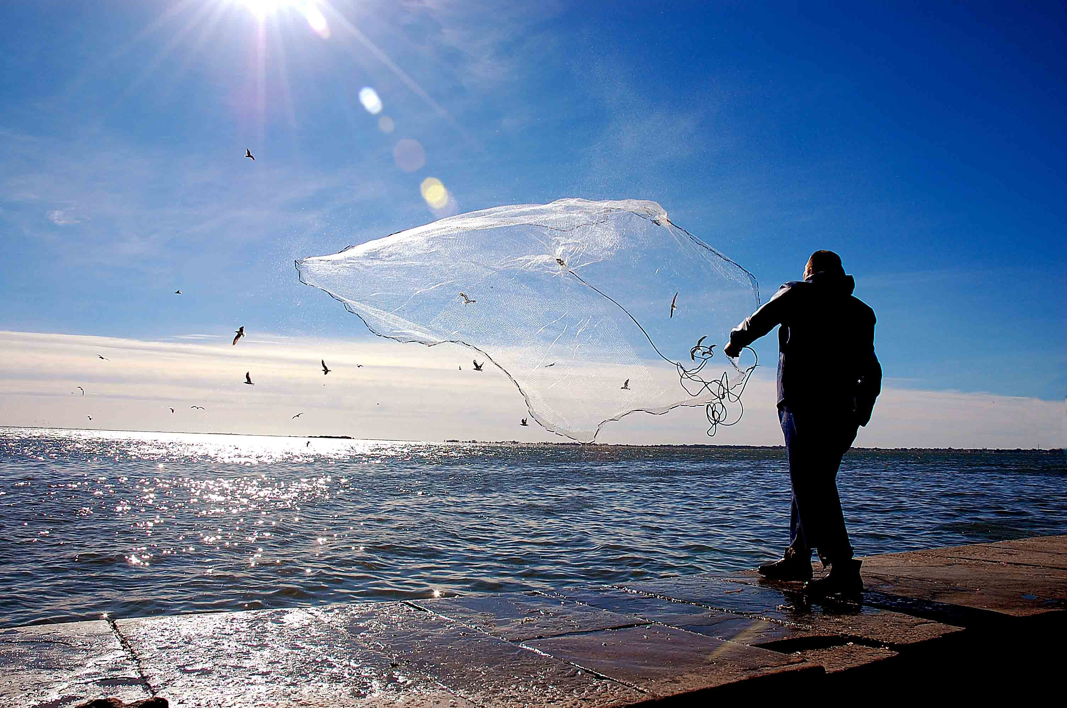
Undergrad Courses in Oceanography or Marine Sciences
in Brazil
●
●
●
●
●
●
●
●
●
●
●
●
●
●
●
●
●
UESC; UFRPE; UFPB; UFRN;
UFRGS; IP; UFRJ; UFF; UENF
Law n° 11.760 ⇨ Profession of Oceanographer is recognized in Brazil => NEW CYCLE ?
Foto João Paulo

Slide 16
Brazilian Research Vessels for Marine Sciences in Open Ocean
Available for Research

Slide 17
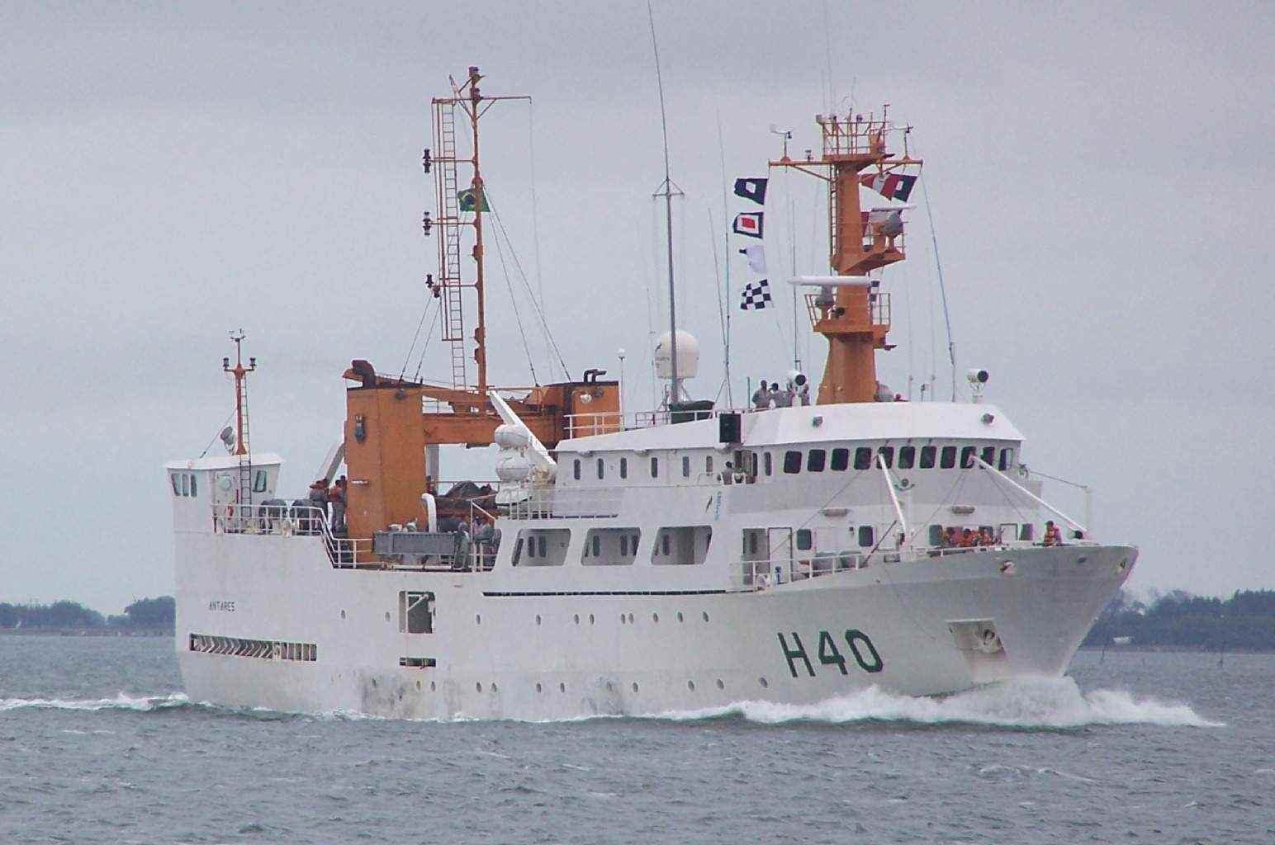
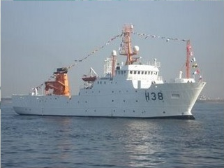
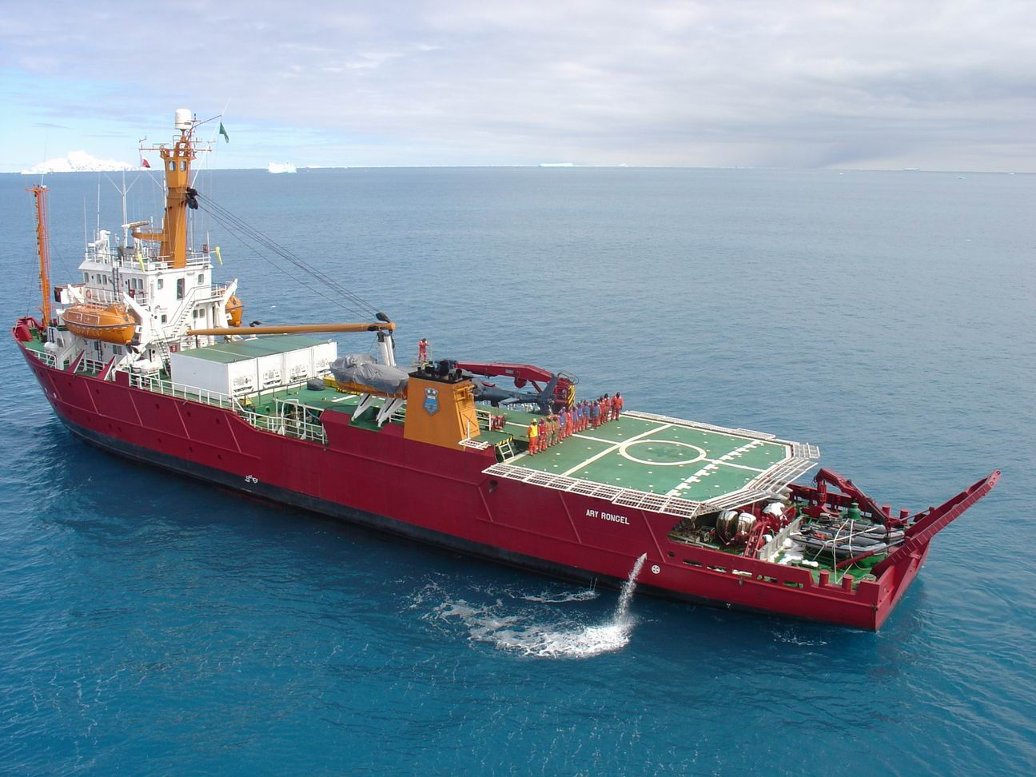
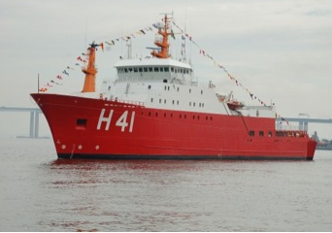
Brazilian Ships Available for Open Ocean Studies
Antares
Cruzeiro do Sul
Ary Rongel
Alte Maximiano

Slide 18
RV “ARY RONGEL”
Brazilian Navy

Slide 19
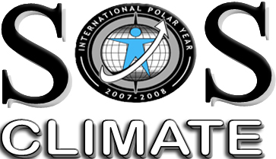
Southern Ocean Studies for Understanding Global-CLIMATE Issues
Carlos Garcia & Mauricio Mata
Institute of Oceanography
Federal University of Rio Grande
Brazilian contribution to the International Polar Year
www.goal.furg.br

Slide 20
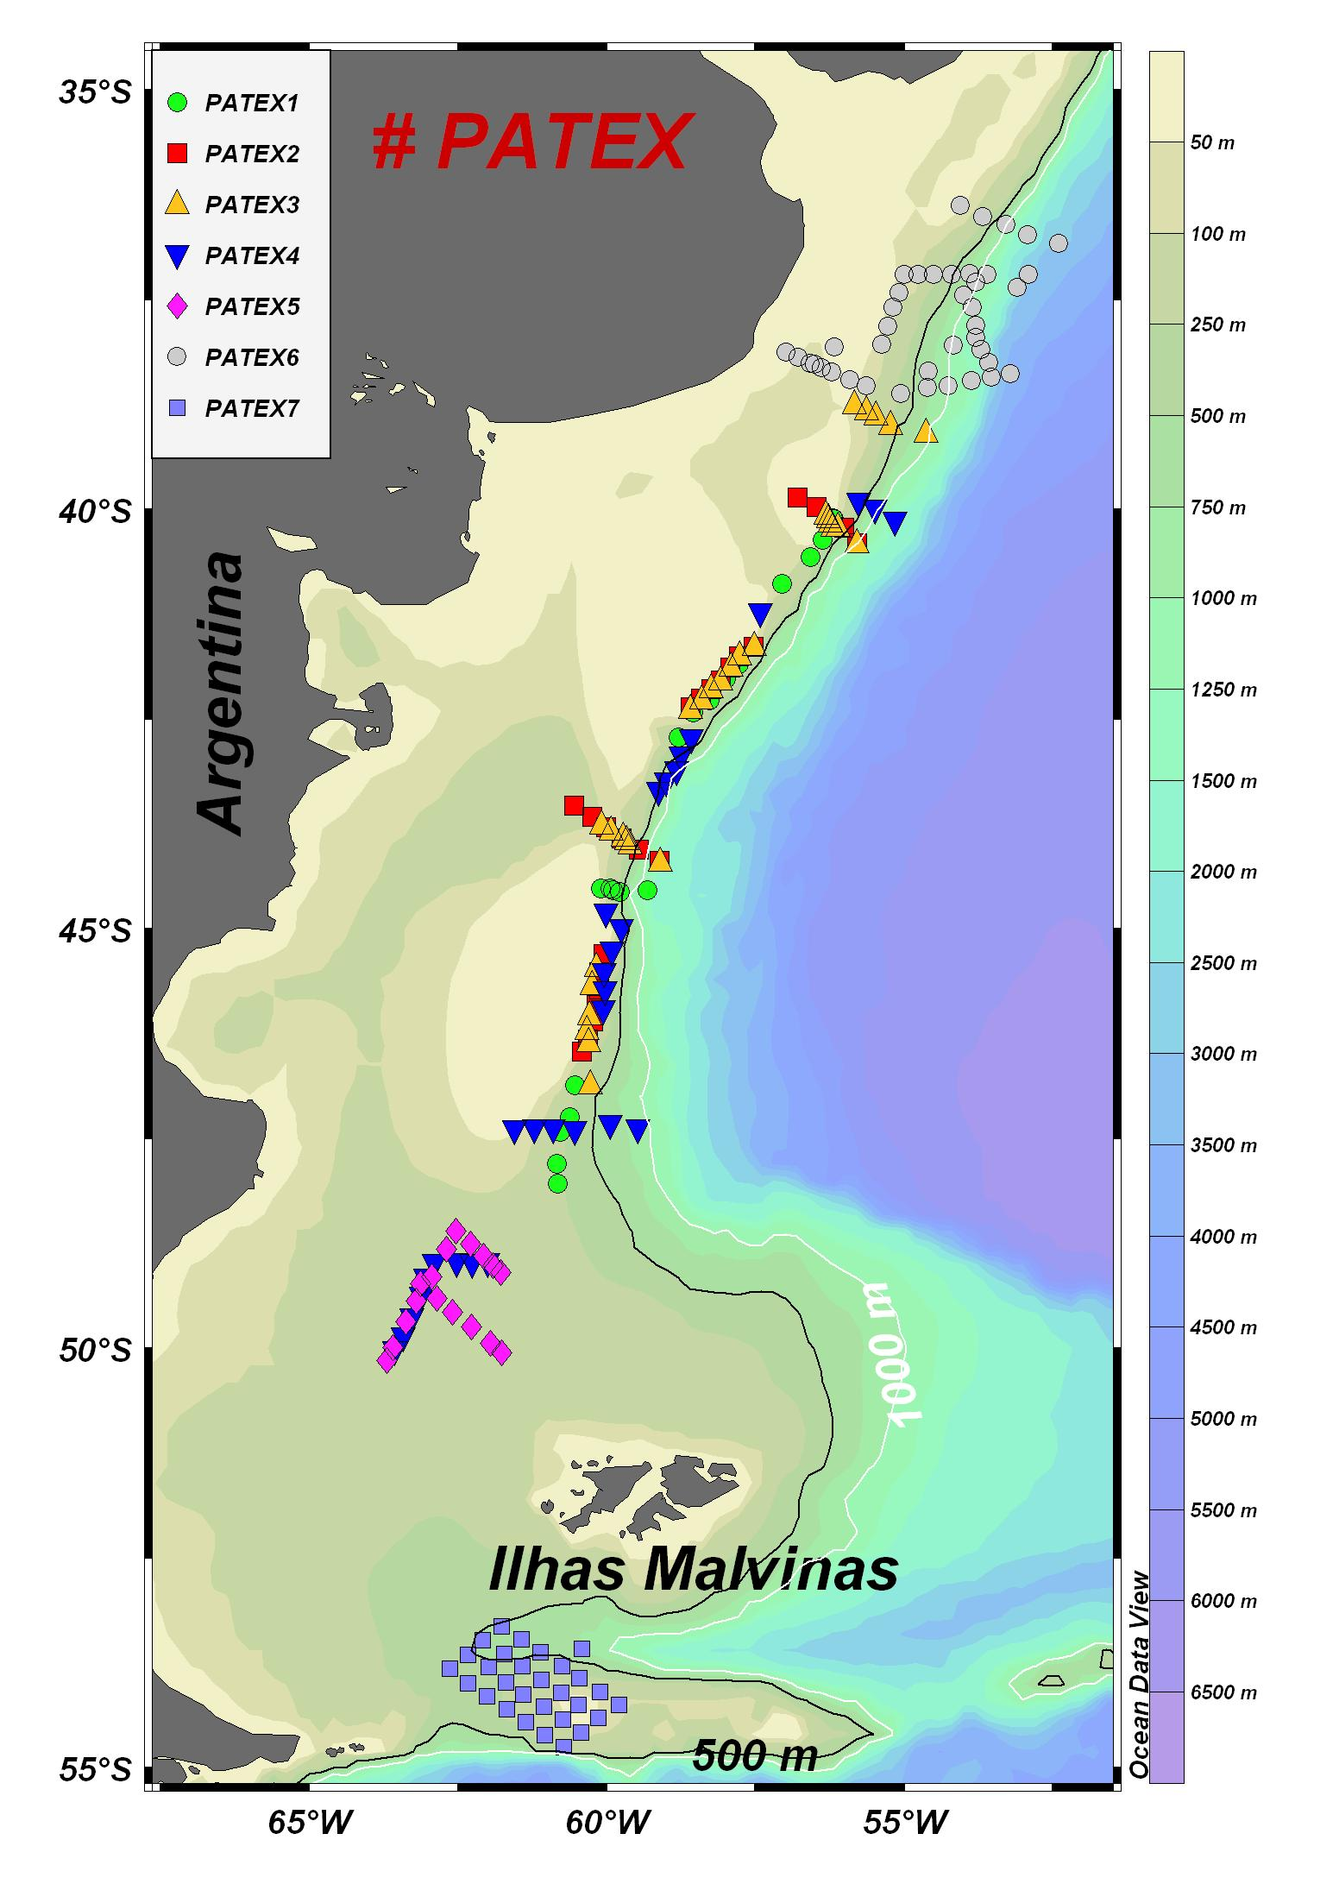
PATagonia Experiment (PATEX)
Objectives:
Investigate the environmental factors that control the occurrence phytoplankton blooms
to determine the main nutrient levels
to characterize the phytoplankton assemblage and primary production rates, and ratios associated with the bloom waters
to determine their bio-optical characteristics
to quantify the CO₂ fluxes, and atmospheric aerosols and DMS concentration in the studied area.

Slide 21
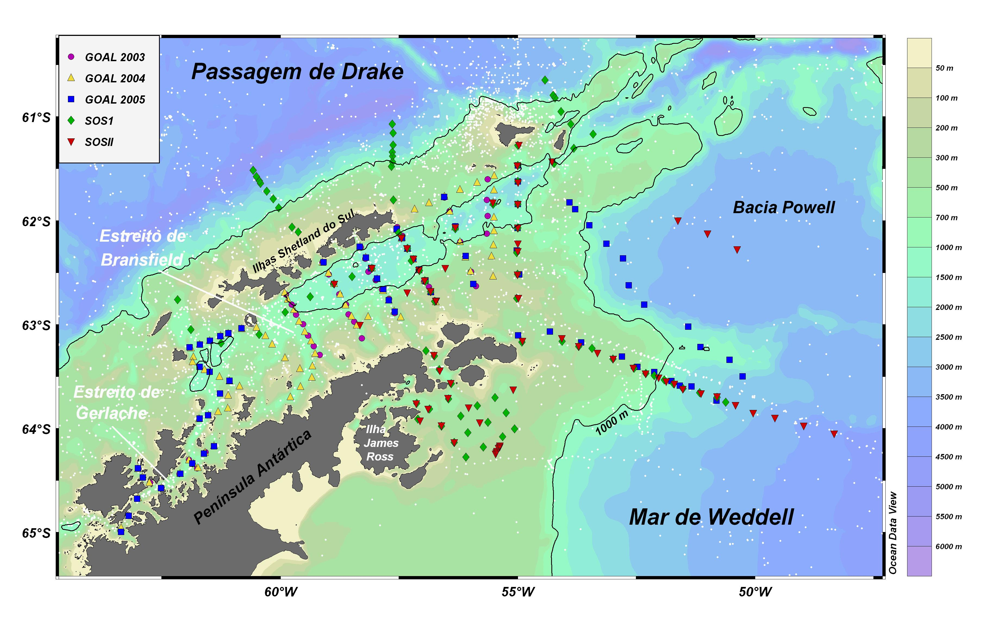
Locations of CTD stations
MEASUREMENTS DURING IPY
CTD/Rosette (24 bottles – 5 liters) system
2C, 2T, D, O2, fluorescence, c660, PAR
Seawater sampled for
Chlorophyll-a (fluorometry and HPLC techniques)
Phytoplankton counting and identification
Nutrients (auto-analyzer)
Spectral absorption of phytoplankton, CDOM and detritus
POC & DOC (Antonio Mannino, NASA)
Primary production (C¹⁴ technique)
Optical measurements
Multispectral surface reflectance - SeaWiFS bands
Hyperspectral radiometric profiles (Satlantic)
Absorption and attenuation of seawater (ac-9)
Backscattering of seawater
Underway measurements
SSS, SST, air-sea pCO2 (CO2 flux), aerosol, DMS
Deployment of 3 moorings in the BS
ACDP (RDI) + CT (SeaBird) +
Current meter (Aanderaa)+
double acoustic releases (Benthos).
Moorings
SOS 1 – Feb 2008
SOS 2 – Feb 2009
Moorings deployed in Feb 2009
SOS 3 – Feb 2010

Slide 22
Sampled Regions in Recent Years
I Comissão Trans-Atlântico
Brasil- Africa
II Comissão Trans-Atlântico
Brasil- Africa
PATEX
Ano Polar Internacional
SOS-CLIMATE
Ano Polar Internacional
INCT - Criosfera

Slide 23
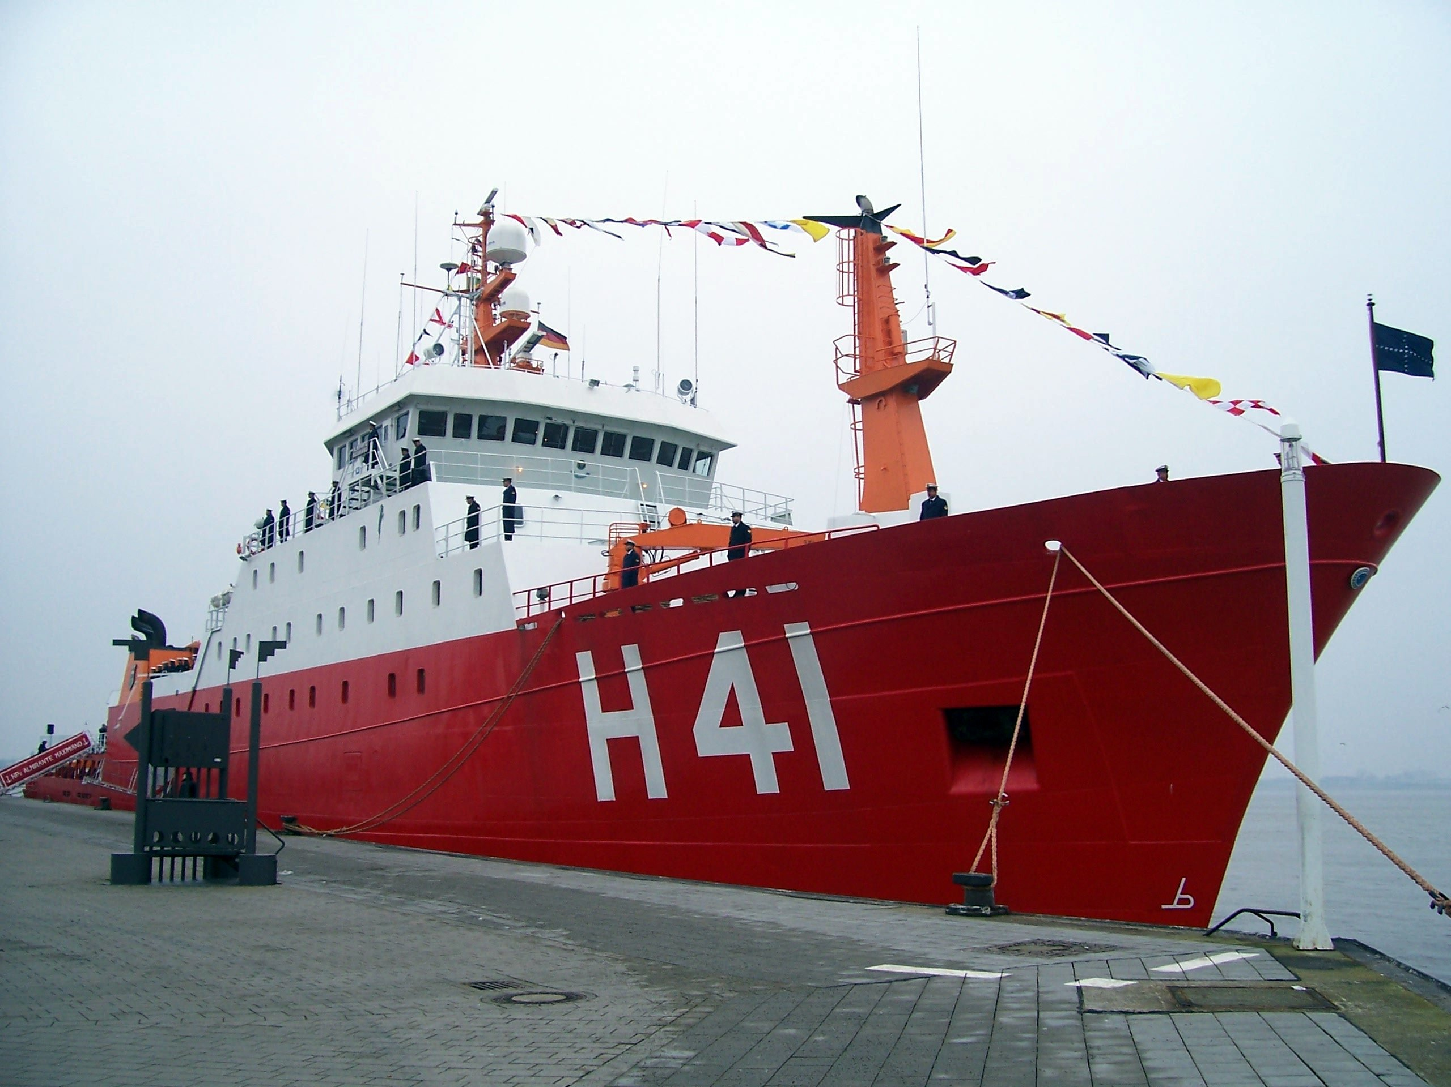
Polar RV “Alte Maximiano”
Brazilian Navy

Slide 24
FUTURE Brazilian Ships for Open Ocean Studies
The Terms of Reference for a new Research Announcement of Opportunity (RAO) for acquiring research vessel to be placed at Universities in Brazil has been approved by Ministry of Science and Technology (MCT) in March 2010.
Two research vessels ( ~ 50 meters long) are expected to be acquired and placed at two Brazilian Universities.
FINEP is about to release the RAO

Slide 25
Perspectives for Observational Oceanography in Open Oceans
The number of Brazilian universities working in Marine Science has substantially increased.
Funding levels for Marine Science research have increased in recent years
Brazilian Antarctic Program (ex. US$ 5M in 2007, US$ 8M in 2009)
National Institutes of Science and Technology (INCT) – support several research activities in oceanography and marine science – ~ US$ 7M
Special Program in Marine Science launched in 2009 by CAPES – 26 projects ( ~ US$ 15M) – in MSc, PhD and Postdoc scholarships
Climate and Carbon in the South Atlantic Ocean (~ US$ 6M)
New research vessels owned by Brazilian Navy ( R.V. Cruzeiro do Sul and R.V. Alte Maximiano ).
Real possibility of two new Research Vessels in the near future, most certainly at IO-USP and IO-FURG, for coastal and oceanic research.
EXCELLENT PERSPECTIVES IN MY VIEW!!!

