Slide 1
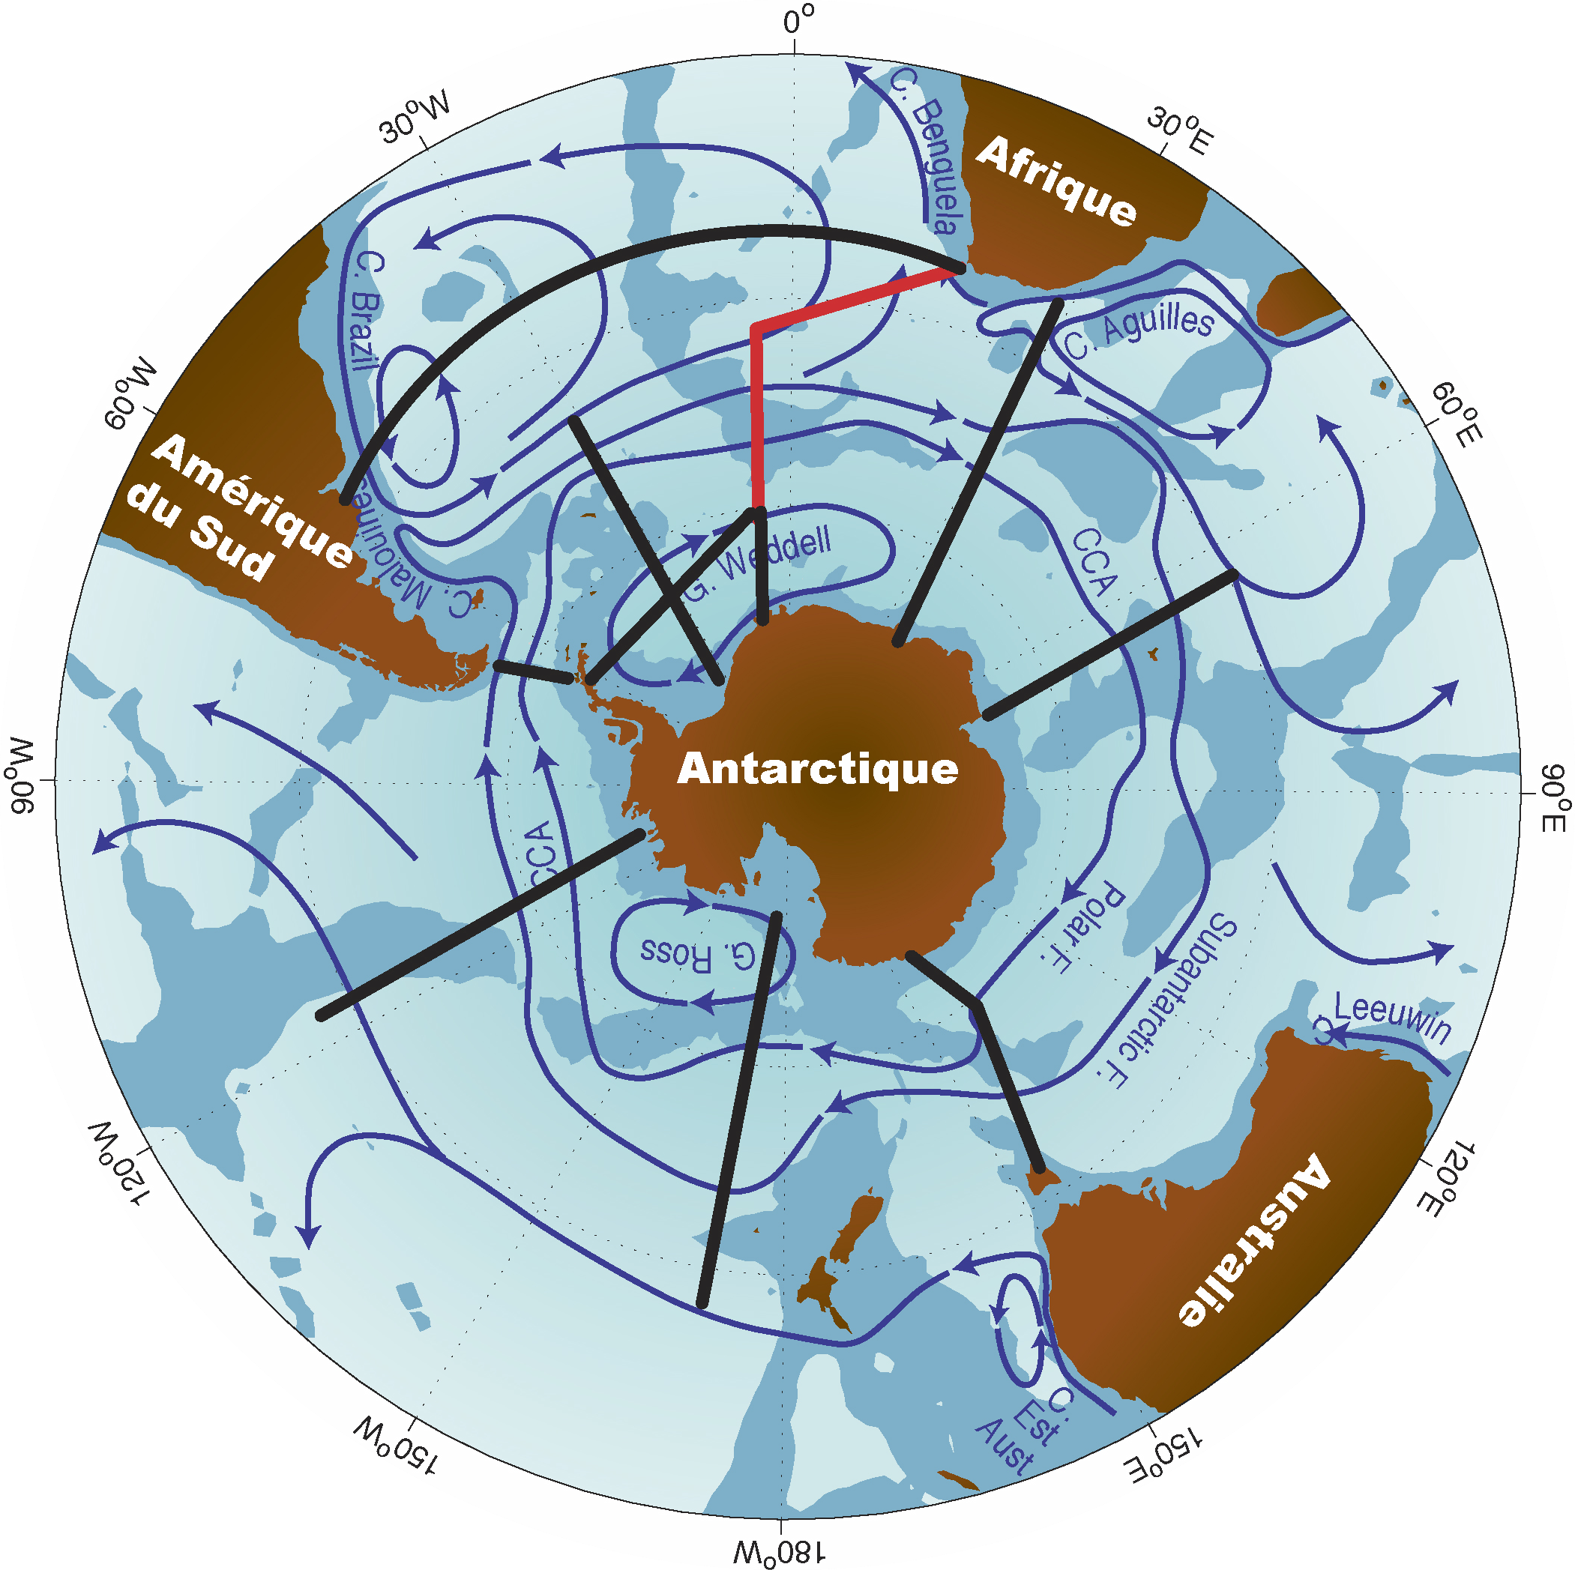
GOODHOPE
S. Speich
M. Arhan, I. Ansorge, S. Garzoli, S. Gladyshev, G. Goni, E. Key, J. Lutjeharms, C. Meinem, A. Sokov, S. Swart & et al.

Slide 2
The Southern Ocean south of Africa is the major link to the global MOC
It is the “gate” for NADW to the rest of the world ocean and to the return of thermocline waters (including AAIW) to the North Atlantic
GoodHope
(since 2004)
Notes:
The region South of Africa is a « key » region as it aloud the NADW to exit the South Atlantic and be injected in the SO and other ocean basins; it is also the region from where all the thermocline waters are injected into the South Atlantic (and within these also the upper branch of the AMOC). This beceause the south-west of the Atlantic ocean receive waters from the Indian Ocean but also is an eastern ocean boundary, the zonal dynamics is less intense than in a western boundary and therefore meridional exchanges are dynamically easier. They take mostly place as mesoscale and submesoscale exchanges

Slide 3
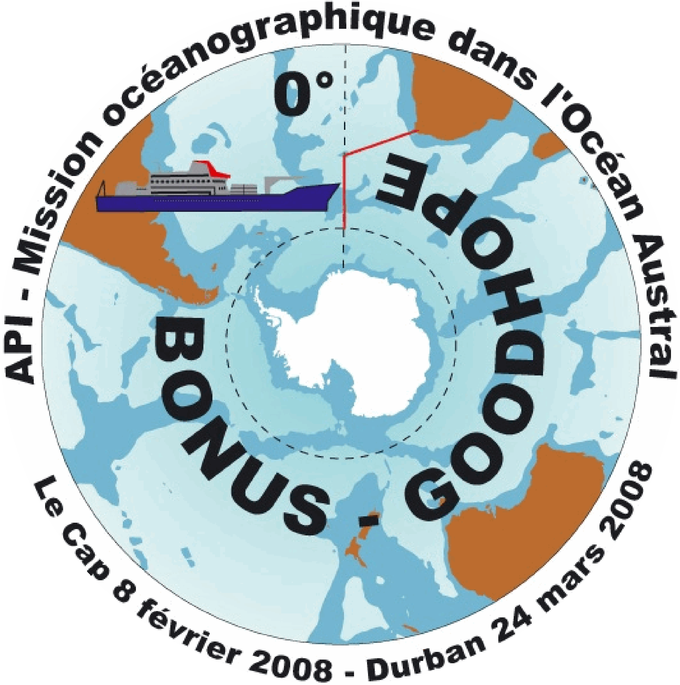
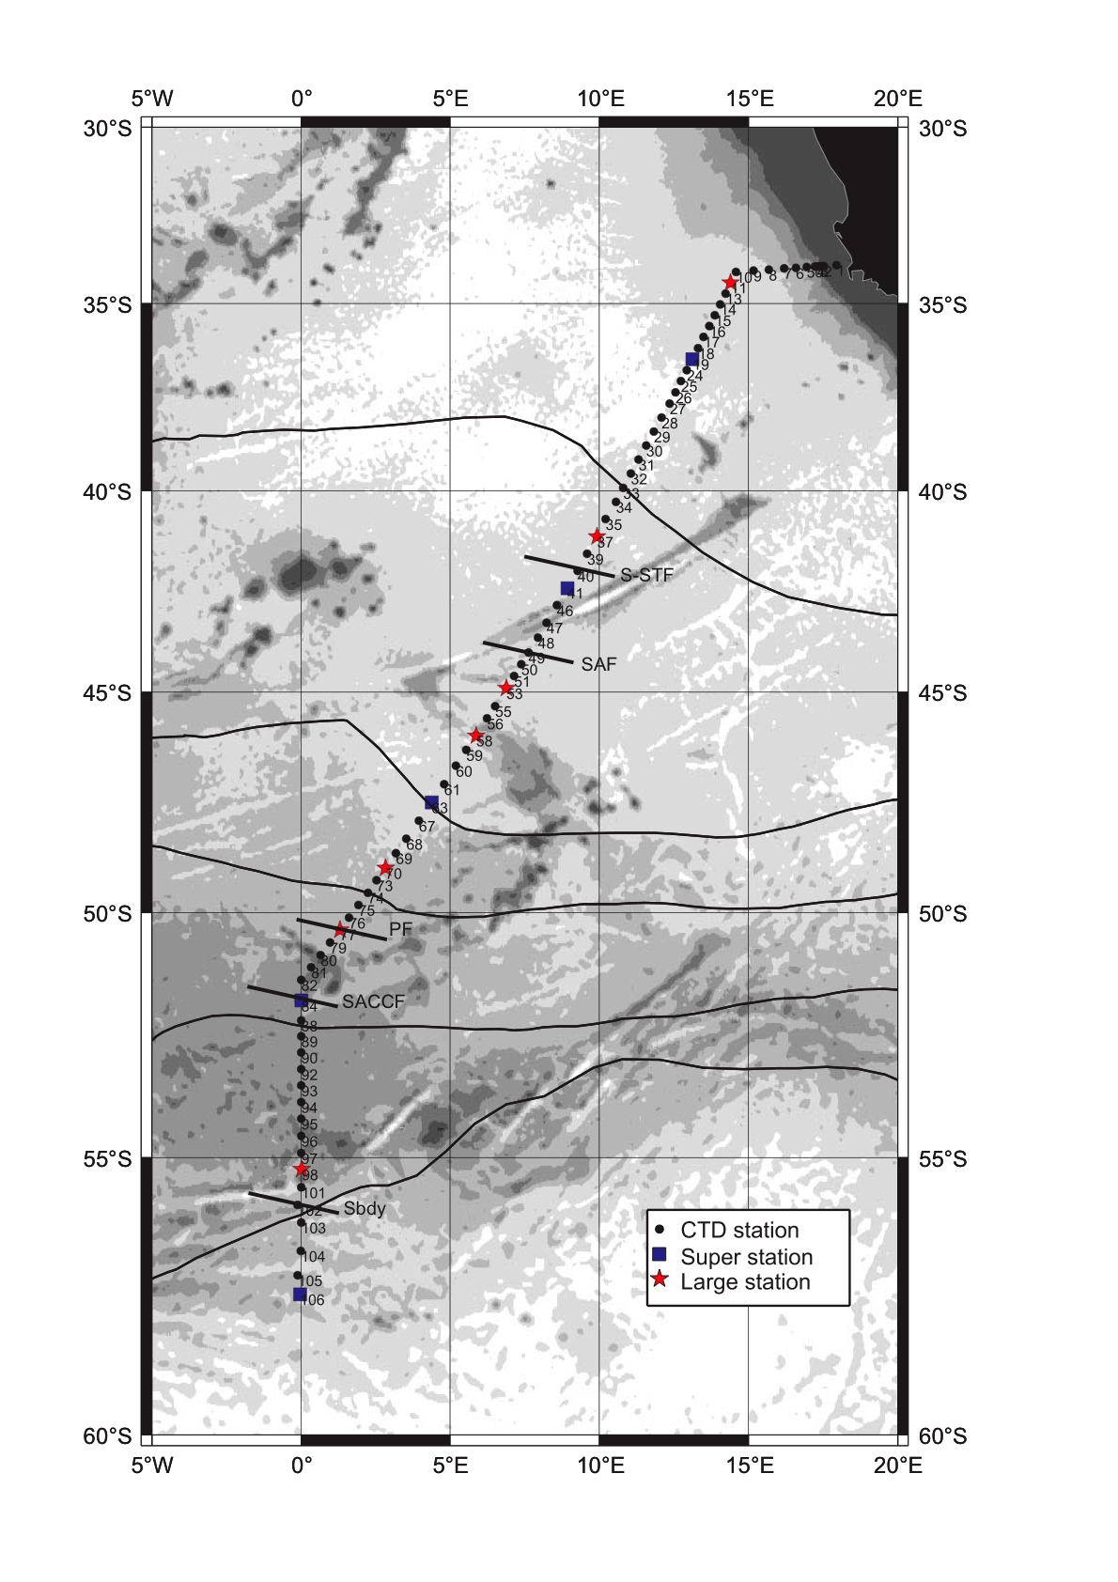
IPY BONUS-GoodHope
13 February – 24 March 2008
79 stations :
68 “Hydro”~ 4 hrs
7 “Large” ~ 7-11 hrs
5 “Super” ~ 49 hrs
many“Intercalibrations”
111 CTD deployments
2 C-PIES mooring deployment
132 XBTs
17 ARGO profiling floats
60 atmospheric radiosounding
Notes:
BGH= an intesne observing effort… C-PIES = Current-Pressure Inverted Echo Sounders : they have been deployed in the first part of the transect on the African slope (at 1000 m and 4000 m) for long term monitoring of interocean exchanges

Slide 4
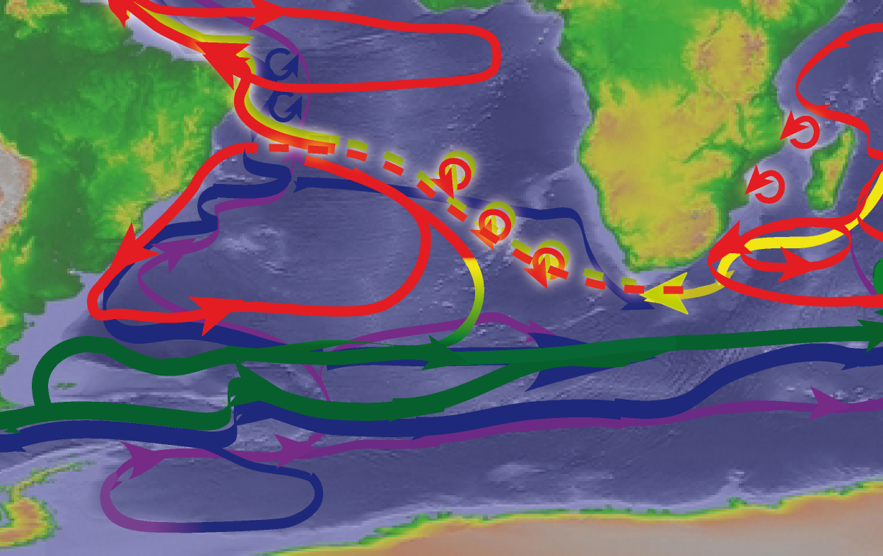
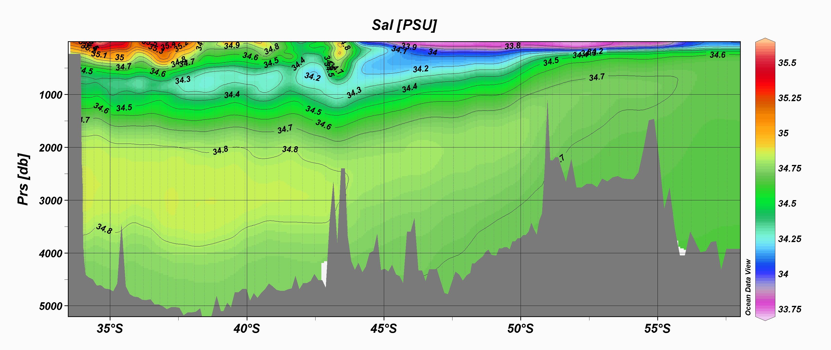
BGH Water Masses
Agulhas Rings & Agulhas Bank Cyclones
“Old” Agulhas Ring M
SAF
PF
S. Atlantic AAIW
NADW
« western route »
+ LCDW
LCDW
Indian AAIW
NADW
« eastern route »
WDW
BW
Bottom waters
S
UCDW
WG
BW
Oxygen
Notes:
NADW & CDW: different veins: the NADW slope current along the South African slope; then the more classical branch from the western South Atlantic basin; then LCDW

Slide 5
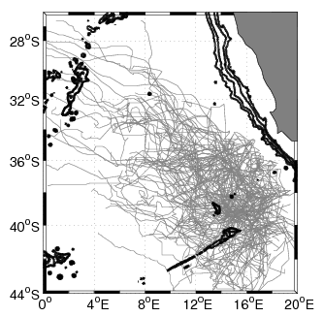
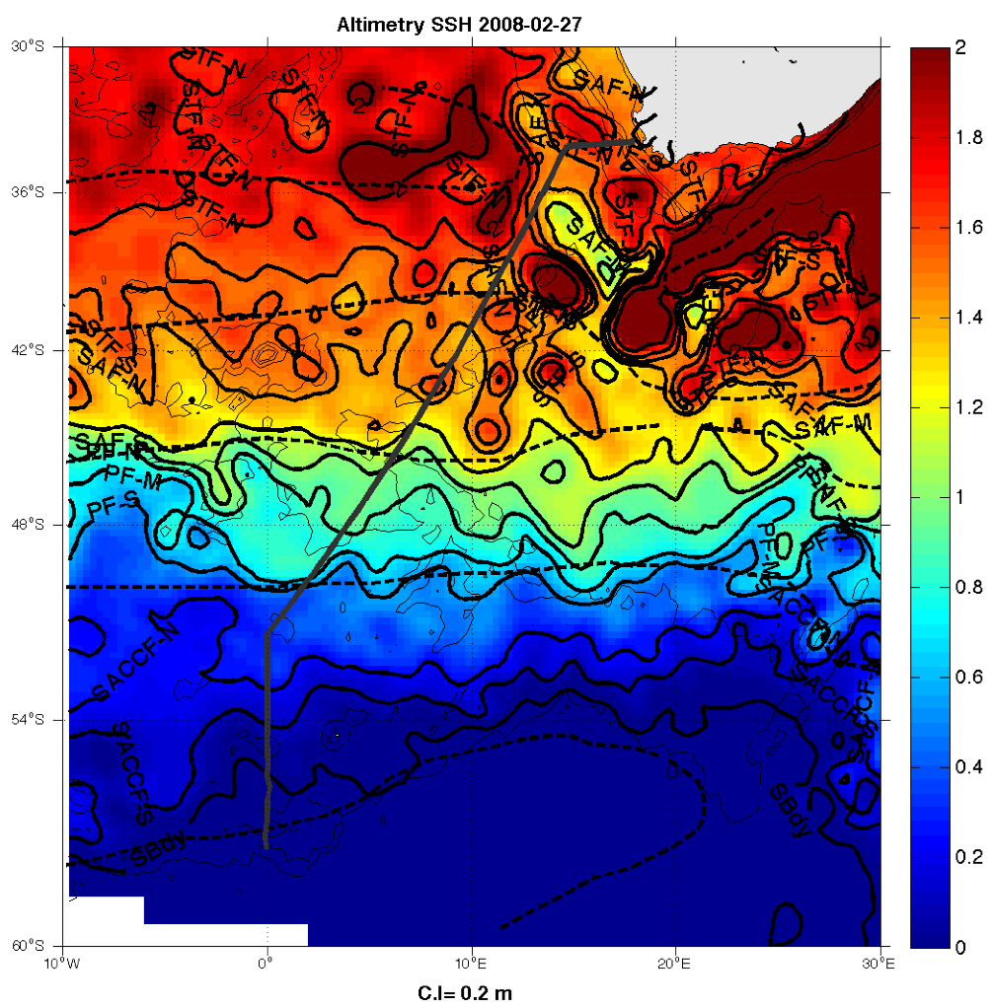
Paths of Agulhas Rings
AVISO absolute Dynamic height
during BGH cruise
(Febr. 27 2008)
Northern
Route
Central Route
Southern
Route
Ring trajectories derived from altimetry (MADT-UPD) with WATERS wavelet based method (Doglioli et al. 2007
Dencausse, G. M. Arhan, S. Speich, Deep Sea Res. 2010 a & b, under revision

Slide 6
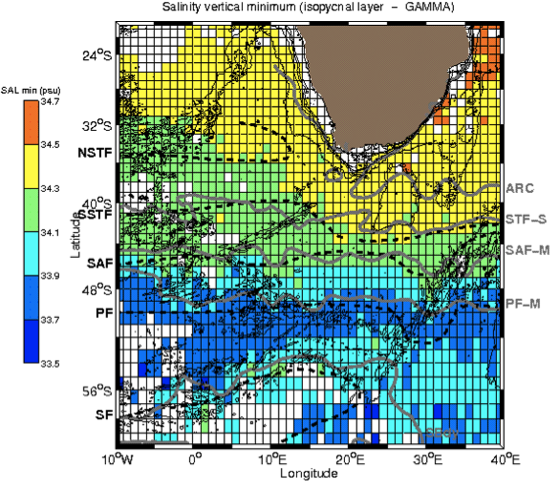
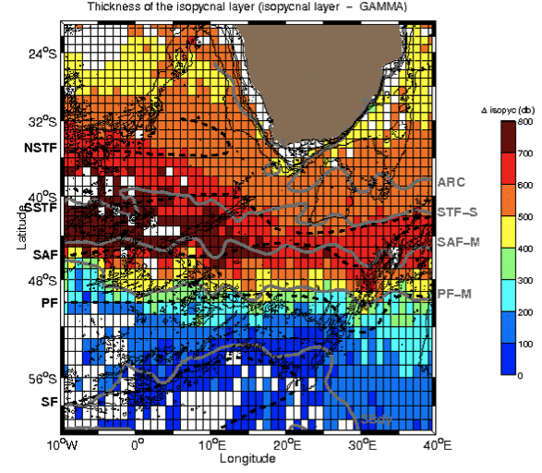
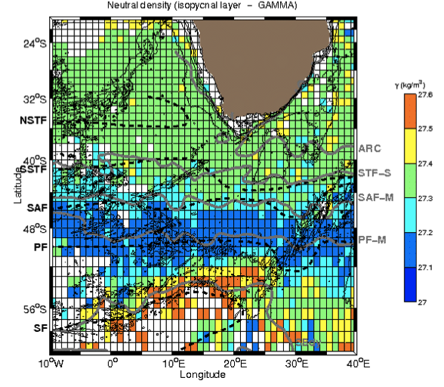
Paths of SO-Indo-Atlantic Eddies
AAIW from ARGO floats (27.1 ≤ γ ≤ 27.6)
Salinity minimum
Layer Thickness
NEUTRAL DENSITY
E. Rusciano, S. Speich, M. Arhan, in preparation

Slide 7
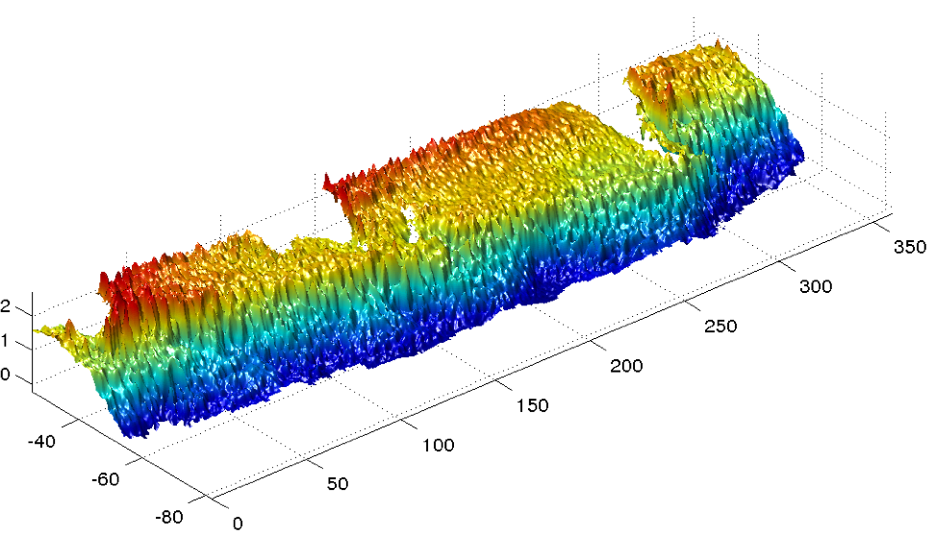
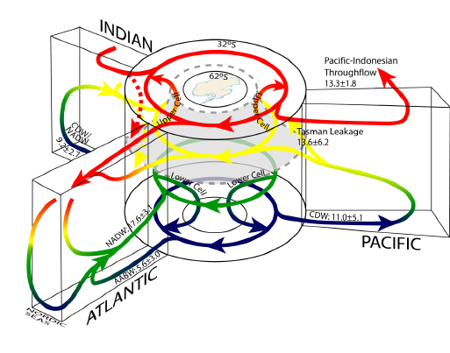
Lumpkin et Speer 2007
Paths of SO-Indo-Atlantic Eddies
High to mid-latitudes: A turbulent Ocean
Australia
Africa
23 January 2008
Absolute Dynamic Height
from AVISO

Slide 8
Paths of SO-Indo-Atlantic Eddies

Slide 9
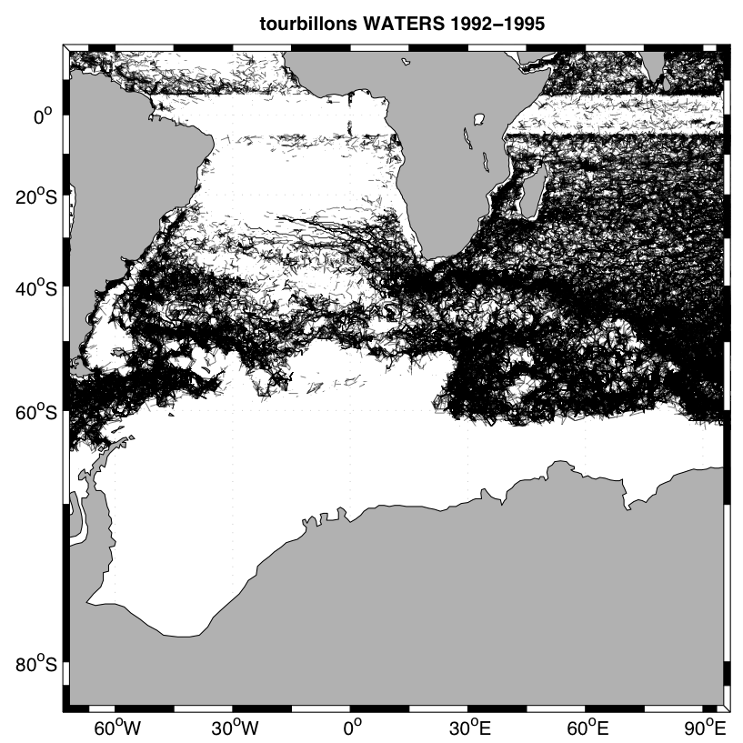
Paths of SO-Indo-Atlantic Eddies
High to mid-latitudes: A turbulent Ocean
Eddy detection by an objective method (WATERS, Doglioli et al. 2007, 2008);
Examples for 1992-1995 eddies
A. David & S. Speich in preparation

Slide 10
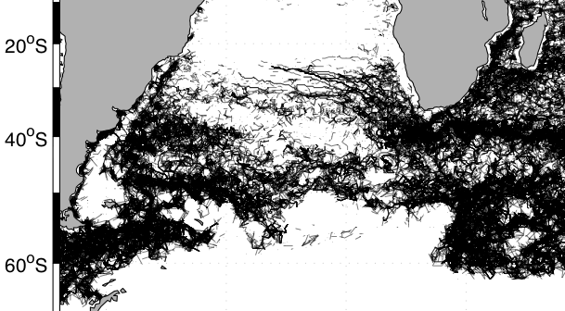
Paths of SO-Indo-Atlantic Eddies
AAIW from ARGO floats & Eddies
E. Rusciano, S. Speich, M. Arhan, in preparation

Slide 11
Paths of SO-Indo-Atlantic Eddies
A. David & S. Speich in preparation

Slide 12
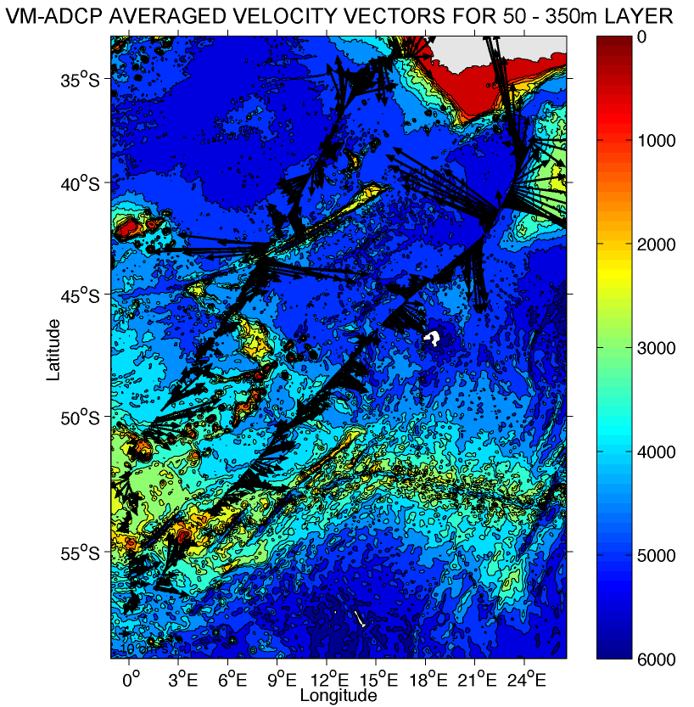
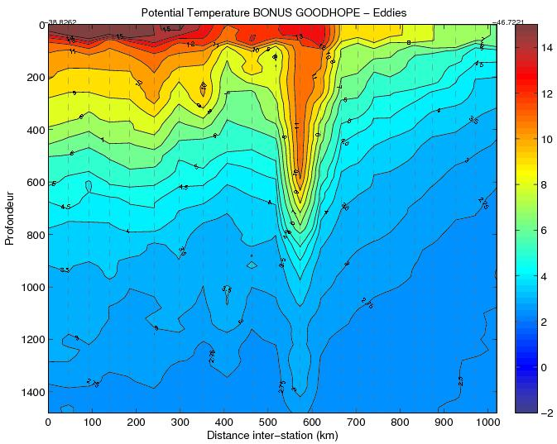
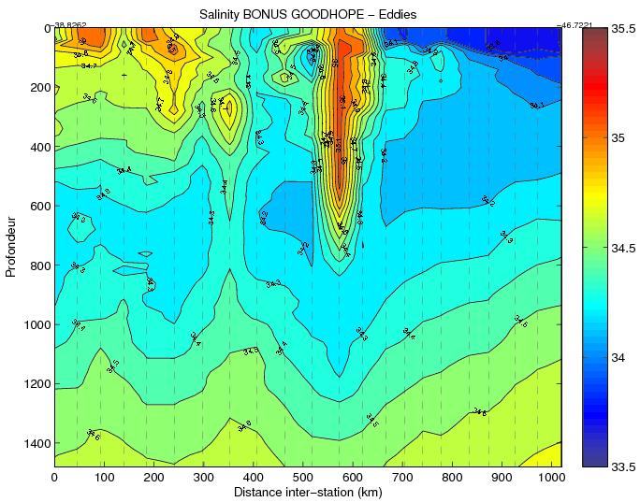
The Agulhas Rings
Southern Route
SAF
Agulhas Bank cyclone
SAF
Agulhas Ring M
Agulhas Rings & Agulhas Bank Cyclones
“Old” Agulhas Ring M
SAF
PF
S. Atlantic AAIW
Indian AAIW
S
Theta
S
N
S
N
S

Slide 13
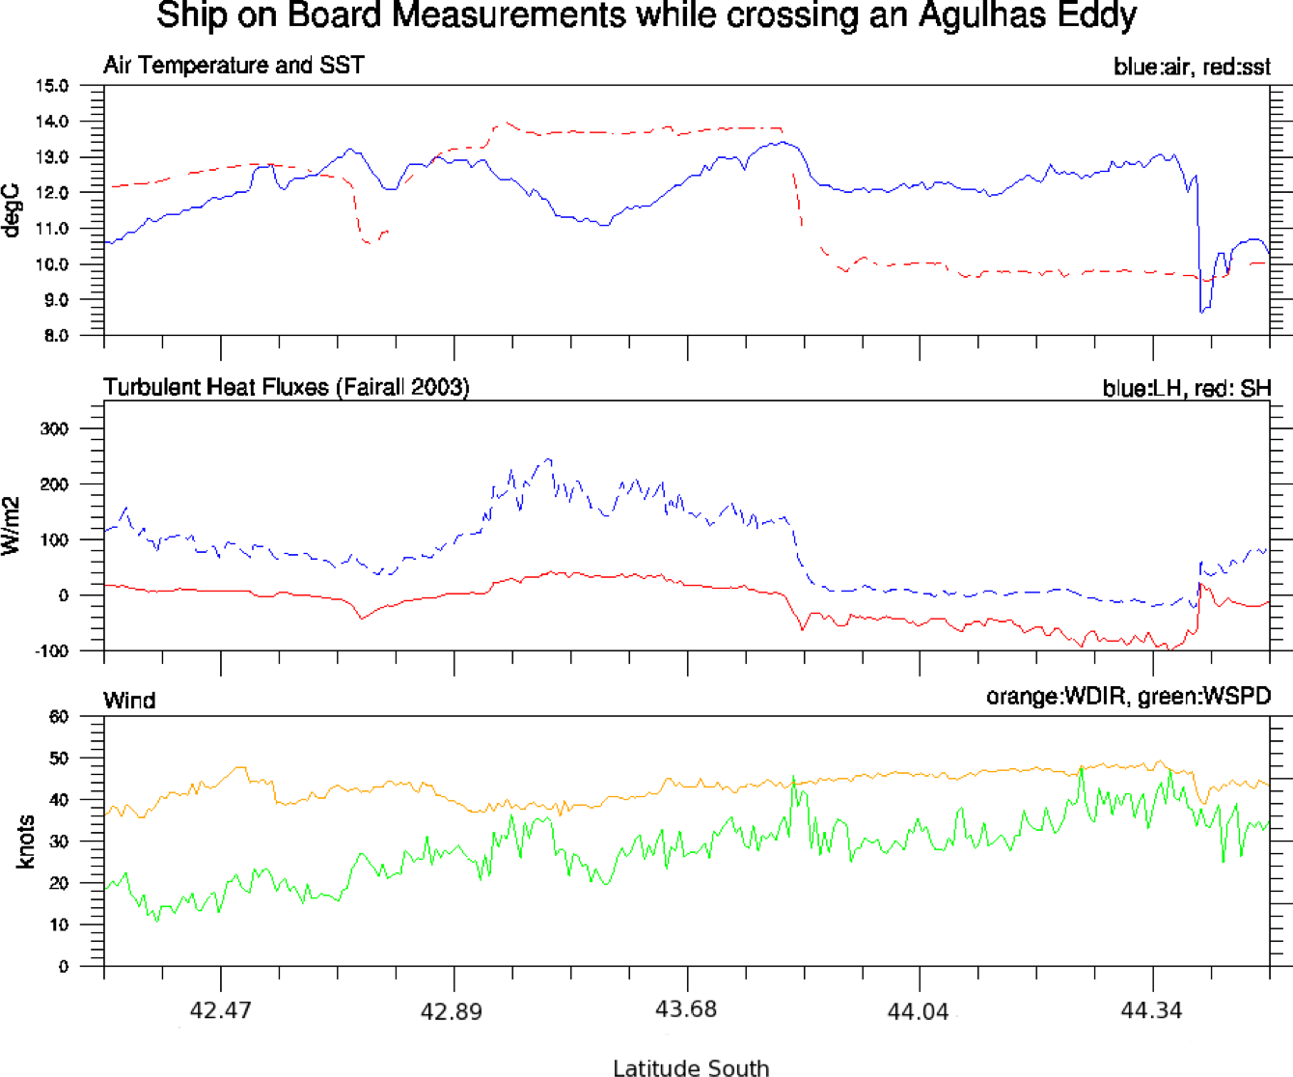
The Agulhas Rings Southern Route & Air-Sea interaction
Agulhas Ring M & air-sea heat fluxes
Agulhas Ring M
Air temperature
Despite its elevated age and cooling experienced during Winter, Agulhas Ring M is still releasing heat to the atmosphere
Air-sea interaction over Ring M is still affecting wind direction and wind speed
SST
Latent Heat Flux
Sensible Heat
Wind direction
Wind Speed
Sachs et al. in preparation
Notes:
Partial pressure of CO₂ (pCO₂) ranged from 325 to 415 ppmV, and exhibited significant changes across fronts and eddies than can be tracked as step changes in SST (Figure 1).
Subtropical area appeared to be undersaturated in CO₂ compared to the atmosphere, while the subantarctic and polar frontal zones were below or near the saturation, and the polar open oceanic zone was oversaturated. The maximum of pCO₂ was observed at the southern circumpolar antarctic front (SACCF).

Slide 14
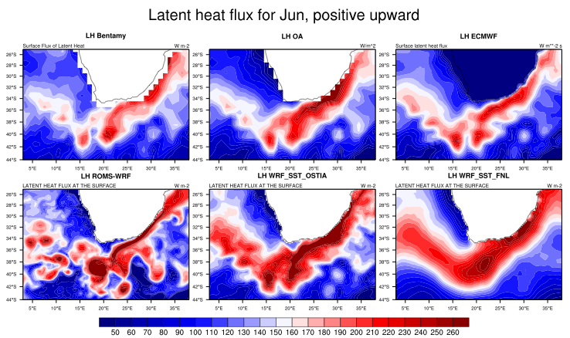
The Agulhas eddies & Air-Sea interaction
Agulhas Current system heat fluxes
Satellite derived
OA product
ECMWF
A coupled mesoscale resolving model reproduces stronger and more localized air-sea interactions
Agulhas Rings represent an intense and long lasting energy source because of their important heat content
WRF coupled to ROMS
WRF forced by SST Ostia
WRF forced by SST FNL
Le Bars et al. in preparation
Notes:
Partial pressure of CO₂ (pCO₂) ranged from 325 to 415 ppmV, and exhibited significant changes across fronts and eddies than can be tracked as step changes in SST (Figure 1).
Subtropical area appeared to be undersaturated in CO₂ compared to the atmosphere, while the subantarctic and polar frontal zones were below or near the saturation, and the polar open oceanic zone was oversaturated. The maximum of pCO₂ was observed at the southern circumpolar antarctic front (SACCF).

Slide 15
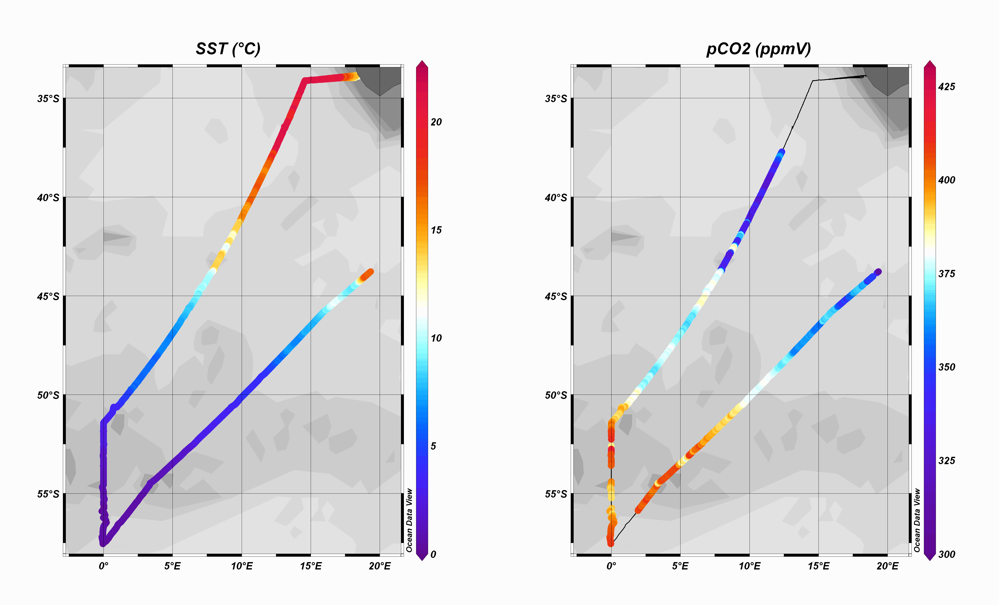
The Agulhas Rings Southern Route, air-sea interaction & Biogeochemistry
Agulhas Ring M & pCO2
STF
SAF
BGH (Feb. 2008)
PF
BGH (Mar. 2008)
SACCF
SBy
SST
pCO2
Delille et al. in preparation
Notes:
Partial pressure of CO₂ (pCO₂) ranged from 325 to 415 ppmV, and exhibited significant changes across fronts and eddies than can be tracked as step changes in SST (Figure 1).
Subtropical area appeared to be undersaturated in CO₂ compared to the atmosphere, while the subantarctic and polar frontal zones were below or near the saturation, and the polar open oceanic zone was oversaturated. The maximum of pCO₂ was observed at the southern circumpolar antarctic front (SACCF).

Slide 16
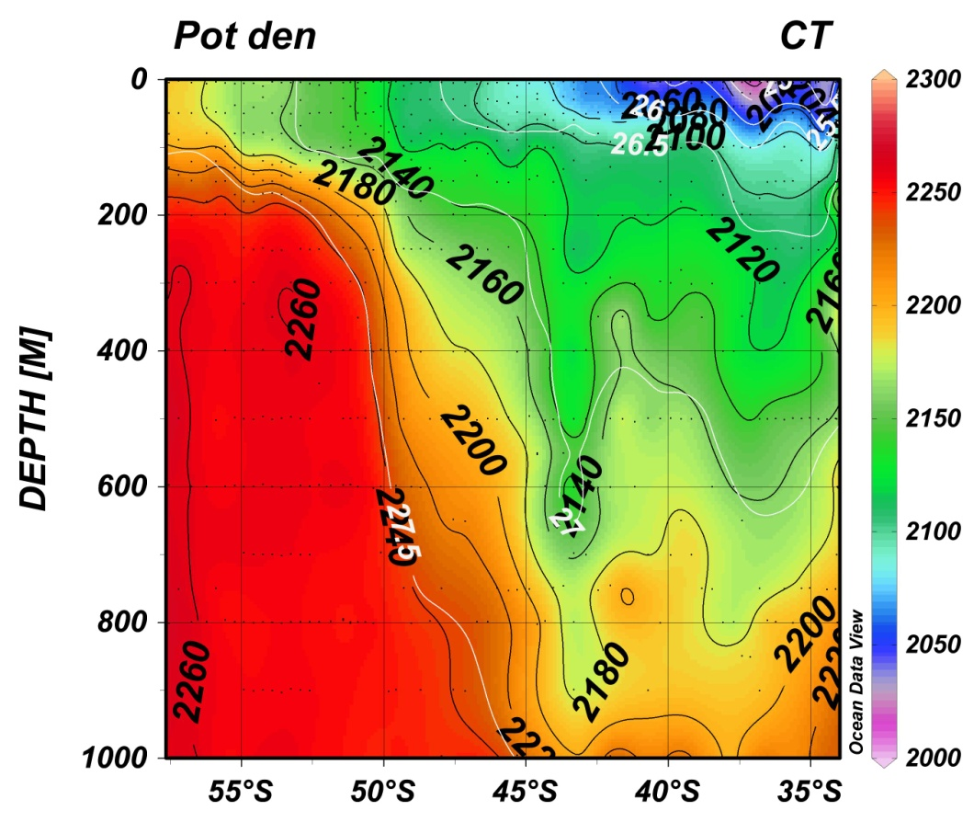
The Agulhas Rings Southern Route & Biogeochemistry
Agulhas Ring M & DIC
4 MTons C have been pumped into the eddy
Note: The content of a mass of water moving within the eddy is corrected by temperature change, dilution, biological activity and carbonate production.
Agulhas Ring M is more than an efficient pump for atmospheric CO2
This eddy is quickly subducted in the South Atlantic: Agulhas Rings contribute actively to Atmospheric CO2 sequestration
Gonzalez-Davila et al. in preparation
Notes:
Anticyclonic Agulhas rings detached from the Agulhas Current retroflection is usually found in the South tropical area north of the SAF

Slide 17
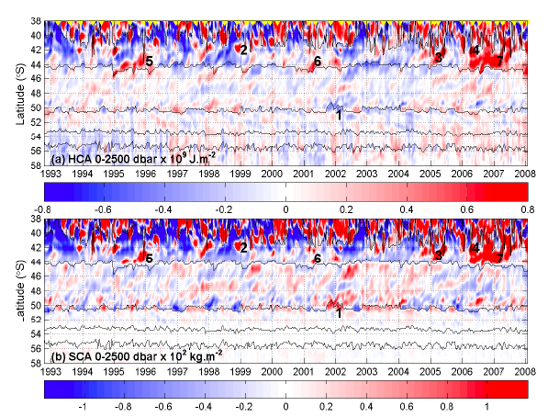
SO, interocean exchanges and climate
Variability in the ACC along GH deduced fro, in situ & altimetry data
AGEM Heat Content Anomaly
1992-2008
AGEM Salt Content Anomaly 1992-2008
Swart & Speich 2010
Notes:
Anticyclonic Agulhas rings detached from the Agulhas Current retroflection is usually found in the South tropical area north of the SAF

Slide 18
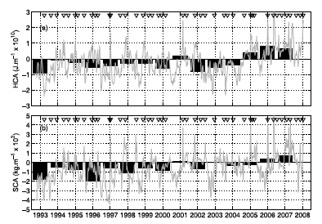
SO, interocean exchanges and climate
Variability in the ACC along GH deduced fro, in situ & altimetry data
AGEM Heat Content Anomaly
1992-2008
AGEM Salt Content Anomaly 1992-2008
Swart & Speich 2010
Notes:
Anticyclonic Agulhas rings detached from the Agulhas Current retroflection is usually found in the South tropical area north of the SAF

Slide 19
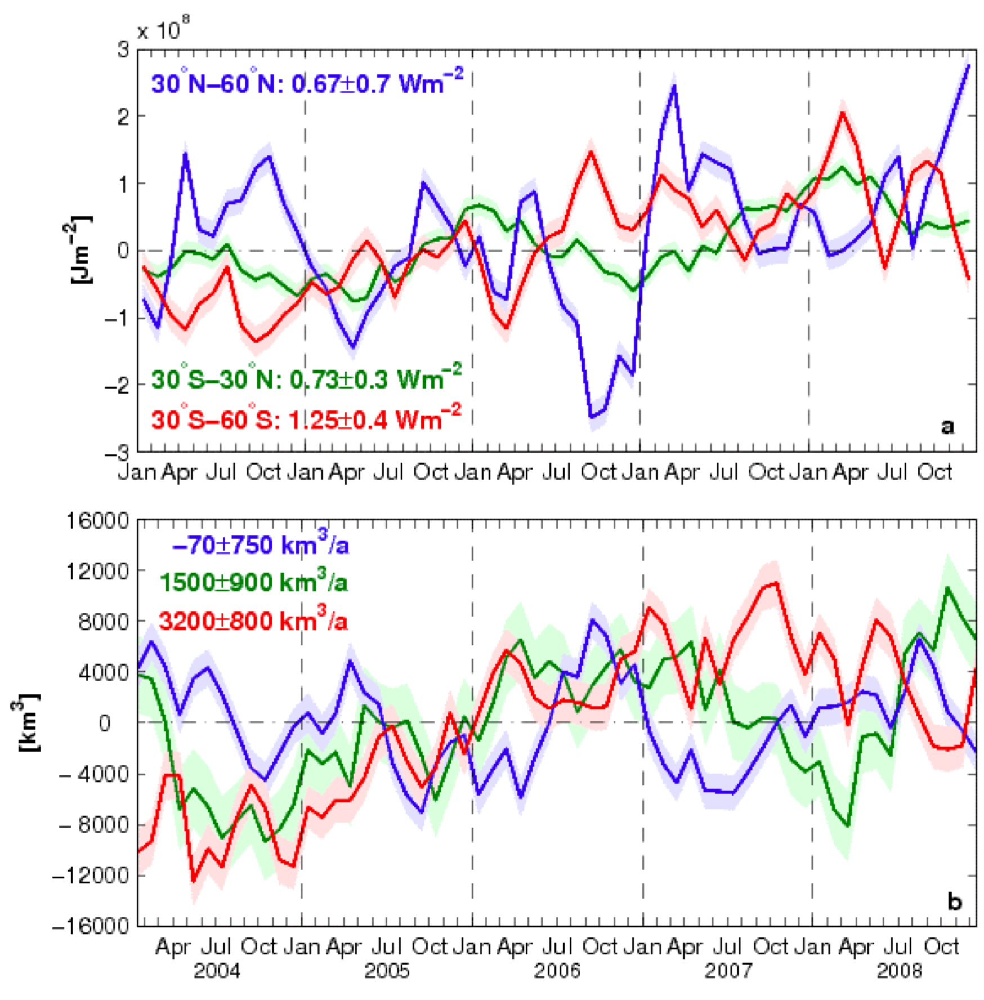
SO, interocean exchanges and climate
Variability in heat content and Fresh Water Volume from in situ data
Heat Content Anomaly
2004-2008
Fresh Water Volume Anomaly 2004-2008
von Schukman et al. submitted
Notes:
Anticyclonic Agulhas rings detached from the Agulhas Current retroflection is usually found in the South tropical area north of the SAF

Slide 20
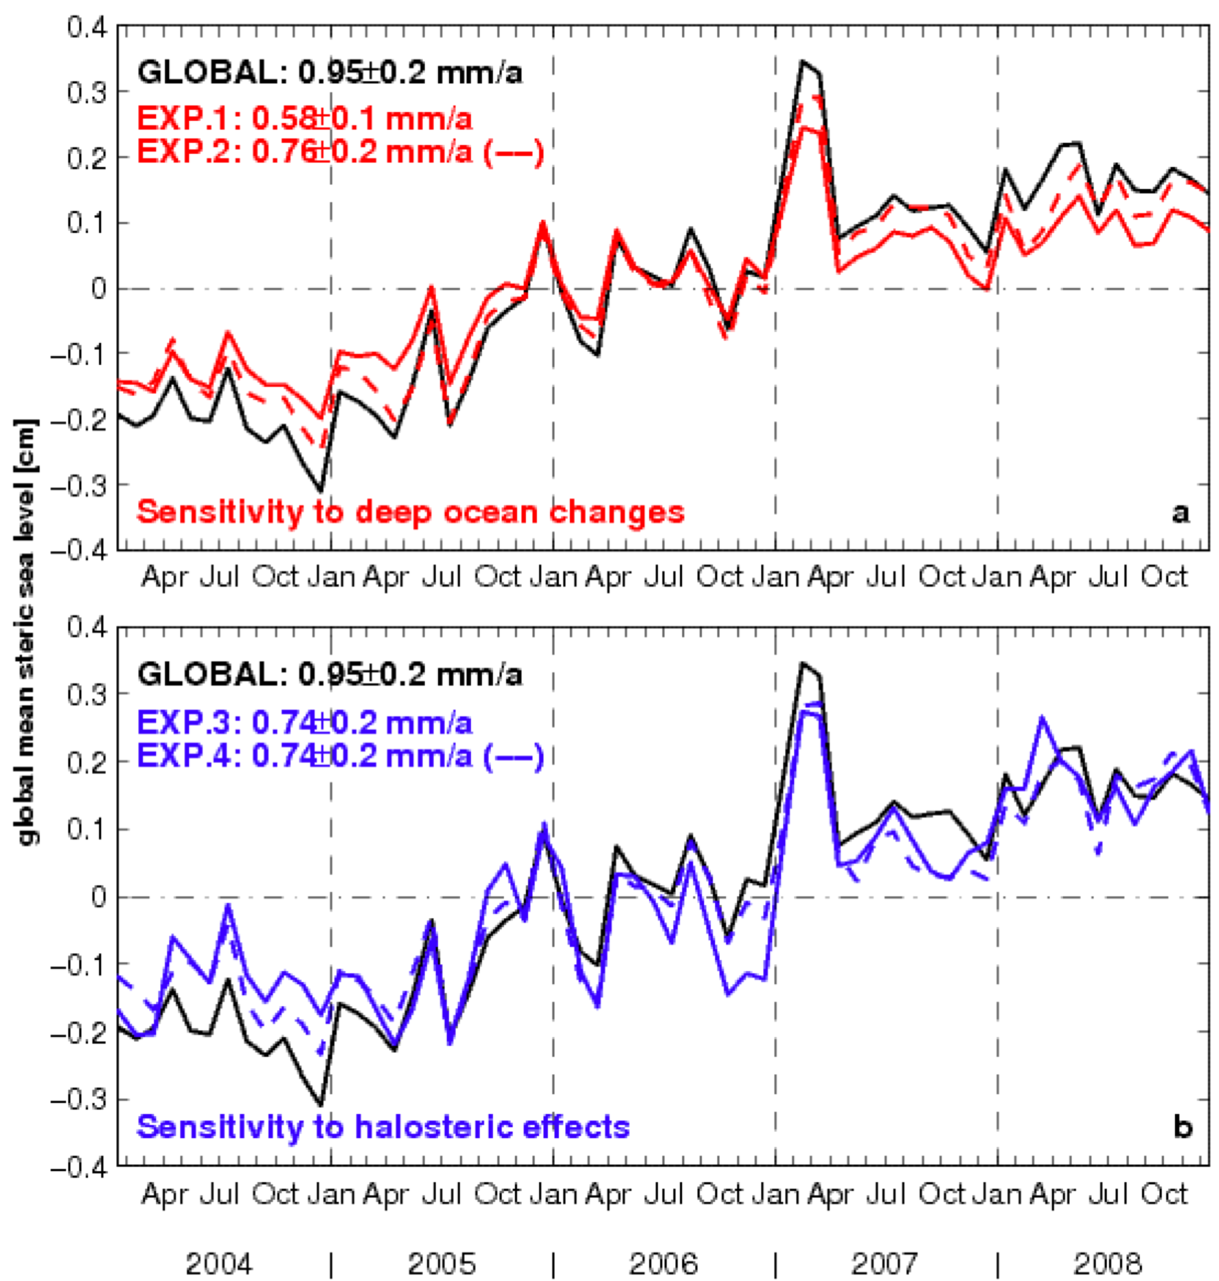
SO, interocean exchanges and climate
Impact of Deep Ocean Changes on Steric Height
von Schukman et al. submitted
Notes:
Anticyclonic Agulhas rings detached from the Agulhas Current retroflection is usually found in the South tropical area north of the SAF

Slide 21
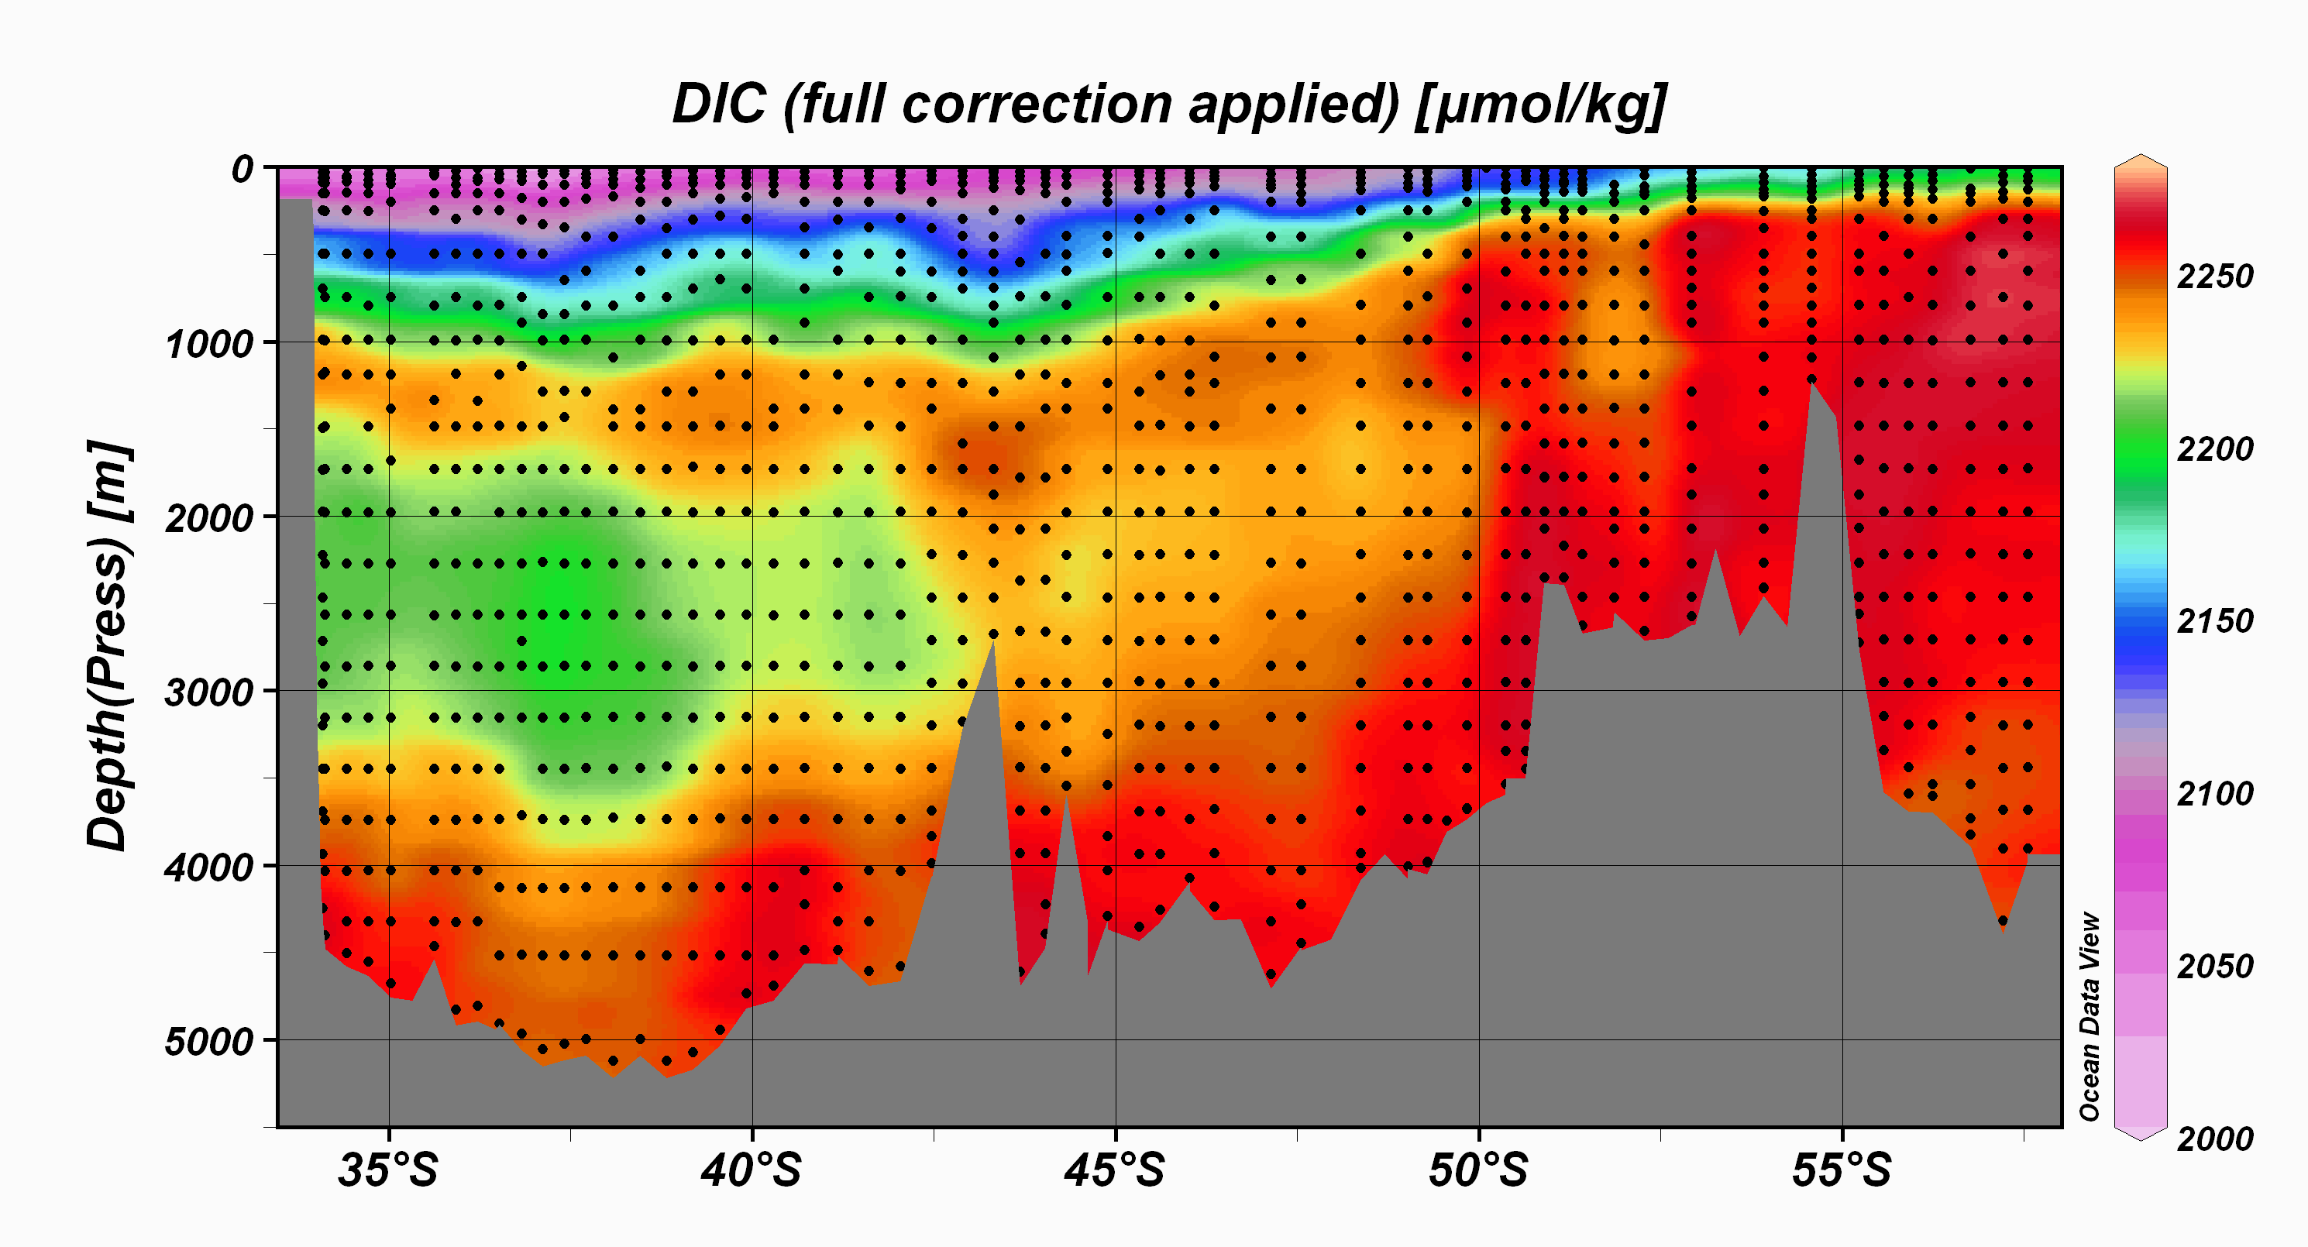
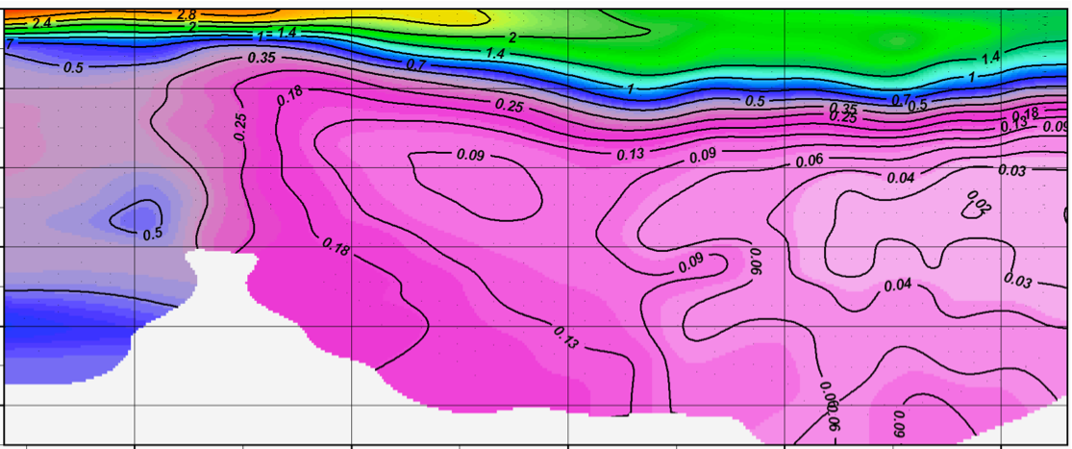
Deep & Bottom Water Masses
DIC and CFCs
STF
SAF
PF
SAACF
SBy
West. NADW
East. NADW
BGH DIC & CFCs observations suggest:
Eastern NADW (along the South Africa slope) most preserved in properties (Salinity, DIC, CFCs, pH, Alkalinity, nutrients, …)
Western NADW (injected in the SO from Argentina Basin) lies south of SAF & is more diluted and mixed with SO waters.
DIC
Davila-Gonzalez et al.
DIC (µmol.kg⁻¹)
West. NADW
East. NADW
Fine et al.
Notes:
Significant increase of DIC over the thousand first meters of the water column is related to mesopelagic biomineralisation. Below 1000 m, main water masses of the subtropical area and circumpolar current (e.g. north antlantic deep water, circumpolar deep water, intermediate antarctic waters, among others) appears in the vertical distribution. For instance, in the subtropical area, a tongue of antarctic intermediate water with DIC ranging between 2210 and 2235 µmol kg⁻¹ water is transported northward between 1000 and 1500 m. We observed an overall DIC increases southwards to reach a maximum south of the SBy in the top 1000 m.

Slide 22
Conclusions
The SO and subtropics are characterized by a highly nonlinear dynamics. This affects in the GoodHope region:
Water masses dynamics and interbasin exchanges (exchanges through ACC jets, slope currents, eddies and filaments)
Air-sea exchanges, that are highly impacted by mesoscale dynamics (eddies, fronts)
Biogeochemical budgets via eddies, filaments, slope currents, …
Notes:
Anticyclonic Agulhas rings detached from the Agulhas Current retroflection is usually found in the South tropical area north of the SAF

Slide 24
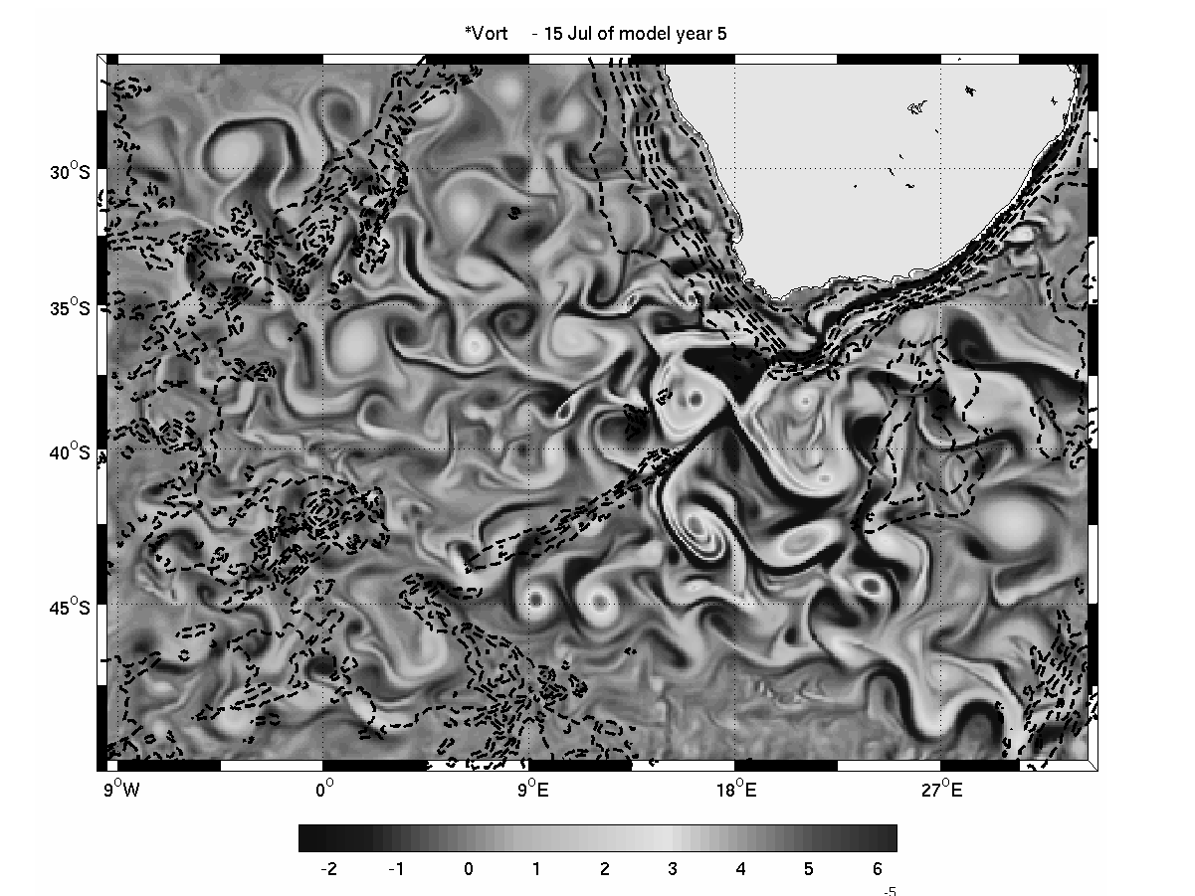
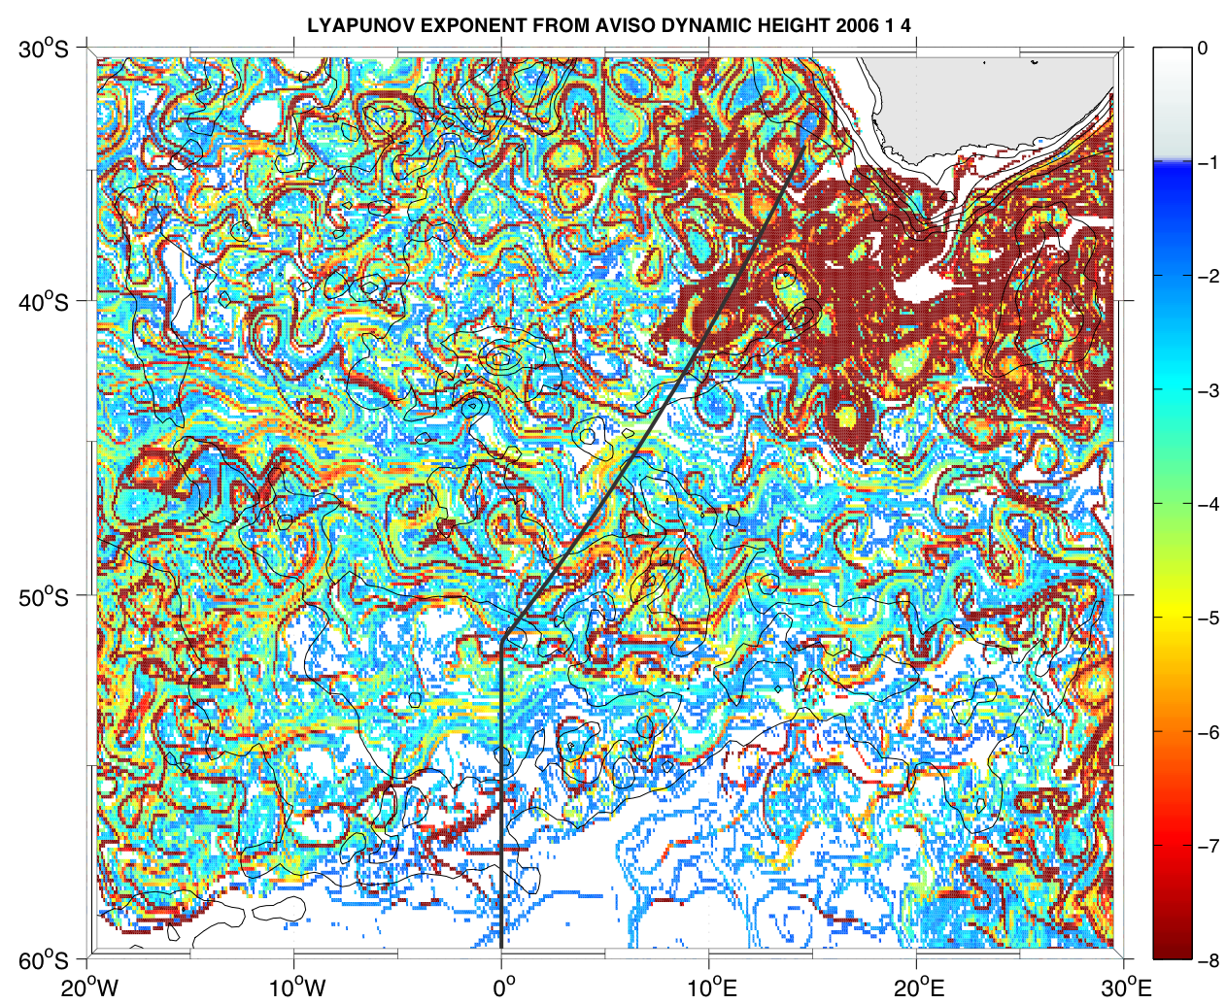
SO dynamics:
Small scale & highly non linear
23 January 2008
AVISO Absolute Dynamic Height
Surface relative vorticity from a 1/10° ROMS regional ocean simulation
Finite Size Lyapunov Exponent from AVISO MADT (courtesy F. D’Ovidio)

