Slide 1
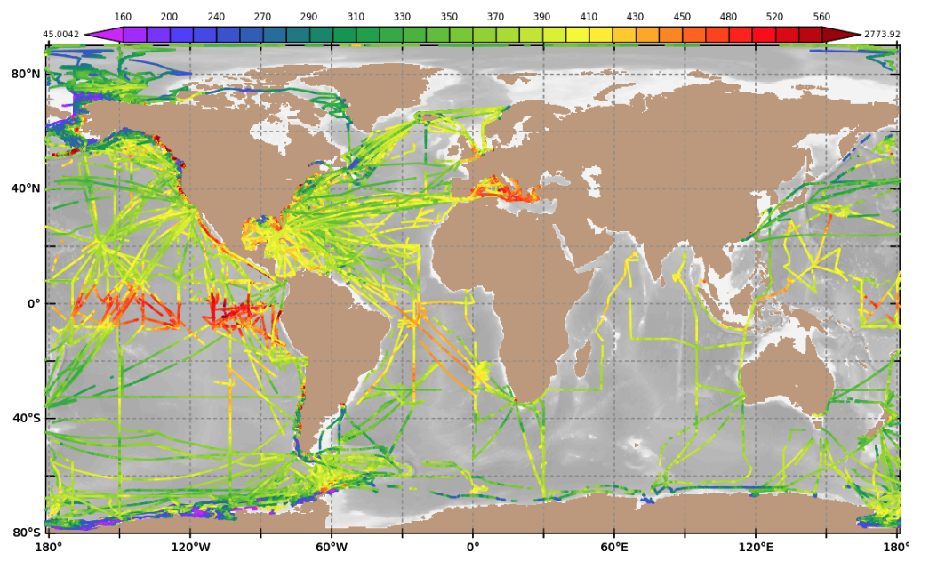
Largest Network of Surface pCO₂ data in the world.
~ 9 M data points since 2005. Represents ~¼ of world wide data.
2020, 2021 and 2022 had a 40% data loss compared to previous years
Contributes to the GCB-2023 estimate of the Ocean sink of 2.8 +/- 0.4 GtC/year.

Slide 2
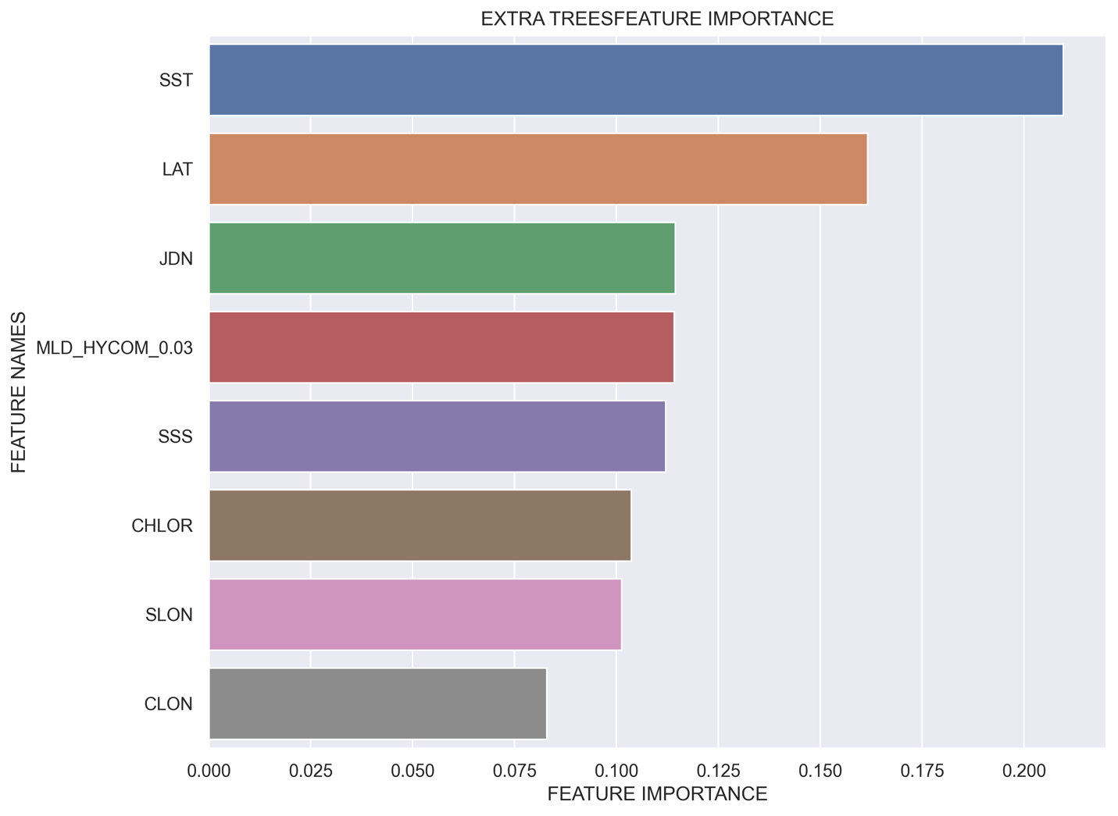
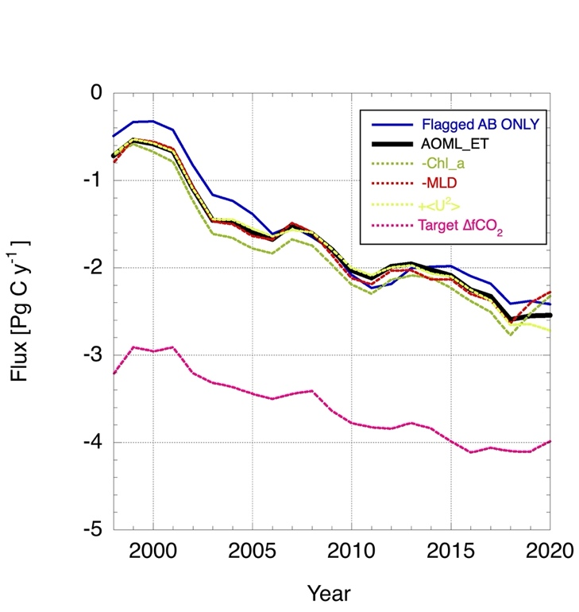
Impact of predictor variables on estimates of global sea-air CO₂ fluxes using an Extra Trees machine learning approach
FEATURE IMPORTANCE
USING DIFFERENT PREDICTOR COMBINATIONS
No large impacts in the global annual averages of magnitude, variability and trends (except for target).
Using ∆fCO₂ instead of fCO_{2w} as the target creates poor agreement in both magnitude and trend of the global flux. Reason is unclear but could be sampling bias.
Effect of data quality (AB flags only) could be due to the sampling bias of high quality measurements toward open ocean and temporal bias of near-shore, higher variability values toward later years.
From Wanninkhof et al., 2024, submitted
Location (sum of Lat, SLON and CLON) has the greatest importance.
SST has second due to strong dependence of physical and chemical factors controlling fCO_{2w}
Time (JDN, for Julian day) is the main driver of trends due to the increasing atmospheric CO₂ levels over time.

Slide 3
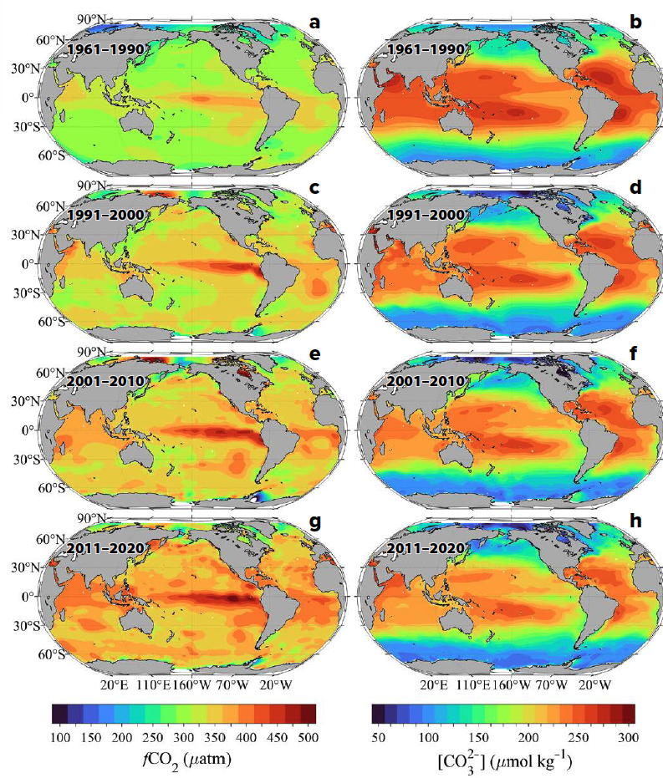
Rapidly changing condition put stocks at risk.
fCO₂ Carbonate ions
Using a combination of GO-SHIP and SOOP underway surface observations to evaluate changes in surface ocean carbonate chemistry between 1961 and 2020
Looking at air-sea anthropogenic CO2 uptake, warming, upwelling, and changing buffering capacity
Conditions are changing rapidly in regions that would normally be considered refugia, with implications for stocks of sensitive species
From Feely et al., 2023

Slide 4
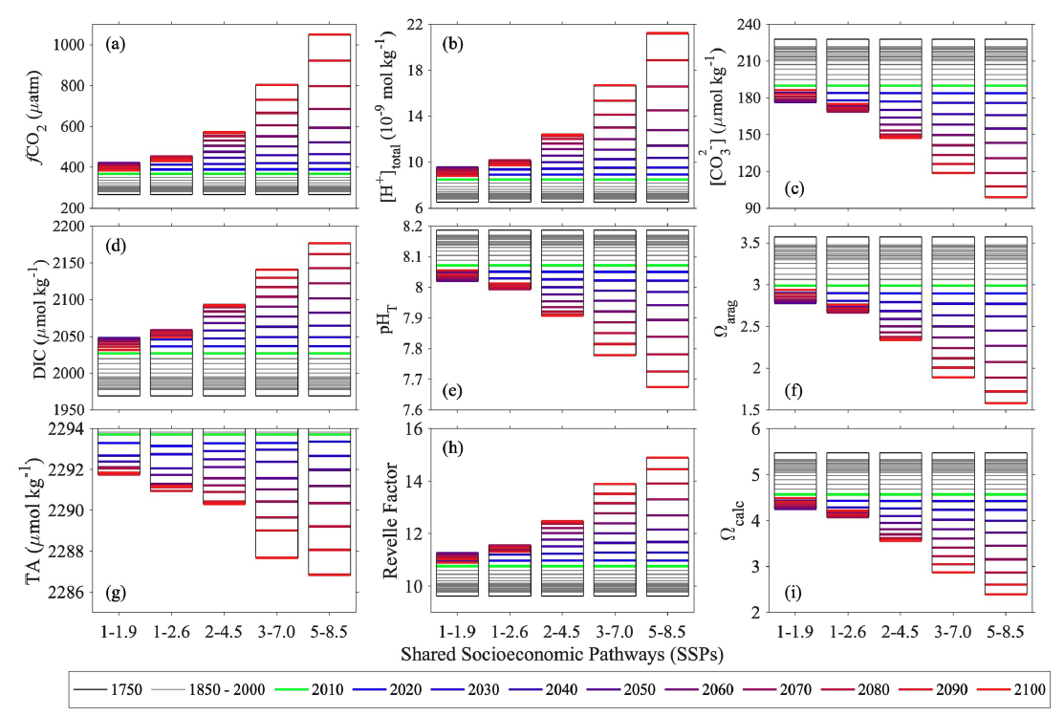
Temporal changes of global surface ocean acidification indicators under different scenarios.
Combines SOCAT observations and other observational data products to adjust CMIP6 Earth System Model results.
Maps of 1ºx1º decadal averages for 9 parameters (fCO2,pH_{T}, TA, DIC, [H⁺], [CO3²⁻], Ω_{arag}, Ω_{cal}, Revelle factor).
Temporal range: 1750 to 2100 using five Shared Socioeconomic Pathways for 2020–2100, representing different future emissions scenarios (SSP1–1.9, SSP1–2.6, SSP2–4.5, SSP3–7.0, and SSP5–8.5).
Temporal changes of global surface ocean acidification indicators (inter-model median values out of 14 CMIP6 Earth System Models after applying adjustments with observational data [including SOCAT data], area-averaged). The x-axes labels, 1–1.9, 1–2.6, 2–4.5, 3–7.0, and 5–8.5 indicate the Shared Socioeconomic Pathways: SSP1–1.9, SSP1–2.6, SSP2–4.5, SSP3–7.0, and SSP5–8.5, respectively. From Jiang et al. 2023

Slide 5
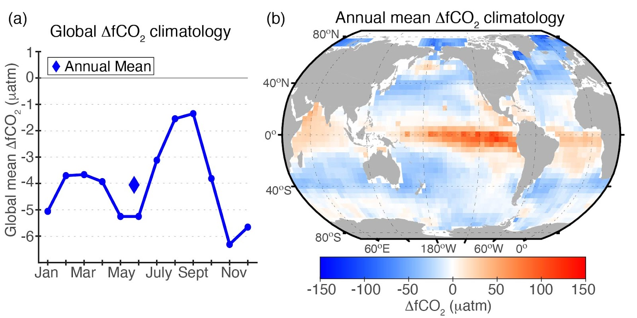
An updated climatological mean surface ocean pCO₂, and net sea–air CO₂ flux over the global oceans
Constructed using SOCATv2022
~7x more data than the last climatology (Takahashi et al. 2009).
No time normalization procedure (uses ΔfCO₂ rather than pCO_{2oce})
(a) Global mean ∆fCO2 seasonal climatology from the SOCAT database; annual mean value is indicated by the diamond (-4.1µatm). (b) Map of annual ∆fCO2 climatology. from Fay et al., 2024 (submitted)

