Slide 1
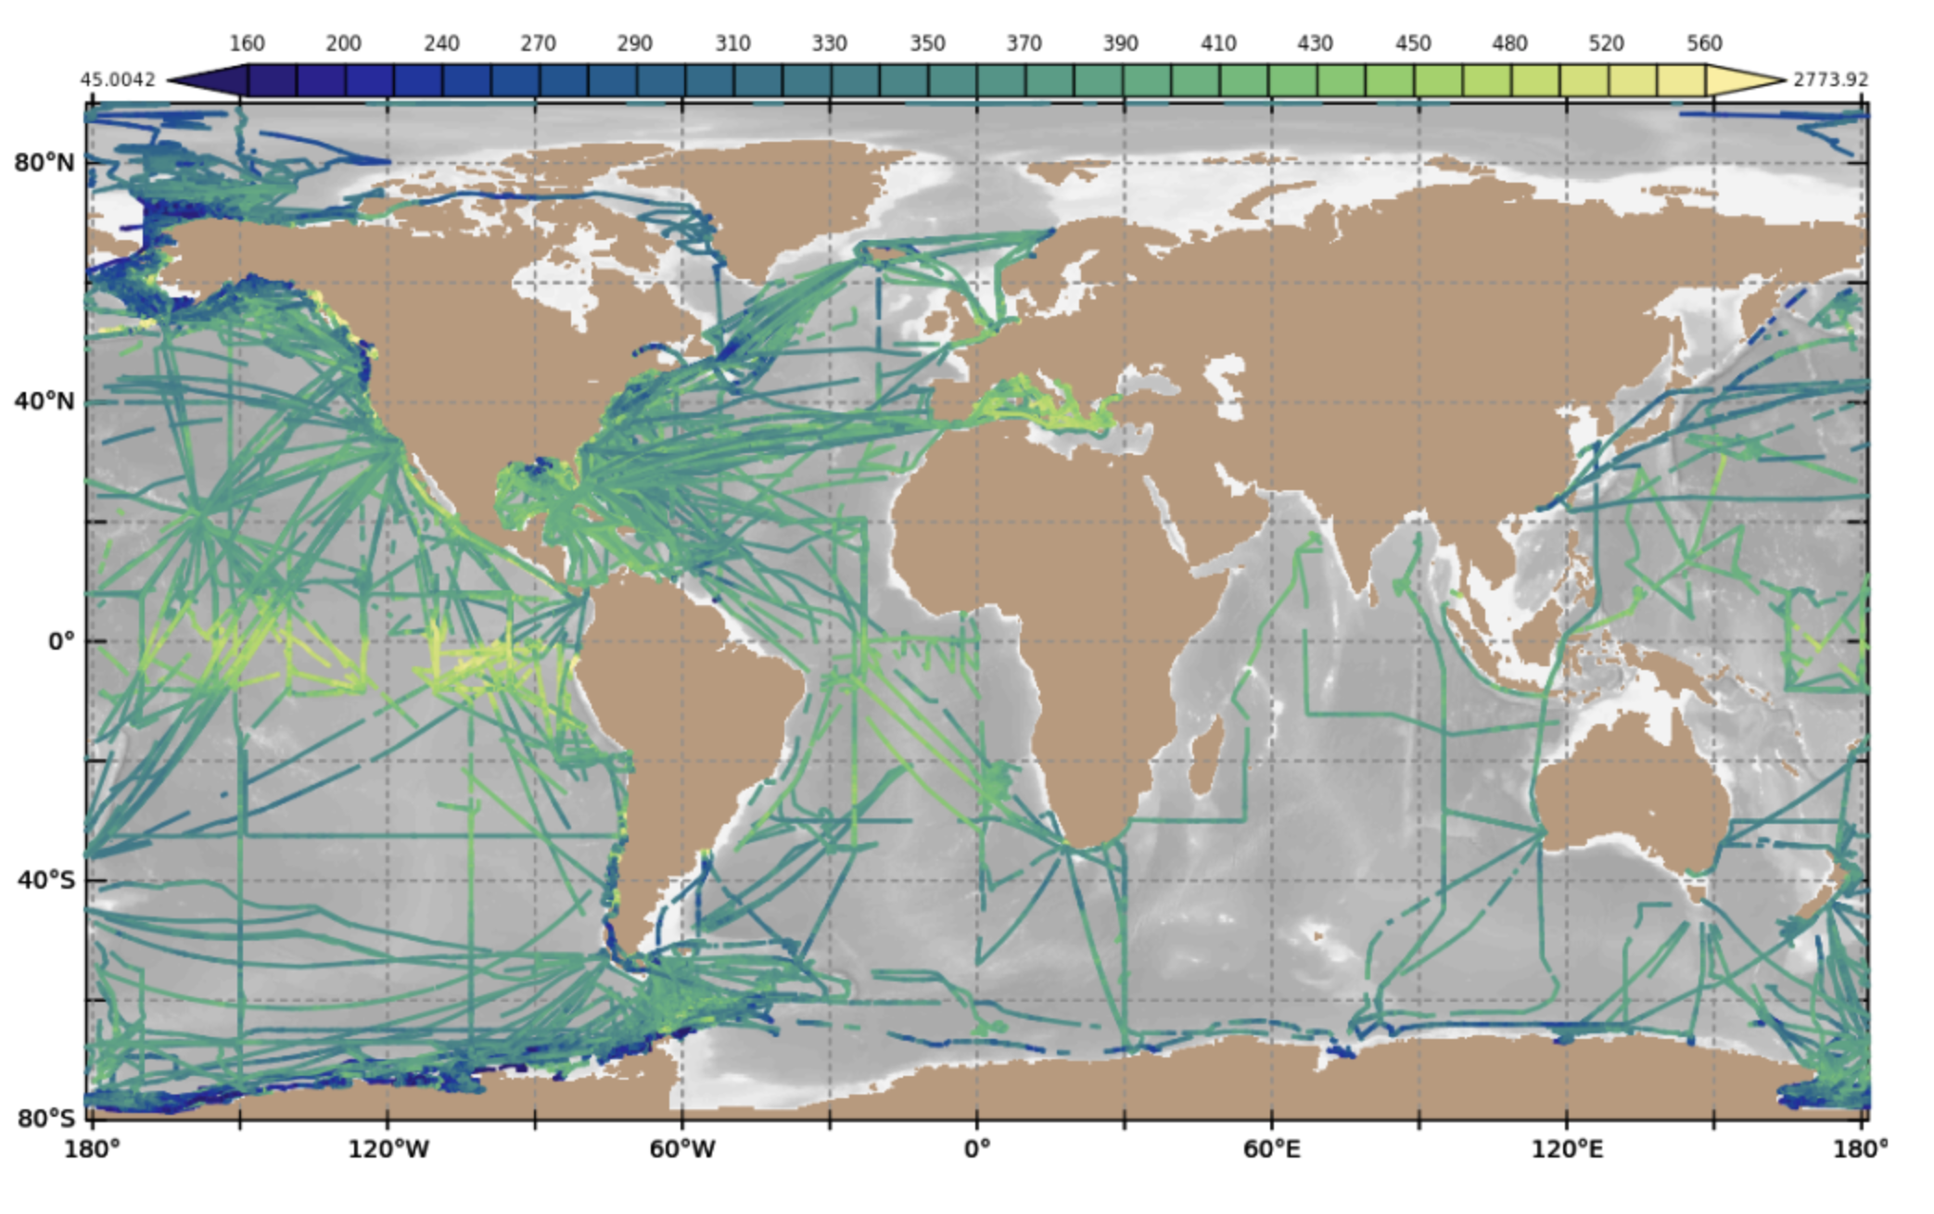
Largest Network of Surface pCO₂ data
in the world.
FY 2022
HIGHLIGHTS
~ 8.5 M data points since 2005. Represents ¼ of world wide data.
2020, 2021 and 2022 had a 40% data loss compared to previous years
Contributes to the GCB-2022 estimate of the still increasing Ocean sink of 2.9 +/- 0.4 GtC/year.

Slide 2
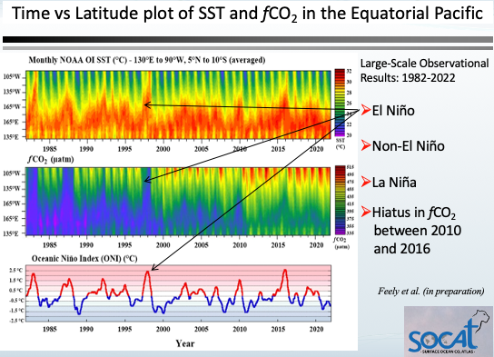
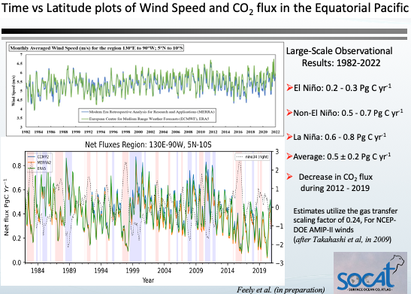
Equatorial time-series of fCO₂ observations reveals relationship between CO₂ flux and ENSO cycle.
FY 2022
HIGHLIGHTS
The eastern and central equatorial Pacific are:
large sources of CO₂ to the atmosphere during non-El Niño and La Niña events (strong trade winds, cold tropical SSTs, and enhanced upwelling)
near neutral during strong El Niño events (warming of SST ,large-scale weakening of the trade winds, decrease in upwelling )
weak sources during weak El Niño events.

Slide 3
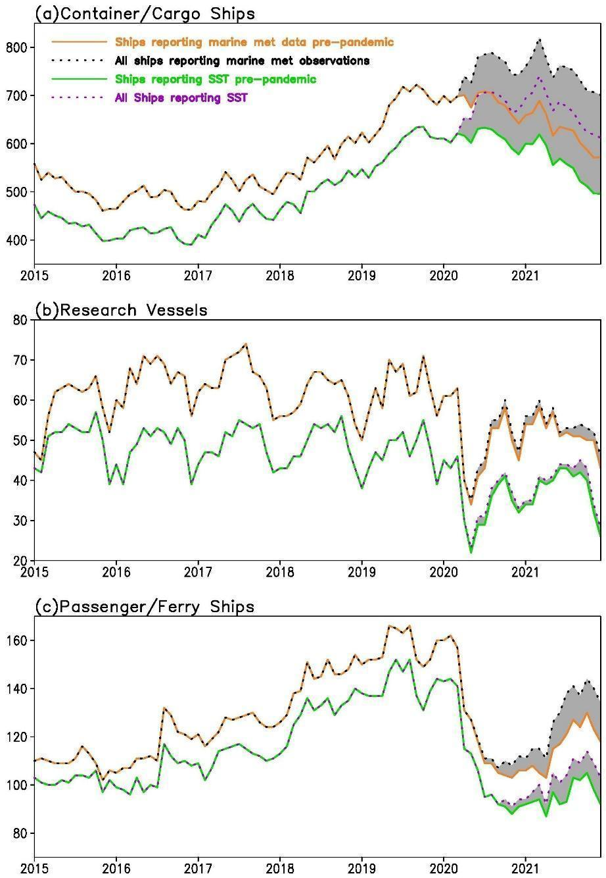
Effect of the Pandemic
FY 2022
HIGHLIGHTS
2020, 2021 and 2022 had a 40% data loss compared to previous years
Similar to VOS ships reporting met data (left figure), passenger and cargo ships responsible for most of SOOP-CO2 data loss
Passenger ships stopped sailing whereas cargo ships restricted access
Number of ships with independent WMO call sign numbers since 2015 in the ICOADS R3.0.2 near real-time collection.
(Shaded Area = loss of capacity during pandemic
Figure 2 in Boyer et al. (2023) accepted in BAMS

Slide 4
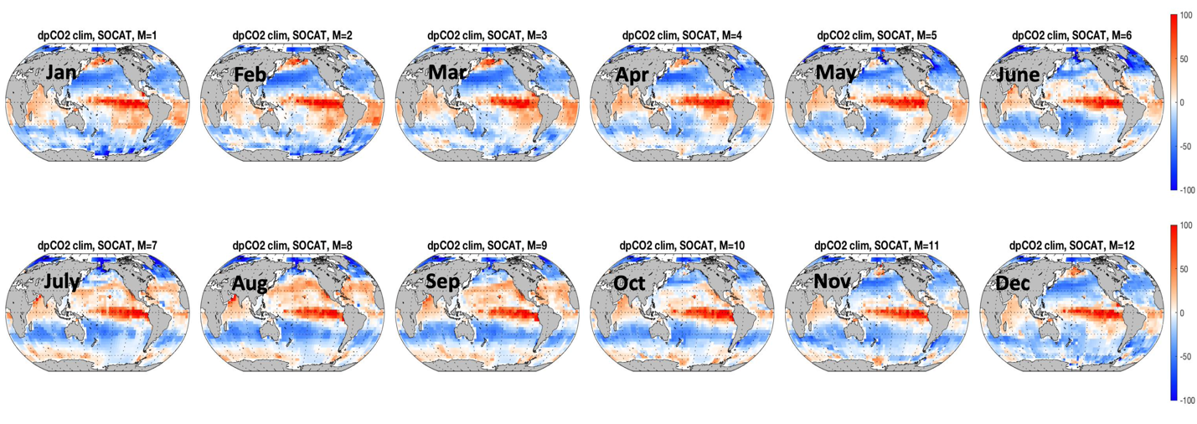
Updated “Takahashi” Climatology
FY 2022
HIGHLIGHTS
Updated climatological maps of ΔpCO₂ created using the Takahashi approach (Takahashi et al., 2009) and the SOCAT version 2022 database including the more than 8.5 million observations collected by the SOOP pCO2 from ships program. (Fay et al. in preparation)
Constructed using both the LDEOv2019 and SOCATv2022 databases
Has several times the number of observations used to create the last climatology (Takahashi et al. 2009)
constructed using ΔpCO₂ (pCO2oce – pCO2atm) rather than pCO2oce, avoiding the time normalization procedure used in Takahashi et al. (2009)

Slide 5
Atmospheric measurements from ships used in atmospheric studies
FY 2022
HIGHLIGHTS
Measurements from ships quality comparable to Surface Monitoring Stations and Aircraft Campaigns.
Ship measurements from the ARSV Laurence M. Gould, funded by GOMO.
Ship-based measurements extend back to 2005 and are utilized due to extensive temporal coverage.
This analysis estimates a net uptake of CO₂ south of 45°S. Consistent with ship-based estimates but stronger than recent estimates based on profiling-float observations.
From Long, M., et al. (2021), Strong Southern Ocean Carbon Uptake Evident in Airborne Observations, Science.
Notes:
Recreated from Fig. S15 from Long et al. (2021). Compilation of mean CO₂ observed at surface monitoring stations and as sampled from ships minus the NOAA in situ record at the South Pole Observatory (SPO) over 2012-2017 for (A) winter (DJF) and (B) summer (JJA). The black line is a spline fit provided simply as a visual guide. Blue shading denotes the latitude band in which we designate “Southern Ocean stations.” This record includes shipboard in situ measurements from the ARSV Laurence M. Gould (LMG), from the NOAA equilibrator pCO₂ system (cyan circles with black outlines) and from the NCAR atmospheric O₂ system (cyan diamonds with black outlines). The NOAA LMG data are available from 2005 to the present. The NOAA DRP flask record is collected from this same ship. The NOAA shipboard in situ atmospheric CO₂ data are available in the ObsPack GV+ v7.0 product (http://doi.org/10.25925/20210801).

