Slide 1
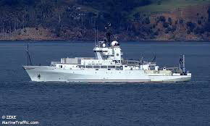
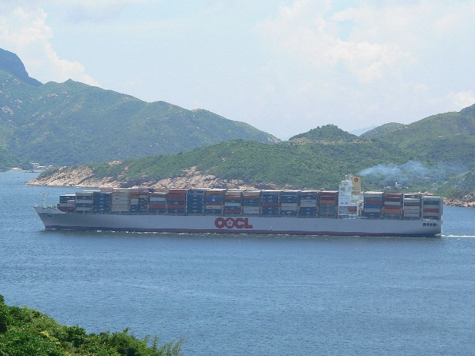
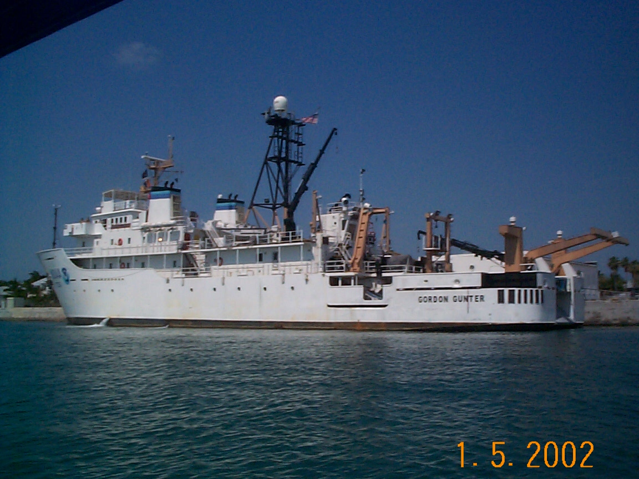
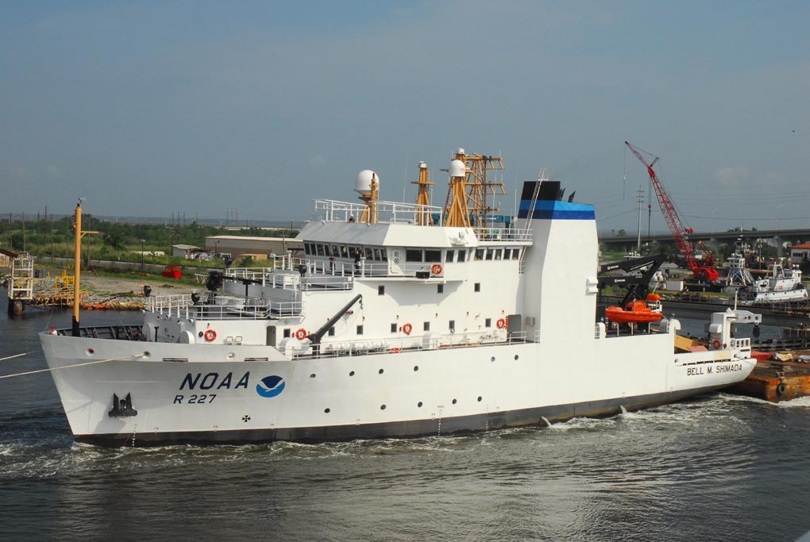
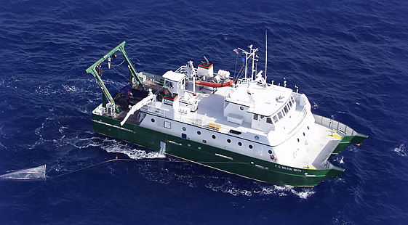
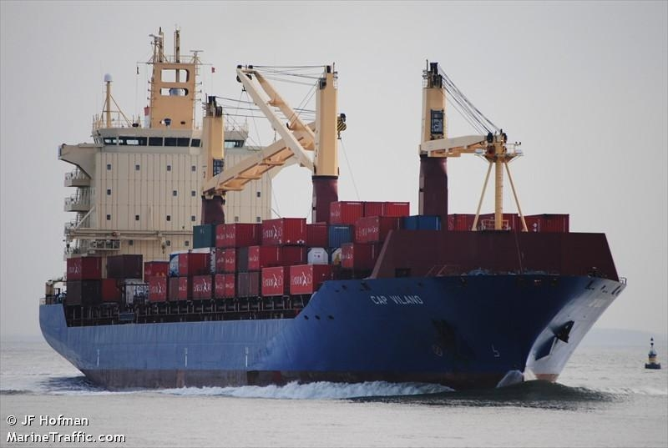
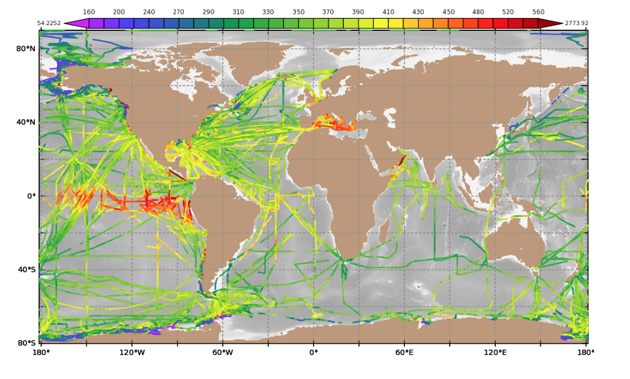
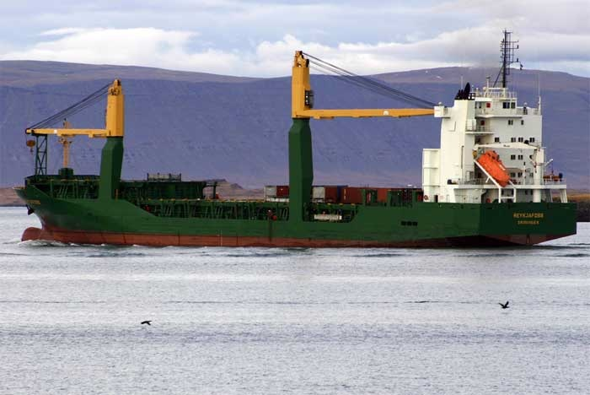
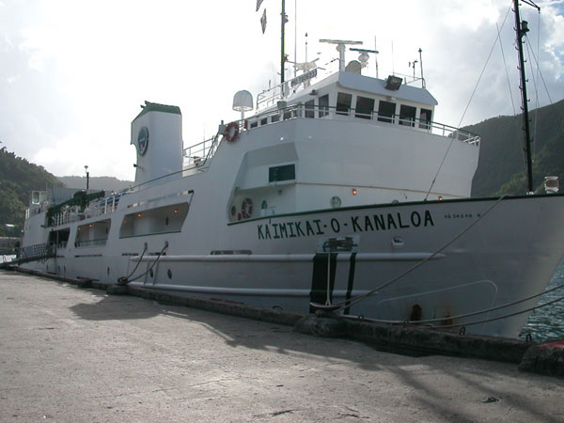
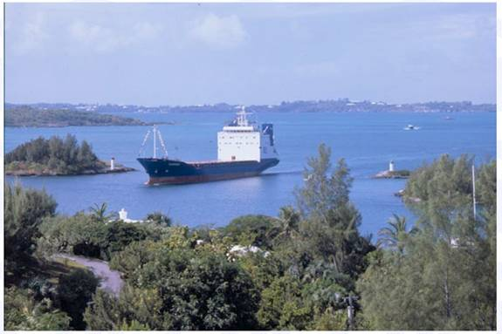
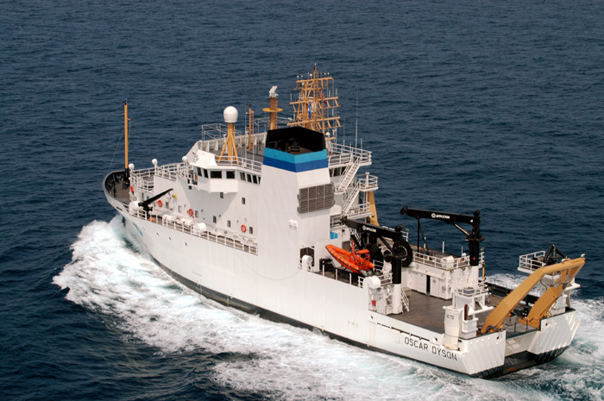
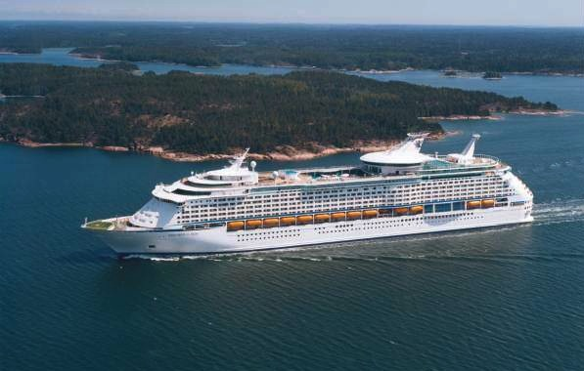
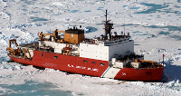
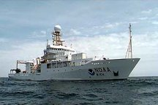
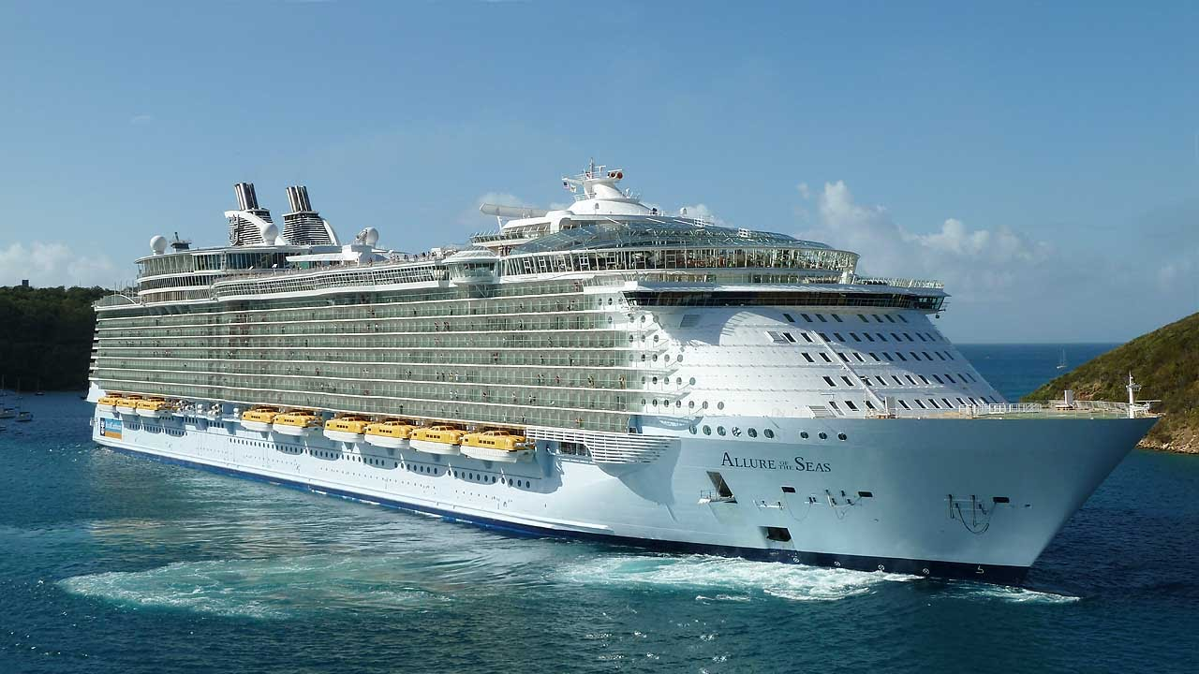
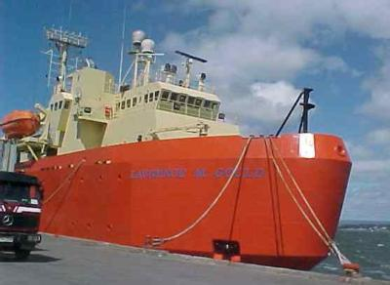
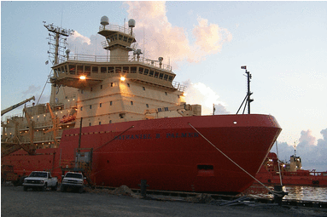

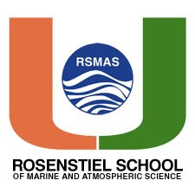



Data gathering:
Ocean Carbon Cycle – Sea-air CO₂ fluxes
Sea-air CO₂ flux = k K_{o} ∆pCO₂
NOAA OOMD supports the largest ship of opportunity pCO₂ measurement campaign in the world comprised of 15 ships of opportunity with automated CO₂ systems in FY20
Ship tracks and ships with autonomous pCO₂ systems sponsored by the NOAA/GOMO program
Notes:
Sea-air CO₂ flux = k K_{o} ∆pCO₂ : the sea-air CO2 flux is determined from the gas transfer velocity (k), the solubility of CO2 (Ko) and the partial pressure difference between the surface ocean and atmosphere. The ocean carbon program sponsored by NOAA CPO/COD supports the largest sustained measurement campaign from ships of opportunity in the world contributing roughly half of all the data that goes into the SOCAT effort (Surface Ocean Carbon ATlas) that is used as a comprehensive database to constrain the amount of CO2 entering the ocean.

Slide 2
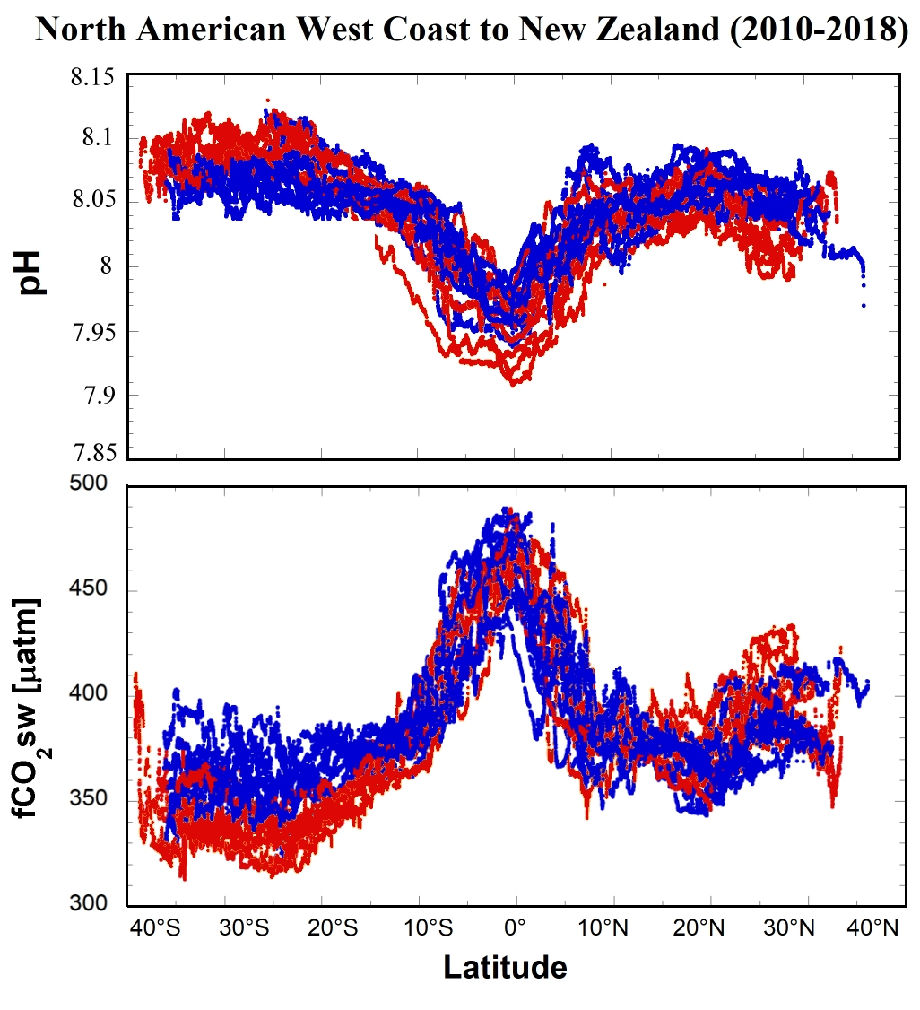
Monitoring the Carbonate System in the Northeast Pacific Ocean
The tropical Pacific is the major natural source of CO₂ from the ocean to the atmosphere, contributing nearly 70% of the global flux to the atmosphere. Interannual variability of the sea-air CO₂ flux in the tropical Pacific is also the major source of CO₂ flux variability in the global oceans. Underway fCO₂ data collected in the equatorial Pacific play a significant role in many publications, highlighting the importance of this dynamic region to the global CO₂ cycle.
pH and fCO₂ data from trans-Pacific container ship crossings from the North American Pacific Coast to New Zealand during 2010–2018. Crossings shown in red occurred during months of April through September, while those in blue happened during October through March. These data will be included in an Earth Systems Science Data paper we are preparing (Cosca et al., in preparation).

Slide 3
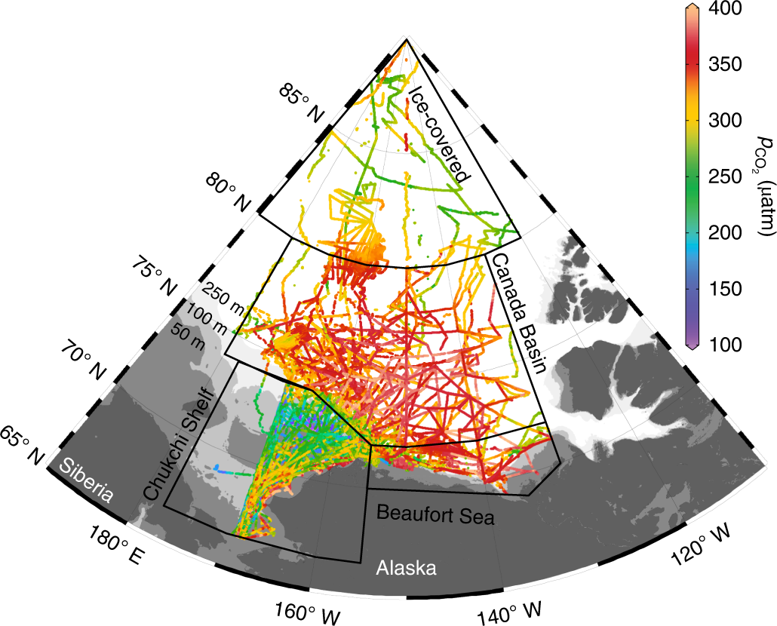
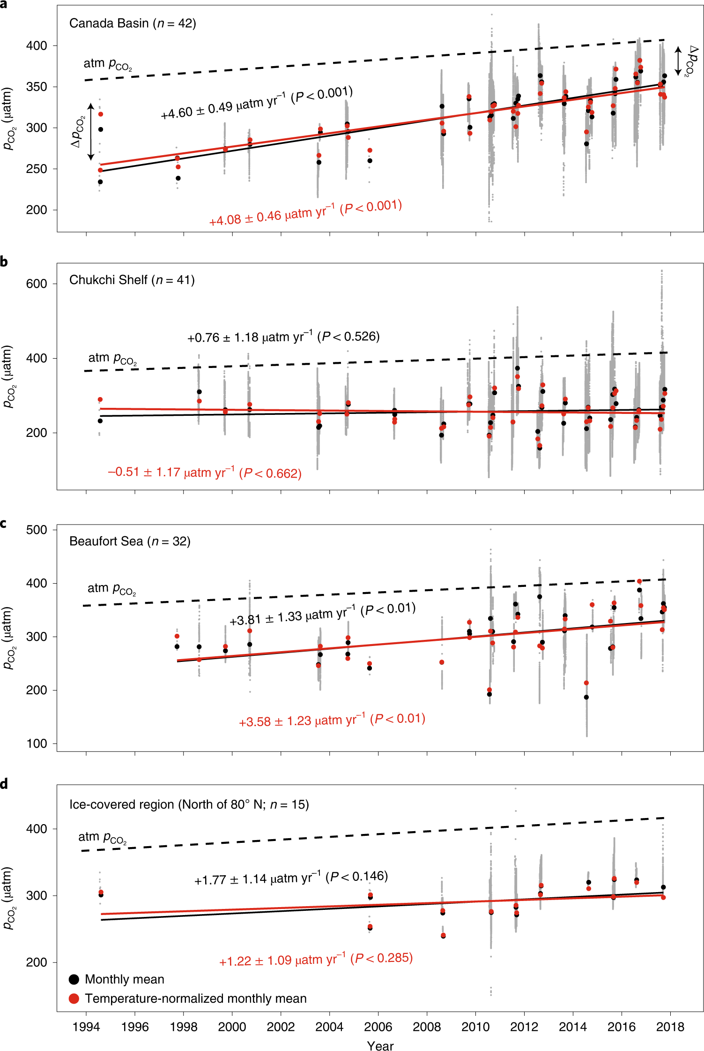
Dramatic trends in summer ΔpCO₂ over the past two decades in the Canada Basin related to declines in sea ice
Summer pCO₂ has increased dramatically over the past two decades in the Canada Basin which is in sharp contrast to trends in the Chukchi Sea. An analysis of the drivers of pCO₂ trends in these regions indicates that summer sea ice loss in the Canada Basin has led to changes in the upper ocean that have caused this dramatic trend in pCO₂
(left) Summer pCO₂ observations in the western Arctic Ocean from 1994-2017 from Fig. 1 of Ouyang et al. (2020). (right) Long-term trends in summer pCO₂ in different regions of the Arctic Ocean from Fig. 2 of Ouyang et al. (2020). Most observations in the later years were contributed by NOAA pCO₂ systems installed on the USCGC Healy (since 2011) and the R/V Sikuliaq (since 2015).
Notes:
Data collected from the Cap Blanche and Bluefin have been incorporated in updated fCO₂-SST relationships, allowing estimates of CO₂ flux in the tropical Pacific over the last 34 years. In addition to the large-scale interannual variability caused by the strong and weak ENSO cycles, the increased winds and enriched DIC from anthropogenic sources since the 1997–98 El Niño caused a 10–14% increase in the overall flux of CO₂ to the atmosphere from the Equatorial Pacific region. This is one of the largest documented decadal changes in the carbon flux of the global oceans.

Slide 4
A final update of the canonical Takahashi climatology of surface ocean pCO₂
We have recreated the climatology with a dataset of more than 12 million observations for the reference year 2010. The new version of the climatology revises the contemporary global ocean sink by nearly 25% from -1.42 to -1.76 Pg C in comparison to the Takahashi et al. (2009) product. The subtropics and the high latitude Northern Hemisphere accounts for most of this increase in ocean uptake which more than offsets a nearly 25% increase in outgassing from the tropics.
Mean annual air-sea CO₂ flux from the updated climatology for reference year 2010 in mol C m-2 yr-1 defined such that negative (positive) values represent regions of ocean uptake (outgassing).

Slide 5
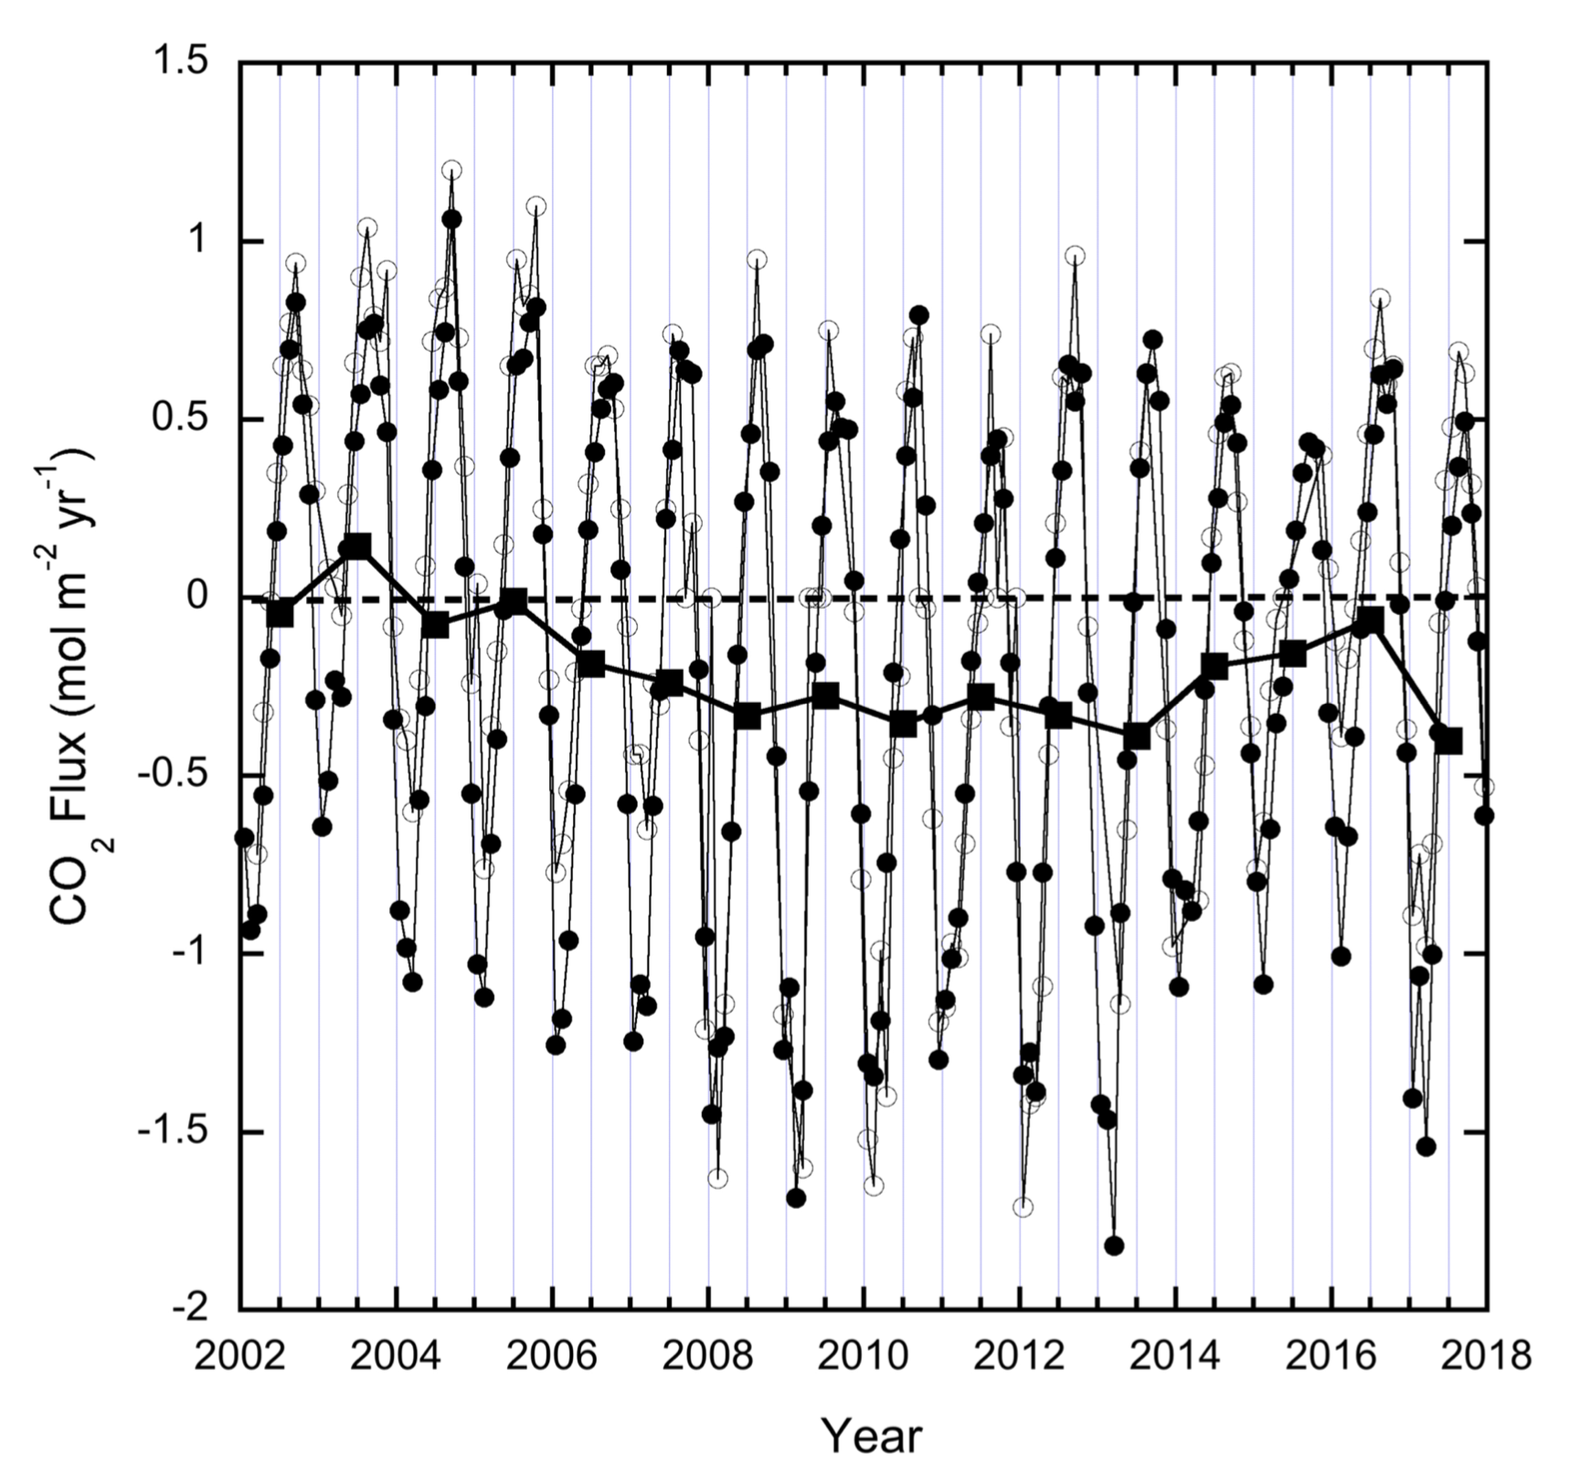
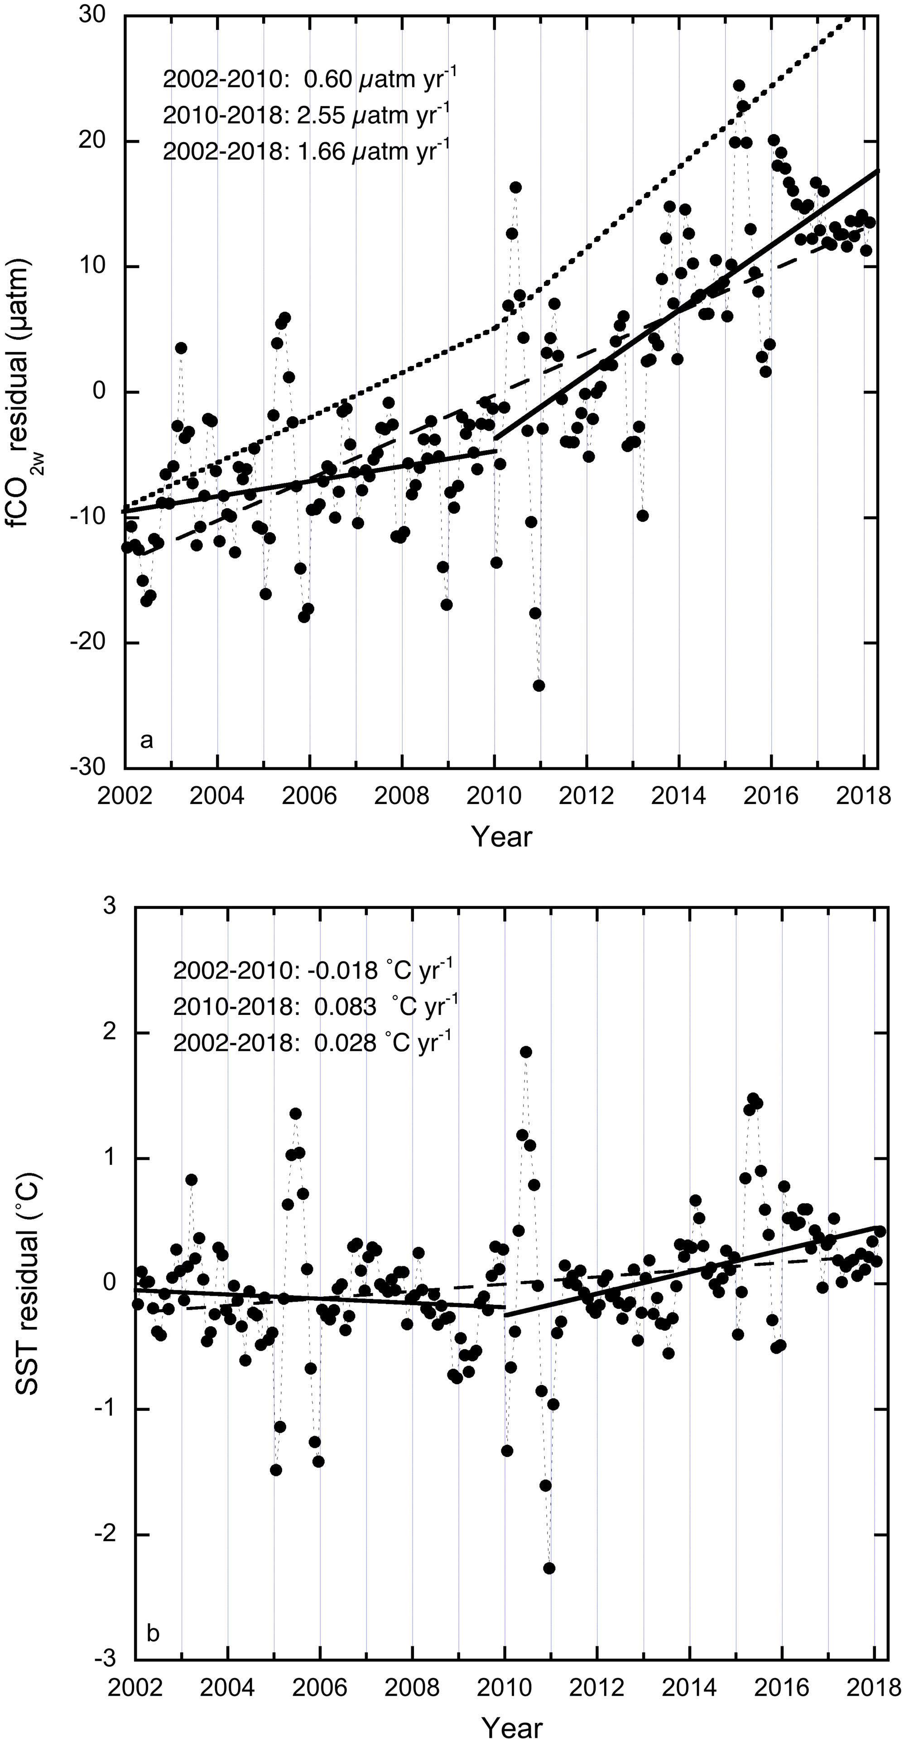
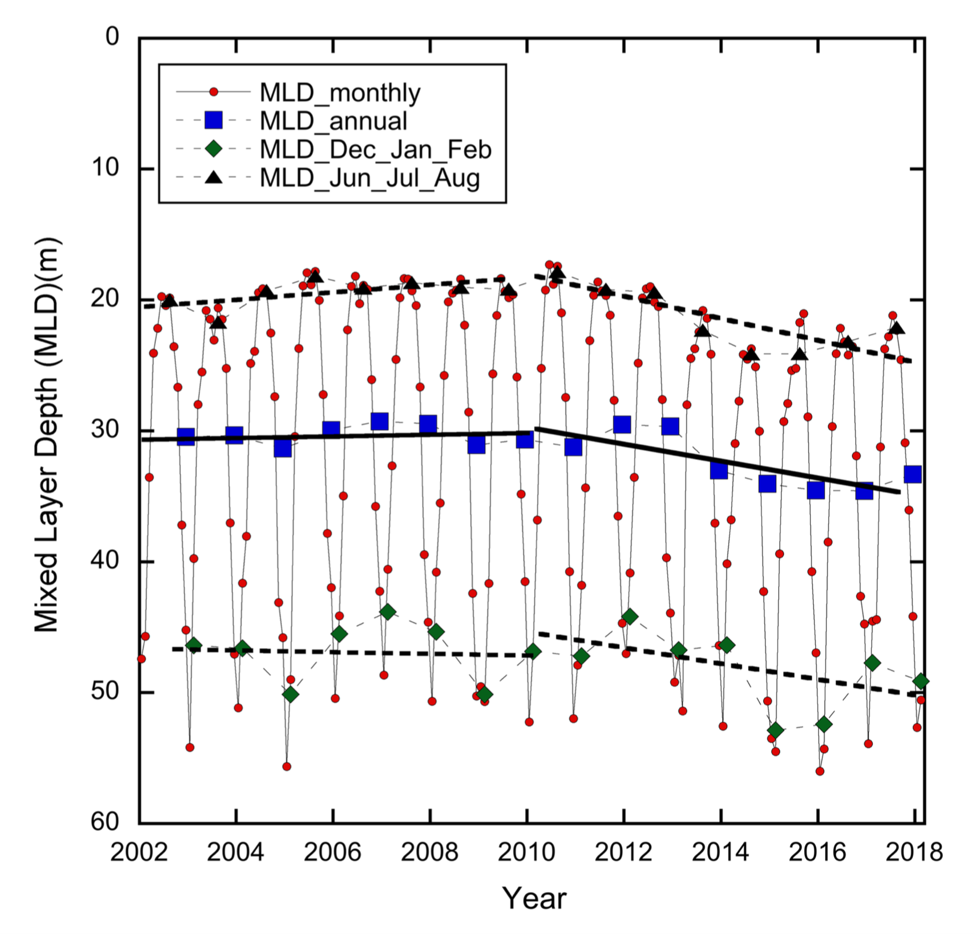
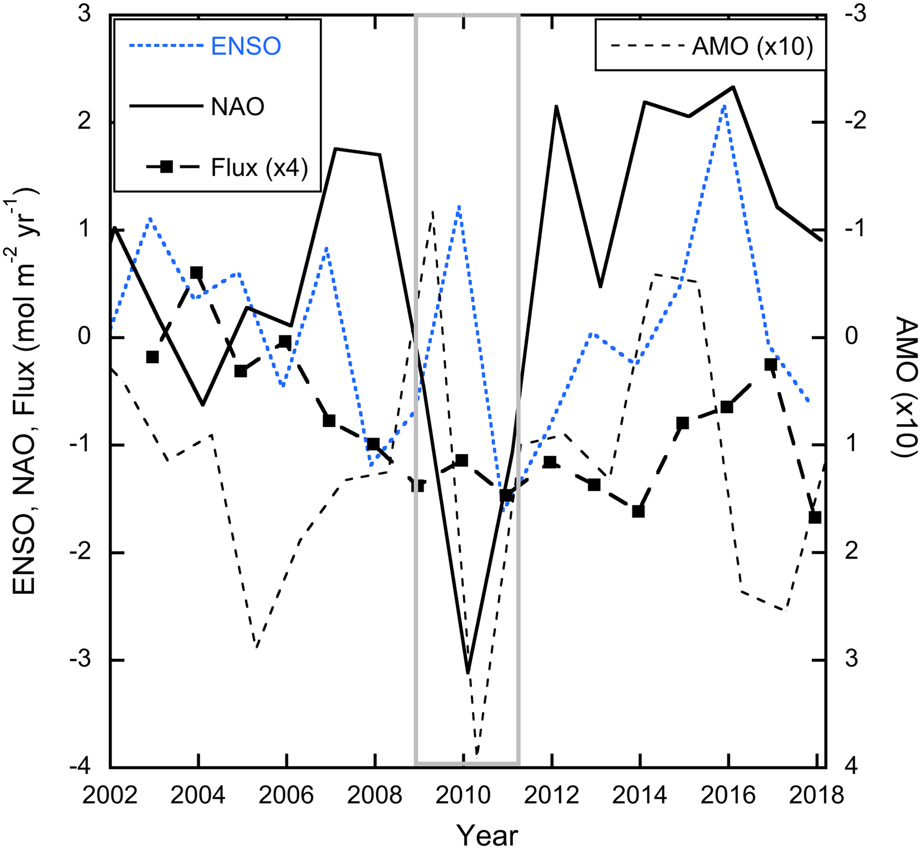
Large Decadal Changes in Air‐Sea CO₂ Fluxes in the Caribbean Sea
Taking advantage of a 17-year dataset from ships of the Royal Caribbean Cruise Lines in the Northern Caribbean we created monthly maps at 1˚ by 1˚ using a multi-linear regression analysis with robust error analysis. The results showed surprisingly large decadal changes in surface water CO₂ and air-sea CO₂ fluxes. From 2002 to 2017, the Caribbean Sea became an increasing CO₂ sink until 2009-2010. The trend then reversed itself and the CO₂ flux became slowly less negative, while still remaining a sink
The reversal of the trend is mostly attributed to changes in sea surface temperature (SST) and mixed layer depth (MLD) which showed similar trends through the decade
The reversal seems to be synchronous with large climate re-organizations such as the North Atlantic Oscillation (NAO) or the Atlantic Multidecadal Oscillation (AMO)

