Slide 1

Products from a surface ocean CO₂ reference network, SOCONET
Presenter: Rik Wanninkhof, NOAA/AOML
(rik.wanninkhof@noaa.gov)
Bakker, D. C. E., B. Pfeil, K. Smith, S. Hankin, S. R. Alin, C. Cosca, S. Harasawa, A. Kozyr, Y. Nojiri, K. M. O'Brien, M. Telszewski, B. Tilbrook, C. Wada, J. Akl, L. Barbero, N. R. Bates, J. Boutin, Y. Bozec, W. J. Cai, R. D. Castle, F. P. Chavez, L. Chen, M. Chierici, K. Currie, H. J. W. de Baar, W. Evans, R. A. Feely, A. Fransson, Z. Gao, B. Hales, N. J. Hardman-Mountford, M. Hoppema, W. J. Huang, C. W. Hunt, B. Huss, T. Ichikawa, T. Johannessen, E. M. Jones, S. D. Jones, S. Jutterström, V. Kitidis, A. Körtzinger, P. Landschützer, S. K. Lauvset, N. Lefevre, A. B. Manke, J. T. Mathis, L. Merlivat, N. Metzl, A. Murata, P. Monteiro, T. Newberger, A. M. Omar, T. Ono, G. H. Park, K. Paterson, D. Pierrot, A. F. Rios, C. L. Sabine, S. Saito, J. Salisbury, V. V. S. S. Sarma, R. Schlitzer, R. Sieger, I. Skjelvan, T. Steinhoff, K. F. Sullivan, H. Sun, A. J. Sutton, T. Suzuki, C. Sweeney, T. Takahashi, J. Tjiputra, N. Tsurushima, S. M. A. C. van Heuven, D. Vandemark, P. Vlahos, D. W. R. Wallace, A. Watson, R. Wanninkhof, P. A. Pickers, A. M. Omar, A. Sutton, A. Murata, A. Olsen, B. B. Stephens, B. Tilbrook, P. Monteiro, D. Munro, D. Pierrot, G. Rehder, J. M. Santana-Casiano, J. D. Müller, J. Trinanes, K. Tedesco, K. O’Brien, K. Currie, L. Barbero, M. Telszewski, M. Hoppema, M. Ishii, M. González-Dávila, N. R. Bates, N. Metzl, P. Suntharalingam, R. A. Feely, S.-i. Nakaoka, S. K. Lauvset, T. Takahashi*, T. Steinhoff and U. Schuster
Virtual ICOS Science Conference 2020
Plenary Presentation Wednesday, 16th September, 2020
Notes:
A very early Good Morning from Miami Florida.
I do not think I will ever forget that there are two EST’s: A Eastern Standard time and an European Standard Time.
I will be given an over view of a fledging network for surface water and Marine Boundary layer CO2 observations called Surface Ocean Carbon Reference Network or SOCONET with a focus on what type of products such Network can provide.
Wednesday, 16th September, 2020: 9 -10:15 (3 talks) EEST (3 AM)
https://www.icos-cp.eu/sc2020/programme#Wednesday
Products from a surface ocean CO₂ reference network, SOCONET
Rik Wanninkhof and the surface ocean observing community
The nascent Surface Ocean CO2 NETwork (SOCONET) for measurement of CO₂ from ships and buoys focuses on the operational aspects of measurements of CO₂ in both the ocean surface and atmospheric marine boundary layers. The goal is to create a global network that provides accurate pCO₂ data to within 2 micro atmosphere (µatm) for surface ocean and 0.2 parts per million (ppm) for marine boundary layer MBL measurements following rigorous best practices, calibration and intercomparison procedures. The network, will aid in production of important products such as maps of monthly resolved surface ocean CO₂, and air-sea CO₂ flux measurements. These products and other derivatives using surface ocean and MBL CO₂ data, such as surface ocean pH maps will be of high value for policy assessments and socio-economic decisions regarding the role of the ocean in sequestering anthropogenic CO₂, and how this uptake is impacting ocean health by ocean acidification. Here we will describe the effort and show an example on regional products in the Caribbean Sea that have been developed over the past two decades. These deliverables provide an idea of what can be delivered by the ICOS Ocean thematic Center.

Slide 2

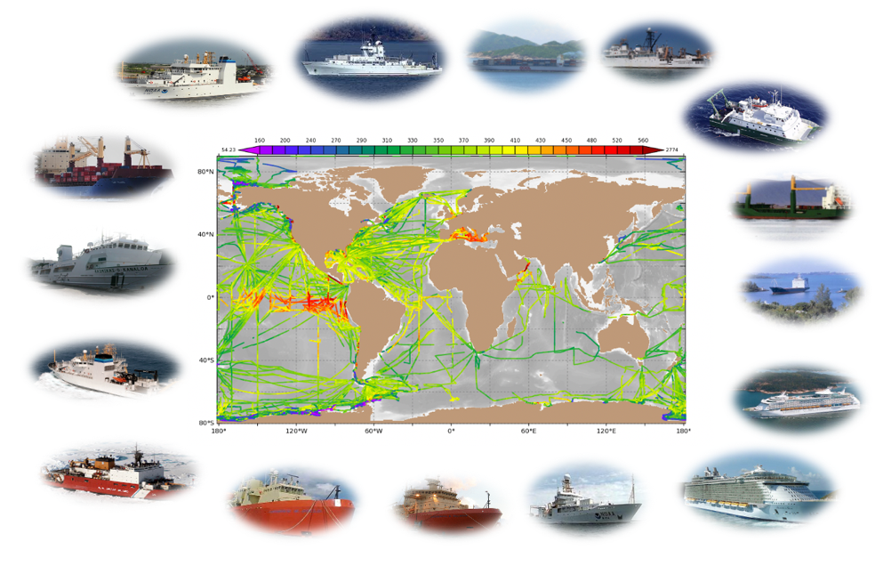



Outline
Purpose of surface water CO₂ reference network
How the network fits into a hierarchy of efforts under the aegis of Intergovernmental organizations
Development of products, example operations from cruise ships.

Slide 3
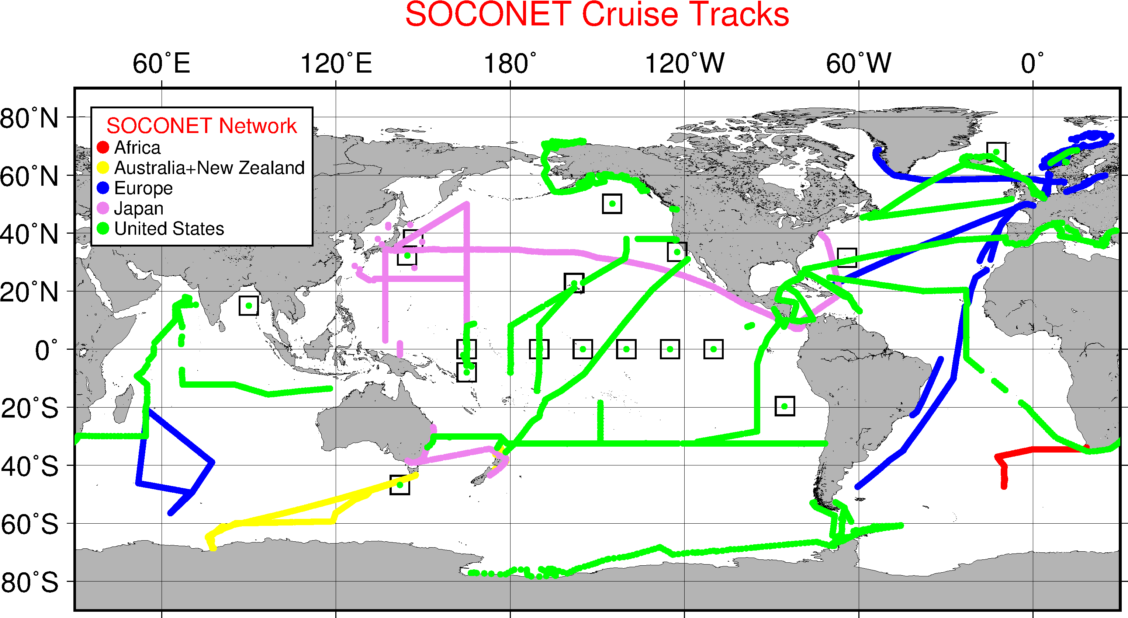
What is SOCONET ?
SOCONET is a subset of a larger surface water CO₂ observation campaign
and part of a sustained ocean carbon observation effort (IOCOS-Richard Sanders lead)
The Surface Ocean CO₂ Reference Observing Network (SOCONET) is a volunteer group of established operators who provide sustained quality global surface ocean CO₂ and atmospheric data from SOOP, ASV and moorings. SOCONET will tracks observations and data following established network principles. ( for more information see: www.soconet.info)
Notes:
SOCONET is comprised of a group of operators of automated CO2 systems on ships mooring and other autonomous platforms who have agreed to follow a set operational and network principles to deliver reference quality CO2 data within 6-months of acquisition. Its primary focus is to deliver data good to within 2 uatm in water and 0.2 ppm in air needed to constrain air-sea CO2 fluxes to within 0.2 Pg C (10 %)
From Arlyn Andrews:The term “reference network” was chosen to emphasize the quality and traceability of the measurements as well as the long-term stability of the network.
SOCONET is a subset of a larger surface water CO₂ observational campaign
and part of a sustained ocean carbon observation effort (IOCOS) that -Richard Sanders of the ICOS/OTC is currently spearheading

Slide 4
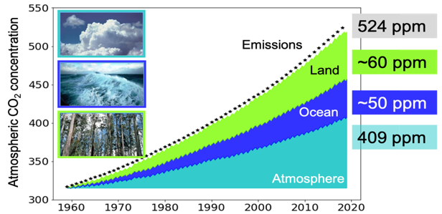
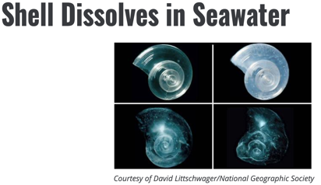
Why do we need SOCONET?
Quantify air-sea CO₂ fluxes
Mitigation of temperature increase and sealevel rise:
GCP, 2019
=208 ppm ∆SST ≈ 1.9 ˚C ≈ 30 cm SLR
∆SST ≈0.6 ˚C
Without CO₂ uptake by the ocean, global temperatures would be ≈ 0.5 ˚C warmer and sealevel ≈ 8 cm higher since 1960
∆SST ≈ 0.5 ˚C ≈ 8 cm SLR
= 93 ppm ∆SST ≈ 0.8 ˚C ≈ 14 cm
www.epa.gov/climate-indicators
110 ppm/˚C; 15 cm/100 ppm
Impact ecosystems- ocean acidification:
Sequestration of CO₂ produced by man has decreased pH by about 0.12
Value- will the ocean sink be counted as a carbon credit:
If the annual 2.5 Pg C of uptake by the ocean CO₂ was counted as a an “emission allowance” in the European Union (EU) emission trading scheme (ETS),it would have an annual value of 150 billion Euro

Slide 5
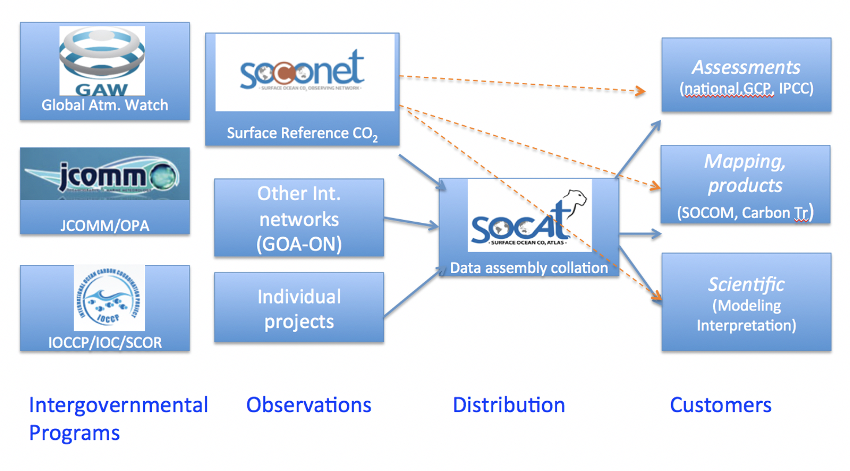

The SOCONET value chain
ICOS-OTC

Slide 6
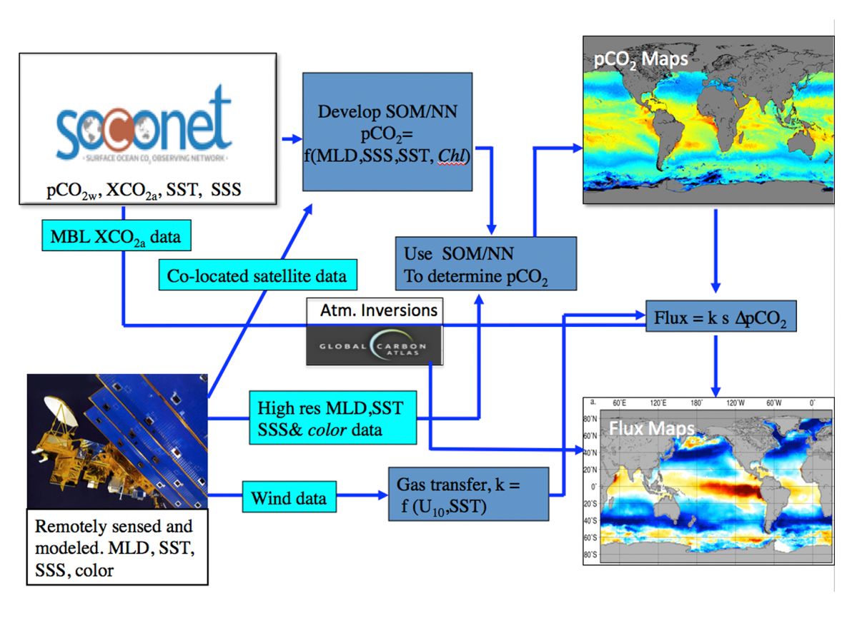
The creation of products
To sustain a network there must be regular and anticipated products
Products require more input than “just” surface CO₂ measurements

Slide 7
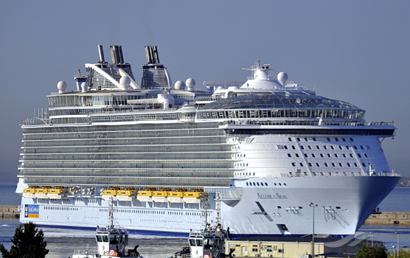
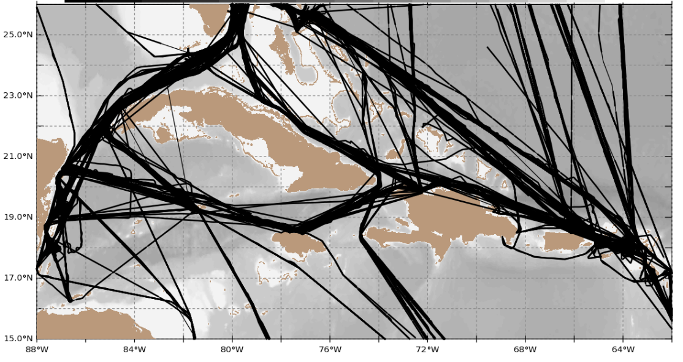
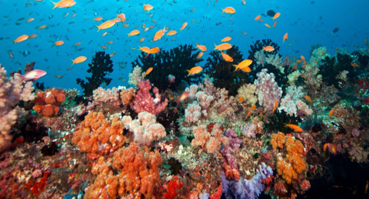
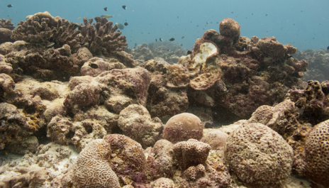
Products
Example of a regional timeseries: Northern Caribbean Sea, 2002-2019
www.ncei.noaa.gov/data/oceans/ncei/ocads/metadata/0207749.html
>620 cruises
> 1.2 M observations (5 % of data in SOCAT
Product suite updated annually
Data gap since March 2020: COVID19

Slide 8
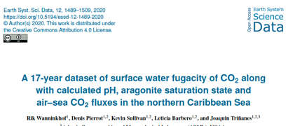
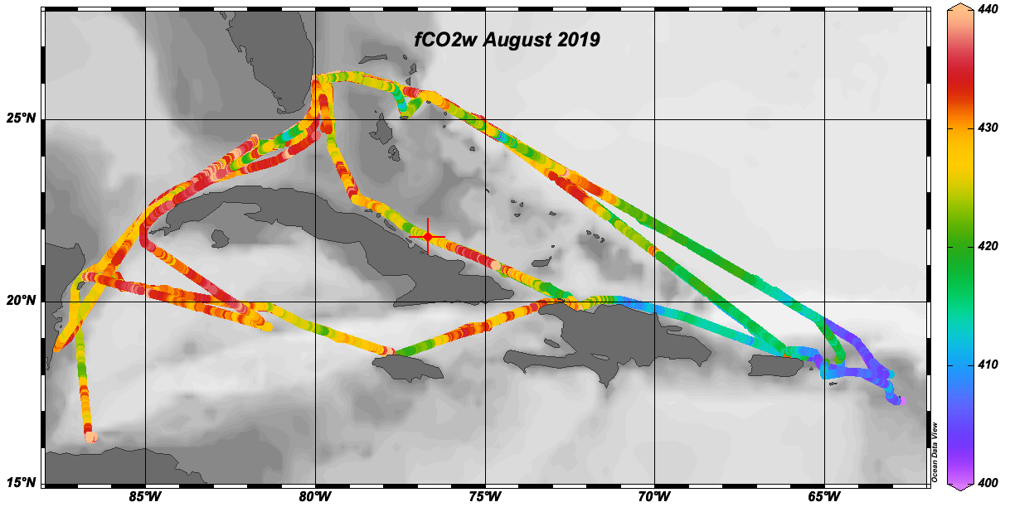
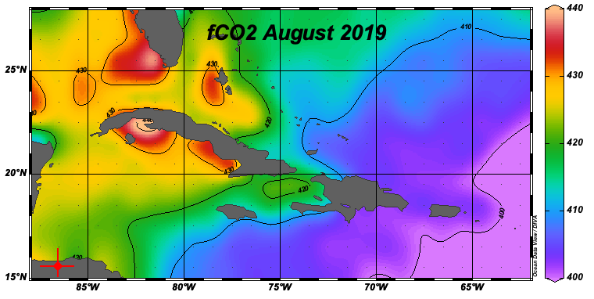
From observations to data products
Spatial interpolation
Measurement fCO_{2w} gridding Algorithm fCO_{2w} = f(position, SST, SSS,MLD)

Slide 9
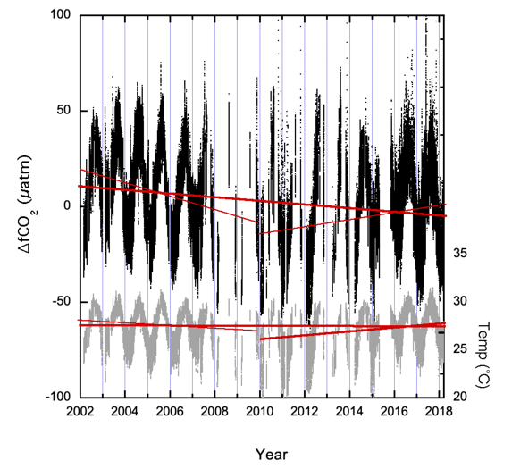
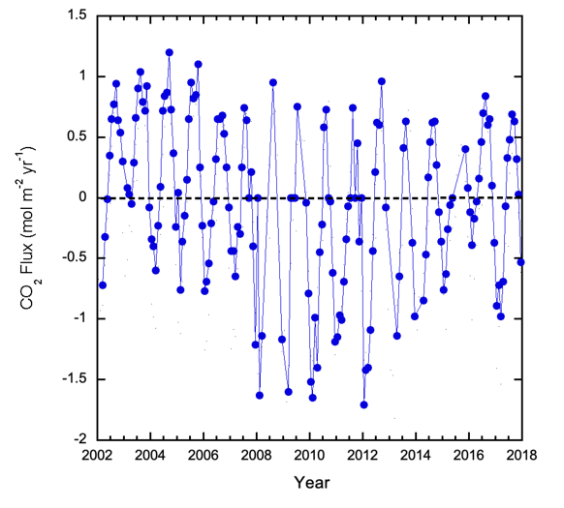
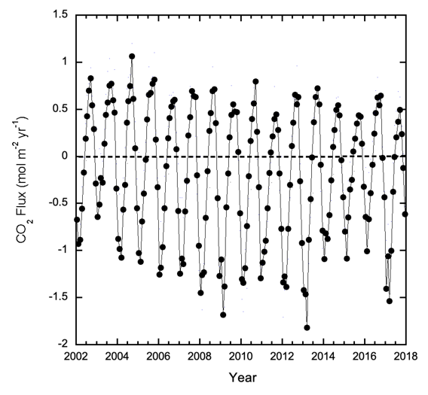
From observations to data products
A hierarchy of products from fCO₂ observations to derived quantities (based on fCO₂ and other observations, inorganic carbon thermodynamics and interpolation)
Temporal interpolation- the seasonal cycle in SST dominates variability
Observations
Monthly Gridded
Monthly mapped
The solid red lines are the least squares linear ﬁt through all the fCO_{2w} and SST data from 2002 to 2018. The black dashed lines are the ﬁts from 2002 to 2010 and 2010 to 2018. For fCO_{2w} the slopes are 1.30 ± 0.003; −1.37 ± 0.017; and 3.69 ± 0.011 μatm/year, respectively. For SST the slopes are −0.0080 ± 0.0003, −0.178 ± 0.002, and 0.1941 ± 0.001 °C/year, respectively.

Slide 10
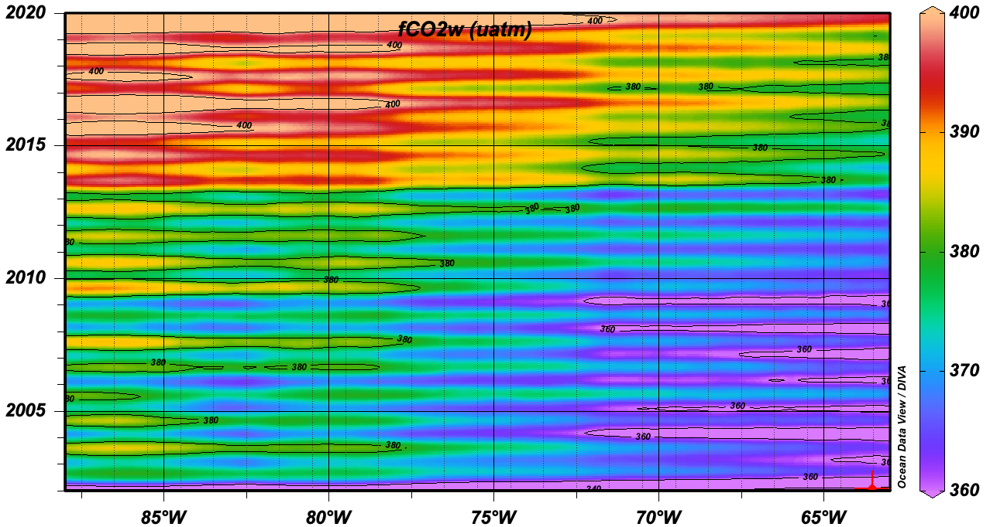
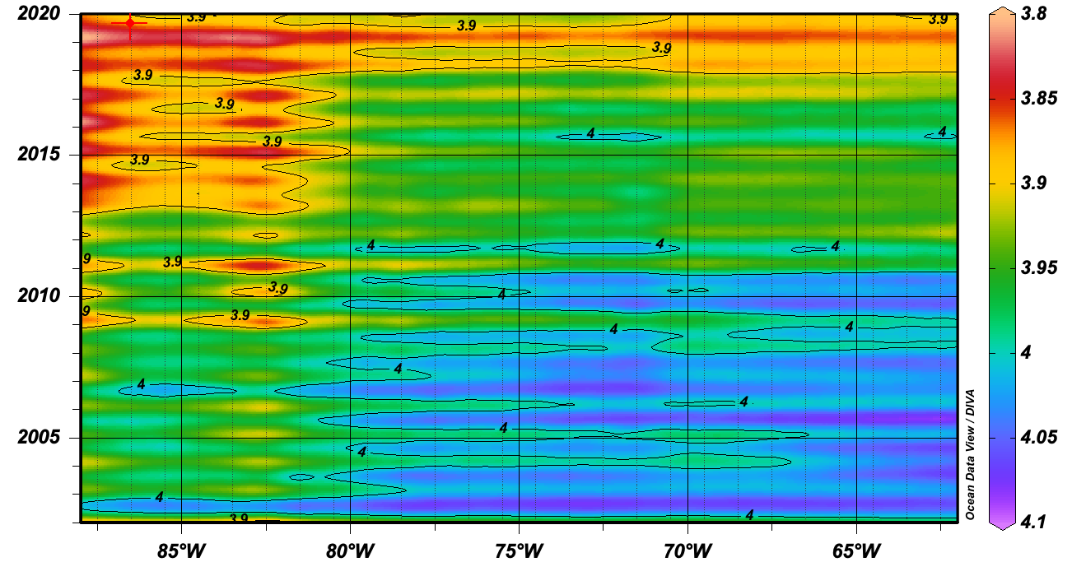
Time series
Derived products
Aragonite saturation State
(influencing shell and coral growth)
fCO_{2w} [µatm]
Ω_{Ar} = f(TA, fCO_{2w}, SST)

Slide 11
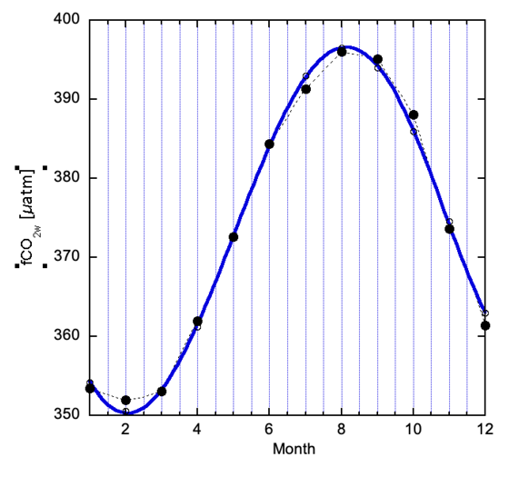
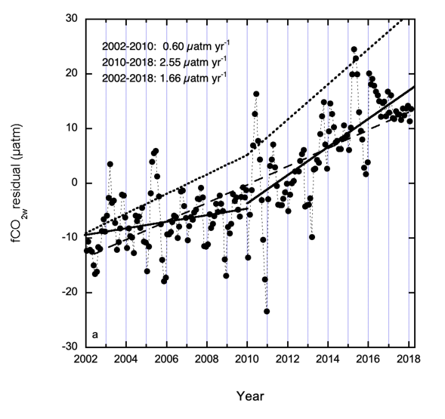
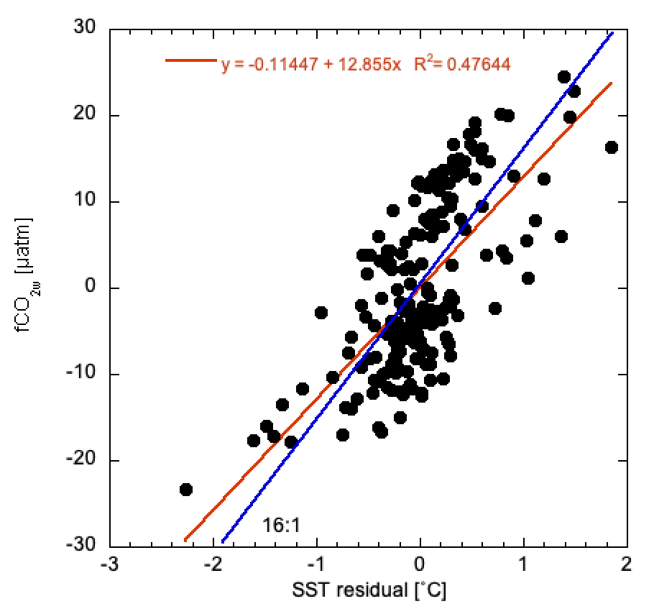
Higher-level products from regional time series
Long-term trends through de-seasoning
Harmonic fit -18 years
De-seasoned
Attribution
18-year seasonal cycle
Monthly fCO_{2w} Residuals
Correlation residuals fCO_{2w} and SST
Slope =12 µatm/ ˚C
Thermodynamic =16 µatm/ ˚C

Slide 12
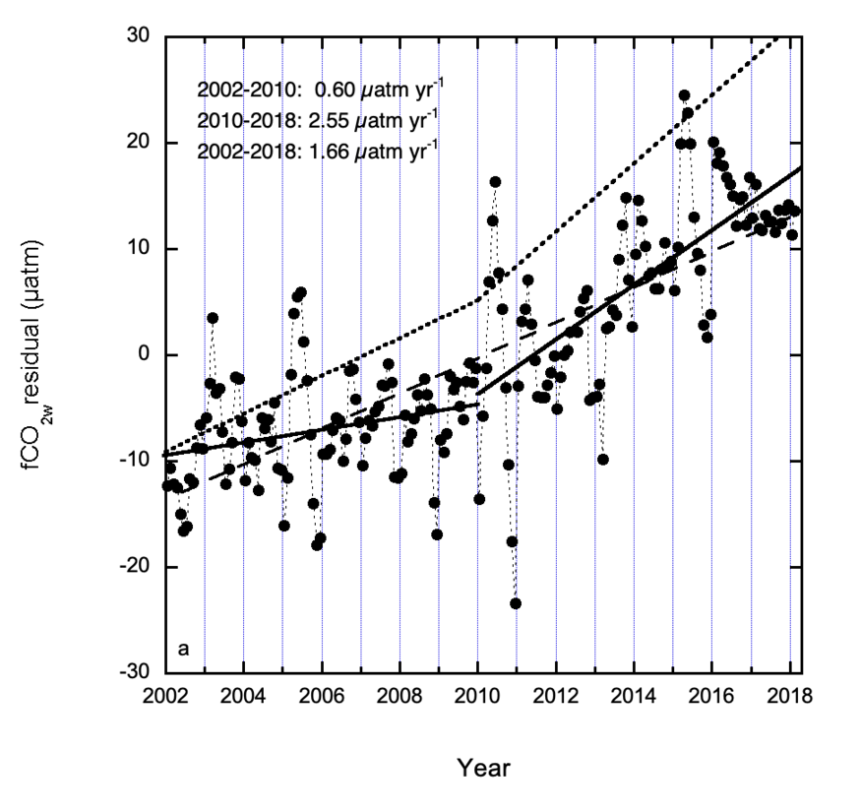
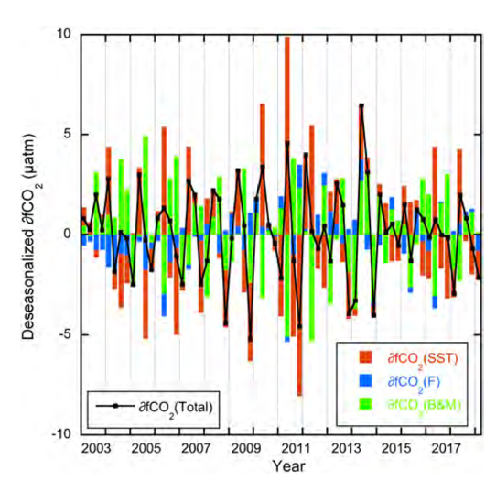
Deconvolution of processes controlling long term trends
From Wanninkhof et al., 2019 JGR
Temperature: Red; Air sea gas fluxes: Blue
“The rest” (biology and mixing) : Green

Slide 13
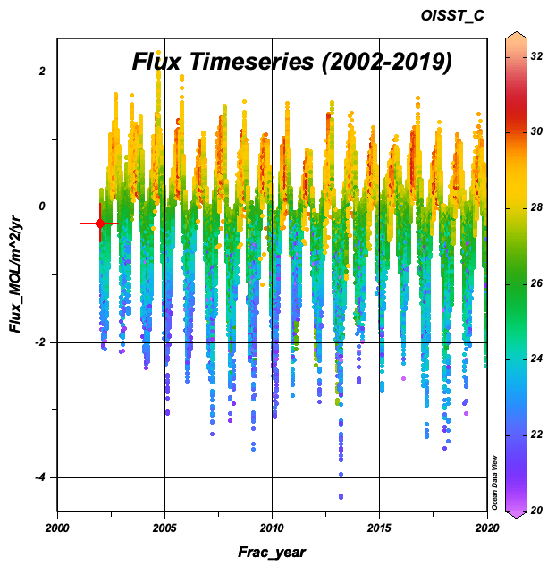
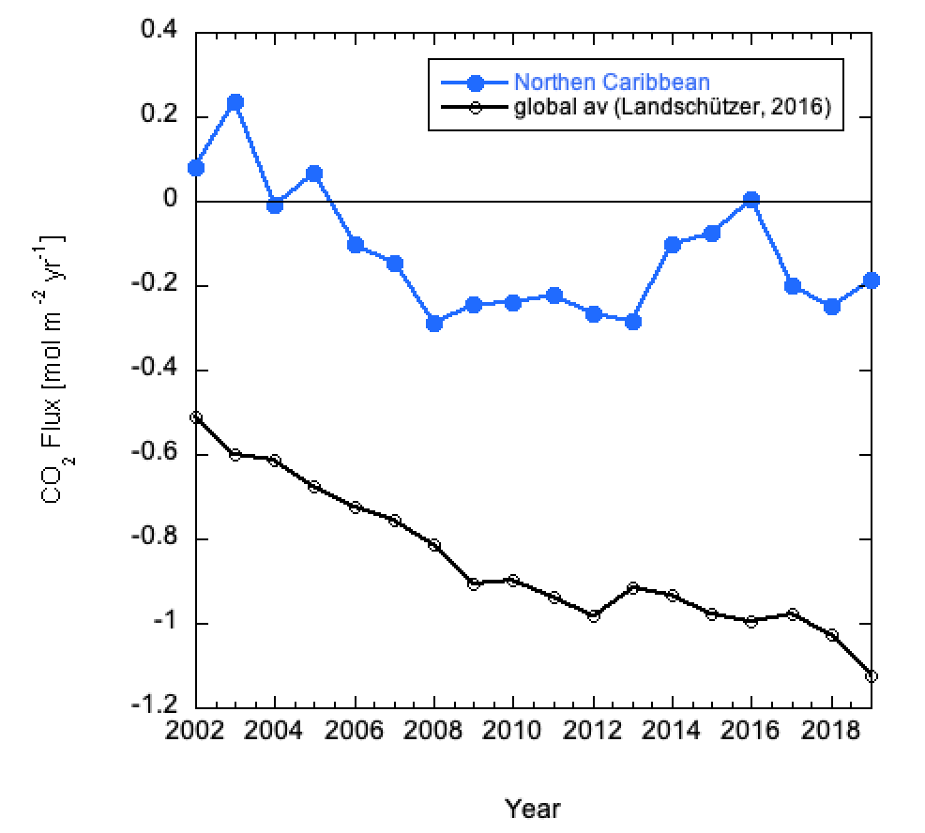
Flux time series and global comparison
The sum of regional magnitudes, variabilities and trends yield the global patterns
Fluxes from the mapped product
Greater interannual variability at regional scales than globally

Slide 14
Conclusions
With sufficient observations and regional synoptic coverage of SST, MLD, SSS and wind, robust quantitative regional information can be obtained regarding patterns and trends in carbon fluxes and other surface ocean carbon variables.
This information will be important for monitoring the health of the ocean, its ability to provide services, and projection of variability and trends into the future.
A coordinated and unified approach based on a firm sustained infrastructure and observational support is the goal in SOCONET . An observational program of surface water and marine boundary layer CO₂ is critical to continue to provide products such as air-sea CO₂ fluxes and ocean acidification indicators.

