Slide 1
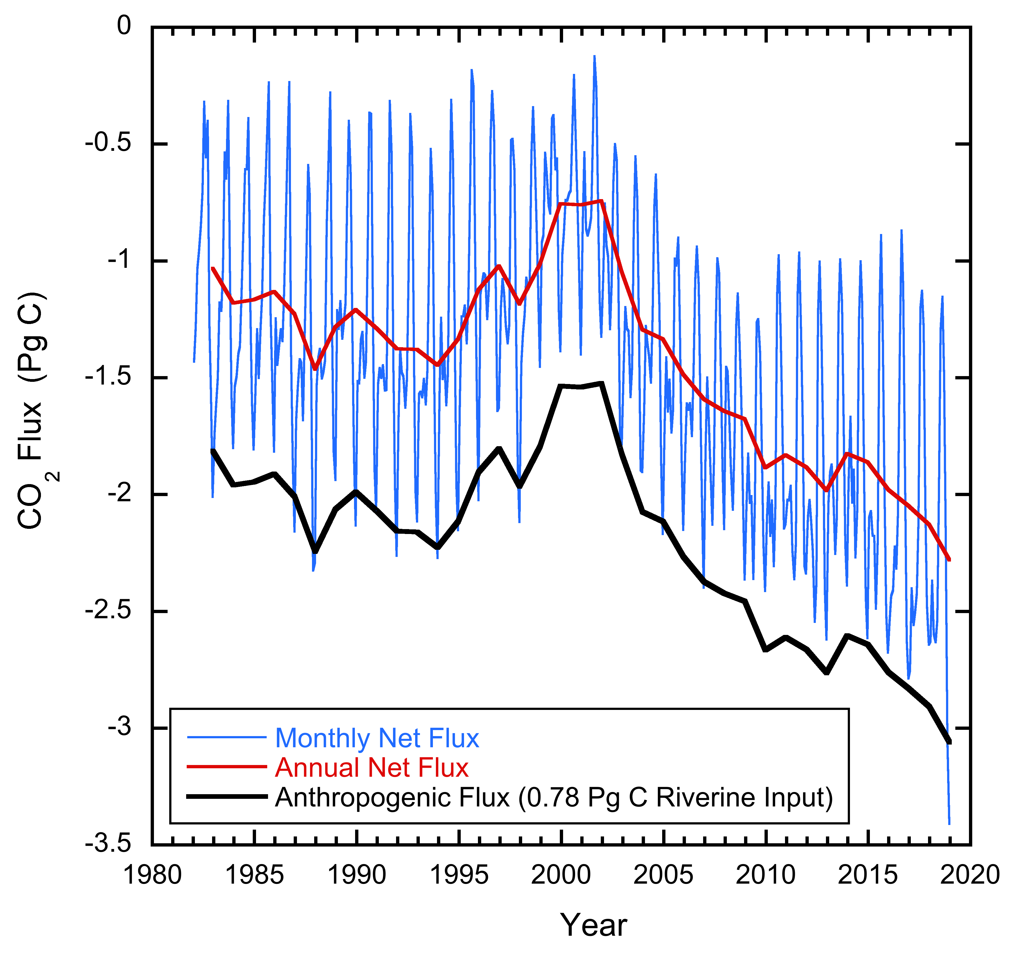
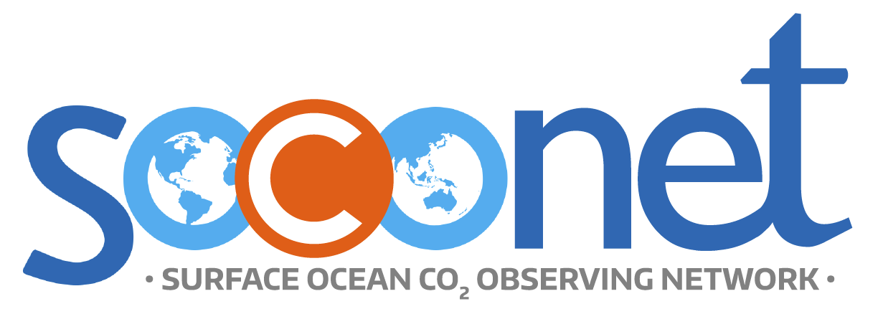
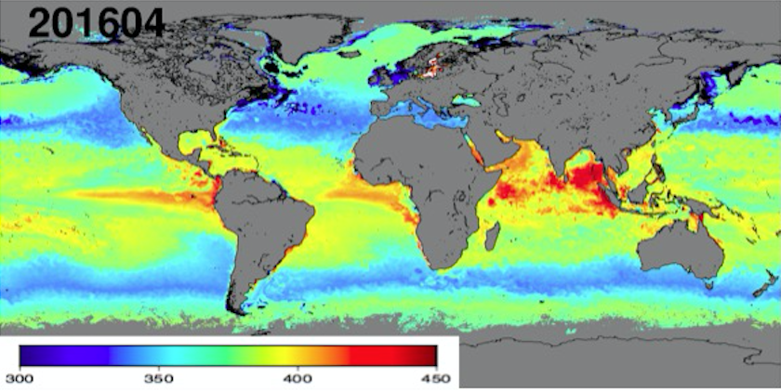
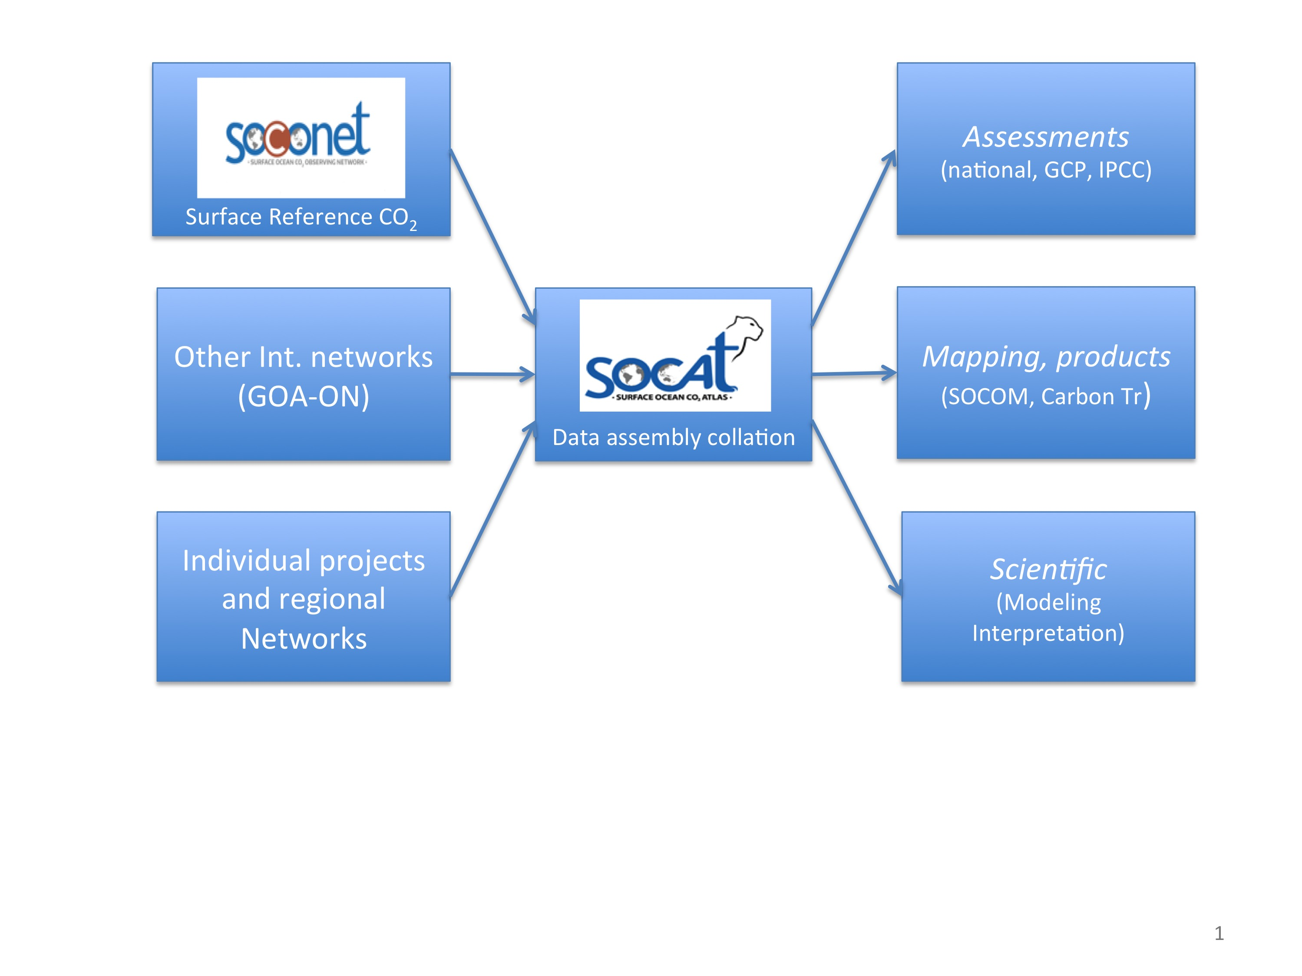
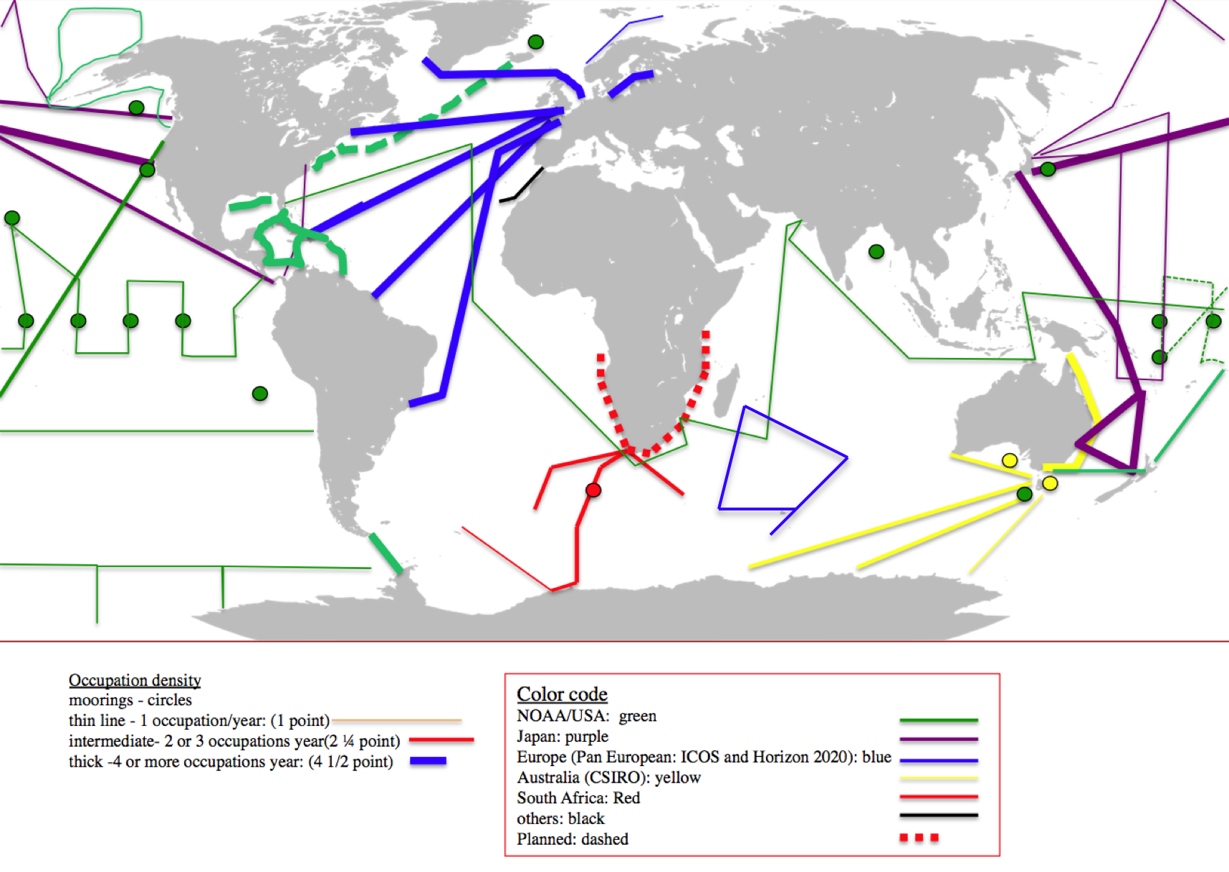
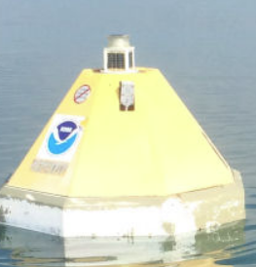
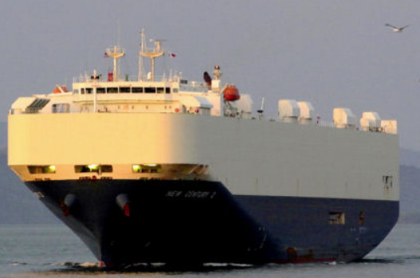
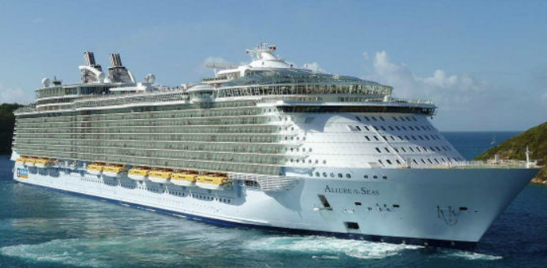
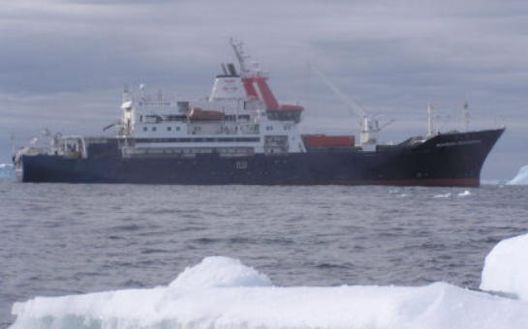
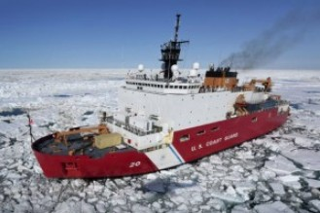
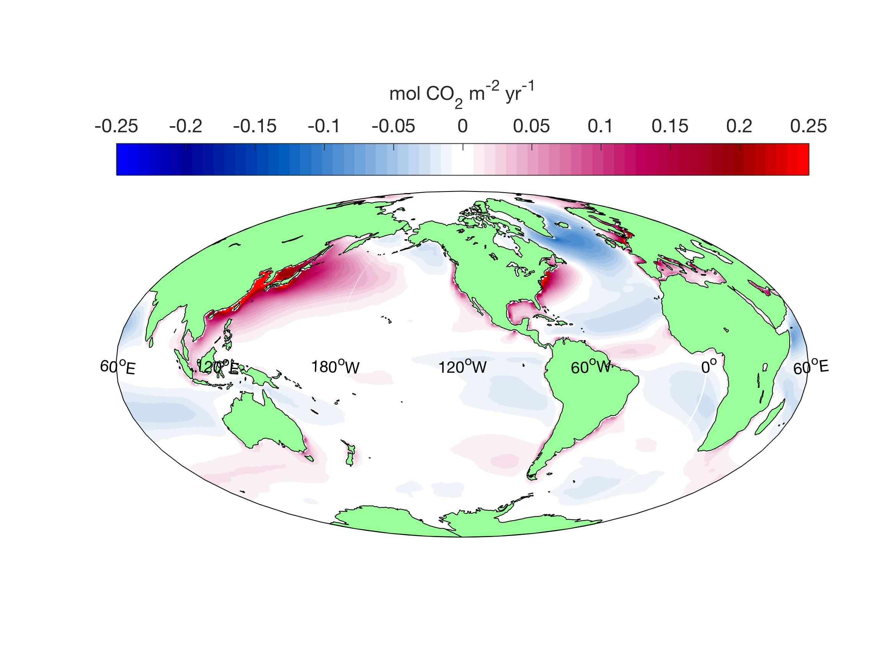
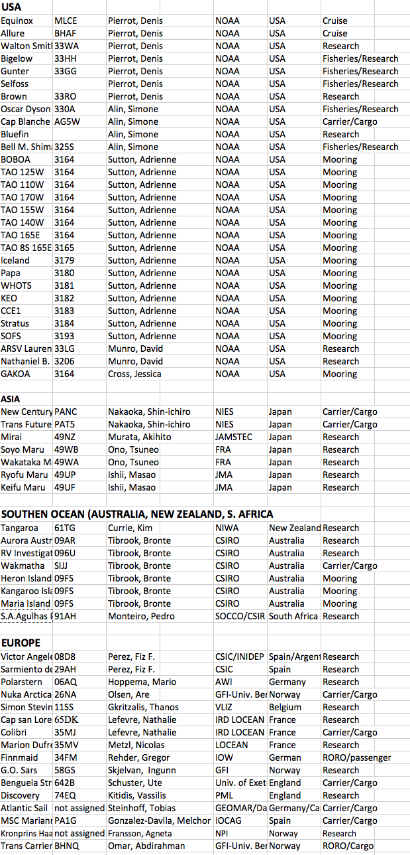
A surface ocean CO₂ reference network, SOCONET and associated marine boundary layer CO₂ measurements , Abstract The Surface Ocean CO₂ NETwork (SOCONET) and atmospheric Marine Boundary Layer (MBL) CO₂ measurements from ships and buoys focus on the operational aspects of measurements of CO₂ in both the ocean surface and atmospheric marine boundary layers. The goal is to provide accurate partial pressure of CO₂ (pCO₂) data to within 2 micro atmosphere (µatm) for surface ocean and 0.2 parts per million (ppm) for MBL measurements following rigorous best practices, calibration, and intercomparison procedures. Platforms and data will be tracked in near real-time and final quality-controlled data will be provided to the community within a year. The network, involving partners worldwide, will aid in production of important products such as maps of monthly resolved surface ocean CO₂ and air-sea CO₂ flux measurements. These products and other derivatives using surface ocean and MBL CO₂ data, such as surface ocean pH maps and MBL CO₂ maps, will be of high value for policy assessments and socio-economic decisions regarding the role of the ocean in sequestering anthropogenic CO₂ and how this uptake is impacting ocean health by ocean acidification. SOCONET has an open ocean emphasis but will work with regional (coastal) networks. It will liaise with intergovernmental science organizations such as Global Atmosphere Watch (GAW), and the Joint Technical Commission for Oceanography and Marine Meteorology (JCOMM).
Rik Wanninkhof^{1*}, Penelope Pickers², Abdirahman Omar³, Adrienne J. Sutton⁴, Akihiko Murata⁵, Are Olsen⁶, Britton Stephens⁷, Bronte Tilbrook⁸, David Munro⁹, Denis Pierrot¹⁰, Gregor Rehder¹¹, J. Magdalena Santana Casiano¹², Jens D. Müller¹¹, Joaquin A. Trinanes¹³, Kathy A. Tedesco¹⁴, Kevin M. O'Brien¹⁵, Kim Currie¹⁶, Leticia Barbero¹⁰, Maciej Telszewski¹⁷, Mario Hoppema¹⁸, Masao Ishii¹⁹, Melchor Gonzalez-Davila¹², Nicholas R. Bates²⁰, Nicolas Metzl²¹, Parvadha Suntharalingam², Richard A. Feely⁴, Shin-ichiro Nakaoka²², Siv K. Lauvset³, Taro Takahashi²³, Tobias Steinhoff²⁴, Ute Schuster²⁵
¹Atlantic Oceanographic and Meteorological Laboratory, NOAA, (NOAA), United States, ²University of East Anglia, United Kingdom, ³NORCE Norwegian Research Centre, Norway, ⁴Pacific Marine Environmental Laboratory (NOAA), United States, ⁵Japan Agency for Marine-Earth Science and Technology, Japan, ⁶University of Bergen, Norway, ⁷National Center for Atmospheric Research (UCAR), United States, ⁸CSIRO Oceans and Atmosphere, Australia, ⁹University of Colorado Boulder, United States, ¹⁰Cooperative Institute of Marine and Atmospheric Sciences (CIMAS) and NOAA, United States, ¹¹Leibniz Institute for Baltic Sea Research (IOW), Germany, ¹²Instituto de Oceanografía y Cambio Global, IOCAG, Spain, ¹³University of Santiago de Compostela, Spain, ¹⁴Ocean Observing and Monitoring Division (NOAA), United States, ¹⁵University of Washington, United States, ¹⁶NIWA, New Zealand, ¹⁷Institute of Oceanology (IO PAN), Poland, ¹⁸Helmholtz Center for Polar and Marine Research, Germany, ¹⁹JMA, Japan, ²⁰Bermuda Institute of Ocean Sciences, Bermuda, ²¹Sorbonne Universités, France, ²²National Institute for Environmental Studies, Japan, ²³Lamont Doherty Earth Observatory (LDEO), United States, ²⁴GEOMAr Helmholtz Centre for Ocean Research Kiel, Germany, ²⁵University of Exeter, United Kingdom
The socio-economic imperative for SOCONET
CO₂ is an important anthropogenic greenhouse gas, and a major driver of climate change that has far reaching consequences for our society. Its relevance is highlighted as an Essential Climate Variable (ECV) in the atmosphere and the ocean, as well as a biogeochemical Essential Ocean Variable (EOV). At the most basic valuation, CO₂ has an economic cost/value associated with it. It currently is traded as an “emission allowance”. While ocean carbon uptake is currently not part of the trading scheme, it would have an annual value of US $230 billion¹. The sequestration comes at an environmental and ecological cost though, in that the resulting elevated CO₂ levels in the surface ocean cause ocean acidification which impact ocean biota. There are no estimates of the current annual cost of the global impact of ocean acidification but an economic assessment of the impact of a future “OA catastrophe” ranges from a total cost of $97 billion to $301 billion². The anthropogenic component of the carbon cycle translates into many billions of dollars, and impacts ecosystem health and human well-being. It thus requires thorough investigation and monitoring.
¹Based on a 2.5 Pg C yr⁻¹ ocean uptake (≈ 25 % of the global emissions) and a price of $26 per tonne CO₂. ²Colt, S. G., and G. P. Knapp (2016), Economic Effects of an Ocean Acidification Catastrophe, American Economic Review, 106(5), 615-619, doi:10.1257/aer.p20161105.
SOCONET and its relationship to established programs
SOCONET is a voluntary, collaborative, multi-national reference network focused on delivering uniform surface water and air CO₂ data that meet the accuracy standards required to constrain air-sea CO₂ fluxes.
As such the data will also be of critical importance for validation of other measurements, and model initialization and comparison.
The data will be served through SOCAT (www.SOCAT.info), within a year of acquisition and utilized through a common framework, as illustrated in Figure 1.
Examples of the products that will be improved through this effort are estimates of the global air-sea CO₂ flux (left panel on banner), and monthly air-sea CO₂ flux maps (right panel on banner). Figure 1
SOCONET participants
Current lines and moorings that meet SOCONET quality and (meta)data criteria are shown in Figures 2 and 5. The project utilizes a large range of ships and moorings (Figure 3) that have equipment that can be appropriately calibrated to meet the required data quality of 2 µatm for partial pressure of CO₂ (pCO₂) of water and 0.2 ppm for mole fraction of CO₂ (XCO₂) in air.
Figure 3
Figure 2
Improvement in Marine Boundary Layer (MBL) measurements using SOCONET
SOCONET has a strong focus on accurate pCO_{2w} measurements, but offers a unique opportunity to contribute to (air) MBL CO₂ data, which are undersampled over the open ocean. Most of the pCO₂ systems used in SOCONET take air measurements, and with implementation of improved instrumental techniques and quality control can meet the goal to be compatible to within ±0.2 ppm of the global CO₂ scale maintained by the WMO/GAW Central Calibration Laboratory (CCL). This will lead to improvement of air-sea CO₂ fluxes. Currently values for pCO_{2a} are obtained from the Marine Boundary Layer Reference data product provided by the Global Monitoring Division (GMD) of NOAA/ESRL. While this data product is useful for identifying large-scale trends, it does not reflect the full spatial or temporal variability of MBL CO₂ that exists in the atmosphere, and use can lead to regional biases in Fluxes (Figure 4).
Figure 4
∗ ∗ ∗ ∗
Outlook and recommendations for SOCONET
SOCONET is a partnership of many investigators that have as major goal measuring surface ocean CO₂ and MBL CO₂ levels on an operational basis following agreed upon procedures. The accurate measurements will be disseminated within a year of measurement. Platform and instrument metadata tracking will occur in near-real time. The current list of platforms and participants that expressed interest in being part of SOCONET can be found at www.soconet.info and is shown in Figure 5.
The recommendations are focused on the initial steps necessary to implement the program:
Recruit participants for SOCONET.
Inventory platforms, and their metadata that are part of SOCONET.
Set up a system to track platforms in near-real time.
Develop procedures to quality control and assess accuracy of air CO₂ measurements taken from the platforms.
Further information on SOCONET can be found in the prospectus (https://www.aoml.noaa.gov/ocd/gcc/SOCONET/SOCONET_prospectus.pdf)
and in the community white paper for Ocean Obs-19 (https://www.frontiersin.org/article/10.3389/fmars.2019.00400). An example of regional implementation of SOCONET principles can be found in the ICOS-Ocean thematic Center poster (CWP-03).
Investigators interested in joining the network are encouraged to reach out to the participants (listed as co-authors) and/or contacting the current lead investigator: rik.wanninkhof@noaa.gov. This start-up activity is supported by IOCCP and NOAA/OAR/OOMD.
Figure 5

