Slide 1
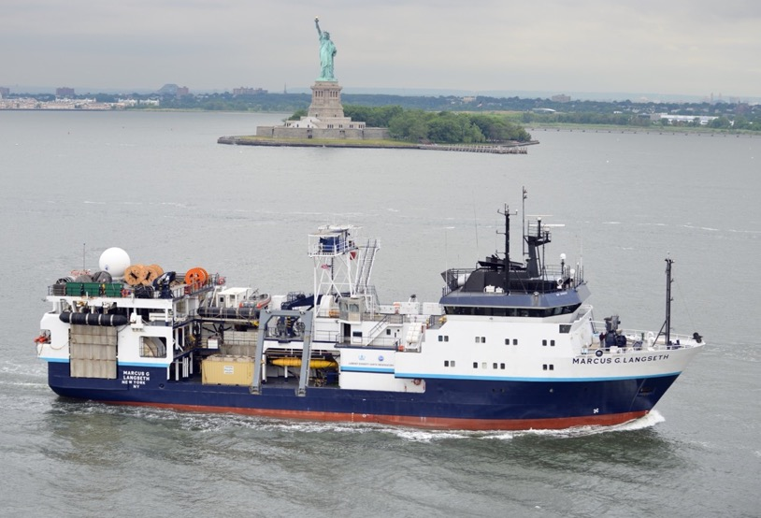

Slide 2
Notes Andy, Denis, jim in folder
https://drive.google.com/drive/folders/1CdpUFRUPAzyPOe48npD4LXROk0wq_I7C
Andy Stefanik notes:here is a link with my folder, pics, notes.
https://drive.google.com/drive/folders/1--xAankJCboOmq72QWsS6znwv4cWUnuN?usp=drive_link
RV Marcus Langseth visit 13 June 2023 J Swift notes & photos
We had an enjoyable, productive visit. The ship’s ‘can-do’ officers, crew, and science support team are accommodating, friendly, and experienced.
The ship’s starboard A-frame serves an excellent location for rosette launch and recovery, not too sensitive to pitch, with good visibility from the bridge, and adequate visibility of the landing spot from the winch shack. [That visibility should be excellent after installation of new windows in the winch shack.] The winch operator is also the A-frame operator. The winch operator and bridge can see the CTD cable from the winch to the water.
Rosette launch and recovery can be fraught times, but with an A-frame these operations will require extra care. Tag line use will be required to help maintain rosette in-air stability during launch and recovery. There will need to be appropriate gear for the tag lines, dedicated training of student tag line operators, and careful supervision from a deck expert on every cast.
There seemed to be adequate means for launching floats and drifters.
The ship uses the twin props and bow thruster to maintain on-station heading and position.
A few notes:
The ship has tremendous ‘sail’ area. Work in the typical Southern Ocean mixed wind and swell directions could be challenging at times. It was stressed that avoiding slack wire during CTD ops was primary over maintaining position, and to a reasonable extent primary over wire angle considerations.
Rosette sampling would best be carried out on deck, and there is adequate cover (and height) available immediately to port of the rosette landing area. Lighting in the sampling area is now ‘OK’ but the ship has additional lights of several types that can be added to the sampling area. A cart & tracks set-up is strongly recommended for safety.
It will be beneficial to install one or two wave-sturdy benches in the sampling area. The ship is ready to do that.
The ship takes a good deal of water on the main deck, especially in following seas. Rosette sampling will be a wet operation at times.
There is good access from a small dry lab (called the “Port Lab” on the diagrams) to the sampling area. This would be useful for rosette electronics and data support.
There is good access to the landing point from the Wet Lab. This might be a good location for rosette bottle maintenance, plus staging for rosette sampling.

Slide 4
Wet Lab
The spacious Wet Lab is open to the deck but the entrance can be timbered and the garage door closed. Following seas put a lot of water on the main deck and so may be an issue at times. The Wet Lab deck may be wet in those situations. The chiller in the Wet Lab is presently not operational. Lighting, power, etc. do not seem to be issues.
The Wet Lab might not be the best location for rosette sampling, but it is a very good location for staging items (sample boxes, floats, etc.) for use on deck.
The Wet Lab has the ship’s seawater line and would be the location for GO-SHIP underway seawater sampling.
The wet lab may also be a good spot to set up storage for daily deck ops wear such as foul weather gear, boots, and hard hats?
The Wet Lab may turn out to be essential to store ‘overflow’ and ‘handy’ items for the Dry Lab, which will be very busy/full and is immediately forward.
Wet Lab looking forward
Wet Lab sinks & seawater line
Wet Lab looking aft
Wet Lab looking aft

Slide 5
Dry Lab
The Dry Lab is immediately forward of the Wet Lab on the starboard side of the ship. There is a screen on the aft/port side of the lab that can be removed or moved back 2 feet, which will add a good amount of space, and allow 3 (or was it 4?) 4x8 benches to be installed athwartships. The Dry Lab is often used as a passaway but there is a fine alternative passage. The lab chiller works. It is likely that GO-SHIP analytic operations for O2, nutrients, alkalinity, and pH will fit here. Lighting, power, sink, etc. do not seem to be issues. Might bring water filters??
The Wet Lab can be used for ‘overflow’ and ‘need it handy’ items for the Dry Lab, which will be very busy/full.
Screen can be removed or moved back two feet
Benches can be rotated athwartships.
Dry Lab looking forward and port
The Dry Lab will be the busiest, most crowded space on a GO-SHIP cruise. With care, ingenuity, and cooperation – and strict discouragement of its use as a passasway – it should work OK.
Dry Lab sinks & water filter
Dry Lab looking starboard

Slide 6
Seismic Lab
The Seismic Lab, one deck down from the Main Deck, is a very large space and the obvious location for CTD console ops, data processing, scientist laptop/workstations, general hang-out & planning area, daily watch team meetings, etc. It had video screens or communications access to ‘everything’.
The IT Office, on the starboard side of the ship and off the starboard/aft area of the Seismic Lab, may be the preferred location for the two salinometers. May want a barrier between the IT Office and the Seismic Lab, and a small heater with good thermostat to help with temperature regulation (probably best to keep it a but above Seismic Lab temperature).
Seismic Lab looking forward and port
IT Office does have an exterior bulkhead. Will sun on the hull cause warming at times?
IT Office
IT Office
Seismic Lab looking aft into server room
starboard aft area of Seismic Lab

Slide 7
Port Lab
The Port Lab (the name on the deck plan, and maybe not what the ship now calls it) is an intriguing lab with several possibililties. It will be close by the rosette sampling area, so might be a good location for the LADCP power supply and other rosette electronics and data support.
Note the extra sinks in the photo. The ship can install these in various locations.
Port Lab looking aft
Port Lab looking forward

Slide 8
Working Deck
View of the working deck and the CTD cable from the bridge aft control station is good.
View of the working deck from the winch shack is OK now but should be good with planned new window(s). View of the CTD cable from the winch shack is good.
Best location to sample would be straight to port from the landing site (sampling area not shown in photos).
aft view of A-frame, deck, & winch shack
view aft from inside bridge aft control station
Strongly recommend cart and tracks to safely move rosette to/from landing point and sampling area.
Recommend installation of additional lighting (floods?) in sampling area. (Ship has various lights ready to install.)
forward view of A-frame, deck, winch shack, bridge, & wet lab
A-frame & deck

Slide 9
Accomodations and other comments
The ship’s accomodations areas are ‘up and forward’, well separated from working areas. None of the science berths seem to be underneath, above, or adajcent to major ship’s equipment.
Staterooms often include a comfortable chair, and only one berthing compartment had three bunks. (The six-person suite had three two-person berthing compartments and a common living area.)
Staterooms either had a private head or shared a head with one other stateroom.
CCTV and various data, etc., are available to each stateroom via the ship’s network.
The mess room is welcoming. While the ship does not serve hot mid-rats, the cooks are fine with saved plates, and there is ample access to ‘the usual variety’ of foods for those coming onto watch at midnight.
It should be noted that the ship’s engineering and science staff are basically at the ready to make things work, add or remove partitions, add/move lighting, etc.
mess room
corrugated plastic material available for partitions

Slide 10
Visit of r/v Marcus Langseth: notes Andy stefanik
6/13/2023
Andy Stefanick, Jim Swift, Denis Pierrot
Logistics:
Port: Cape Canaveral
Accessibility: One gate with guard 100ft from ship, put on list, showed CAC card. Not able to take a vehicle inside the gate.
Hotels: Just over bridge multiple hotels 5min drive, not walkable to get food from ship
Docking: Located at 799 Snapper Rd. Port Canaveral, FL 32920
Could not be guaranteed berthing because of SpaceX priority (but usually clear)
Ship capabilities:
Crane: Shipboard cranes cannot lift containers onto ship.
Main deck large crane, second deck knuckle boom (can move CTD etc from 2nd deck to
main deck)
Stern aft boom and small winch for Argo deployments
Metric deck bolt patterns
Hydraulic winches: multiples and can setup for CTD retrieval, don’t typically use air tuggers
Containers: Power, have 480v
Can supply “LOTS” of compressed air
Can supply fresh water hoses to vans, discharge hoses can go overboard
Can supply phone and network cable to vans
Orientation of doors has limited access inboard
Supply container would be on 2nd deck
Argos and drifters can be housed in container or on deck (would need multiple pallots if
On deck to keep out of water but would be under cover.
D-containers can be stored on 2nd deck
CTD winches: main on 2nd deck setup, .322 wire, articulated arm level wind system, wire looked
good, also run a fresh water rinse and lube wire (can request not to be lubed
Closer to CTD)

Slide 11
Backup: will be installed and operated on 3rd deck. Both go through a turn block
Inline with A-frame.
They have multiple a-frame blocks on hand. No auto-stop anit-two block
Have winch redout with tension in the main lab and dog house.
Prefer to have us do CTD wire termination
Are OK with us using primary and backup Cable grips for main connection
Dog House overlooks CTD ops and A-frame good
CTD: Control console would be in main lab, they do not have an installed SBE deck unit, would
Have to bring deck units and an acquisition computer. They will have wires run from the
Slip Rings to the main lab for hookup.
Inboard of A-frame overhang has plenty of clearance for CTD under cover
Can pallet jack CTD inboard for sampling but I am seeing about rail and sled from Brown
ADCP acquisition can be setup in wetlab or inboard “bird lab”
Use VHF to communicate with bridge and winch driver. Have 2 base stations in main lab
COMS: Network drops throughout ship, Wifi coverage throughout ship, handheld Sat phone on
Bridge, use voip for outside calls, says “plenty” of bandwidth
Equipment:
Multi-beam
Knudsen
EM122 hull-mounted ADCP
Lab spaces:
Berthing:
Contacts:

Slide 12
RV Langseth Visit
June 12, 2023
Port Canaveral
D. Pierrot notes

Slide 13
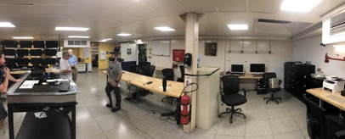
Lab Spaces- Main Lab
Possible Salinity Room
Plenty of room for:
Chief (Co-) Sci,
CTD ops,
meetings,
computer space

Slide 14
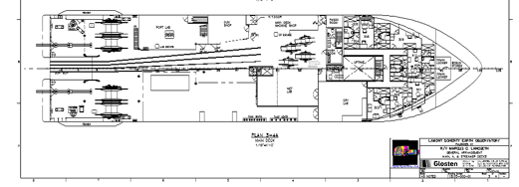
Lab Spaces- Dry Lab (Starboard side forward dry lab)
Will be removed
Can fit 3 (8’x4’) tables
Has sink
Has Milli-Q system (state?)
Has extra benches
Has freezer
Close to sampling bay
Not much traffic
Could accommodate:
Nutrients
Alkalinity/pH
Oxygen
Discrete pCO2

Slide 15
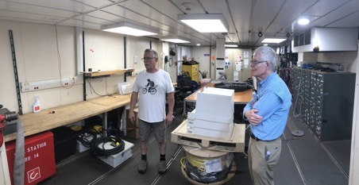
Lab Spaces- Port Lab
Can fit 2 (8’x4’) tables
Could add sink
Has extra benche (188 Lx30.5 W)
Close to sampling bay
Not much traffic
To sampling bay
Could accommodate:
CTD OPS
Nutrients
Alkalinity/pH
Oxygen
Discrete pCO2

Slide 16
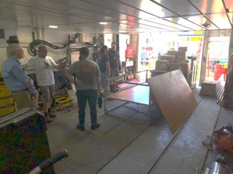
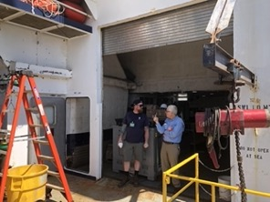
Lab Spaces- Wet Lab (Starboard side aft wet lab)
Can fit 2 (8’x4’) tables
Has sink
Space for uw pCO2 system
Possibility to add flowing system
Possibility to add wall
May remove big A/C unit
Issues:
Not well insulated room
Supposedly can flood
Could accommodate:
Filtration systems
Bio?

Slide 17
Lab Spaces- Wet Lab (Starboard side aft wet lab)
PORT
CTD
DICE
WET
DRY
CFC

Slide 18
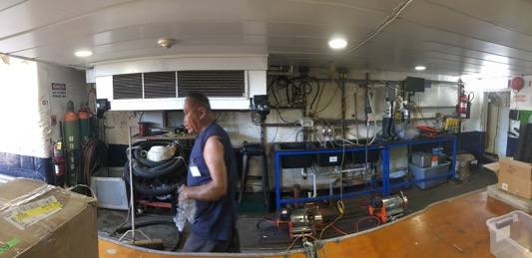
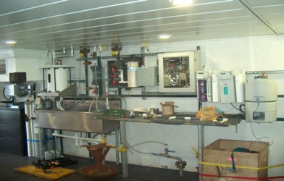
UW pCO2 system
Pump provides 20+ Gal/min at 18 psi
Air line already in place but not ideal. Will run a new one
Plenty of space for system, cylinders

Slide 19
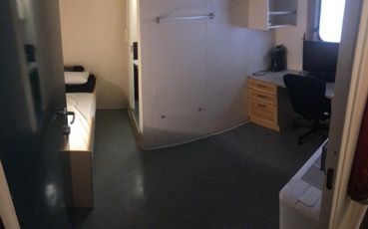
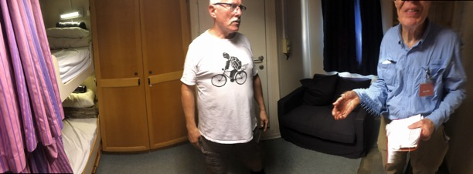
State Rooms
55 berths total
19-21 for the crew
Additional 5-6 for AB group
Leaves 28 minimum for science (and observers)
Science and Crew don’t share.
Flexible on drills to accommodate science

Slide 20
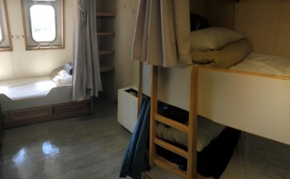
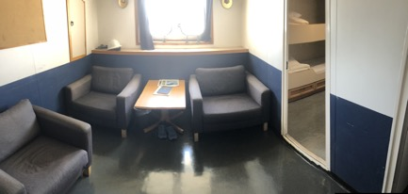
State Rooms
3-person room
“6-person” room

Slide 21
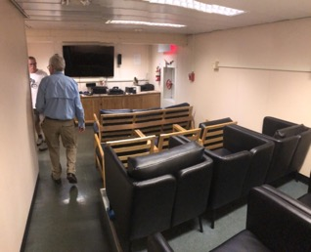
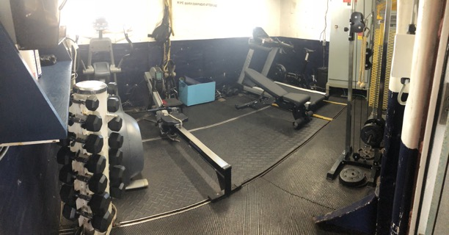
Living quarters
TV room
Gym

Slide 22
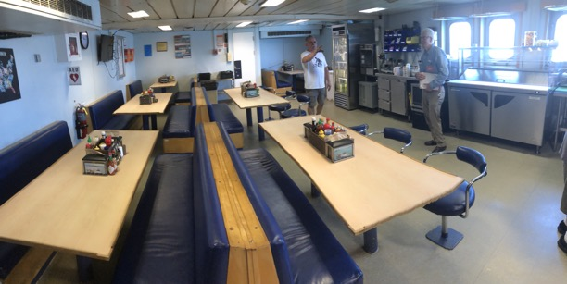
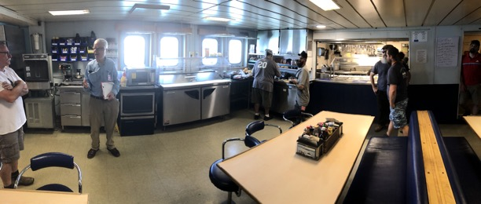
Galley

Slide 23
Ship capacities
Can provide 480 3-phase
Can provide compressed air and add filters to it
Can provide fresh water
Wifi throughout the ship
Evap water available
Can install sinks, benches
Has space for chem locker, outdoor (covered) storage for boxes, floats

Slide 24
Palmer

Slide 25
Notes rik from debriefing with Jim, Andy and Denis,
It is an IT oriented ship with good cameras internet and wifi
People will needs to help each other and be accommodating
Port lab was an undiscovered lab that could holp 2 groups
Need more lights installed in deck area
Need to rent crane to load vans
Should install table near CTD operations
We will supply rail system
We should supply milliQ system cartidges and perhaps cartidges themselves
Ship uses evaps and does not brominate water (double check this)
CTD winch and wire seem in good shape they have a different level wind than we are used to . Need to tell them how much wire should be unlubed
CTD acquisition computer,deck unit need to be supplied by us
We need to specify what cabling will run from both CTD winches to main lab
We will be responsible for CTD terminations
Floats and drifter can likely be stored aft in seismic area [check this]
No secondary storage (e.g in hold)
Dry lab nuts, O2, TAlk and discrete fCO2
Wet lab for DOC filtering and extra bottles (overflow from dry lab)
Underway pump is a combination centrifugal pump and diaphragm pump 28 gallons per minute 18 psi (where is intake temp and TSG?)
Should timber the wet lab hanger door
Provide idea how many deckhands we need and survey tech
Should we supply a NOAA survey tech?
Bird lab does not seem too useful, it is one deck up
Winch and wire pool

Slide 26
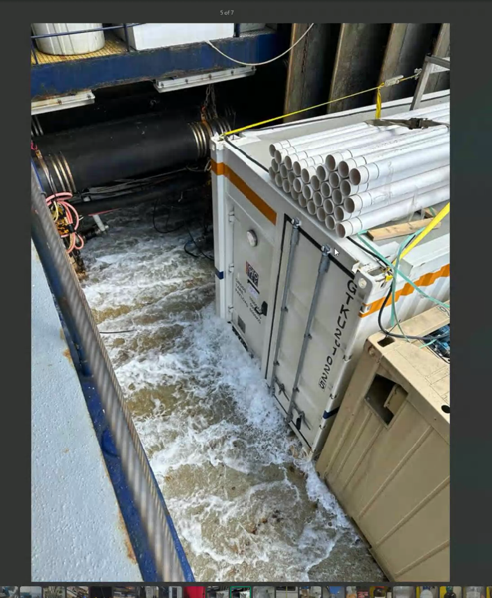
3-4 meter seas

Slide 27
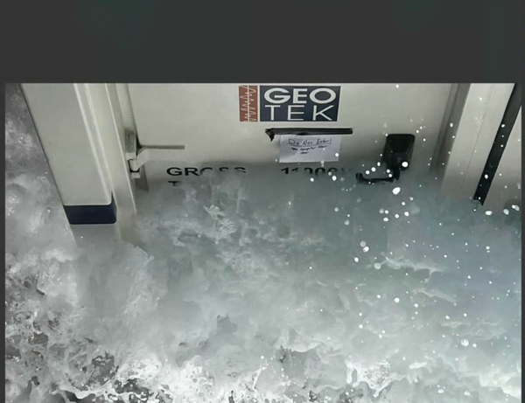

Slide 28
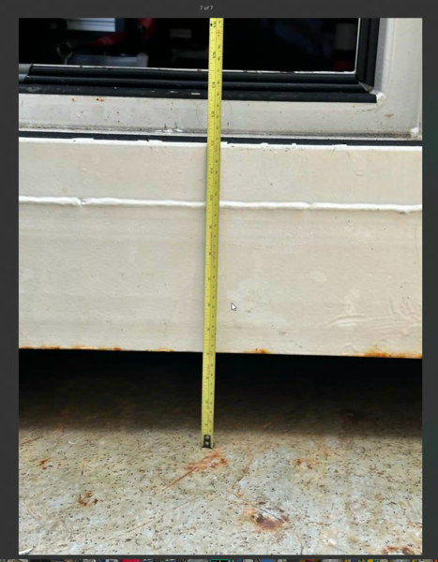

Slide 29
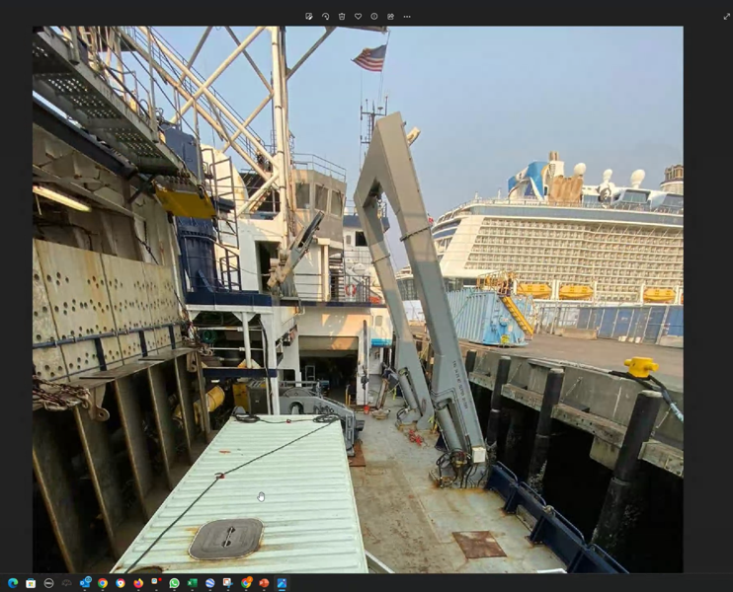

Slide 30
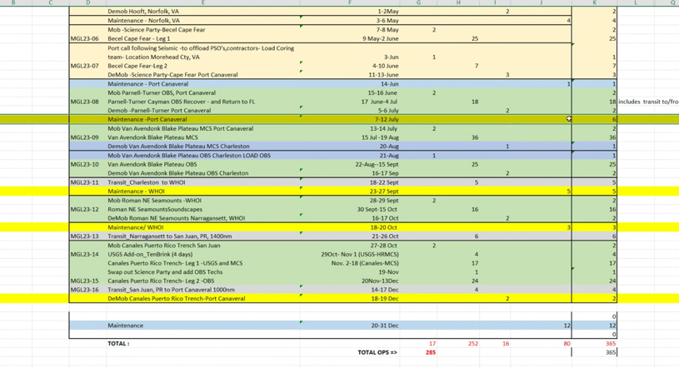
Langseth schedule 2023

Slide 31
