Slide 1
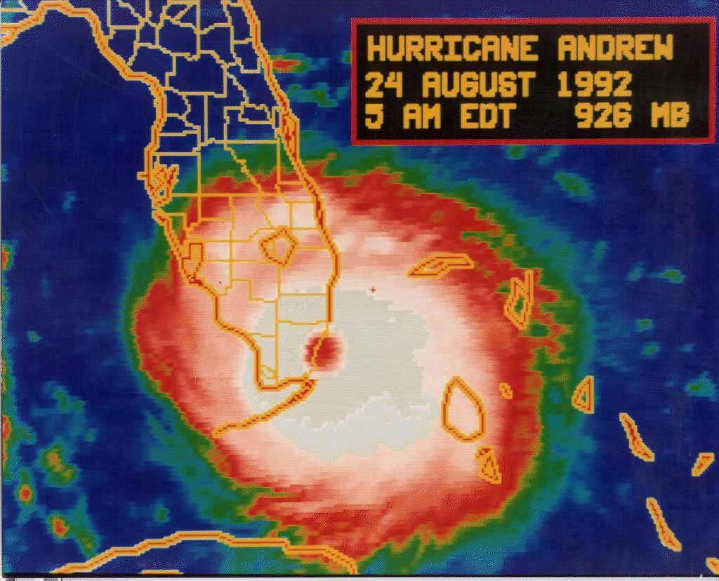
Hurricane Preparedness

Slide 2
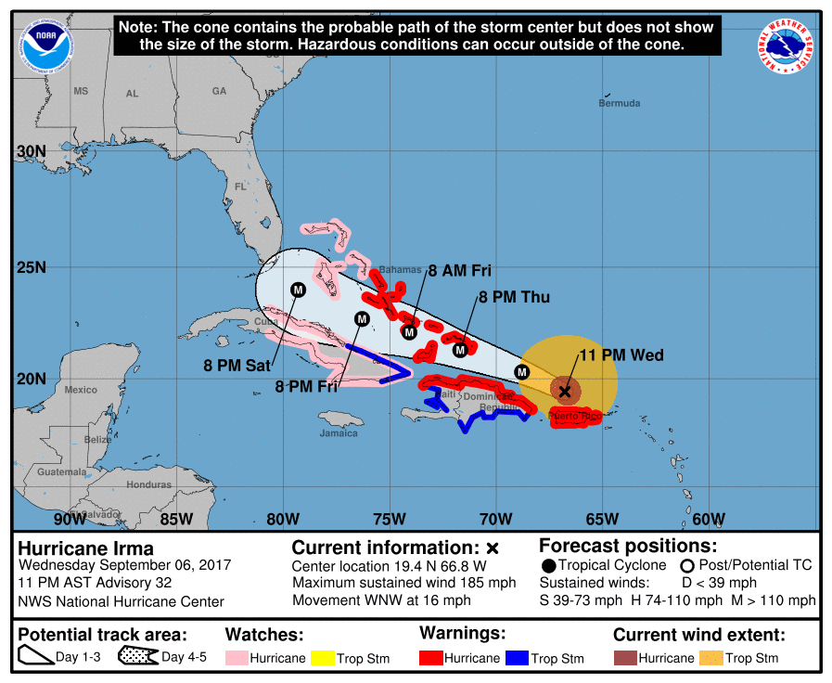
3 Days Before The Storm
It’s 3 days from a potential major hurricane landfall in South Florida.
Are you and your family ready?
Are you ready for the long work days ahead?
Is your home ready?
Do you need to leave?

Slide 3
Rewind!
If you are asking yourself this just a few days before a potential major hurricane landfall in South Florida, you might feel some anxiety and that’s why we are here today!

Slide 4
Luck is the residue of preparation
People
Pets
Prescriptions
Papers
Personal Needs
Property

Slide 5
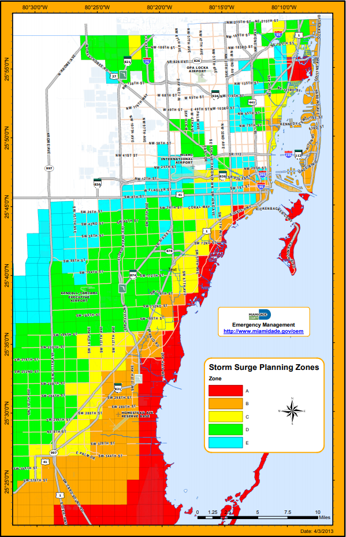
Miami-Dade County
Evacuation Zones
Find your evacuation zone by visiting
http://www.miamidade.gov/fire/evacuation-zones.asp
Notes:
http://www.miamidade.gov/fire/evacuation-zones.asp

Slide 6
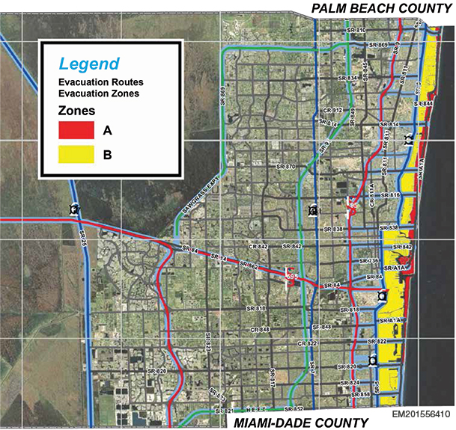
Broward County Evacuation Zones
Find your zone by visiting
http://www.broward.org/Hurricane/Documents/HurricaneEvacMap.pdf

Slide 7
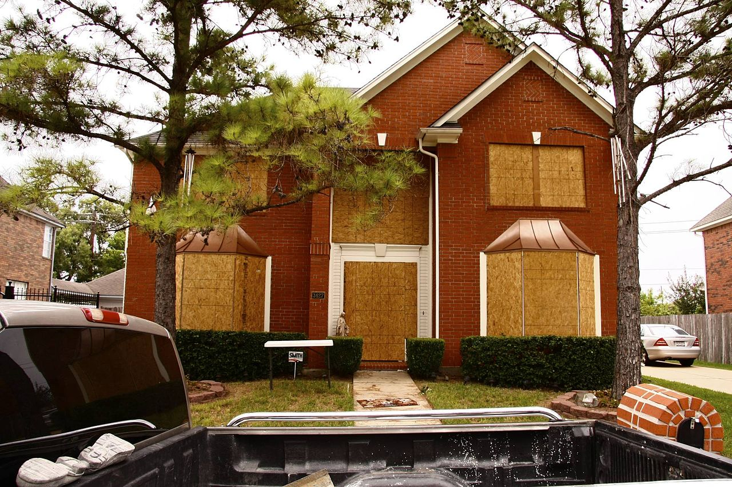
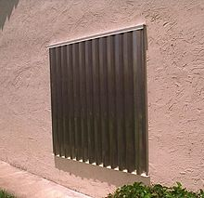
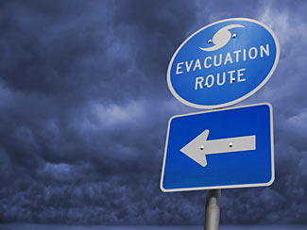
People
Hide from wind, run from water.
Have needed supplies and accomidations for children, disabled and elderly.
Evacuations are stressful -
Know your evacuation zone and plan accordingly.
Know how strong your home is built, some homes in south Florida are built to higher codes than other areas or states.
Use hurricane shutters if possible – have them (or other protection) in place days prior to forecast landfall.

Slide 8
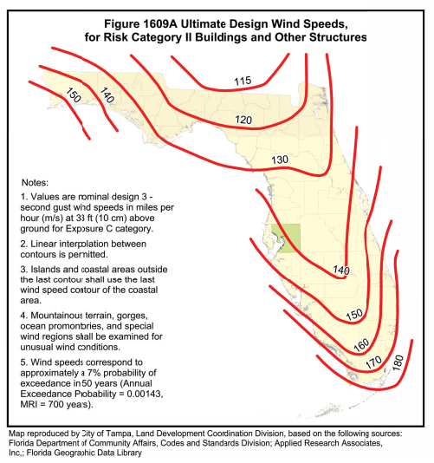
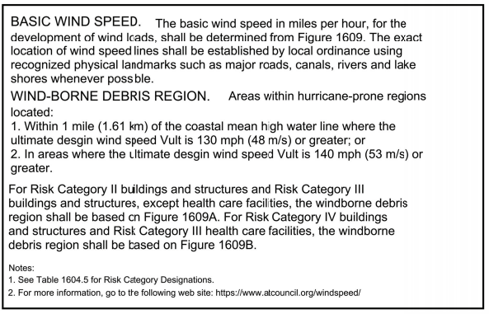
Building codes

Slide 9
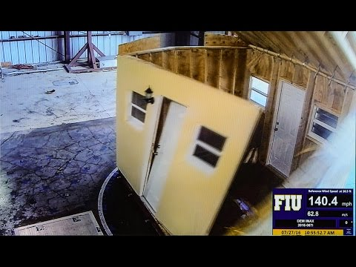
Property
How much time do you need to install shutters or other protective systems?
Focus on windows, doors, garage doors, and any other large openings.
Will you need help from others?
Do you need to transport recreational vehicles to storage?
Do you have relatives or neighbors that need assistance?

Slide 10
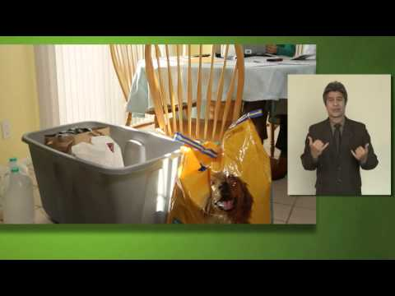
Pets
Where will your pets spend the storm event?
If you evacuate can you take your pet/s
with you? Will the hotel, shelter or
other location accept your pet?
Vaccine records? Will you need these? Will your pet need to be in a crate?
Make sure to bring food, water, medications if needed and clean up materials such as cat litter, plastic bags etc.

Slide 11
Prescriptions
Contact your doctor to make sure you have refills authorized.
Arrange with your pharmacy to have prescriptions refilled before the storm so that you have ample supplies through the storm.

Slide 12
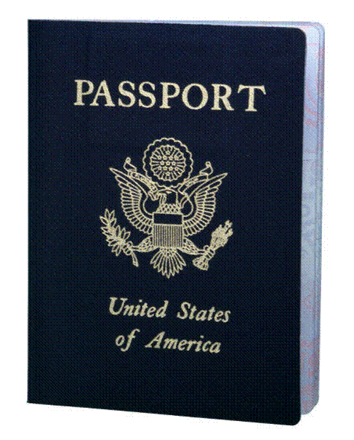
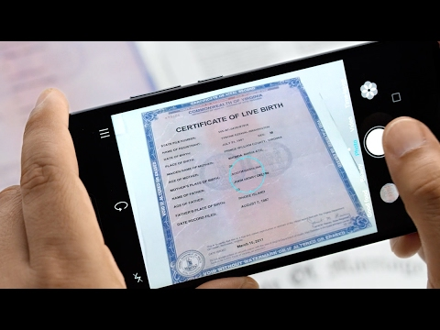
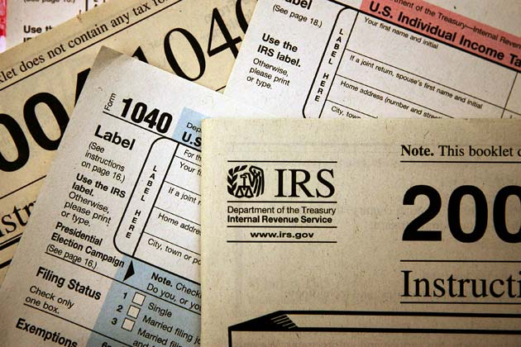
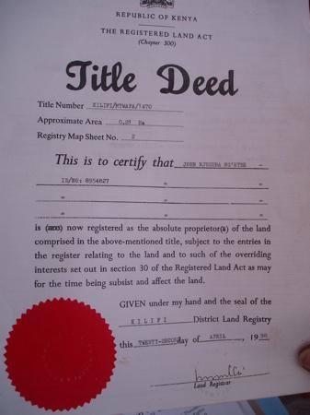
Papers
Consider what important papers you may need should you not be able to return to your home…
Birth & Marriage Certificates
Passports
Social Security Numbers
Drivers license or other personal identification
Insurance documents
Copy of recent bills showing your address and balances
Bank statements
Mortgage papers
Tax documents
Employment information
Wills and deeds
Stocks, bonds and other negotialbe certificates
People and Pet medical records
Contracts

Slide 13
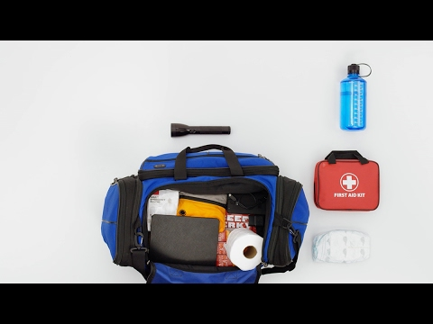
Personal Needs: Create a SIP comfort bag!
SIP = Shelter In Place
Food
Water
Toiletries – shampoo, toothpaste and brush, toilet paper, medical kit etc.
Flashlights
Batteries
Cell phone charger and adaptor
Battery powered radio

Slide 14
The Aftermath
Do you and your family have a plan on a place to stay if you can’t return home?
Do you know how to start an insurance claim?

Slide 15
Some Helpful Websites
Ready.gov Hurricane Checklist
How to Prepare for a Hurricane – FEMA.gov
National Hurricane Center
American Red Cross – Hurricane Saftey
National Weather Service – Hurricane Safety Tips and Resources

