Slide 1
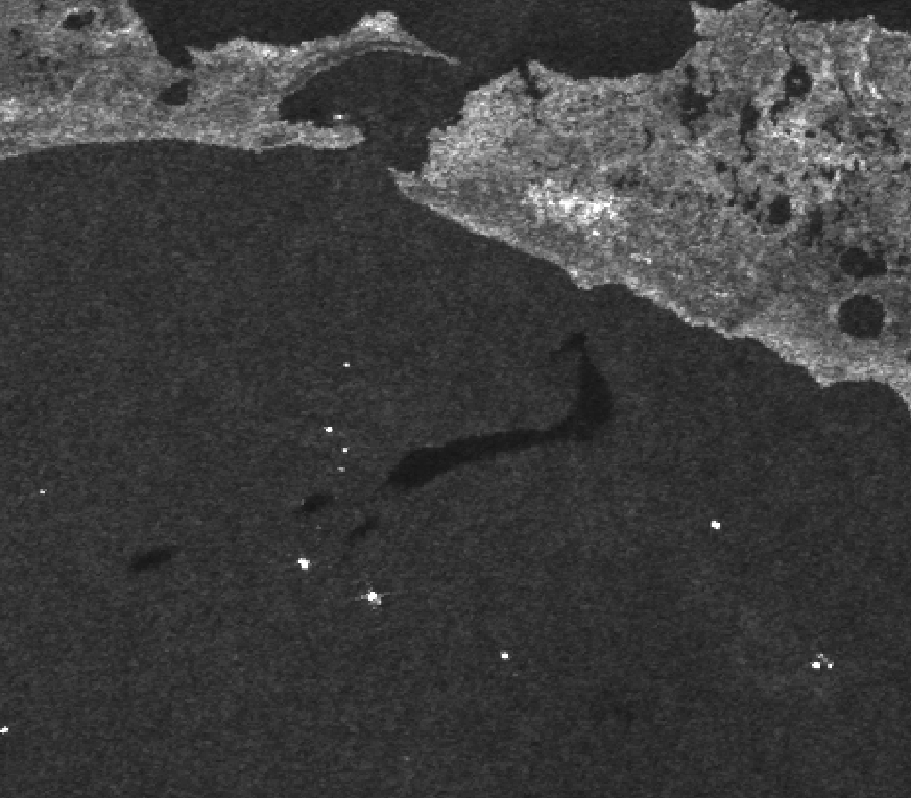
Signatures from Sargassum
Envisat August 8, 2010 04:08: Confirmed by overflights to be sargassum.

Slide 2
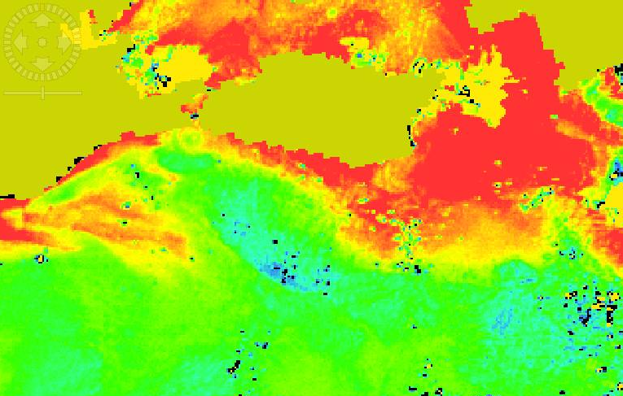
??
Distance between these 2 features: ~10 miles
Time difference: 12h 20 min
MERIS MCI August 8, 2010 16:28
Notes:
MCI is high in “red tide” conditions (intense, visible, surface plankton blooms) and also when aquatic vegetation is present.

Slide 3
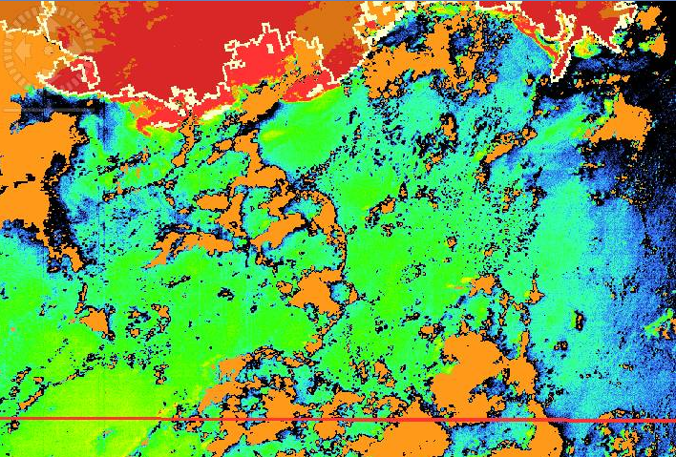
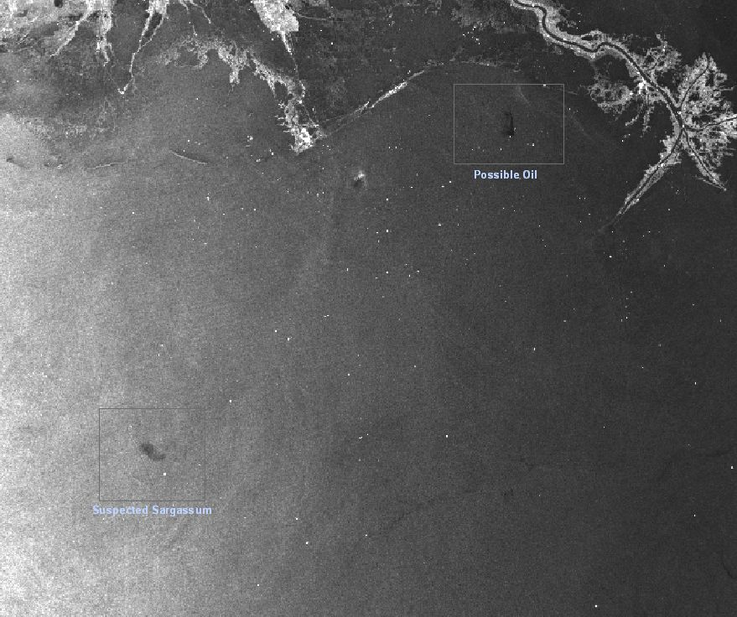
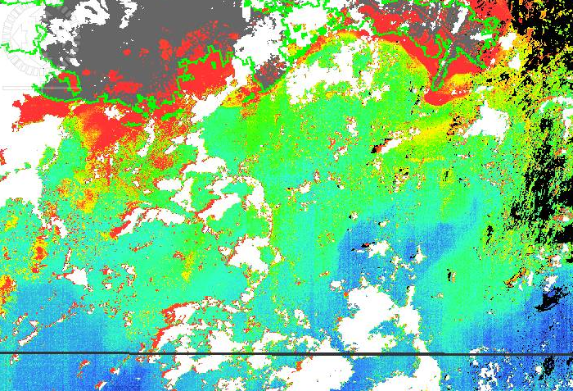
MCI
Yellow Substance
??
August 18, 2010
Notes:
MCI is high in “red tide” conditions (intense, visible, surface plankton blooms) and also when aquatic vegetation is present.

Slide 4
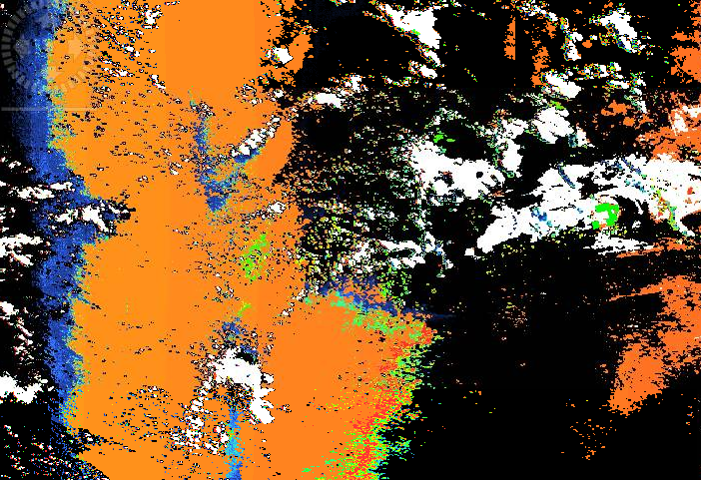
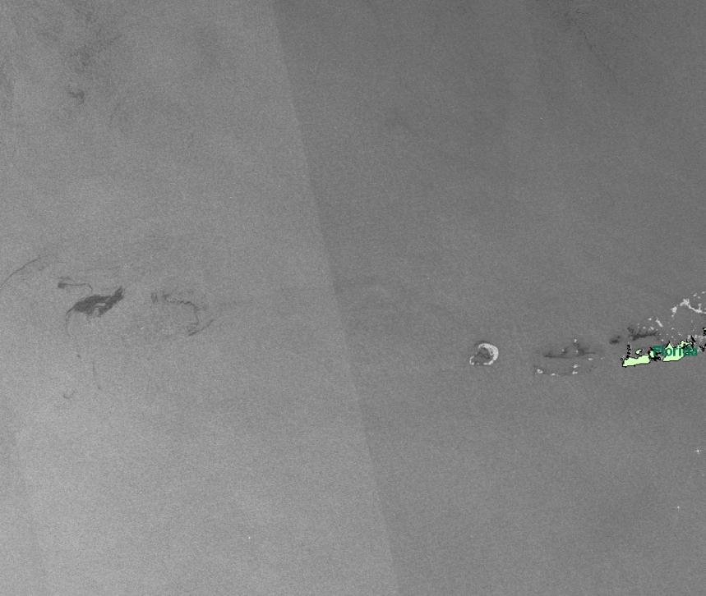
Yellow Substance (Sunglint region-low confidence)
??
We would need:
more concurrent (SAR&VISIBLE) passes
In-situ data and metadata (e.g. currents)
August 6, 2010
Notes:
MCI is high in “red tide” conditions (intense, visible, surface plankton blooms) and also when aquatic vegetation is present.

