Slide 1
NOAA ocean observations to improve hurricane intensity forecasts
Prepared by Gustavo Goni and Rick Lumpkin
National Oceanic and Atmospheric Administration
Atlantic Oceanographic and Meteorological Laboratory
Miami, Florida
Partners: Scripps Institution of Oceanography, University of Miami, University of Puerto Rico Mayaguez, CARICOOS, ANAMAR (Dominican Republic), Island School (Bahamas), OCOVI/USVI, Rutgers University, IOOS, …
IOCARIBBE MEETING,
Aruba
May 2019

Slide 2
Ocean Field Observations in place
Profiling floats
Underwater gliders
Expendable BathyThermographs
Surface drifters
Moorings
Ships of Opportunity
Voluntary Observing Ships

Slide 3
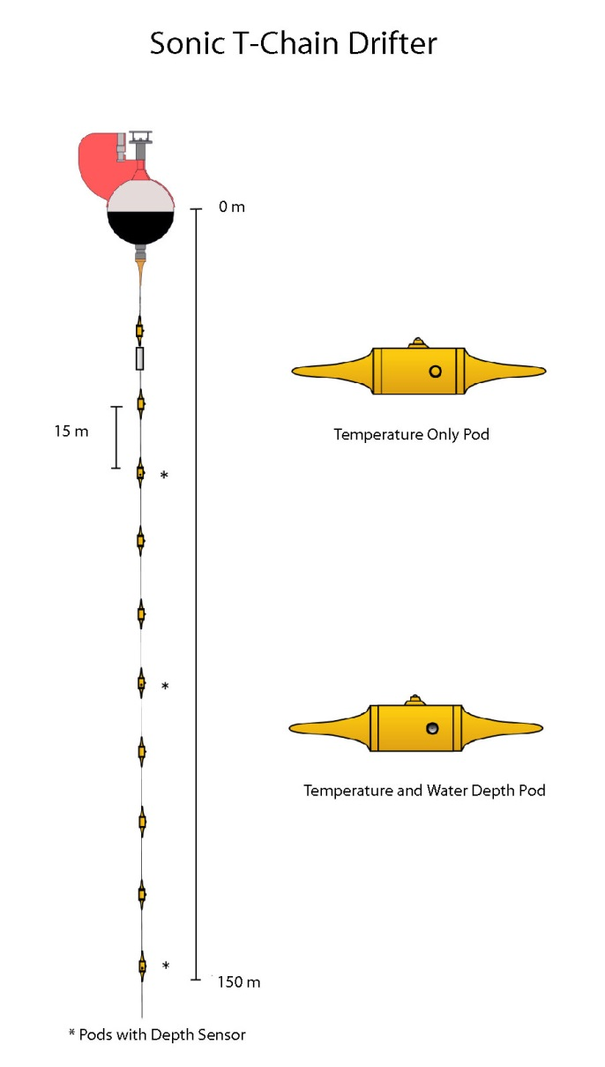
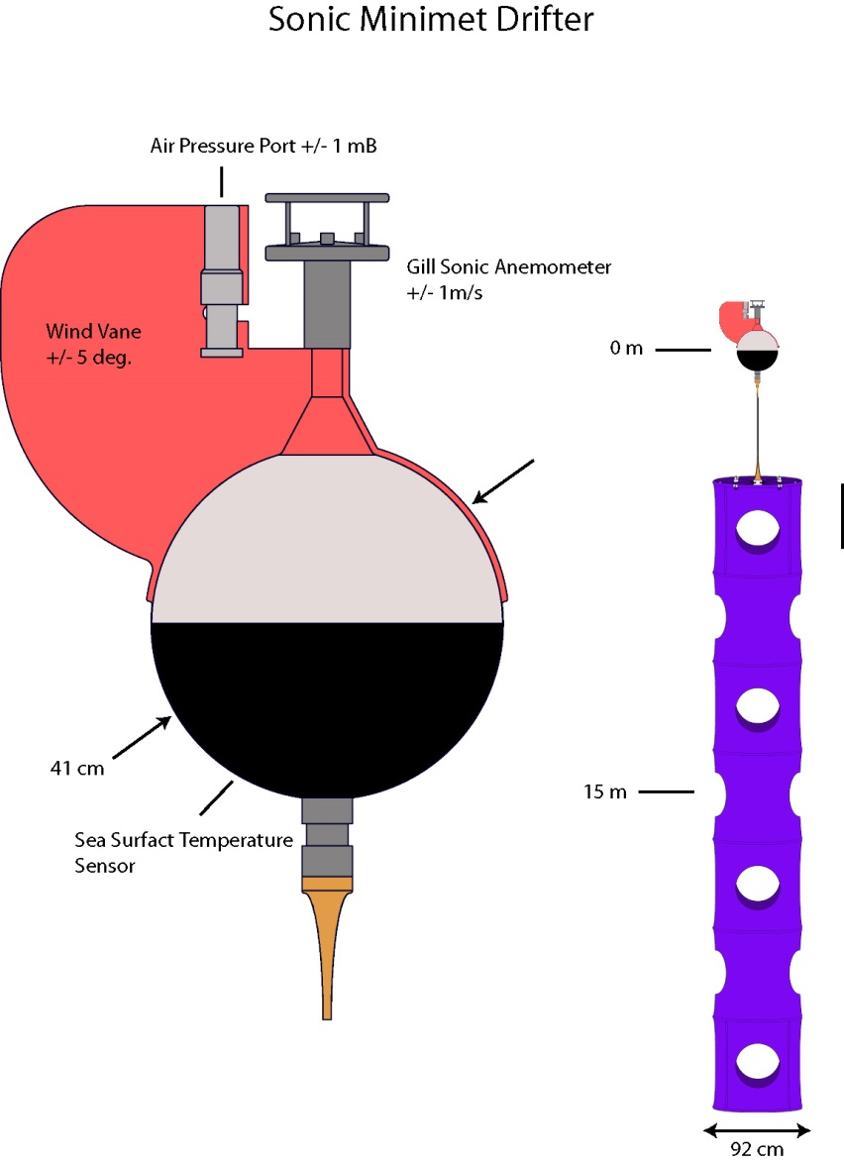
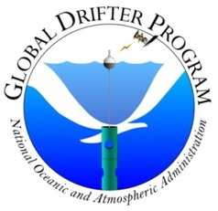
Targeted observations: Hurricane Drifters
Drifters measure surface and subsurface temperature, wind speed and direction, air pressure, ocean currents, and directional wave spectra.
Notes:
Minimet: approx. $5k each ?
Thermistor chain: $14.9k each.

Slide 4
Deployments coordinated via CARCAH, conducted by 53rd Reconnaissance Squadron “Hurricane Hunters” C-130Js

Slide 5
Left: deployments in the path of category 5 Hurricane Dean (2007).
Below: surface winds and SST (top layer) and temperatures at 100m depth (bottom layer) in a frame of reference moving with the storm.

Slide 6
Hurricane gliders
Gliders measure upper ocean temperature, salinity , chlorophyll, dissolved oxygen, and currents.
Notes:
Minimet: approx. $5k each ?
Thermistor chain: $14.9k each.

Slide 7
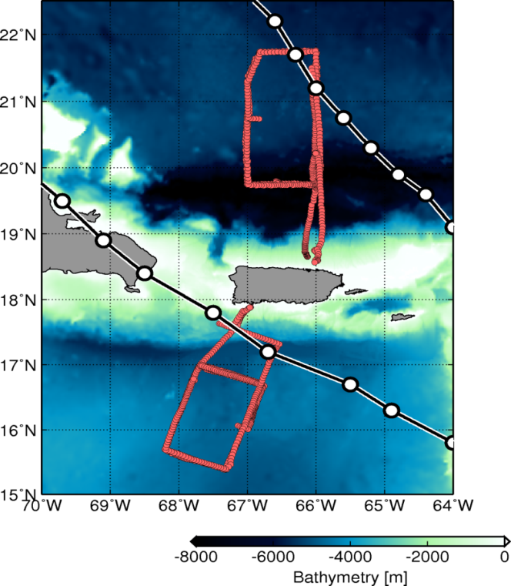
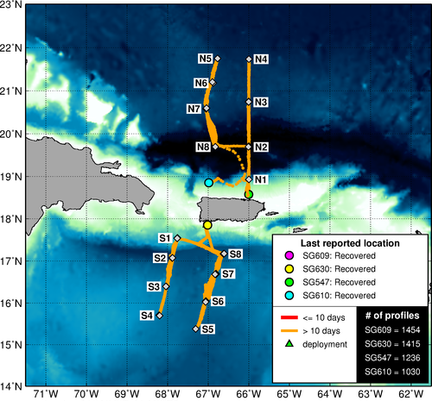
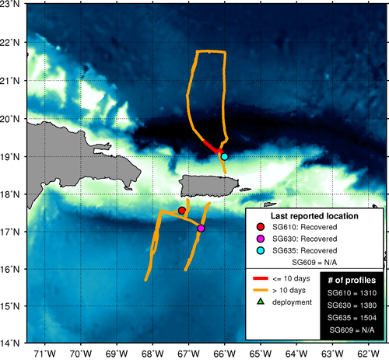
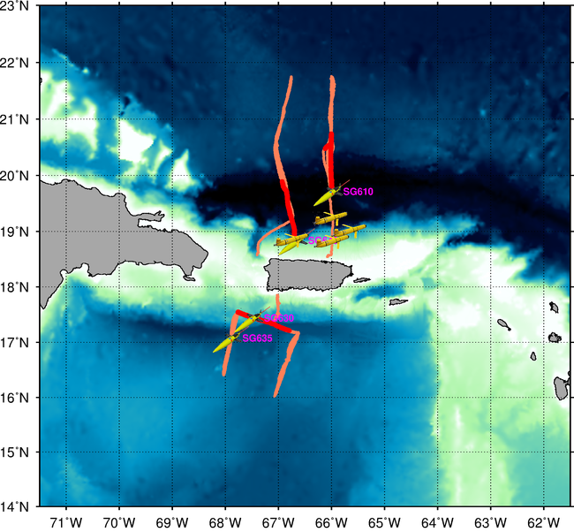
First dedicated glider network started in 2014 off the coast of Puerto Rico.
2014 hurricane season
2015
2016
Hurricane Gonzalo
(October, 2014)
2017
2018
TS Bertha
(August, 2014)
Glider Technology for Sustained Oceanic Observations, Lima, November 2017

Slide 8
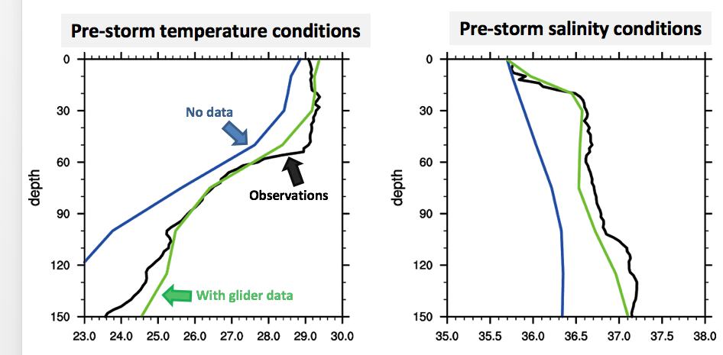
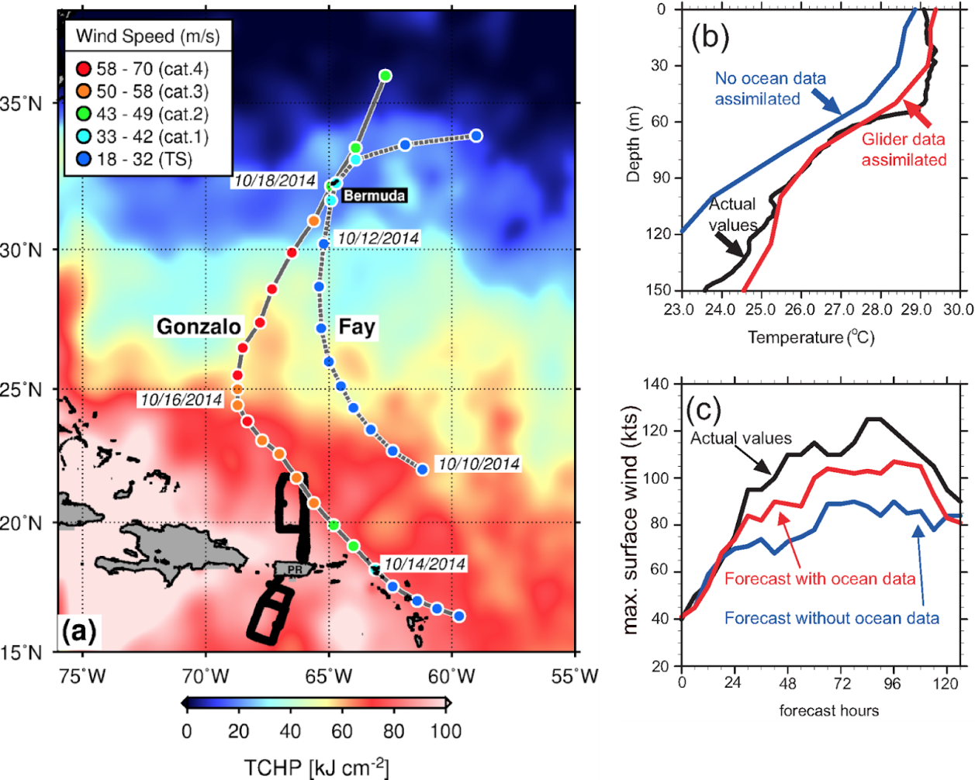
Can glider data improve forecasts? Hurricane Gonzalo (2014)
Use of underwater glider data along with other ocean observations reduced the error on Hurricane Gonzalo intensity forecast by approximately 50% using the next generation NOAA operational model.
The barrier layer* is only represented in numerical model fields when glider data are assimilated. *=low salinity warm layer, very difficult to mix with colder subsurface waters, allows for intensification
Glider Technology for Sustained Oceanic Observations, Lima, November 2017

Slide 9
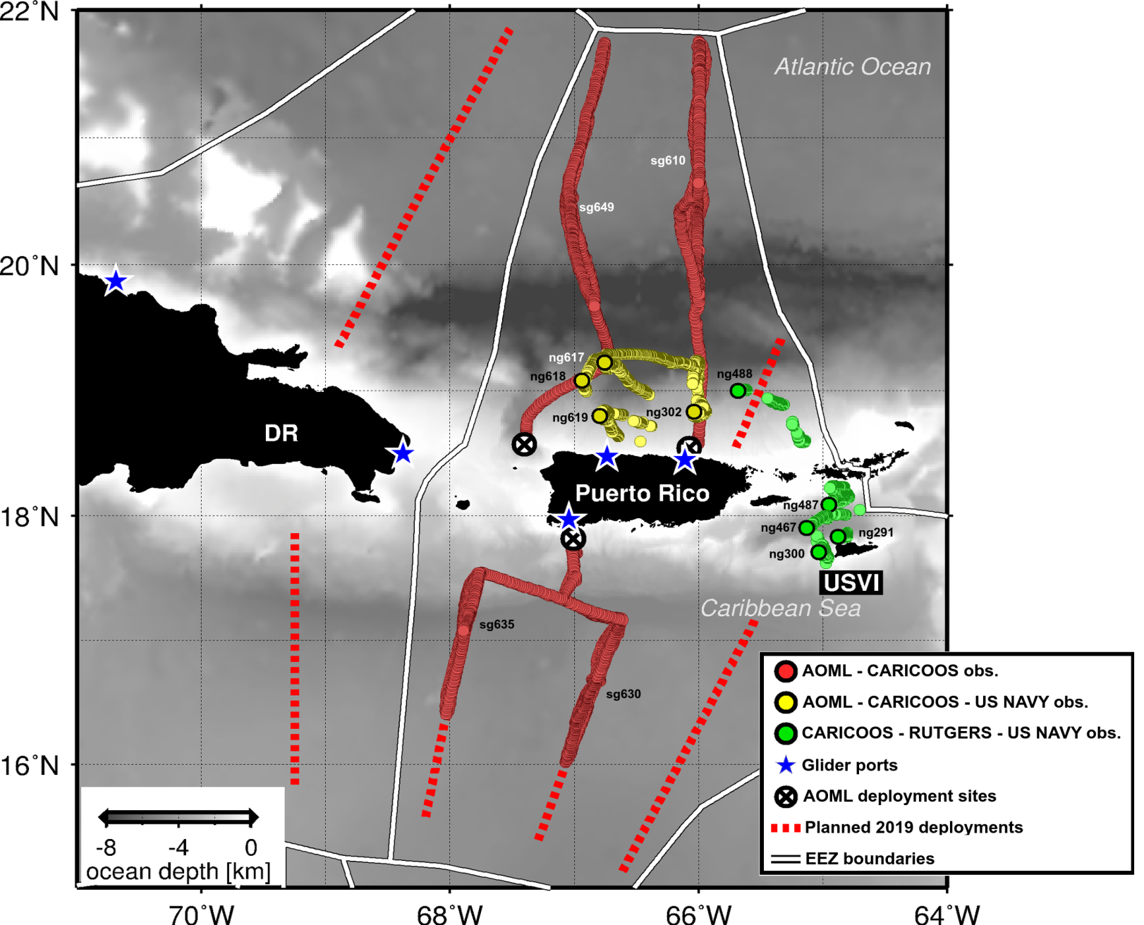
2018 NOAA and US Navy Glider observations in the tropical Atlantic and Caribbean Sea
Participant institutions:
NOAA/AOML, Miami
U.S. Navy
University of Miami
University of Puerto Rico
CARICOOS
OCOVI, USVI
Rutgers University
99% of ocean profile observations in this regions were provided by gliders during 2018

Slide 10
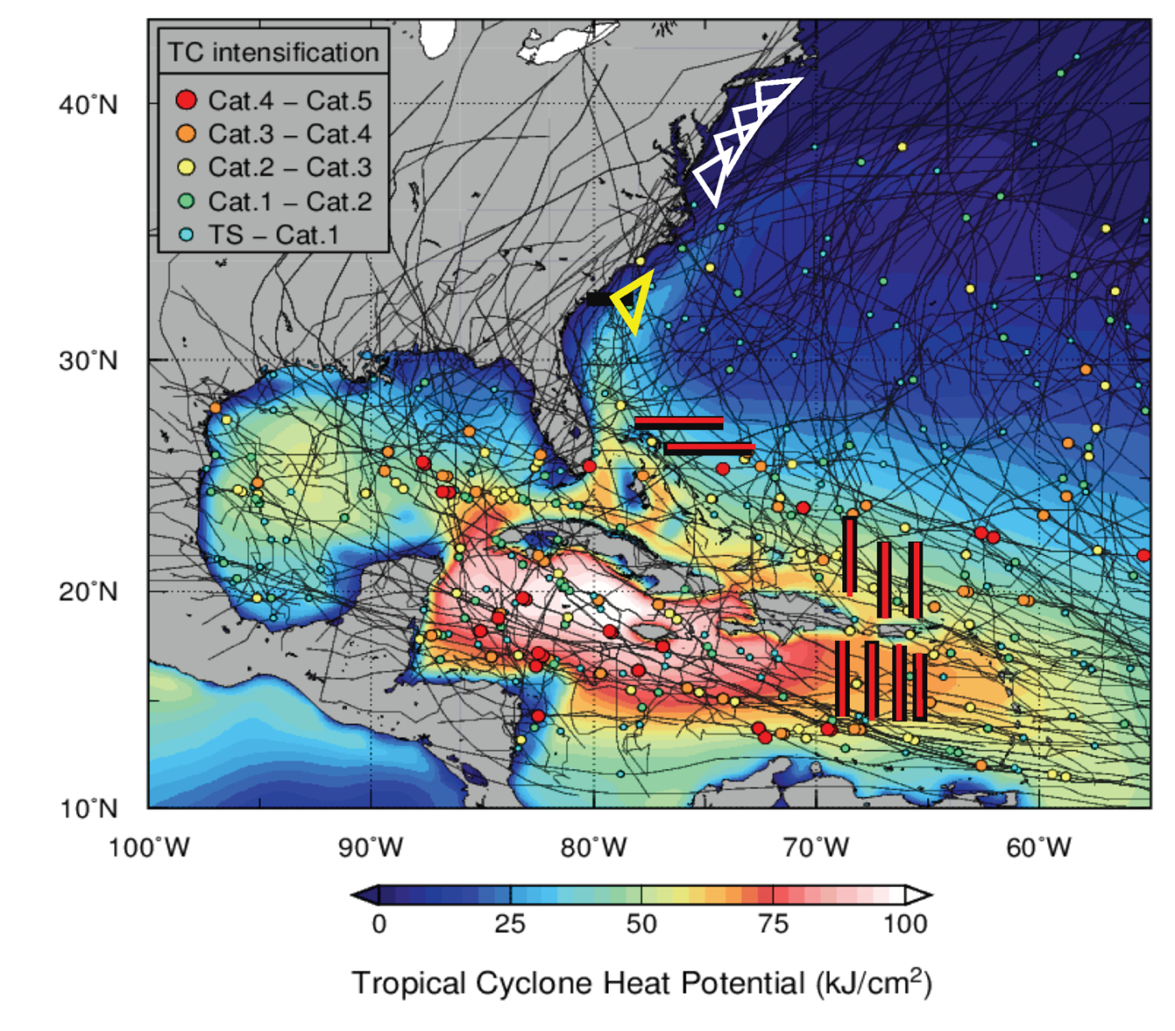
2019: A Picket line of hurricane gliders for Atlantic Hurricane Intensity Forecasts NOAA/AOML, US Navy, IOOS, Rutgers U, U of Miami, CARICOOS, MARACOOS, SECORA, ANAMAR (Dominican Republic), CEI (Bahamas), OCOVI/USVI
Through the US Hurricane Supplemental Funding, NOAA (Gustavo Goni, Lead PI) will support an enhance effort that will include > 30 gliders in the Atlantic, Caribbean Sea, and Gulf of Mexico, in support of hurricane intensity forecasts.
Orange circles indicate where US Navy gliders may be deployed.

Slide 11
Summary
This is the first international effort geared towards implementing an ocean observing system to improve Atlantic hurricane intensity forecasts
Appropriate ocean monitoring is key for hurricane intensity forecasts. What type of ocean observations do we need ?
Resolve mesoscale features
Collect T and S profiles in the upper 100’s meters (warm rings, barrier layers, …)
Observations implemented beginning of hurricane season in survey regions
Transmission in RT for data assimilation into forecast models
Plans and Needs
This is an international effort
This effort is involved and is supported by government, academic, and private industry institutions
This effort also assesses the value of observations to evaluate error reduction in numerical models
Please contact Gustavo.Goni@noaa.gov with questions.

