Slide 1


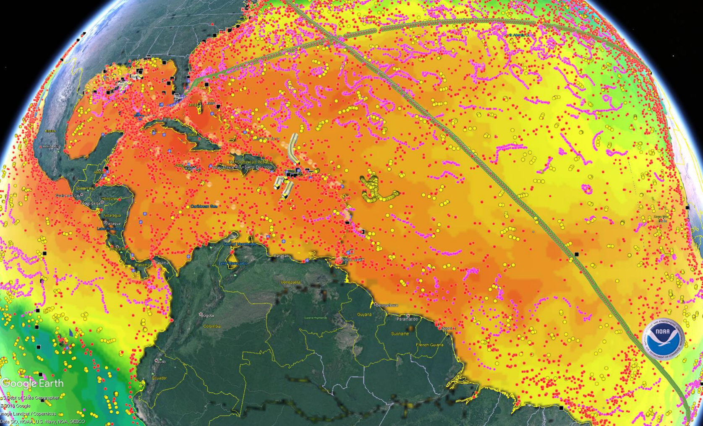

National Oceanic and Atmospheric Administration
Atlantic Oceanographic and Meteorological Laboratory
Physical Oceanography Division – PHOD
Miami, FL
If You Like Your Weather Forecast, Thank an Oceanographer
The Physical Oceanography Division at NOAA/AOML designs, implements, and maintains key components of the global ocean observing system. These ocean observations are a crucial component for weather and climate forecasts and outlooks.
Variables that are typically observed are:
Temperature and heat content
Ocean currents, eddies, and frontal regions
Salinity, Surface pressure, and Meridional heat transport, and volume transport.
Without ocean observations, which provide initial and boundary conditions, weather forecasts would have large errors even at short 12-hours forecasts.
XBT
Drifters
Marine Met. Obs.
Argo
Gliders
NOAA’s ICON.
TSG
Moorings
An example of how ocean observations help predicting high-impact weather is the case of explosive cyclogenesis associated with Nor'easter storms. On March 21st , 2018, the winter storm Toby intensified over the warm Gulf Stream and dumped record-setting snowfall in the Northeast.
Relative number of observations
Relative impact in forecast skill
Sea surface temperature (color), 850mb geopotential height (contour) and rain+snow (green hatching)
Recent studies have shown that ocean in-situ observations in the Atlantic Ocean improve the forecast of Nor’easters more than any other observing platforms, including satellites.
Satellites Scatterometer Surface Aircraft Ocean Obs.
Source: Horanyi et al. 2017
PDF of this poster
References:
Centurioni, L., Horányi, A., Cardinali, C., Charpentier, E. and Lumpkin, R., 2017. A global ocean observing system for measuring sea level atmospheric pressure: Effects and impacts on numerical weather prediction. Bulletin of the American Meteorological Society, 98(2), pp.231-238.
Horányi, A., Cardinali, C. and Centurioni, L., 2017. The global numerical weather prediction impact of mean‐sea‐level pressure observations from drifting buoys. Quarterly Journal of the Royal Meteorological Society, 143(703), pp.974-985.

