Slide 1
Evidence coastal sea level changes along the east coast of United States associated with the Florida Current transport and heat content using satellite altimetry and hydrographic observations
Ricardo Domingues^{1,2}
Gustavo Goni²
Molly Baringer²
Denis Volkov^{1,2}
¹ University of Miami, Cooperative Institute for Marine and Atmospheric Studies - CIMAS, Miami, Florida, USA
² NOAA Atlantic Oceanographic and Meteorological Laboratory - AOML, Miami, Florida, USA
Ricardo.Domingues@noaa.gov

Slide 2
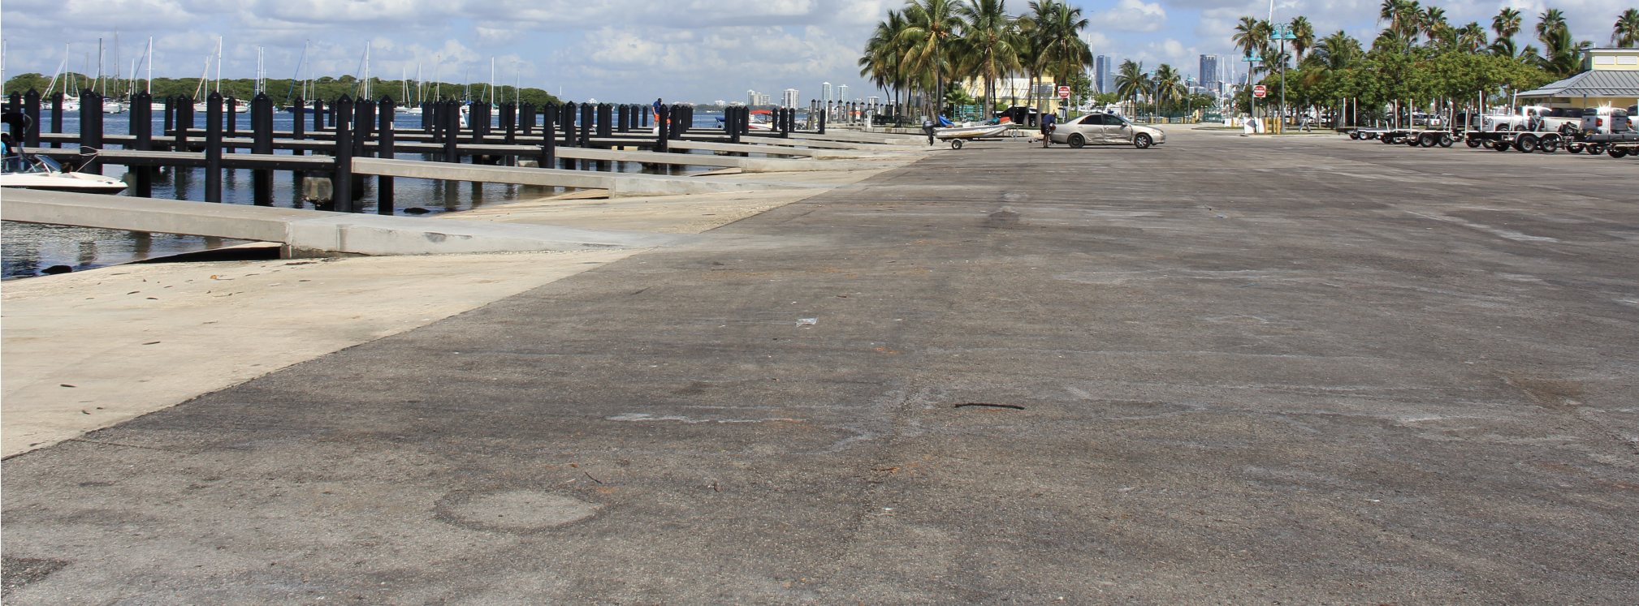
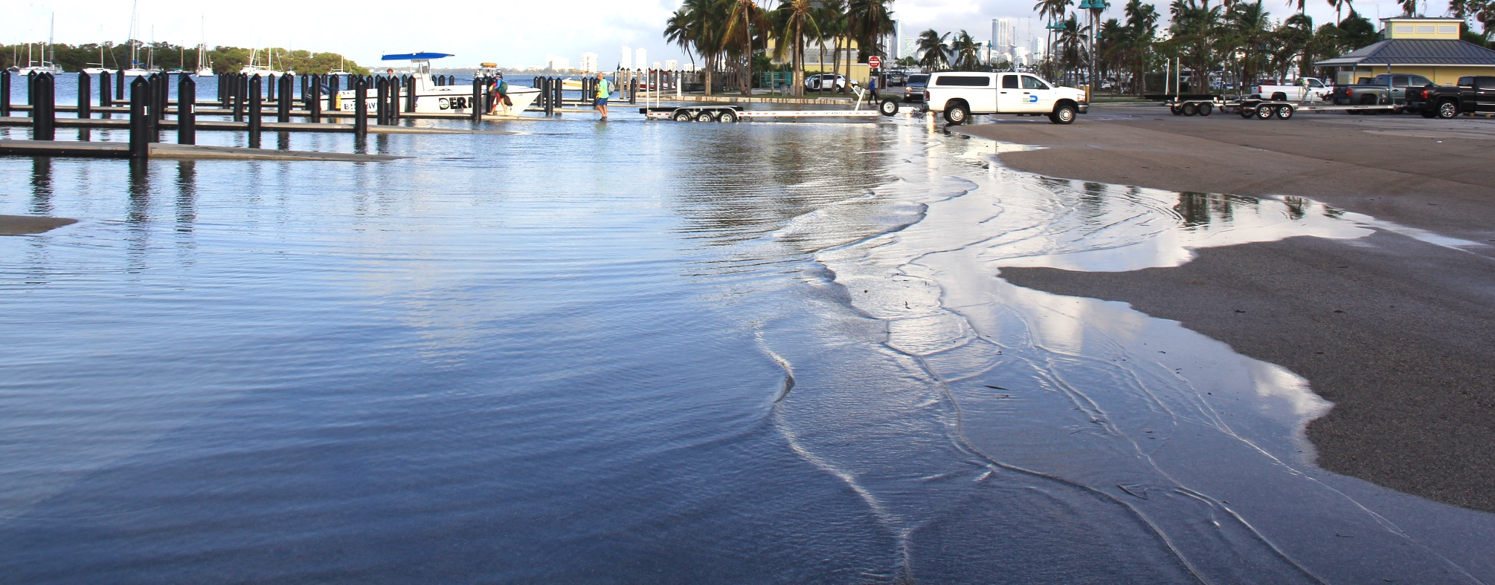
High-tide Flooding Events in Miami
Low tide – normal conditions
King tide – October 6, 2017
Credit: Grant Rawson (NOAA/AOML)

Slide 3
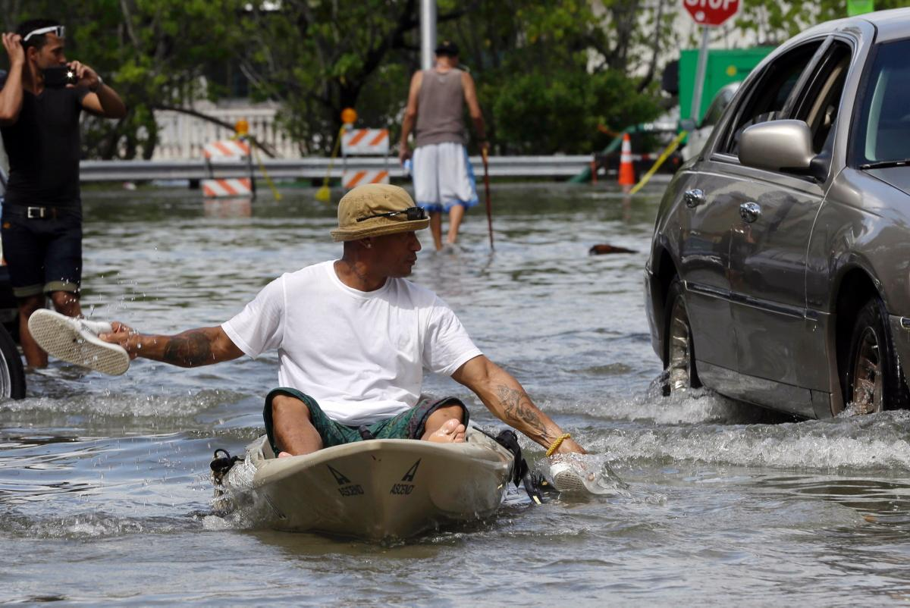
High-tide Flooding Events in Miami: September-October 2015
Credit: Miami New Times
Credit: New York Times
Estimated return period of 6 years (Sweet et al., 2016)

Slide 4
High-tide Flooding Events in Miami: September-October 2015
2015
King Tides
2006-2017
Astronomical tides
Monthly sea-level observed in Miami
(NOAA/NOS Virginia Key Tide Gauge)
1995-2005
J F M A M J J A S O N D

Slide 5
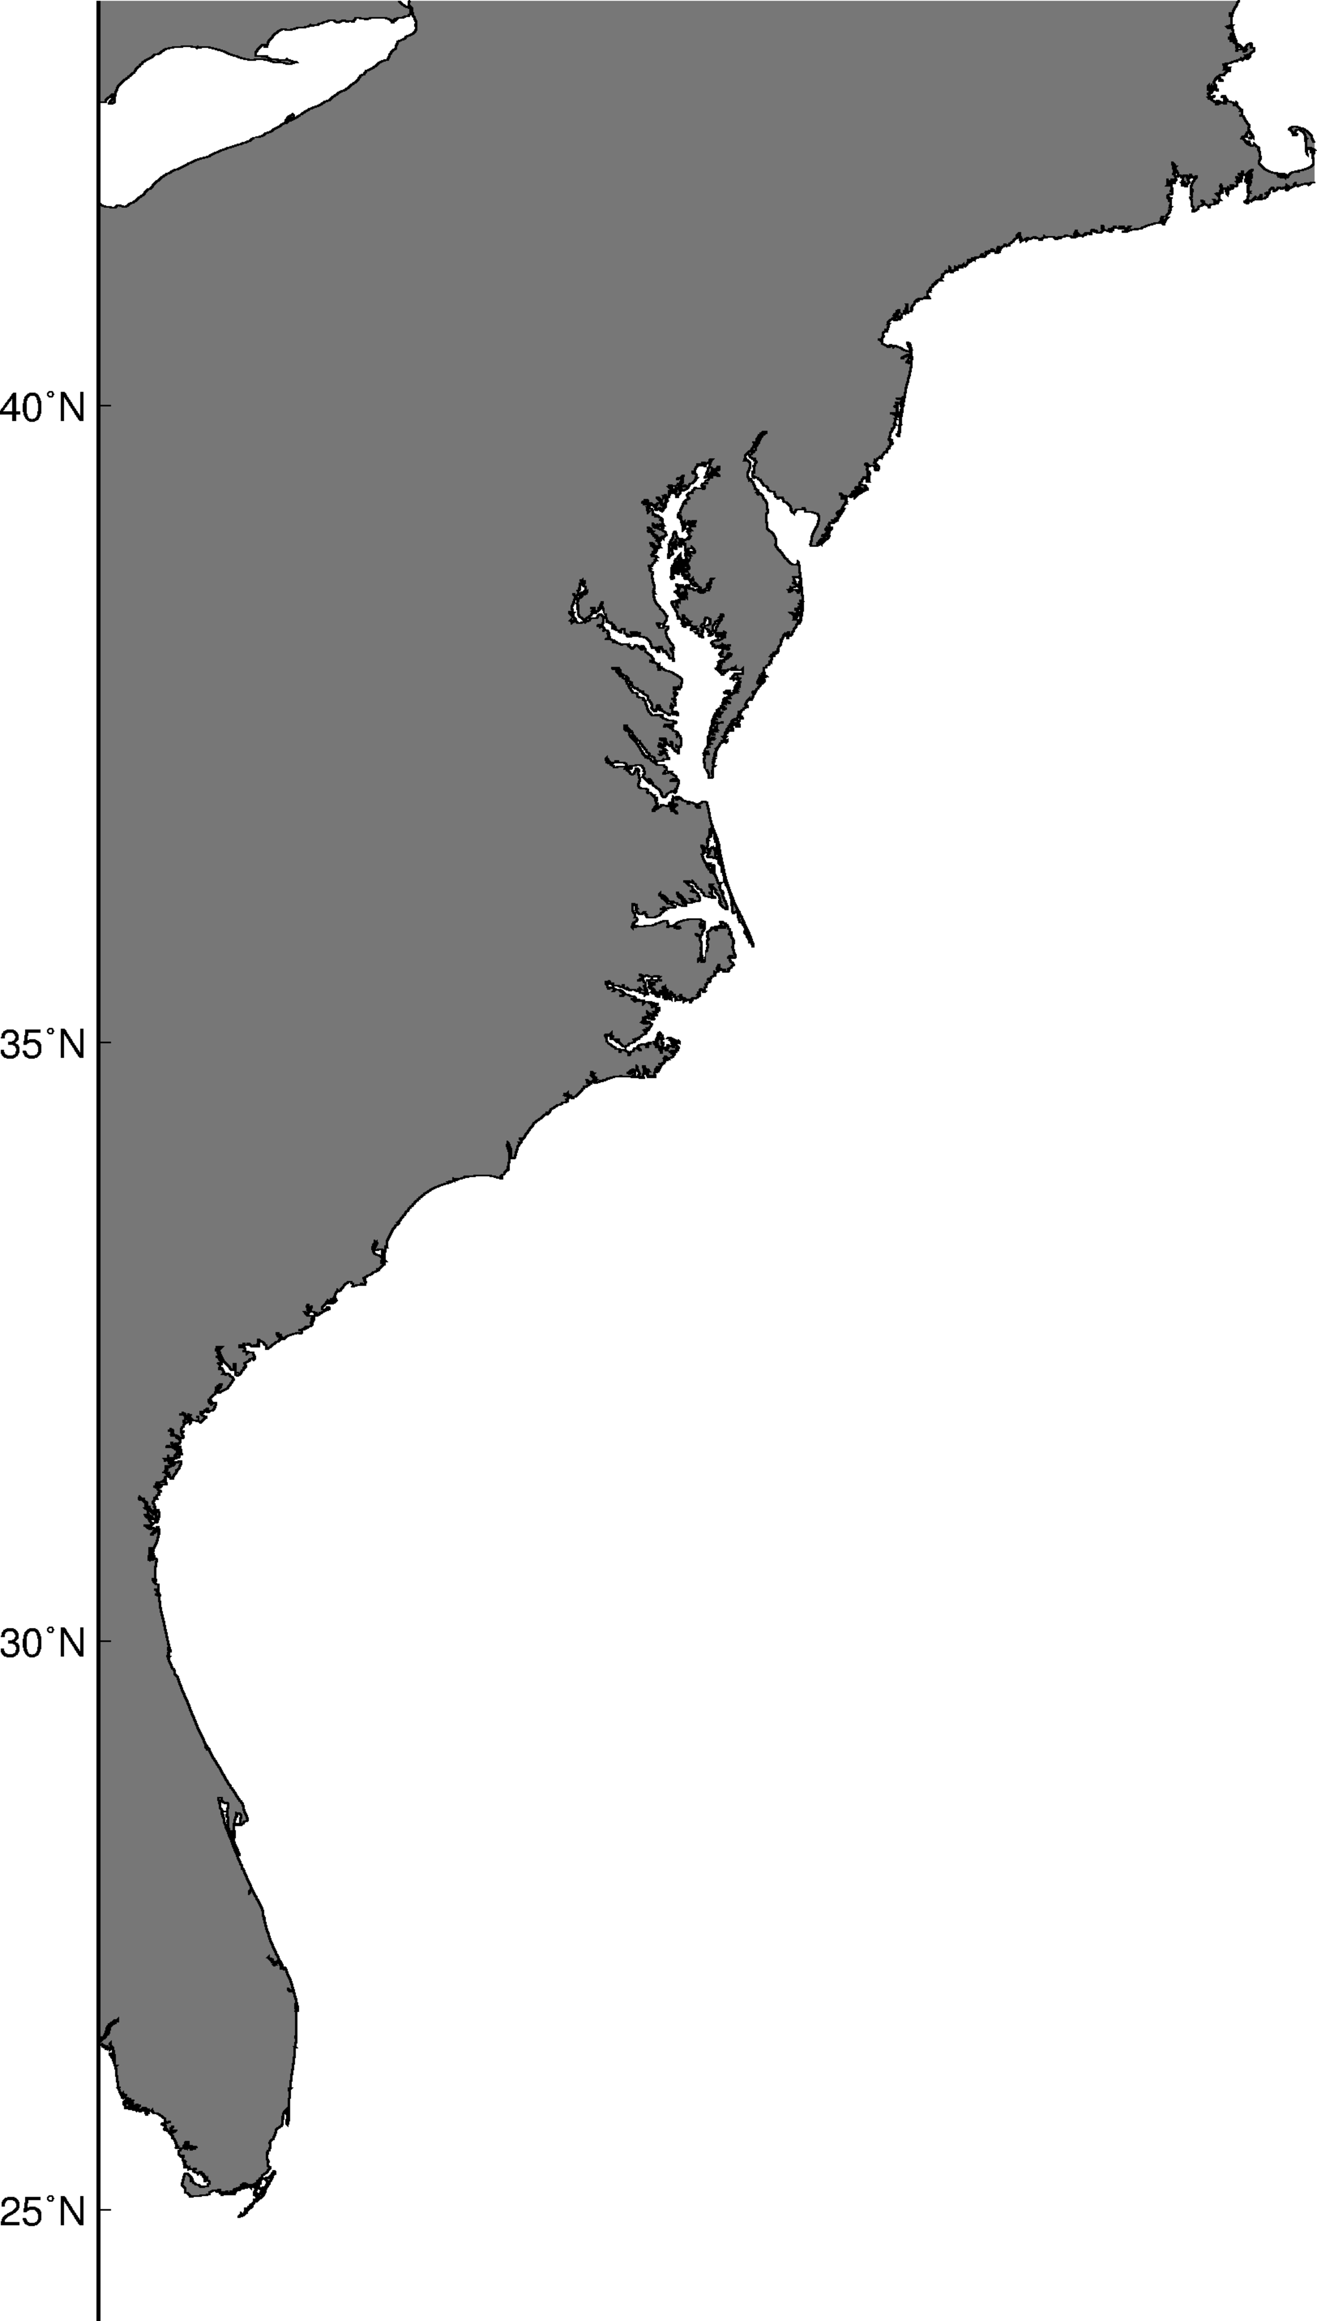
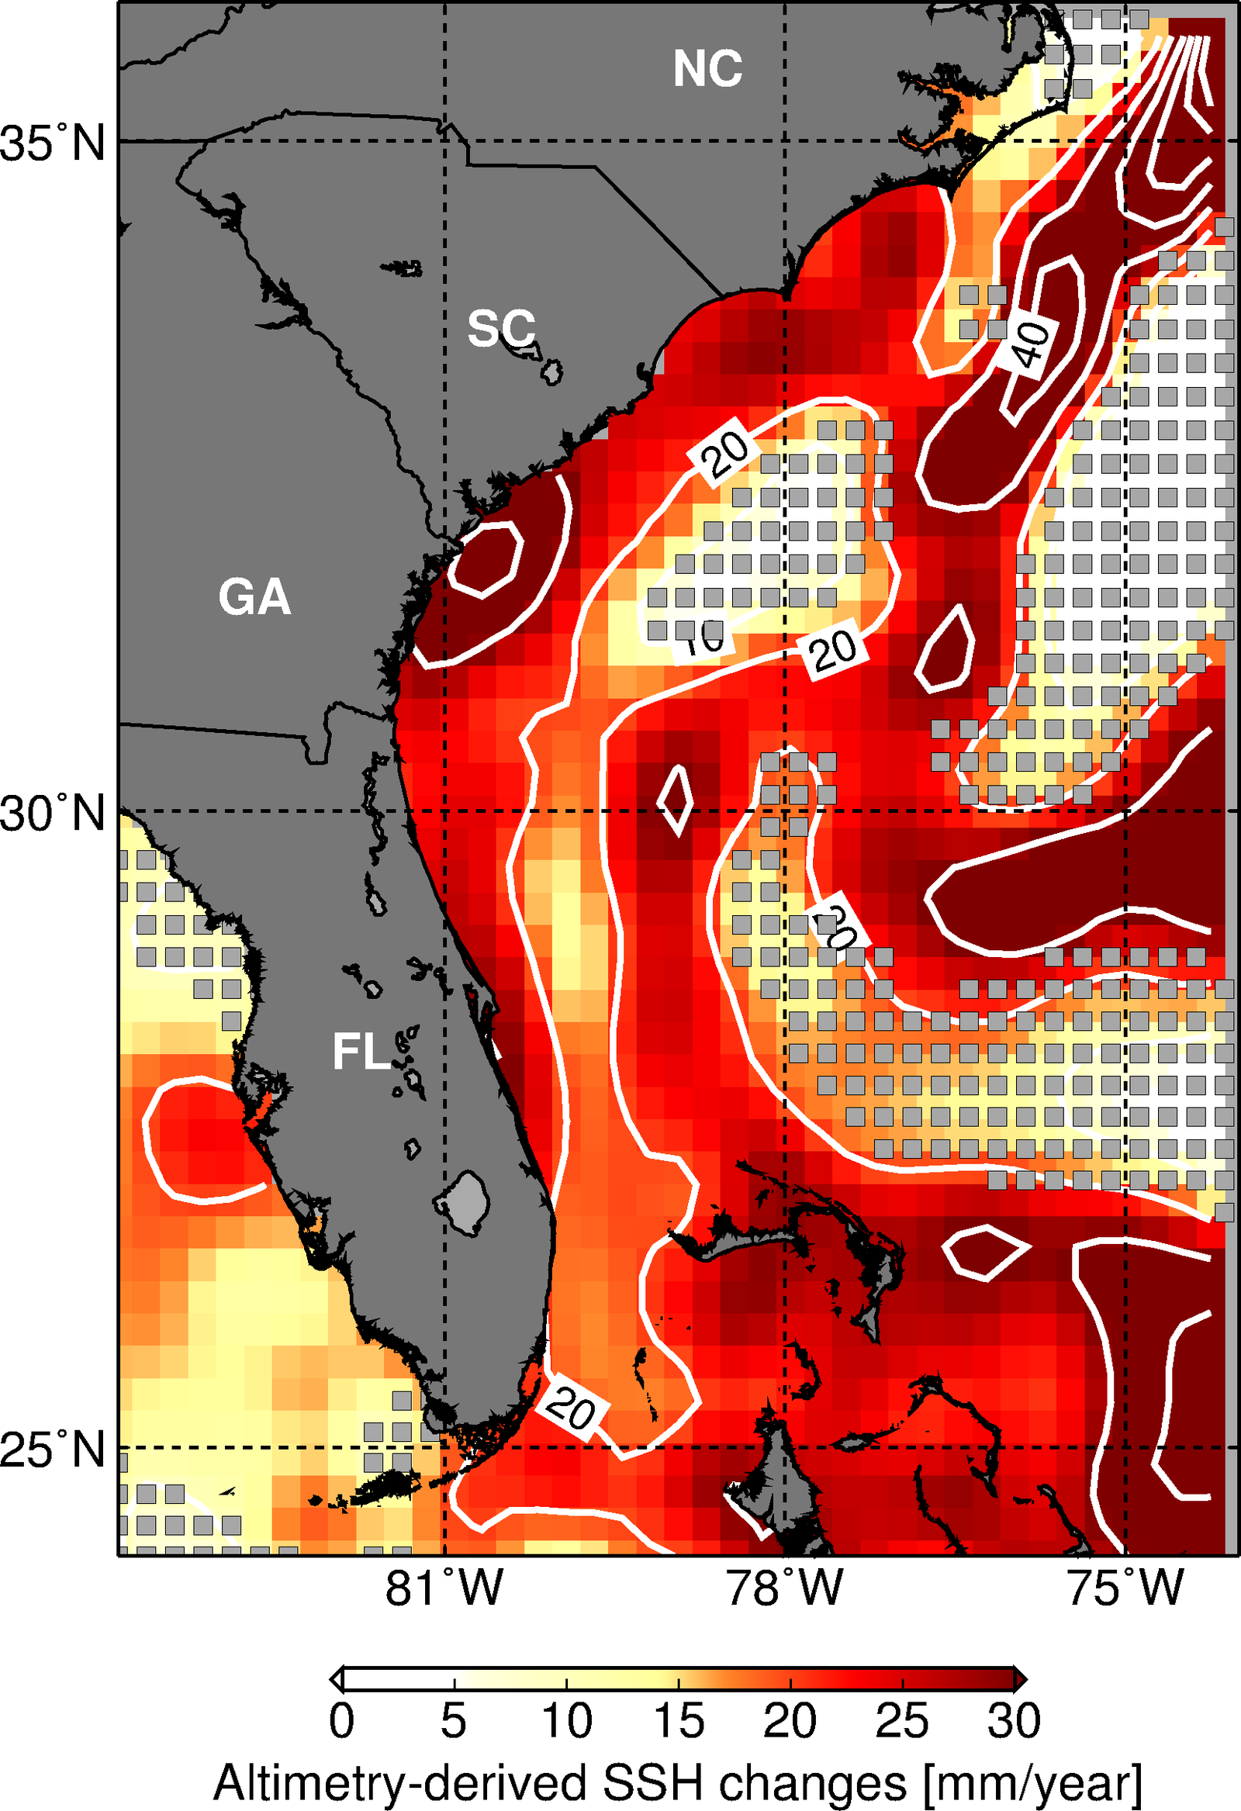
Sea Level Changes Along U.S. East Coast
Tide Gauges
Satellite-Altimetry: 2010-2015
entire record
2010-2015
16.8
17.7
3.9
10.0
3.9
19.6
3.5
18.6
Recent accelerated sea-level changes along U.S. east coast has been attributed to changes in the ENSO and NAO (Valle‐Levinson et al., 2017)
4.0
20.1
4.2
20.7
2.5
22.4
Latitude
5.0
25.5
Miami
Miami
4.9
17.4
4.6
15.1

Slide 6
Sources of Sea Level Changes
$Obs. SL= \overline{SL}+ ∆{SL}_{tides}+∆{SL}_{waves}+ ∆{SL}_{weather}$ + $∆{SL}_{land}$ $+ ∆{SL}_{GL}$
$$+ ∆{SL}_{Ocean Currents}$$
$\overline{SL}$ mean sea level
$∆{SL}_{tides}$ effect of astronomical tides
$∆{SL}_{waves}$ local effect of waves
$∆{SL}_{weather}$ effect of local winds and atm. pressure changes
$∆{SL}_{land}$ effect of land subsidence
$∆{SL}_{GL}$ effect of global changes in ocean mass and density
$∆{SL}_{Ocean Currents}$ effect of Ocean Currents in sea level changes

Slide 7
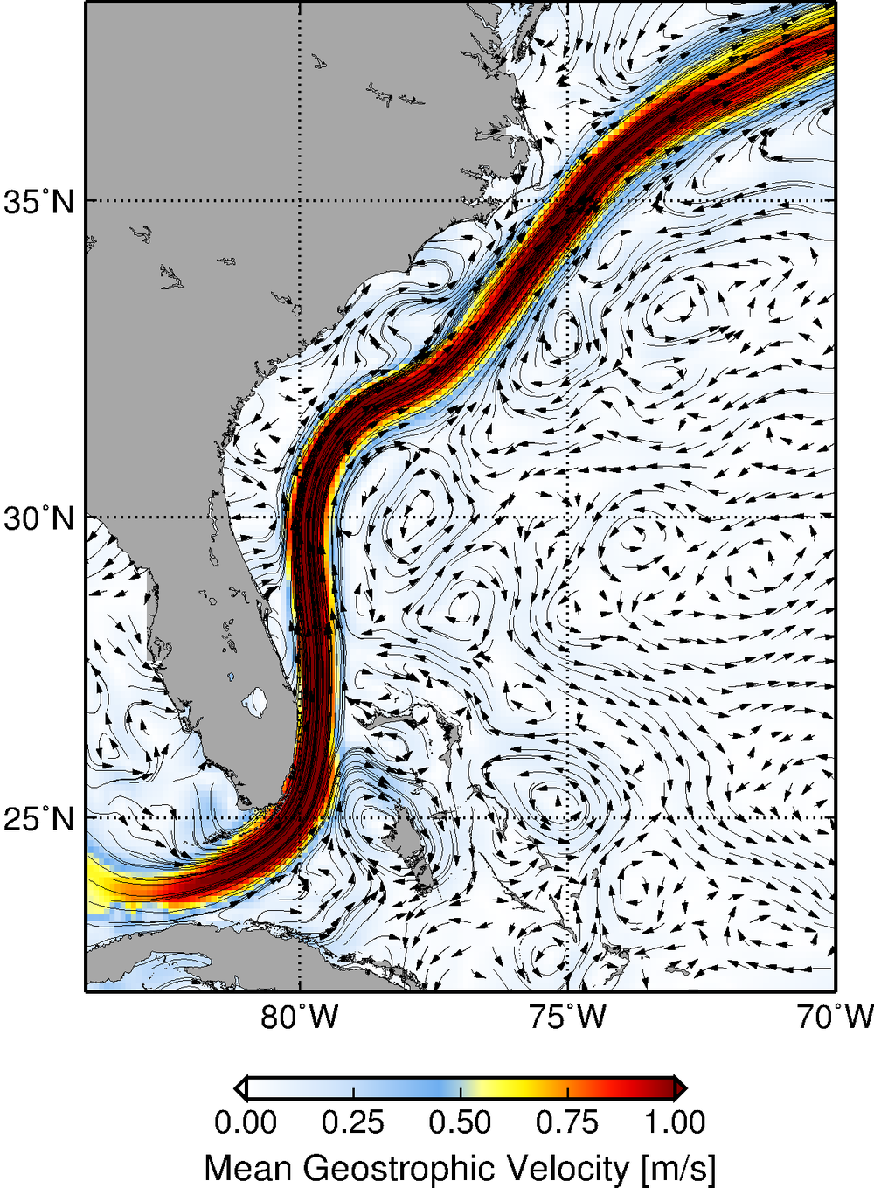
Florida Current and Gulf Stream Effect on Sea Level Along East U.S. coast
$$∆{SL}_{Ocean Currents}$$
The Florida Current sustain a sea level difference between south Florida and the Bahamas of almost 1m
Gulf Stream
Florida Current

Slide 8
Florida Current and Gulf Stream Effect on Sea Level Along East U.S. coast
$$∆{SL}_{Ocean Currents}$$
Mean sea level
Florida
Bahamas
sea level
Changes in the intensity of the Florida Current and Gulf Stream are, therefore, associated with sea level changes along the east coast of U.S.
Mean Florida Current flow

Slide 9
Florida Current and Gulf Stream Effect on Sea Level Along East U.S. coast
$$∆{SL}_{Ocean Currents}$$
Mean sea level
Florida
Bahamas
sea level
Decrease in sea level at Florida
Increase sea level at the Bahamas
Intense Florida Current flow

Slide 10
Florida Current and Gulf Stream Effect on Sea Level Along East U.S. coast
$$∆{SL}_{Ocean Currents}$$
Mean sea level
Florida
Bahamas
sea level
Increase in sea level at Florida
Decrease sea level at the Bahamas
Weak Florida Current flow
Ratio: 1-3 cm change in FL coastal sea-level per 1 Sv change in the Florida Current transport

Slide 11
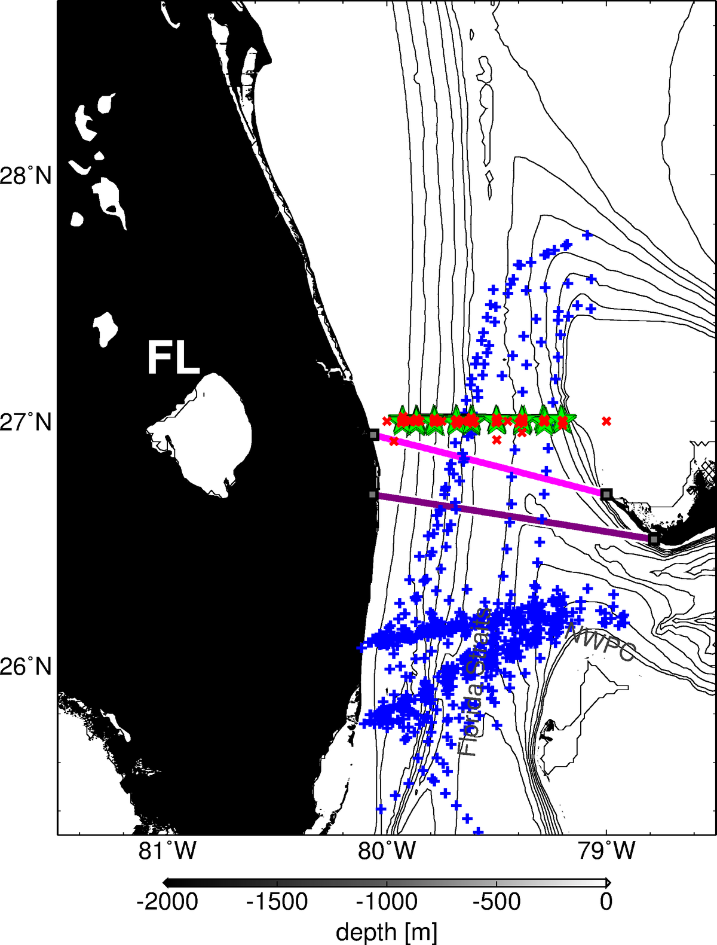
Current efforts by NOAA/AOML to monitor the Florida Current
Cape Canaveral
Bahamas
Miami

Slide 12
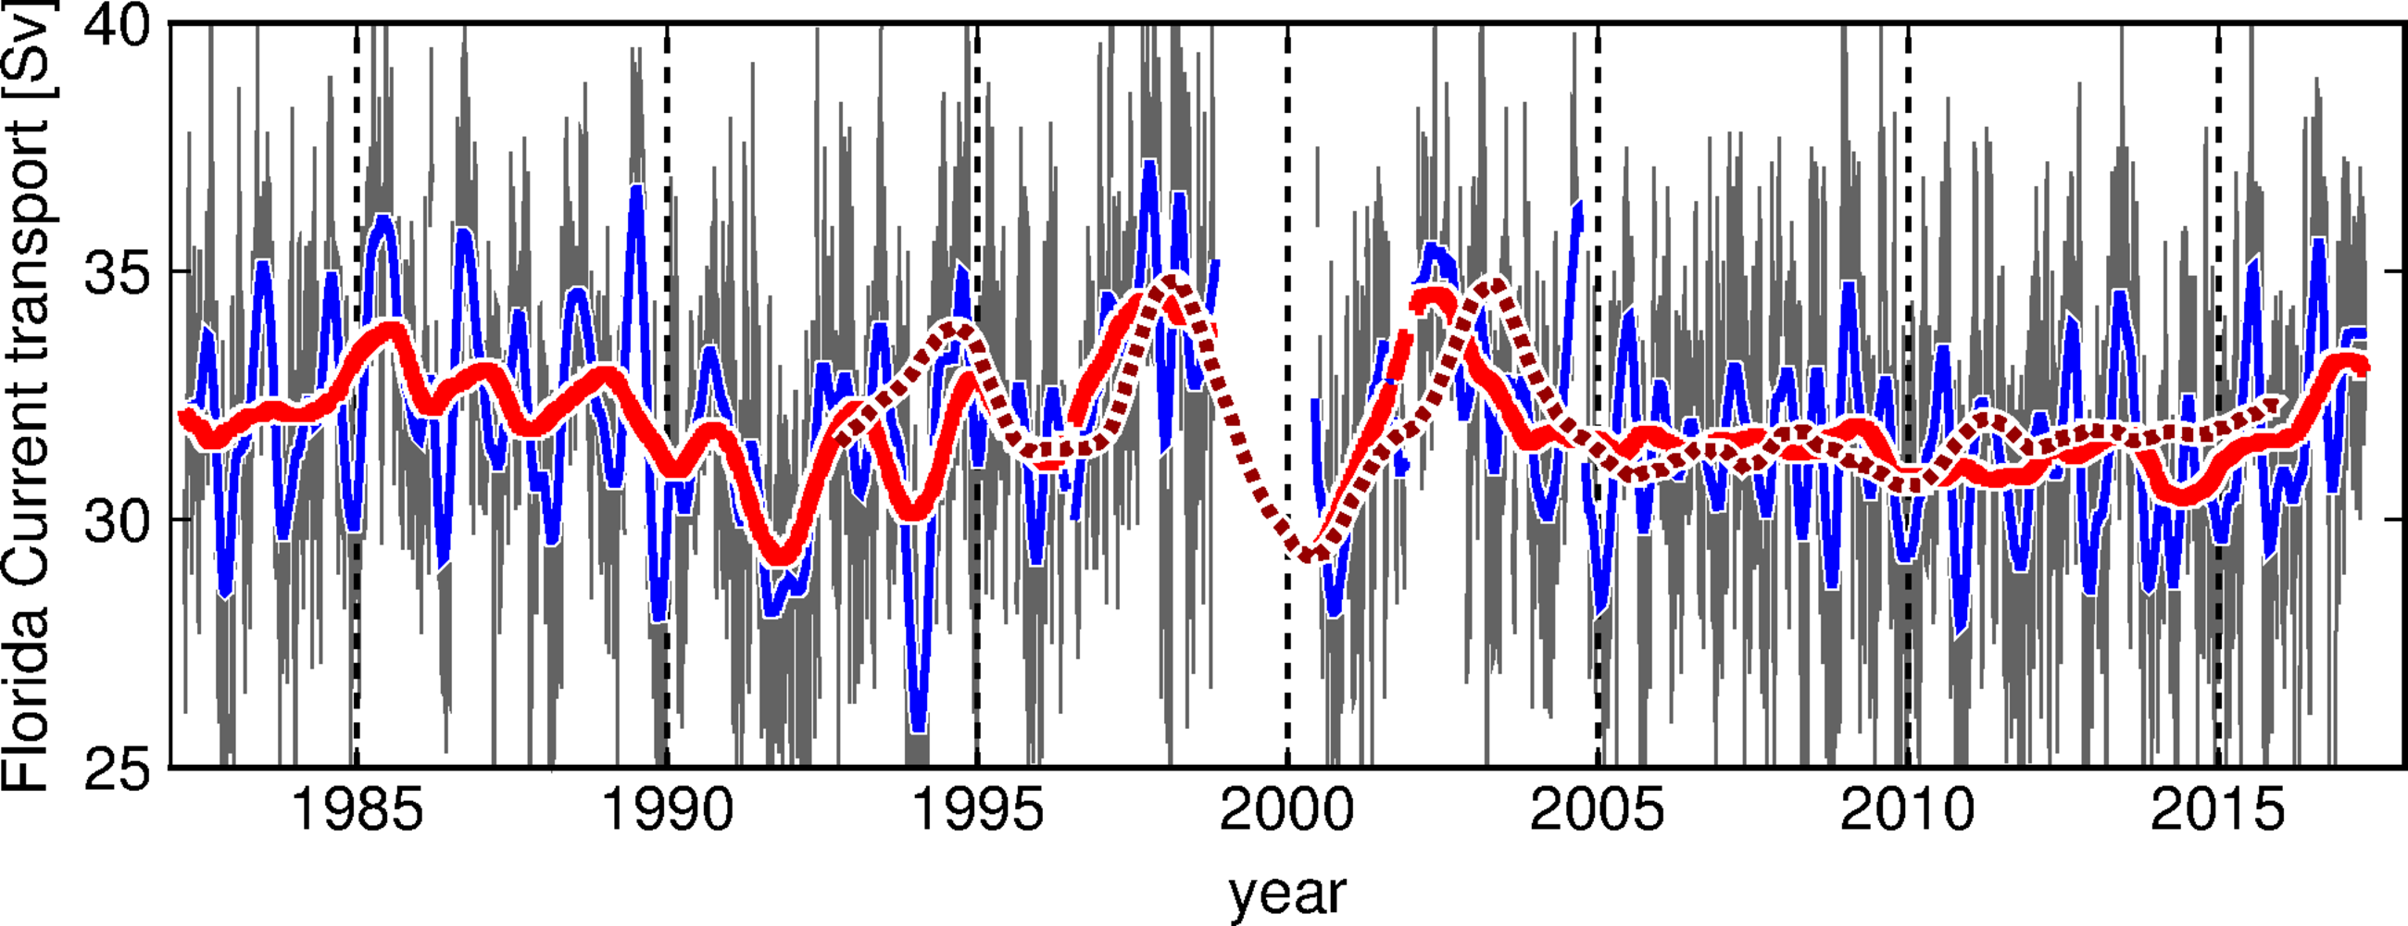
The Florida Current Cable Transport Time-series
Daily record of the Florida Current flow since 1982
Daily FC transport (cable)
1 year low-pass (cable)
90 days low-pass (cable)
1 year low-pass (altimetry)

Slide 13
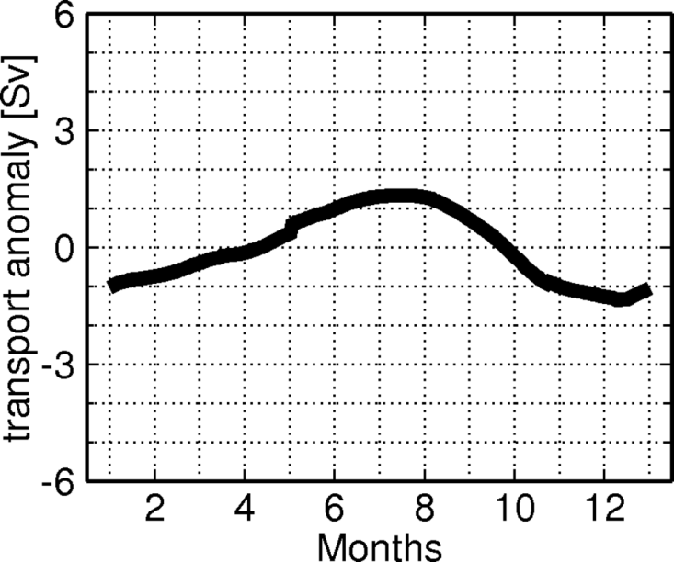
Seasonal Changes in the Florida Current Flow
The FC annual variability
+18
High during late spring to summer
Low during fall to winter
+9
Niiler and Richardson (1973);
Leaman et al. (1987)
Schott et al., (1988)
Baringer and Larsen (2001);
Meinen et al., (2010)
0
sea level change [cm]
-9
± 3 cm expected sea level change associated with the mean FC annual cycle
-18
J F M A M J J A S O N D

Slide 14
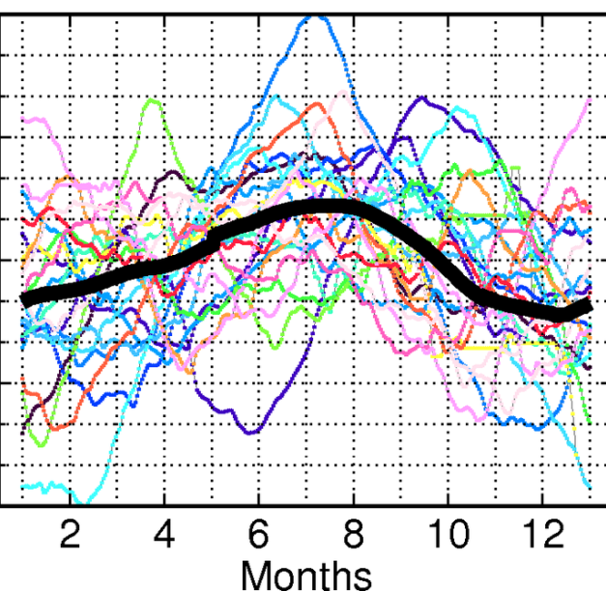
Seasonal Changes in the Florida Current Flow
The FC annual variability
+18
Significant changes in the Florida Current annual variability from one year to the next
+9
0
sea level change [cm]
-9
-18
J F M A M J J A S O N D

Slide 15
Sources of Seasonal Changes in the Florida Current Flow
Filtered Satellite Altimetry Sea Height Anomaly
~ ±10 cm coastal sea level changes usually associated with the seasonal FC flow
SHA – sea height anomaly measured by satellite altimetry
*displayed data is filtered for the 73-525 days band, after removal of average annual cycle
Domingues et al., (2016). Remote sources for year-to-year changes in the seasonality of the Florida Current transport. Journal of Geophysical Research-Oceans

Slide 16
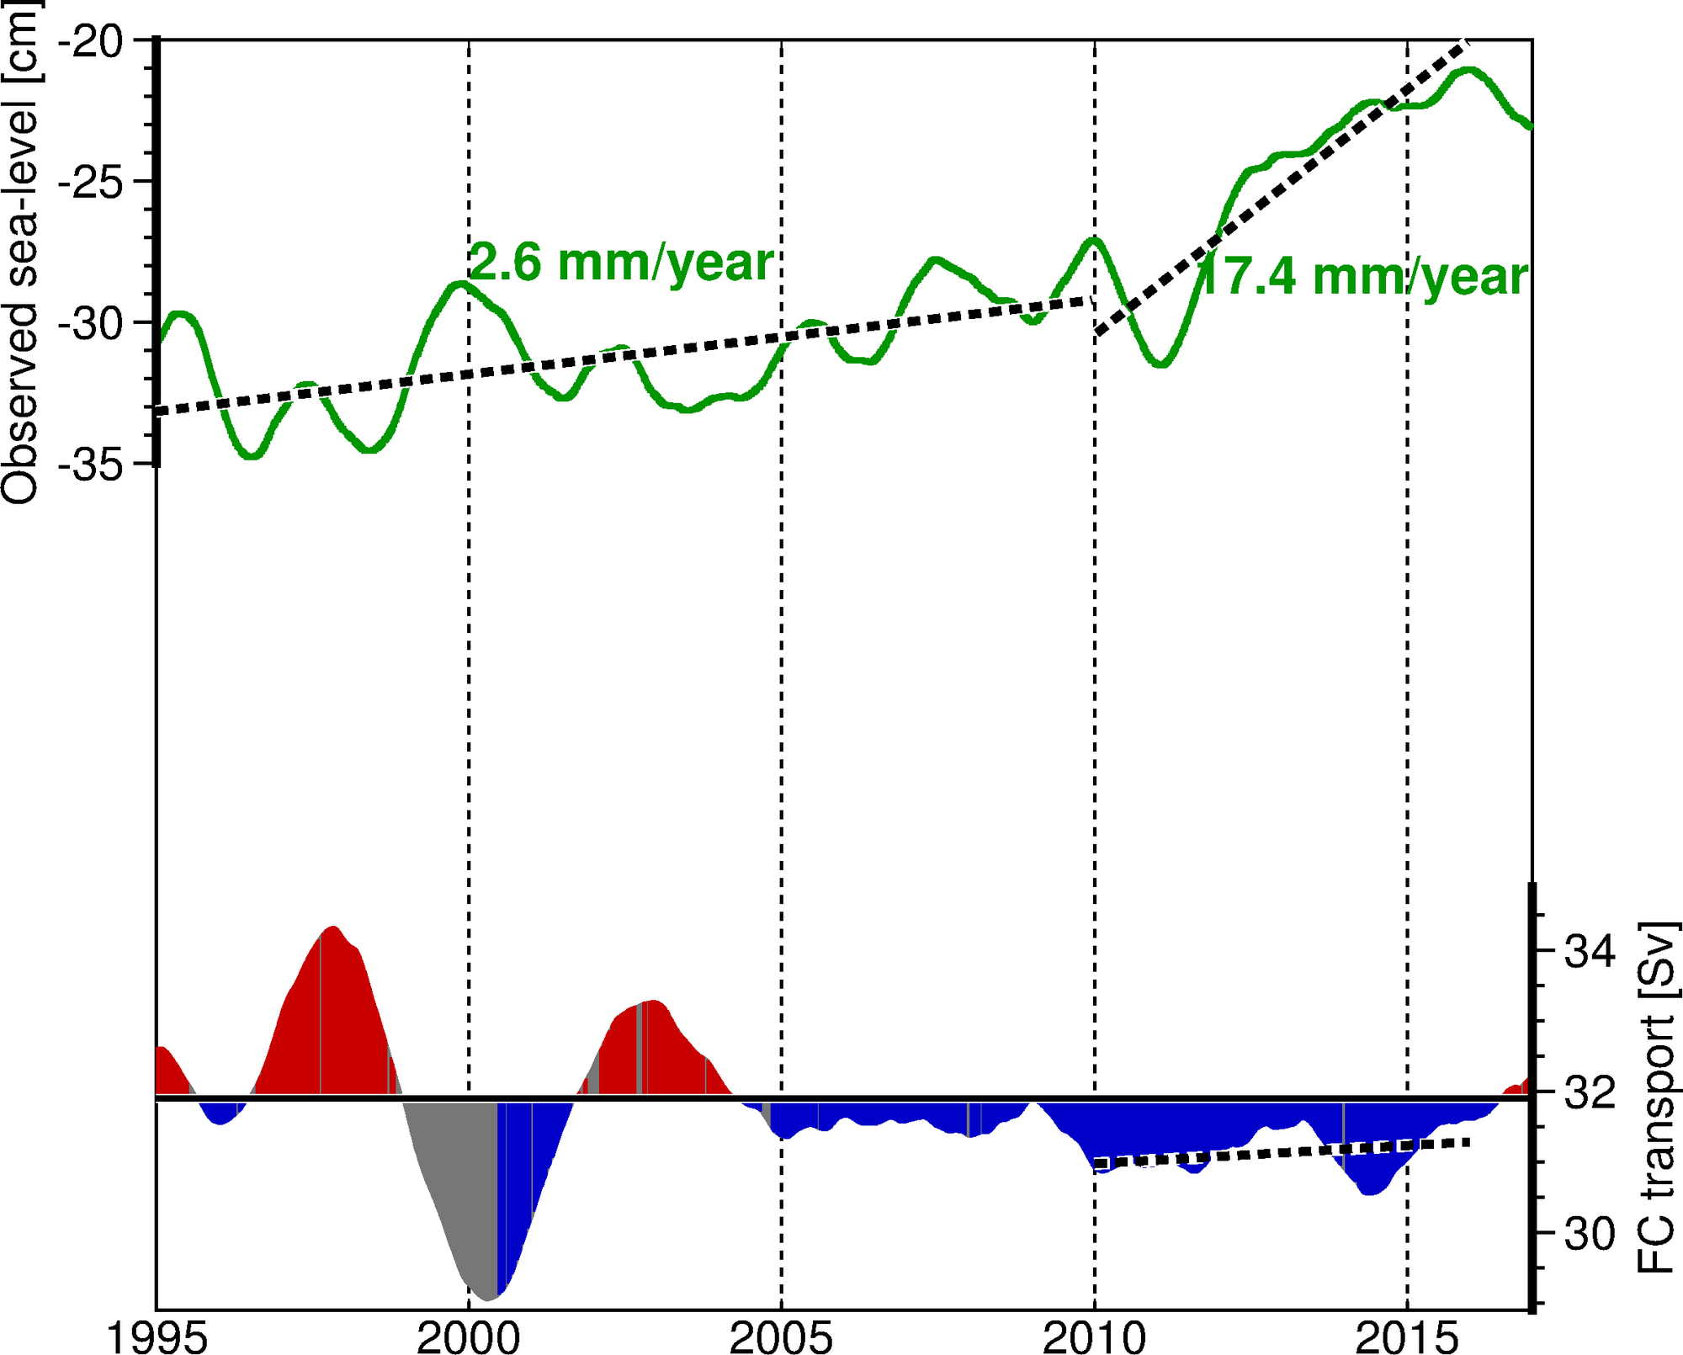
The Florida Current Flow and Sea Level Changes During 2010-2015
Observed Sea Level – Miami, FL
FC transport
1995 2000 2005 2010 2015

Slide 17
Year-to-year Changes in the Florida Current Temperature
Over 250 in situ surveys since 1995

Slide 18
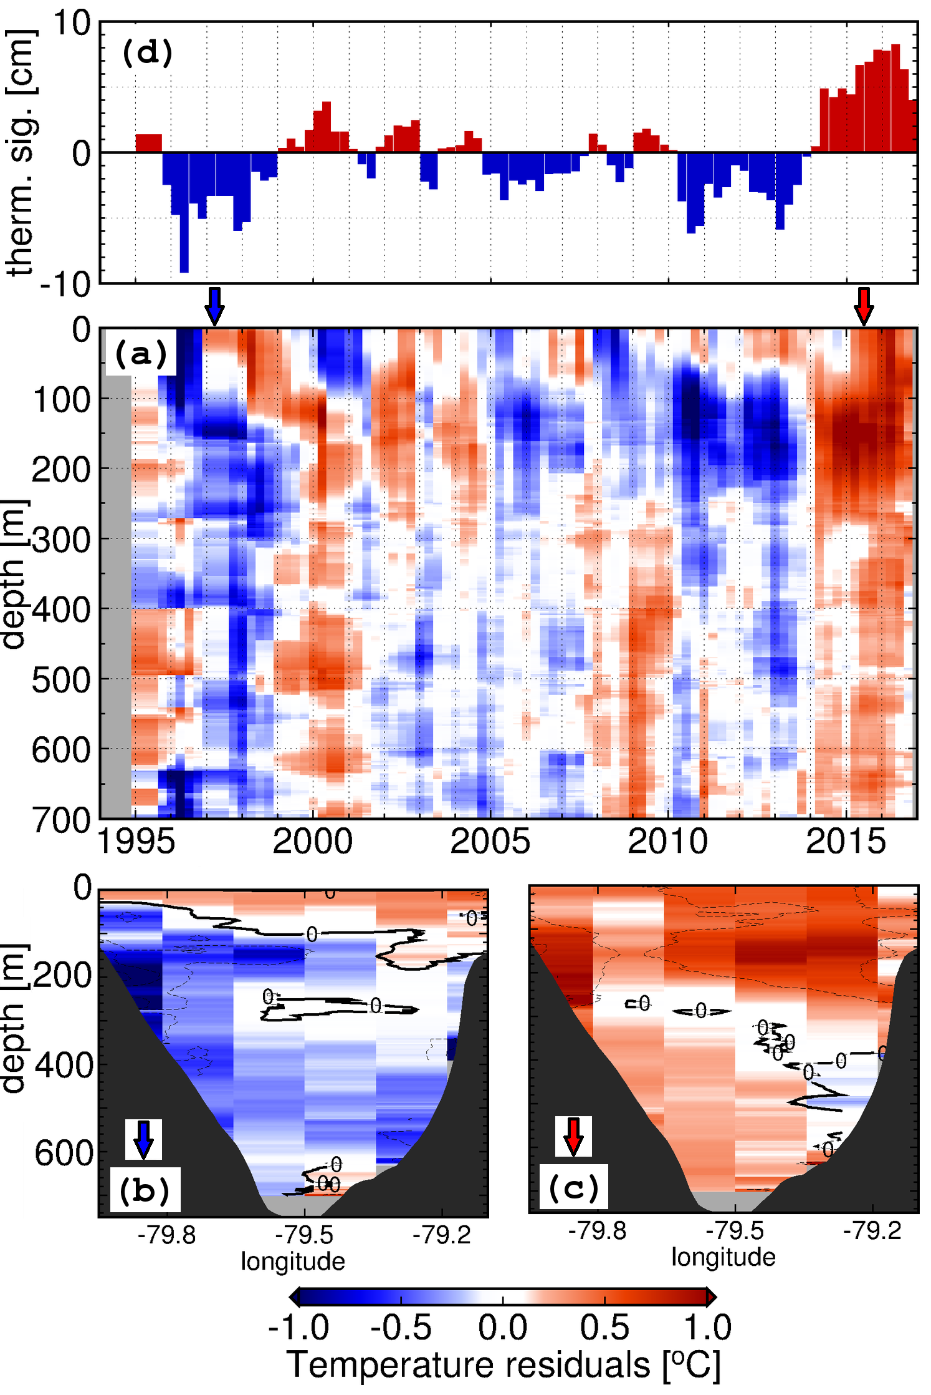
Year-to-year Changes in the Florida Current Temperature
Temperature anomalies associated with:
Thermosteric height anomalies ranging between:
-10 and 10 cm
Trend of 2 cm / decade
The 2010-2015 event:
Florida Current temperature shifted from a cold regime during 2010-2013 to a warm regime during 2014-2015
The observed peak in late 2015 coincided with observed flooding events
November, 2011
Temperature anomalies with respect to the annual cycle, and averaged for the Florida Straits
Domingues et al., (in preparation). Accelerated sea level changes in the United States east coast: links with recent warming of the Florida Current

Slide 19
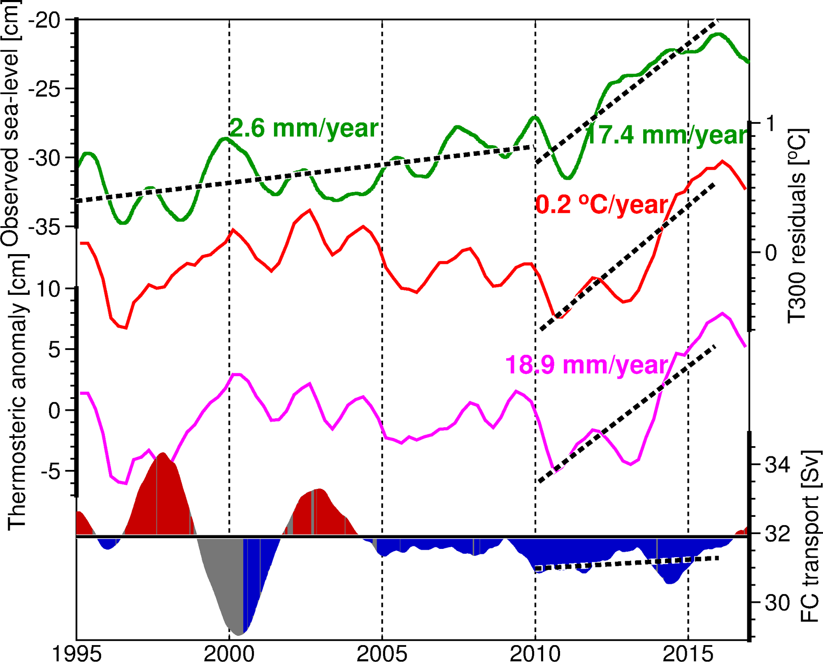
The Florida Current Temperature and Sea Level Changes During 2010-2015
Observed Sea Level – Miami, FL
FC temperature and transport changes likely contribute independently to coastal sea-level variability
FC temperature 0-300m
FC thermosteric anomaly
FC transport
1995 2000 2005 2010 2015
Domingues et al., (in preparation). Accelerated sea level changes in the United States east coast: links with recent warming of the Florida Current

Slide 20
Conclusions
Changes in the Florida Current transport and temperature cause sea-level variability along the east coast of U.S.
On seasonal time-scales, changes in the Florida Current flow are largely associated with westward propagating signals originated in the open ocean, which cause sea level changes of ±10 cm
On year-to-year time-scales, changes in the Florida Current temperature can also account for ±10cm in coastal sea-level due to thermal expansion of the water column
Accelerated sea-level changes observed during 2010-2015 along the U.S. east coast is consistent with the warming of the Florida Current for the period
Flooding events in Miami during the very large King Tide from September-October 2015 coincided with:
Lower than average Florida Current transport -> ~5cm increase in sea-level
Warmer than average Florida Current - > ~10 cm increase in sea-level

Slide 21
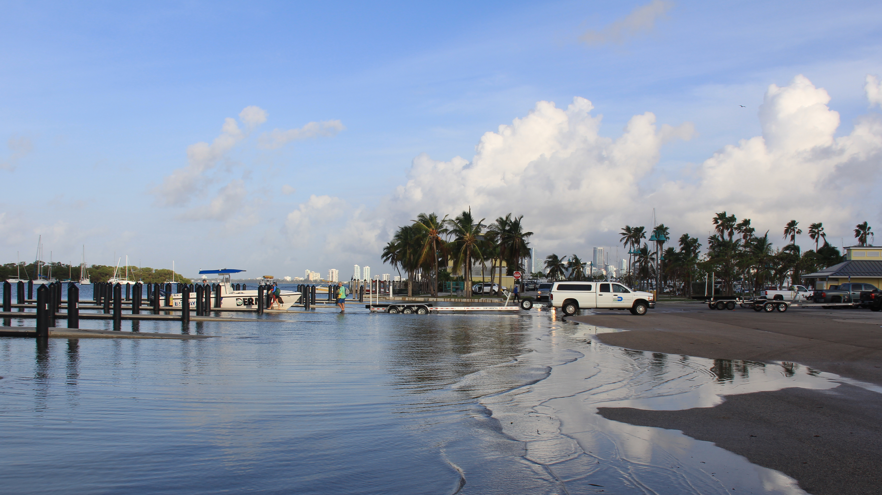
Evidence coastal sea level changes along the east coast of United States associated with the Florida Current transport and heat content using satellite altimetry and hydrographic observations
Ricardo Domingues^{1,2}
Gustavo Goni²
Molly Baringer²
Denis Volkov^{1,2}
Thank you
Ricardo.Domingues@noaa.gov
¹ University of Miami, Cooperative Institute for Marine and Atmospheric Studies - CIMAS, Miami, Florida, USA
² NOAA Atlantic Oceanographic and Meteorological Laboratory - AOML, Miami, Florida, USA
Ocean Surface Topography Science Team Meeting, Miami, FL, October 2017

