Slide 1
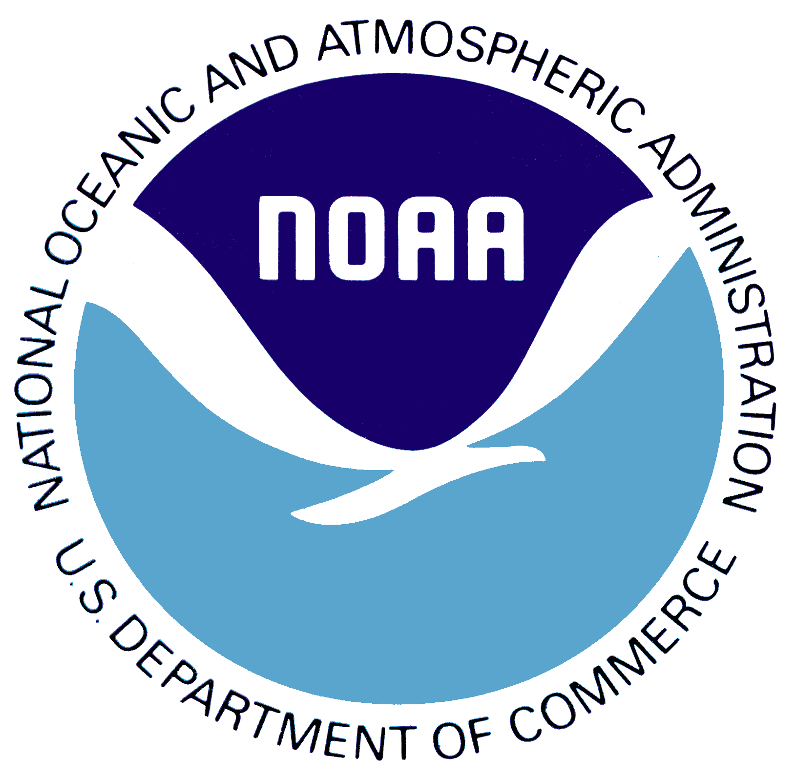
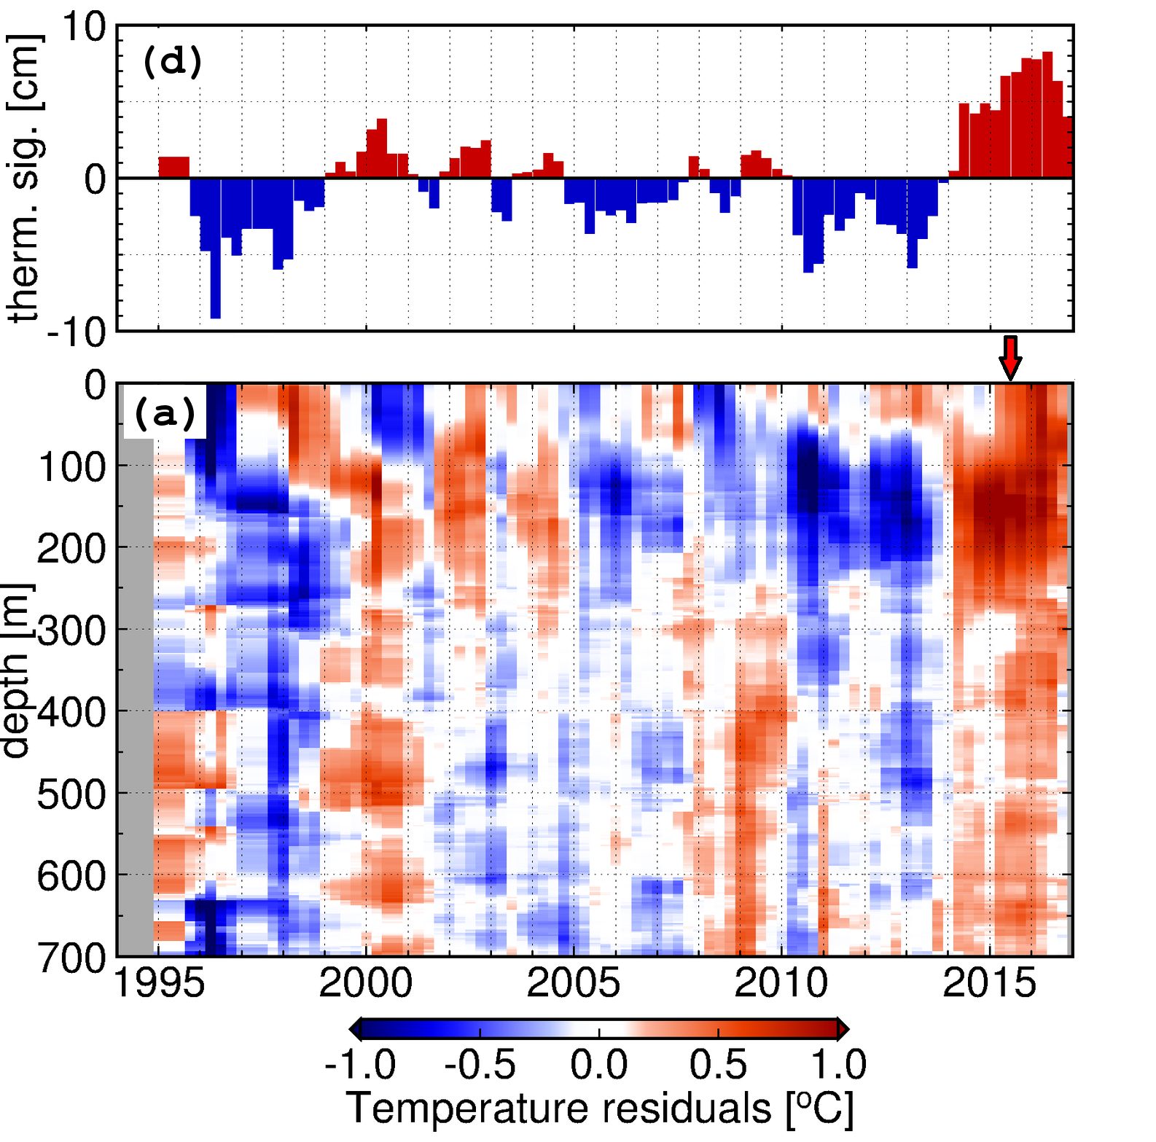
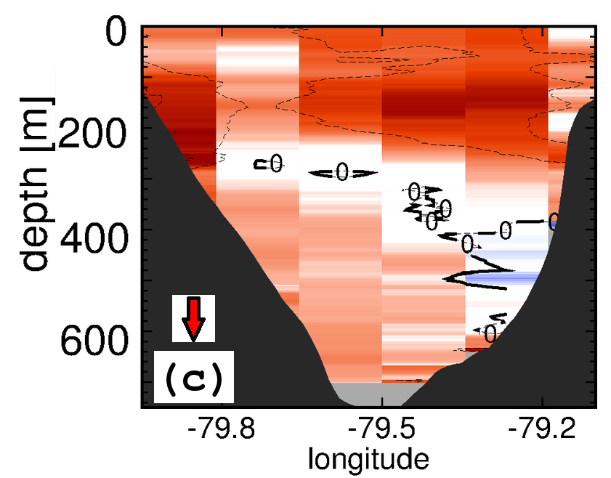
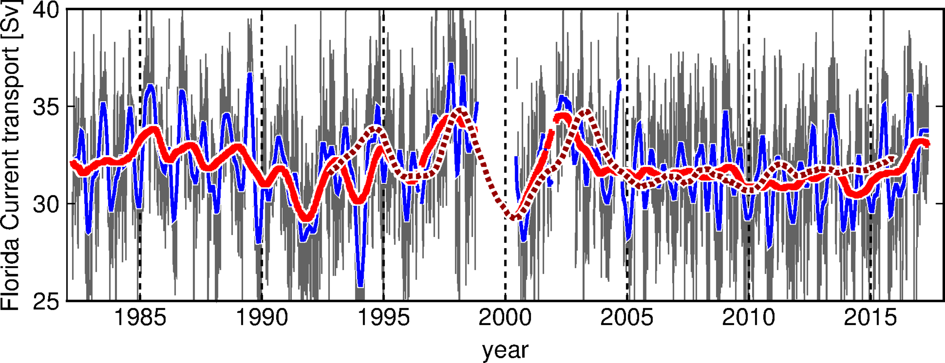
NOAA Ocean Observations and Tools for Attributions of Sea Level Changes Along the U.S. East Coast: Ongoing Efforts and Prospective Future
Molly Baringer⁽¹⁾ , Gustavo Goni ⁽¹⁾, Ricardo Domingues^{(2,1)}, Denis Volkov^{(2,1)}, and William Sweet⁽³⁾
The National Oceanic and Atmospheric Administration (NOAA), along with its national and international partners, maintains an extensive network of in situ ocean observations that is designed to improve our understanding of ocean variability and its impact on weather, climate, and ecosystems. These observations can also provide critical information on global and regional sea level variability. Some of these observational efforts include, for example, tide gauge stations, XBT Network, Argo Project, Global Drifter Program, and Western Boundary Time Series project. They provide sustained in situ ocean observations that enable extensive research aimed at understanding some of the key drivers of sea level changes along the U.S. East Coast, such as changes in the: (i) upper ocean thermal and saline structure; (ii) Florida Current and Gulf Stream; and (iii) Atlantic Meridional Overturning Circulation (AMOC). Spatial and temporal variability of the Florida Current and Gulf Stream, for example, are known for driving relevant (~20 cm) sea-level changes along the U.S. East Coast on various time-scales. These western boundary currents are continuously monitored using repeated ship-based hydrographic surveys that include XBT, CTD, and LADCP observations, and on a daily record of the Florida Current transport since 1982 based on telephone cables between Florida and the Bahamas. These data enabled identifying recent drives of accelerated sea level rise in the Southeast US coast, which were associated with the warming of the upper layer of the Florida Current and Gulf Stream. In order to obtain accurate assessments of sea level changes of attributions to sea level changes in the east coast of the US, plans to expand these efforts include targeted underwater gliders observations with the goal of improving meridional sampling along the Southeast U.S. Coast between the Florida keys (~24.5°N) and North Carolina (~32°N). The proposed targeted observations will be designed to study changes occurring at frequencies higher than the seasonal cycle, which include episodic elevated sea level events and that are dominant along the record. In this presentation, an brief overview of ongoing and future efforts by NOAA in support of monitoring and understanding sea level changes along the U.S. East Coast is also provided.
Ocean Observing System
The Florida Current
The Florida Current is the strong oceanic current that flows northward along the eastern coast of Florida carrying warm tropical waters that eventually feed into the Gulf Stream. The Florida Current represents both the western boundary current for the subtropical wind-driven gyre as well as a return pathway for the Thermohaline Overturning Cell, which consists of a slow circulation redistributing the waters of the world ocean based on sinking at the high latitudes and upwelling elsewhere.
Changes in temperature and intensity of the Florida Current and downstream in the Gulf Stream (see poster Slowdown of the Gulf Stream, by M. Baringer et al, ID# 398) and of planetary waves (see poster Remote sources of Florida Current variability on seasonal timescales: links with coastal sea-level variability along the east coast of United States, by Domingues et al, ID# 211) are being assessed to investigate the impact of water mass properties and ocean dynamics on sea level changes along the coast of the southeastern United States.
Sea Level and Temperature Changes
Vertical temperature changes across the Florida Current measured using Conductivity Temperature Depth (CTD) and eXpendable BathyThermograph (XBT) observations show more than 1ºC average increase during the last 20 years (b), which have produced an average increase in sea level of approximately 4 cm (a). However, these trends exhibit different values during the periods 1993-2010 (2.6 mm/year) and 2010-2016 (14.9 mm/year). New observations obtained from underwater gliders will help to extend the analysis to a wider range of latitudes and to enhance the temporal resolutions of observations.
XBTs: for vertical temperature profiles
CTDs: for vertical temperature and salinity profiles
Inverted echosounders, IES, for vertical temperature and salinity assessments
Underwater gliders: autonomous vehicles for T, S profiles and ocean currents
Domingues, R., Goni, G., Baringer, M., and Volkov, D., 2018: What caused the accelerated sea level changes along the United States East Coast during 2010-2015?. Geophysical Research Letters. 45(24):13,367-13,376 (doi:10.1029/2018GL081183)
Profiling floats: for T, S profiles
Dropsondes: for average vertical currents
Coastal Sea Level and the Florida Current Flow
The intensity and location of the Florida Current can be determined using a combination of observational data, including CTD, dropsondes, submarine cable, XBTs, underwater gliders, and satellite data. The intense Florida Current flow sustains a sea level difference between Florida and the Bahamas of approximately 1m. A weaker than average Florida Current transport is linked to a smaller difference in sea level between Florida and the Bahamas causing a higher than average sea level along the coast of Florida. Short time fluctuations of the Florida Current transport may have amplitudes as large as 10 Sv. In this current, 1 SV represents approximately 1cm of sea level difference between Florida and the Bahamas.
Tide gauges: for time series of sea level
Surface drifters: for sea surface temperature and ocean currents
Florida
mean sea level
Bahamas
Depth
Weak Florida Current
Satellites: for surface ocean and meteorological observations
Florida
Bahamas
PDF of this poster
Research cruises
Strong Florida Current
Daily record of the Florida Current flow since 1982
Current and planned ocean observing system to analyze attributions to sea level changes in Southeast Florida.
Daily FC transport (cable)
1 year low-pass (cable)
90 days low-pass (cable)
1 year low-pass (altimetry)
Affiliations
(1) National Oceanic and Atmospheric Administration, Atlantic Oceanographic and Meteorological Laboratory, Miami, FL 33149; Molly.Baringer@noaa.gov
(2) The University of Miami, Cooperative Institute for Marine and Atmospheric Studies, Miami, FL 33149
(3) National Oceanic and Atmospheric Administration, Center for Oceanographic Products and services, Silver Spring, MD
Changes in the Florida Current transport and temperature at 27N as obtained by the current ocean observing system provide critical components of the sea level variability along the South Florida coast.

