Slide 1
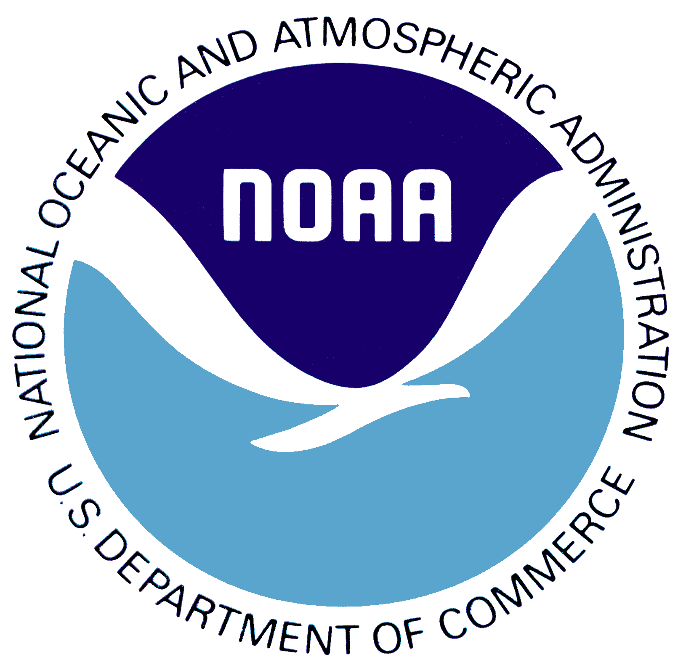
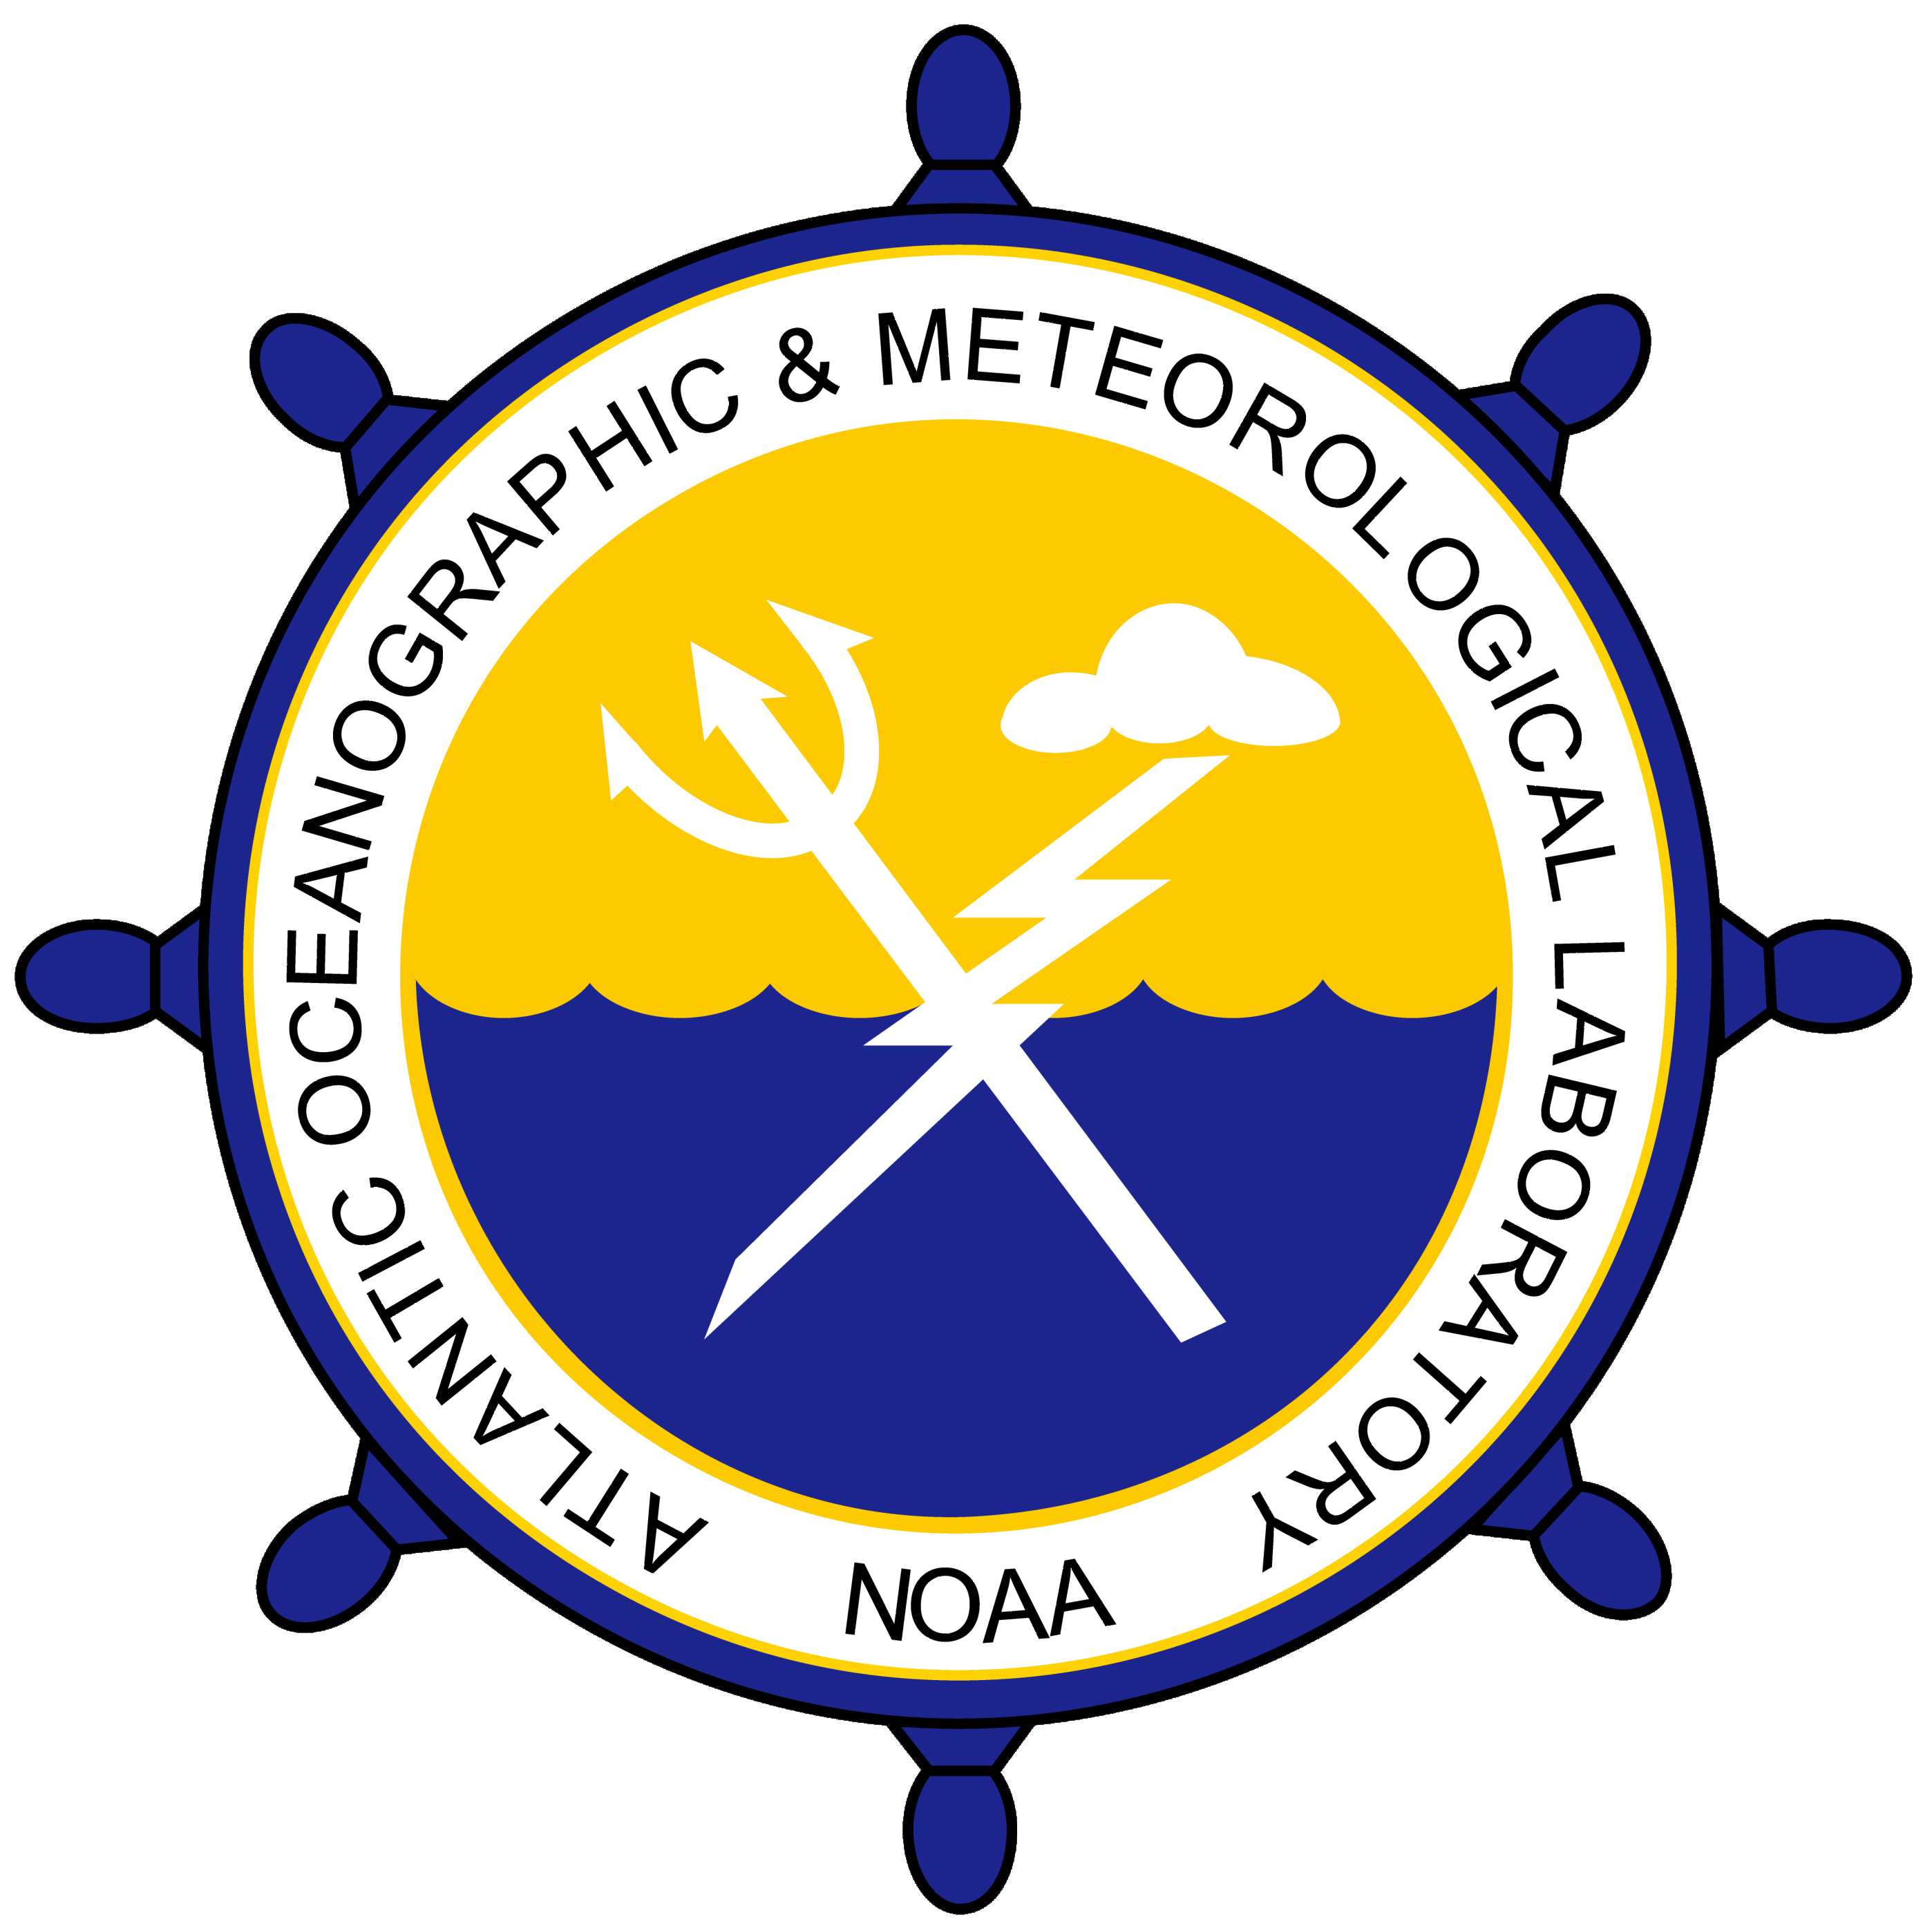
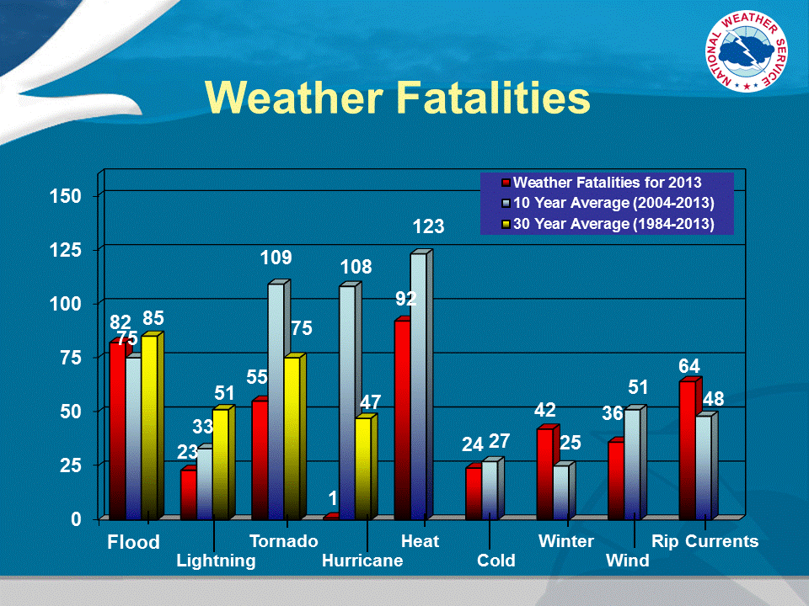

National Oceanic and Atmospheric Administration
Atlantic Oceanographic and Meteorological Laboratory
Physical Oceanography Division – PHOD
Miami, FL
The Oceans as Predictors of Heat Waves
Heat waves are the leading weather-related cause of death in the US. The severity of heat waves has increased in recent decades and is projected to continue increasing.
Some examples of deadly heat waves are:
1980 Midwest and Great Plains, US (1,700 deaths)
1995 Chicago, US (1,021 deaths)
2003 Europe (52,452 deaths)
2010 Russia (55,736 deaths)
2011 US Great Plains (206 deaths)
2015 India (2,500 deaths)
A study by PHOD scientists shows that:
Western US and Great Lakes: Human-induced climate change will be responsible for at least half of the heat waves by the 2020s and 2030s respectively. Thus, these are the regions where greater mitigation and adaptation efforts are needed.
Great Plains: There is large uncertainty in heat wave projection. This is the region where the efforts for identifying naturally-occurring heat wave predictors are most needed.
Common heat wave regions in the US and the years where human-induced climate change will dominate their occurrence
Red indicates regions of increased heat wave days due to a weaker Atlantic Ocean heat transport.
Scientists at PHOD have shown that the Atlantic Ocean heat transport is a predictor of heat waves. Weaker Atlantic Ocean heat transport increases the number of heat wave days in the Great Plains as well as how often they occur.
Number of Days
PDF of this poster
References:
Lopez, H., R. West, S. Dong, G. Goni, S.-K. Lee, B. P. Kirtman, and R. Atlas (2018): Early emergence of anthropogenically-forced heat waves in the western US and Great Lakes. Nature Climate Change, doi: 10.1038/s41558-018-0116-y.
Lopez, H., G. Goni, and S. Dong (2017): A reconstructed South Atlantic Meridional Overturning Circulation time series since 1870. Geophysical Research Letter, doi: 10.1002/2017GL073227.

