Slide 1


ADB Comparison Study, Argos-3, Iridium
Presenters:
Shaun Dolk, Mayra Pazos
Collaborators:
Erik Valdes, Rick Lumpkin
Drifter Operations Center (DOC)/
Drifter Data Assembly Center (DAC)
NOAA/AOML/GDP
Miami, Florida
September 26-30, 2011
Geneva, Switzerland

Slide 2
AOML Drifter Buoy (ADB)
Comparison Study
Compare drifters from different manufacturers, deployed in clusters (at the same time and at the same location), in different regions of the world.
The goals of the ADB Comparison Study are:
  Determine how well drifter transmitters are surviving in
  varying ocean conditions.
  Compare actual transmitter lifetimes to the 450 day
  requirement.
  Examine drogue presence detection.
  Determine drogue lifetimes and compare this finding to the expected lifetime of 300 days.
  Evaluate packaging and ease of deployment.
Notes:
Don’t really like the usage of the word “durability” here.
Need a word to describe the ruggedness which is needed to withstand the bumps these units take while navigating gangways and narrow vessel quarters.

Slide 3
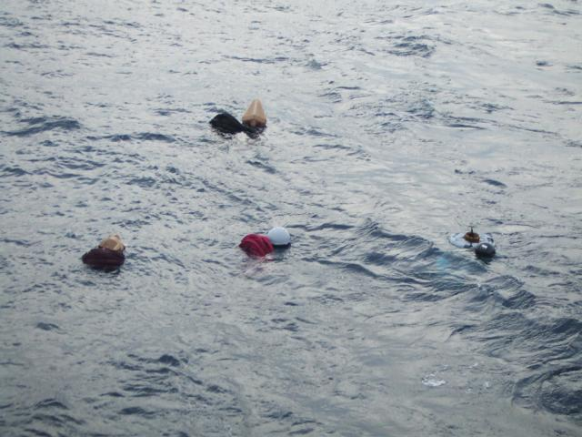
The History of the ADB Comparison Study
2005 – 8 clusters were deployed in the Atlantic, all SVPs
2006 – 8 clusters were deployed in the Atlantic, all SVPs
2008 – 5 clusters of SVPs, in different regions of the world
2010 – 5 clusters of SVPs from 4 manufacturers and
5 clusters of SVPBs from 5 manufacturers

Slide 4
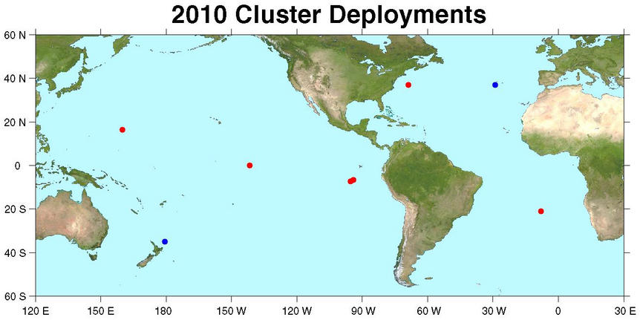
Oct 2
Aug 15
Aug 19
Oct 8
Jan 23
Jan 23
Jan 12
Aug 26
Mar 6
Aug 23
5 clusters each of 4 SVP drifters from 4 different manufacturers, total 20 drifters
5 clusters each of 5 SVPB drifters from 5 different manufacturers, total 25 drifters

Slide 5

SVP Clusters
Cluster Manufacturer | 1 | 2 | 3 | 4 | 5
Clearwater | 261 111 | 227 135 | 473 254 | 7 7 | 381* 108
Technocean | 294 72 delayed 32 d | F.O.D | F.O.D | 85 85 | F.O.D
Metocean | 596* 66 | 502 502 | 585* 114 | 543* 170 | 194 66
Pacific Gyre | 596* 596* | 90 90 | 297 297 grounded | 543* 400 | 91 91
Max. Days Possible | 596 | 585 | 585 | 543 | 381
Top number: Transmitter life, Bottom number: Drogue life
* Alive or drogue on
Last updated: August 31, 2011

Slide 6
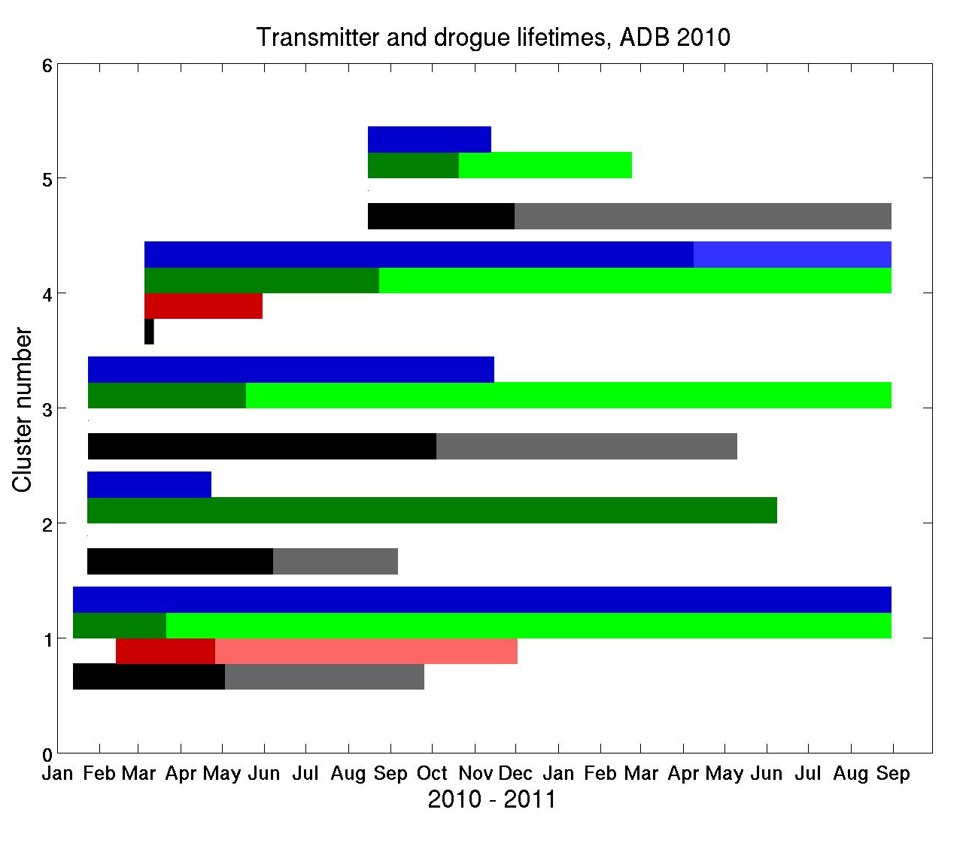
SVP Clusters
--Pacific Gyre
--Metocean
--Technocean
-- Clearwater
F.O.D
grounded
F.O.D
F.O.D

Slide 7
SVPB Clusters
Cluster Manufacturer | 1 | 2 | 3 | 4 | 5
Clearwater | 92 92 Delayed 11 d | 9 9 Delayed 2 d | 370* 101 Delayed 10 d | F.O.D | F.O.D
Technocean | 49 49 | 157 98 | 210 108 | 187 68 grounded | 86 86 Delayed 17 d
Metocean | 196 90 | 232 53 | 366 47 | 245 72 | 34 34
Pacific Gyre | 377* 377* | 181 68 grounded | 370* 370* | 333* 136 | 327* 244
Marlin-Yug | 377* 377* | 373* 69 | 370* 230 | F.O.D | F.O.D
Max. Days Possible | 377 | 373 | 370 | 333 | 327
Top number: Transmitter life, Bottom number: Drogue life
* Alive or drogue on -- Last updated: August 31, 2011

Slide 8
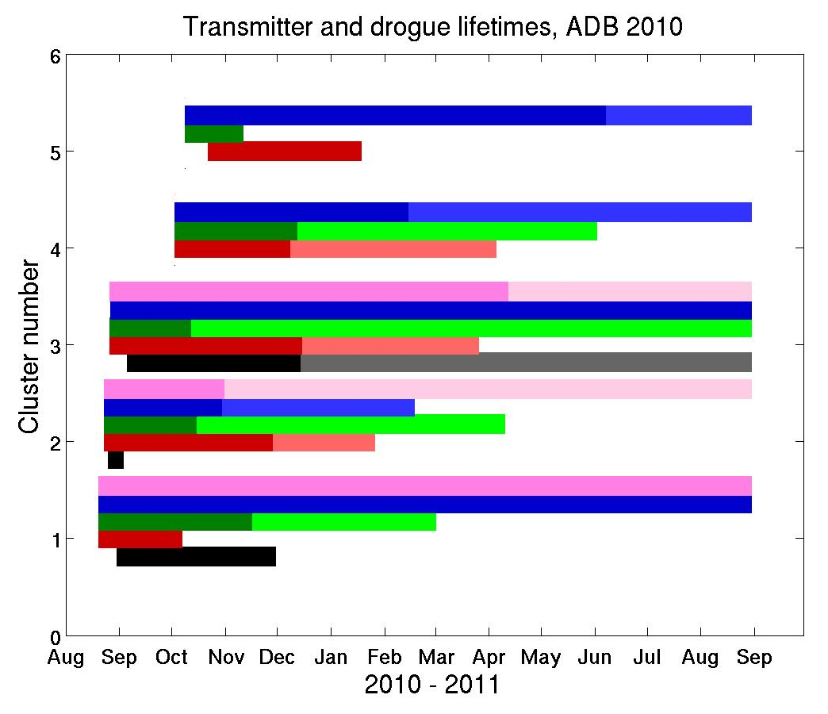
SVPB Clusters
-- Marlin-Yug
--Pacific Gyre
--Metocean
--Technocean
-- Clearwater
F.O.D
F.O.D
F.O.D
grounded
F.O.D
grounded

Slide 9
2011 ADB Cluster Deployment Plan

Slide 10
Additional Testing in 2011
What/Why:
Test new and “old” drifters manufactured by Technocean, as well as test refurbished drifters manufactured by Clearwater.
When:
January 11, 2011
Where:
Gulf Stream, off the coast of Miami, FL

Slide 11
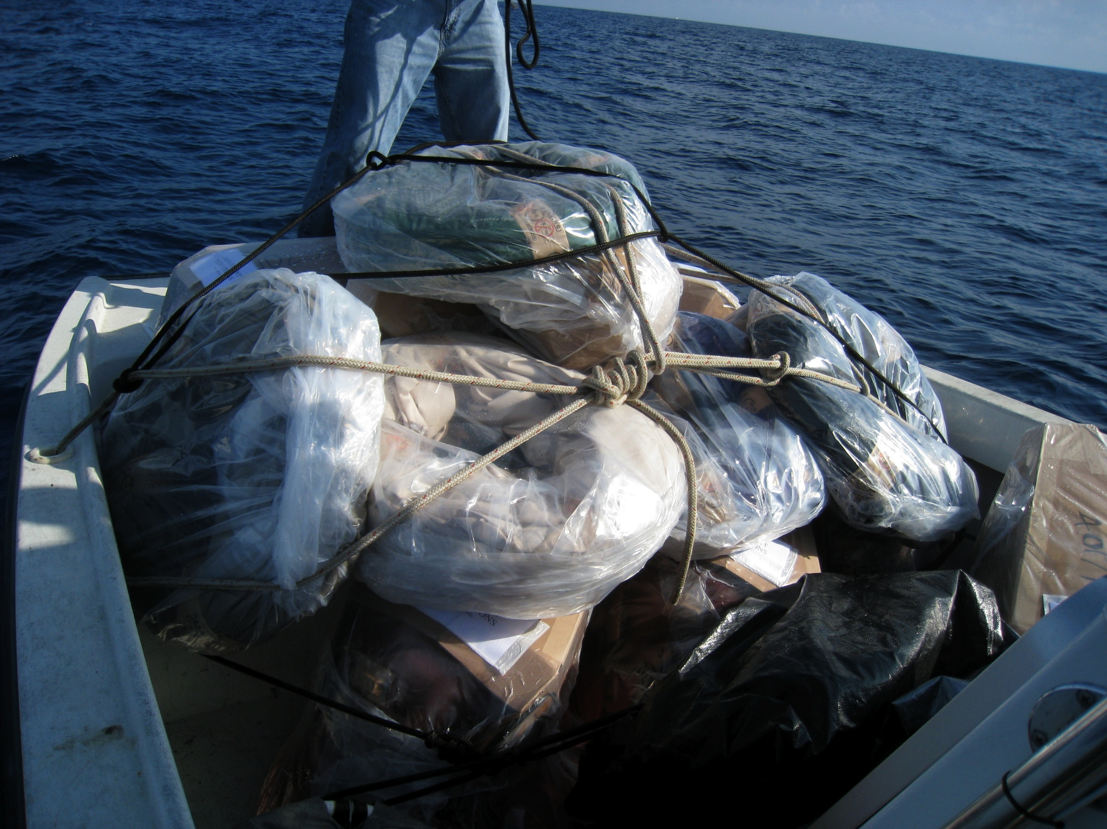
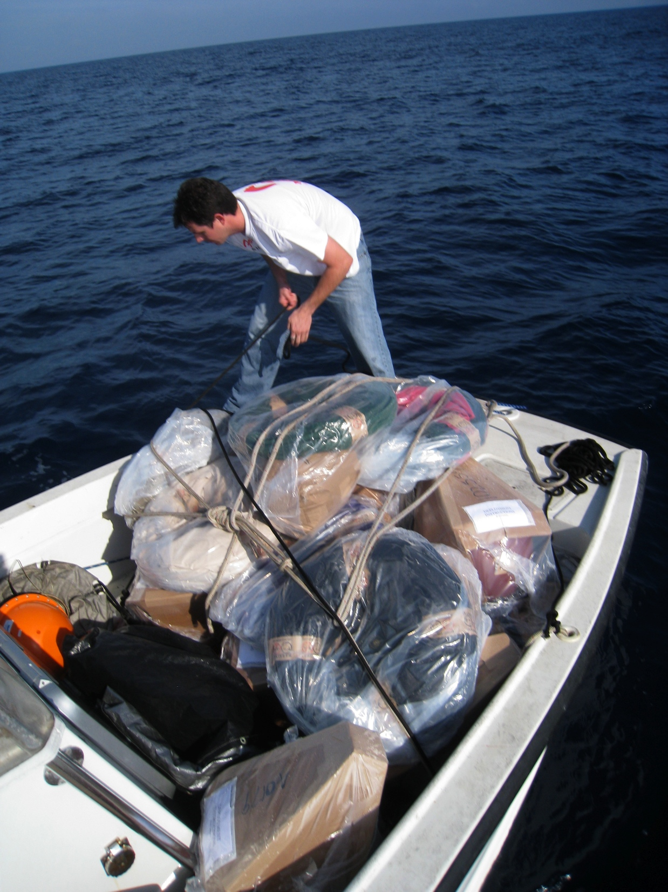
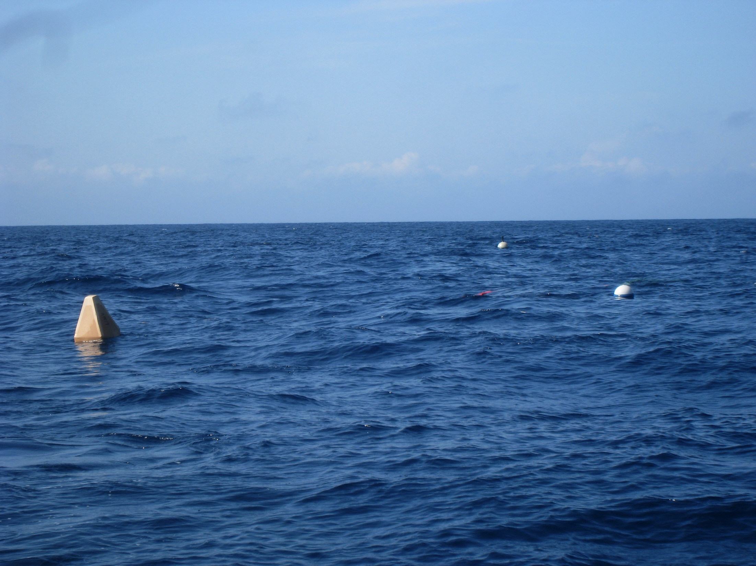
Deployed:
6 “new” Technocean SVPB’s
3 “old” Technocean SVPB’s
6 refurbished Clearwater SVP’s
1 Metocean SVP

Slide 12
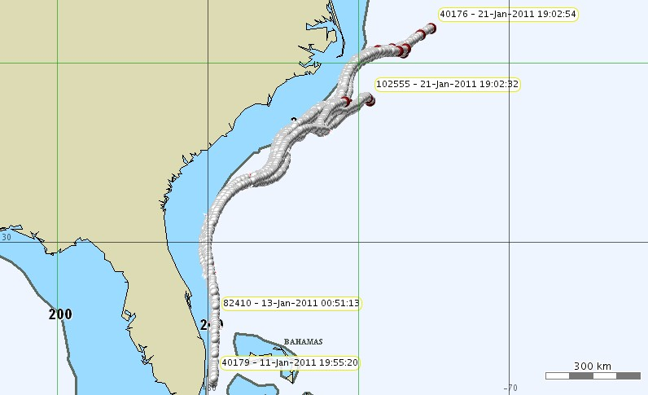
Key Factors:
Activation magnets were removed prior to deployment.
Water soluble tape around the drogue and tether were removed to
ensure drogues deployed, reduce the chances of buoys running
aground.
Deployments were made in pairs and trios.

Slide 13
Results
Cluster Manufactuer | 1 | 2 | 3 | 4 | 5 | 6
ID Technocean “old” -SVPB |  | 40176 249* 249 | 40294 249* 133 |  | 40179 10 9
ID Technocean “new” -SVPB | 102553 249* 34 | 102554 207 207 | 102558 107 85 | 102555 34 34 | 102557 249* 46 | 102556 39 39
ID Clearwater -SVP | 43647 249* 82 | 38595 186 68 | 43572 172 112 | 82410 121 59 | 82413 249* 249 | 82447 249* 140
ID Metocean -SVP |  |  | 88574 249* 05
Max. Days Possible = 249 days
(as of 02 September, 2011)
Top number: Transmitter life, Bottom number: Drogue life
* Alive or drogue on

Slide 14
Argos-3 Drifters
There was a total of 24 Argos-3 drifters deployed from August 2010 through April 2011, all processed at AOML.
All SVPB with no GPS
  9 Clearwater
  8 Marlin-Yug
  7 Pacific Gyre

Slide 15
Argos-3 -- Summary Table as of August 31, 2011 Manufacturer: Clearwater
Argos-3 ID | Man | Type | Days alive | Days Drogue on
A total of 9 SVPB Clearwater Argos-3 drifters were deployed in 2011
3 failed on deployment
4 are still alive, one of them with the transmitter still alive after 595 days
One had drogue on for 425 days, and another one has drogue still on after 236 days
82542 | C | SVPB | 595* | 425
82544 | C | SVPB | 236* | 236*
82583 | C | SVPB | F.O.D | F.O.D
82545 | C | SVPB | 8 | 8
82546 | C | SVPB | 22 | 13
82547 | C | SVPB | F.O.D | F.O.D
82549 | C | SVPB | 147* | 24
82584 | C | SVPB | F.O.D | F.O.D
82585 | C | SVPB | 147* | 94
* Star and green color mean transmitter is working, or drogue is on

Slide 16
Argos-3 -- Summary Table as of August 31, 2011 Manufacturer: Marlin-Yug
8 Argos-3 drifters from Marlin-Yug were deployed between August – November 2010
2 failed on deployment and 2 ran aground after 289 and 168 days
4 are still alive after more than 300 days
4 had drogues on close to 6 months, with one drogue lasting only 3 days, and another one lasting 329 days
Argos-3 ID | Man | Type | Days alive | Days Drogue on
41803 | M | SVPB | 354* | 170
41882 | M | SVPB | 289 gr | 3
42957 | M | SVPB | 303* | 145
42961 | M | SVPB | 362* | 186
42965 | M | SVPB | 168 gr | 168
42973 | M | SVPB | 362* | 329
42964 | M | SVPB | F.O.D | F.O.D
41885 | M | SVPB | F.O.D | F.O.D
* Star and green color mean transmitter is working, or drogue is on

Slide 17
Argos-3 -- Summary Table as of August 31, 2011 Manufacturer: Pacific Gyre
Argos-3 ID | Man | Type | Days alive | Days Drogue on
7 Argos-3 drifters from Pacific Gyre were deployed in 2011
1 SST sensor lasted only 97 days
none failed on deployment and 1 died after 30 days
6 are still alive after 180 days
One has drogue on after 240 days
42716 | PG | SVPB | 181* | 170
42737 | PG | SVPB | 30 | 0
42750 | PG | SVPB | 181* | 178
42755 | PG | SVPB | 182* | 83
42757 | PG | SVPB | 180* | 56
42758 | PG | SVPB | 240* | 240*
42759 | PG | SVPB | 181* | 112
* Star and green color mean transmitter is working, or drogue is on

Slide 18
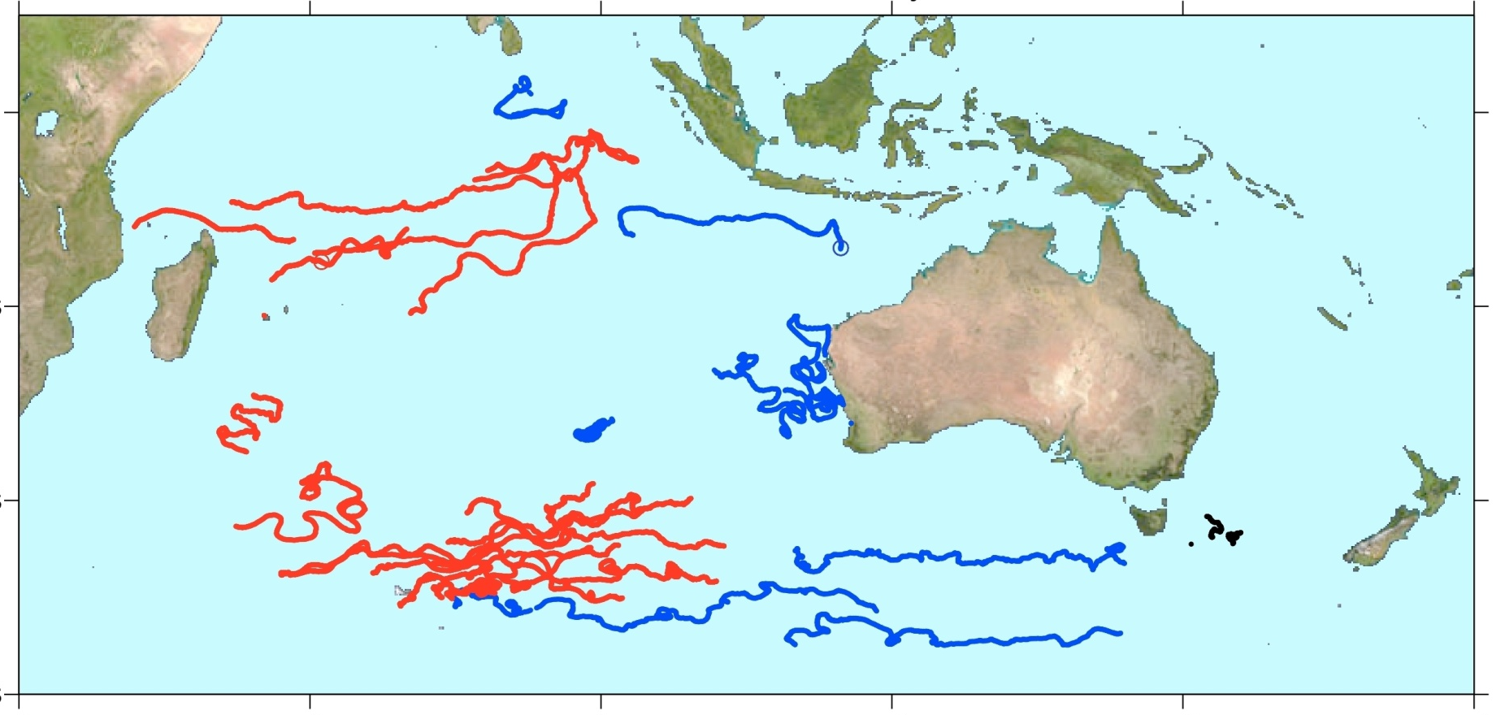
Metocean Iridium Drifters Processed by AOML
0⁰
20⁰S
40⁰S
August 15, 2011
60⁰S
30⁰E 60⁰E 90⁰E 120⁰E 150⁰E 180⁰
AOML: 19 deployed between February – July 2011
  1 died after 13 days, all others are still alive
New Zealand: 2 deployed in July both are alive and with drogues on
Australia: 11 deployed between December 2010 – July 2011
  3 grounded after 28, 93 and 94 days, 1 died after 113 days
  2 died between 181-210 days and 2 died between 241-270 days
  3 are still alive, 1 deployed in April (> 120 days and 2 in May (> 90days)
Note: AOML drifters were upgraded by Meteo-France and DBCP

Slide 19
Iridium Drifters Processed by AOML through August 15, 2011
Drogue life
Days | 0-30 | 31-60 | 61-90 | 91-120 | 121-150 | >300 Still ON
AOML | 2* | 1 | 6 | 7 |  | 3
ABOM | 1** | 4*** | 2 | 1 | 1 | 2
Total
19
11
Number of buoys
* 1 died with drogue on after 13 days, 1 had drogue off since the beginning
** 1 grounded with drogue on after 28 days,
***2 were grounded with drogue on
Manufacturer: Metocean. All drogues are strain gauge
Drogue life needs improvement!

Slide 20
Iridium Drifters Processed by AOML
SST had no problems
SLP: Two AOML drifter’s pressure sensors went bad and taken off GTS after 5 months
Voltage: Voltage drops to near or below 10 volts after 6 months of operation
Metocean communicated that a new Iridium SVP will be released by mid 2012 with a larger hull with ruggedized tether/drogue assembly, more batteries, etc. They believe the smaller hull configuration is just not suitable for the existing mini-SVP design

Slide 21
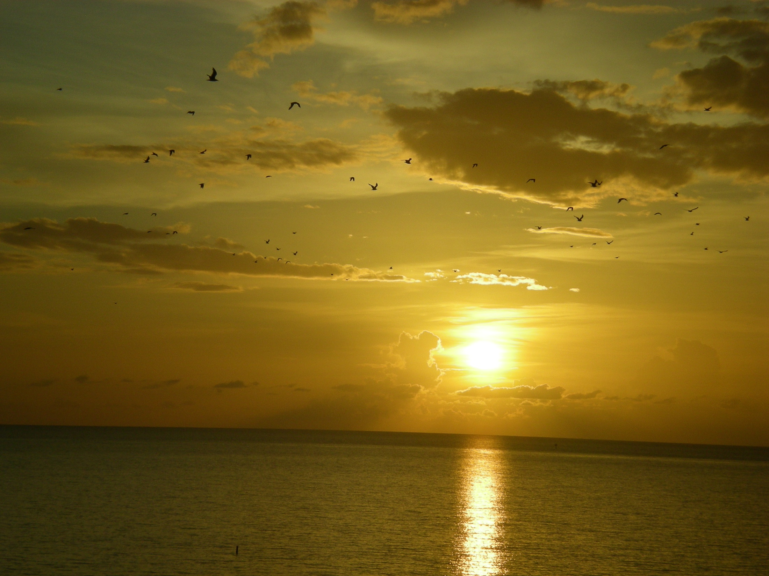
Thank you!
Merci!
Gracias!

