Slide 1





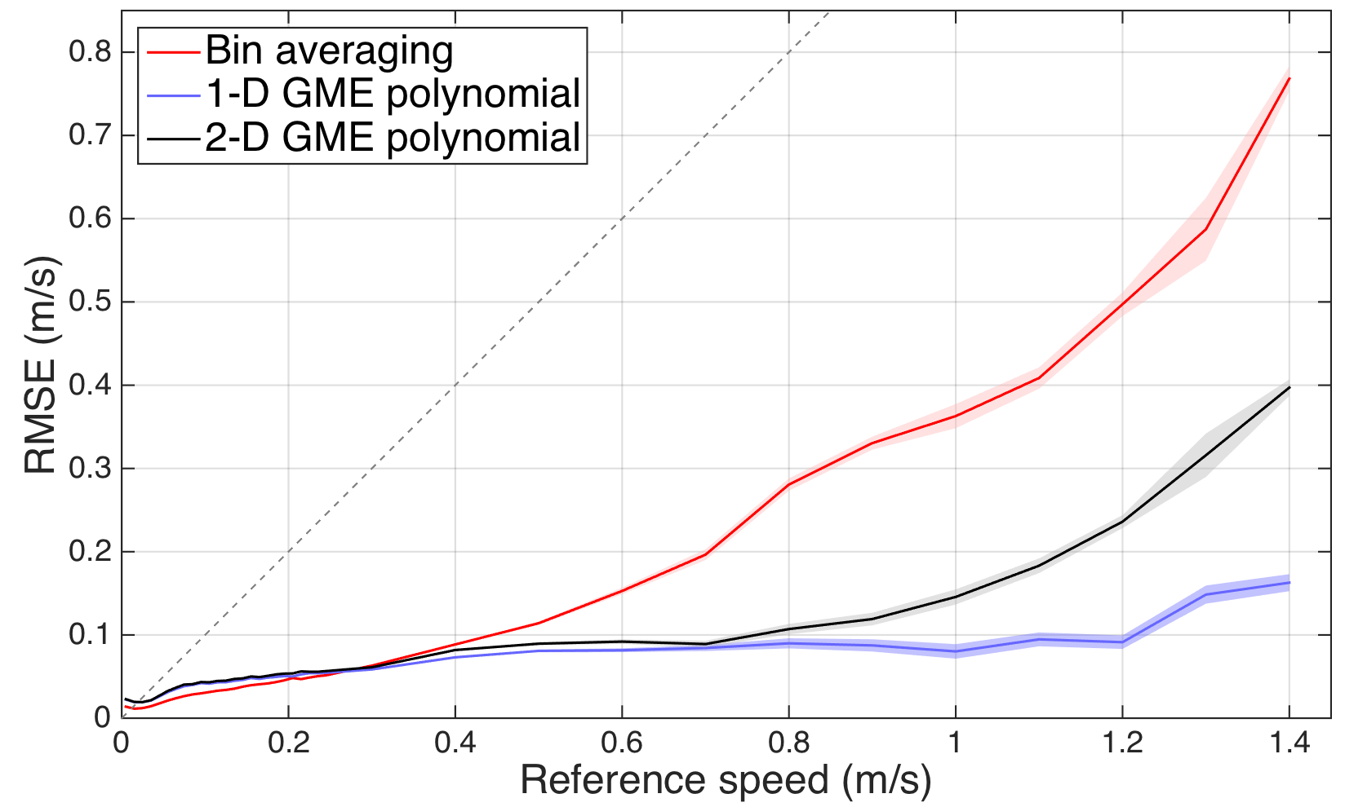
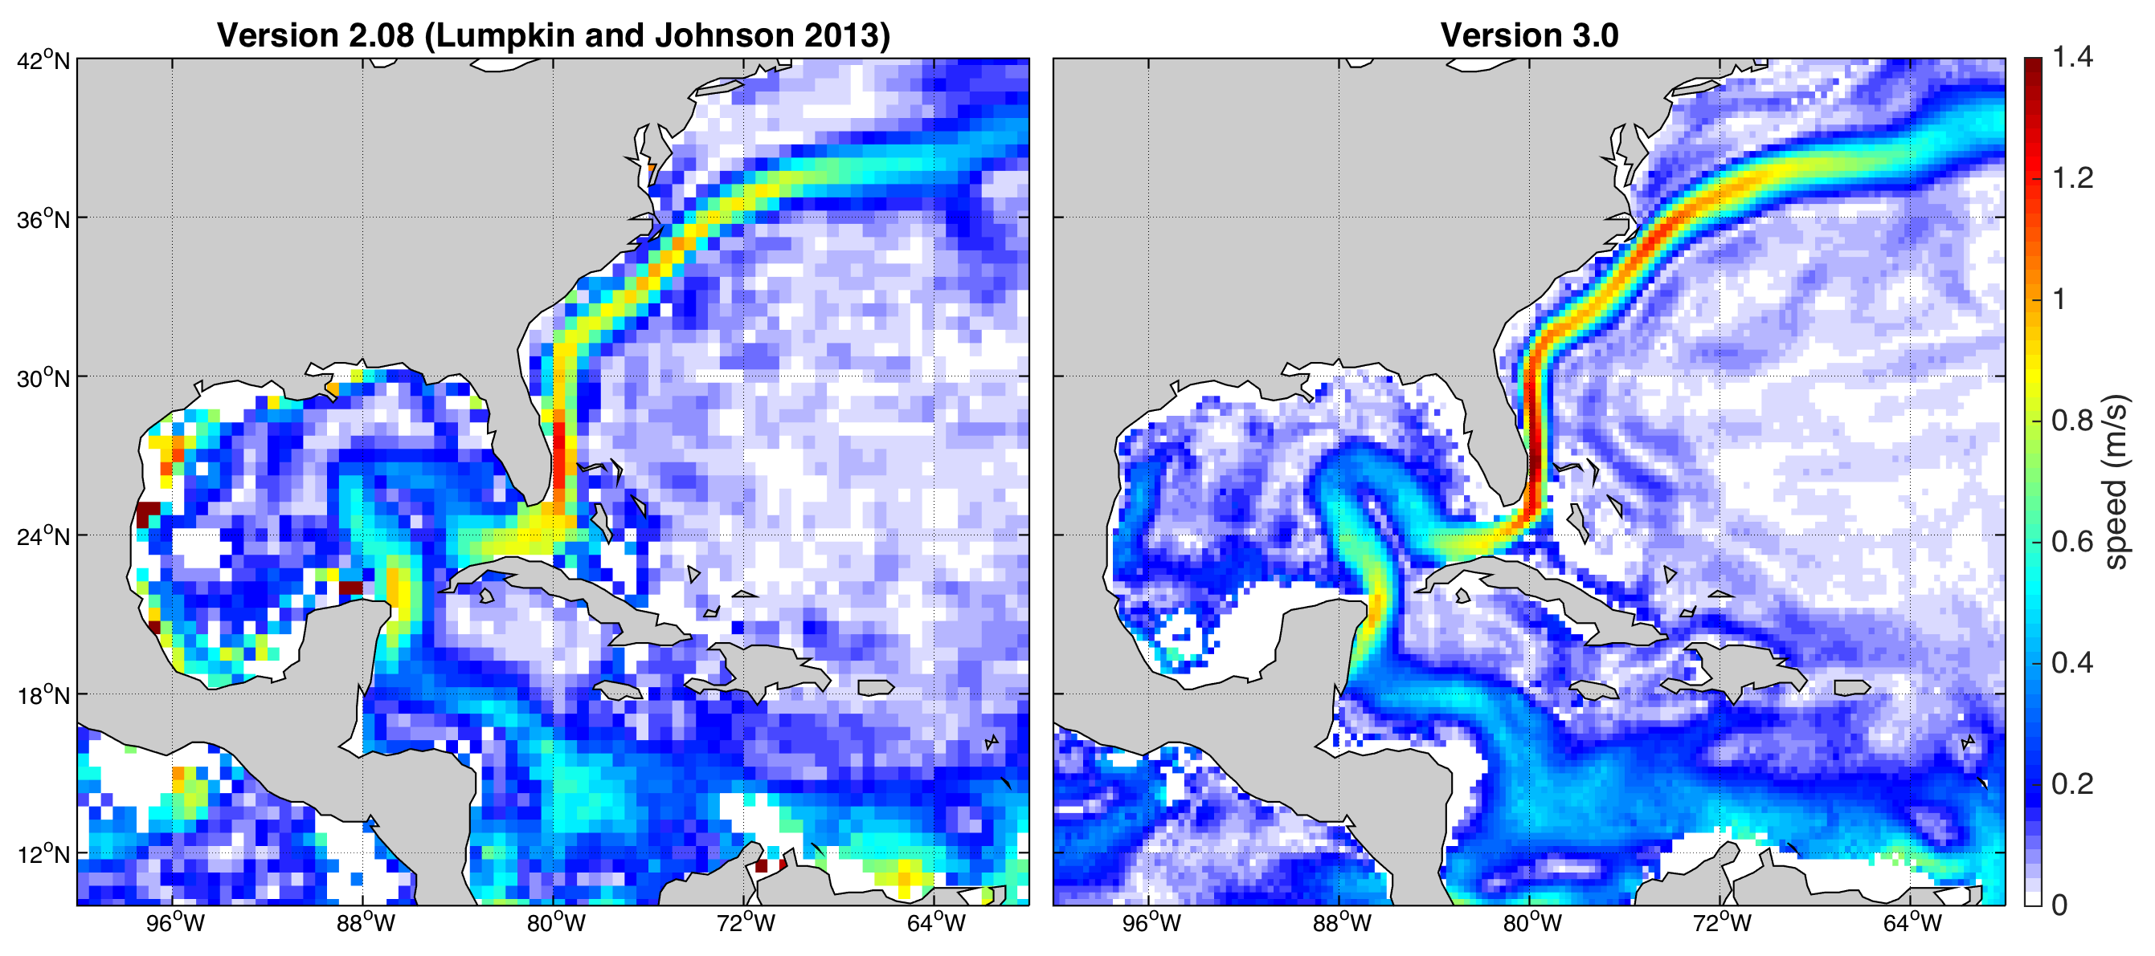
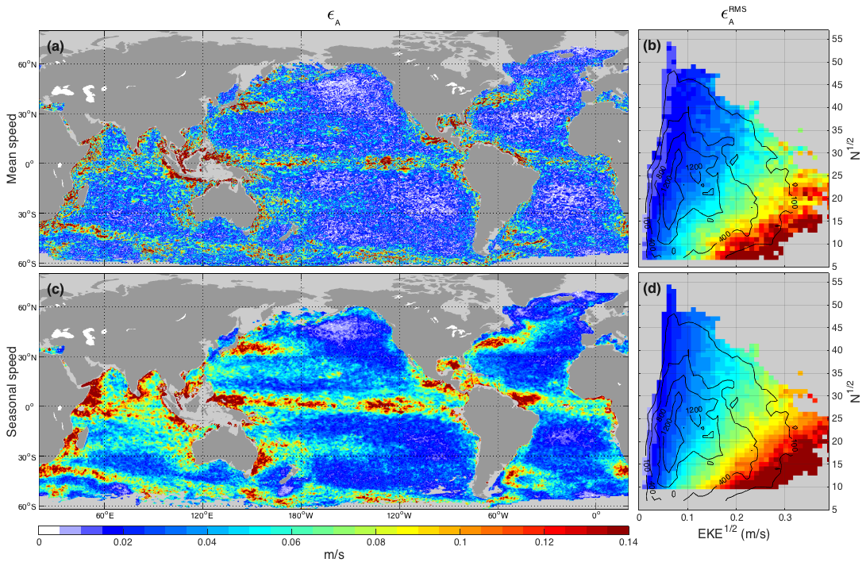
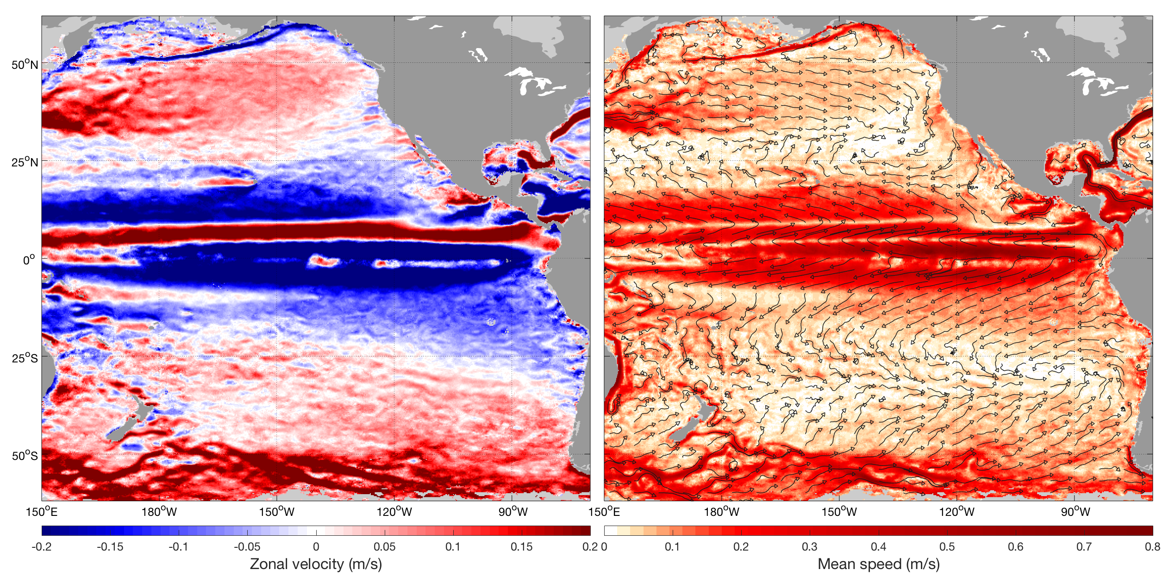
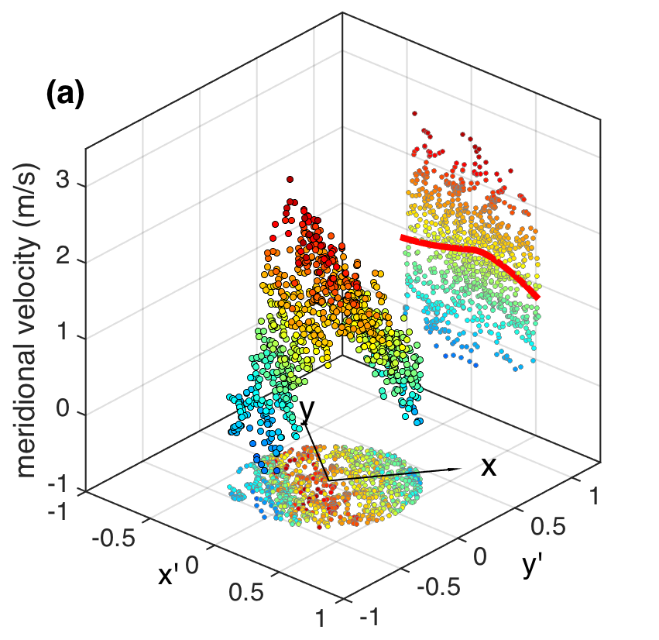
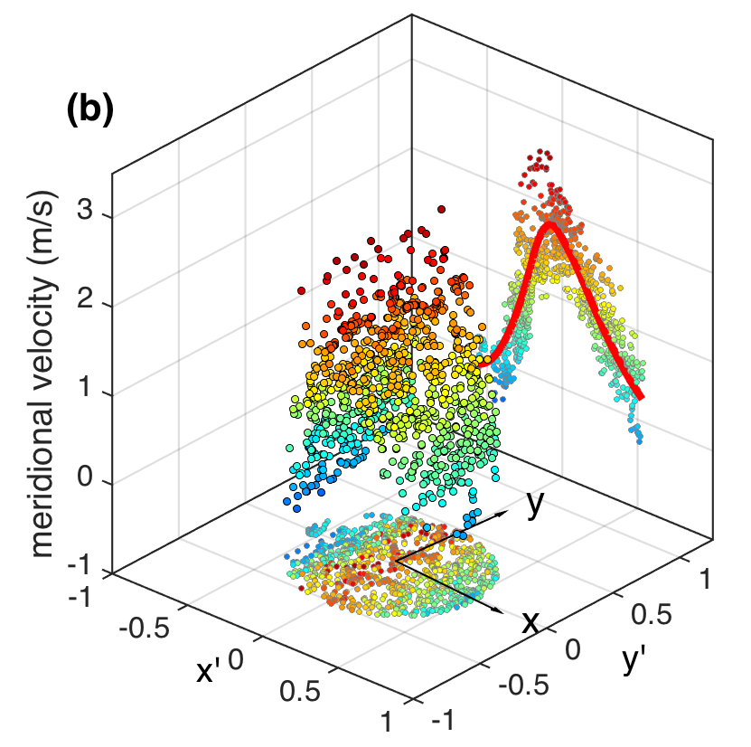
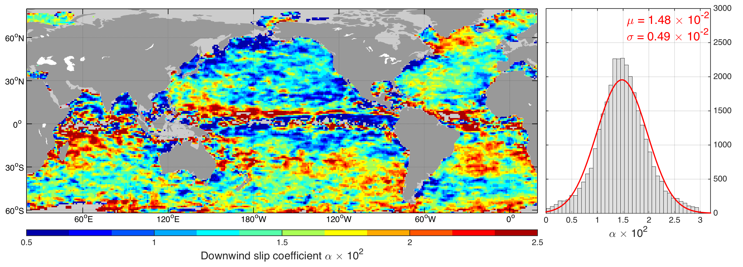
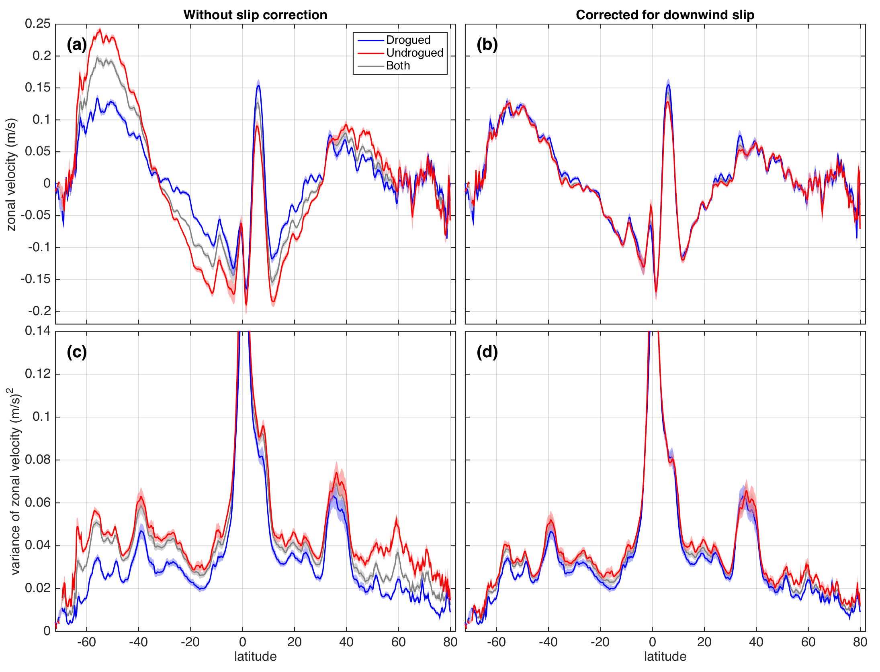
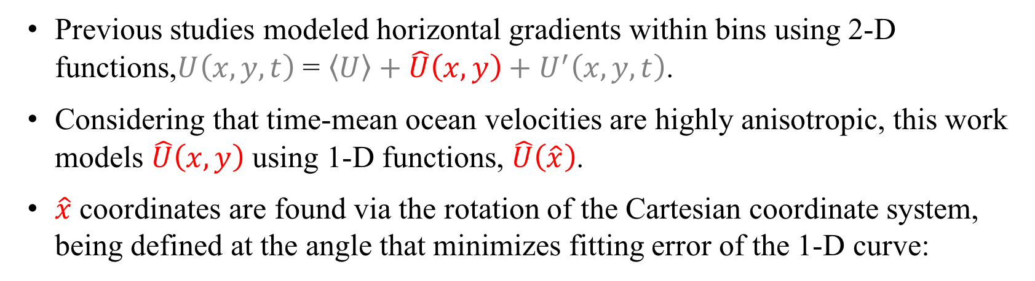

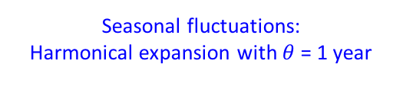





An improved near-surface velocity climatology for the
global ocean from drifter observations
Rick Lumpkin¹, Lucas C. Laurindo², and Arthur J. Mariano²
¹NOAA/AOML, ²RSMAS/Univ. Miami
1. Introduction:
3. Method tuning and error analysis:
5. New Global Drifter Program climatological fields:
Global Drifter Program (GDP) drifters currently provide the most accurate observations of near-surface ocean velocities globally. Using data from 15-m drogued GDP drifters, Lumpkin and Johnson (2013) [1] produced a global near-surface velocity climatology using a new binning method that simultaneously models spatial and temporal variations.
To obtain statistically significant estimates homogeneously distributed throughout the oceans, [1] selected observations within relatively large bins [ellipses with areas of $A=π{\left(2°\right)}^{2}$], with the potential to smooth horizontal velocity gradients at scales smaller than the bin size.
Aiming to refine the drifter-derived climatology, this work [2] updates the methods of Lumpkin and Johnson (2013) by (a) incorporating data from undrogued drifters to the analysis, and (b) introducing a new estimation method designed to further reduce the smoothing of spatial gradients inherent in data binning methods.
Method is evaluated using Eulerian and pseudo-Eulerian statistics of a ‟toy” dataset, consisting of altimeter-derived geostrophic velocities (GV) subsampled at the GDP drifter locations, and the full GV fields.
Absolute errors $\left(ε_{A}\right)$ are defined as the magnitude of the difference between Eulerian and pseudo-Eulerian statistics.
Sensitivity tests resulted in n = 4, m = 2, T_{d} = 6.33 days, and a ¼° × ¼° mapping resolution.
1° radius bins are chosen to balance smoothing and N.
Top: $ε_{A}$ of pseudo-Eulerian mean velocities obtained via bin-averaging, 2-D GME [1], and 1-D GME, as a function of the reference Eulerian values, for 1° radius bins.
Right: $ε_{A}$ map for (a) mean and (c) seasonal velocity estimates. (b) and (d) are diagrams of the RMS $ε_{A}$ calculated as a function of EKE^{1/2} and N^{1/2} for each component.
Absolute errors ($ε_{A}$) scale as a function of ($σ/$N)^{1/2}, however are about 2× larger than the standard errors ($ε_{SE}$) predicted by theory.
2. Decomposition method:
Pseudo-Eulerian mean speed maps for the Gulf of Mexico and the western North Atlantic from GDP drifter data. Left: calculated as described in Lumpkin and Johnson (2013) [1]. Right: obtained using the updated procedure [2].
The right panel shows core speeds for the Florida Current and Gulf Stream up to 50% larger, and includes a better resolved Antilles Current, recirculation cells, and circulation patterns in the basin’s interior.
Previous studies modeled horizontal gradients within bins using 2-D functions,$U\left(x,y, t\right)$ = $\left\langle U\right\rangle +\hat{U}\left(x,y\right)+U^{′}\left(x,y,t\right)$.
Considering that time-mean ocean velocities are highly anisotropic, this work models $\hat{U}\left(x,y\right)$ using 1-D functions, $\hat{U}\left(\hat{x}\right)$.
$\hat{x}$ coordinates are found via the rotation of the Cartesian coordinate system, being defined at the angle that minimizes fitting error of the 1-D curve:
4. Correction of the slip bias of undrogued drifters:
Rotate!
Slip is modeled as a simple downwind motion:
$U_{o}^{s}=α×U_{a}$
where $U_{a}$: 10-m winds from the
ECMWF ERA-Interim reanalysis
For drogued drifters [3]:
$$α_{d}=7 × {10}^{−4}$$
For undrogued [4]:
$α_{u}= \frac{\left\langle U_{o}^{u}\right\rangle −\left\langle U_{o}^{d}\right\rangle }{\left\langle U_{a}\right\rangle }+ α_{d}$
Within a bin with N observations, $U_{p}\left(\hat{x}, t\right)$, p = 1, 2, 3, …, N:
$$U_{p}\left(\hat{x}, t\right)= \sum_{i=0}^{n}{[a_{i}{\left(\hat{x}\right)]}^{i}}+ \sum_{j=1}^{m}{\left[b_{j}\sin\left(\frac{θt}{j}\right)+c_{j}\cos\left(\frac{θt}{j}\right)\right]}+U_{p}^{′}(\hat{x}, t)$$
In matrix form: $U=Az+U′$;
Gauss-Markov Estimation (GME) solution for z is [1]:
$z=R_{z}A^{T}{\left(AR_{z}A^{T}+R_{n}\right)}^{−1}U$, where:
$R_{z}$: variance-covariance matrix of the coefficients in z,
$R_{n}$: variance-covariance matrix of the eddy residuals, given by:
$R_{n}= σ^{2}\cos\left(\frac{πt}{2T_{d}}\right)\exp\left[−\left(\frac{πt}{2\sqrt{2T_{d}}}\right)\right]$, where
$T_{d}$: decorrelation time scale.
Variance-covariance matrix of the standard errors ($ε_{SE}$) of z:
$$P_{z}=R_{z}−{R_{z}A}^{T}{\left(AR_{z}A^{T}+R_{n}\right)}^{−1}AR_{z}$$
Errors are propagated to modeled velocities via $P_{n}=AP_{z}A^{T}$
Left: New pseudo-Eulerian mean zonal velocities for the Pacific Ocean, revealing numerous zonally-elongated striation patterns. Right: mean velocity magnitude (speed) overlaid with curly vectors (streamlines), to indicate the general direction of the large-scale circulation. Unlike in previous studies, the streamlines are calculated using unsmoothed mean velocity estimates.
Top: large-scale patterns of $α_{u}$ suggests a geophysical forcing mechanism:
Response to a spatially-varying surface gravity wave field?
The slip correction takes into account the spatial variations of $α_{u}$ by interpolating the obtained values to drifter locations.
Left: correction produces zonally-averaged pseudo-Eulerian mean velocities for drogued and undrogued data that are statistically similar across most latitudes, and reduces differences between their zonally-averaged variances.
Remaining differences are largely caused by factors unrelated to the slip bias, e.g. method errors, biased sampling, and reduced N.
Mean spatial structure:
1-D, n^{th} degree polynomial
Seasonal fluctuations:
Harmonical expansion with $θ$= 1 year
6. Conclusions:
7. References:
The proposed decomposition method reproduces pseudo-Eulerian mean velocities, their monthly variations, and formal error estimates better than other methods;
Standard errors underestimate the actual errors by about a factor of two;
The correction of drifter slip bias produces similar mean and variances for the drogued and undrogued drifter velocity datasets, allowing for a large increase in data density;
The new version of the climatology better resolves features such as the cross-stream structure of western boundary currents, recirculation cells, and zonally-elongated mid-ocean striations.
[1] Lumpkin, R. and G. C. Johnson, 2013:. Global ocean surface velocities from drifters: mean, variance, ENSO response, and seasonal cycle. J. Geophys. Res., 118, 2992– 3006.
[2] Laurindo, L., A. Mariano, and R. Lumpkin, 2017: An improved near-surface velocity climatology for the global ocean from drifter observations. Deep-Sea Res., accepted April 2017.
[3] Niiler, P. P., A. S. Sybrandy, B. Kenong, P. M. Poulain, and D. Bitterman, 1995:. Measure- ments of the water-following capability of holey-sock and tristar drifters. Deep-Sea Res. 42 (11/12), 1961–1964.
[4] Pazan, S. E. and P. P. Niiler, 2001:. Recovery of near-surface velocity from undrogued drifters. J. Atmos. Oceanic Tech., 18, 476–489.

