Slide 1
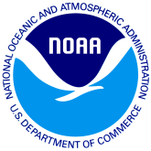
NOAA’s Atlantic Oceanographic and Meteorological Laboratory (AOML) Ocean Acidification activities in the Caribbean region prepared by Leticia Barbero, AOML

Slide 2
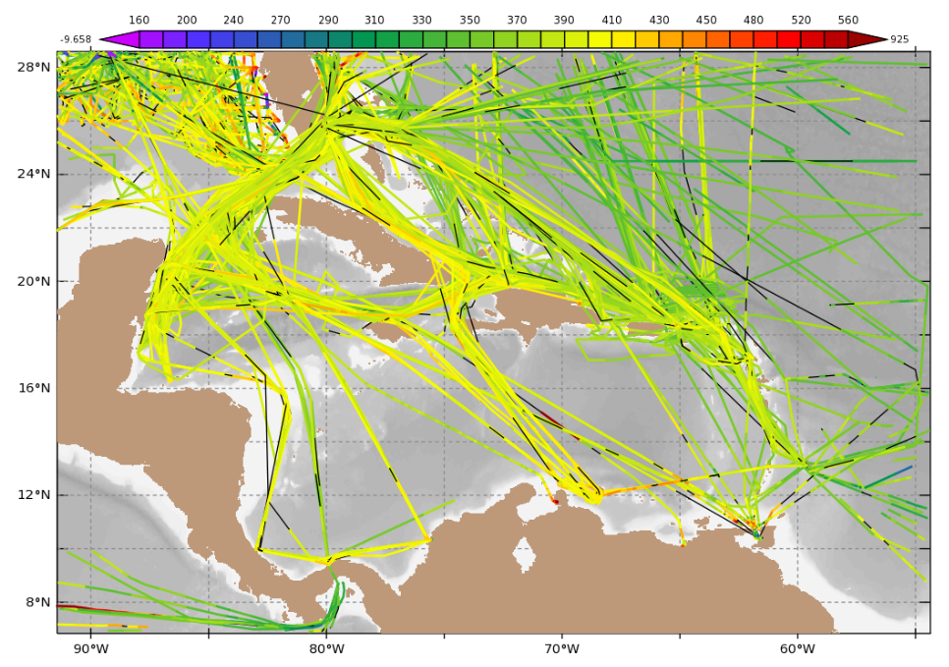
Ships of Opportunity
CPO provides funds for pCO₂ measurements on board several ships including Royal Caribbean’s Explorer of the Seas, Equinoz and Allure of the Seas, collecting data in the Caribbean, and two NOAA ships: R/Vs Gordon Gunter and Henry Bigelow.
AOML data in the Caribbean
Data is sent to CDIAC/NCEI for storage as well as to SOCAT (socat.info).
Data are used in several annual carbon estimates, e.g. Global Carbon Budget. 2018 budget available at:
All data routinely made available at: http://www.aoml.noaa.gov/ocd/ocdweb/occ.html

Slide 3
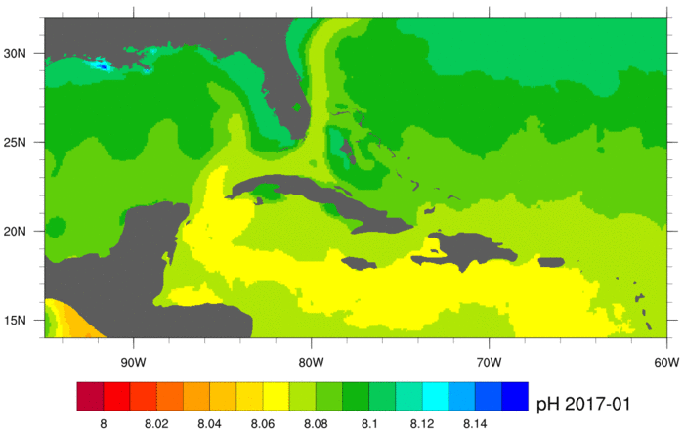
Ocean Acidification Product Suite
A tool to view ocean acidification in the Gulf of Mexico and Caribbean, using satellite data and a data-assimilative hybrid model to map the components of the carbonate system of surface water.
Animations show the monthly progression of pH, surface pressure of CO₂, total alkalinity, aragonite, and calcite saturation states (Ω_{Ar} and Ω_{Ca}), as well as NetCDF files for each variable, can be found at:
https://www.coral.noaa.gov/accrete/oaps.html

