Slide 1
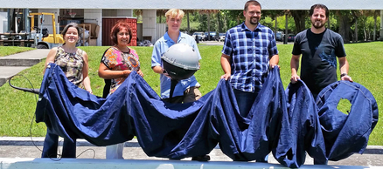
Global Drifter Program (GDP)
Drifting buoy measurements of Mixed Layer Currents (and Sea Surface Temperature, Atmospheric Pressure, Salinity, Wind, and Waves)
http://www.aoml.noaa.gov/phod/dac/gdp.html
GlobCurrent User Consultation Meeting, March 21—23, Frascati, Italy
Notes:
Global drifter program: an overview.

Slide 2
GDP purpose
GDP: the principal component of the Global Surface Drifting Buoy Array, a branch of NOAA’s Global Ocean Observing System and Global Climate Observing System and a scientific project of the Data Buoy Cooperation Panel.
Objectives:
Maintain a global 5ºx5º array of ~1300 satellite-tracked Lagrangian surface drifting buoys to meet the need for an accurate and globally dense set of in-situ observations of mixed layer currents, SST, atmospheric pressure, winds, and salinity.
Provide data processing system for scientific use of these data.
These data support short-term (seasonal-to-interannual) climate predictions as well as climate research and monitoring.
Notes:
Goals of the GDP

Slide 3
Organization of the Global Drifter Program
Funding from NOAA’s Climate Observations Division of the Climate Program Office. Additional development and instruments at Scripps funded by ONR.
Manufacturers in private industry, who build the drifters according to closely monitored specifications
AOML (Miami, FL)
Rick Lumpkin
Scripps (La Jolla, CA)
Luca Centurioni
Supervises the industry, upgrades the technology, purchases most drifters, and manages several aspects of Iridium data stream
Drifter Operations Center
Drifter Data Assembly Center

Slide 4
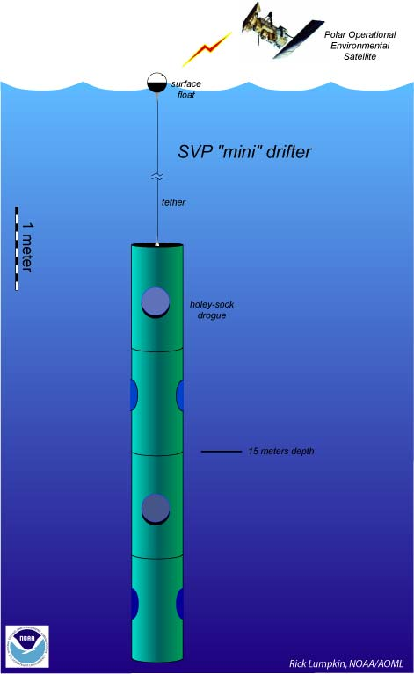
The satellite-tracked drifter
Spherical surface float
Polyurethane impregnated tether
Holey Sock nylon drogue centered at 15m depth
D-cell batteries inside the float
Sensors:
Drogue: drogue detection by submergence or tether strain sensor
Thermistor: measure SST
Voltage: indicates batteries’ life
Cost: ~$1600
Holey-sock drogue
(sea anchor)
Notes:
Batteries provide power, nominal operation of 2 years. Average life ~ 400 days
Cost of basic drifter ~ $1800, ~ $3000 Barometer, ~ $1200 for baro upgrade
Drogued at 15-m depth to measure mixed layer currents.
Original SVP made out of ordura nylon, original designed: 7 sections each 92 cm long and 92 cm in diameter.

Slide 5
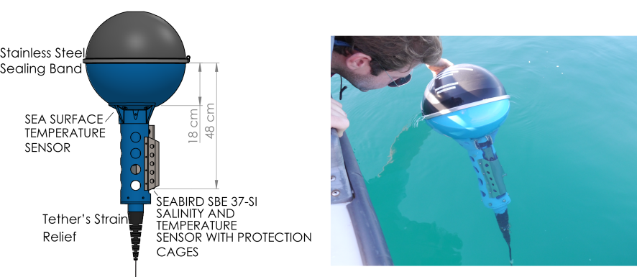
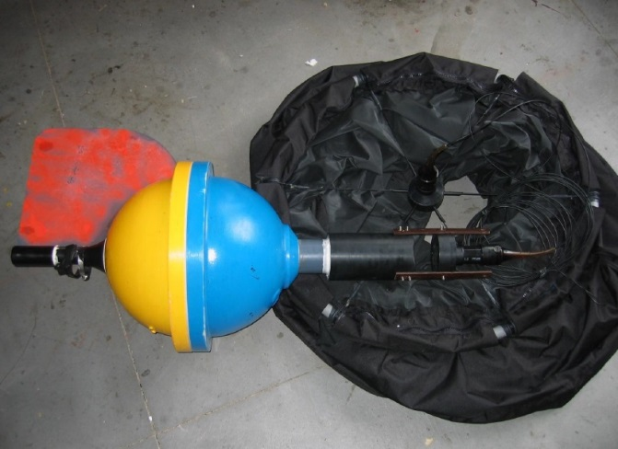
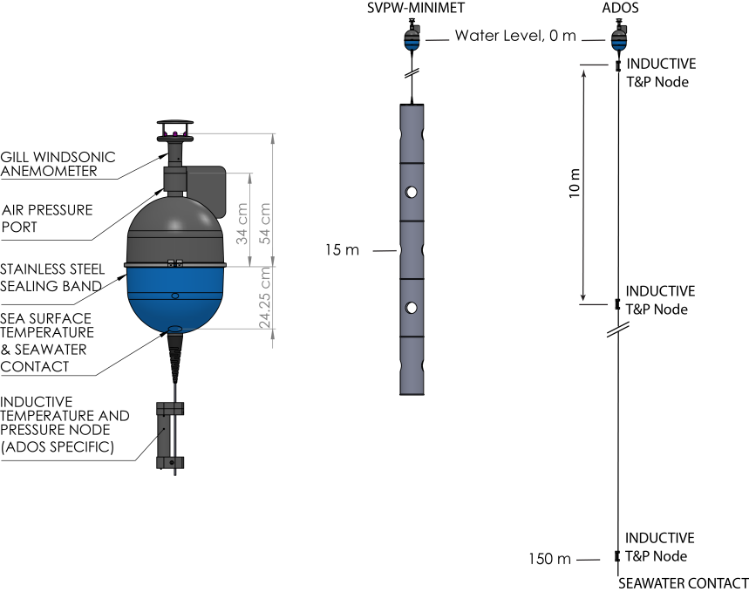
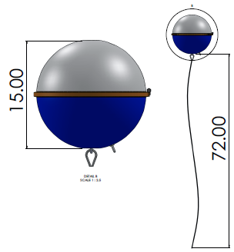
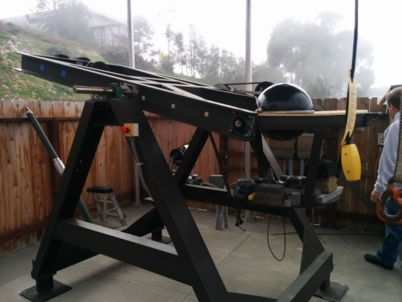
Provides a solid global infrastructure to add new sensors to directly measure essential ocean and climate variables such as wind, salinity, subsurface temperature, and waves and supply new in situ measurements for satellite cal/val
Salinity Drifter
ADCP Drifter (v. 2004)
ADOS and Minimet
Wave Drifter

Slide 6
Velocity observations
To lowest order, the velocity of a drifter is a combination of the large-scale geostrophic flow and the Ekman flow at a depth of 15m.
However, drifters do not perfectly follow the water at the drogue depth.
For example, water can sink beneath the surface, while the drifter is forced to stay at the sea surface.
Also, the drifter can "slip" through the water with respect to the motion at the drogue depth.

Slide 7
Slip
Slip is caused by wind pushing on the surface float, drag on the float and tether, and rectification of surface waves (Niiler et al., 1987; Geyer, 1989).
As long as the drogue remains attached to the drifter, the downwind slip is estimated at 0.7 cm/s in 10 m/s of wind speed (Niiler and Paduan, 1995). If a drifter loses its drogue, it will slip downwind at a speed of 8.6 cm/s in 10 m/s of wind (Pazan and Niiler, 2001).
Few studies have carefully examined the motion of drifters that have lost their drogues. However, these data tell us much about how the ocean carries floating marine debris (e.g., Beron-Vera et al., 2017).

Slide 8
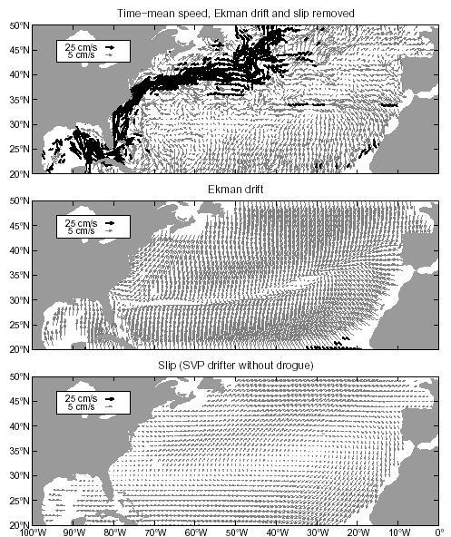
Total speed
The resulting total speed of a drifter is a combination of the large-scale geostrophic currents at 15 meters depth, plus the upper-ocean wind-driven Ekman flow, plus the slip.
Lumpkin and Pazos (2007)

Slide 9
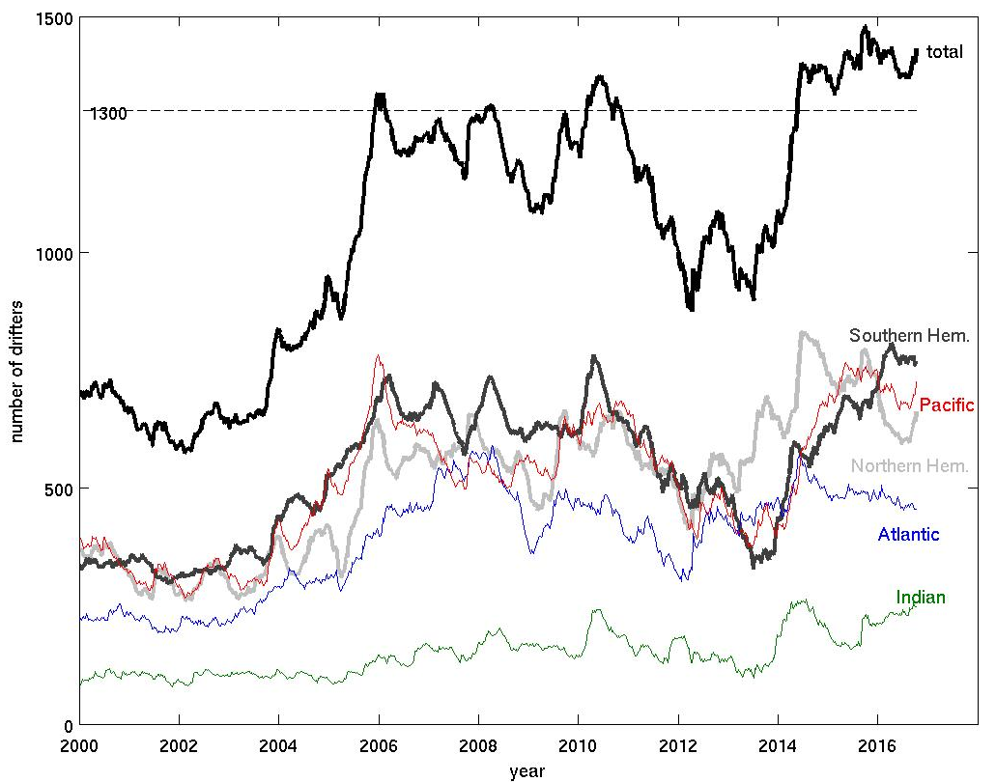
Evolution of the array by basin
Notes:
arraysize.m

Slide 10
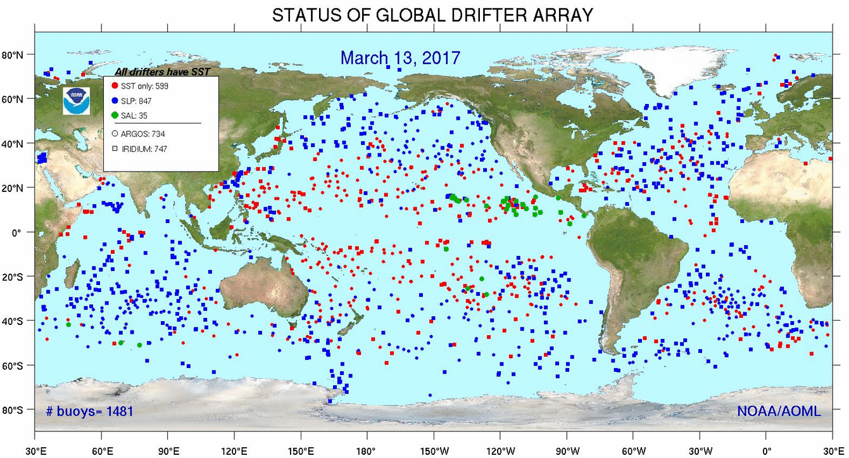
Current status of the global array

Slide 11
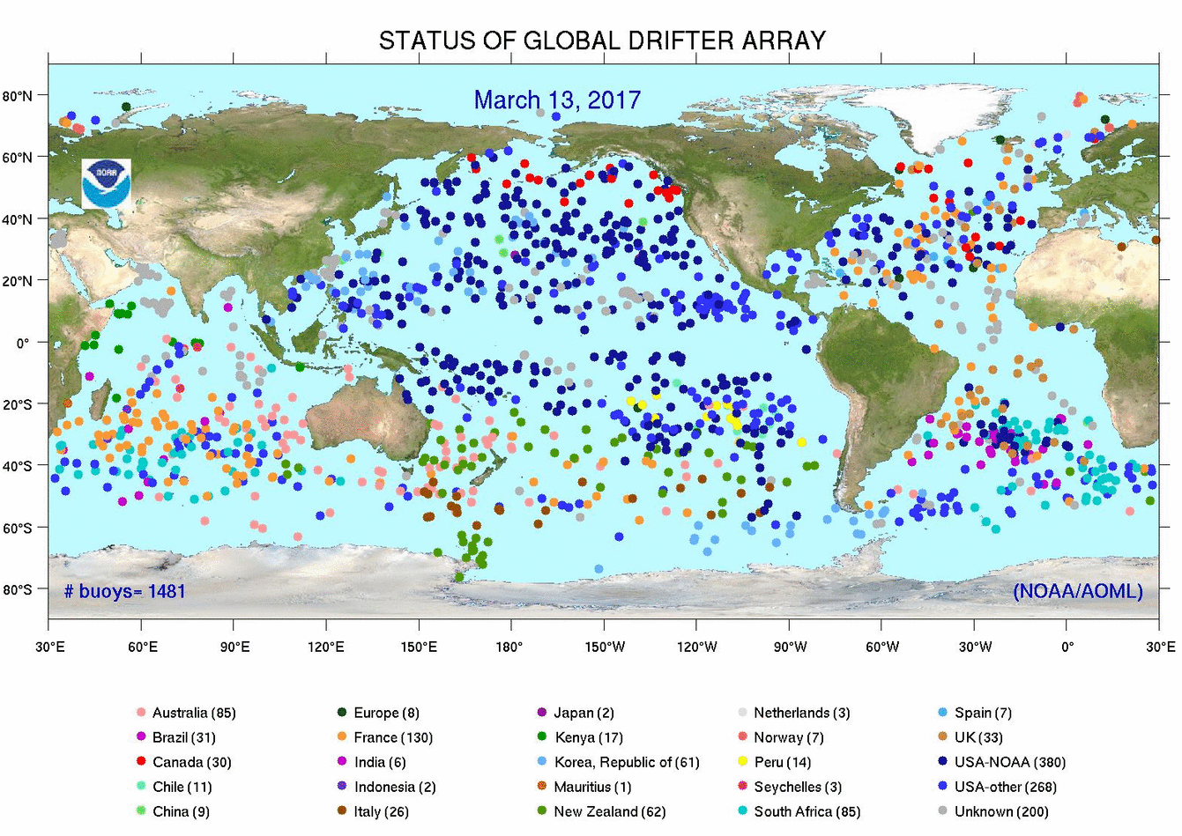
Current status of the global array

Slide 12
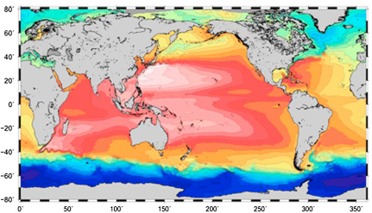
Use of Velocity from Drifters at Low Frequency: the Mean Dynamic Topography (MDT)
The MDT can be computed from large-scale information (GRACE) and small-scale information (geostrophic currents derived from drifters).
Maximenko et al. (2009)
Rio et al. (2014): CNES-CLS13 MDT used in GlobCurrent v2.0

Slide 13
Drifter Sampling Submesoscale, Inertial, Superinertial, Tidal and Diurnal Cycle
Near-inertial variance from hourly drifter position, from Elipot et al. 2010

Slide 14
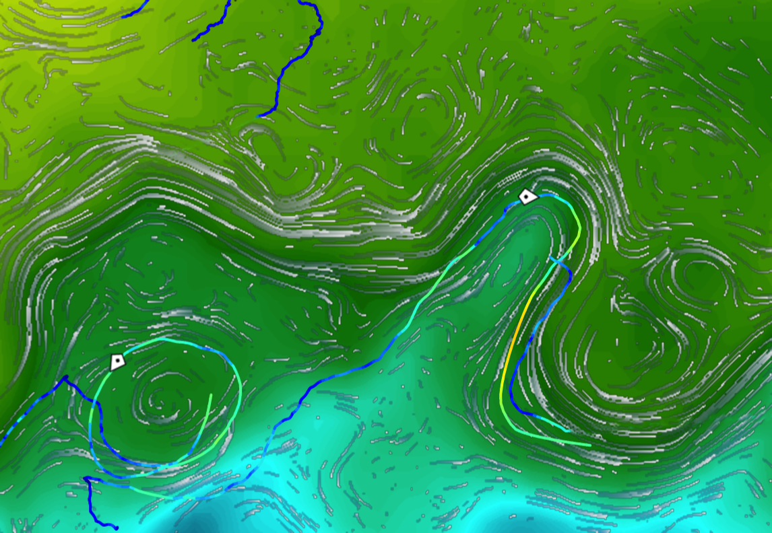
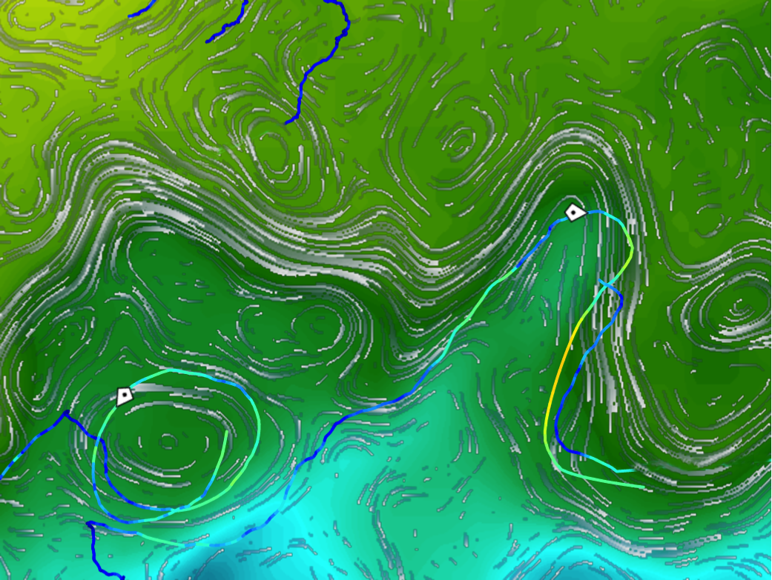
24 April 2015, Uncorrected velocity field
24 April 2015, Corrected velocity field
Courtesy Lucille Gaultier, OceanDataLab
Streamlines of altimeter derived velocities overlaid microwave SST and drifters.
Streamlines of corrected velocities using SST plotted with microwave SST and drifters.

Slide 15
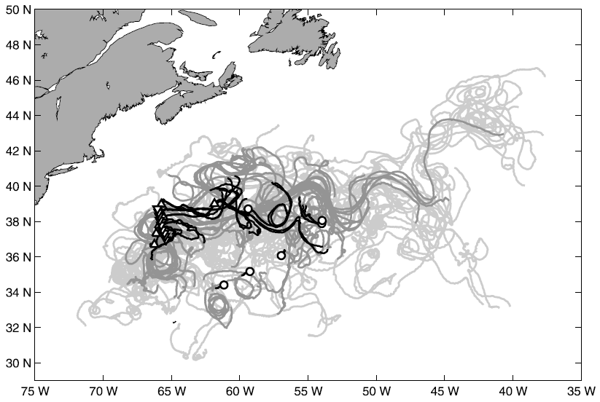
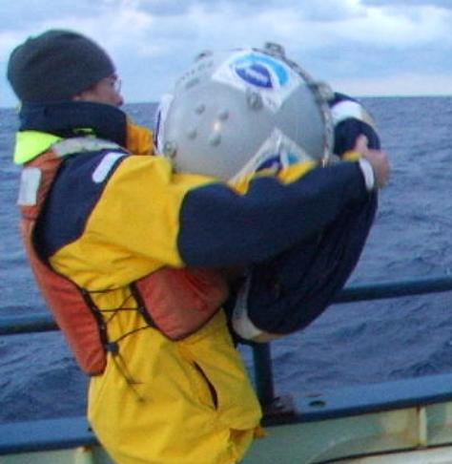
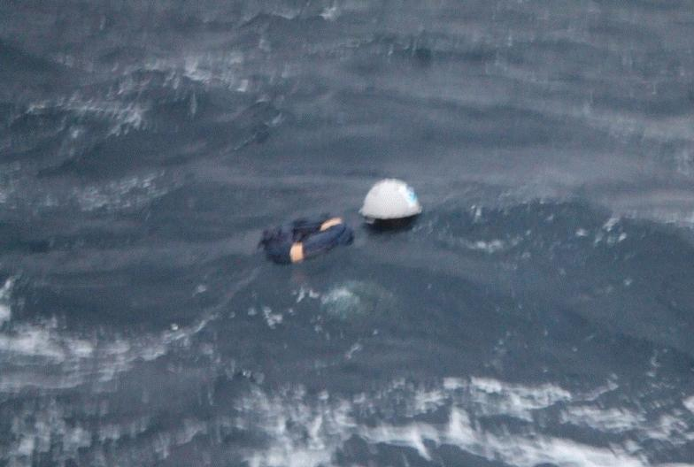
Drifter array in the Gulf Stream region February—March 2007 cruise, R/V Knorr Goal: measure dispersion (spreading)
60 drifters deployed in trios and pairs
Black: February. Dark Grey: March. Light Grey: Apr-July

Slide 16
A typical pair
deployed
10 days
20 days
Deployed on 4 March 2007 as part of a trio. Separation at rate close to the mean for all of the drifter pairs.
Lumpkin and Elipot (2010)

Slide 17
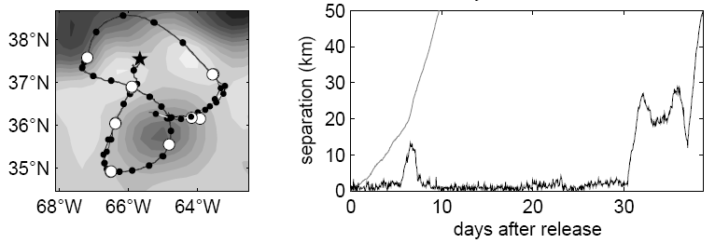
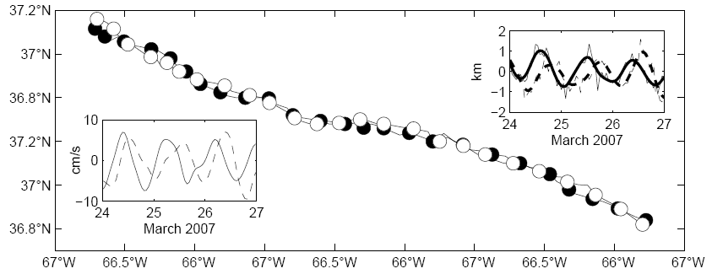
A very unusual pair
deployed
30 days
10 days
20 days
Deployed on 4 March 2007 (a different pair of the same trio as “typical pair”). Separated to 14 km at day 6, but then reconverged and stayed <3km apart for 23 days!
Cyclonic submesoscale vortex, orbital period 0.87-0.9 days (IP: 0.83d), radius <3km.
Lumpkin and Elipot (2010)

Slide 18
Using drifter statistics to estimate the fate of floating marine debris
Strategy:
Divide world’s oceans into small boxes.
For each box, find all the drifters that were ever in the box.
Calculate where each of those drifters went five days later.
Assume that those statistics will also describe how marine debris will be carried by ocean currents and winds.
Use these statistics to simulate the spread of hundreds, thousands or millions of particles.

Slide 19
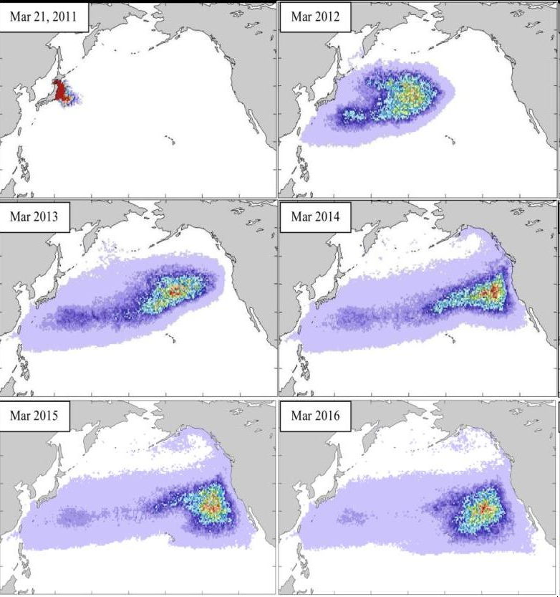
Simulations by Nikolai Maximenko and Jan Hafner (Univ. Hawaii) using drifter statistics, to simulate fate of debris from 11 March 2011 earthquake and tsunami.

Slide 20
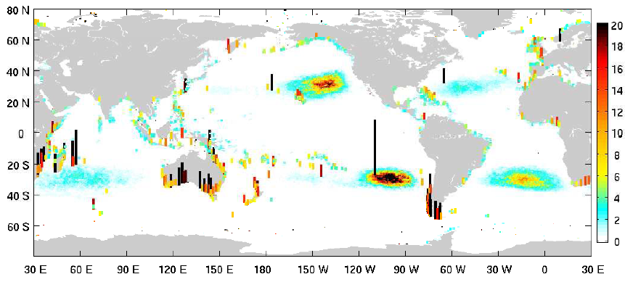
Exposure to marine debris
Distribution of the concentration of floating marine debris in arbitrary units, 10 years after being released homogeneously at a concentration of 1. Vertical bars indicate the concentration of material that has washed ashore, with color corresponding to 10X the value in the color bar.
Lumpkin, Maximenko and Pazos (2012)

Slide 21
Other recent advances
Drifter array transitioning to 80% Iridium+GPS by mid-2019. Now >50%.
Drogue presence using Time To First Fix (from GPS) has been validated as more robust than tether strain.
Real-time drogue detection is being developed as more drifters transition to Iridium with GPS, thus allowing operational near-surface currents to be released to the GTS.

Slide 22
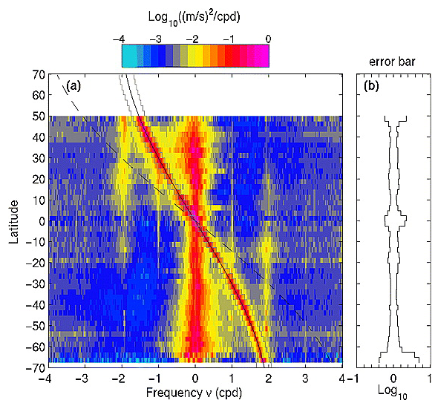
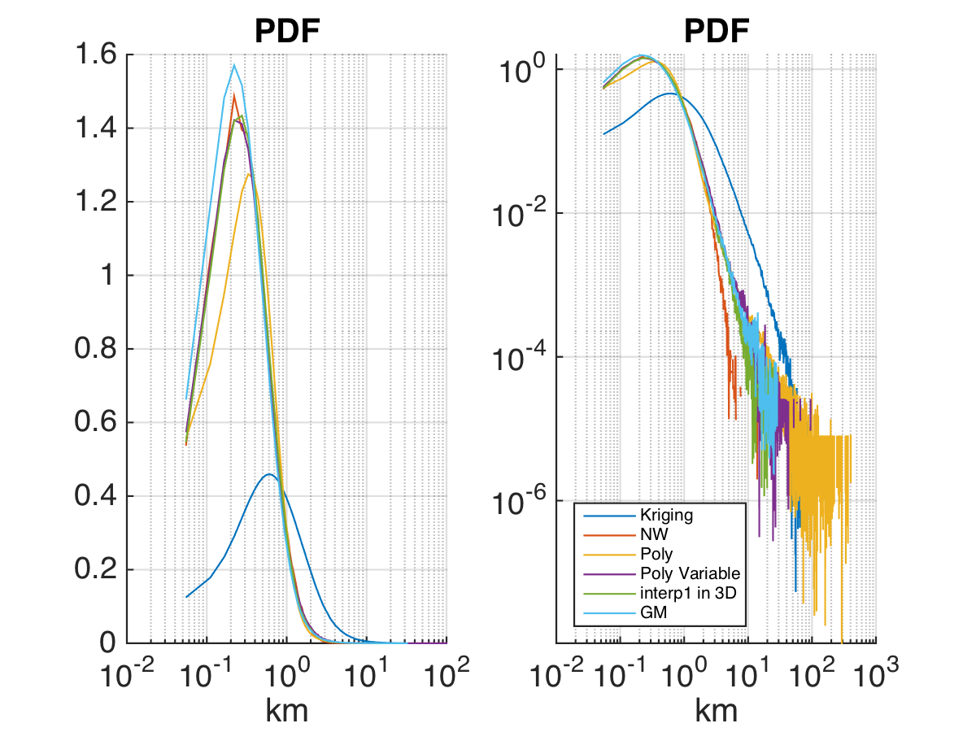
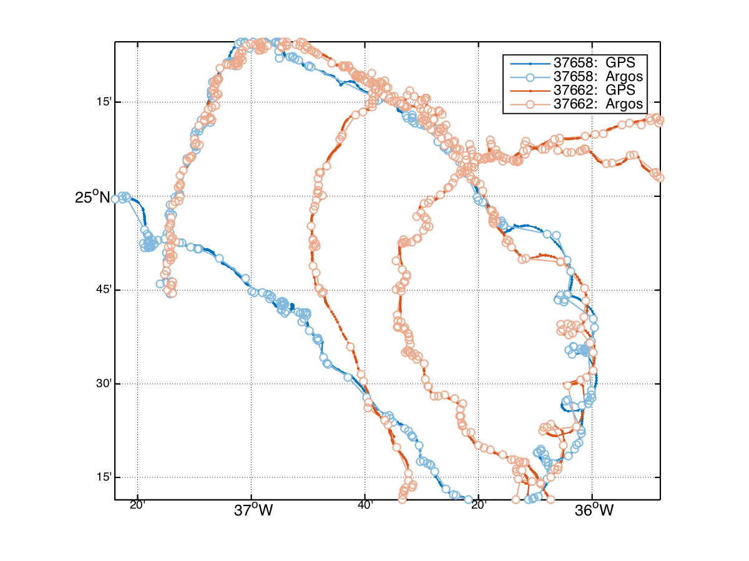
New product: hourly drifter data includes error estimates for hourly position
SPURS drifters
Left: spectral energy density in hourly drifter observations as a function of latitude, showing inertial, tidal (diurnal and semidiurnal) and subinertial (primarily geostrophic) variations (Elipot and Lumpkin, 2008)
Elipot et al., 2016

Slide 23
New Product: hourly drifter data includes error estimates for position, velocity
Left: drifter exhibiting inertial oscillations in 6h data.
Right: the same drifter with hourly resolution.
Elipot et al., 2016

Slide 24
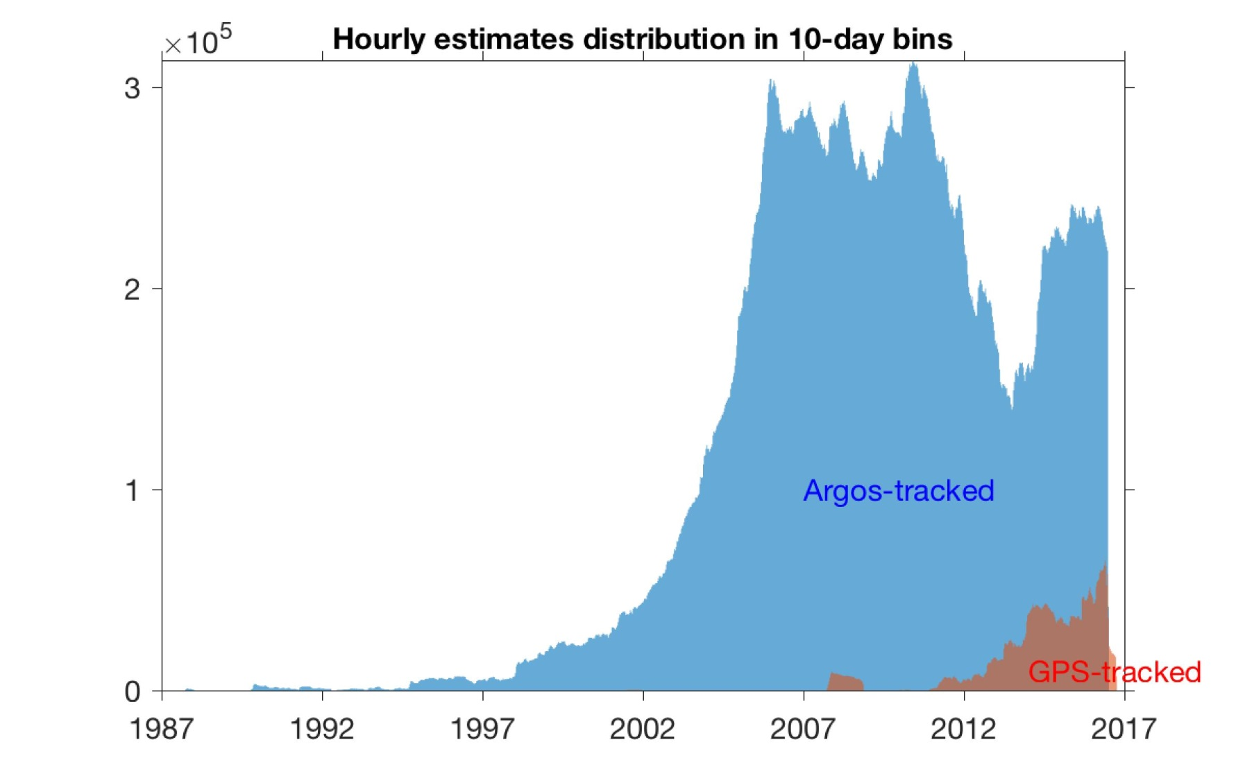
New Product: hourly drifter data Version 1.01 update: now includes data before January 2005, plus one year of newer data

Slide 25
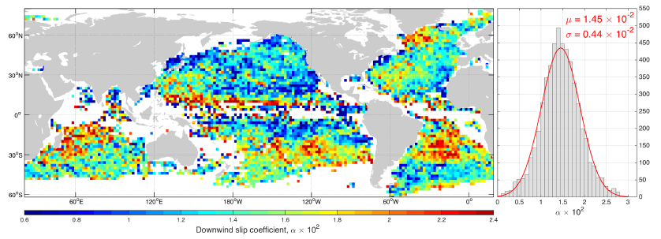
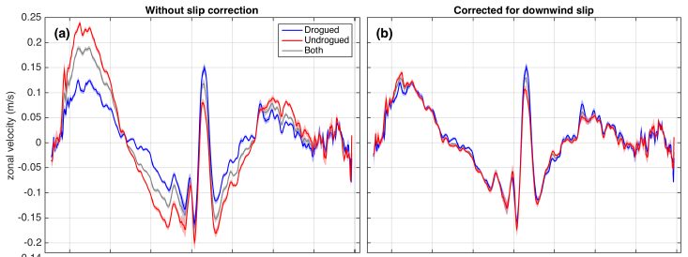
New Product: monthly surface current and EKE climatologies
Downwind slip of undrogued drifters corrected with spatially-varying coefficient to make velocities consistent with drogued velocities
Laurindo et al., in revsion

Slide 26
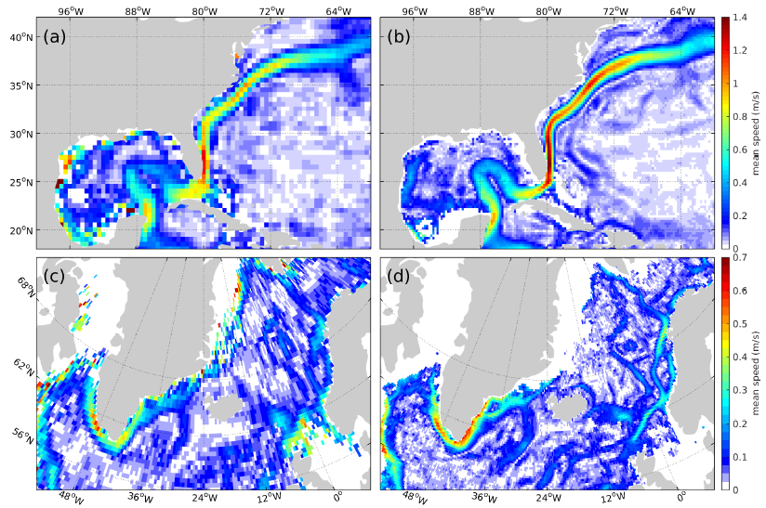
New Product: monthly surface current and EKE climatologies
Left: present mean velocity climatology of the Gulf Stream (top) and the North Atlantic (bottom). Right: new climatology.
Laurindo et al., in revsion

Slide 27
Evaluating GlobCurrent and OSCAR against lowpassed, drogued drifter observations
Spatially averaged correlation coefficients, Jan. 2012—Dec. 2014
Global mean: 0.65
Global mean: 0.70
Global mean: 0.61
Global mean: 0.66
Both OSCAR and GlobCurrent v2 do better for zonal than meridional currents. Lowest values near equator. GlobCurrent has higher values overall, esp. in eddy-poor North Pacific. OSCAR is marginally better than GlobCurrent in the near-equatorial band (+0.04 at 1S—1N) for zonal currents, but marginally less good (-0.12) for meridional currents.

Slide 28
Evaluating GlobCurrent and OSCAR against lowpassed, drogued drifter observations
Spatially averaged velocity difference and std. dev., Jan. 2012—Dec. 2014
Global mean: 5.5 cm/s
Global mean: 4.8 cm/s
Global mean: 16.9 cm/s
Global mean: 16.3 cm/s
OSCAR and GlobCurrent v2 perform similarly with respect to mean offsets and standard deviations. GlobCurrent has slightly smaller mean offsets than OSCAR everywhere, most markedly at 5S—5N (mean difference: -3.5 cm/s, OSCAR-GlobCurrent).
OSCAR has slightly lower std.dev. in low latitudes off the equator, while GlobCurrent tends to have lower std.dev. on the equator and poleward of 20º latitude.

Slide 29
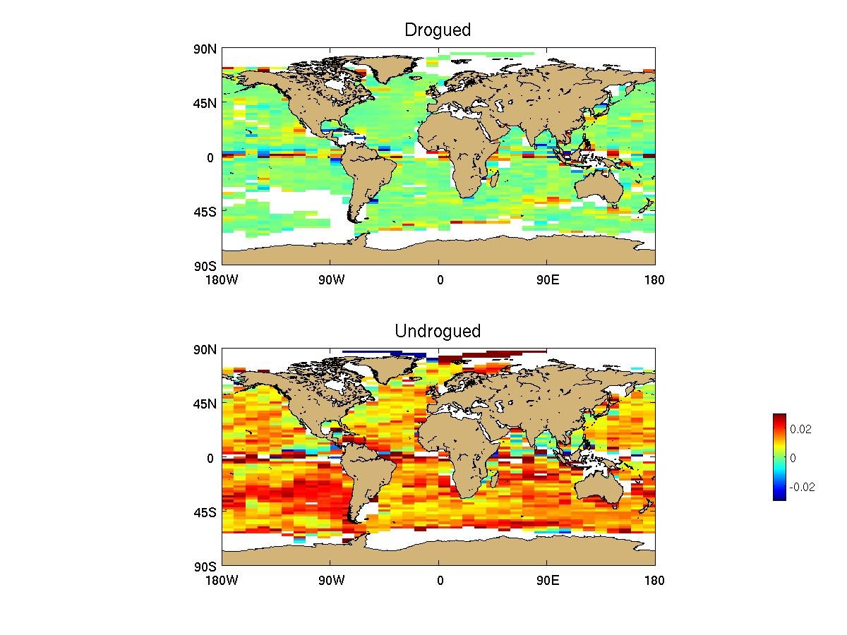
How the drifter program could use GlobCurrent
Bin-averaged values of anomalous downwind speed divided by wind speed, drifter minus GlobCurrent v2 (15m, total), Jan. 2012-Dec. 2014.
Top: drogued.
Bottom: undrogued, same scale.

Slide 30
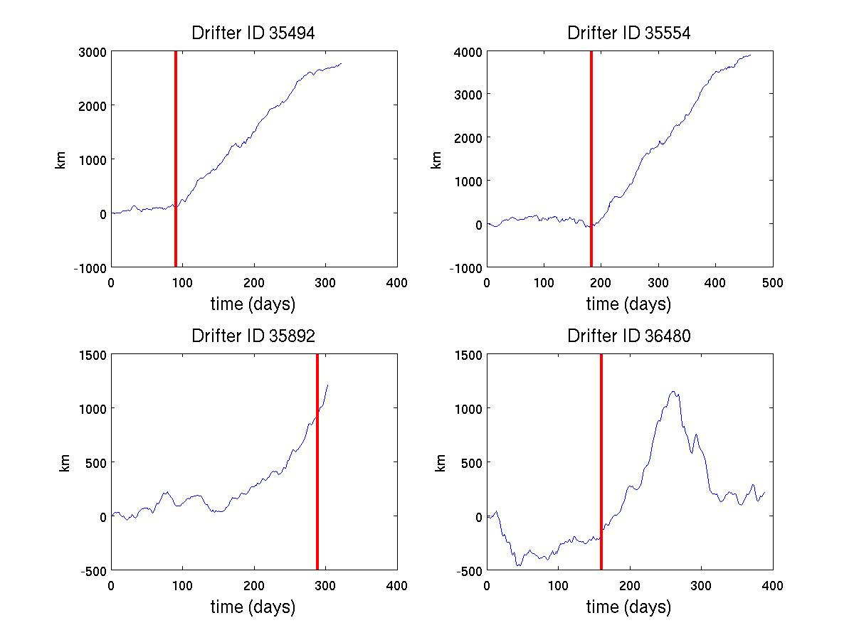
How the drifter program could use GlobCurrent
Anomalous downwind displacement, from integrated drifter minus GlobCurrent v2 (15m, total) downwind velocity
Drogue off
Note: low-latitude drifter (between 3.6—8.5ºN after drogue loss)
Misdiagnosis? Note that drifter is very close to equator before drogue loss (<3º).

Slide 31
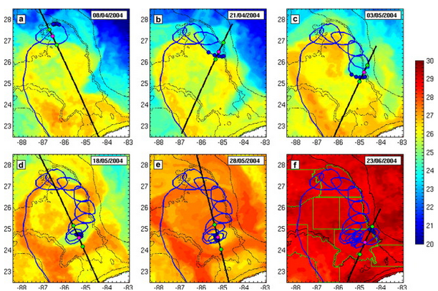
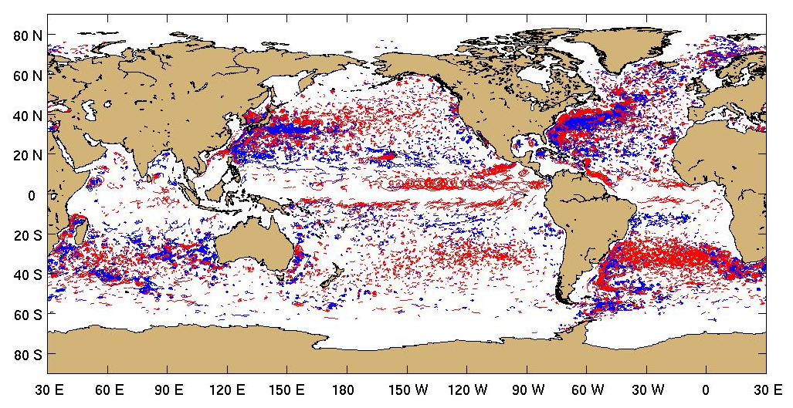
Recent research using Drifters
Structure of cyclonic frontal eddies in the Gulf of Mexico from drifter and satellite measurements
Le Henaff et al. (2014)
Global characteristics of looping drifter trajectories
Lumpkin (2016)
Notes:
Le Henaff et al. (2014): The Loop Current (LC) is the dominant dynamical feature in the Gulf of Mexico (GoM). Its journey varies with time from a retracted position to an extended one, in which it can interact with the northern GoM continental shelf. Once extended, the LC eventually closes its circulation and sheds a large anticyclonic eddy, or ring, while the base of the LC retracts. These changes in the LC extension have important economical, ecological and biological impacts. The ring shedding sequence of the LC is strongly influenced by the presence of smaller, cyclonic eddies, named Loop Current frontal eddies (LCFEs), which are advected along the edge of the LC. Results from a modeling study, based on the Hybrid Coordinate Ocean Model (HYCOM), show that the specific topography of the northern GoM shelf slope is responsible for the
intensification of LCFEs. This intensification allows the LCFEs to play an effective role during the ring shedding. This localized intensification is confirmed by ~20 years of surface drifterobservation data, which also illustrate new aspects of the LCFE dynamics.
Lumpkin (2016): An algorithm is developed that can automatically identify loopers in Lagrangian trajectory data, i.e., looping trajectories that complete at least two orbits . This algorithm is applied to the Global Drifter Program data set, and over 15,000 looping trajectory segments are identified worldwide. The paths taken by the vortices at the center of these looper trajectory segments can be calculated from these data. The Lagrangian integral time scale can also be estimated for the looper segments, and is generally very close to the orbital period – a value several times larger than the integral time scales characterizing nonloopers. Fundamental time-mean quantities such as total kinetic energy and velocity are shown to be significantly different between loopers and nonloopers. These results suggest that a careful approach to the data might require separately calculating means of the nonloopers and loopers, and only afterward combining the weighted results for an overall time-mean picture. While many of the loopers with large radii orbit vortices identified in altimeter-derived eddy census data, many with smaller radii do not match vortices resolved in altimetry. The data from this study are available at http://www.aoml.noaa.gov/phod/loopers/.

Slide 32
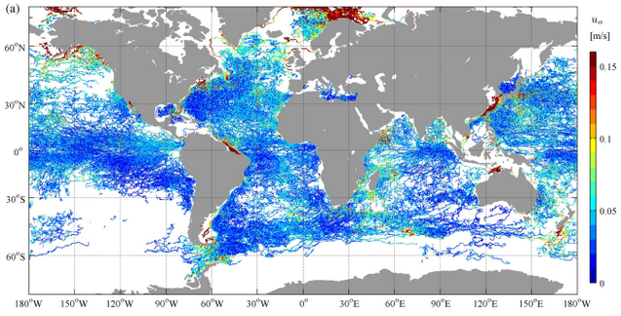
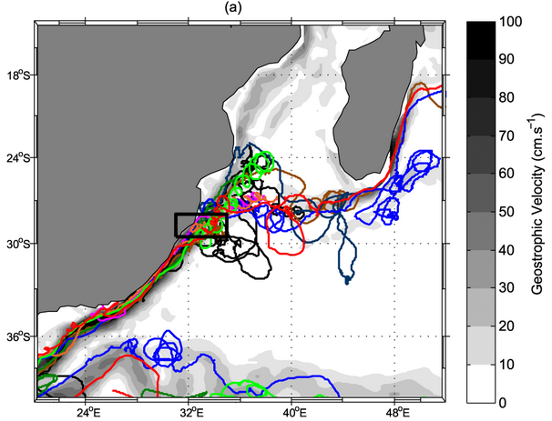
Recent research using Drifters
High-resolution distribution of M2 tidal amplitude derived from high frequency drifter positions
Kodaira et al. (2016)
Drifter trajectories used to diagnose eddy dissipation in the Agulhas Current system. Braby et al. (2016)

Slide 33
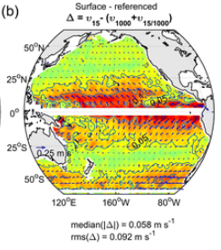
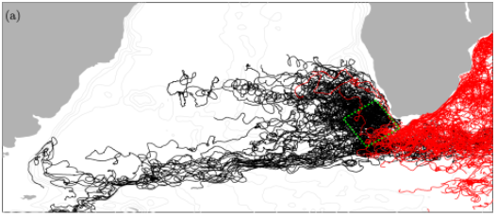
Recent research using Drifters
Estimate of wind-driven ageostrophic time-mean flow in the Pacific from drifter and Argo float observations, revealing larger values than found in earlier studies
Chiswell (2016)
Drifter trajectories used to evaluate the life cycle of Agulhas rings
Wang et al. (2016)

Slide 34
Vision
The GDP is in a unique position because it is the only existing global infrastructure from which in-situ air-sea interaction observations can be made
Direct observations of the ageostrophic velocity in the upper ocean, where the transfer of momentum and vorticity from the wind occur, will improve our physical understanding, with impact on models on climate and shorter scales
Observations of the ageostrophic vertical shear, that can be made globally from drifters, is virtually unknown and will be crucial to constrain the horizontal and vertical turbulent viscosity coefficient, thus improving models
Hourly, real-time, GPS-quality current observations will elucidate the role of tidal and near-inertial currents, and associated mixing
It is anticipated that global measurements of directional wave spectra will have a significant impact in wave forecasting and ocean physics
It is anticipated that a 100% barometer array will further improve NWP

Slide 35
Global Drifter Program (GDP)
Drifting buoy measurements of Mixed Layer Currents (and Sea Surface Temperature, Atmospheric Pressure, Salinity, Wind, and Waves)
http://www.aoml.noaa.gov/phod/dac/gdp.html
GlobCurrent User Consultation Meeting, March 21—23, Frascati, Italy
Notes:
Global drifter program: an overview.

Slide 37
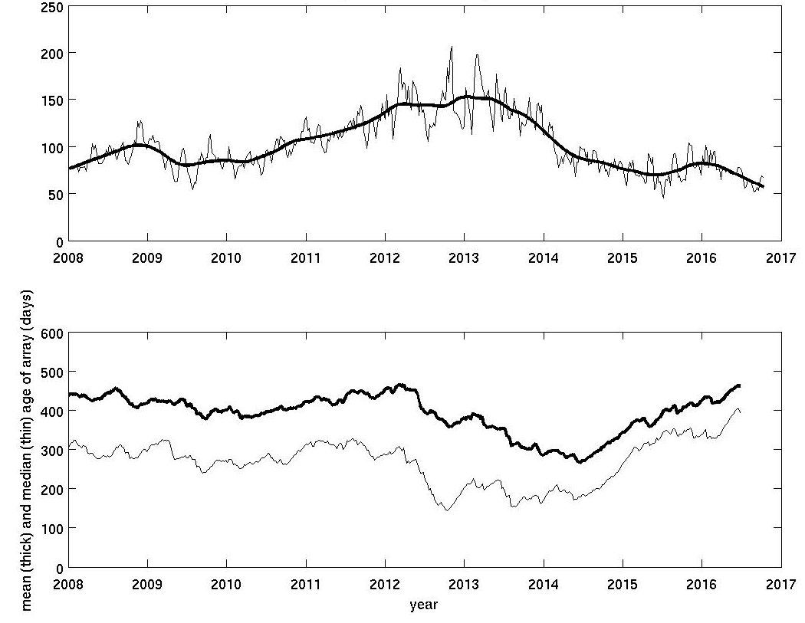
Number of deaths per 1250 drifters per month
160 per month = 1920 per year
57 per month = 684 per year
Cost savings: ~$5.7M per year
Mean age of drifter
Median age
Notes:
Via calcdeathrate.m (top), array_age.m (bottom). Cost savings assumes half of drifters are $1800 each, the other half are $3000 each (baro), i.e. mean cost $2400

Slide 38
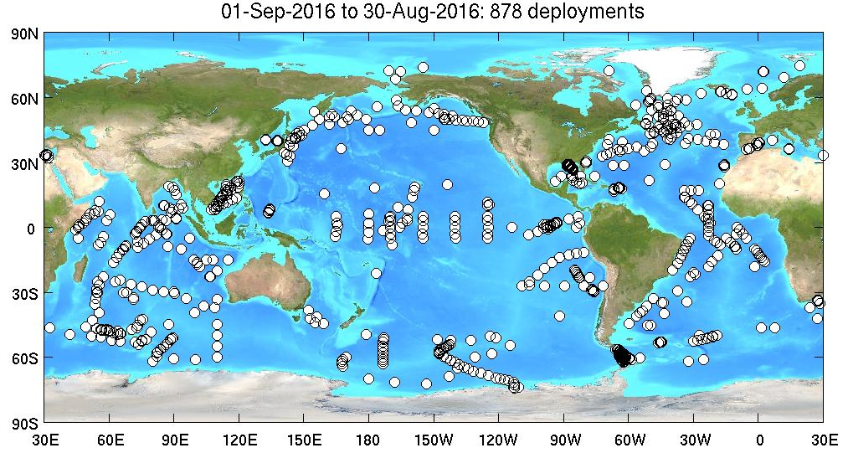
deployments
A total of 878 drifters were deployed this year, compared to 1086 last year and 1664 the year before (when the array had fallen below 1250 and needed to be replenished).

Slide 39
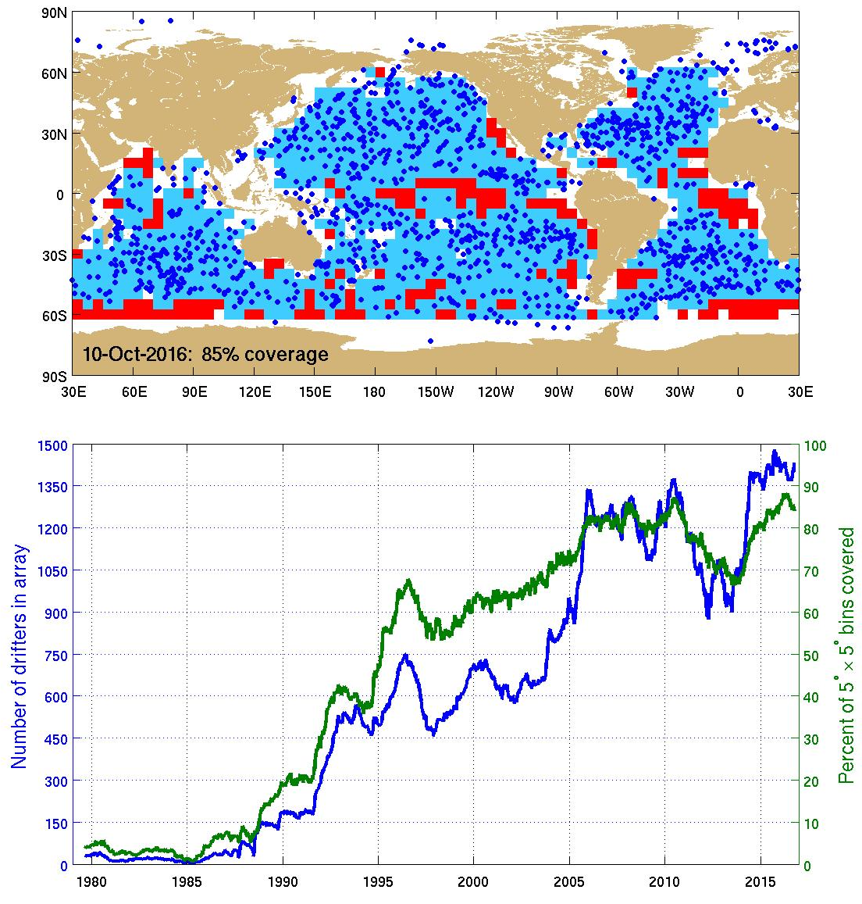
Evaluating the array for 5ºx5º coverage

Slide 40
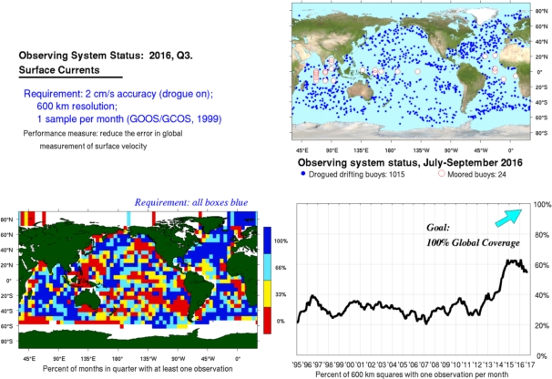
Evaluating the GOOS for SSV

Slide 41
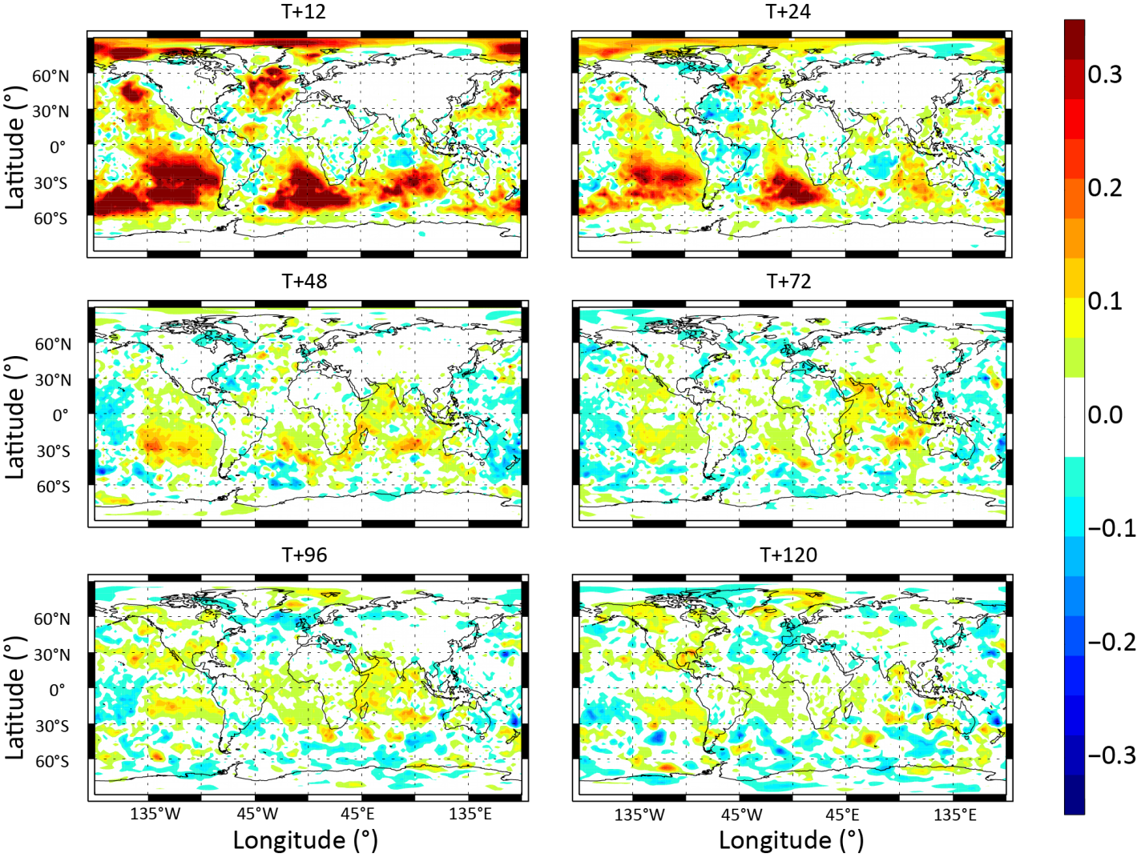
Impact of In-Situ Air Pressure Data from Drifters on Marine Weather Forecasting
In-situ sea level air pressure data from drifters were denied during assimilation in the ECMWF forecast model. The plots show normalised differences of mean sea level pressure root mean-squared errors between the control and denial experiment for November-December 2010. Red (blue) colours indicate degradations (improvements) in the denial experiment. Forecast ranges: 12h, 24h, 48h, 72h, 96h and 120h.
The positive effect of the drifters data is felt most in the southern ocean, polar regions and mid latitudes. The fact that the beneficial effect of the drifter data is less apparent in the tropical regions is likely because there are few observations to deny in that latitude band.
Centurioni et al. 2016, BAMS, in press.
The OSE study
RMS error differences (denial-control), Sea level pressure
Notes:
In light of the strong and successful rationale provided by the SST metric studies we have recently began a parallel effort to quantify the impact of the SLP data
Also driven by budget cuts threats at NOAA
In 2002 I was funded by the World meteorological Organization to run a pilot study on the impact of drifter data on numerical weather prediction beyiond SST
I have contracted ECMWF to run a data denial experiment and to analyze their Forecast Sensitivity to Observation Impact (adjoint model) for the drifting buoys only and we have designed the experiments together
Results show the global beneficial effect for the medium range (up to five days)
Not only for the pressure field but for the geopotential and wind
The affect 9not shown) propagates up in the troposphere, to 200 hPa
Southern ocean and northern latitudes are strongly affected
But also the tropics, where there are drifter data.
Since the tropical array is very sparse, I think the beneficial effect is not shown.
The contribution of drifter SLP is not limited to NWP. The reanalysis of SLP (not shown here) is crucial for the altimeter mission (inverse barometer effect correction) and for the climate record and definition of various climate indexes

