Slide 1
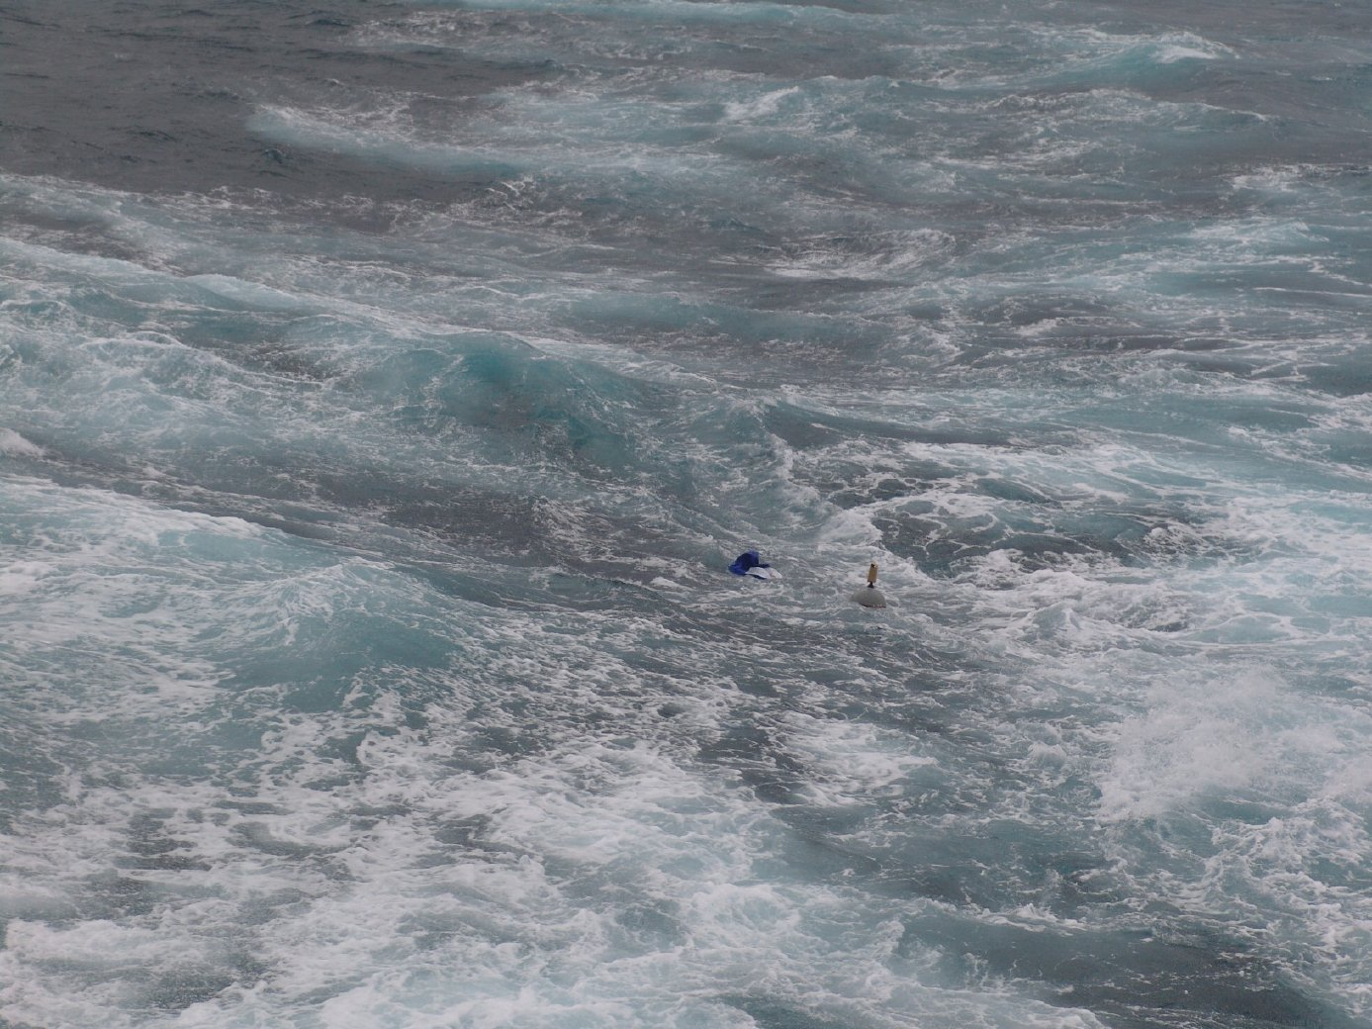

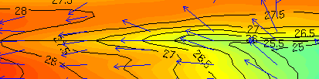
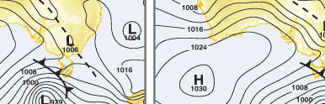
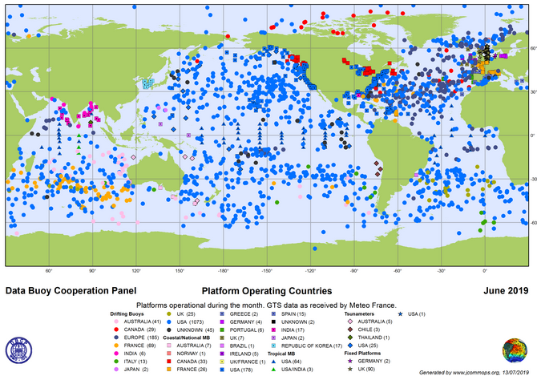
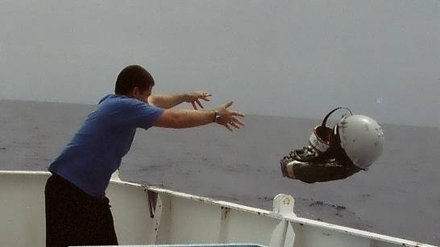
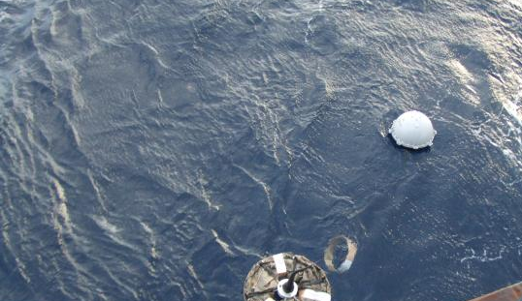
DATA BUOY
COOPERATION PANEL
Increasing the quantity, quality and timeliness of atmospheric and oceanographic data in ocean areas where few other measurements are taken.
IMPROVING GLOBAL FORECASTS OF WEATHER & OCEAN CONDITIONS
» Moored and drifting data buoys measure a range of atmospheric and oceanic variables including air pressure, temperature (sea-surface & air), salinity, ocean current velocity, winds, and waves across all oceans. These observations are relayed by satellite and used to improve forecasts and increase marine safety.
Top: winds (arrows) and sea temperatures (contours) in the equatorial Pacific. Bottom: air pressure over the ocean .
SHIPS AHOY!
» Most data buoys are deployed by commercial ships and research vessels. Without such cooperation the global buoy network of over 1300 drifting buoys and 400 moored buoys could not exist today and would be hard to sustain in future.
HOW CAN MARINERS HELP?
» The DBCP is looking for ships to be part of this global effort. We have an ongoing need to deploy drifting buoys in order to maintain the global network. Drifters are pre-packaged for easy deployment from the lowest deck or ramp whilst underway.

Slide 2
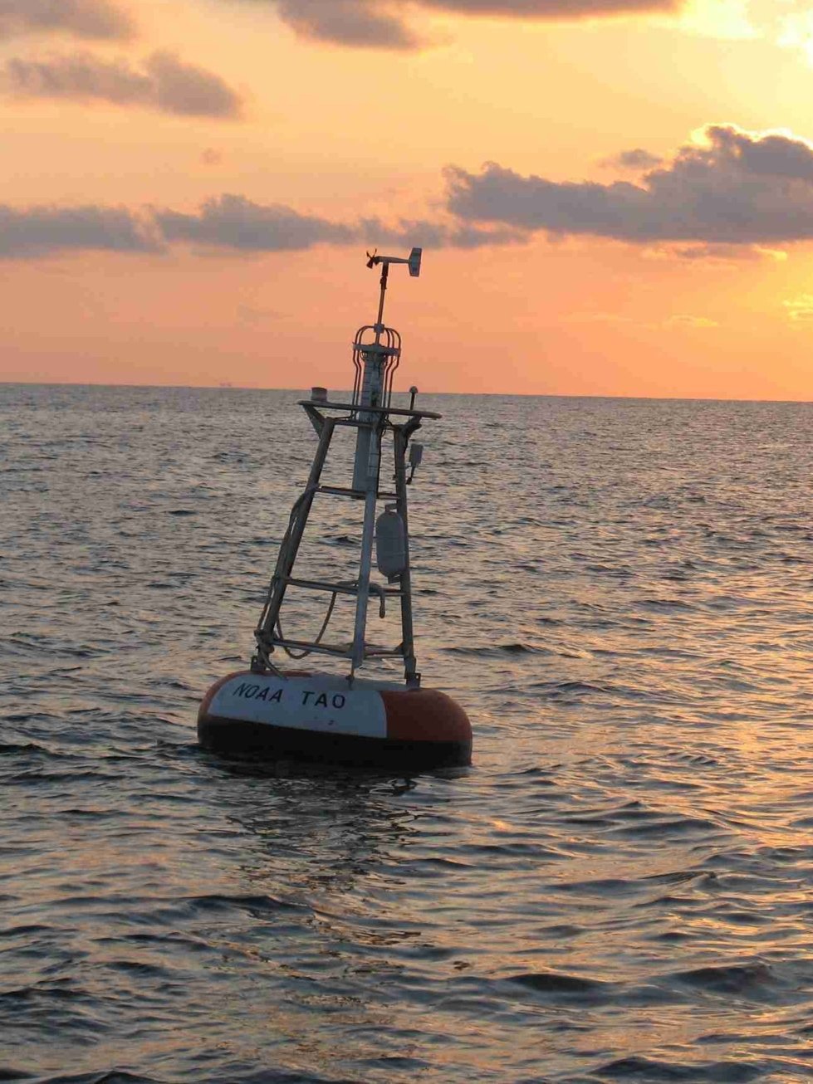
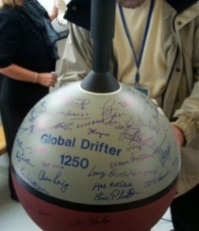
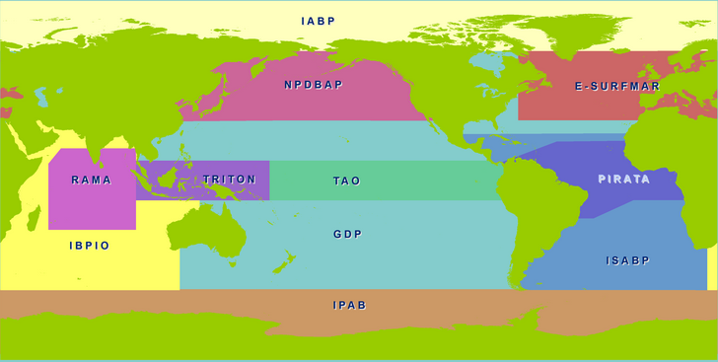
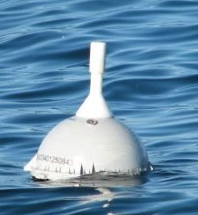
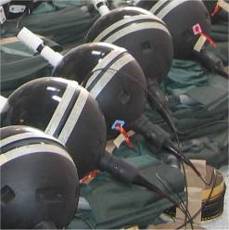

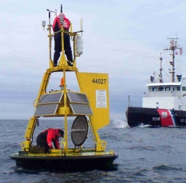

The DBCP is an international program coordinating the use of autonomous
data buoys to observe the atmosphere and ocean for forecasting and research.
WHERE THE ACTION IS
Much of the work achieved by the DBCP is through Action Groups. Each group maintains an observational buoy program that supplies data for operational and research purposes.
The DBCP has the following action groups:
The DBCP was formed in 1985 as a joint body of the World Meteorological Organization (WMO) and Intergovernmental Oceanographic Commission (IOC) of UNESCO. It coordinates the data buoy component of the Joint WMO-IOC Technical Commission for Oceanography and Marine Meteorology (JCOMM).
Global
» The Global Drifter Program (GDP)
» Tropical Moored Buoy Implementation Panel
(TAO, TRITON, PIRATA, RAMA)
Regional
» European EUCOS Surface Marine Programme (E-SURFMAR )
» International Arctic Buoy Programme (IABP)
» International South Atlantic Buoy Programme (ISABP)
» North Pacific Data Buoy Advisory Panel (NPDBAP)
» International Buoy Program for the Indian Ocean (IBPIO)
» International Programme for Antarctic Buoys (IPAB)l
Global Drifter 1250
The DBCP was the first component of the Global Ocean Observing system (GOOS) to achieve its initial goal, when in 2005, it reached its 1250th operating drifter, with coverage of approximately every five degrees.
DBCP Action Group Map
DATA BUOYS
» Data Buoys, whether drifting or
moored, measure and routinely
transmit their data in real time via
satellite systems such as Iridium and
Argos. Their observations make
significant contributions to our ability
to model, understand and describe
global weather and climate on all time and space scales. The observations complement data from other platforms such as from Voluntary Observing Ships and are used to validate remotely- sensed data from satellites.
A Drifting Buoy at sea
GET INVOLVED
Credits: Produced by JCOMMOPS 2019. Photos by NOAA USA (AOML, NDBC & PMEL), Metservice NZ, Bureau of Meteorology (Aust.) , SAMS (Scotland) and JCOMM.
» Membership
All IOC and WMO member states are invited to participate in the DBCP. Panel membership is also open to any other interested parties, such as buoy manufacturers, data users, researchers and ship operators.
» Annual meetings
Join us each year as we meet to progress our work and continually improve our coordination and impact to users. We meet alternately between Switzerland, France and elsewhere in the world.
» Contact
Long Jiang
DBCP Technical Coordinator
JCOMMOPS (WMO/IOC) c/o
World Meteorological Organization
7bis Avenue de la Paix
1202 Geneva
Switzerland
Tel: +41 22 730 87 78
Email: dbcp-tc@jcommops.org
>> Drifting Buoys, generally attached to a drogue (sea-anchor), are easy to deploy and relatively inexpensive, with an average lifetime of 18 months. They typically measure sea-surface temperature and air pressure, and track ocean currents at the depth corresponding to the centre of their drogue. Under the DBCP there is a standard design for drifting buoys to best meet the observational requirements for meteorological and oceanographic applications.
>> Moored Buoys are anchored at fixed locations and can collect observations for a much wider range of atmospheric and oceanic variables. Moored buoys
are usually deployed to serve national
needs for forecasting, maritime
safety, or research, or to observe
regional climate patterns. They are
generally replaced or serviced yearly.
Drifting Buoys during manufacture
www.wmo.int
A Moored Buoy being serviced
www.ioc-unesco.org
www.jcommops.org/dbcp
www.jcommops.org

