Slide 1
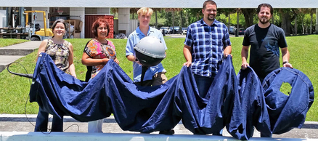
Global Drifter Program (GDP)
Drifting buoy measurements of Sea Surface Temperature, Mixed Layer Currents, Atmospheric Pressure, Salinity and Wind
www.aoml.noaa.gov/phod/dac
Rick Lumpkin, NOAA/AOML
Luca Centurioni, UCSD/SIO
Climate Observations Division Community Workshop
15-17 June 2015
College Park, MD
Notes:
Global drifter program: an overview.

Slide 2
Funding from NOAA’s Climate Program Office. Additional instrument development and instruments at Scripps funded by ONR.
Organization of the Global Drifter Program
Manufacturers in private industry, who build the drifters according to closely monitored specifications
AOML (Miami, FL)
Rick Lumpkin
Scripps (La Jolla, CA)
Luca Centurioni
Supervises the industry, upgrades the technology, purchases most drifters, and develops enhanced data sets.
Drifter Operations Center
Drifter Data Assembly Center

Slide 3
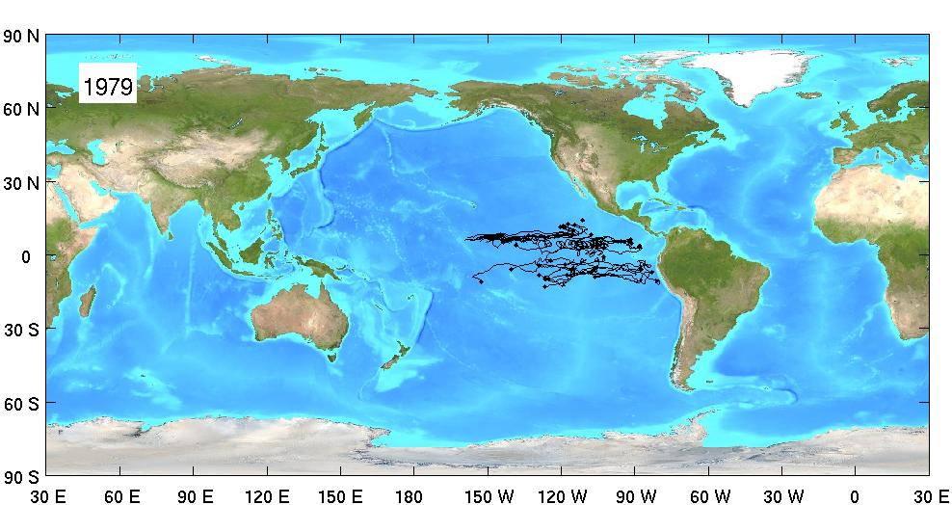
Evolution of the array
1979: 40 unique drifters

Slide 4
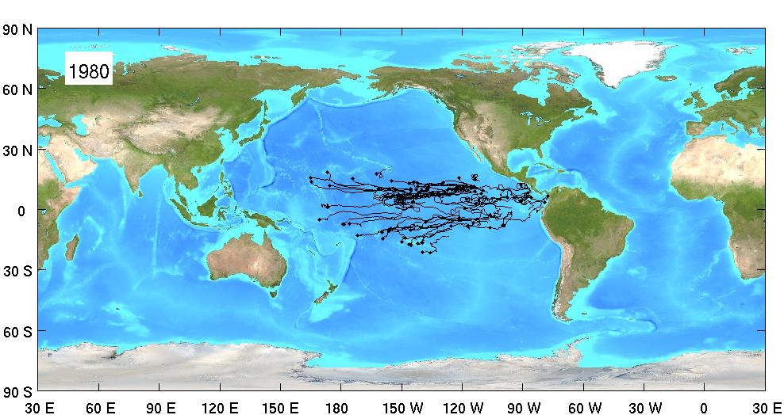
Evolution of the array
1980: 72 unique drifters

Slide 5
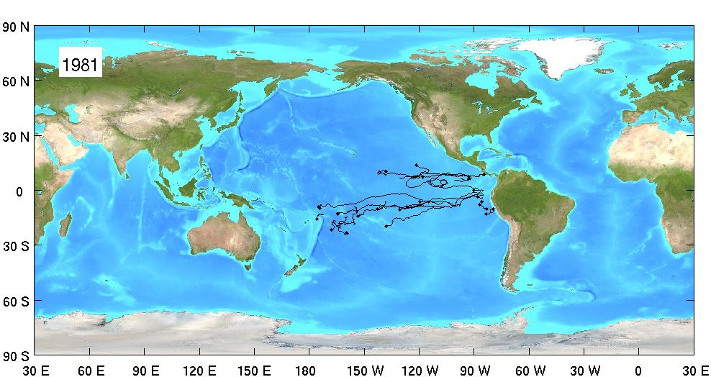
Evolution of the array
1981: 23 unique drifters

Slide 6
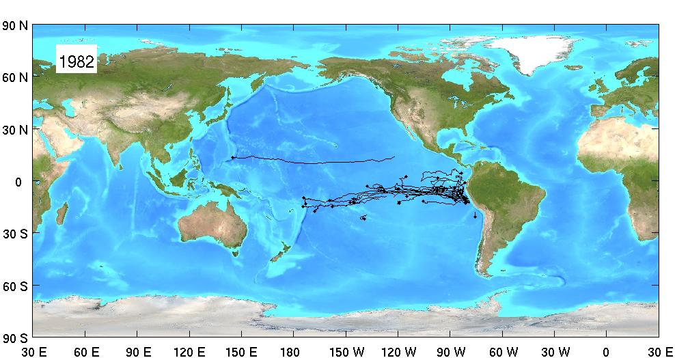
Evolution of the array
1982: 32 unique drifters

Slide 7
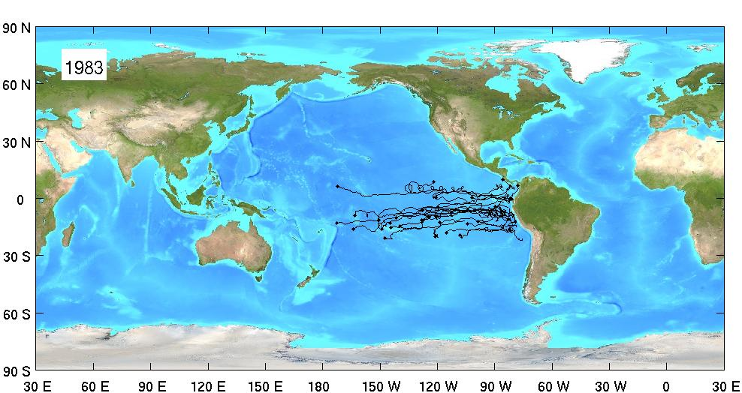
Evolution of the array
1983: 35 unique drifters

Slide 8
Evolution of the array
1984: 29 unique drifters

Slide 9
Evolution of the array
1985: 33 unique drifters

Slide 10
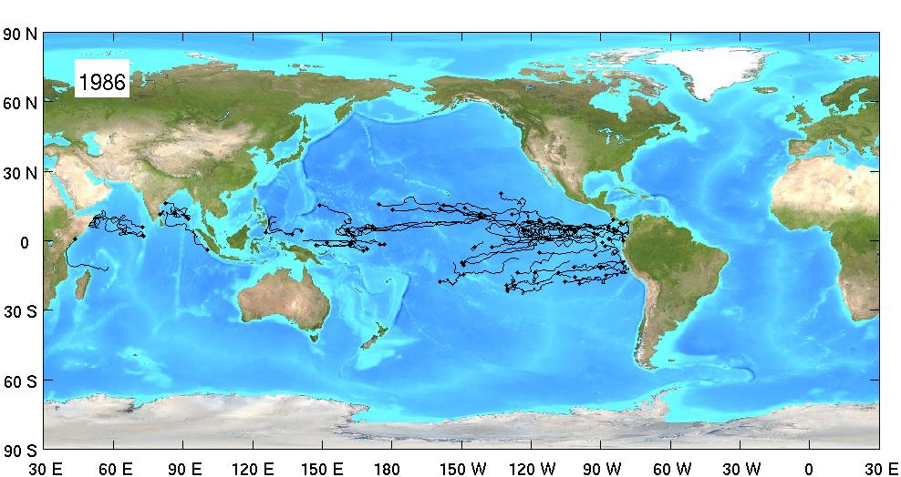
Evolution of the array
1986: 79 unique drifters

Slide 11
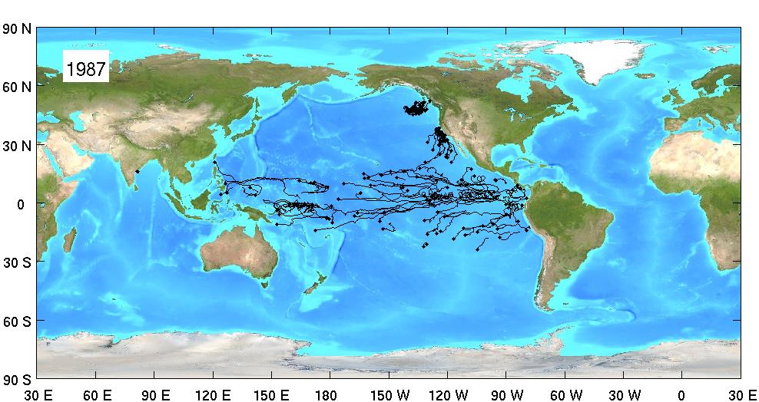
Evolution of the array
1987: 154 unique drifters

Slide 12
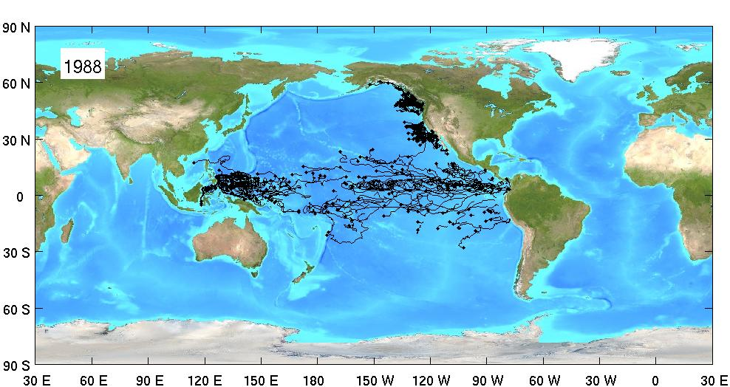
Evolution of the array
1988: 285 unique drifters

Slide 13
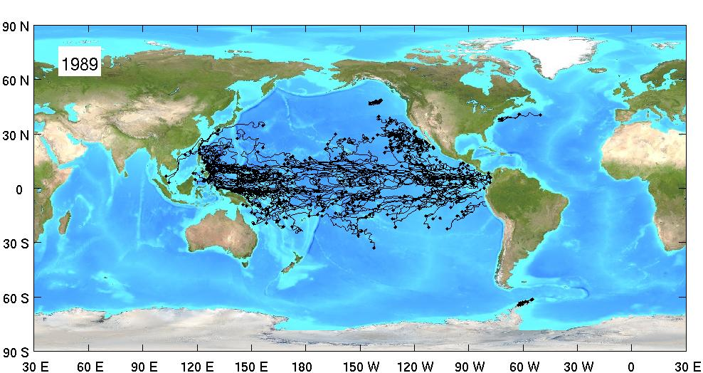
Evolution of the array
1989: 344 unique drifters

Slide 14
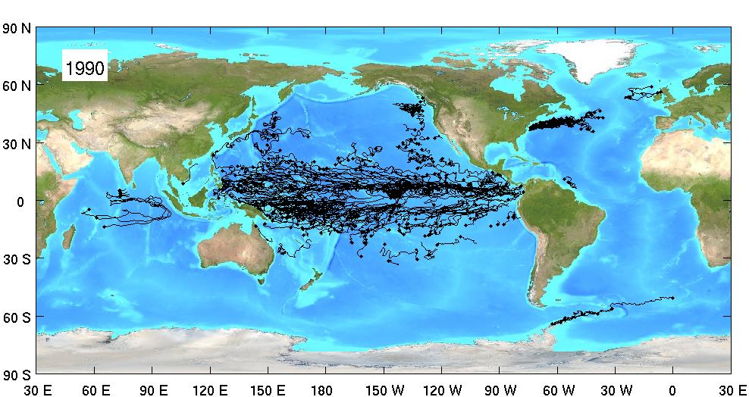
Evolution of the array
1990: 427 unique drifters

Slide 15
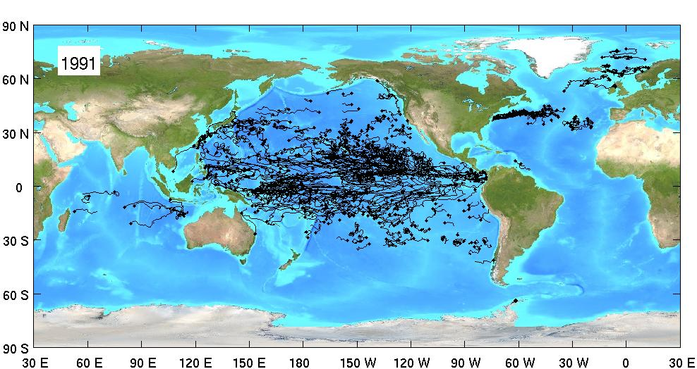
Evolution of the array
1991: 514 unique drifters

Slide 16
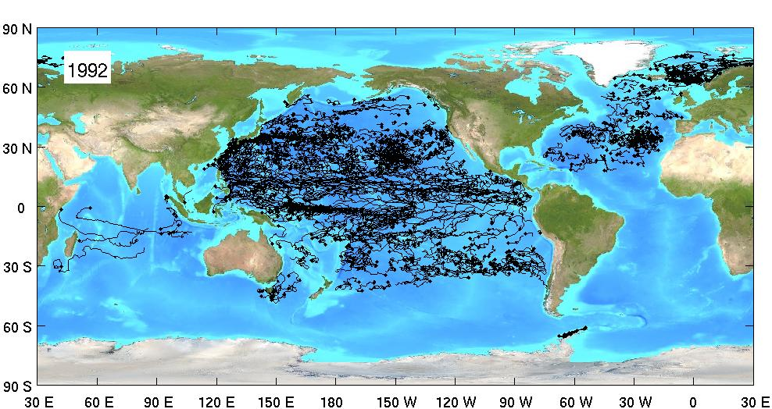
Evolution of the array
1992: 773 unique drifters

Slide 17
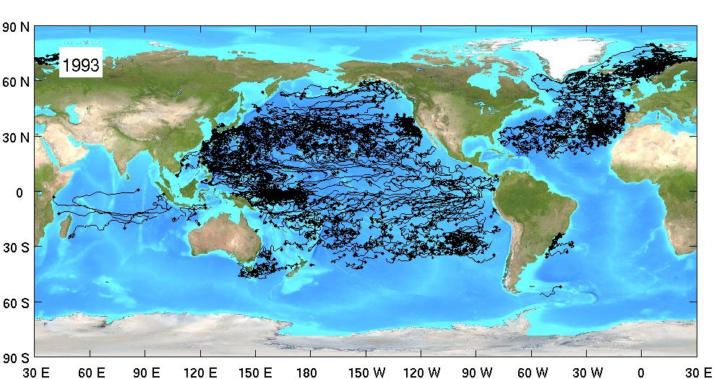
Evolution of the array
1993: 931 unique drifters

Slide 18
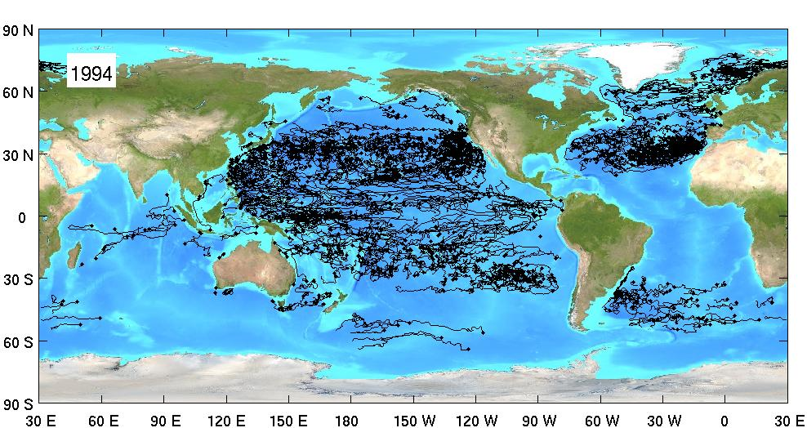
Evolution of the array
1994: 862 unique drifters

Slide 19
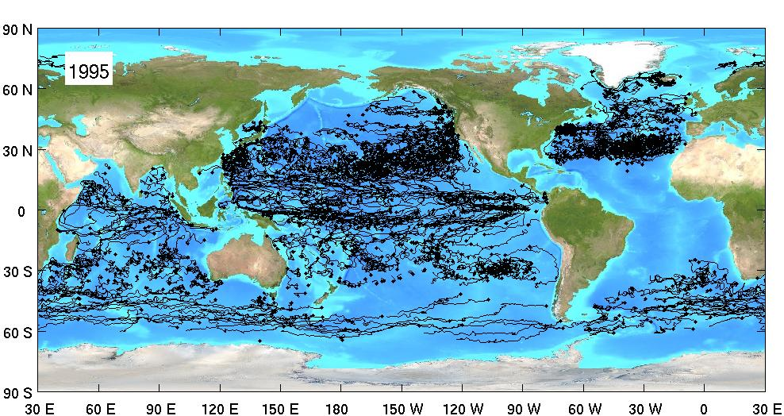
Evolution of the array
1995: 1038 unique drifters

Slide 20
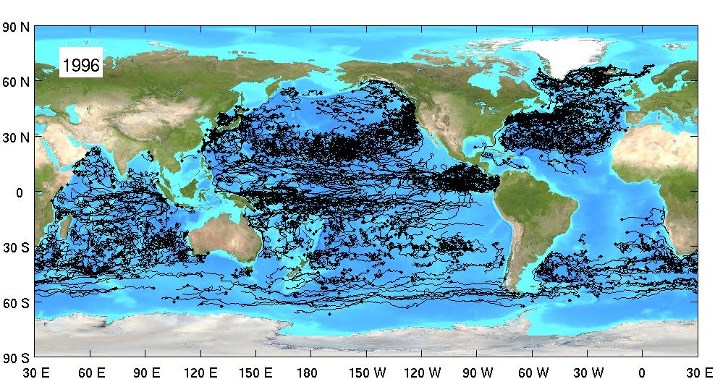
Evolution of the array
1996: 1235 unique drifters

Slide 21
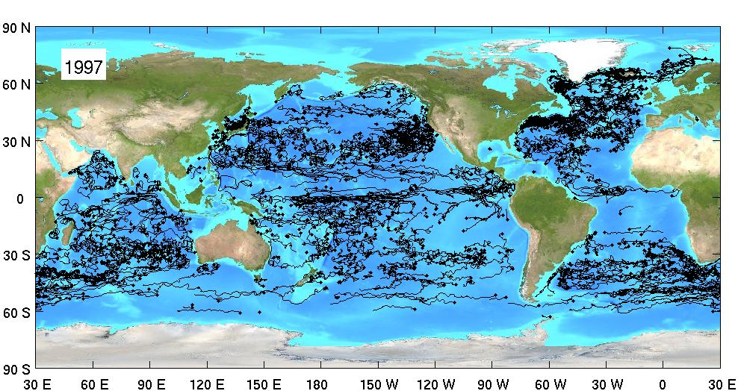
Evolution of the array
1997: 1080 unique drifters

Slide 22
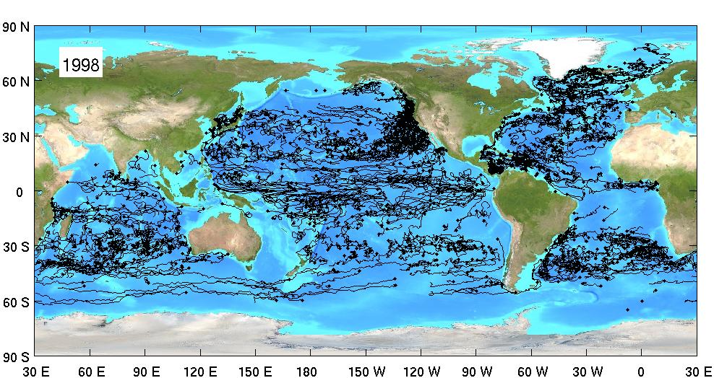
Evolution of the array
1998: 1008 unique drifters

Slide 23
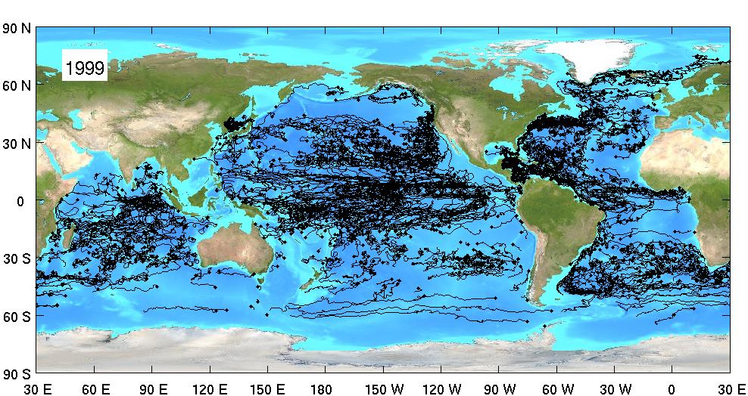
Evolution of the array
1999: 1278 unique drifters

Slide 24
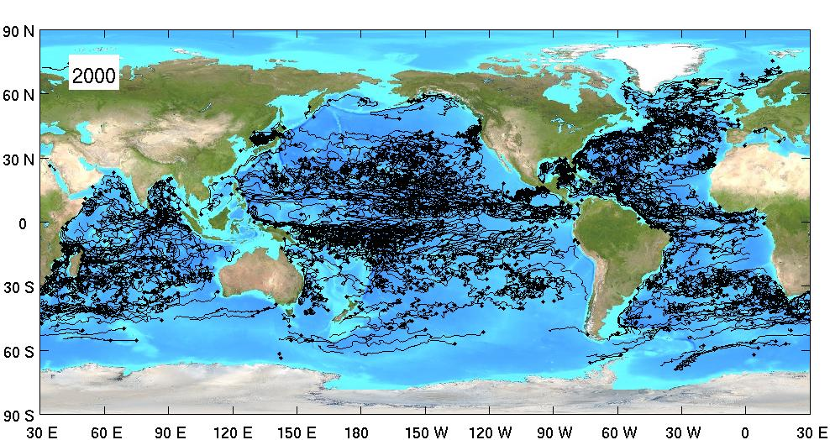
Evolution of the array
2000: 1302 unique drifters

Slide 25
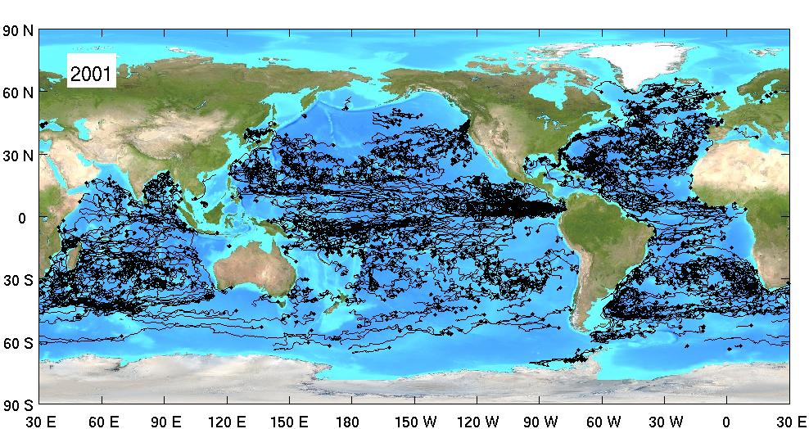
Evolution of the array
2001: 1198 unique drifters

Slide 26
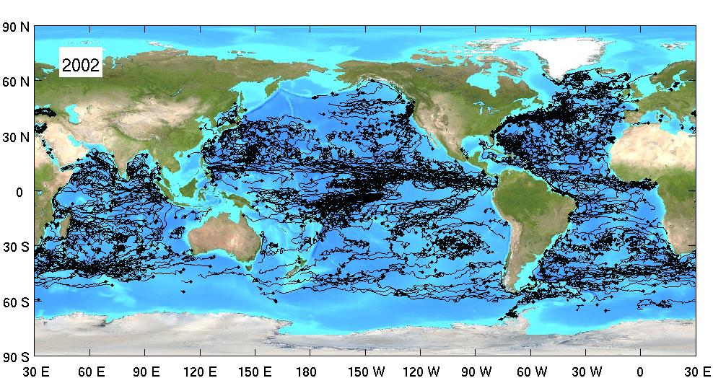
Evolution of the array
2002: 1187 unique drifters

Slide 27
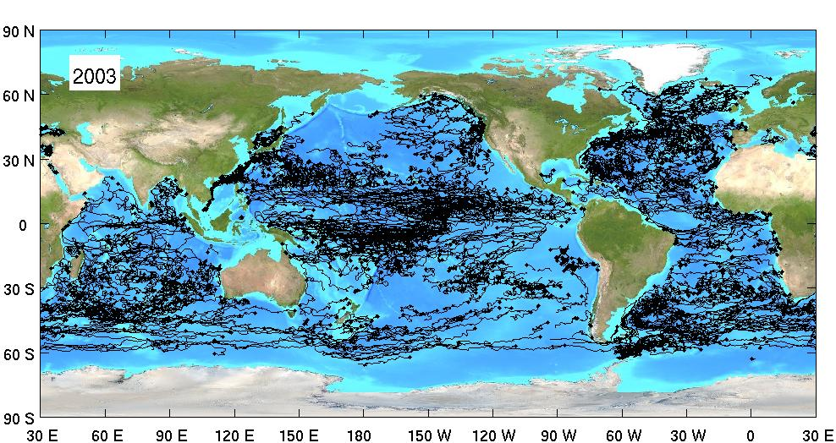
Evolution of the array
2003: 1391 unique drifters

Slide 28
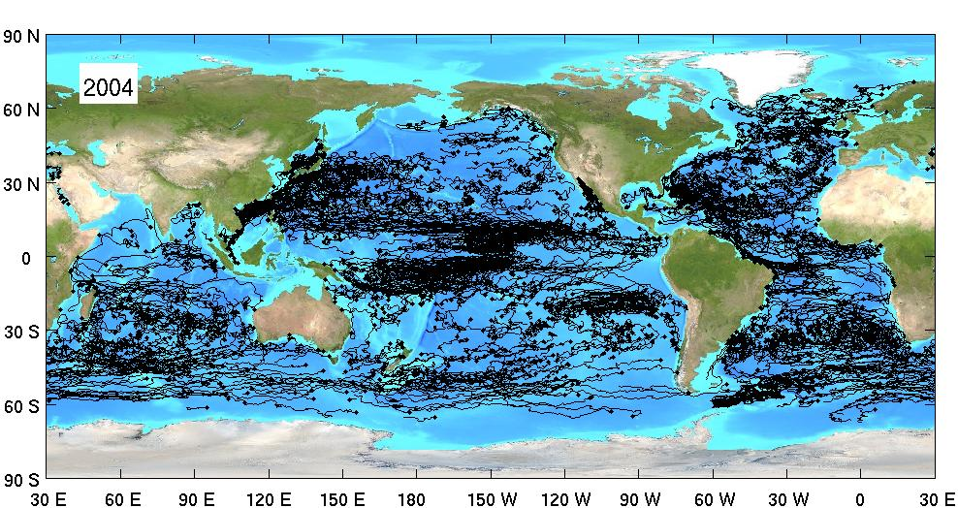
Evolution of the array
2004: 1666 unique drifters

Slide 29
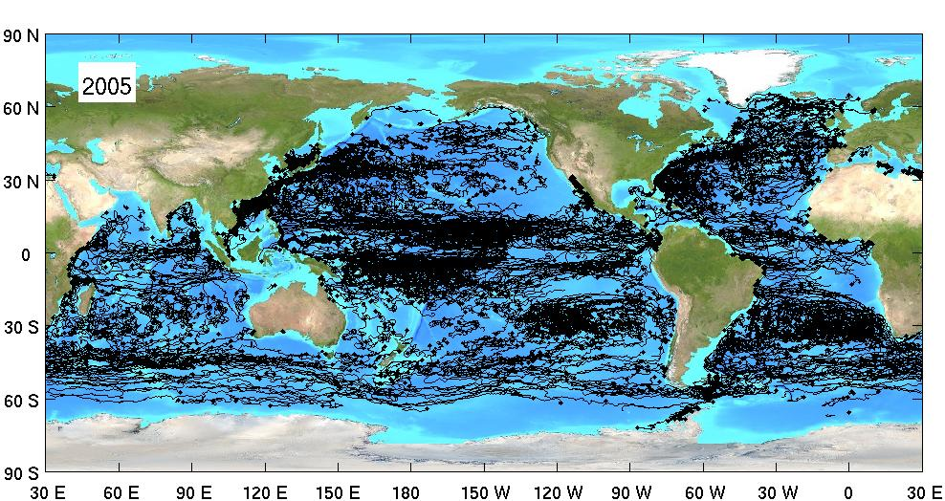
Evolution of the array
2005: 2158 unique drifters

Slide 30
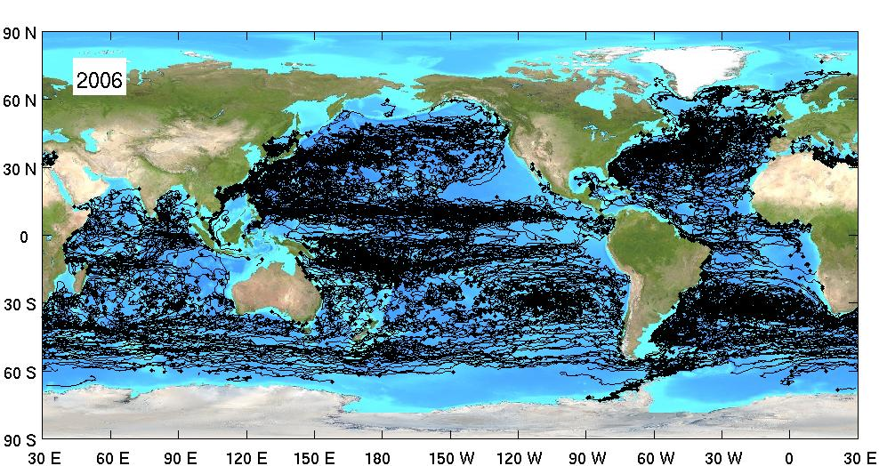
Evolution of the array
2006: 2235 unique drifters

Slide 31
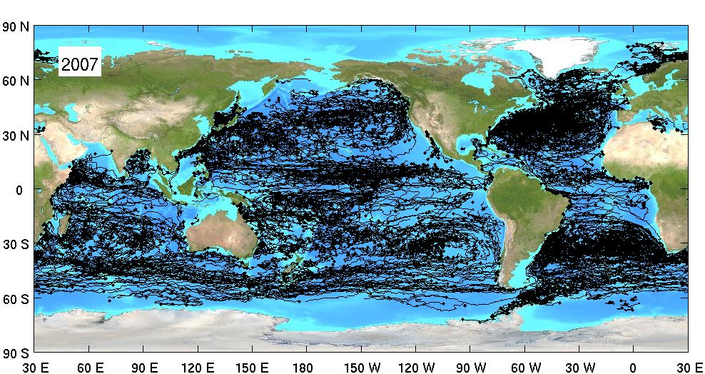
Evolution of the array
2007: 2328 unique drifters

Slide 32
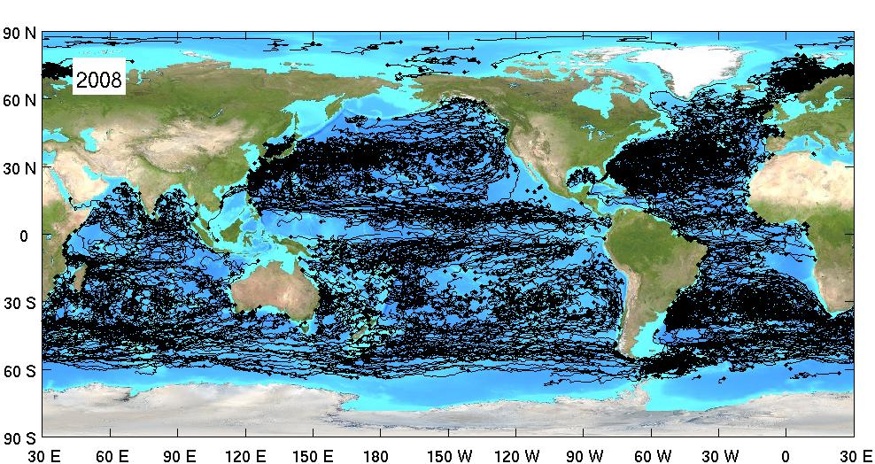
Evolution of the array
2008: 2265 unique drifters

Slide 33
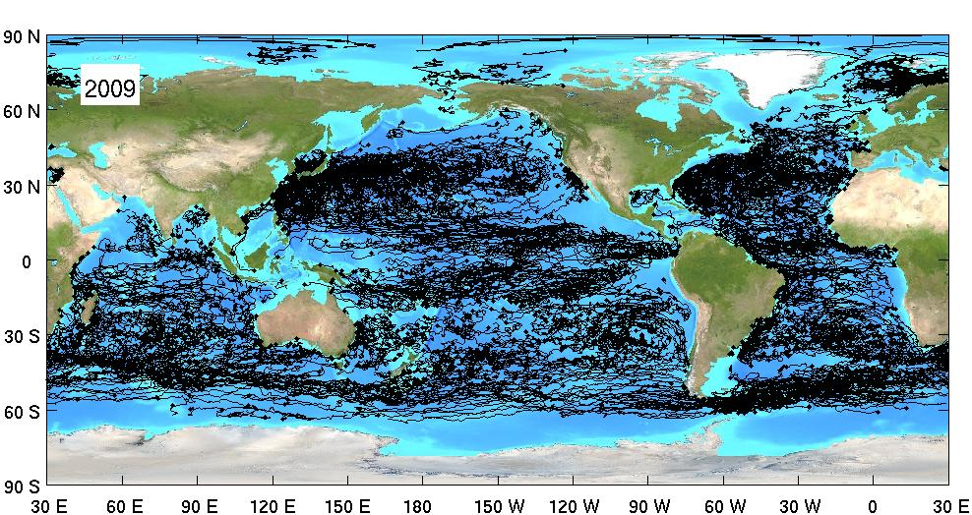
Evolution of the array
2009: 2225 unique drifters

Slide 34
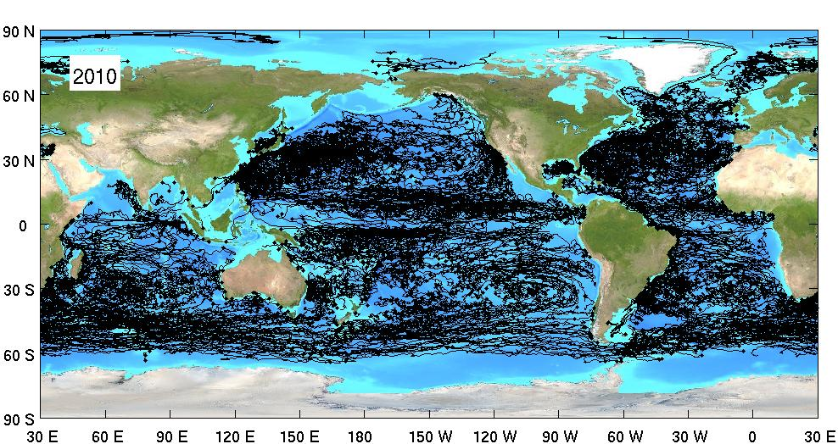
Evolution of the array
2010: 2449 unique drifters

Slide 35
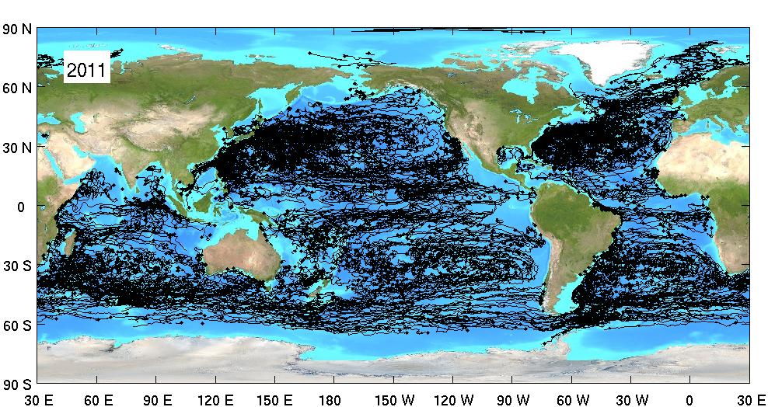
Evolution of the array
2011: 2270 unique drifters

Slide 36
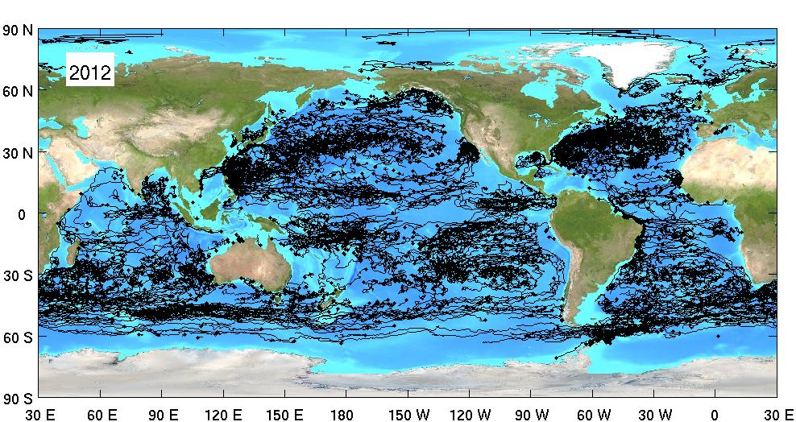
Evolution of the array
2012: 2011 unique drifters

Slide 37
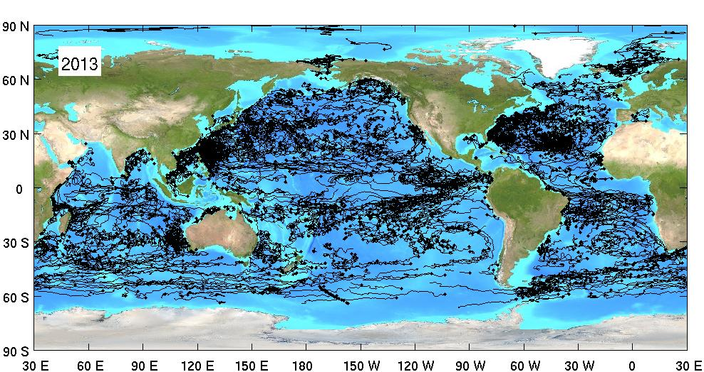
Evolution of the array
2013: 1852 unique drifters

Slide 38
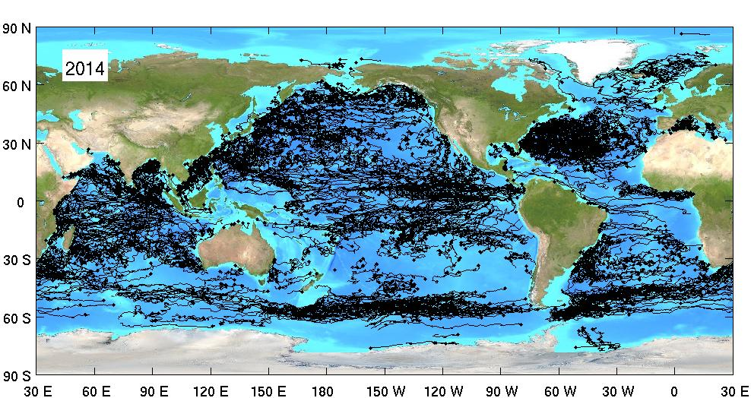
Evolution of the array
2014: 1947 unique drifters

Slide 39
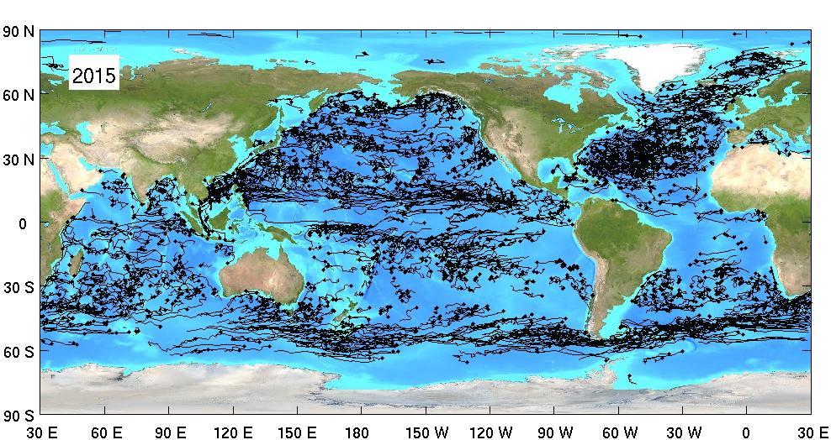
Evolution of the array
(so far)
2015: 1844 unique drifters so far

Slide 40
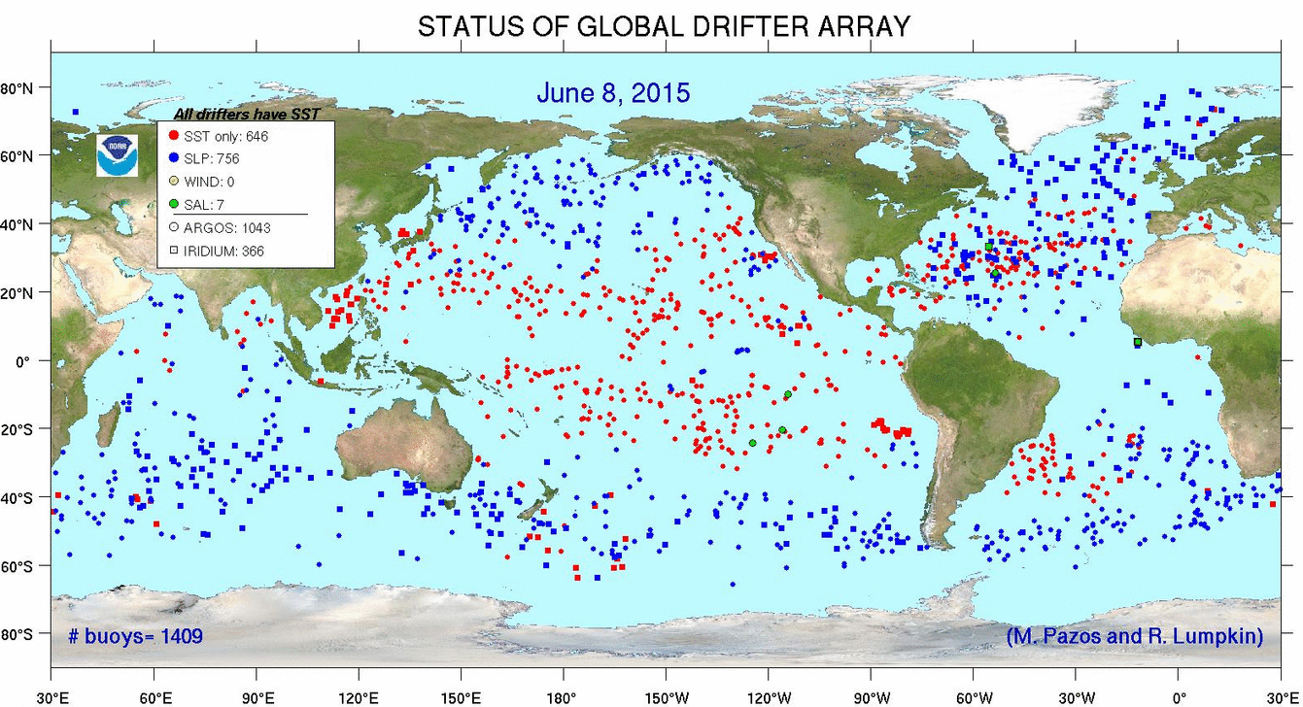
Current status of the global array

Slide 41
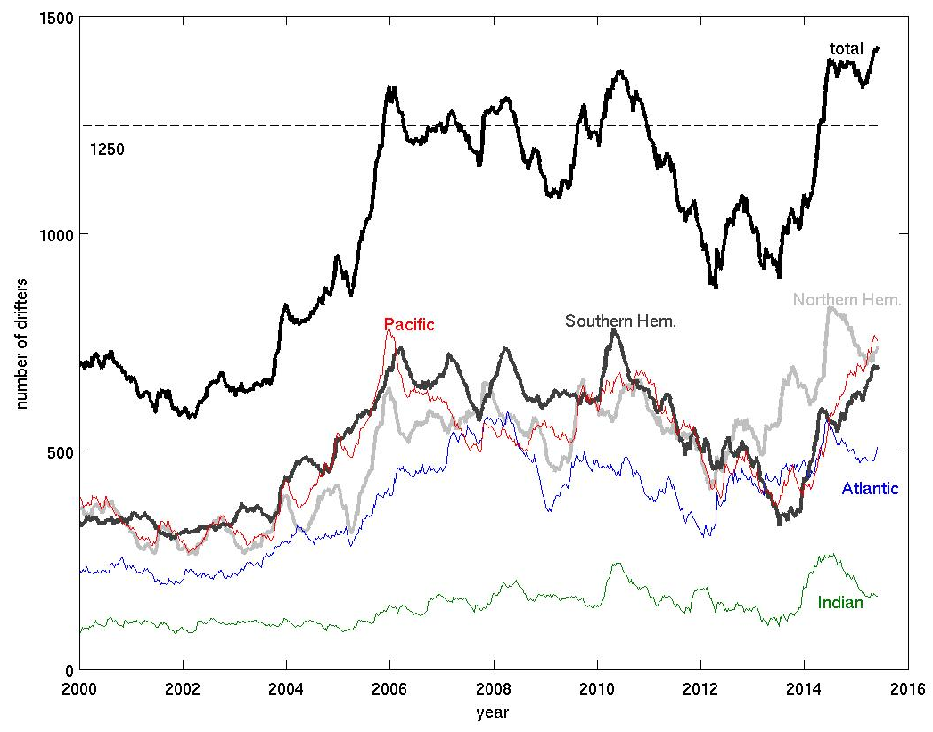
Evolution of the array
1409 on 8 Jun 2015
875 on 16 April 2012
Notes:
arraysize.m

Slide 42
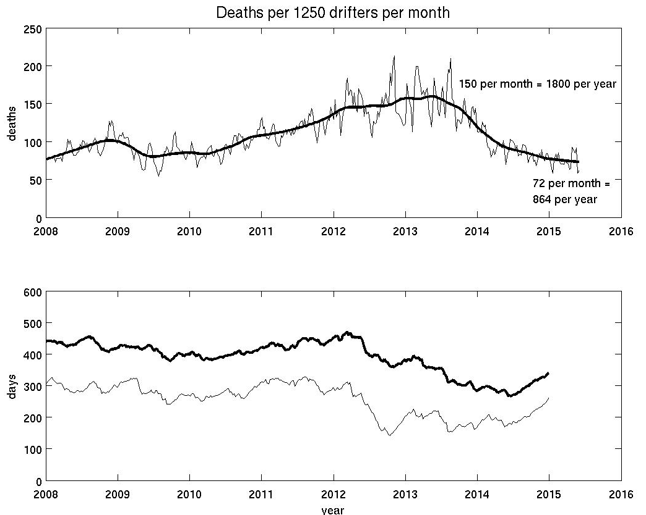
Death rate
Mean age of drifter in array
Median age
Notes:
Via calcdeathrate.m (top), array_age.m (bottom)

Slide 43
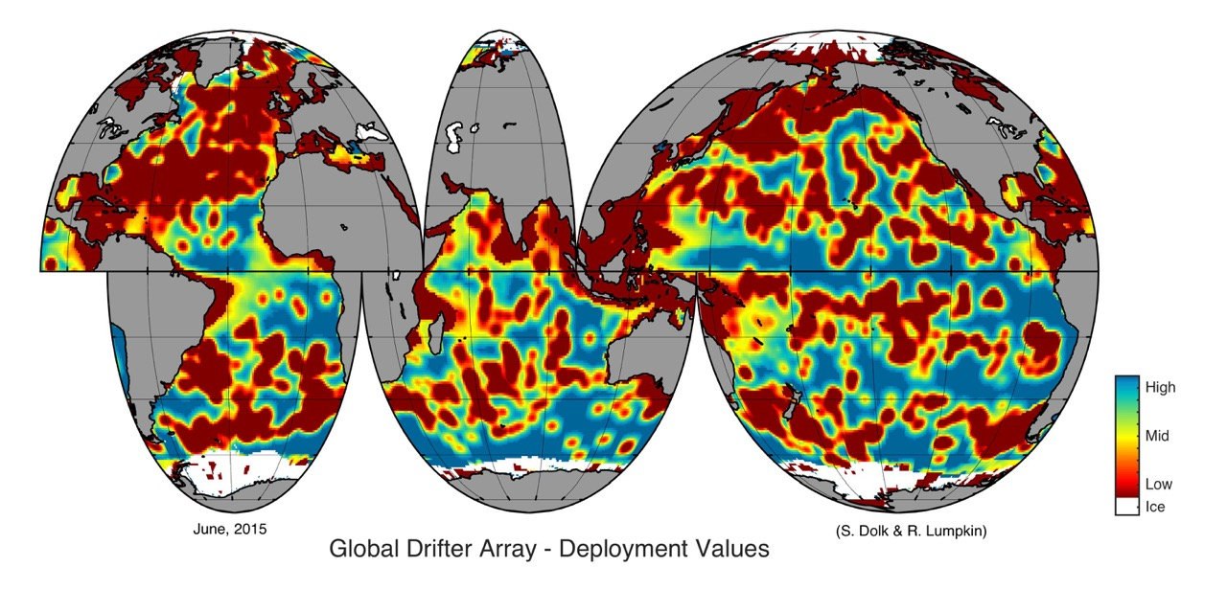
New product: drifter deployment value maps
http://www.aoml.noaa.gov/phod/dac/doc_valuemaps.php

Slide 44
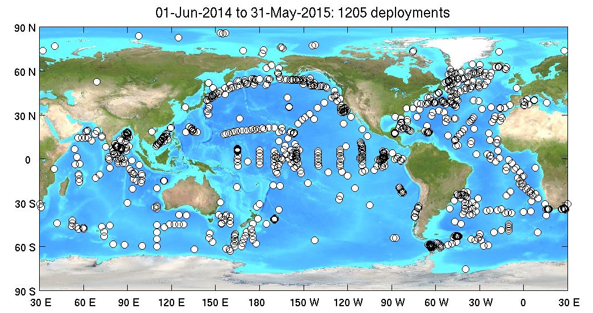
deployments

Slide 45
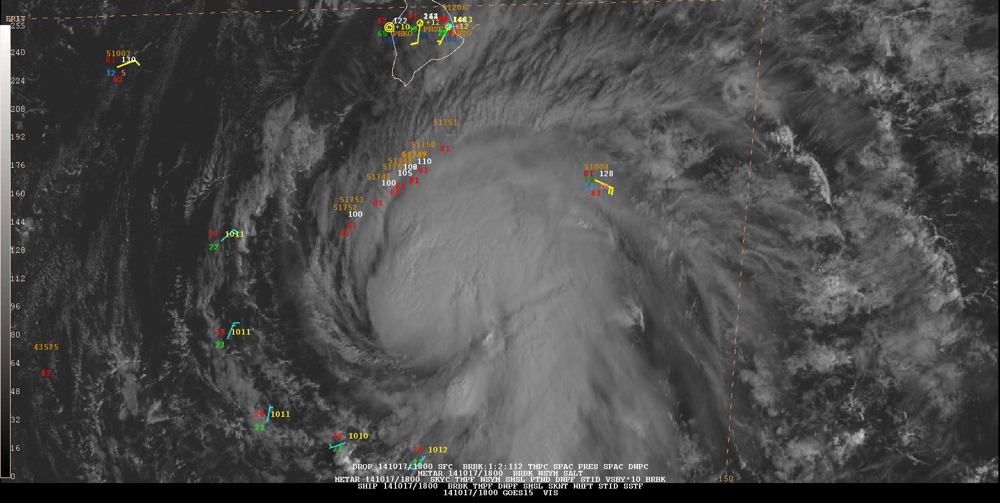
Hurricane drifter deployments
10 hurricane drifters (5 with thermistor chains) deployed by Air Force Hurricane Hunter C-130J in the path of strengthening (soon to be hurricane) Ana, south of the Big Island of Hawaii on 17 October 2014.

Slide 46
Iridium transition plan
Purpose of transition:
Provide timely data worldwide for ocean state estimation and numerical weather prediction.
Include GPS, which provides hourly, highly accurate positions and allows real-time drogue detection
Overview of process:
Iridium SBD modems are purchased by the manufacturer
Registration/activation of the modems: OAR @ PMEL (primary), SIO and AOML (secondary)
Receipt of the data: SIO and AOML both email recipients. Two raw data archives will be maintained
SIO provides decoded data to AOML, and assistance during implementation of decoding at AOML.
SIO handles GTS insertion. AOML handles data screening for GTS removal.
GOAL: transition to 80% Iridium+GPS by end FY18

Slide 47
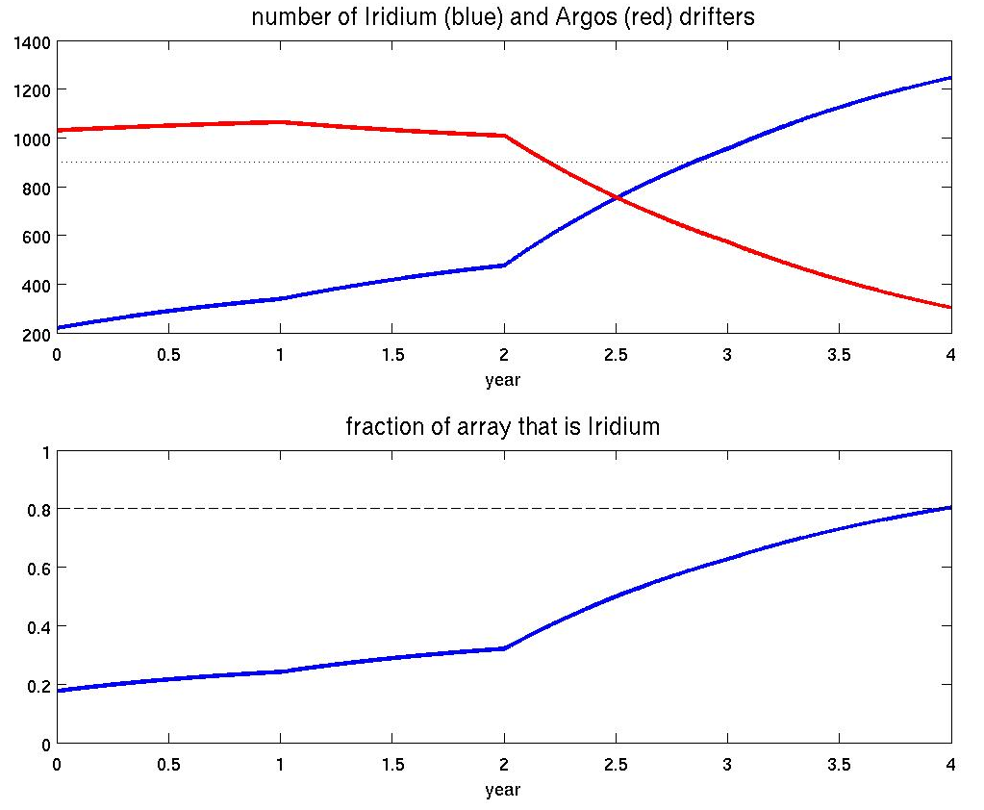
Iridium transition plan
FY15
FY16
FY17
FY18

Slide 48
Other significant advances since OceanObs ‘09
Real-time drogue detection is being implemented as more drifters transition to Iridium and are retrofitted with GPS sensors, thus allowing operational near-surface currents to be released to the GTS.
The positive effect of drifter’s SLP assimilation in NWP models was quantified through a data denial experiment run by ECMWF. The impact of the drifter data is also monitored operationally by NASA (http://gmao.gsfc.nasa.gov/products/forecasts/systems/fp/obs_impact/). Drifters data have a very large impact on a per observation basis.
The salinity drifter technology has reached maturity and substantial deployments in conjunction with NASA’s salinity mission were performed (88 GDP drifters deployed during SPURS)

Slide 49
OceanObs ‘09 goals for drifters:
Talley et al. (“Surface Circulation and Ventilation”)
The principal recommendation for continuing to quantify and map the surface and near-surface circulation in the next decade is to continue the programs that are already extremely successful. These include … [g]lobal surface drifter deployments with uniform specifications for drogue capability and depth.
The surface drifter network is of equal importance [to satellite observations] for surface circulation analyses because it provides in situ calibration of the satellite observations and because its temporal and spatial resolution differ from those of the satellites, i.e. it provides information about much higher frequency motions. The high frequency, high spatial resolution of the surface drifter and SWOT data sets will require general progress in understanding the momentum balance of the mixed layer since both will observe significant ageostrophic components.
The principal recommendations for surface circulation are to maintain the existing observing systems, based around satellites and surface drifters, to extend observations to the submesoscale (SWOT), and to continue to work to improve diagnostic models that incorporate these data, and which have already proven invaluable in extending the data sets to much higher spatial and temporal resolution than is available in any given part of the data set.

Slide 50
OceanObs ‘09 goals for drifters:
Send et al. (“In Situ Observing System”):
… cruises servicing moorings or tagging animals should be used for deploying/recovering gliders, floats, drifters, and for taking water samples for chemical and biological analyses.
Roemmich et al. (“Mobile Platforms”):
It is widely agreed that the present 5º x 5° measurement resolution of the surface velocity field is not adequate … Requirements for surface drifters are presently being reviewed [Zhang et al. 2009 SST paper] for their adequacy to define the mean circulation [Maximenko et al. 2009 MDT paper] and the seasonal to inter-annual variability, for calibration of satellite-derived sea surface velocity, for their ability to resolve eddy kinetic energy and coastal processes, and for deploying ancillary sensors for SLP, SSS and PCO2.

Slide 51
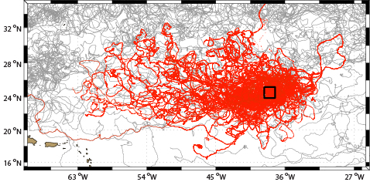
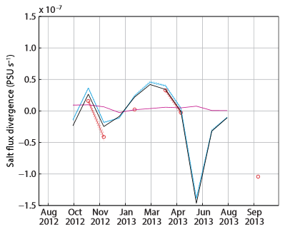
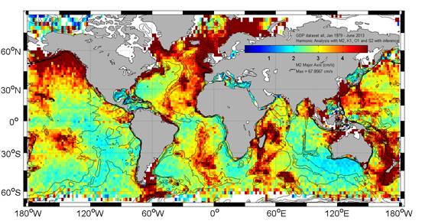
Research
Salinity drifters deployed in SPURS 1 (above) and Lagrangian derivative of SSS from drifters (right, red) vs eddy salt flux divergence from AVISO and Aquarius (black). Centurioni et al. (2015)
Harmonic analysis of drifters velocity to map the amplitude of the main tidal constituents (M2,S2, K1 and O1).
M2 shown here
Poulain and Centurioni (2015)

Slide 52
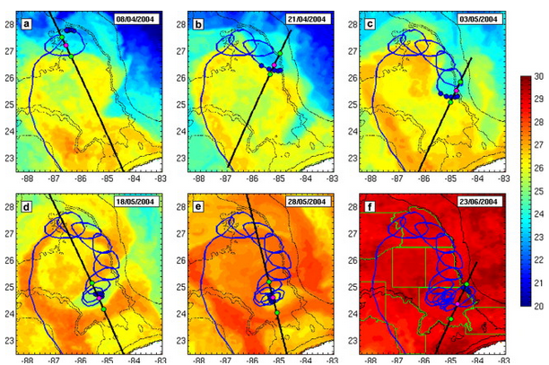
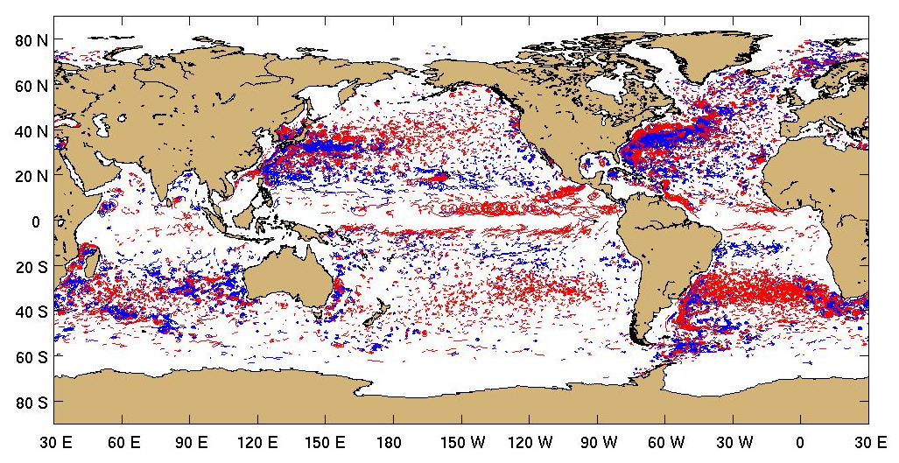
Research
Structure of cyclonic frontal eddies in the Gulf of Mexico from drifter and satellite measurements
Le Henaff et al. (2014)
Global characteristics of looping drifter trajectories
Lumpkin (2015)

Slide 53
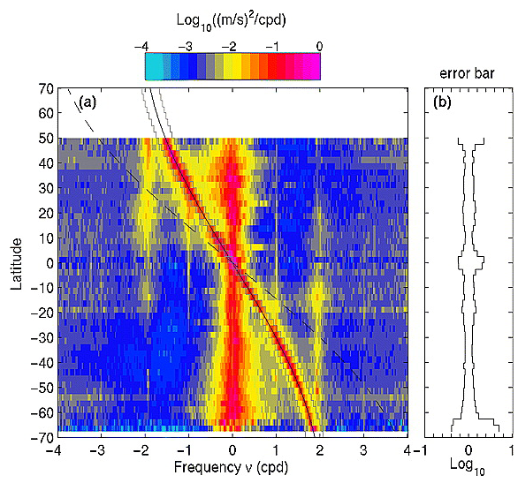
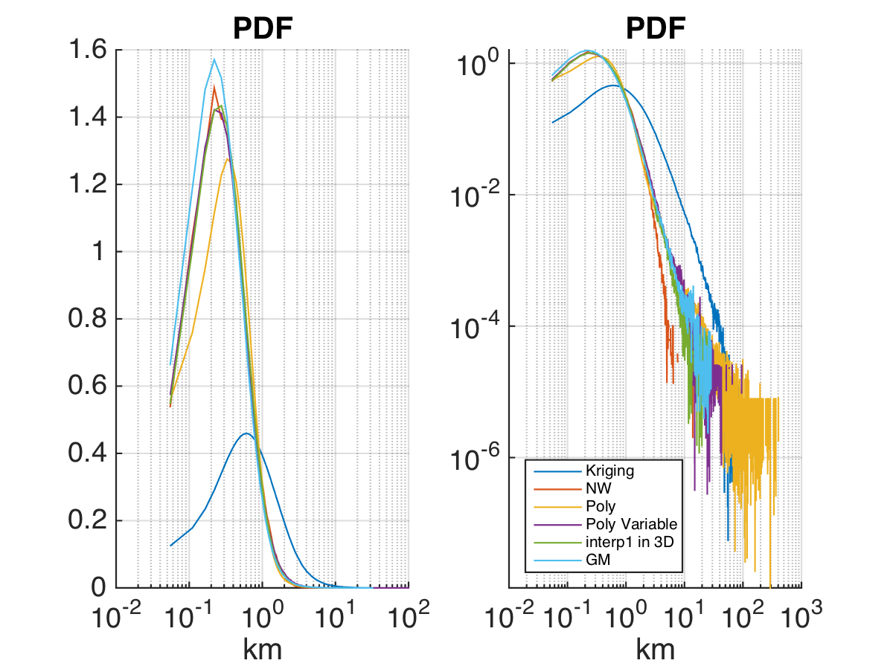
Emerging Product: hourly drifter data (since Jan 2005) will include error estimates for hourly position
SPURS drifters
Left: spectral energy density in hourly drifter observations as a function of latitude, showing inertial, tidal (diurnal and semidiurnal) and subinertial (primarily geostrophic) variations (Elipot and Lumpkin, 2008)
Shane Elipot (U. Miami), Renellys Perez and Rick Lumpkin

Slide 54
Thanks
Our appreciation to the following deployment partners for their contributions to GDP activities
NOAA’s Voluntary Observation Ships, Ships of Opportunity, and National Marine Fisheries Service programs; NOAA/Pacific Marine Environmental Laboratory, NOAA/National Data Buoy Center
Argo program
International Ice Patrol
Institut de Recherche pour le Développement;
Météo-France (France)
Leibniz-Institut für Meereswissenschaften an der Universität Kiel (Germany)
New Zealand Met. Service
Australian Bureau of Meteorology
Fundação Universidade Federal do Rio Grande; Instituto Nacional de Metereologia; Centro de Hydrografia de Marinha; INPE (Nacional Space Institute); Brazilian Navy; Brazilian Naval Directorate of Hydrography and Navigation (Brazil)
Fisheries Research Institute; Servicio de Hidrografía Naval (Argentina)
Instituto Canario de Ciencias Marinas; Universidad de Las Palmas de Gran Canaria (Spain)
Instituto Nazionale di Oceanografia e di Geofisica Sperimentale (Italy)
National Institute of Oceanography; National Institute of Ocean Technology (India)
Institute of Hydrological and Oceanic Services (Taiwan)
Centro de Investigacion Cientifica y de Educacion Superior de Ensenada (Mexico)
Korean Institute of Ocean Science and Technology
Instituto del Mar del Peru
Tristan da Cunha Administration, Tristan Island
United Kingdom Met Office
Environment Canada
University of Cape Town; South African Weather Service (South Africa)
Scripps Institution of Oceanography, Woods Hole Oceanographic Institution, Oregon State University, Marine Resources Research Institute, (United States)
United States Air Force
US Naval Oceanographic Office
United States Coast Guard
Raytheon Polar Services

