Slide 1
Meridional Changes of MOC in the South Atlantic Ocean
Shenfu Dong
CIMAS, University of Miami
This presentation contains material provided by employees of NOAA (U. S. National Oceanic and Atmospheric Administration) who are now on furlough
Research funded by NASA, NOAA CPO and AOML
Ocean Surface Topography Science Team Meeting
Boulder, CO, October 2013

Slide 2
Goal
To investigate spatial (latitudinal) and temporal changes of the Meridional Overturning Circulation (MOC) and Meridional Heat Transport (MHT) in the South Atlantic Ocean using joint analysis of satellite and in situ observations.
What is new in this work
Extend time series of MHT/MOC at 34.5°S to 1993
Extend coverage region (20°S-34.5°S)
Notes:
Altimetry observations as key component of SAMOC
Why altimetry ? Can altimetry replace other observations ?

Slide 3
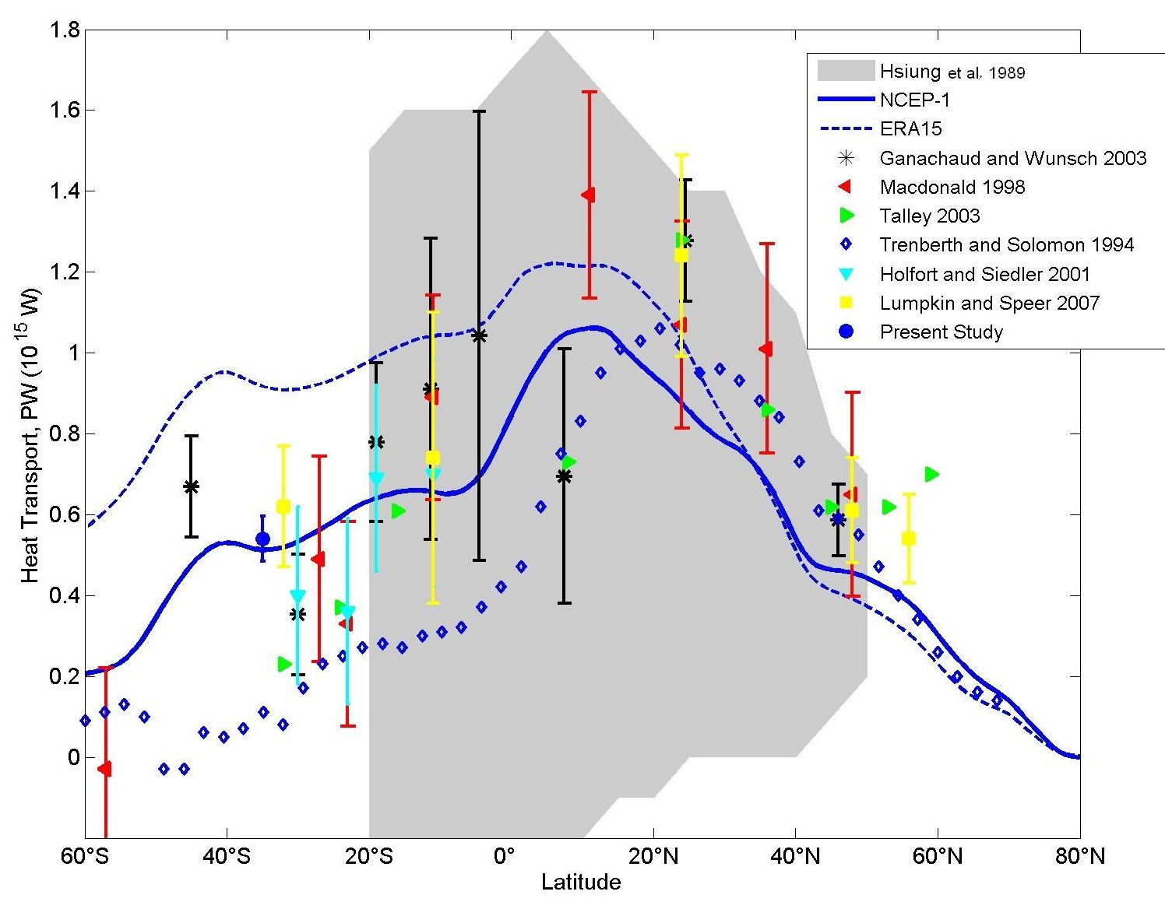
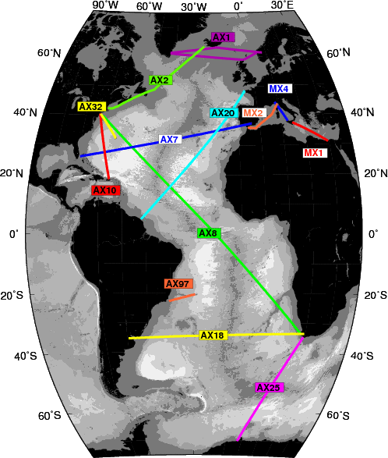
Meridional Heat Transport in the Atlantic Ocean
Altimetry
AX07
AX07
AX18
AX18
Notes:
Altimetry observations as key component of SAMOC
Why altimetry ? Can altimetry replace other observations ?

Slide 4
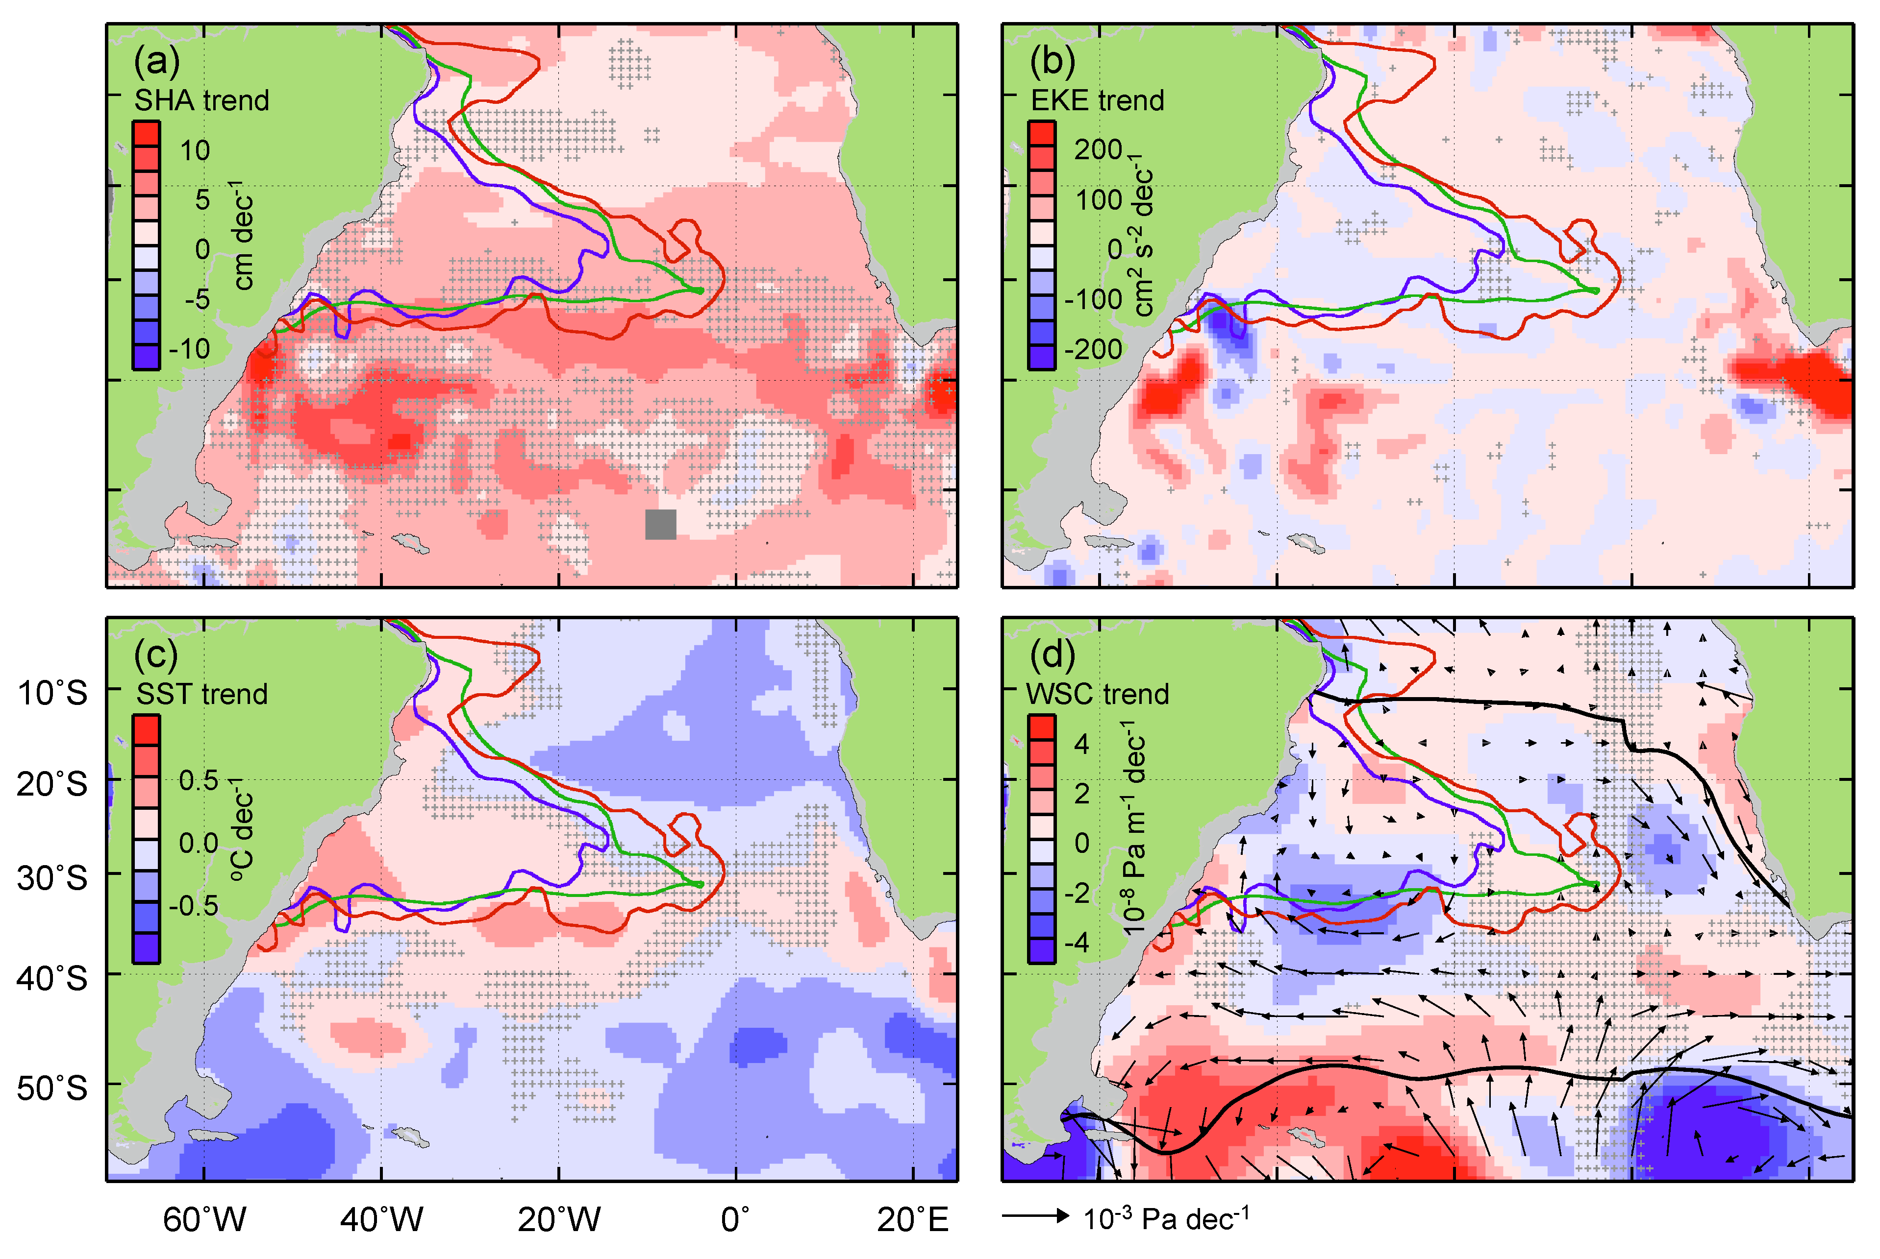
Non secular linear trends in the SA Ocean (1993-2010)
SHA changes
EKE changes
SST changes
WSC changes
Notes:
These trends are presented as a motivation on why we need to obtain these time series and then further investigate if any of these changes observed in the ocean dynamics, temp structure, wind fields may be impacting MHT and MOC.

Slide 5
Multiplatform study
Altimetry observations as the main data set
XBT observations as the main complimentary data set.
T(z) derived from satellite altimetry, T(0) by satellite-derived SSTs
S(z) derived from T(z)-S(z) look up tables built using profiles from all available CTD and Argo observations
NCEP Winds
XBT observations
Wind products
Notes:
Altimetry observations as key component of SAMOC
Why altimetry ? Can altimetry replace other observations ?

Slide 6
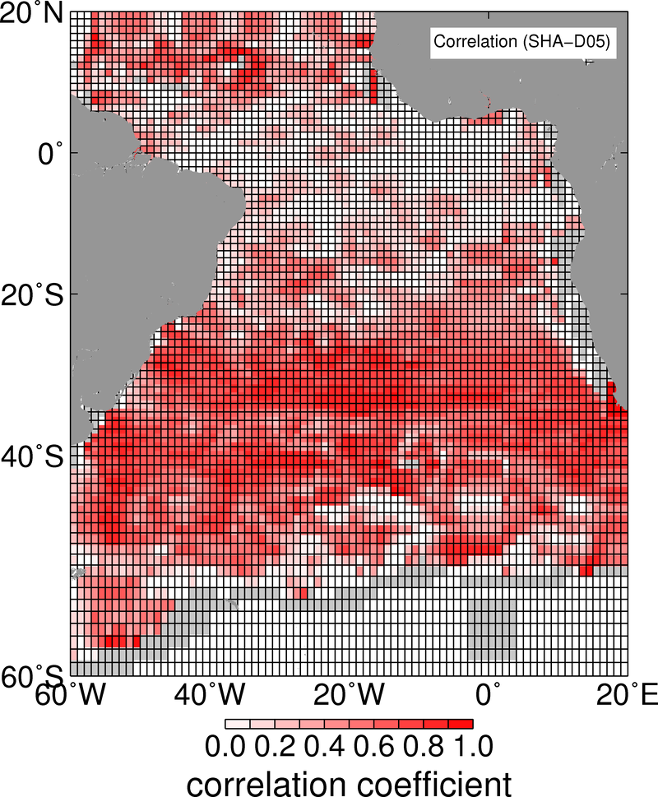
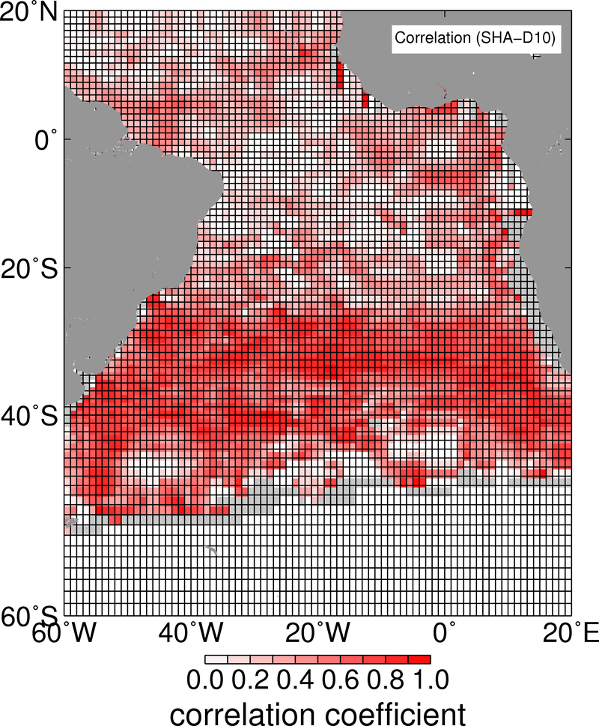
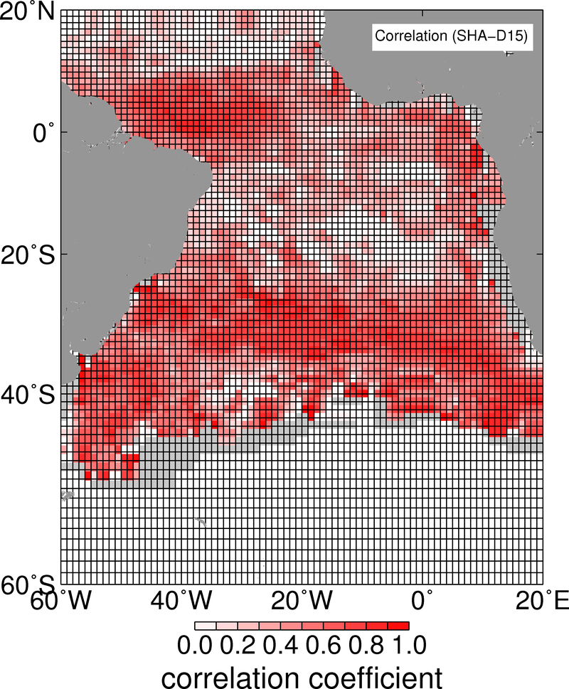
Sea Height Anomalies and Isotherm Depths
5°C
10°C
15°C

Slide 7
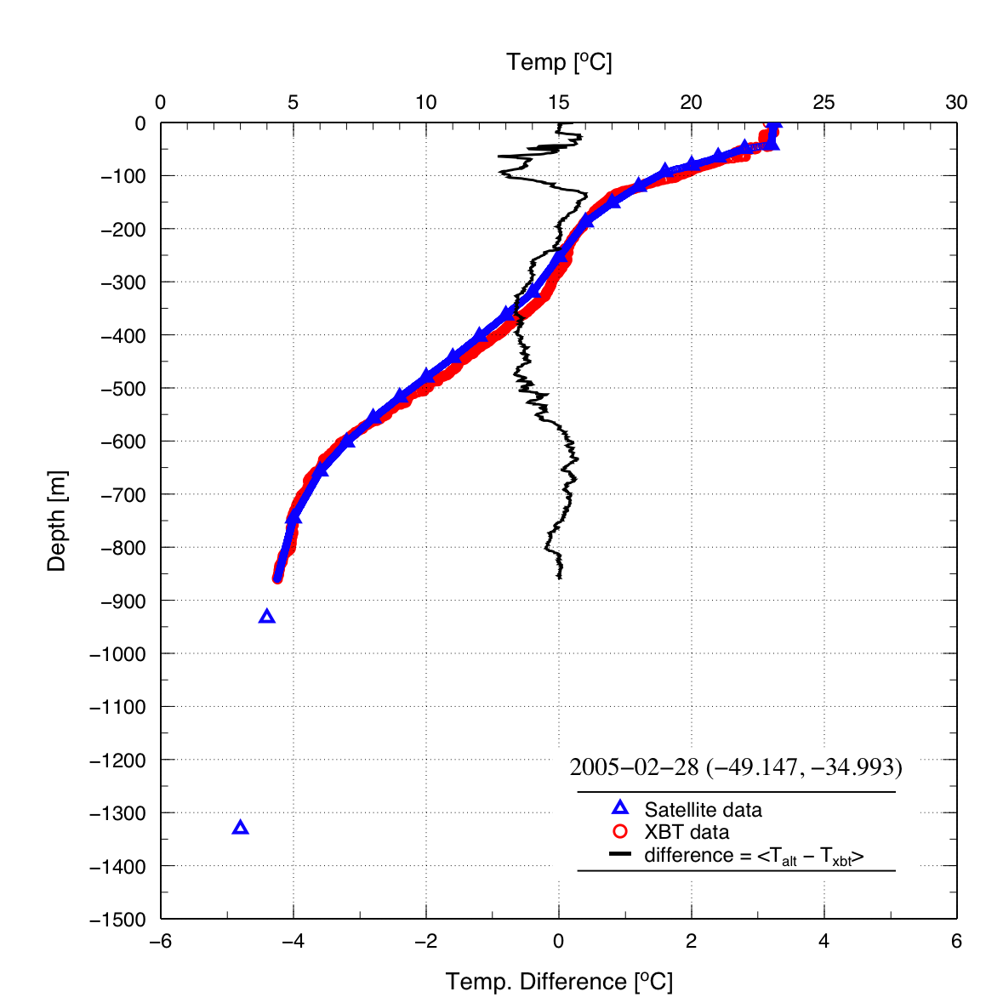
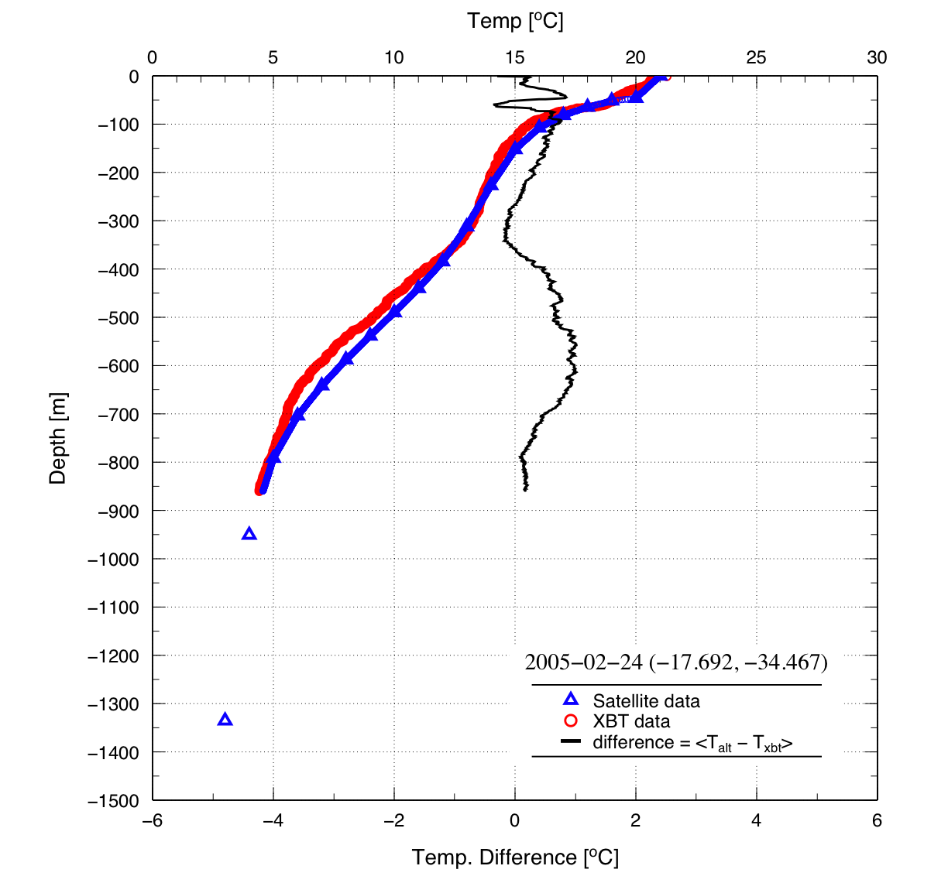
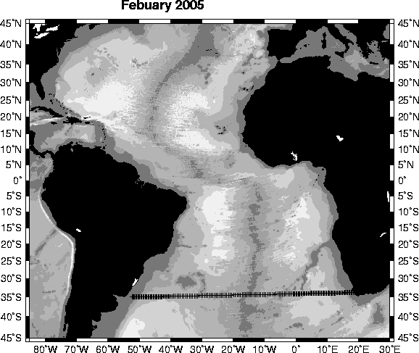
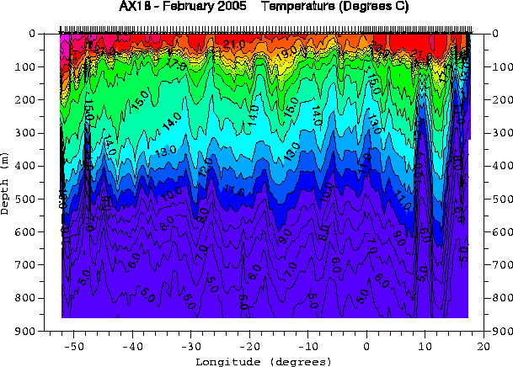

Altimetry-derived temperature profiles
February 2005
XBT T(z) profile
Altimetry T(z) profile
Difference (z)

Slide 8
Difference between Altimetry-derived and XBT-derived
temperature sections (34.5°S), February 2005

Slide 9
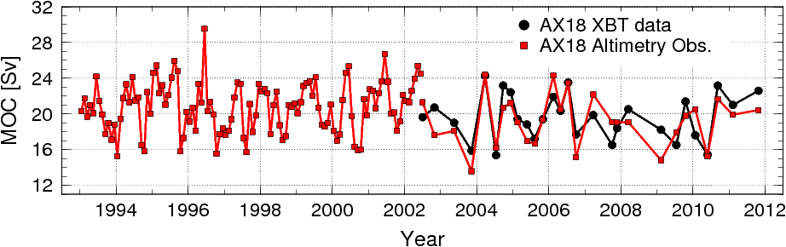
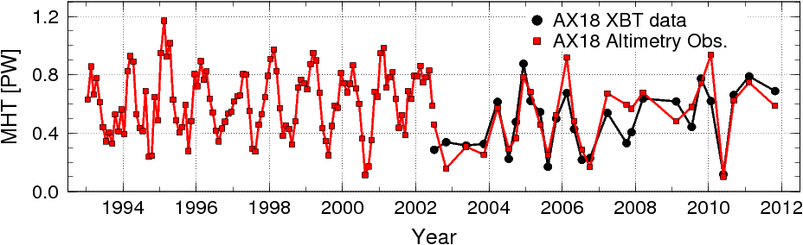
Altimetry-derived MOC/MHT at 34.5°S
Altimetry-XBT comparison
 | MOC (Sv) | MHT (PW)
XBT AX18 | 19.6±2.6 | 0.48±0.20
Altimetry | 19.2±2.8 | 0.51±0.22

Slide 10
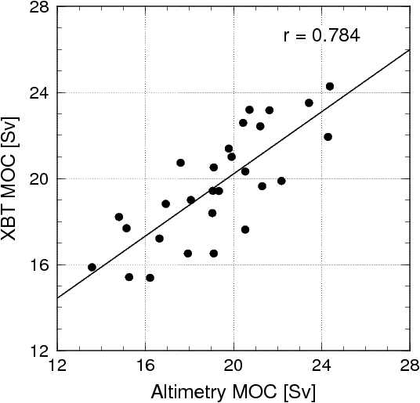
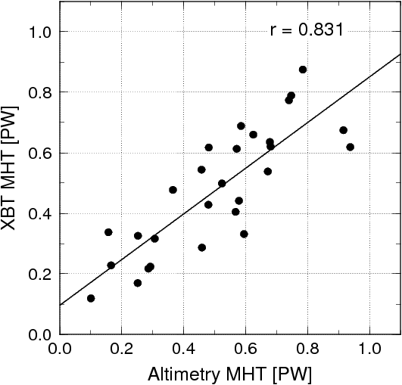
Altimetry-derived MOC/MHT at 34.5°S
Altimetry-XBT comparison
rms dif = 1.8Sv
rms dif = 0.13PW

Slide 11
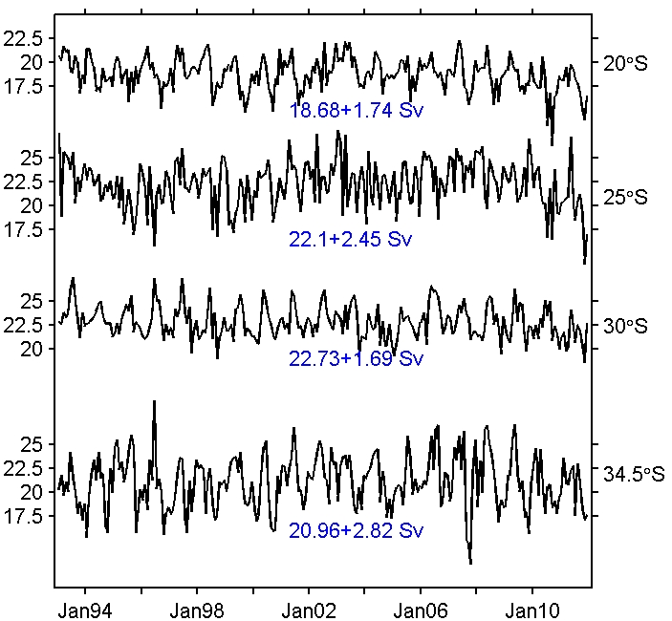
Altimetry-derived MOC
Mean MOC increases towards the center of the subtropical gyre (25-30°S)
Variability is minimum at 30°S
Maximum variability at 34.5°S
Long period signals observed at all latitudes

Slide 12
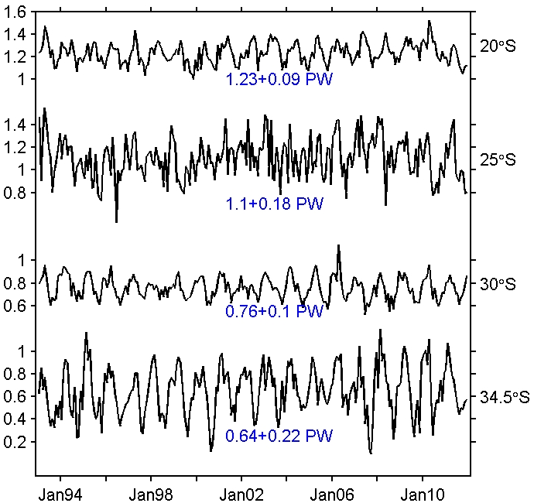
Altimetry-derived MHT
Mean MHT increases towards the north
Variability is minimum at 30°S
Maximum variability at 34.5°S
Long period signals observed at all latitudes

Slide 13
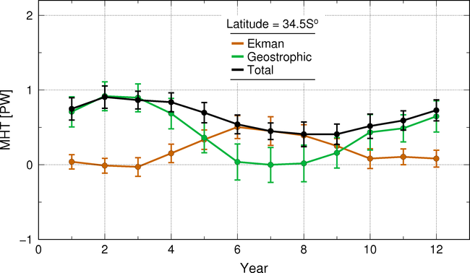
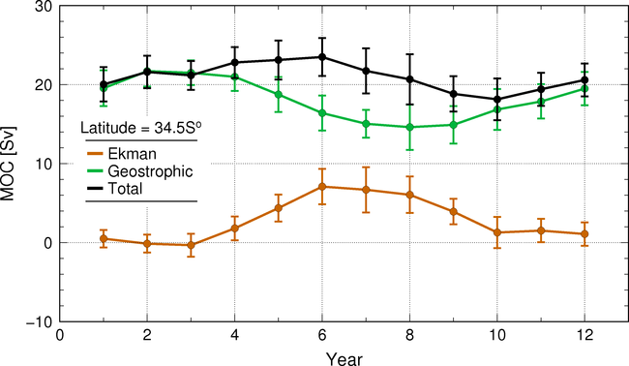
Altimetry-derived MOC/MHT at 34.5°S
Seasonal Variability
Marked seasonality of Ekman and Geostrophic components.
Ekman and Geostrophic components of MOC and MHT are out of phase.
Total MHT and MOC have weak seasonality.

Slide 14
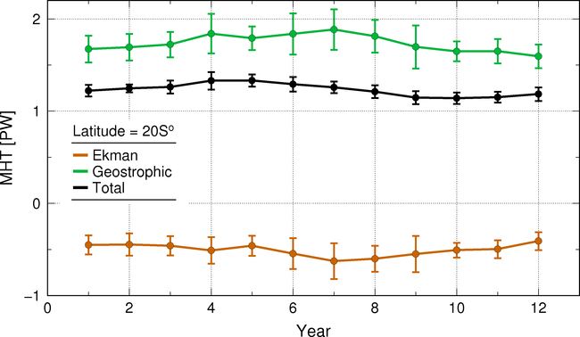
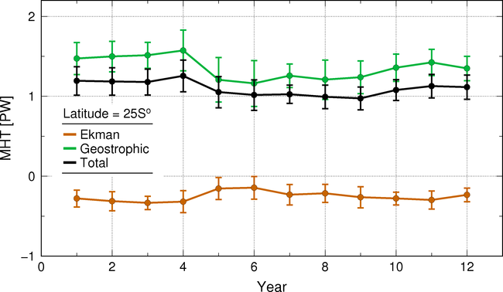
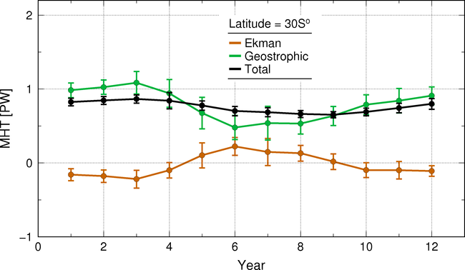
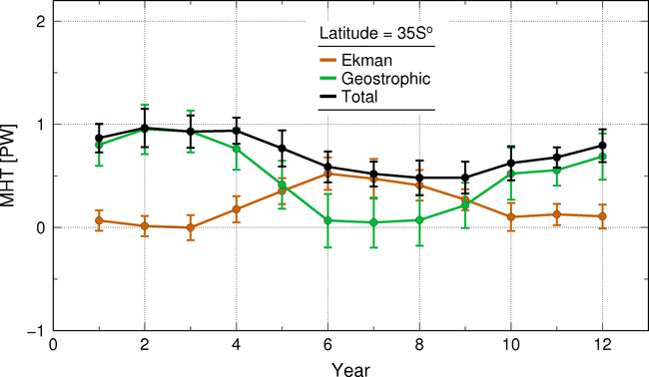
Altimetry-derived MHT (20-34.5°S)
Seasonal Variability
20°S
25°S
30°S
34.5°S

Slide 15
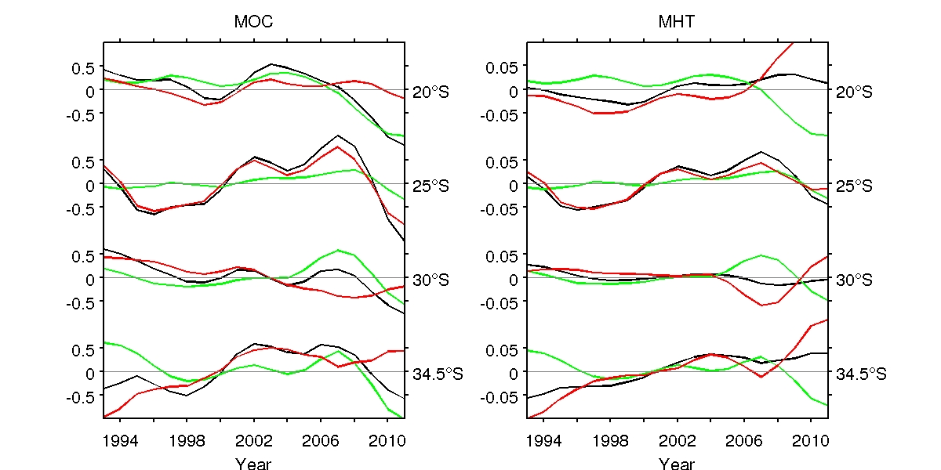
Altimetry-derived MOC
Temporal Variability
Largely dominated by geostrophic component before 2006.
Largely dominated by Ekman component after 2006 (except 25S).
At 34.5°S, long period variability with high in mid 2000’s and low in mid 1990s.

Slide 16
Altimetry-derived MHT
Temporal Variability
Ekman and geostrophic components out of phase at longer than seasonal time scales.
Although the variability of Ekman and geostrophic components exhibit large values, the total component does not

Slide 17
Altimetry-derived Meridional Heat transport

Slide 18
Main Conclusions
Satellite altimetry allows to obtain an extended time series of MHT and MOC to 1993.
RMS difference between XBT and altimetry estimates are smaller than year-to-year changes in MHT and MOC.
Ekman (geostrophic) component dominant after (before) 2006.
Results show that:
  mean values of MHT at 20-34°S are actually larger than previous estimates
  mean values of MHT decrease by approximately half between 20°S and 34°S

Slide 19
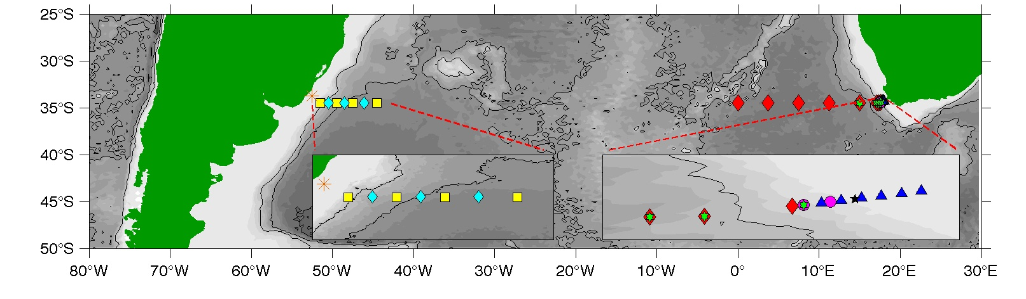
Immediate Plans
Continue joint analysis of data (altimetry, XBT, and other in situ observations) for MHT and MOC studies.
Investigate year-to-year variability (annual cycle removed) and possible MHT/MOC trends (linked to EKE, SH, SST, Wind variability?)
Indexes for model comparisons, in collaboration with NOAA/GDFL

Slide 20
Methodology
  Assume that sea height deviations are proportional to temperature deviations.
  For mass transport, MHT, and AMOC follow same methodology currently used with XBT observations.
  Construct a (long, starting in 1993) time series of MHT in the South Atlantic.

Slide 21
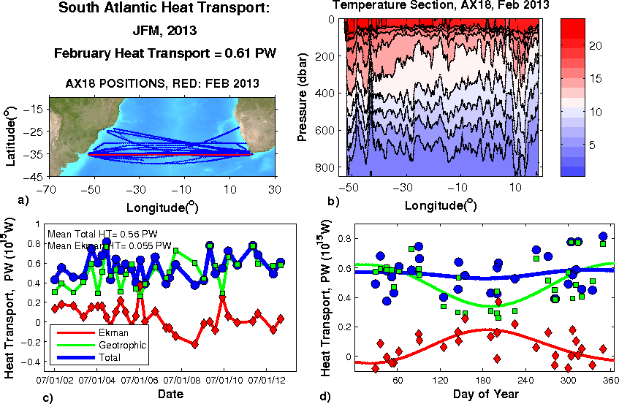
Meridional Heat Transport in the South Atlantic Ocean from XBT transect AX18 (~34.5°S)
Notes:
Synergy with current efforts

