Slide 1
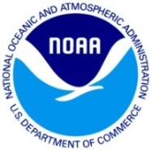
NOAA/AOML – CARICOOS Hurricane Underwater Glider Operations
Gustavo Jorge Goni¹
Francis Bringas¹
George Halliwell¹
Ricardo Domingues^{2,1}
Jili Dong ³
Grant Rawson^{2,1}
Ulises Rivero¹
Thomas Sevilla^{2,1}
Julio Morell⁴
Sang-Ki Lee¹
Hyun-Sook Kim³
Luis Pomales⁴
Becky Baltles⁵
Richard Bouchard⁶
Yamil Rodriguez⁷
1 NOAA Atlantic Oceanographic and Meteorological Laboratory - AOML, Miami, Florida, USA
2 University of Miami, Cooperative Institute for Marine and Atmospheric Studies - CIMAS, Miami, Florida, USA
3 NOAA Environmental Modeling Center , College Park, Maryland, USA
4 University of Puerto Rico, Mayagues, Puerto Rico, and Caribbean Coastal Ocean Observing System - CARICOOS
5 NOAA Integrated Ocean Observing System – IOOS, Silver Spring, MD, USA
6 NOAA National Data Buoy Center, Stennis, Miss, USA
7 Autoridad Nacional de Asuntos Maritimos - ANAMAR, Dominican Republic
Notes:
First of all, Gustavo Goni apologizes for not being able to come here to give you this presentation due to a conflict in schedule,
And we, once again, we’re very thankful for having the opportunity to talk to you about OUR NOAA/
This is a multi-institutional effort involving a large group dedicated towards carrying out underwater glider observations in support of hurricane studies and forecast.

Slide 2
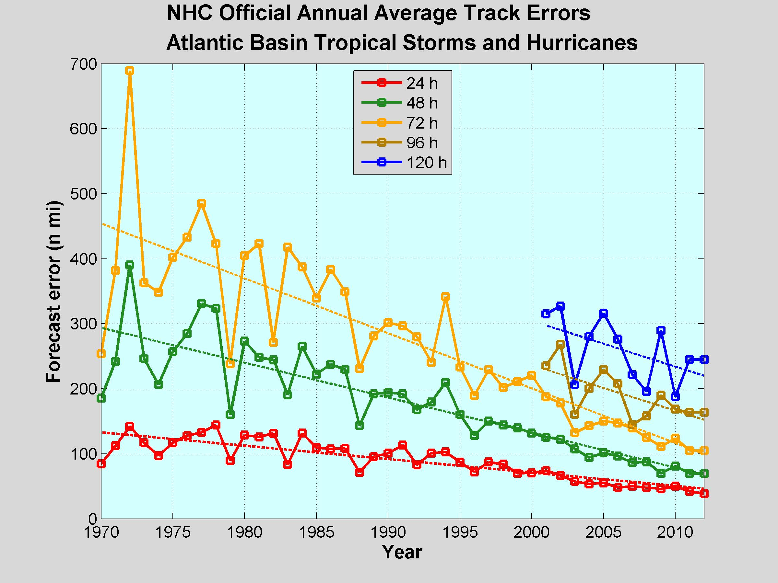
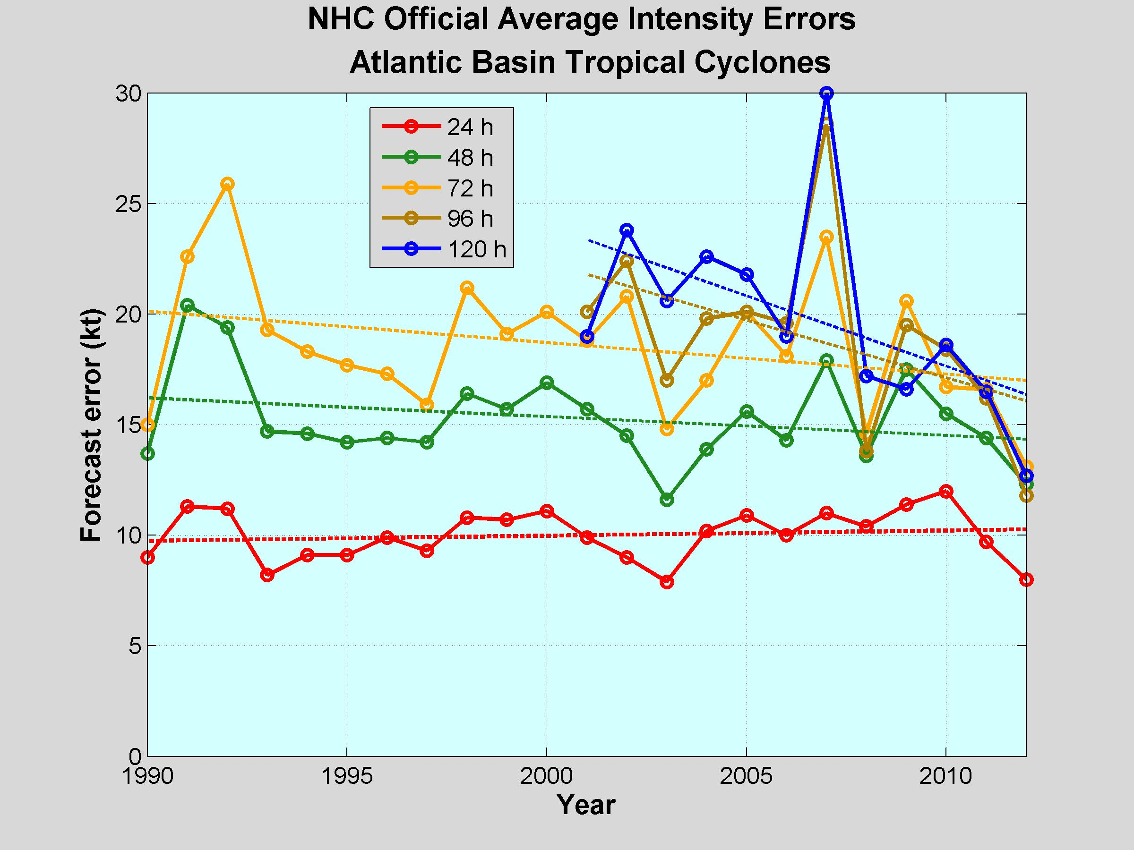
Tropical Cyclone Intensity and Track Forecasts Error
NHC Official Track Error - Atlantic
NHC Official Intensity Error - Atlantic
Notes:
During the past few decades, there has been a substantial improvement on the Hurricane Track Forecast,
as it can be seen on this time-series shown on the left, which shows the hurricane forecast track error as reported by the NHC
And, while there been a significant improvement, in the track forecast, the hurricane intensity forecast has not shown any substantial improvement during the past two decades, as the trends in the hurricane forecast intensity error remained relatively flat during this time-frame

Slide 3
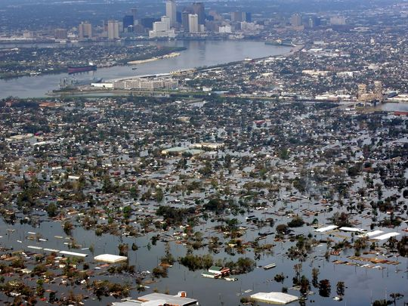
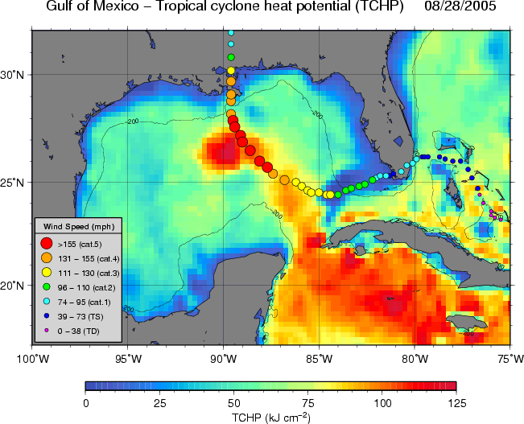
Role of the Ocean in Tropical Cyclone Intensification
Rapid Intensification of Hurricane Katrina (2005)
Other examples:
Opal (1995) [Shay et al., 2000]
Ivan(2004), Wilma (2005) [Mainelli et al., 2008]
Katrina (2005) intensified rapidly from category 3 into a category 5 hurricane in less than 12 hours as it travelled over a warm ocean eddy
Notes:
Previous studies have shown, provided the appropriete atmospheric cnditions, upper-ocean conditions, such as high values of upper ocean heat content
Can lead to the intensification of Tropical Cyclones
This Figure shows the track of the very famous Hurricane Katrina (2005), showing that, as Katrina travelled over a warm ocean feature in the Gulf of Mexico
It experienced a rapid intensification, where it went from a category 3 hurricane into a category 5 in less than 12 hours.
Like Katrina, there are several other cases showing that upper ocean coonditions can indeed lead to Hurricane Intensification.

Slide 4
World Ocean Atlas 2013: # of Temperature profiles
Network of gliders to carry out sustained and targeted ocean observations in the Caribbean Sea and Tropical North Atlantic in support of hurricane studies and forecasts
1955-2012
DO
PR
2005-2012
Number of obs.
< 200
Need for UOHC obs.!
Notes:
Areas off Puerto Rico in the Caribbean Sea and in the Tropical North Atlantic are generally characterized by large
Values of UOHC during the hurricane season, as are also areas where hurricanes very often travel and intensity, as shown
By these lines, which represent the historical tracks of tropical cyclones in this region.
And even though these areas are of importance for hurricanes development and intensification
There was not a an ocean observing system in place providing sustained observations from this region dedictate
In fact, data from the world ocean atlas 2013 shows that during the past decade there were less than 200 observations collected in the vicinity of Puerto Rico.
We then proposed the a network of underwater gliders to carry ….

Slide 5
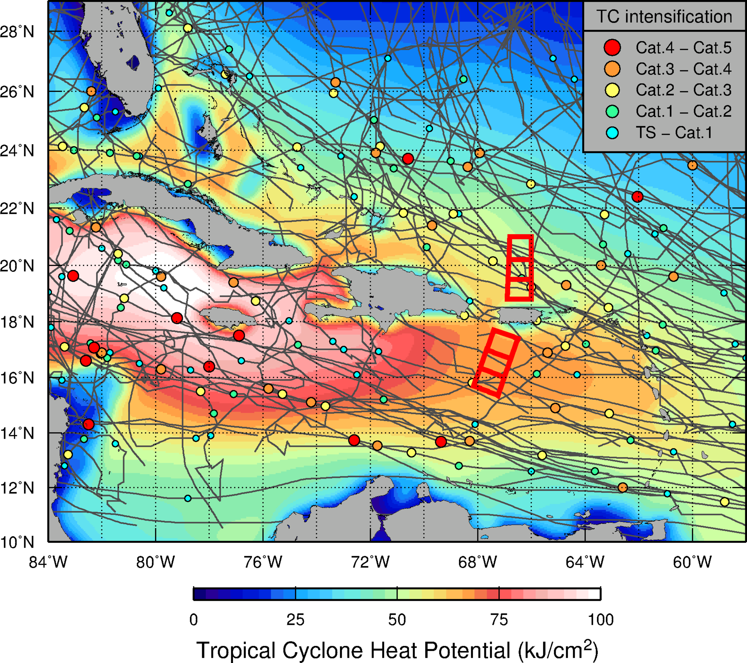
NOAA/AOML – CARICOOS Hurricane Underwater Glider Operations
Goal
Enhance our understanding of air-sea interaction processes during hurricane force wind events.
Objectives
Assess impact of hurricane force winds on upper ocean density structure, and
Assess impact of ocean profile data from underwater gliders in hurricane intensity forecasts.
http://www.aoml.noaa.gov/phod/gliders
Notes:
The goal of this network was to help enhance ….
By assessing
And by assessing …

Slide 6
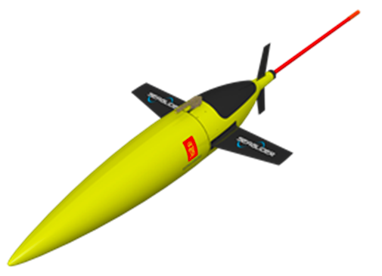
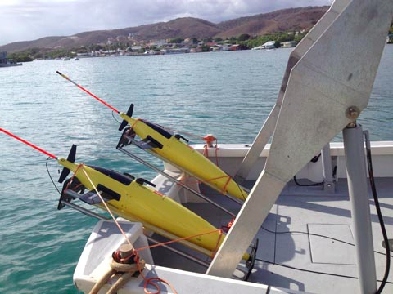
NOAA/AOML – CARICOOS Hurricane Underwater Glider Operations
Underwater gliders
Autonomous Underwater Vehicles
High-quality / high-resolution observations
5 dives per day
~3km hor. Resolution
4-5 months endurence
Large variety of sensors
Temperature
Salinity
Dissolved Oxygen
Chlorophyll-a
Glider operations started in July 2014
Notes:
Once funded, we implemented the network using Seagliders
We currently have 4 vehicles
They are all equiped with these following sensors.
we started using CT sail sensors for temperature and salinity,
And were slowly transitionint all gliders towards a pumped CTD system
And all gliders have an oxygen optode, and a fluorecence sensors

Slide 7
Hurricane Gonzalo (2014)
”
"At the time, the strongest Atlantic hurricane since Igor (2010)”
October 15, 2014
Notes:
And, shortly after we started our operations, we were lucky enough to have the hurricane gonzlo travelling over the location of our glider,
Providing a unique opportunity to collect upper ocean obs. Under TC wind conditions.
Here is an snapshot of hurricane gonzalo on October 15, shortly after it travelled our the location of our glider.
Hurricane Gonzalo, was at the time, the strongest Atlantic Hurricane since Igor in 2010.

Slide 8
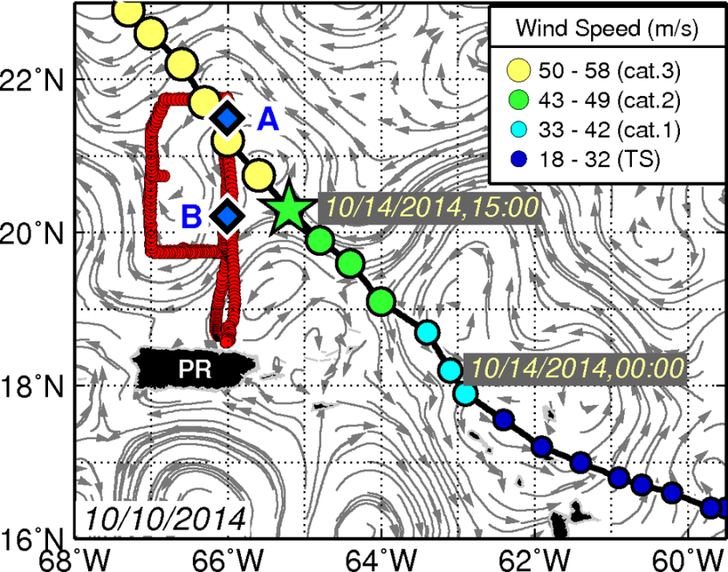
Hurricane Gonzalo (2014)
A
Analysis
1st Stage: Assess the upper ocean response forced by winds of Hurricane Gonzalo: Domingues et al., (2015)
2nd Stage: Assess the impact of assimilating the glider data on the actual forecast of Hurricane Gonzalo: Dong et al., (under revision)
B
PR – Puerto Rico
Notes:
Our sampling strategy during the passage of the hurricane consisted of sampling the section A-B before the passage of the hurricane.
We then parked the glider at site B for two days simulating a fixed mooring with high sampling resolution, waiting for the passage of the hurricane on a fixed point of reference
After the passage of the hurricane, we repeated the section A-B two times to assess changes in the upper ocean forced by the hurricane force winds, and then the ocean recovery after the hurricane.

Slide 9
AOML Underwater Glider Observations:
Impact of ocean data on Hurricane Gonzalo coupled Forecast
Minimum Pressure
NOAA-NHC Best Track
HYCOM-HWRF: no data
HYCOM-HWRF: ALL data
HYCOM with no data assimilated
HYCOM with all ocean data assimilated
Experiment with no data assimilation largely underestimates the intensity of Hurricane Gonzalo
Pressure: assimilation of ocean obs. allowed for 100% error reduction
Maximum wind: assimilation of ocean obs. reduced ~50% the error in terms of maximum wind
Maximum Wind
HWRF-HYCOM: NOAA’s next generation hurricane forecast model
HWRF - Hurricane Weather and Research Forecast model
HYCOM- Hybrid Coordinate Ocean Model
Notes:
To accomplish this, different numerical experiments were carried using the HWRF-HYCOM coupled hurricane forecast modeling system,
which corresponds to one of NOAA’s next generation hurricane forecast model.
The skill of the different experiments were evaluated against the best track data from the NHC in terms of Minimum pressure and maximum wind intensity.
And here we’re showing results from one experiment that does not have assimilation of any ocean data, in blue and for one simulation that had the assimilation of all ocean observations available, including the underwater glider data.
The key results from this analysis is that without the assimilation of ocean data, the hurricane intensity forecast s largely underestimated.
And when ocean observations are assimilated, the model actually reproduced the minimum pressure associated with Gonzalo,
And reduced about 50% of the error in terms of simulated maximum wind

Slide 10
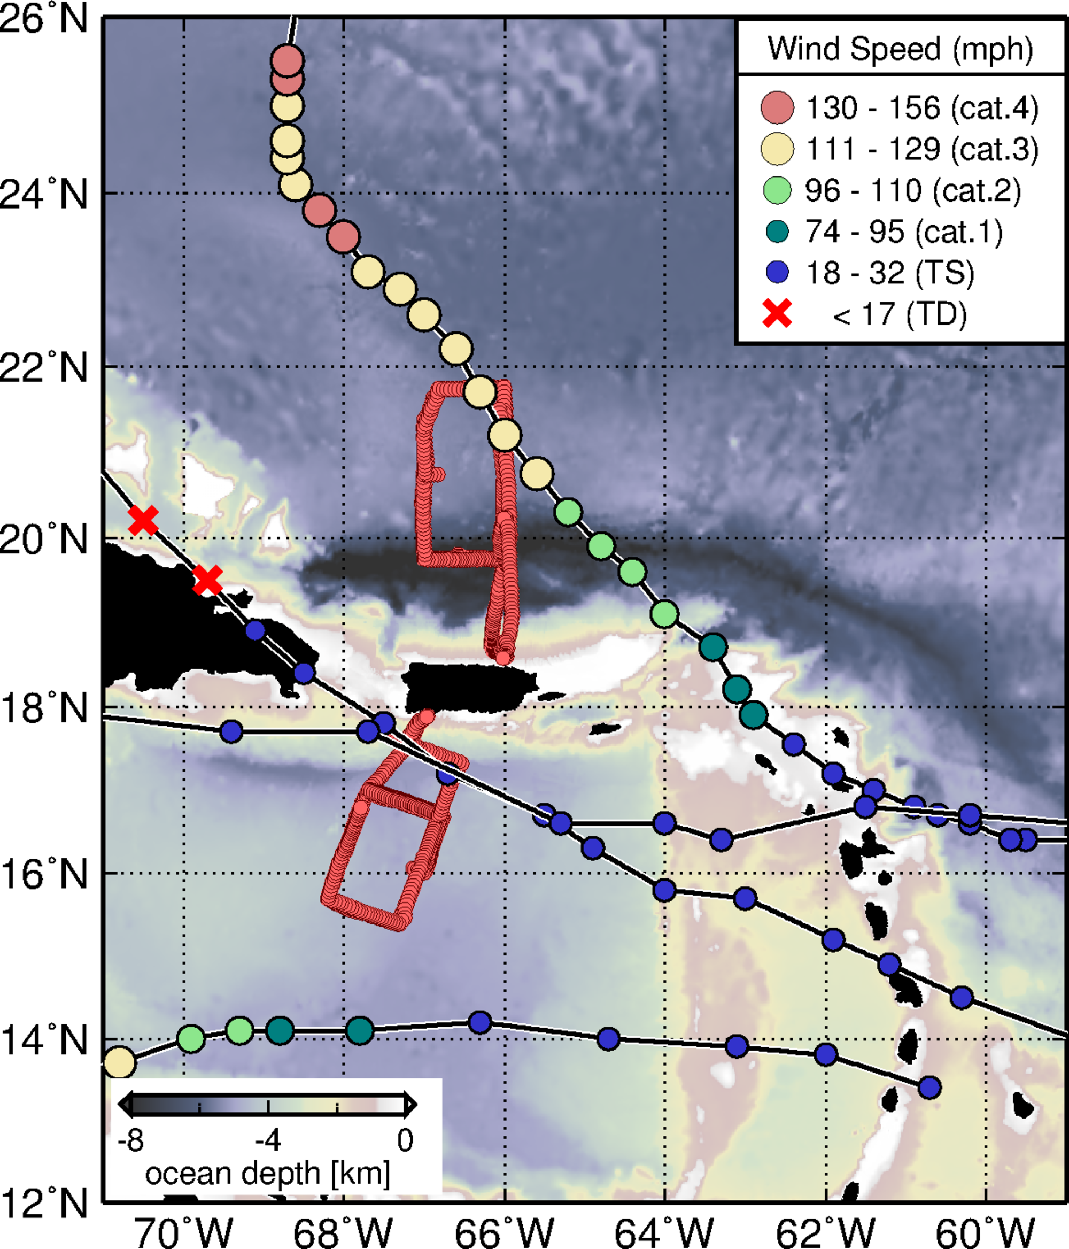
Summary:
Underwater gliders can provide critical temperature and salinity profile data in real-time even during tropical cyclone wind conditions.
Over 10,000 profiles of each observed parameter, such as temperature, salinity, dissolved oxygen, and chlorophyll concentration have been collected during the first two years of the NOAA/AOML-CARICOOS Hurricane Underwater Glider Operations
One case study, with significant results during Hurricane Gonzalo (2014), indicates that glider data improves ocean initialization when assimilated within HYCOM-HWRF model.
TS Erika (2015)
Hurricane Gonzalo (2014)
Future work:
Continue collecting ocean profile data, with enhanced glider network.
Assess optimal observational strategy to improve TC intensity forecast using a suite of ocean observations.
Further collaboration with other institutions interested in monitoring the UOHC in support of Tropical Cyclone intensification studies and forecasts
TS Bertha (2014)
Hurricane Matthew (2016)
Domingues, R., G. Goni, F. Bringas, S.-K. Lee, H.-S. Kim, G. Halliwell, J. Dong, J. Morell, and L. Pomales (2015), Upper ocean response to Hurricane Gonzalo (2014): Salinity effects revealed by targeted and sustained underwater glider observations, Geophys. Res. Lett., 42, doi:10.1002/2015GL065378.
Dong et al, Impact of underwater glider data on Hurricane Gonzalo (2014) forecast, 2016, to be submitted.
Notes:
SO as a Summary…

Slide 11
NOAA/AOML – CARICOOS Hurricane Underwater Glider Operations
Gustavo Jorge Goni¹
Francis Bringas¹
George Halliwell¹
Ricardo Domingues^{2,1}
Jili Dong ³
Grant Rawson^{2,1}
Ulises Rivero¹
Thomas Sevilla^{2,1}
Julio Morell⁴
Sang-Ki Lee¹
Hyun-Sook Kim³
Luis Pomales⁴
Becky Baltles⁵
Richard Bouchard⁶
Yamil Rodriguez⁷
1 NOAA Atlantic Oceanographic and Meteorological Laboratory - AOML, Miami, Florida, USA
2 University of Miami, Cooperative Institute for Marine and Atmospheric Studies - CIMAS, Miami, Florida, USA
3 NOAA Environmental Modeling Center , College Park, Maryland, USA
4 University of Puerto Rico, Mayagues, Puerto Rico, and Caribbean Coastal Ocean Observing System - CARICOOS
5 NOAA Integrated Ocean Observing System – IOOS, Silver Spring, MD, USA
6 NOAA National Data Buoy Center, Stennis, Miss, USA
7 Autoridad Nacional de Asuntos Maritimos - ANAMAR, Dominican Republic
Thank you
Gustavo.Goni@noaa.gov
http://www.aoml.noaa.gov/phod/gliders
Notes:
First of all, Gustavo Goni apologizes for not being able to come here to give you this presentation due to a conflict in schedule,
And we, once again, we’re very thankful for having the opportunity to talk to you about OUR NOAA/
This is a multi-institutional effort involving a large group dedicated towards carrying out underwater glider observations in support of hurricane studies and forecast.

