Slide 1
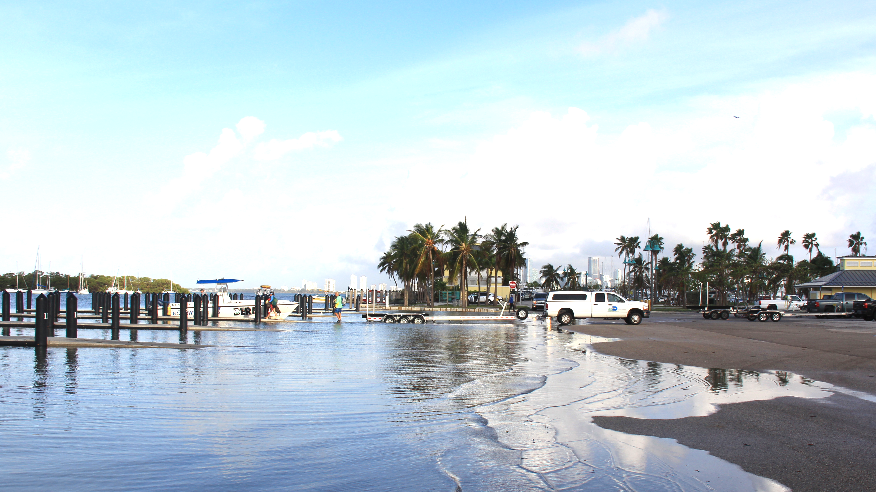


Accelerated sea level changes along the United States East Coast during 2010-2015
Ricardo Domingues^{1,2}
Gustavo Goni²
Molly Baringer²
Denis Volkov^{1,2}
¹ University of Miami, Cooperative Institute for Marine and Atmospheric Studies - CIMAS, Miami, Florida, USA
² NOAA Atlantic Oceanographic and Meteorological Laboratory - AOML, Miami, Florida, USA
Ricardo.Domingues@noaa.gov
Photo by Grant Rawson (NOAA/AOML)

Slide 2
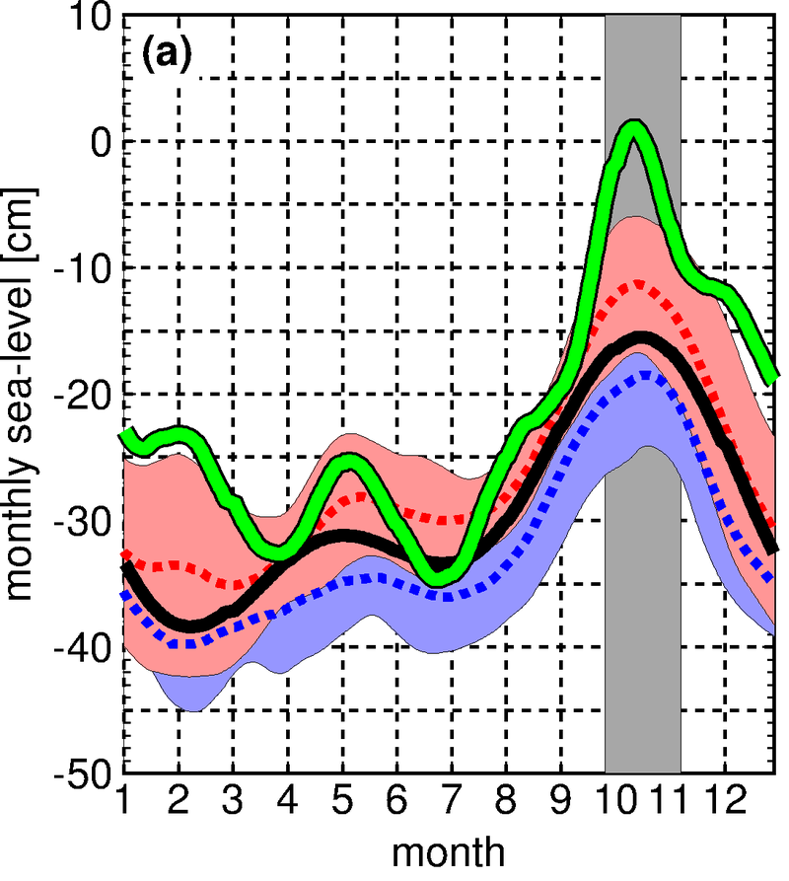

High-tide Nuisance Flooding Events at the U.S. East Coast
Monthly sea-level observed in Miami
(NOAA/NOS Virginia Key Tide Gauge)
Miami: September-October 2015
2015
2006-2017
King Tides
Astronomical tides
source: New York Times
1995-2005
J F M A M J J A S O N D

Slide 3
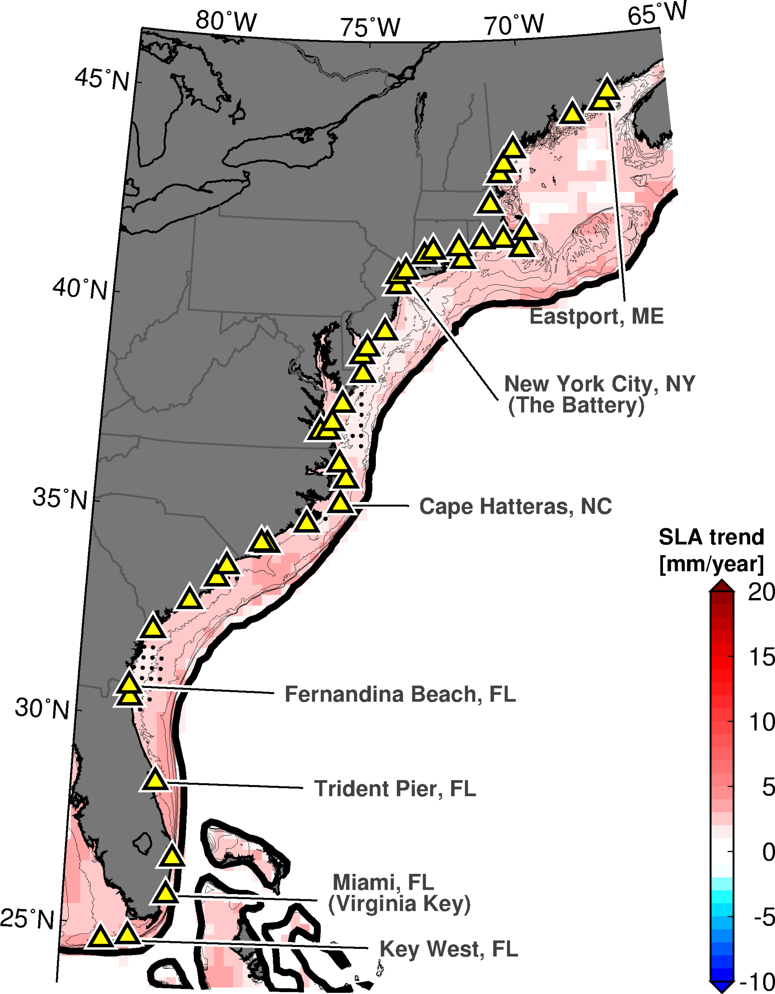
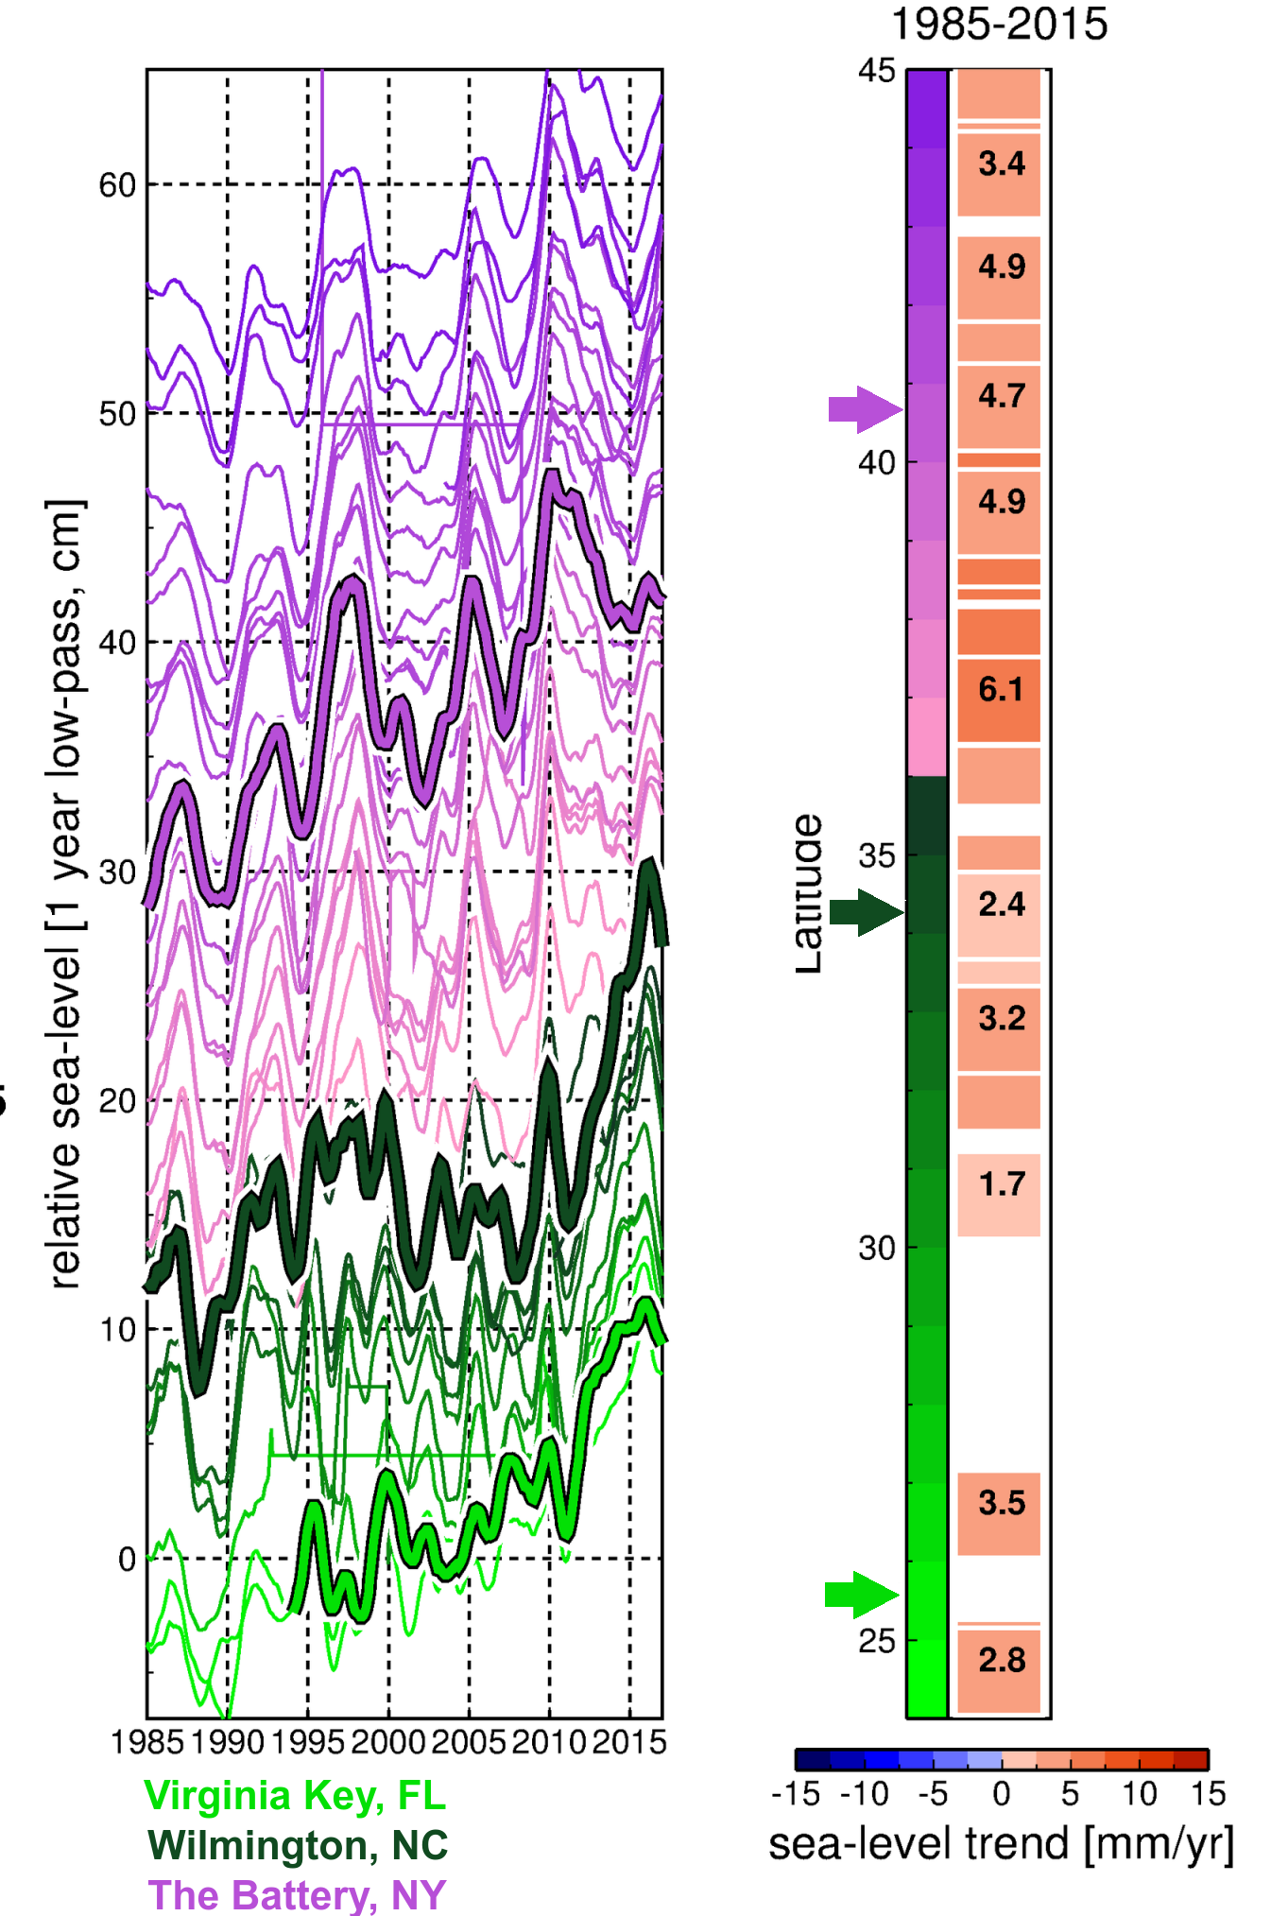
Sea Level Changes Along the U.S. East Coast
Satellite Altimetry (1992-2015)
Tide Gauges (1985-2015)
NOAA/NOS Tide Gauges

Slide 4
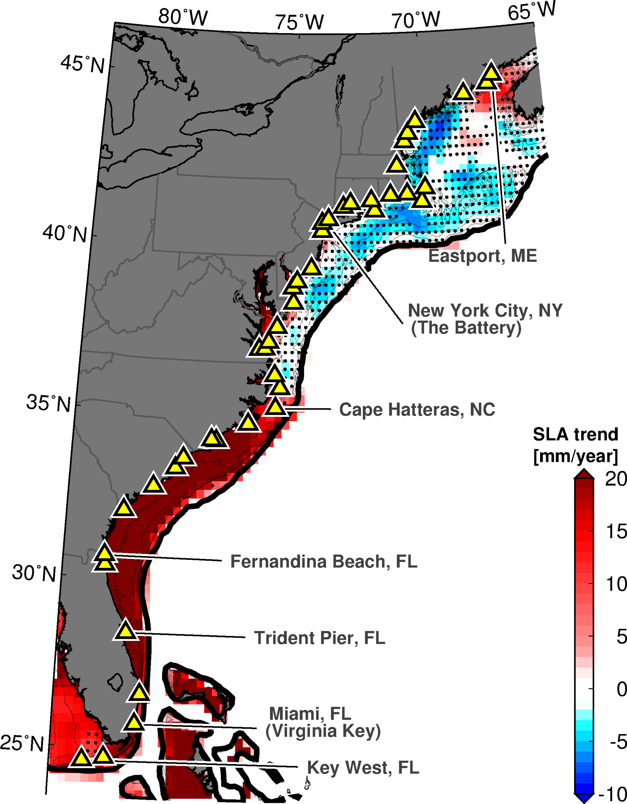
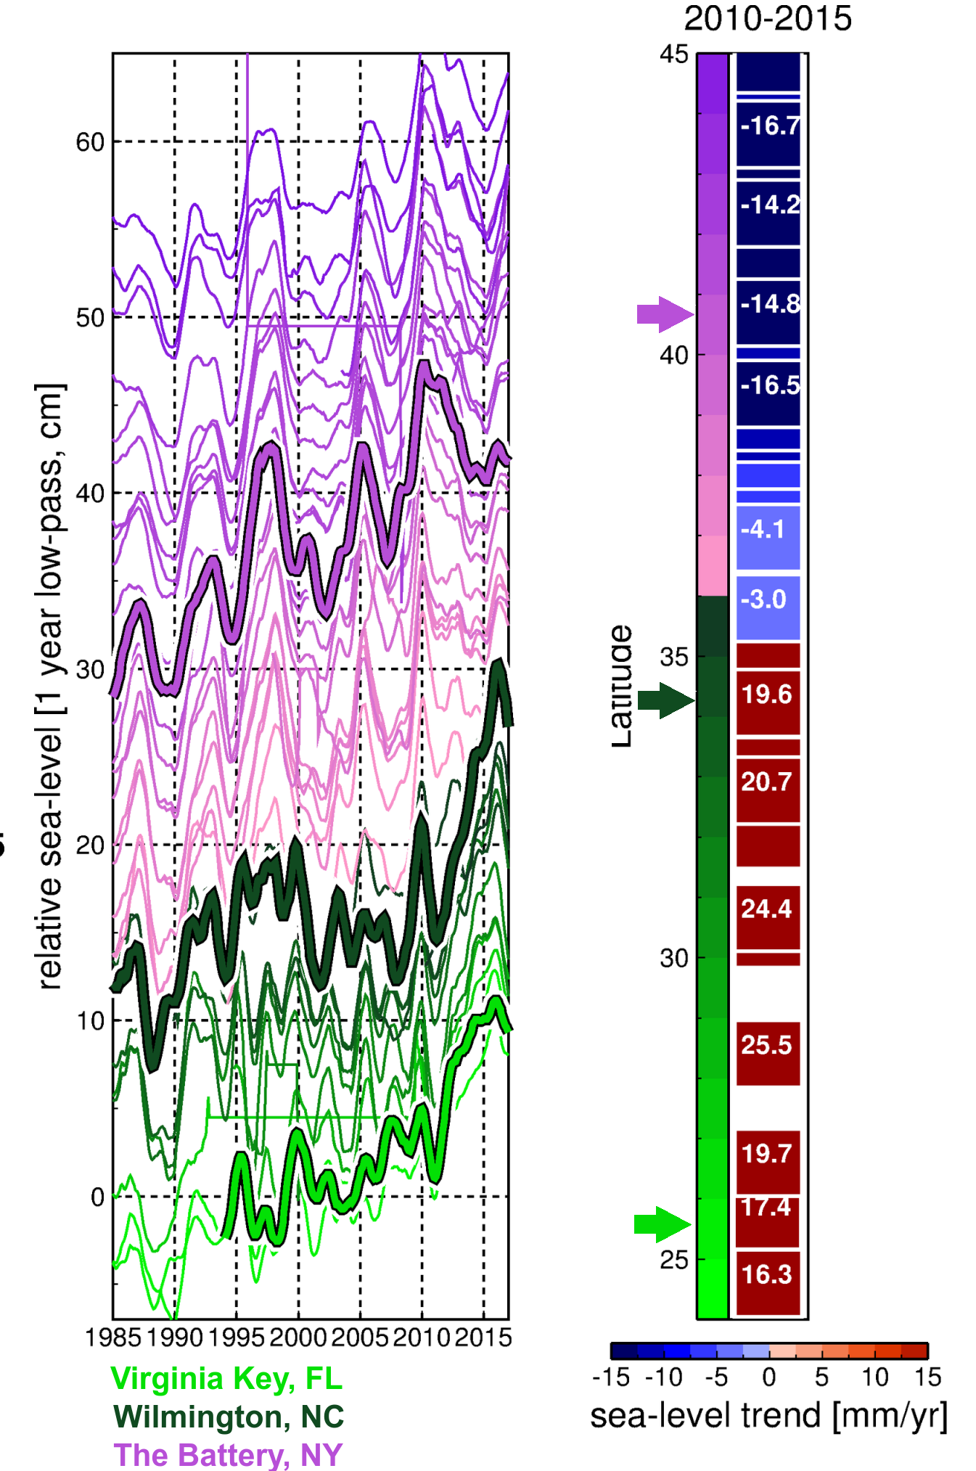
Sea Level Changes Along the U.S. East Coast
Satellite Altimetry (2010-2015)
Tide Gauges (2010-2015)
NOAA/NOS Tide Gauges

Slide 5
Sea Level Changes Along the U.S. East Coast
Satellite Altimetry (2010-2015)
Tide Gauges (2010-2015)
During 2010-2015, sea level has increased in average by ~12 cm along the Southeast U.S. coast; twice the global sea level rise average of ~6 cm during the last two decades (e.g. Cazenave et al., 2014)
NOAA/NOS Tide Gauges

Slide 6
Sea Level Changes Along the U.S. East Coast
Satellite Altimetry (2010-2015)
Tide Gauges (2010-2015)
Valle-Levinson et al., (2017) attributed these accelerated changes in sea level to changes in atmospheric conditions associated with the NAO and ENSO
NOAA/NOS Tide Gauges

Slide 7
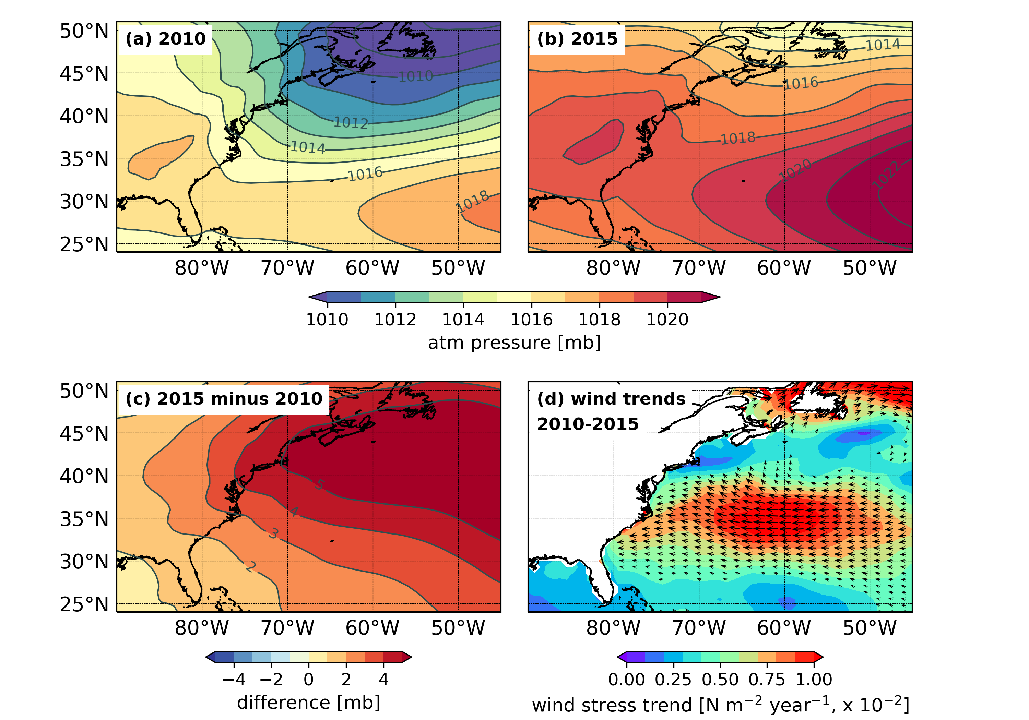
Changes in Atmospheric Conditions During 2010-2015
*atmospheric pressure and wind data from ERA interim reanalysis

Slide 8
Changes in Atmospheric Conditions During 2010-2015
Northeast U.S. coast: Shifting wind patterns and increasing atmospheric pressure account for most of temporary SL decline
Southeast U.S. coast: Wind effects are partially compensated by increasing atmospheric pressure, and do not account for SL increase
*atmospheric pressure and wind data from ERA interim reanalysis

Slide 9
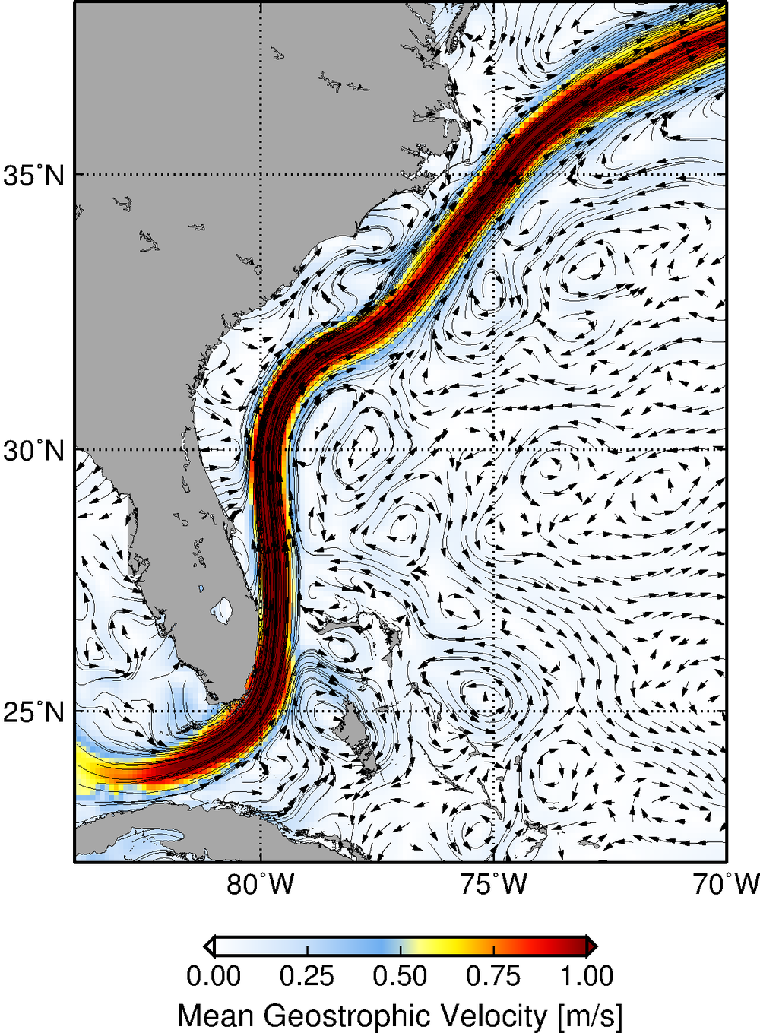
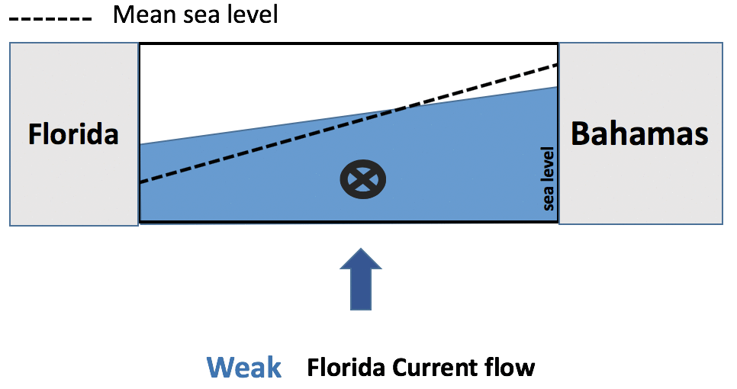
Florida Current and Gulf Stream Effect on Sea Level Along East U.S. coast
Gulf Stream
Florida Current

Slide 10
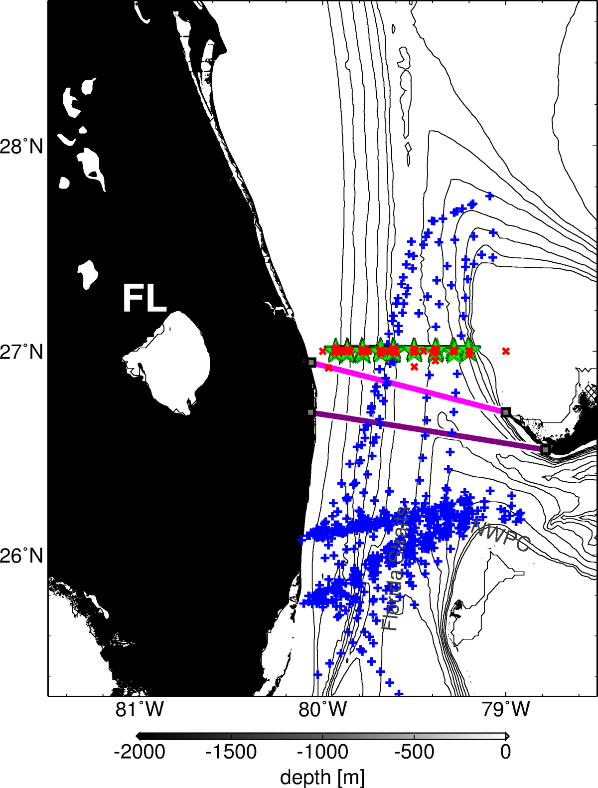

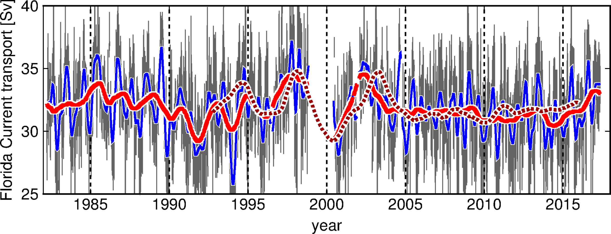

The Florida Current Transport
Daily record of the Florida Current flow since 1982
Cape Canaveral
Bahamas
Daily FC transport (cable)
1 year low-pass (cable)
90 days low-pass (cable)
1 year low-pass (altimetry)
Miami
Florida Current transport stable during 2010-2015

Slide 11
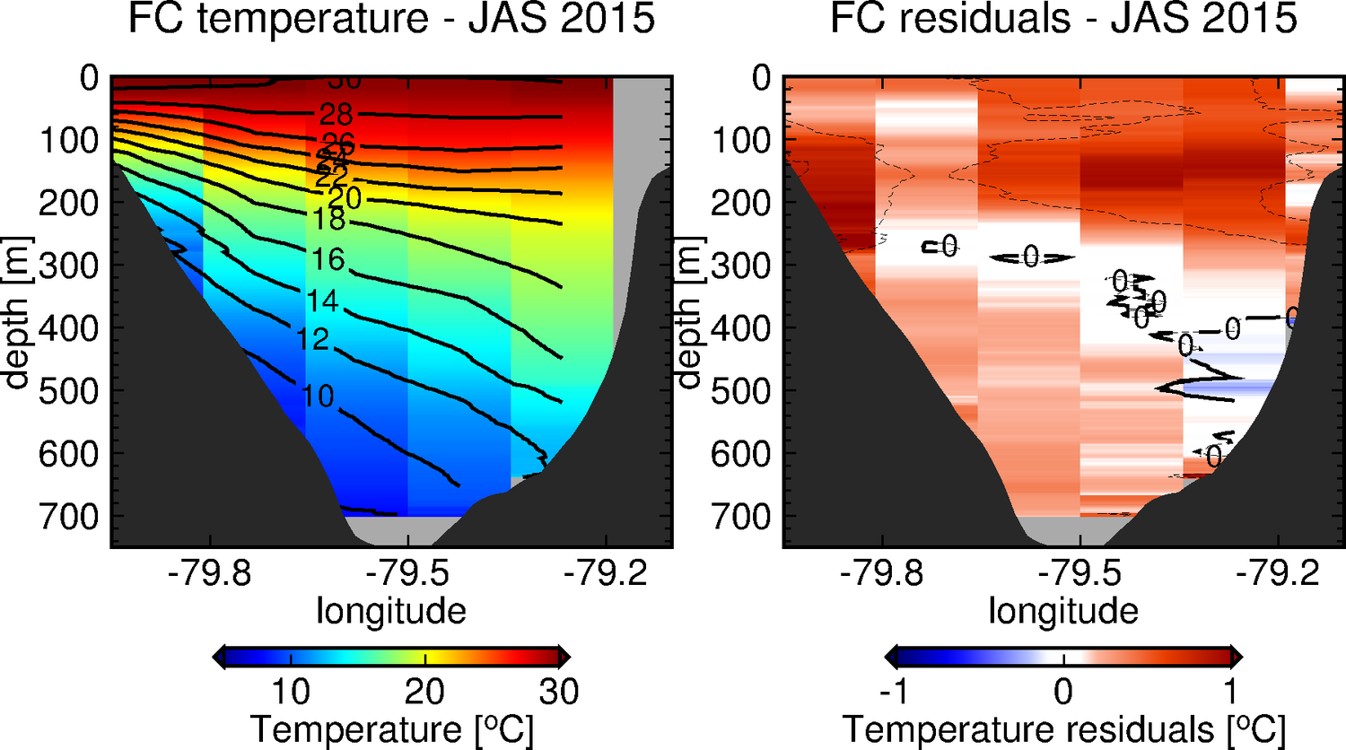
Warming of the Florida Current during 2010-2015
Florida Current Temperature – Fall 2015
Cape Canaveral
Bahamas
Miami

Slide 12
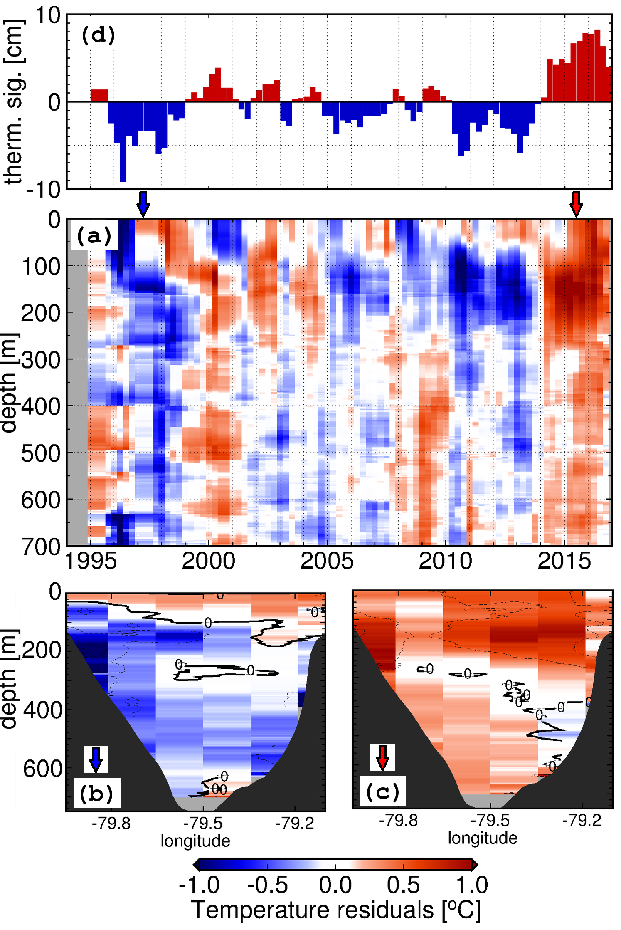
Year-to-year Changes in the Florida Current Temperature
The 2010-2015 event:
  Florida Current temperature shifted from a cold phase during 2010-2013 to a warm phase during 2014-2015
  Florida Current warming over the period (~1ºC) accounted for a 12.5 cm thermosteric sea level rise at a rate of 18.9 mm/year
  Thermosteric sea level rise recorded in the Florida Straits accounts for 95% of the dynamic sea level rise recorded by satellite altimetry, and in situ tide gauges
November, 2011
Temperature anomalies with seasonal cycle removed, and averaged for the Florida Straits

Slide 13
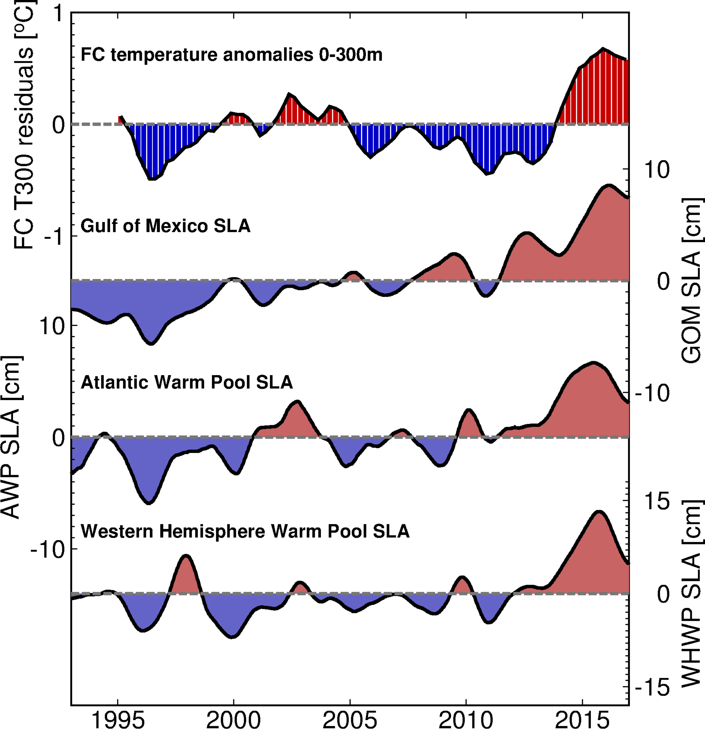
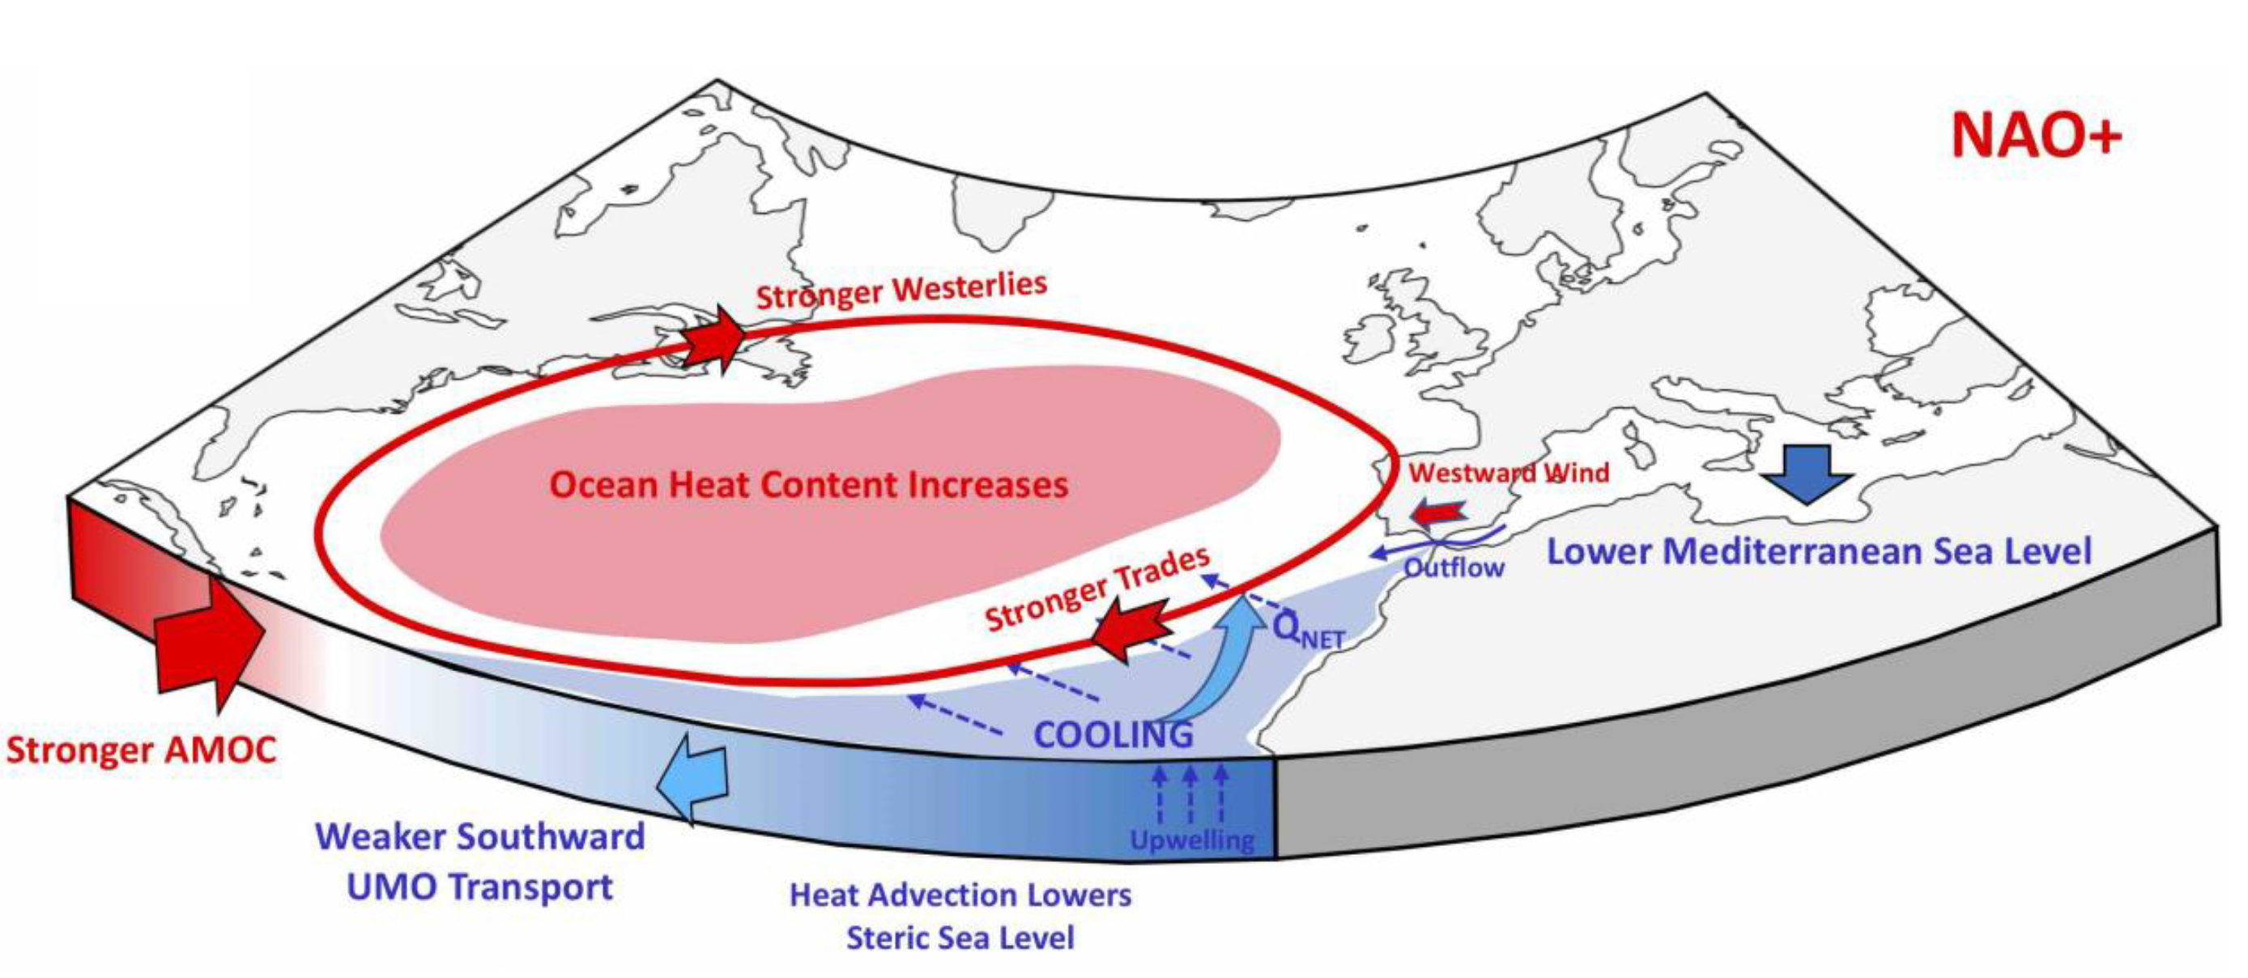
Relationship Between Florida Current Warming and Large-Scale Changes
Oc. Indicators of Large-Scale Changes
AMOC and NAO driven Large-scale Heat Convergence
Volkov et al., (2018)
Florida Current warming during 2010-2015 is consistent with large scale heat convergence caused by the AMOC and modulated by the NAO
Volkov et al., (2018): Teleconnection between the Atlantic Meridional Overturning Circulation and sea level in the Mediterranean Sea. Journal of Climate, (doi:10.1175/JCLI-D-18-0474.1).

Slide 14
Conclusions
Accelerated sea level changes were recorded along the U.S. East Coast during 2010-2015
  Accelerated sea level rise south of Cape Hatteras at rates as large as 25 mm/year
  Temporary sea level decline north of Cape Hatteras at rates reaching 17 mm/year
Temporary decline in sea level North of Cape Hatteras is mostly accounted by changes in atmospheric conditions
Accelerated sea level rise south of Cape Hatteras was mostly thermosteric and accounted for by warming of the Florida Current and Gulf Stream during the period
The observed warming of the Florida Current was part of large-scale heat convergence in the North Atlantic ocean caused by the AMOC and modulated by the NAO
  The Florida Current temperature may serve as a thermometer for monitoring large-scale ocean heat content changes in the North Atlantic ocean

Slide 15


Slide 16
Accelerated sea level changes along the United States East Coast during 2010-2015
Ricardo Domingues^{1,2}
Gustavo Goni²
Molly Baringer²
Denis Volkov^{1,2}
¹ University of Miami, Cooperative Institute for Marine and Atmospheric Studies - CIMAS, Miami, Florida, USA
² NOAA Atlantic Oceanographic and Meteorological Laboratory - AOML, Miami, Florida, USA
Thank you
Reference
Domingues R., G. Goni, M. Baringer, D. Volkov (2018), What caused the accelerated sea level changes along the United States East Coast during 2010-2015?. Geophysical Research Letters, in press, doi: 10.1029/2018GL081183.
Ricardo.Domingues@noaa.gov

