Slide 1
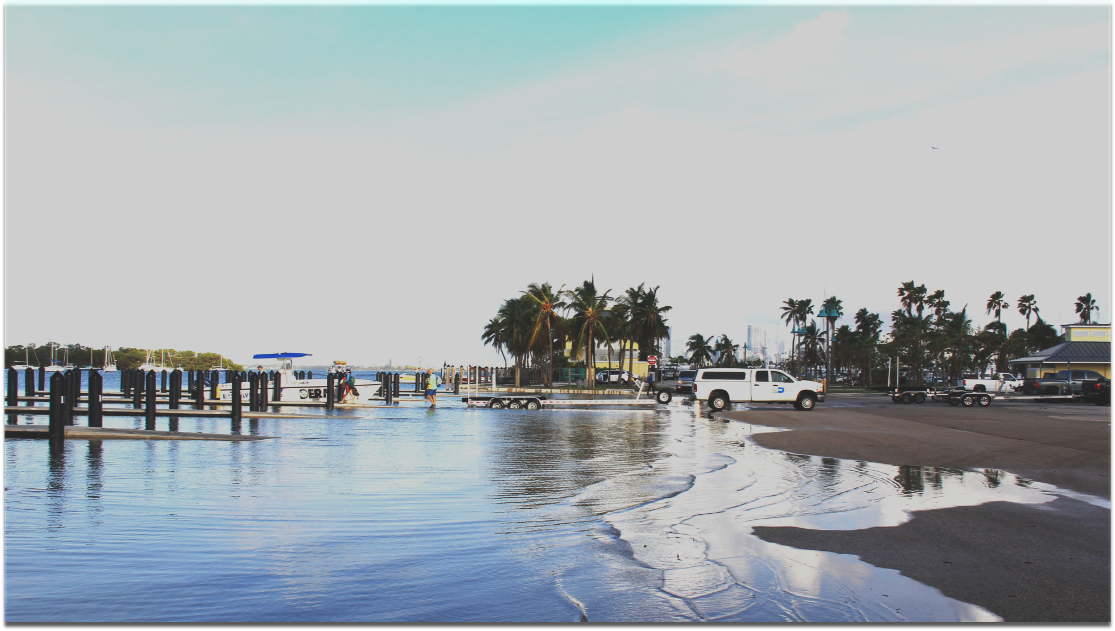


Assessing Attributions of Coastal Sea Level Changes Along the U.S. East Coast
Ricardo Domingues^{1,2}
Gustavo Goni²
Molly Baringer²
Denis Volkov^{1,2}
¹ University of Miami, Cooperative Institute for Marine and Atmospheric Studies - CIMAS, Miami, Florida, USA
² NOAA Atlantic Oceanographic and Meteorological Laboratory - AOML, Miami, Florida, USA
AGU Fall Meeting, San Francisco, December 2019

Slide 2
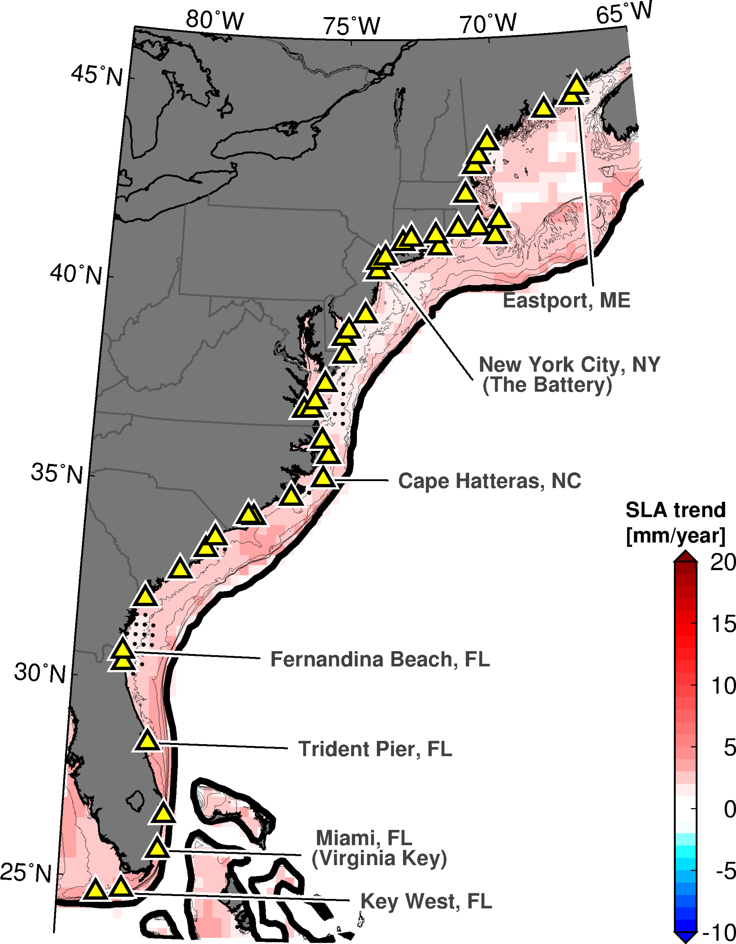
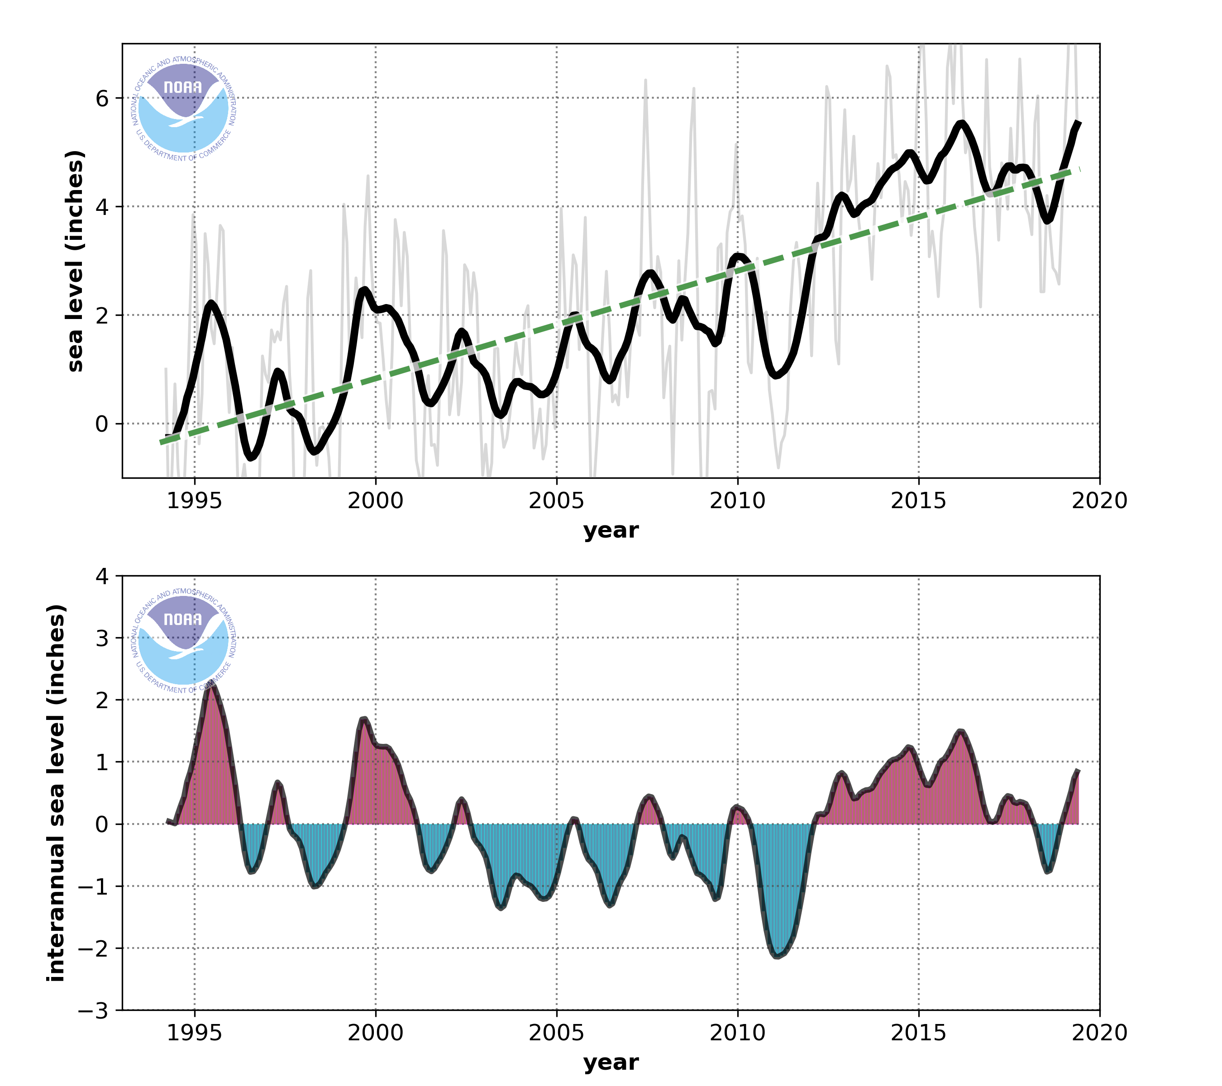

Long-term Sea-level Rise Along the U.S. East Coast
Sea level Observations at Miami
(Virginia Key)
Miami Sea Level Rise = 5.1 mm year⁻¹
Global Mean Sea Level Rise = 3.3 mm year⁻¹

Slide 3
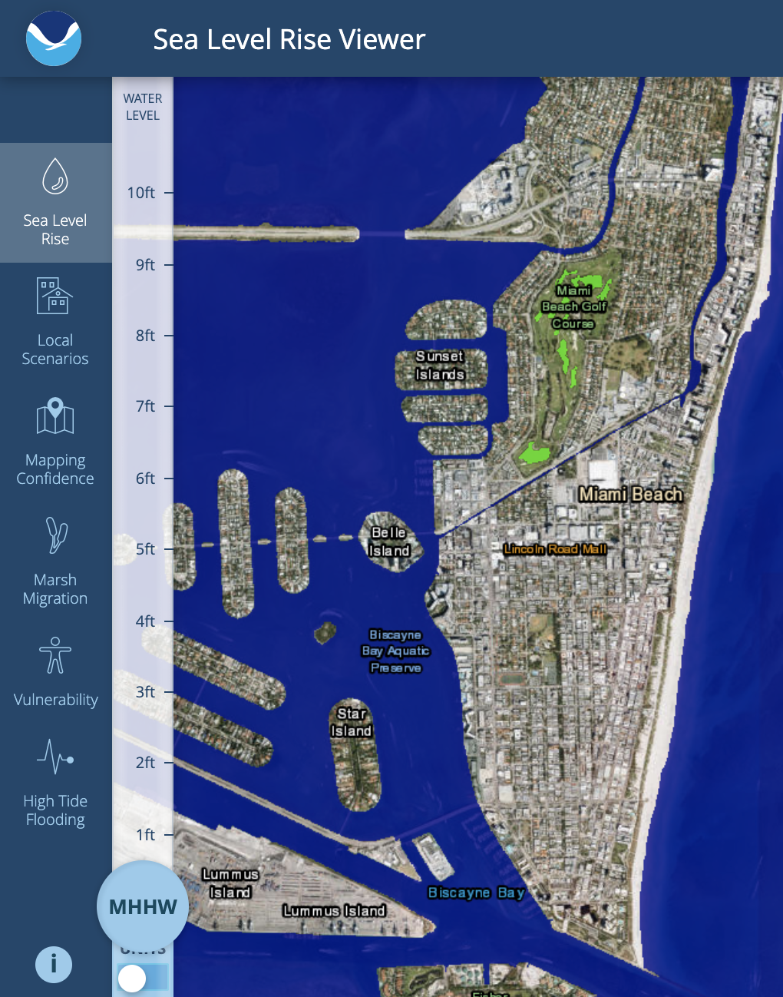
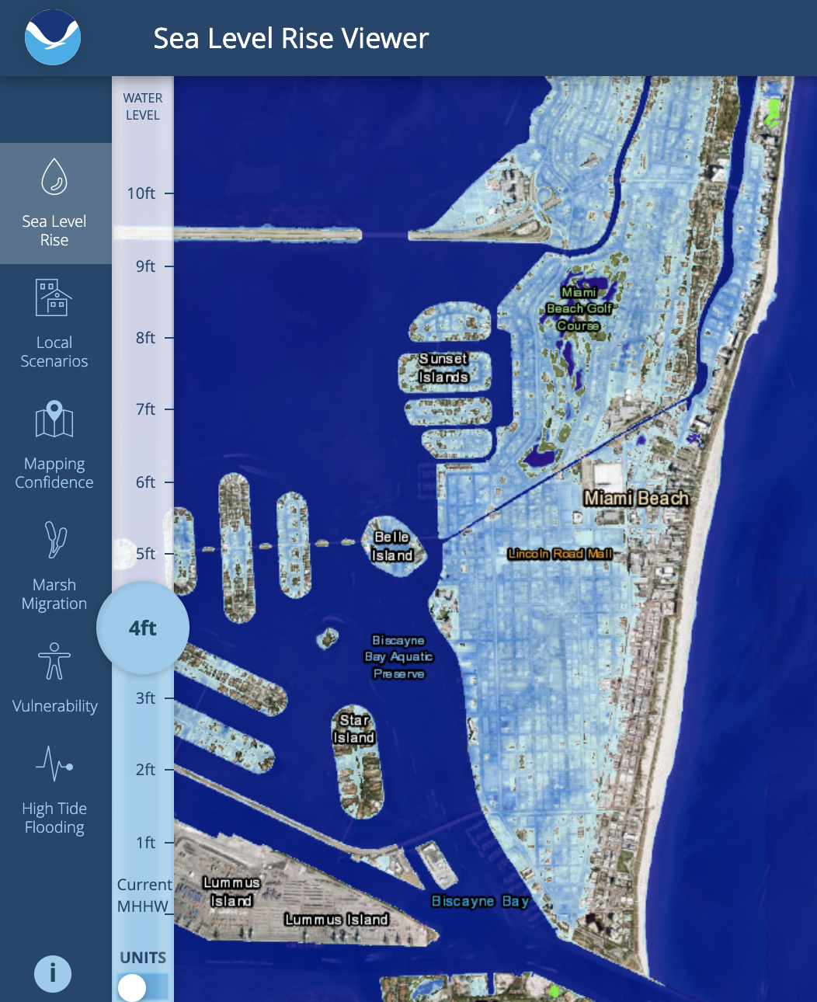
Southeast Florida Vulnerabilities to Sea Level Rise
Current Conditions
4 ft of SLR by 2100
(NOAA intermediate scenario)
Miami is one of the most vulnerable locations in the U.S. to the long-term effects of sea level rise
Notes:
Relevant science manuscript:
Kulp, S. A., & Strauss, B. H. (2019). New elevation data triple estimates of global vulnerability to sea-level rise and coastal flooding. Nature communications, 10(1), 1-12. (https://www.nature.com/articles/s41467-019-12808-z)

Slide 4
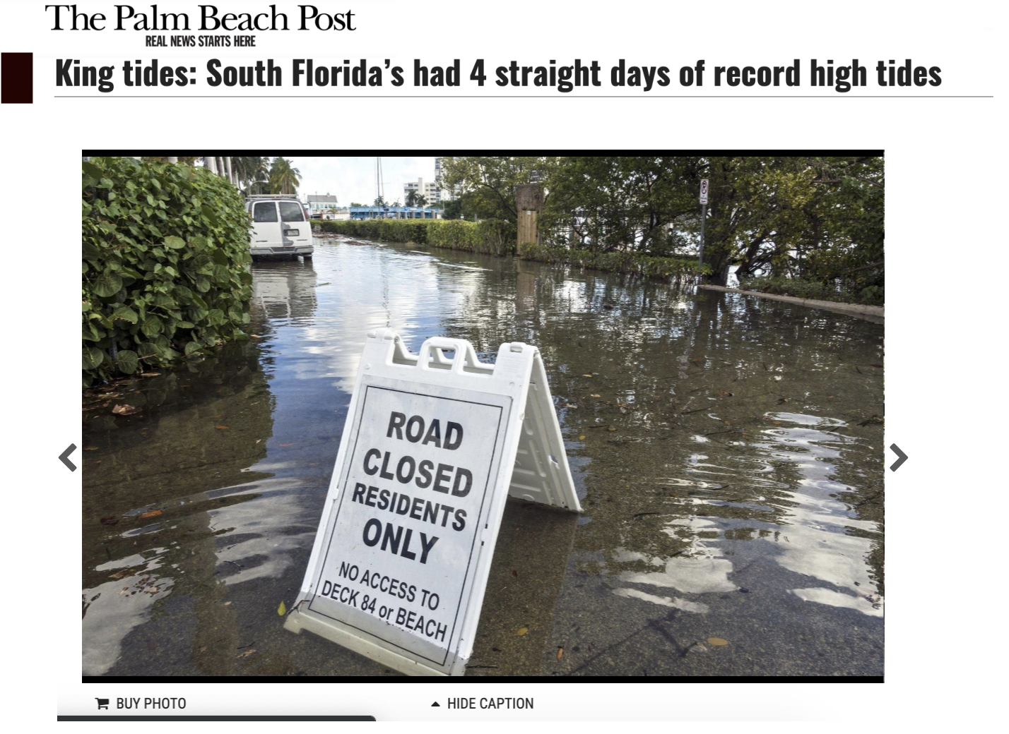
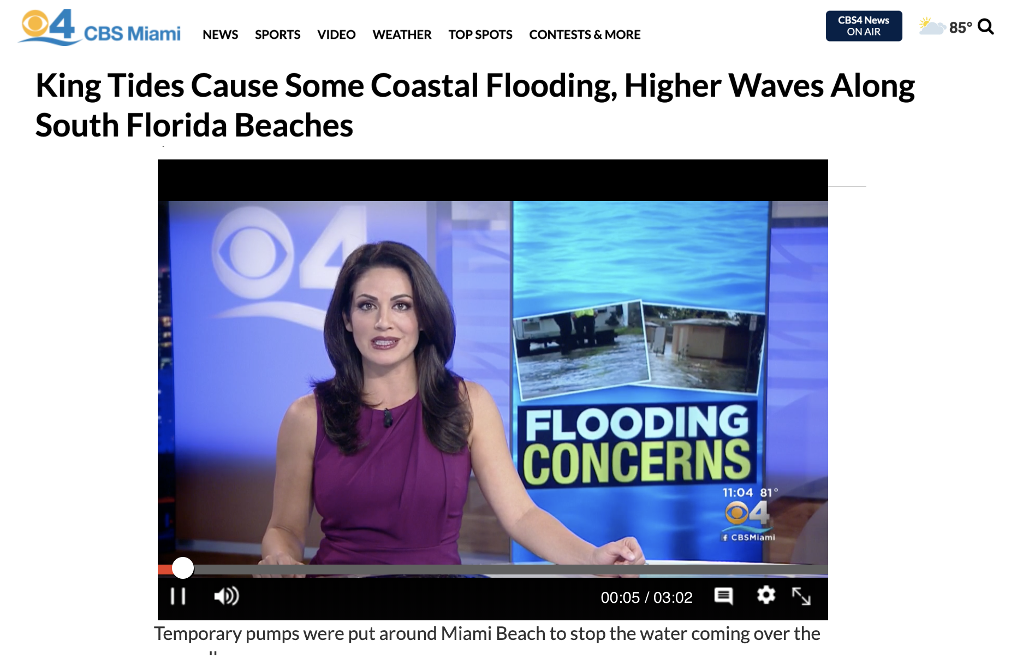
Nuisance Flooding Frequency is Increasing
The 2019 King Tides Flooding
Extensive flooding events are being frequently observed throughout Miami, and Southeast Florida, causing several impacts to local communities
Notes:
News articles:
https://www.palmbeachpost.com/news/20191015/king-tides-south-floridarsquos-had-4-straight-days-of-record-high-tides
https://www.nytimes.com/2019/02/20/opinion/ban-ki-moon-miami-climate-change.html
https://www.miaminewtimes.com/news/sea-level-rise-to-destroy-6000-florida-historic-sites-by-2100-9872871

Slide 5
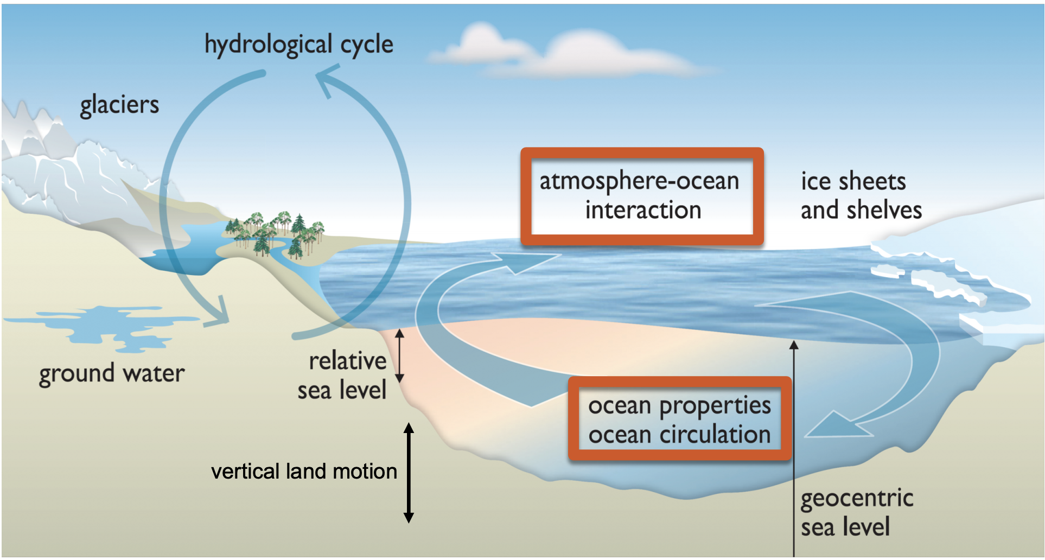
Sources of Sea Level Changes
Several global, regional, and local process contribute to sea level changes experienced at each location
Oceanic/Atmospheric Dynamics play a major role on interannual and synoptic time-scales
Source: IPCC 2013

Slide 6
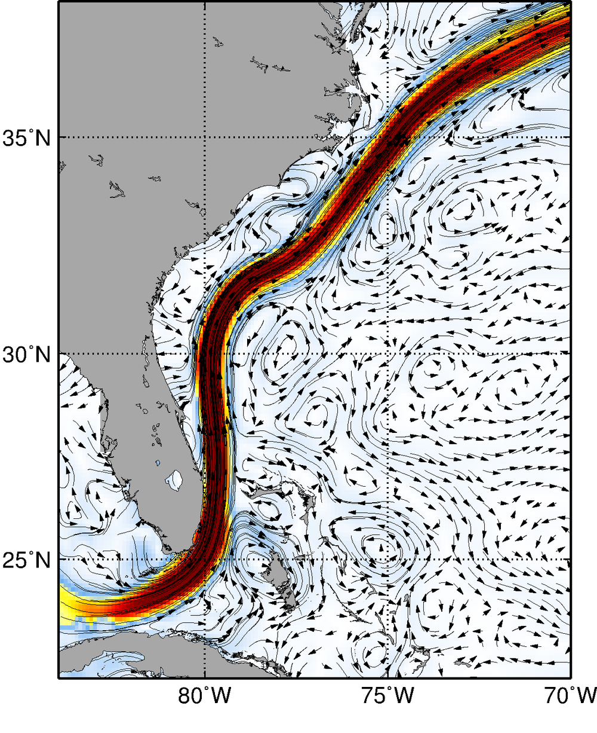
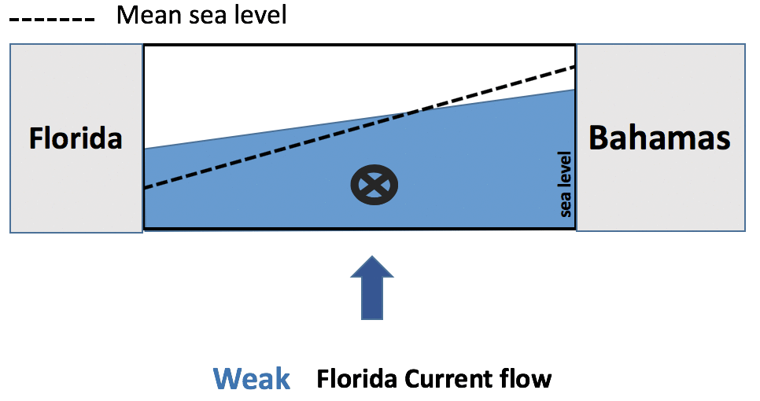
Florida Current Effects on U.S. Coastal Sea-level
Gulf Stream
Florida Current
A weak Florida Current flow can increase sea-level in Miami by up to 20 cm
Notes:
Reference:
Domingues, R., Baringer, M., & Goni, G. (2016). Remote sources for year‐to‐year changes in the seasonality of the F lorida C urrent transport. Journal of Geophysical Research: Oceans, 121(10), 7547-7559.

Slide 7
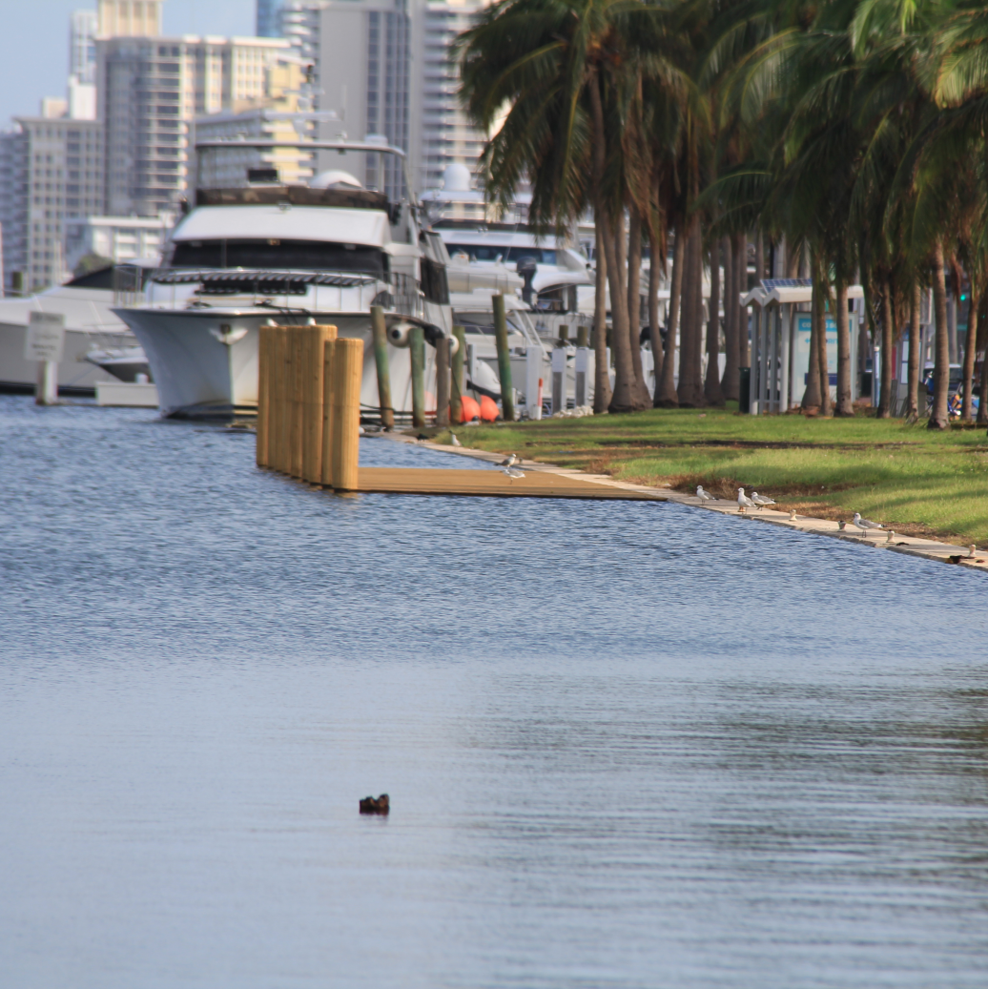
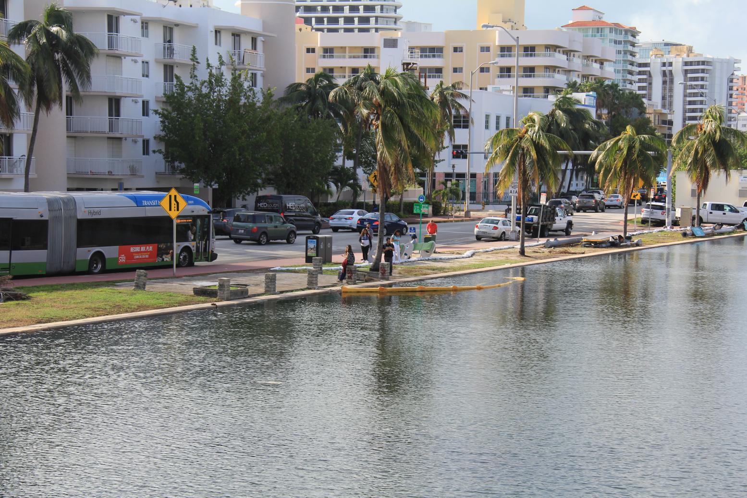
Are few centimeters relevant?
Miami Beach – 2017 King Tides
Few centimeters of above normal sea level can provide the difference needed to drive water levels to overtop sea walls and initiate floods
Photos by Grant Rawson (UM/CIMAS)

Slide 8
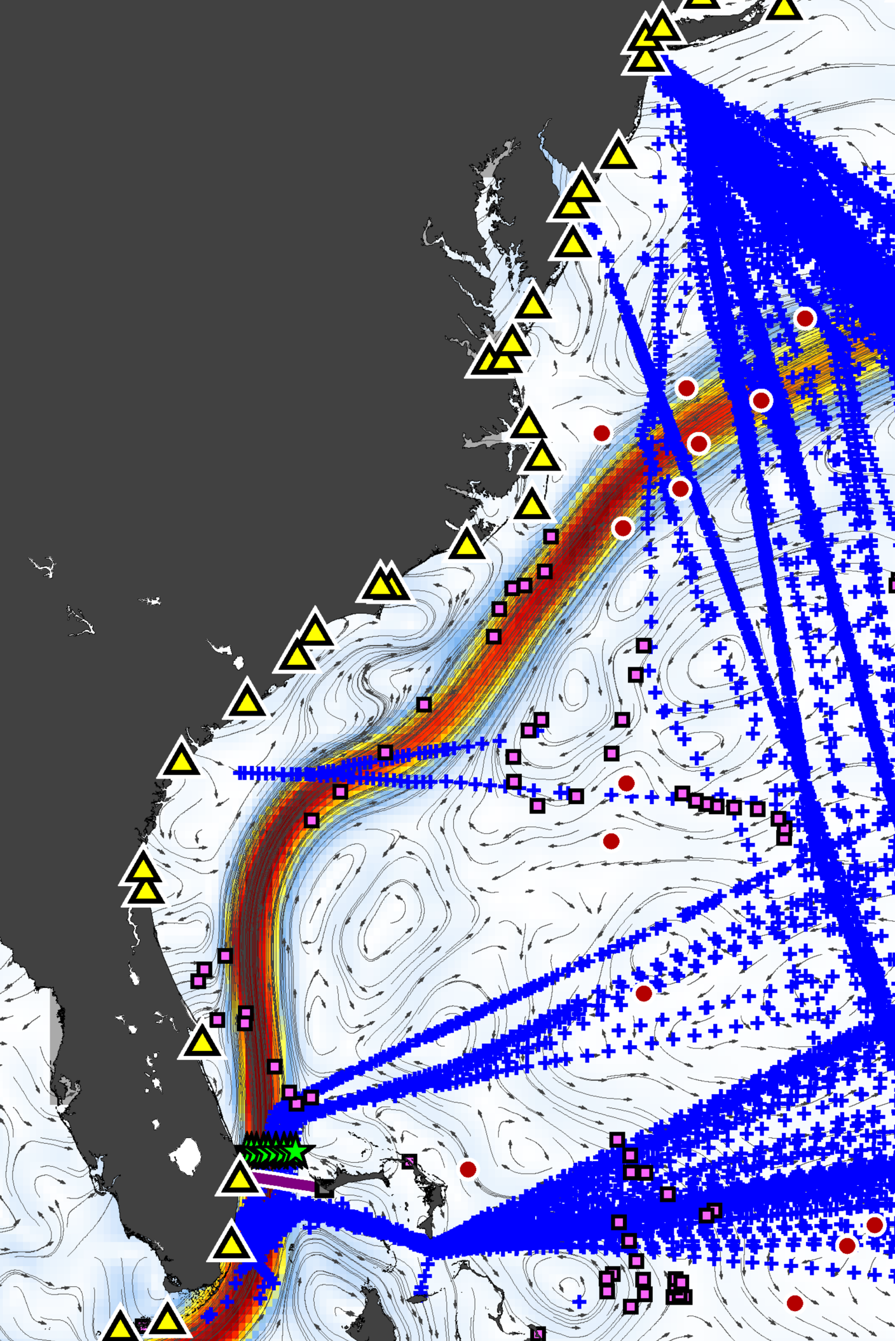
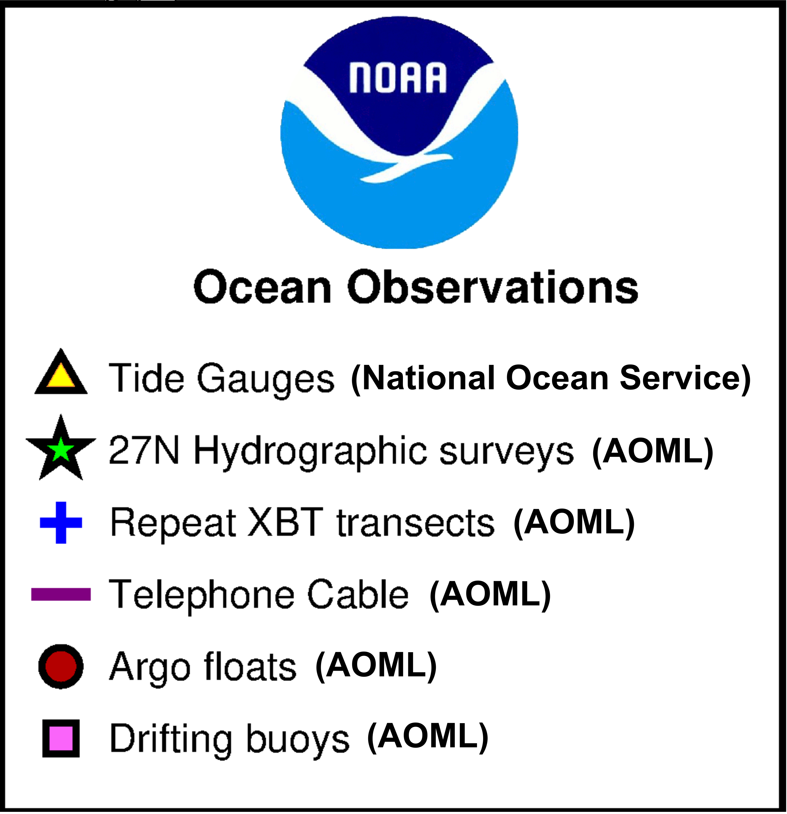
Ocean Observations in Support of Sea Level Attributions Studies
NOAA maintains key components of the ocean observing system used in sea-level attributions studies
Ocean currents derived from satellite altimetry

Slide 9
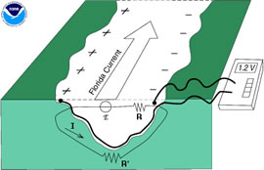
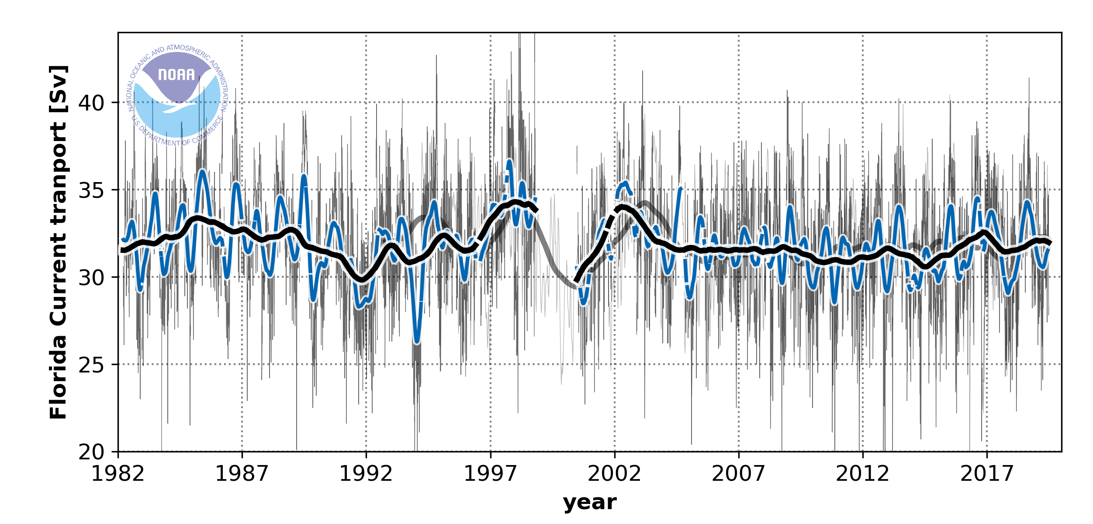
The Florida Current Transport Time-series
One of the longest continuous record of an ocean current based on submarine telephone cables between Florida and the Bahamas
Florida
Bahamas

Slide 10
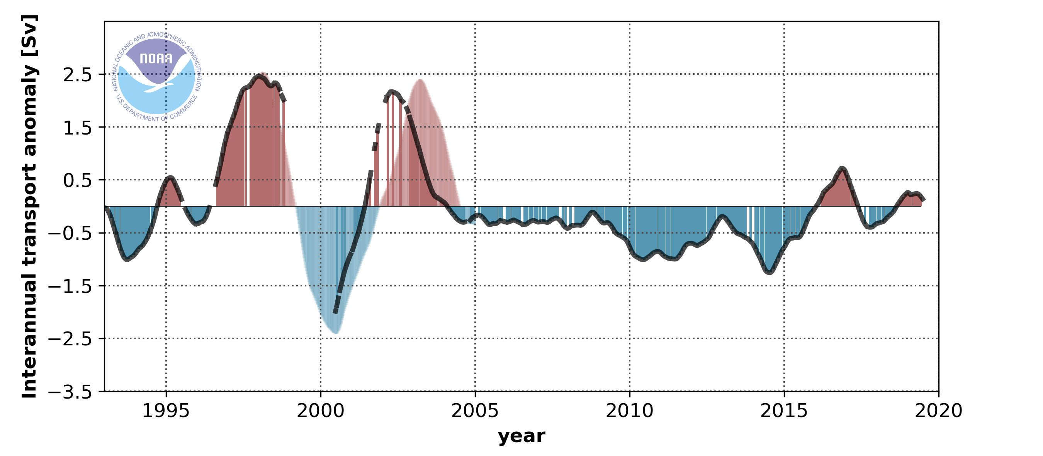
Florida Current Effect on Interannual Sea Level Changes
Florida Current transport
Strong oscillations in the Florida Current intensity played a major role for sea-level variations in Miami from 1997-2005
Sea-level in Miami
Domingues et al., (2016), Domingues et al., (2018)
Notes:
References:
Domingues, R., Baringer, M., & Goni, G. (2016). Remote sources for year‐to‐year changes in the seasonality of the F lorida C urrent transport. Journal of Geophysical Research: Oceans, 121(10), 7547-7559.
Domingues, R., Goni, G., Baringer, M., & Volkov, D. (2018). What caused the accelerated sea level changes along the US East Coast during 2010–2015?. Geophysical Research Letters, 45(24), 13-367.

Slide 11
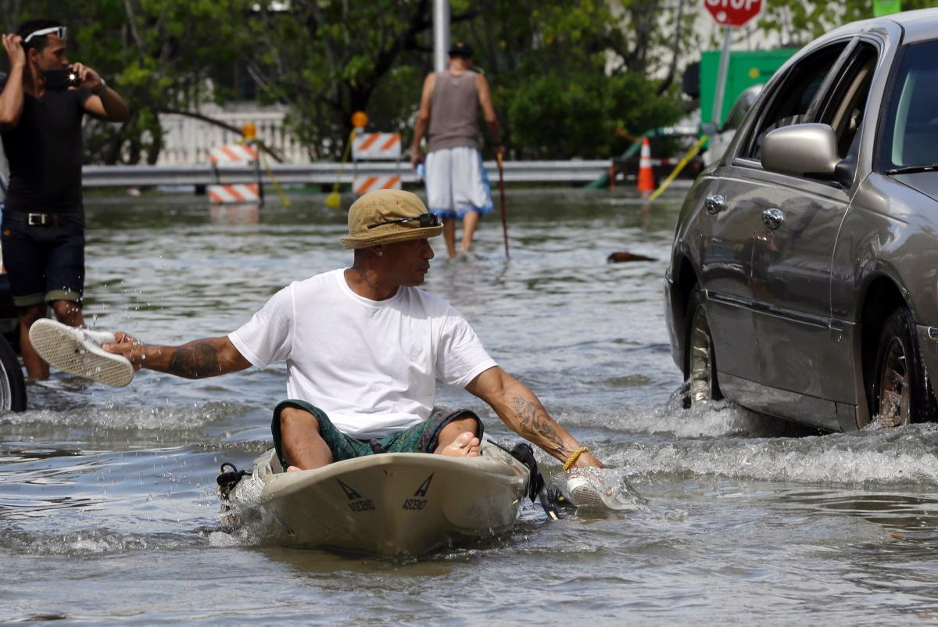
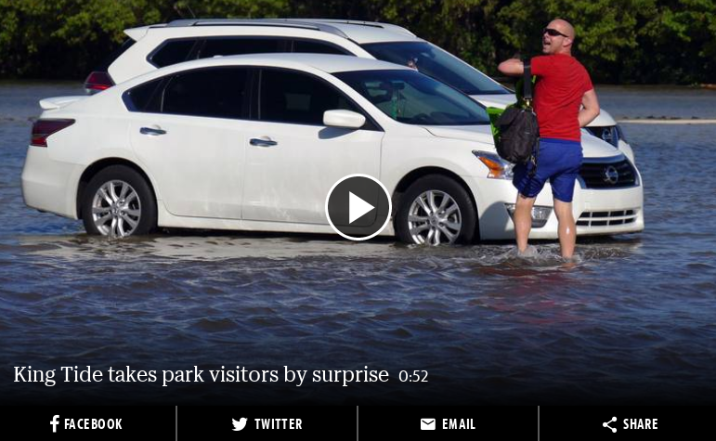
What Caused the Extensive King Tide Flooding in 2015?
source: The New York Times
Notes:
References:
Domingues, R., Goni, G., Baringer, M., & Volkov, D. (2018). What caused the accelerated sea level changes along the US East Coast during 2010–2015?. Geophysical Research Letters, 45(24), 13-367.

Slide 12
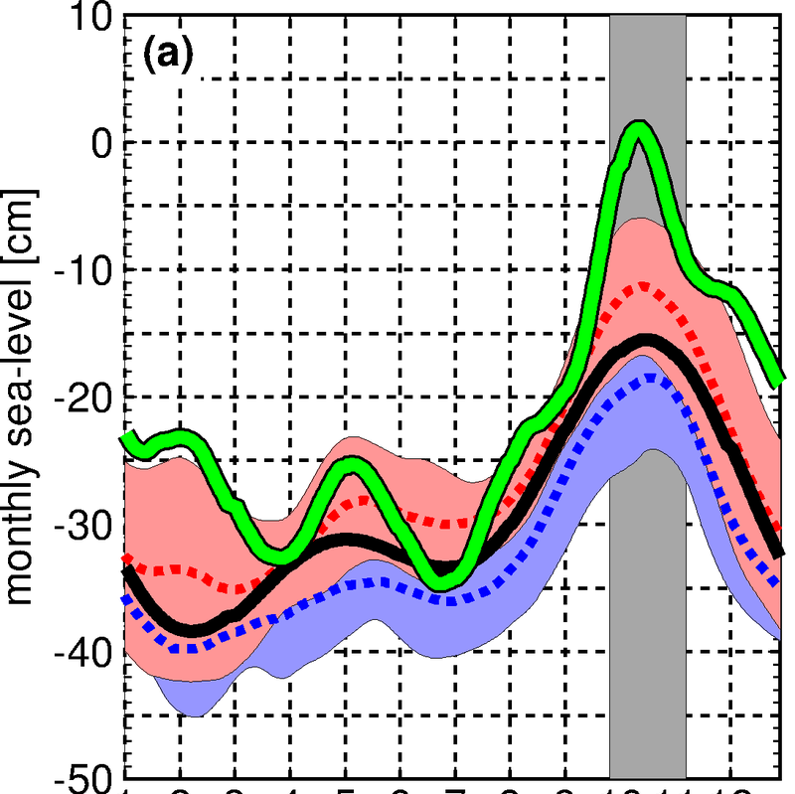
What Caused the Extensive King Tide Flooding in 2015?
Monthly Sea-level in Miami
2015
2006-2017
King Tides
Astronomical tides
2015 King Tides were the result of the combined effect of long-term sea level rise with interannual sea level variability
1995-2005
J F M A M J J A S O N D
Sea-level data from NOAA/NOS/CO-OPS
Notes:
References:
Domingues, R., Goni, G., Baringer, M., & Volkov, D. (2018). What caused the accelerated sea level changes along the US East Coast during 2010–2015?. Geophysical Research Letters, 45(24), 13-367.

Slide 13
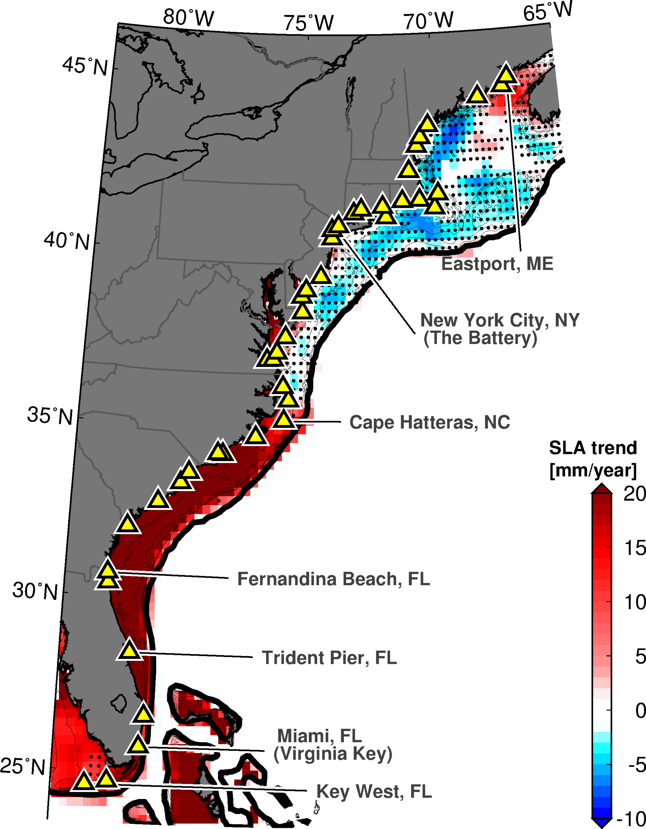
Accelerated sea level changes along the US East Coast during 2010–2015
1993-2016 Sea Level Rise
2010-2015 Sea Level Change
Notes:
References:
Domingues, R., Goni, G., Baringer, M., & Volkov, D. (2018). What caused the accelerated sea level changes along the US East Coast during 2010–2015?. Geophysical Research Letters, 45(24), 13-367.

Slide 14
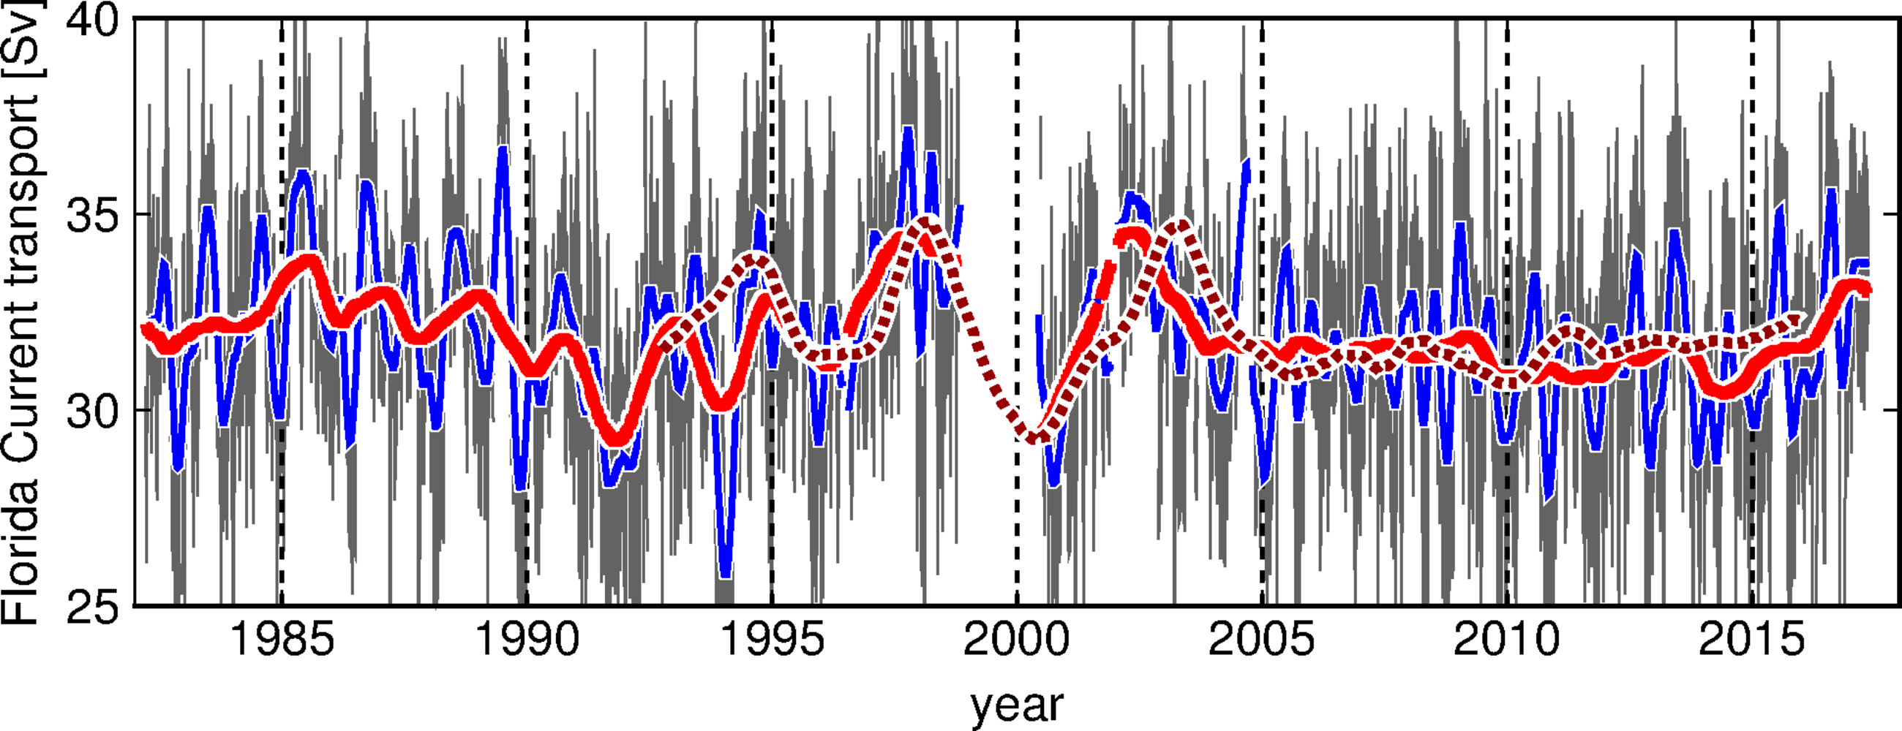
Accelerated sea level changes along the US East Coast during 2010–2015
Florida Current Transport
Daily FC transport (cable)
1 year low-pass (cable)
90 days low-pass (cable)
1 year low-pass (altimetry)
Florida Current transport stable during 2010-2015
Notes:
References:
Domingues, R., Goni, G., Baringer, M., & Volkov, D. (2018). What caused the accelerated sea level changes along the US East Coast during 2010–2015?. Geophysical Research Letters, 45(24), 13-367.

Slide 15
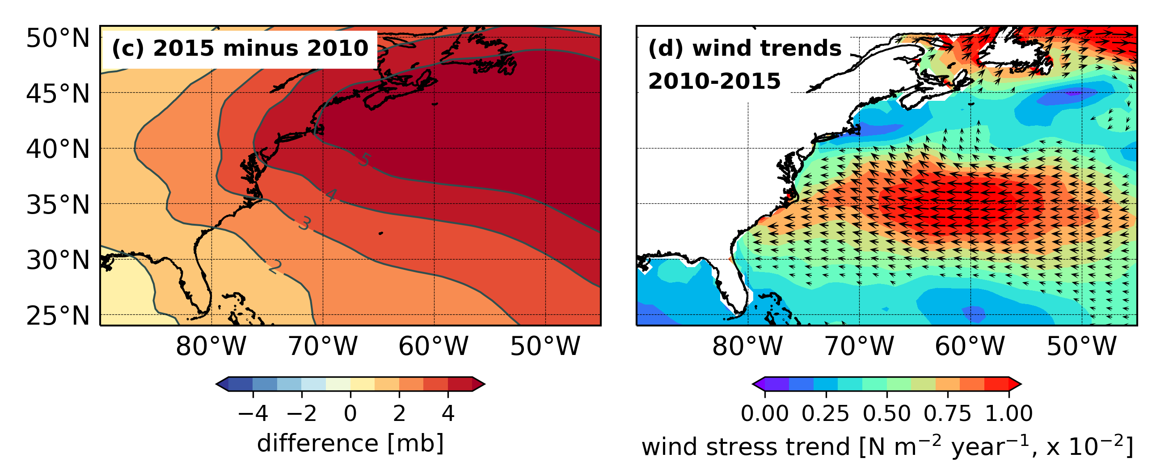
Accelerated sea level changes along the US East Coast during 2010–2015
Atmospheric Pressure Changes
Wind Changes
Northeast U.S. coast: Changes in wind atmospheric pressure account for most of temporary SL decline
Southeast U.S. coast: Changes in wind atmospheric pressure do not account for SL increase
Notes:
References:
Domingues, R., Goni, G., Baringer, M., & Volkov, D. (2018). What caused the accelerated sea level changes along the US East Coast during 2010–2015?. Geophysical Research Letters, 45(24), 13-367.

Slide 16
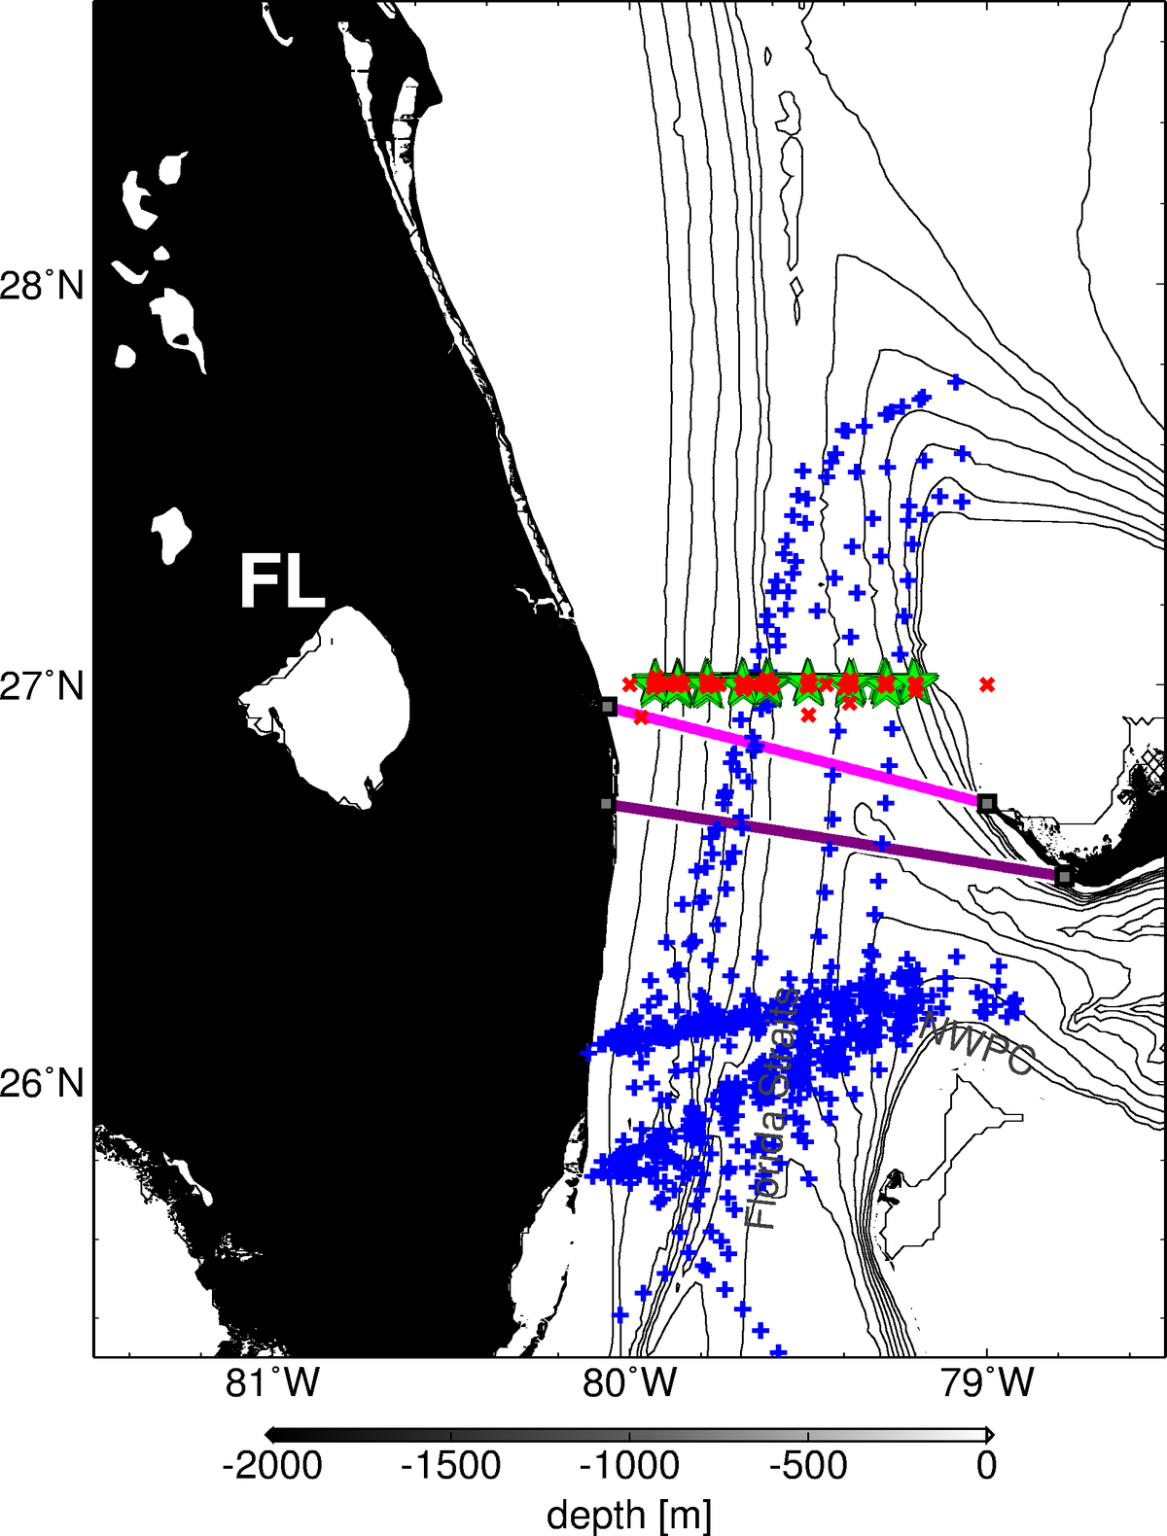

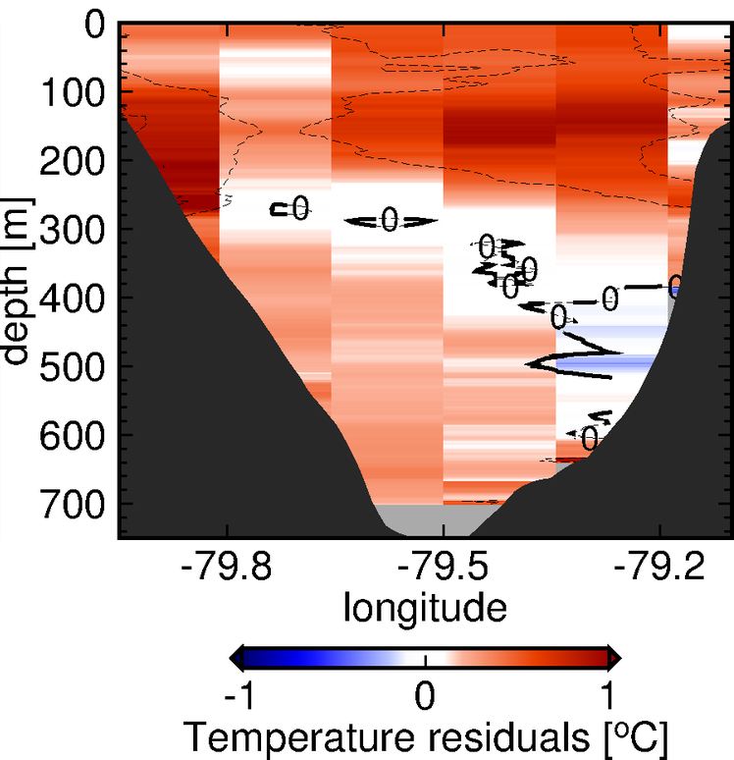

Accelerated sea level changes along the US East Coast during 2010–2015
Florida Current Temperature Anomalies
(Fall 2015)
Cape Canaveral
Bahamas
Miami
Warming of the Florida Current caused
10 cm of anomalous sea level rise during 2010-2015, contributing to the 2015 flooding
Domingues et al., (2018)
Notes:
References:
Domingues, R., Goni, G., Baringer, M., & Volkov, D. (2018). What caused the accelerated sea level changes along the US East Coast during 2010–2015?. Geophysical Research Letters, 45(24), 13-367.

Slide 17
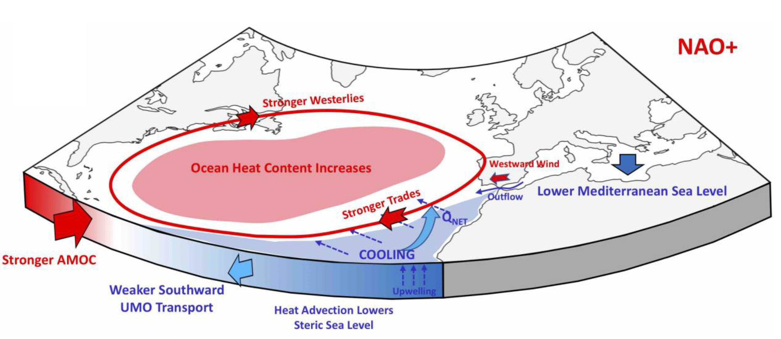
Warming of the Florida Current during 2010-2015
AMOC and NAO driven Large-scale Heat Convergence
Warming of the Florida Current associated with large-scale heat convergence in the North Atlantic's subtropical gyre heat content caused by changes in the Meridional Heat Transport
Volkov et al., (2019), Domingues et al., (2018)
Notes:
References:
Domingues, R., Goni, G., Baringer, M., & Volkov, D. (2018). What caused the accelerated sea level changes along the US East Coast during 2010–2015?. Geophysical Research Letters, 45(24), 13-367.
Volkov, D. L., Lee, S. K., Domingues, R., Zhang, H., & Goes, M. (2019). Interannual sea level variability along the southeastern seaboard of the United States in relation to the gyre‐scale heat divergence in the North Atlantic. Geophysical Research Letters.

Slide 18
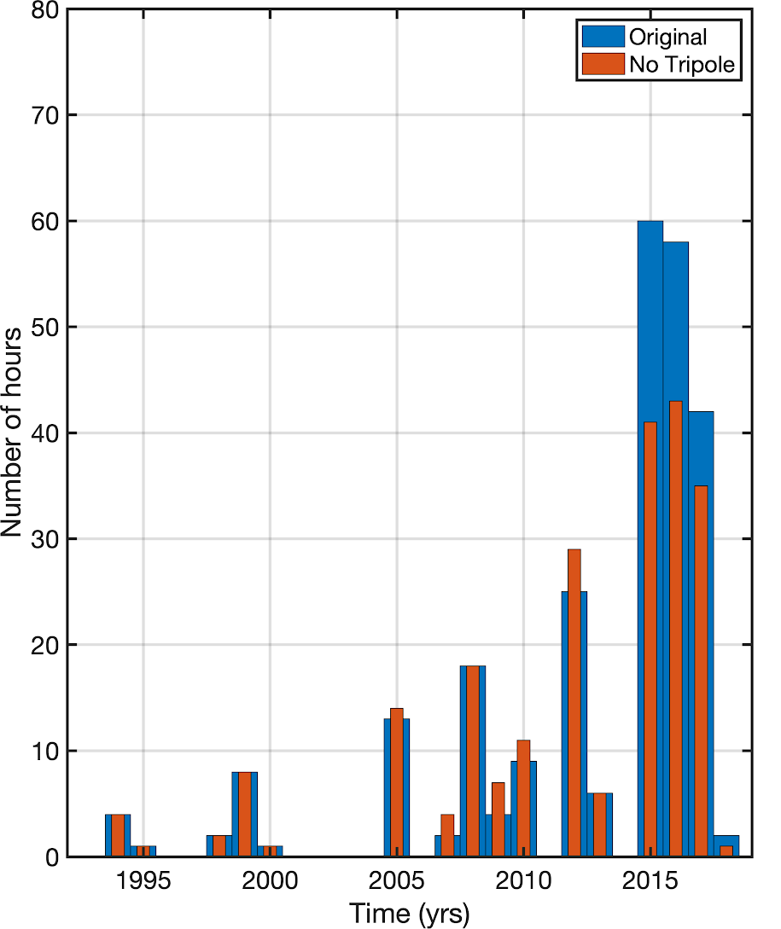
Large-scale Effects on Sunny Day Flooding in Miami
Interannual heat convergence in the North Atlantic is playing a significant role to increase the number of flooding hours in Miami
Sea-level data from NOAA/NOS/CO-OPS
Volkov et al., (in preparation)

Slide 19
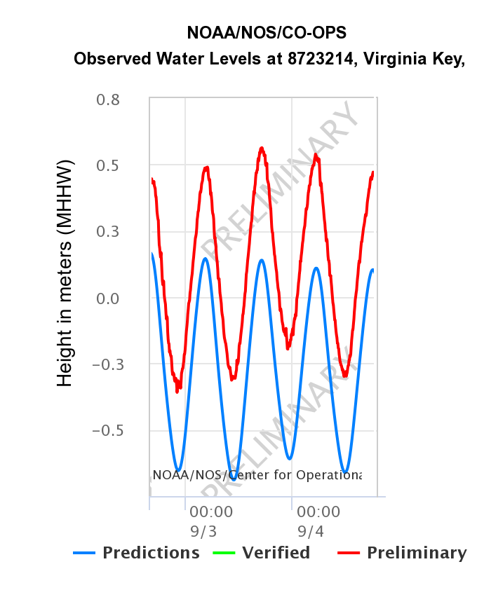
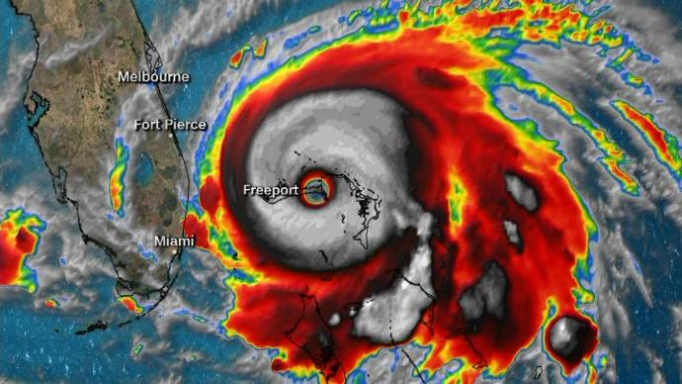
Florida Current Effect on Synoptic Sea Level Changes
In September 2019, sea-level in Miami was 40 cm above predicted associated with offshore Hurricane Dorian
~40 cm difference

Slide 20
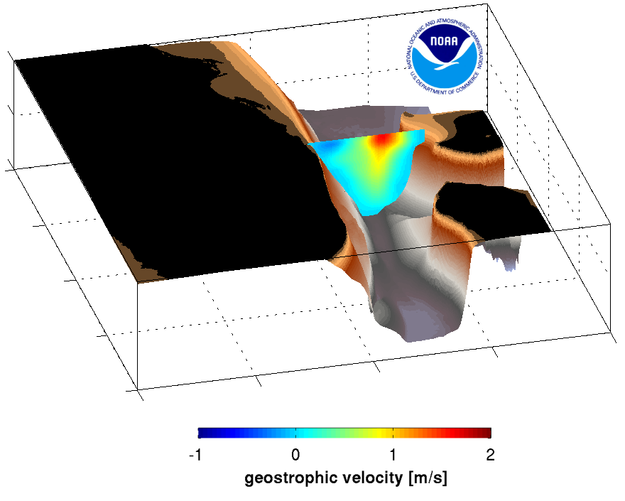
Florida Current Effect on Synoptic Sea Level Changes
AOML 27N Florida Current Survey – 09/26/2019
Hurricane Dorian caused the disruption of the Florida Current flow, causing a reduction by 47% in the flow
The low Florida Current transport contributed to the above normal sea-level during Hurricane Dorian
Depth [m]
Latitude
Longitude

Slide 21
Summary
The U.S. East Coast is currently exposed to sea-level changes that are already affecting communities through recurrent nuisance flooding events
Ocean and Atmospheric Dynamics in the region can play a very important role in driving synoptic and interannual changes in baseline sea level, which can modulate occurrence of flooding
Sustained ocean observations provide a key resource for understanding the drivers of sea level changes

Slide 22
Thank you!
Ricardo Domingues^{1,2}
Gustavo Goni²
Molly Baringer²
Denis Volkov^{1,2}
¹ University of Miami, Cooperative Institute for Marine and Atmospheric Studies - CIMAS, Miami, Florida, USA
² NOAA Atlantic Oceanographic and Meteorological Laboratory - AOML, Miami, Florida, USA
AGU Fall Meeting, San Francisco, December 2019

