Slide 1
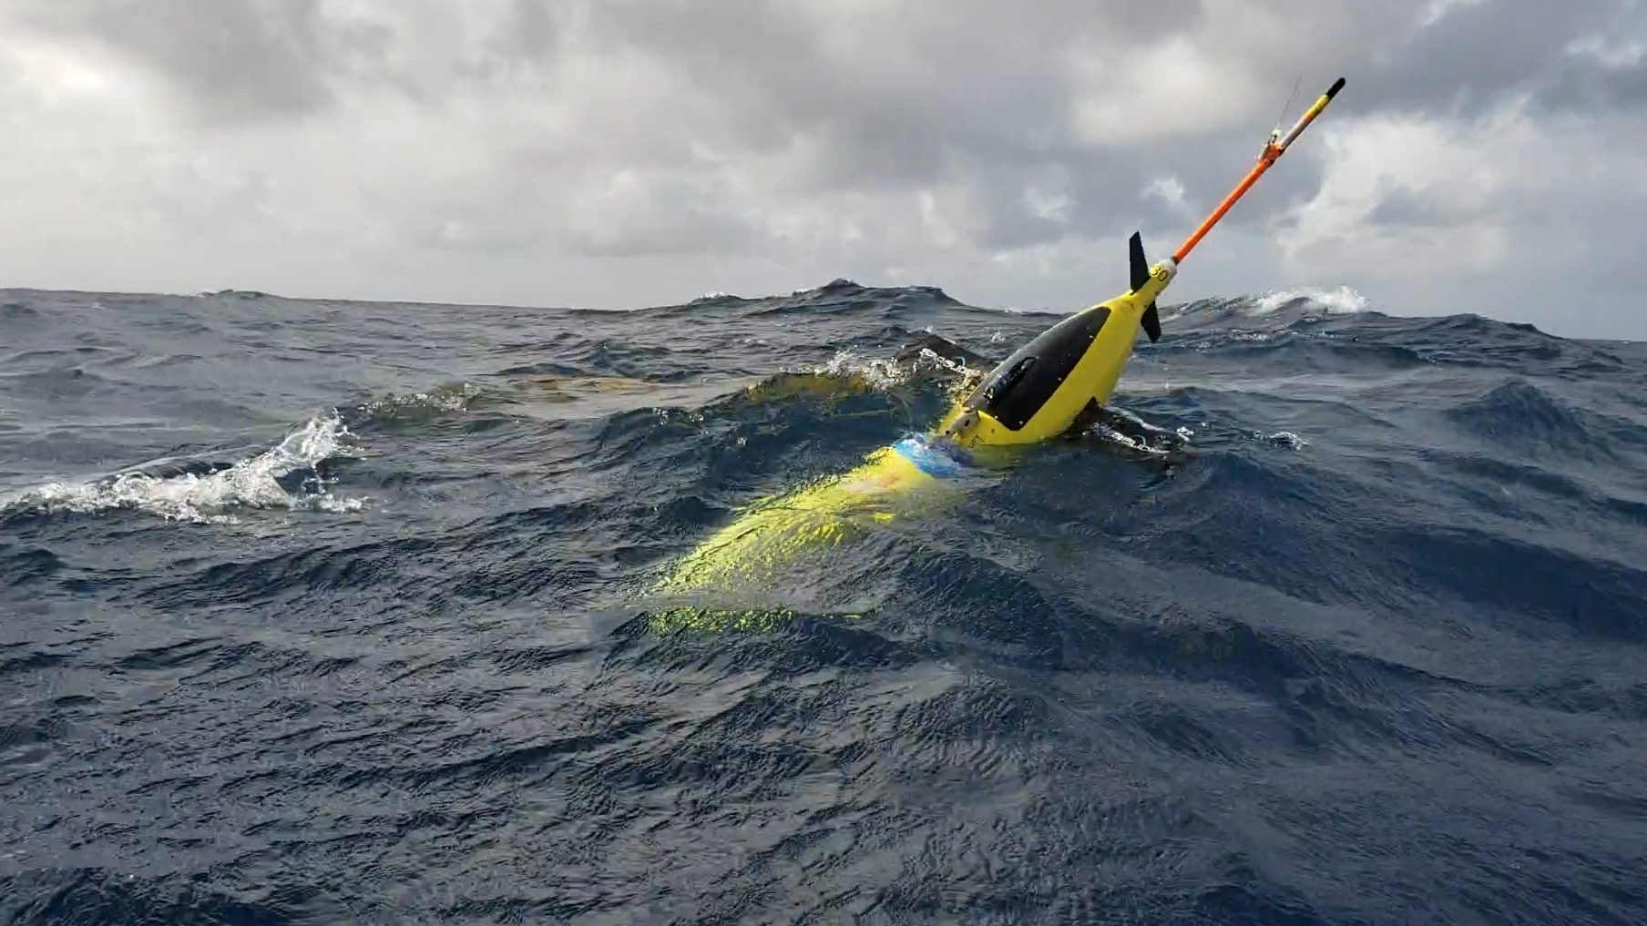
NOAA Hurricane Underwater Gliders Operations Funded by Appropriations Hurricane Supplemental Funds (Gustavo Goni, lead PI) Presented by Ricardo Domingues NOAA-AOML | Cooperative Institute for Marina and Atmospheric Studies
AGU Fall Meeting, San Francisco, December 2019

Slide 2
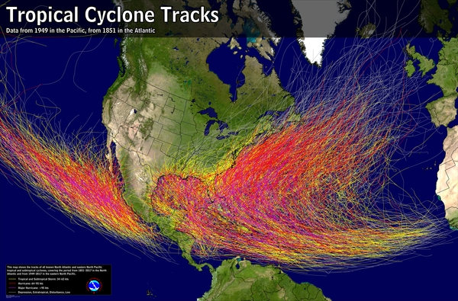
Hurricane Numbers
Number of Storms
Casualties
Damage
~11
1,400
$1.5B
In the Atlantic Basin per year
In the U.S. since 2005
Per storm making landfall
Notes:
Bertha (2014)
Gonzalo (2014)
Erika (2015)
Mathew (2016)
Irma (2017)
Jose (2017)
Maria (2017)
Beryl (2018)
Isaac (2018)
Dorian (2019)
Karen (2019)

Slide 3
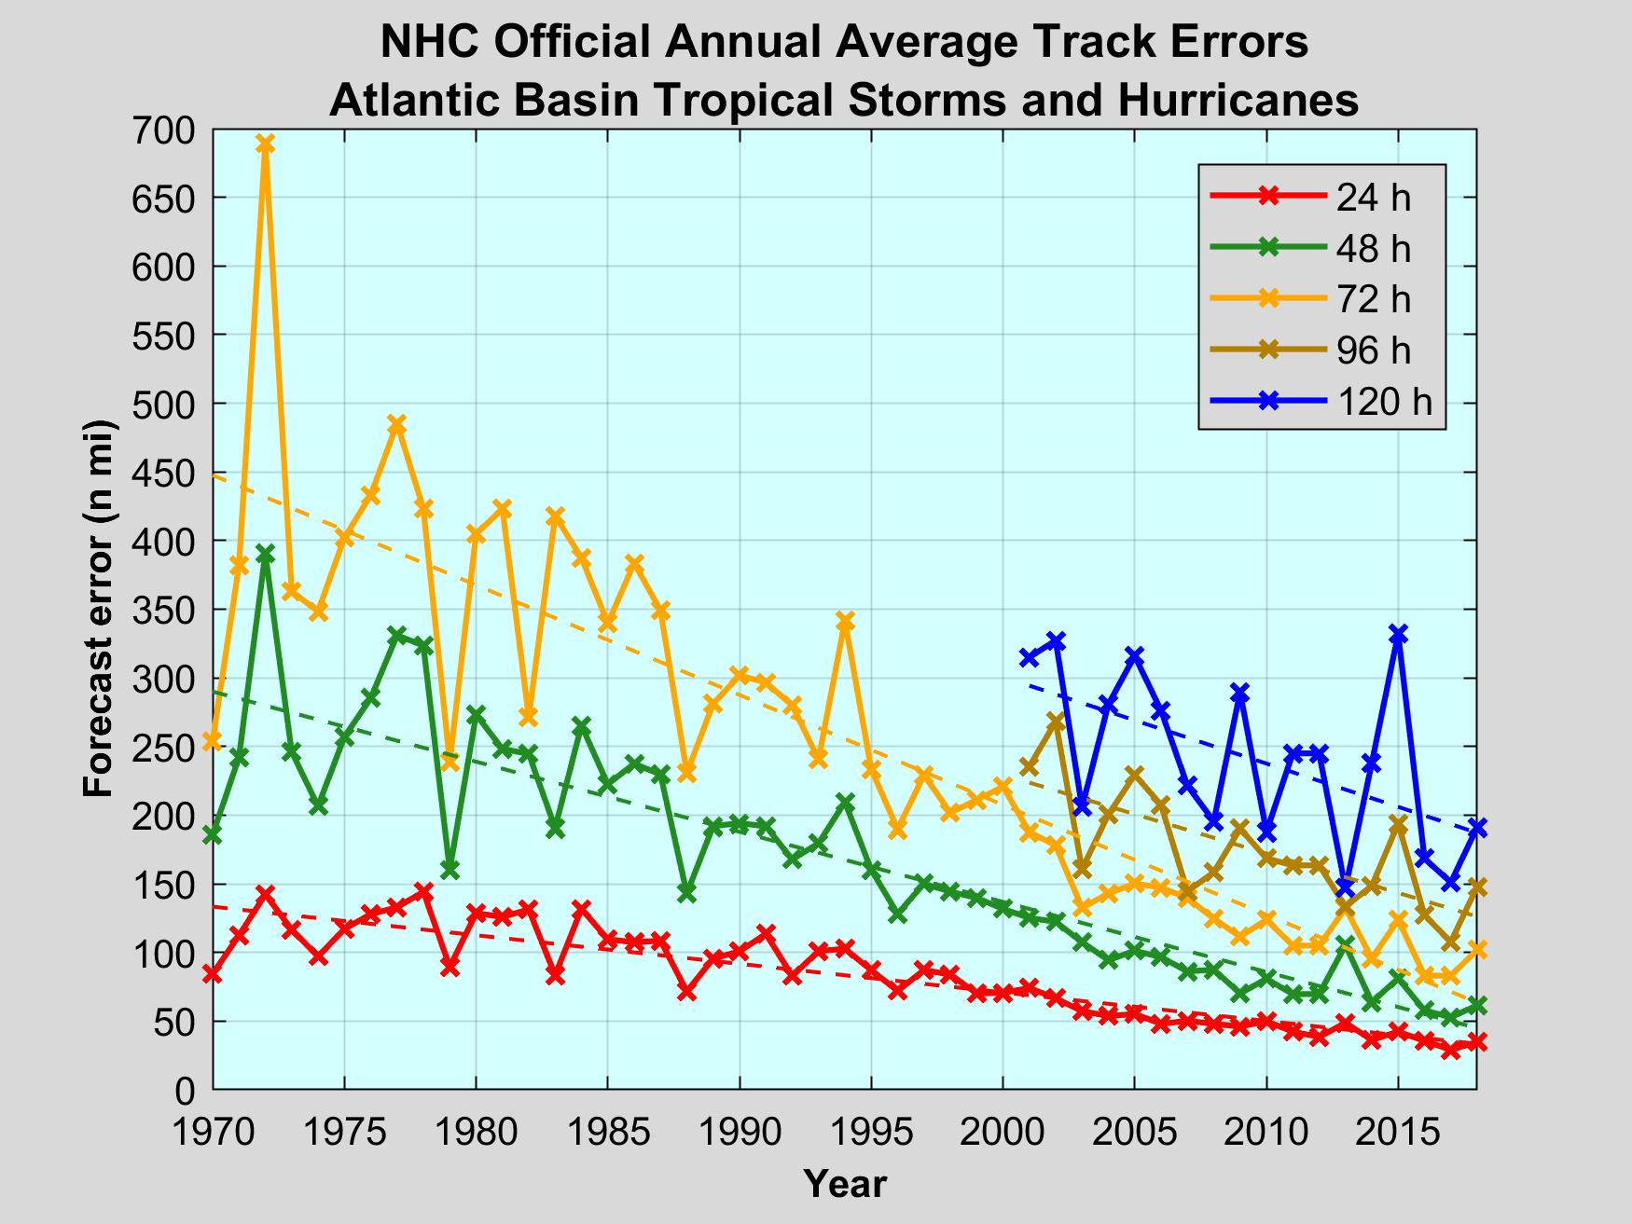
Motivation
NHC – Official Track Errors
The skill of hurricane track forecasts has improved substantially over the past decades

Slide 4
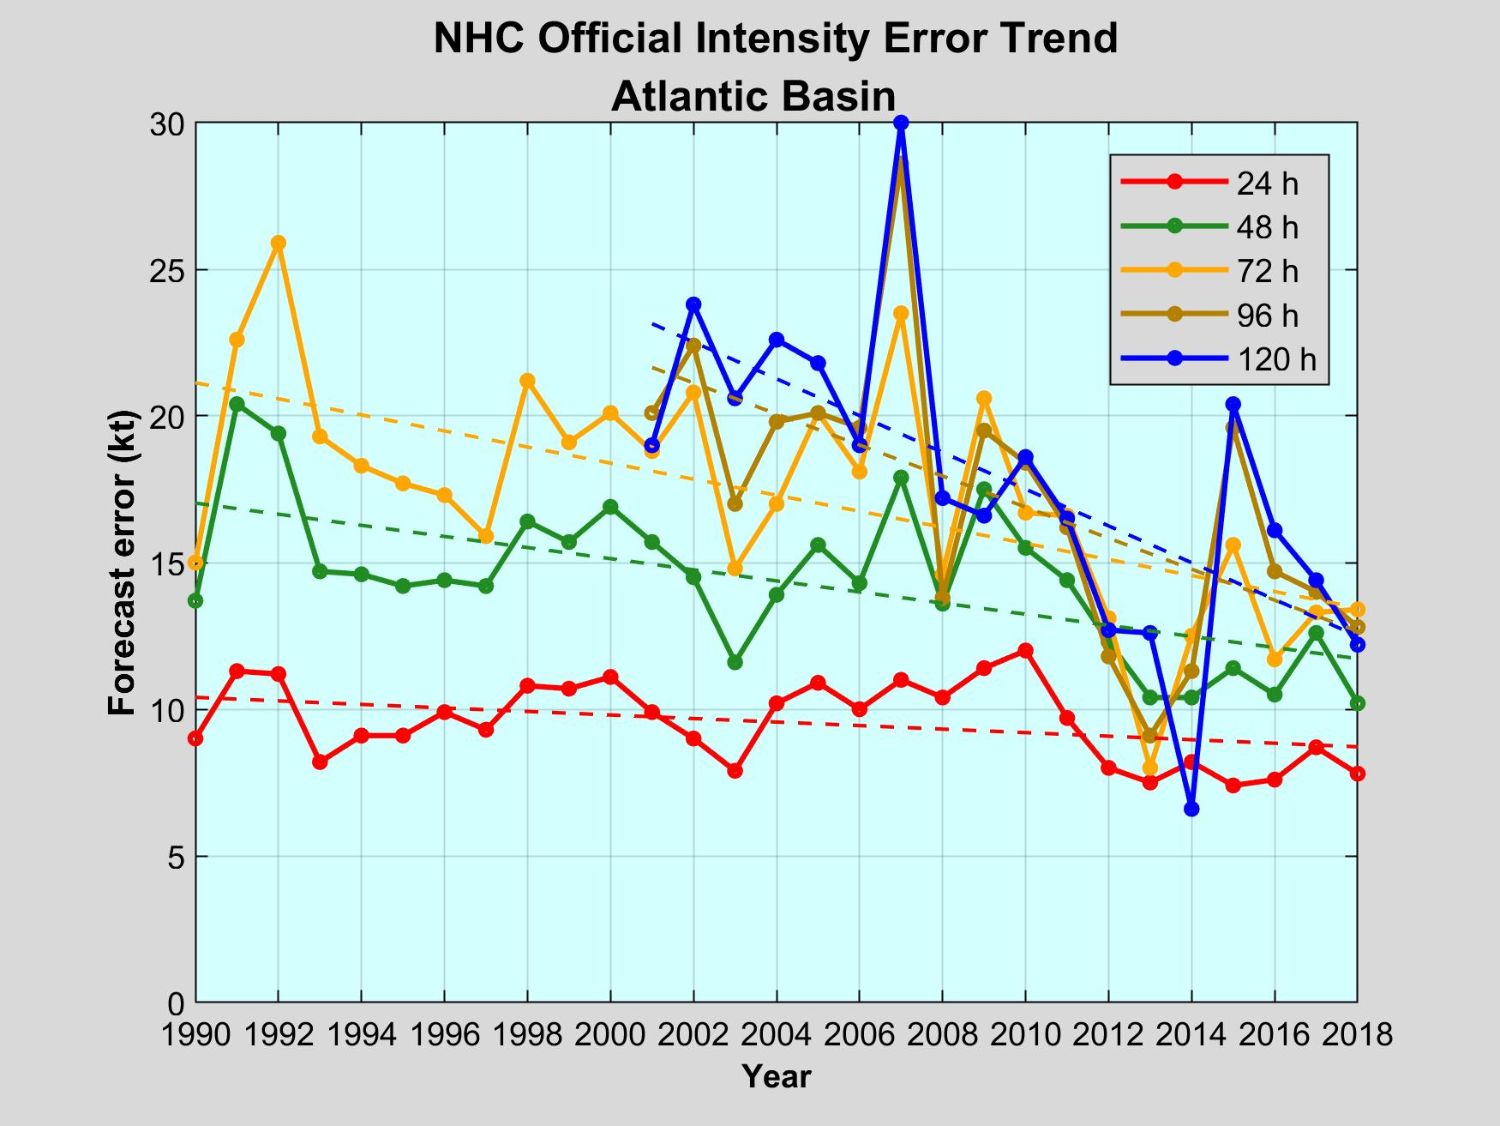
Motivation
NHC – Official Intensity Errors
In terms of hurricane intensity, improvements in skill have lagged over the past decades, remaining relatively unchanged

Slide 5
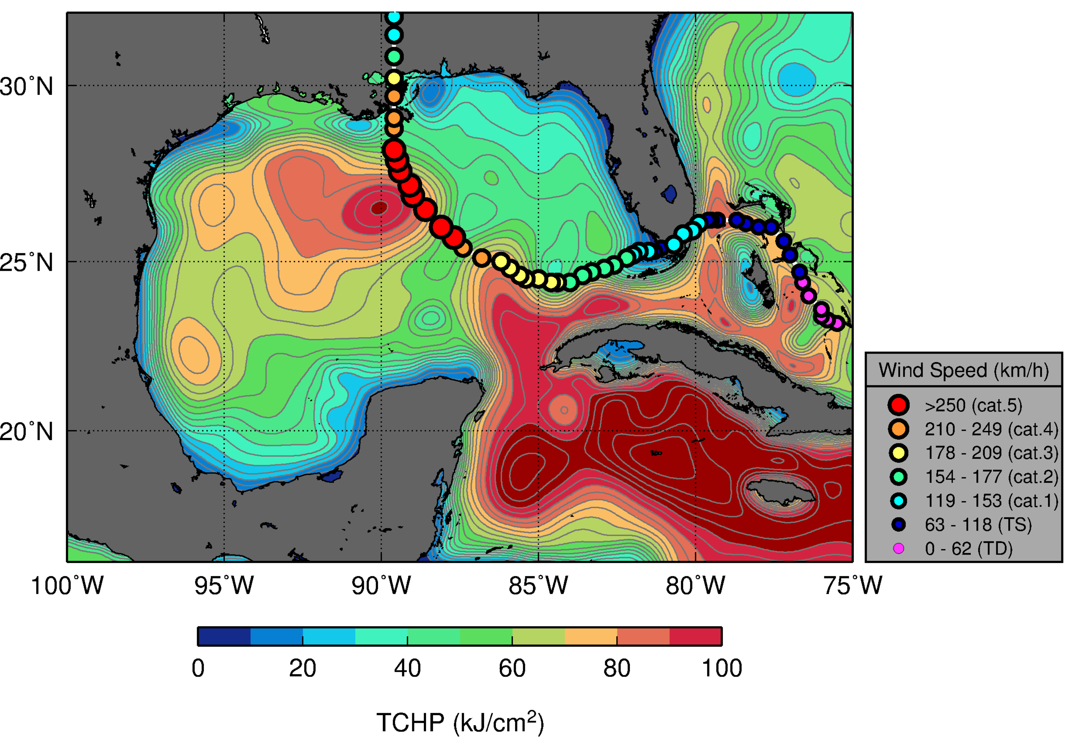
Hurricane Katrina (2005)
Upper ocean heat content provides an energy reservoir that can help fuel and sustain hurricane intensity

Slide 6
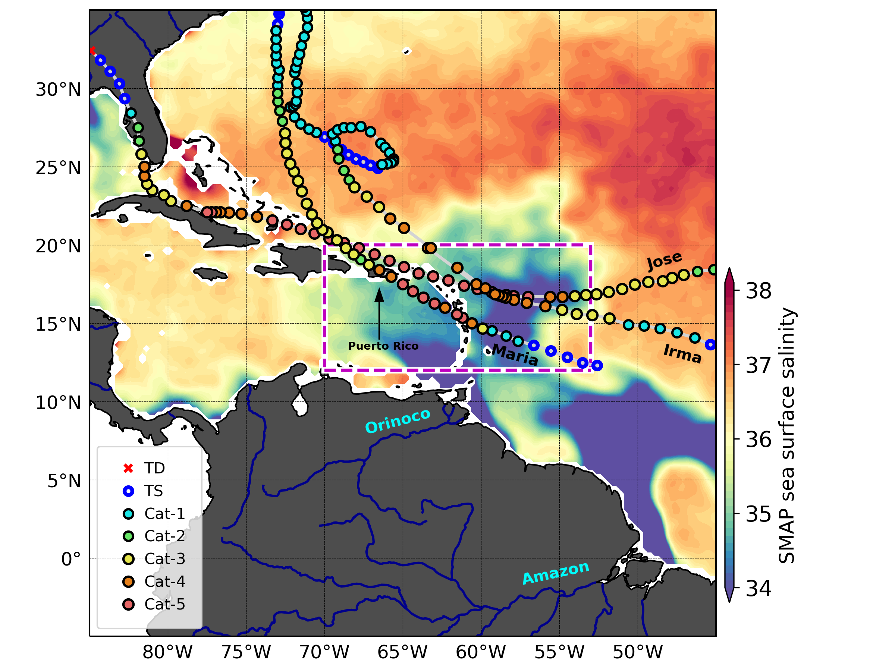
The 2017 Major Hurricanes
Sea surface salinity is also know for favoring intensification by suppressing storm-induced cooling, keeping SSTs warm

Slide 7
Importance of ocean observations
Ocean observations are key to correctly characterize the ocean within operational hurricane coupled forecast models

Slide 8
Goal & Objectives
Help improve the accuracy of hurricane intensity forecasts
Implement a network of underwater gliders to collect and transmit in real-time ocean observations from areas where hurricanes intensify
Assess the impact of such observations in helping improve hurricane intensity forecasts

Slide 9
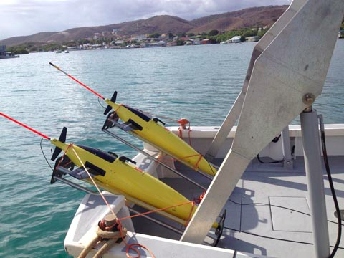
Why underwater gliders?
Underwater gliders
Autonomous Underwater Vehicles
Withstand hurricane winds
Target specific areas
Long endurance (>4 months)
Multiple sensors available

Slide 10
Areas in the Caribbean Sea and North Atlantic off Puerto Rico were identified as a hotspot for Hurricane Intensification
Hispaniola
Puerto Rico
Notes:
Areas off Puerto Rico in the Caribbean Sea and in the Tropical North Atlantic are generally characterized by large
Values of UOHC during the hurricane season, as are also areas where hurricanes very often travel and intensity, as shown
By these lines, which represent the historical tracks of tropical cyclones in this region.
And even though these areas are of importance for hurricanes development and intensification
There was not a an ocean observing system in place providing sustained observations from this region dedictate
In fact, data from the world ocean atlas 2013 shows that during the past decade there were less than 200 observations collected in the vicinity of Puerto Rico.
We then proposed the a network of underwater gliders to carry ….

Slide 11
World Ocean Atlas 2013: # of Temperature profiles
Hispaniola
Puerto Rico
<200 profiles
Notes:
Areas off Puerto Rico in the Caribbean Sea and in the Tropical North Atlantic are generally characterized by large
Values of UOHC during the hurricane season, as are also areas where hurricanes very often travel and intensity, as shown
By these lines, which represent the historical tracks of tropical cyclones in this region.
And even though these areas are of importance for hurricanes development and intensification
There was not a an ocean observing system in place providing sustained observations from this region dedictate
In fact, data from the world ocean atlas 2013 shows that during the past decade there were less than 200 observations collected in the vicinity of Puerto Rico.
We then proposed the a network of underwater gliders to carry ….

Slide 12
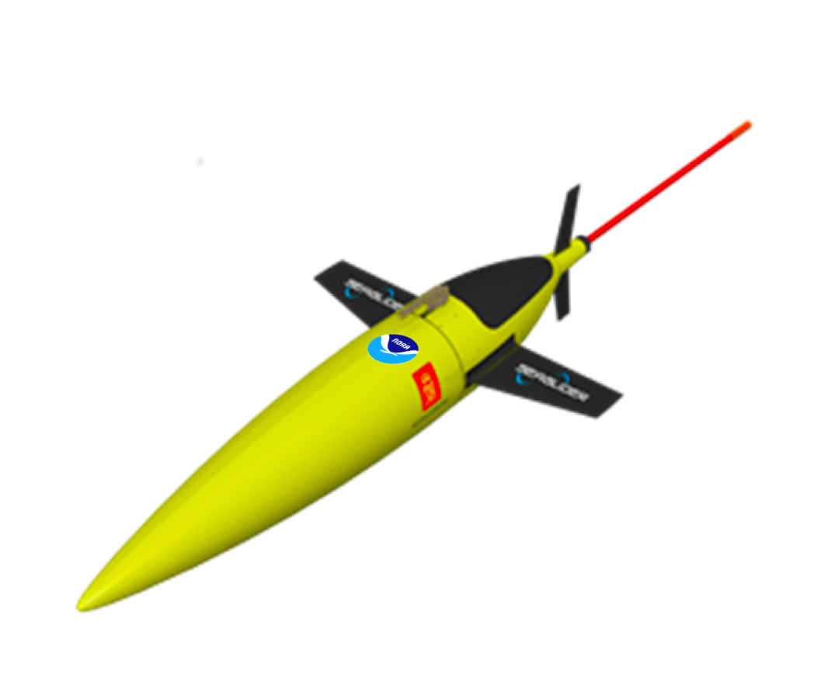
Timeline
2019
2015
2017
2018
National and international partnerships
OSE-OSSE capability developed at AOML
HWRF-HYCOM OSE and OSSE implemented
U.S. Navy
partnership
Hurricane Glider Pilot Network Funded
Congress-approved Sandy supplemental funds
July 2014
July 2015
July 2016
July 2017
July 2018
July 2019
December 2013
2014 Hurricane Missions Start
(2 gliders)
2015 Hurricane Missions Start
(2 gliders)
2016 Hurricane Missions Start
(4 gliders)
2017 Hurricane Missions Start
(3 gliders)
2018 Hurricane Missions Start
(9 gliders)
2019 Hurricane Missions Start
(32 gliders)

Slide 13
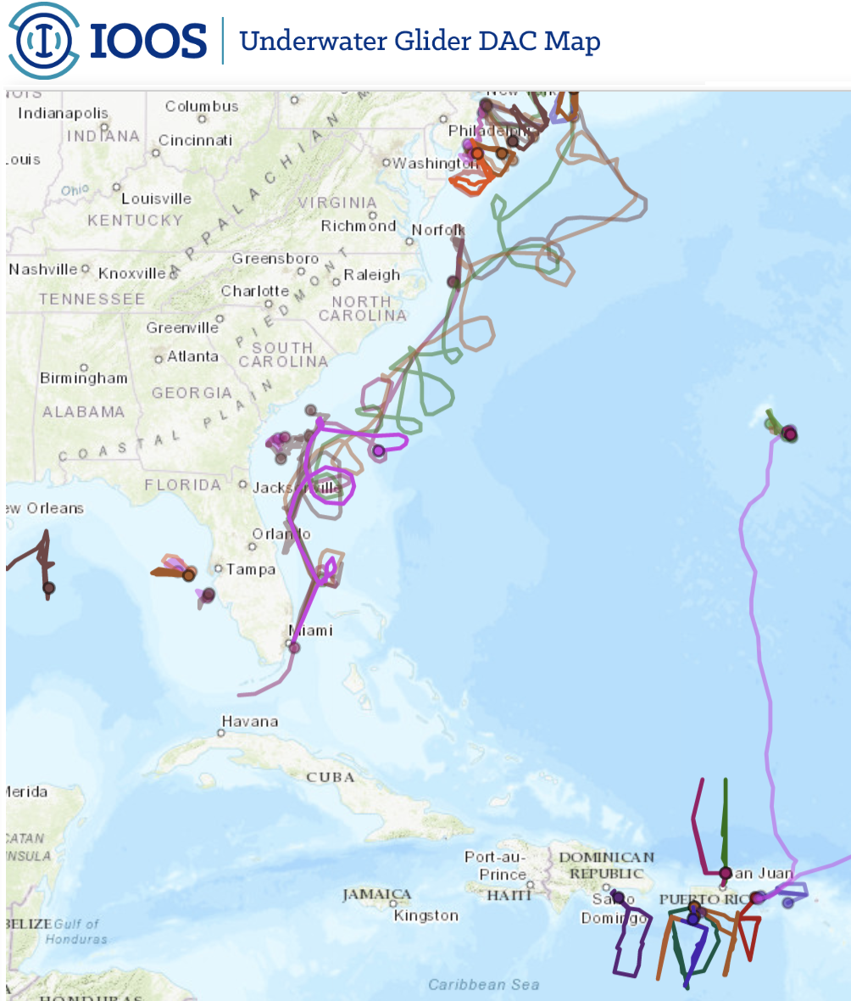
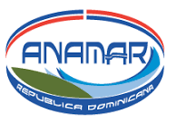
2019 Hurricane Glider Operations
32 gliders deployed
100,000+ profile obs.
IOOS glider DAC: https://gliders.ioos.us/

Slide 14
Summary of AOML deployments
~35,000 temperature and salinity profiles since 2014
Tropical Cyclones Sampled
Tropical Storm Bertha (August, 2014)
Hurricane Gonzalo (October, 2014)
Tropical Storm Erika (September, 2015)
Hurricane Matthew (September, 2016)
Hurricane Harvey (August, 2017)
Hurricane Irma (September, 2017)
Hurricane Jose (September, 2017)
Hurricane Maria (September, 2017)
Hurricane Isaac (September, 2018)
Hurricane Dorian (September, 2019)
Tropical Storm Karen (September, 2019)

Slide 15
What have we learned? What is the impact of glider data within coupled hurricane forecasts?

Slide 16
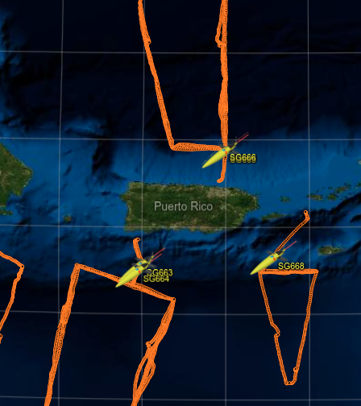
Improved Ocean Representation
NO ocean obs. assimilated
Glider data assimilated
Temperature biases can be reduced an order of magnitude with ocean data assimilation, from ~3ºC to 0.3ºC

Slide 17
Improved Ocean Representation
NO ocean obs. assimilated
Glider data assimilated
ALL obs. assimilated
Hurricane Maria

Slide 18
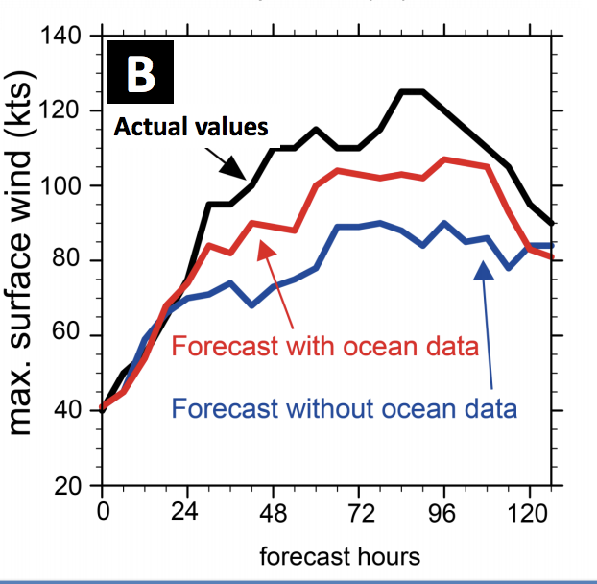
Hurricane Gonzalo (2014)
Assimilation of ocean observations led to a 50% improvement in the intensity forecast of Gonzalo
Dong et al., (2017, Weather and Forecasting)

Slide 19
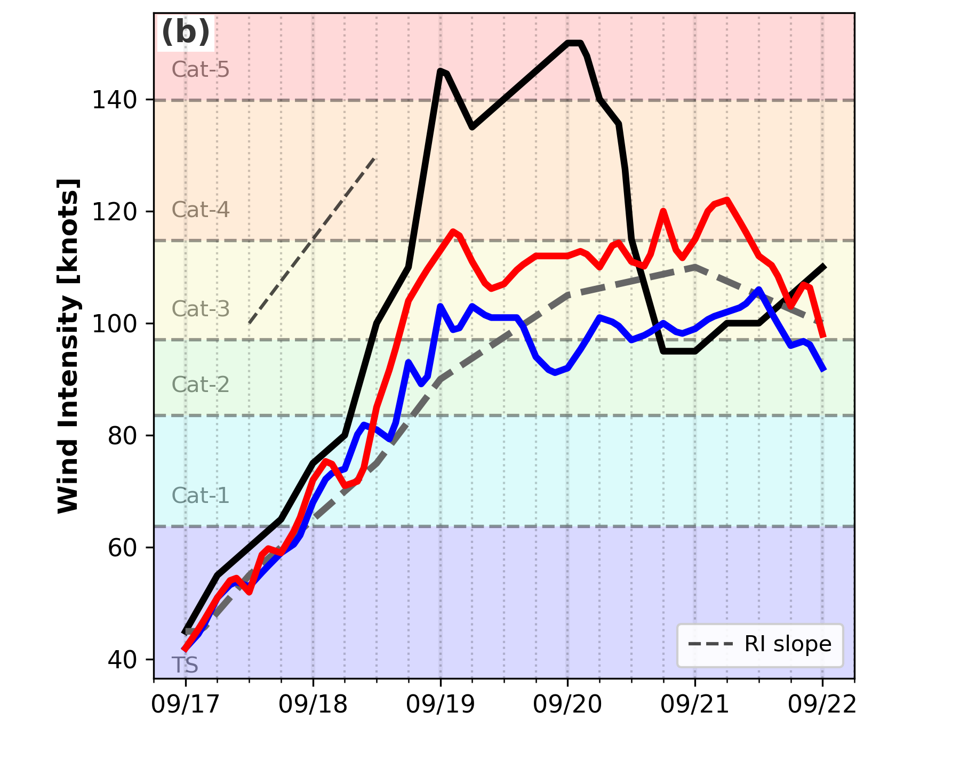
Hurricane Maria (2017)
Best track
Forecast with ocean data
Forecast without ocean data
Assimilation of ocean observations led to a 25% improvement in the intensity forecast of Maria
Domingues et al., (in preparation)

Slide 20
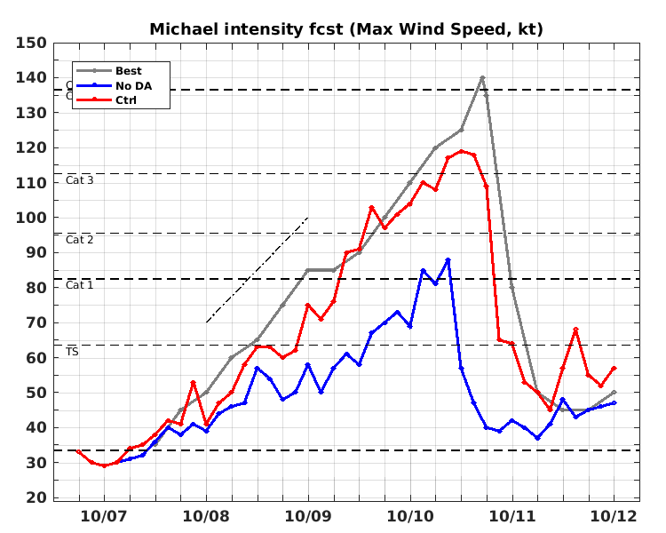
Hurricane Michael (2018)
Best track
Forecast with ocean data
Forecast without ocean data
Assimilation of ocean observations led to a 80% improvement in the intensity forecast of Maria
Le Hénaff et al., (in preparation)

Slide 21
Summary
Having the correct ocean representation (temperature and salinity) is key for obtaining accurate hurricane intensity forecasts
Underwater gliders provide a cost-effective solution for collecting sustained ocean observations in support of hurricane studies and forecasts
The NOAA Hurricane Underwater Glider operations will continue in 2020

Slide 22
For more information, please visit: www.aoml.noaa.gov/phod/gliders
Thank you!
AGU Fall Meeting, San Francisco, December 2019

Slide 23
Mission Metrics
Successful Missions
Profiles Collected
Tropical Cyclones Sampled
29
~35K
11
Notes:
Bertha (2014)
Gonzalo (2014)
Erika (2015)
Mathew (2016)
Irma (2017)
Jose (2017)
Maria (2017)
Beryl (2018)
Isaac (2018)
Dorian (2019)
Karen (2019)

