Slide 1

Identifying Favorable Ocean Conditions for Atlantic Hurricane Intensification
A New NOAA Synthesis Product
Ricardo Domingues^{1,2}, Gustavo Goni², Joaquin Trinanes^{1,2}, Francis Bringas², George Halliwell², Matthieu Le Hénaff^{1,2}
¹Cooperative Institute for Marina and Atmospheric Studies
²NOAA Atlantic Oceanographic and Meteorological Laboratory
AGU Fall Meeting, San Francisco, December 2019

Slide 2
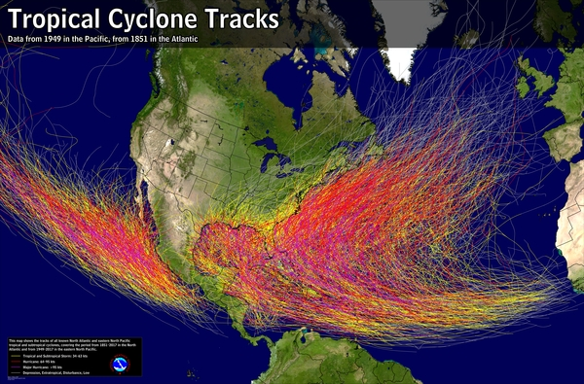
Hurricane Numbers
Number of Storms
Casualties
Damage
~11
1,400
$1.5B
In the Atlantic Basin per year
In the U.S. since 2005
Per storm making landfall
Notes:
Bertha (2014)
Gonzalo (2014)
Erika (2015)
Mathew (2016)
Irma (2017)
Jose (2017)
Maria (2017)
Beryl (2018)
Isaac (2018)
Dorian (2019)
Karen (2019)

Slide 3
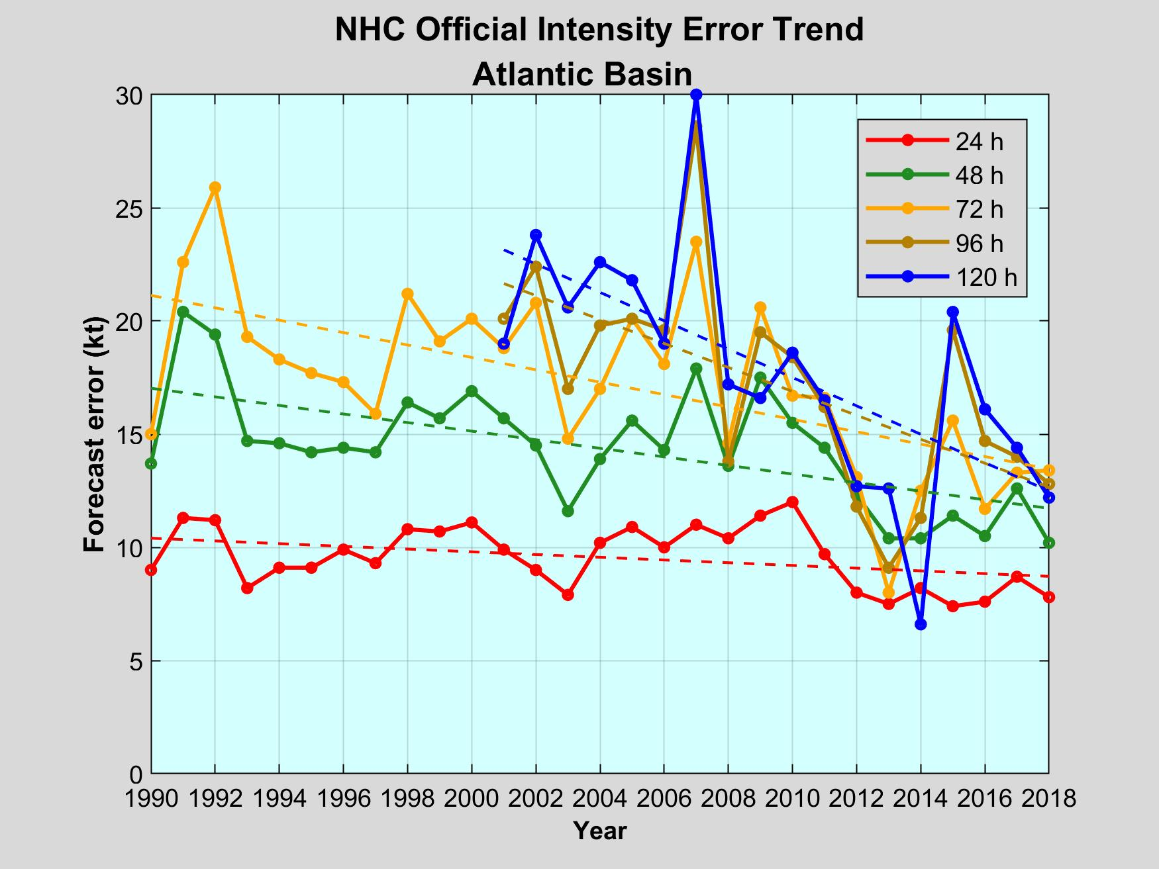
Motivation
NHC – Official Intensity Errors
The skill of hurricane intensity forecasts had only modest improvements over the past few decades

Slide 4
Hurricane Development & Intensification
Hurricanes are exclusively observed to develop and intensify over the ocean
Tracking ocean conditions that can help sustain hurricane intensification is important!

Slide 5
Objective
Develop a satellite-based synthesis product to aid forecasters in identifying ocean areas with favorable conditions for hurricane intensification

Slide 6

The New Product
Near-real-time Information on:
SST conditions
Upper Ocean Heat Content
Sea surface salinity
Real-time Product
https://www.aoml.noaa.gov/phod/goos/gliders/oc_monitoring.php

Slide 7
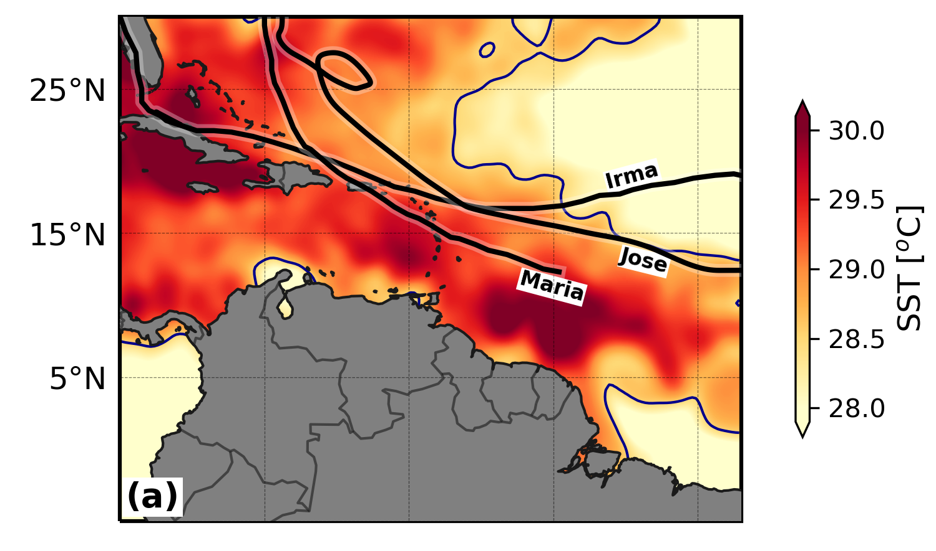
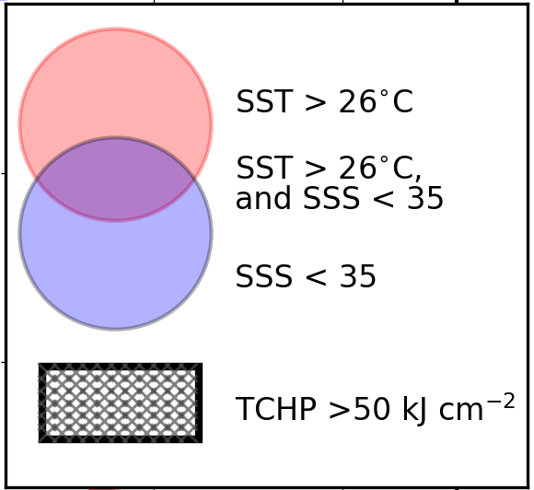
Sea Surface Temperature
SSTs warmer than 26ºC are needed to sustain fluxes of energy (latent + sensible) from the ocean into the hurricane
2017 Major Atlantic Hurricanes
Legend
SST data source: NOAA Optimally Interpolated SST v2

Slide 8
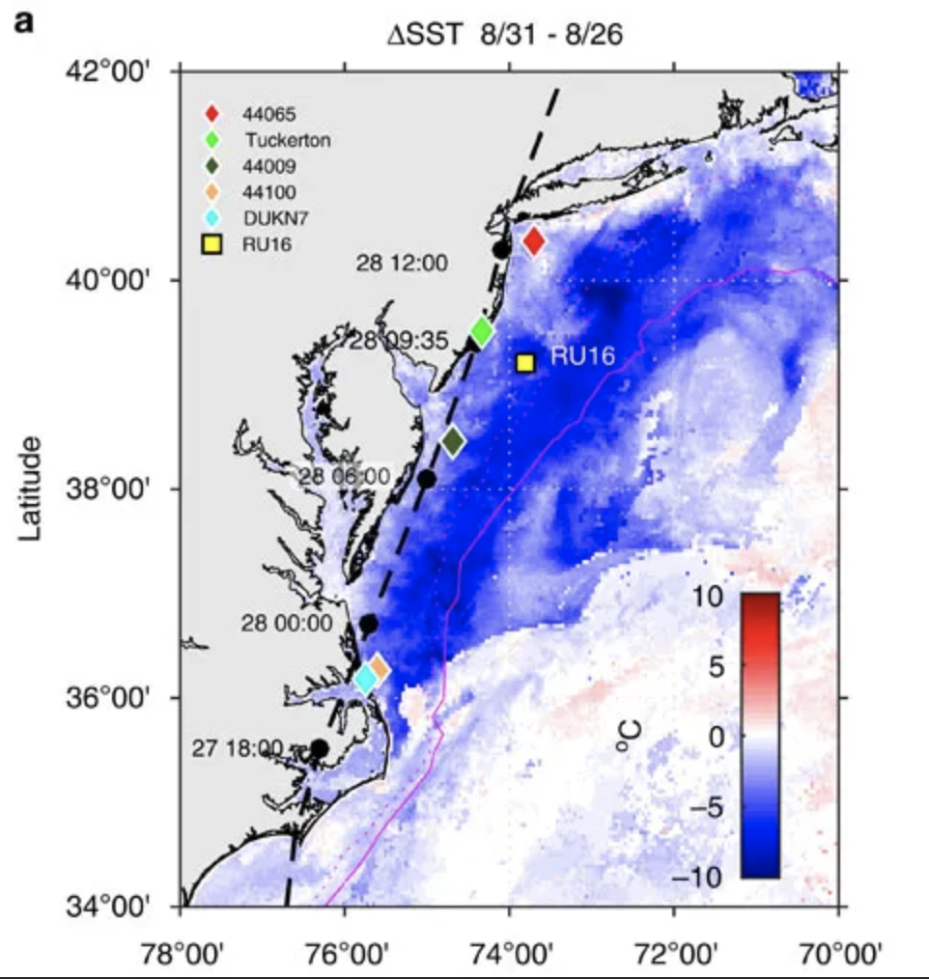
Hurricane-induced SST cooling
Hurricane Irene (2011)
SST conditions are prone to cooling forced by the hurricane, which can lead to rapid hurricane weakening
Need information of subsurface ocean conditions!
Glenn et al., (2016)

Slide 9
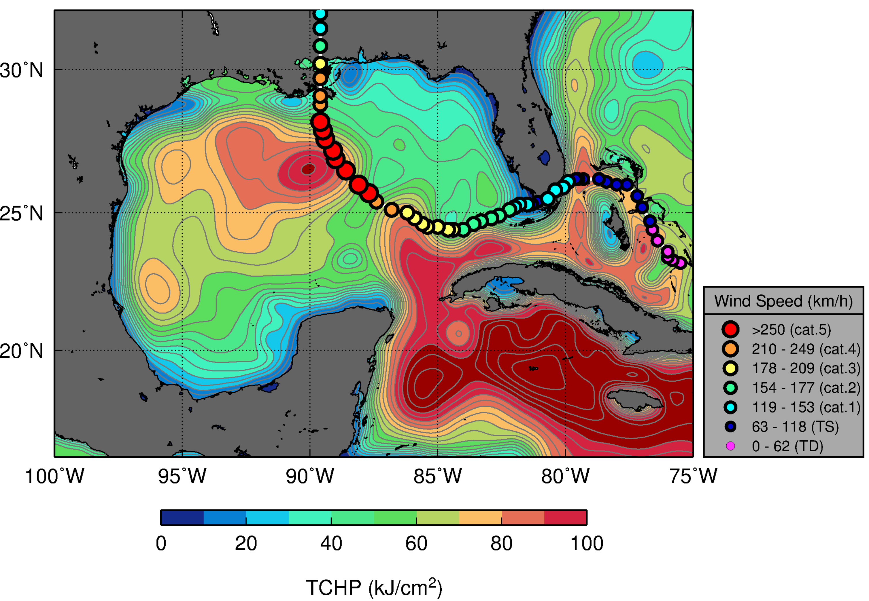
Upper-Ocean Heat Content
Upper ocean heat content provides an energy reservoir that can help maintain SSTs warm during the hurricane, and with that fuel and sustain hurricane intensity
Hurricane Katrina (2005)
Legend
TCHP data source: NOAA Atlantic Oceanographic and
Meteorological Laboratory

Slide 10
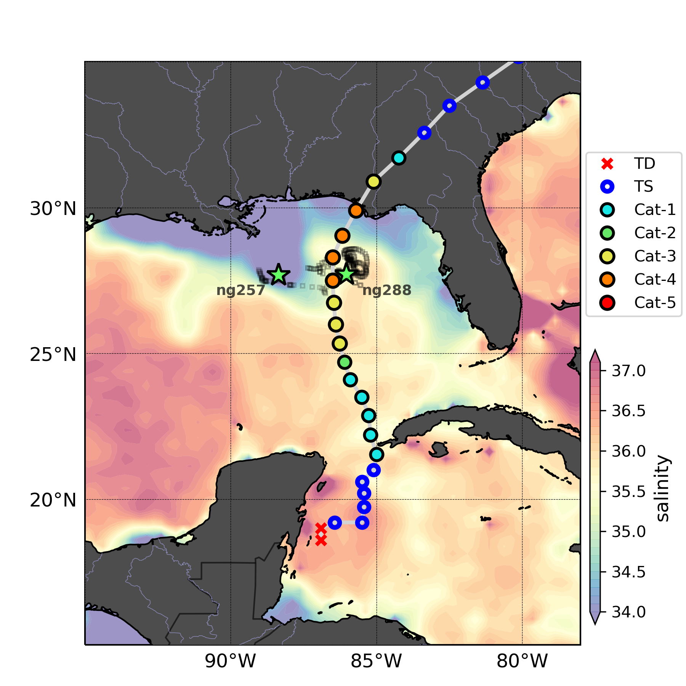
Sea surface salinity
Low sea surface salinity is also know for favoring intensification by suppressing storm-induced cooling, keeping SSTs warm
Hurricane Michael (2018)
Legend
Salinity data source: NASA Soil Moisture Active Passive

Slide 11
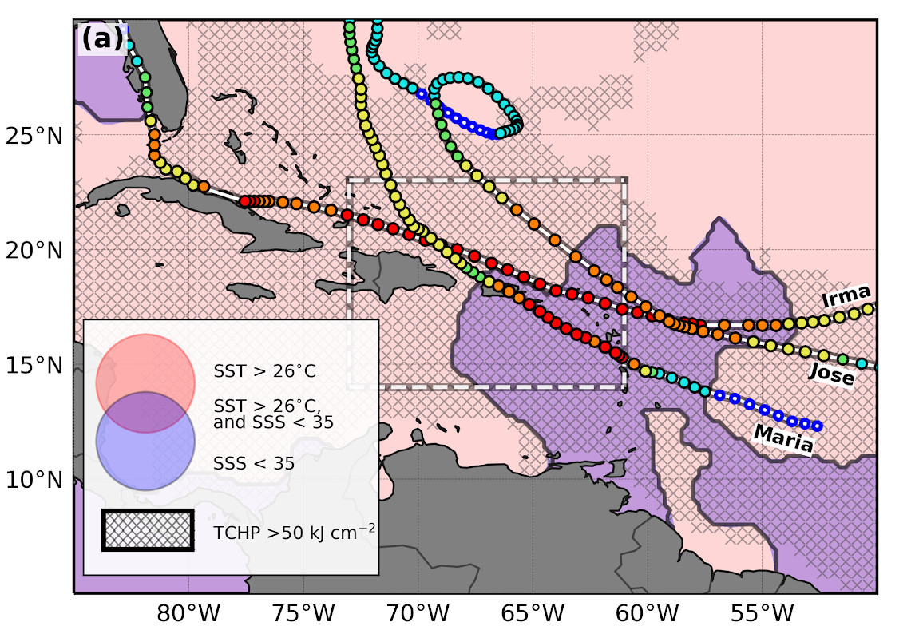
The 2017 Major Atlantic Hurricanes: Irma, Jose, Maria
Irma, Jose, and Maria intensified to their maximum intensity over ocean areas characterized by these 3 favorable conditions:
Warm SSTs
High TCHP
Low Surface Salinity

Slide 12
The New Product
Thank you!
More information
https://www.aoml.noaa.gov/phod/goos/gliders/oc_monitoring.php
Funded by Congress-approved appropriations of Hurricane Supplemental Funds (Gustavo Goni, lead PI)

